Slide 1

WP 9.3 progress at INFN-LNL
on Nb₃Sn films R&D via DCMS
I.FAST 13th WP9 meeting
HZB Helmholtz-Zentrum Berlin – 02.12.2024
Dorothea Fonnesu – INFN Legnaro National Labs

Slide 2
Outline
Recap about last meetings
(16.04.2024 IFAST WP9 Meeting Paris + 17.09.2024 Thin Films Workshop Paris)
New sputtering system with 2” magnetron
Study of film morphology
Status of samples exchange

Slide 3
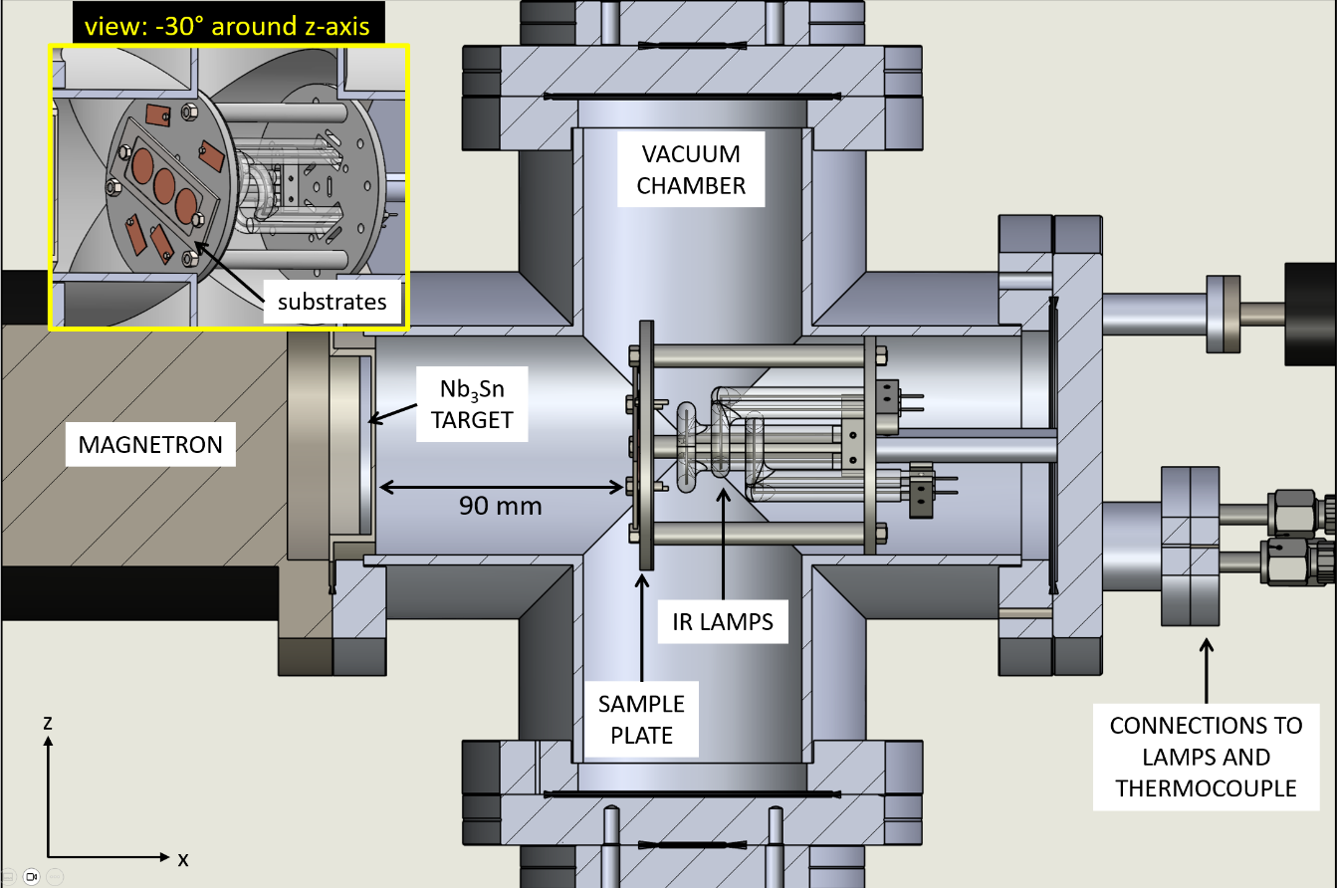
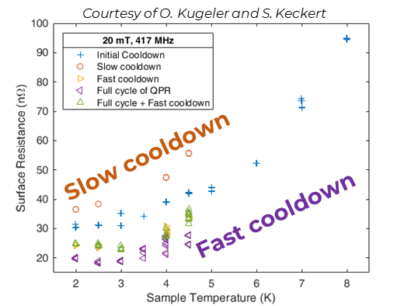
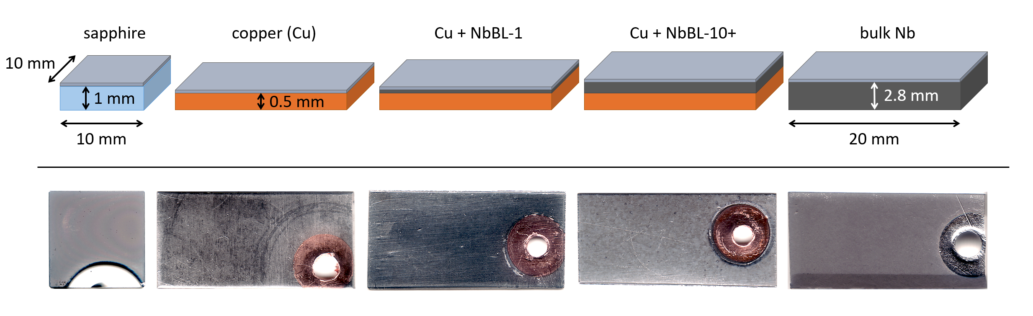
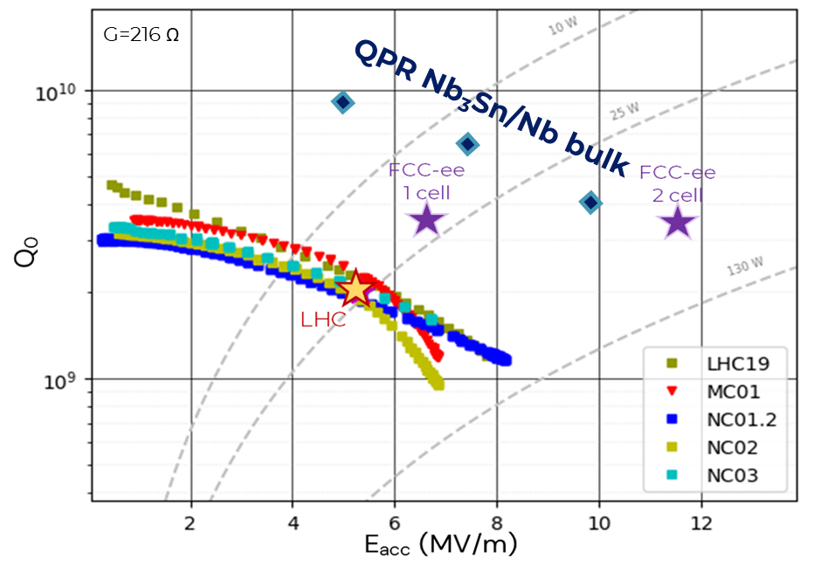
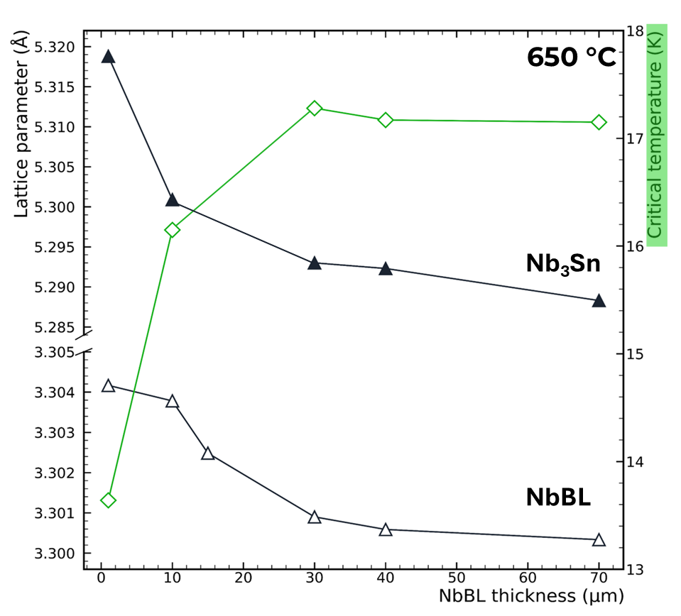
Where we left
Optimized Recipe for Nb₃Sn on small samples via DCMS
4” magnetron with commercial stoichiometric single target
Low cathode power < 20 W
Deposition pressure 2 x 10⁻² mbar
No annealing
Deposition temperature 600 ºC – 650 ºC
Nb buffer layer on copper substrate ≥ 30 μm
First RF test of QPR sample Nb₃Sn/bulk Nb at HZB
R_{s} ~ 23 nΩ @ 4.5 K, 20 mT, 400 MHz
Quench > 70 mT @ 4.5 K
T_{c} = 17.8 K in agreement with inductive measurement
bulk

Slide 4
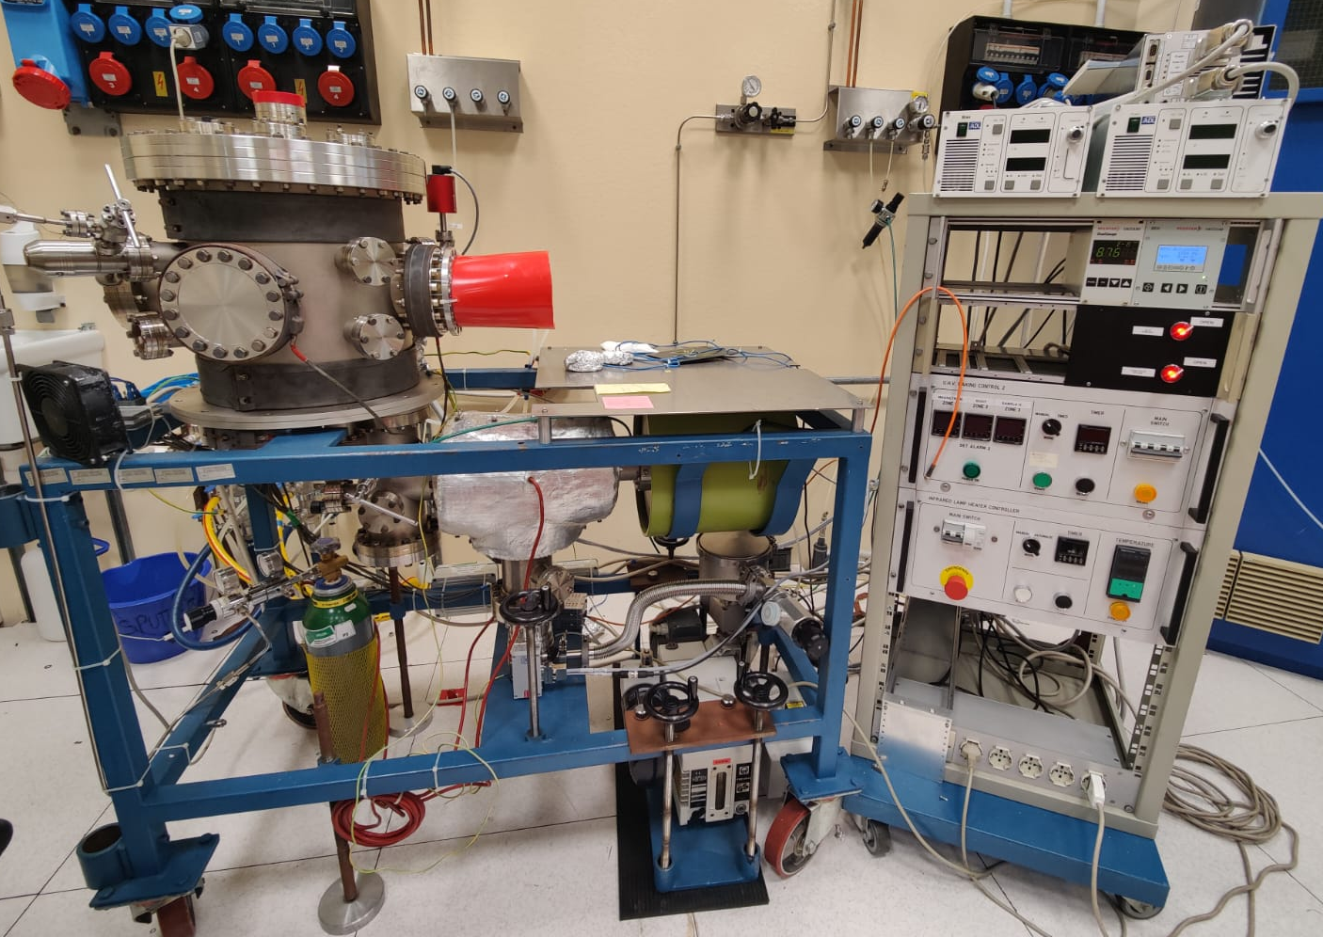
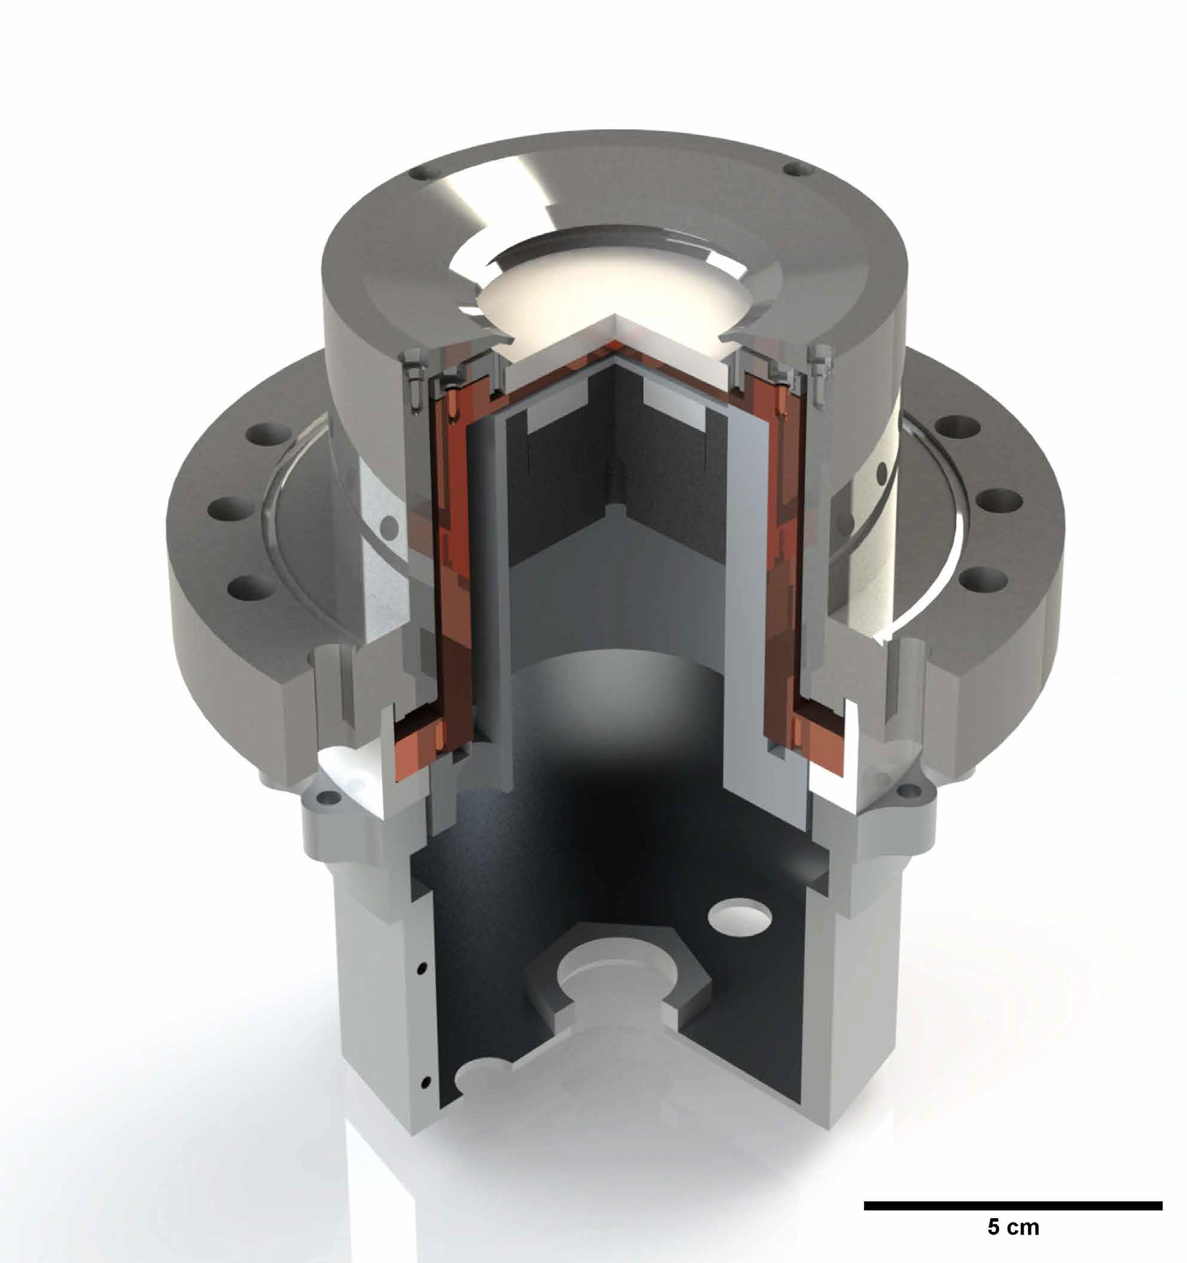
New Nb₃Sn sputtering system
Former V₃Si system re-commissioned
all vacuum chambers cleaned
turbo molecular pump replaced
valves check and replacement
new sample holder (2 IR lamps) designed
new resistive bands for baking
2” magnetron with commercial stoichiometric Nb₃Sn single target

Slide 5
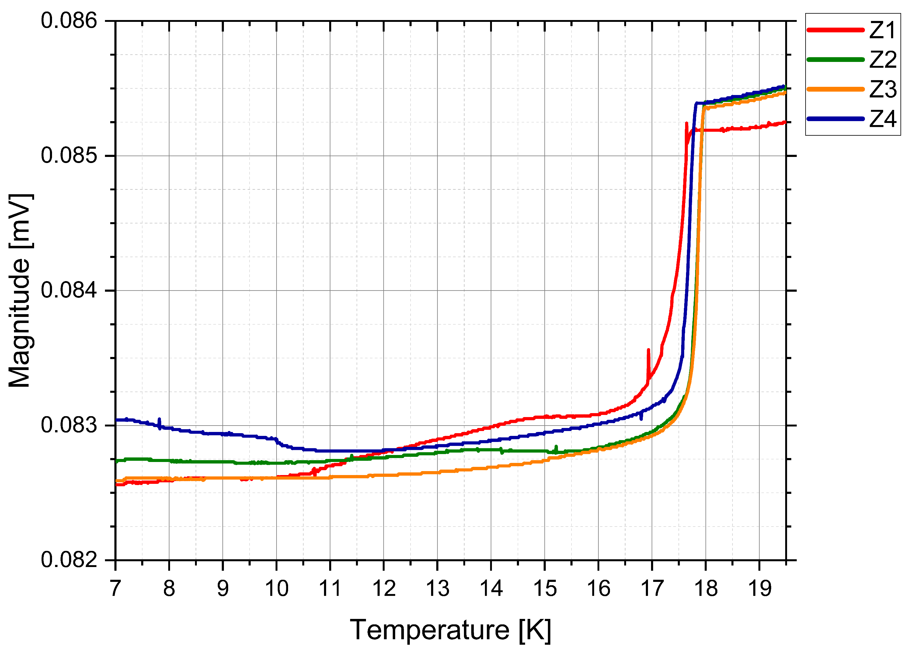
New Nb₃Sn sputtering system
Validation of new system in DCMS regime
2” magnetron with commercial stoichiometric Nb₃Sn single target
Depositions on Al₃O₂ substrate
Low cathode power < 240 mW/cm²
Deposition pressure 2 x 10⁻² mbar
No annealing
Deposition temperature 650 ºC
T_{c} = 17.5 K
2” system operation validated and reproducibility
of Nb₃Sn DCMS recipe with 4” system demonstrated

Slide 6

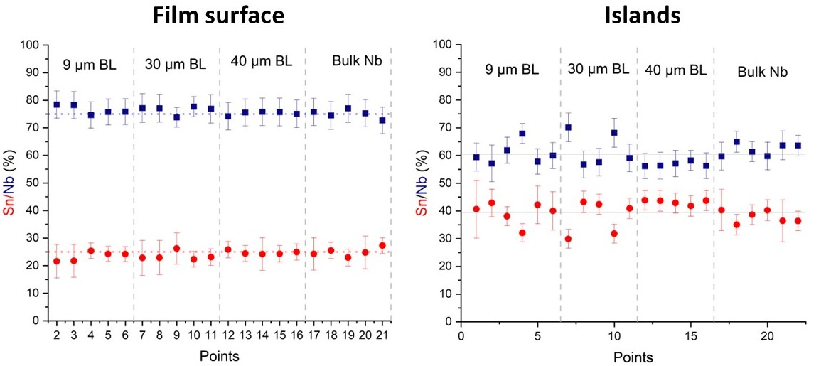
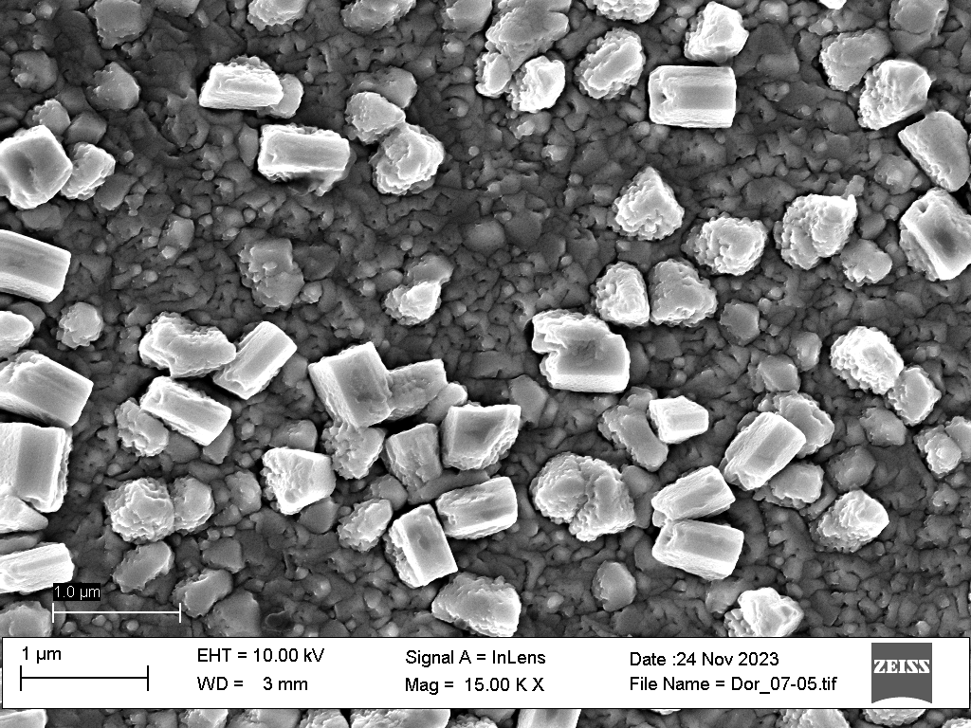
Morphology study
Lehrstuhl für
Oberflächen- und
Werkstofftechnologie
Sn-rich islands observed on Nb₃Sn sample surface
Courtesy of A. Zubtsovskii

Slide 7
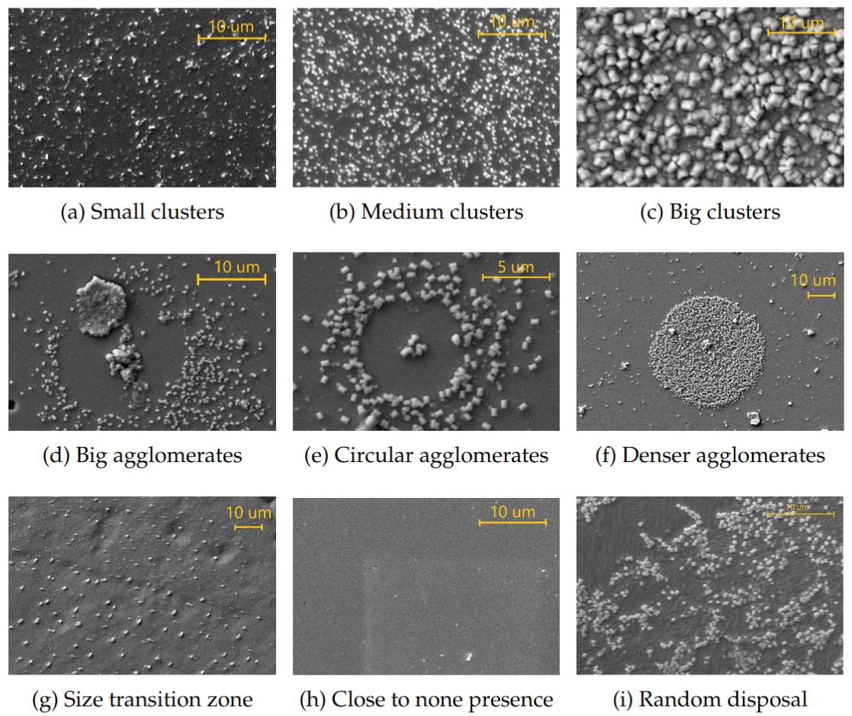
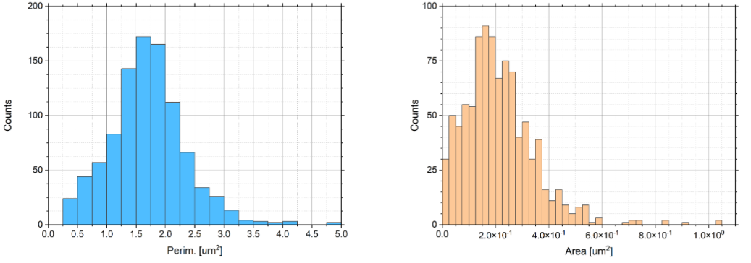
Morphology study
Courtesy of M. Lazzari
Defined island parameters over inspected area:
islands count
island average perimeter
island average area
total area covered by islands
Under study dependencies from:
applied cathode power
deposition temperature
film thickness
duration of deposition process
and critical temperature
[Started as Master thesis project by Matteo Lazzari]

Slide 8
Travelling samples
CEA: Nb₃Sn/NbBL/Cu for SC gap measurement
DESY: 2x disks Nb₃Sn/NbBL/Cu; 2x Nb₃Sn/bulk Nb for thermal conductivity measurement
HZB: 2x slabs Nb₃Sn/NbBL/Cu and Nb₃Sn/Cu for thermoelectric current measurement
HZDR: Nb₃Sn/NbBL/Cu samples tbd based on last results + 6 GHz cavity (long term) for FLA
On our side:
from HZB: QPR copper sample soon to be coated at LNL
from LOT: T_{c} measurements ongoing at LNL

Slide 9
Backup

Slide 10
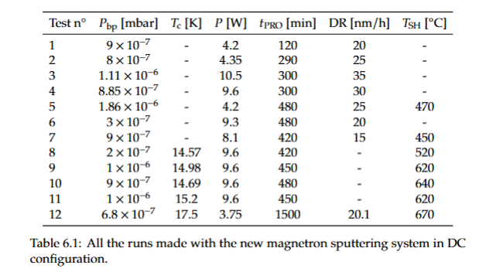
650

Slide 11
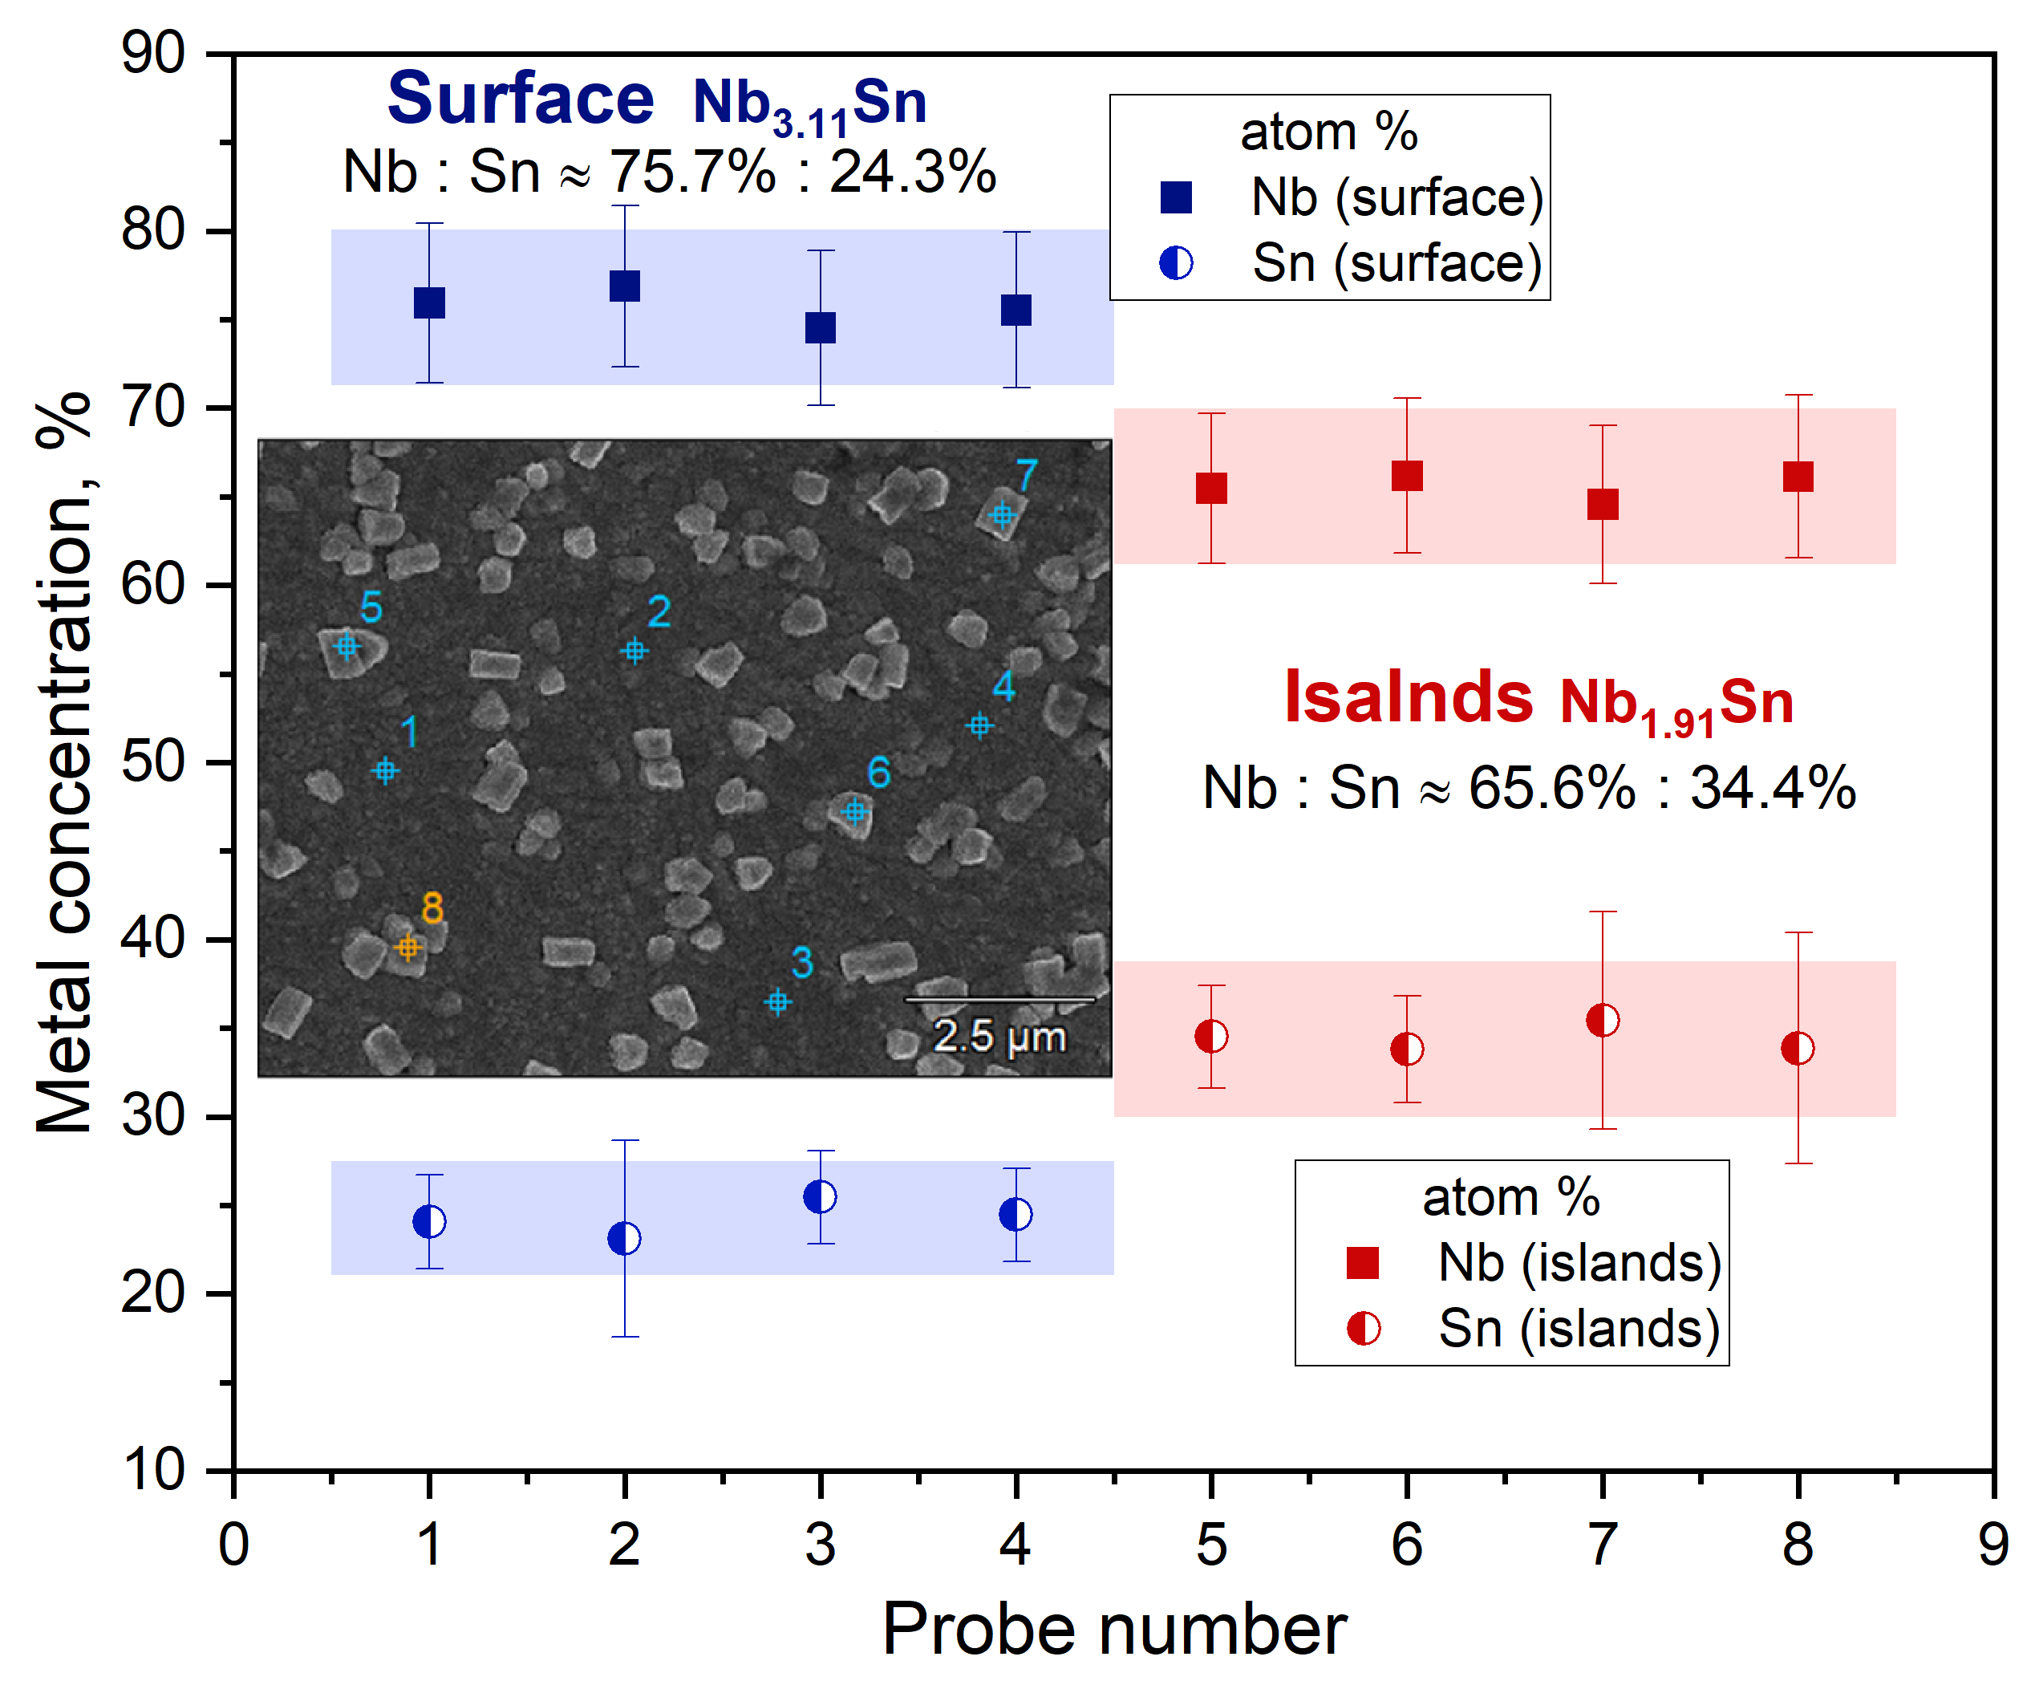
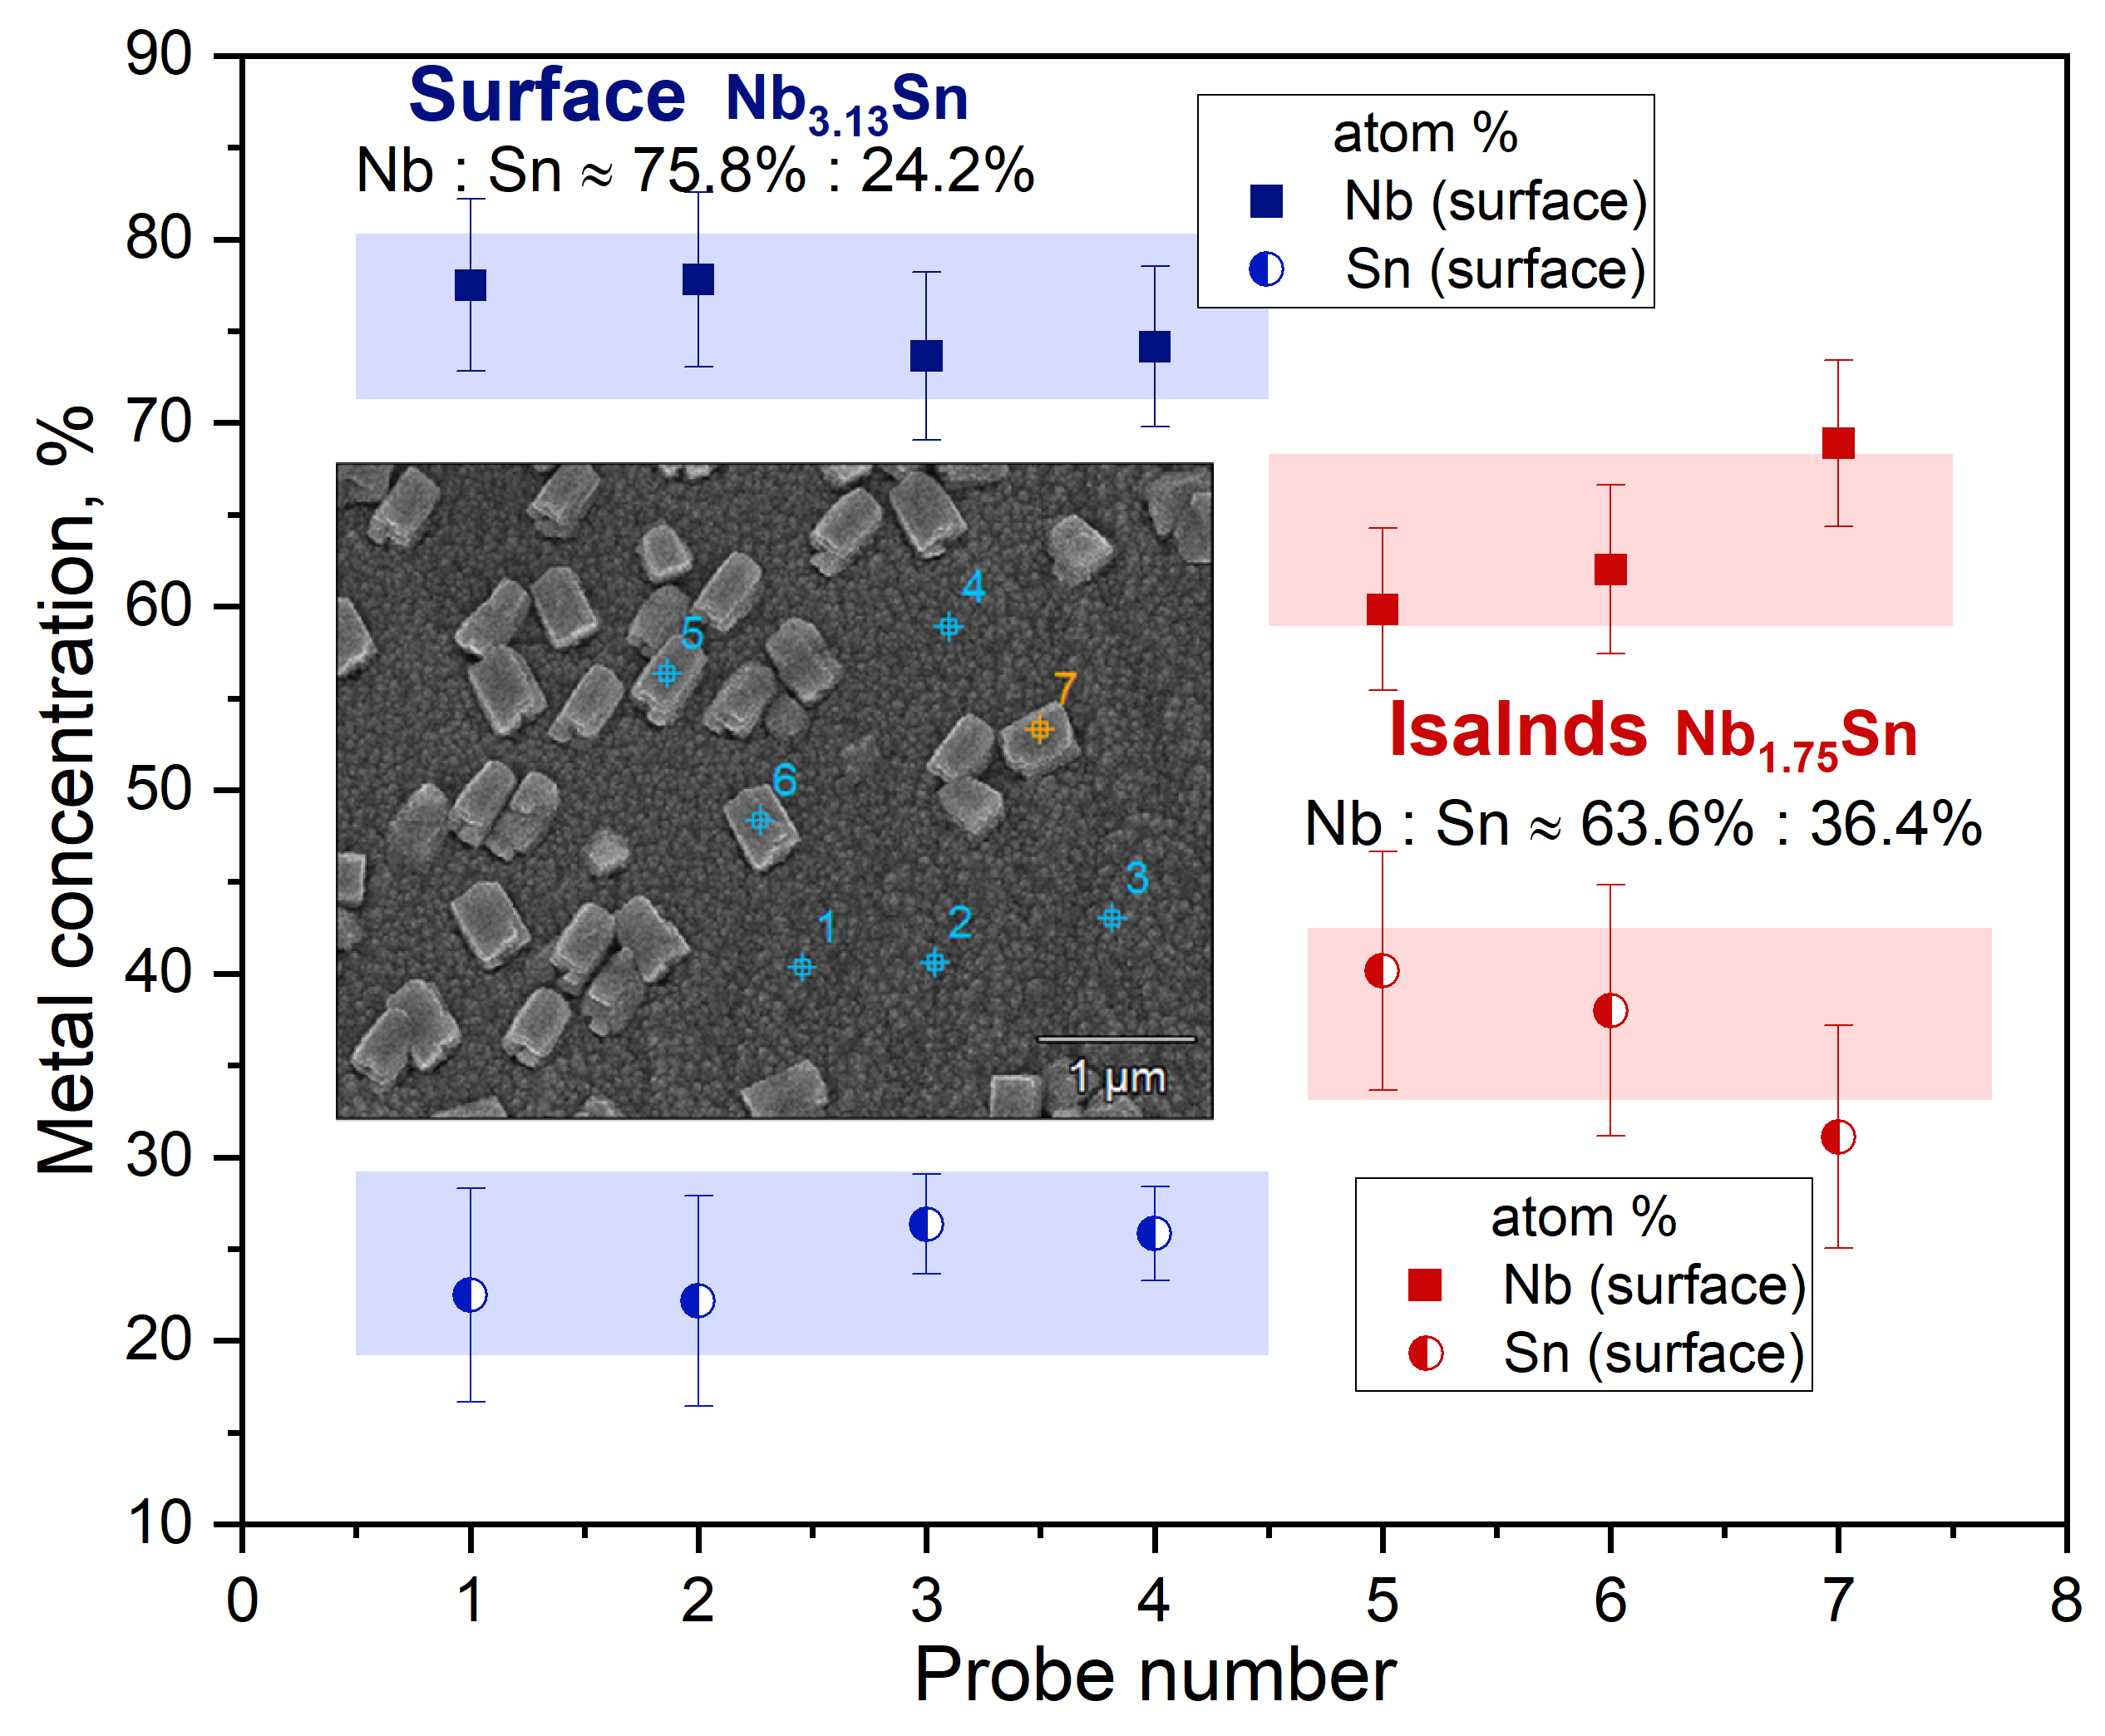
Nb₃Sn/Nb[30µm]/Cu at 600°C
Nb₃Sn/Nb[50µm]/Cu at 500°C

