Slide 1
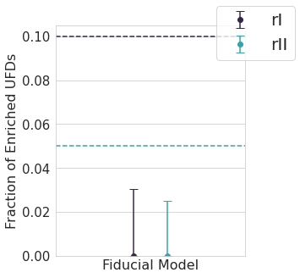
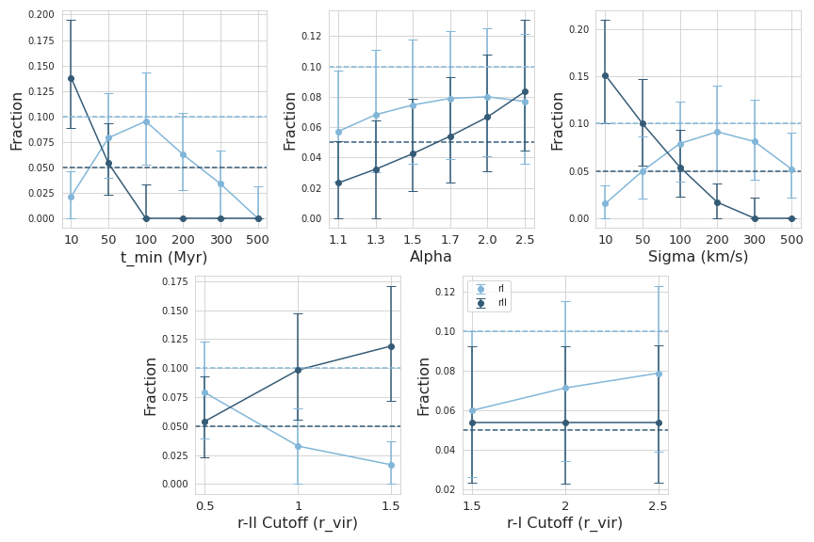
Can Neutron Star Mergers Alone Reproduce r-Process Element Abundances in Ultra-Faint Dwarf Halos?
Christine Gyure, Dr. Kaley Brauer, and Dr. Ashley Villar
University of Richmond, Center for Astrophysics Harvard-Smithsonian
1. Motivation
4. Results
The r-process is directly responsible for over half the abundance of heavy metals in the Universe. Neutron star mergers (NSMs) became the only confirmed source of r-process elements in 2017 after multi-messenger observations of the merger GW170817 revealed significant heavy metal emission, but it is still unclear whether they are the dominant r-process source over the other believed source, collapsars.
One concern preventing NSMs from being accepted as the primary source is that they may not account for the observed r-process enrichment of the smallest, most metal-poor galaxies, “ultra-faint dwarfs” (UFDs). Each NSM has a characteristic natal “kick” velocity and delay time:
Natal kick velocity - an initial momentum of the NS binary caused by asymmetries in the progenitor supernovae (km/s)
Merger time - the time from the formation of NS to the merger (Myr)
If either the kick velocity or the delay time are high relative to the UFD’s escape velocity (~15 km/s) or travel time to the virial radius, the merger will occur well outside the dark matter halo and cannot be considered a source of the galaxy’s enrichment. However, r-process elements have been observed in multiple UFDs orbiting the Milky Way (e.g., Reticulum II, Grus II, and Tucana III), meriting further investigation of the conditions necessary for NSMs to be the dominant source of heavy elements.
While the model reproduces the observed enrichment fractions for a variety of parameters, it predicts no enrichment for the literature values. This indicates that for the accepted velocity and delay time distributions, on average, every NSM flies out of its halo. The parameter combinations that return the correct enrichment fractions heavily favor low values for t_{min} (~50 Myr) and σ (~100 km/s), implying the need to determine the lowest realistic values for these parameters.
Fig 2: Enrichment predictions using the literature parameter values.
The plot below depicts the model's r-process prediction for an alternate parameter combination that correctly reproduced observed fractions:
t_{min}= 50 Myr, α = 2.0, σ = 100 km/s, x = 0.5 r_{vir} , and y = 2.5 r_{vir}.
2. Objectives
We seek to determine if NSMs could be the source of r-process material in small dwarf galaxies, or if another source is necessary. This poster investigates the constraints on the natal kick velocity and delay time distributions necessary for NSMs to be the dominant source of heavy element abundances in UFDs.
3. Model
We implement a stochastic Monte Carlo model returning the level of enrichment (r-no, r-I, or r-II) of UFDs from the Caterpillar suite of dark matter halo simulations. The model assumes UFD enrichment derives entirely from NSMs and the level of enrichment in these systems is based on the merger offset from the galaxy’s rest-frame center. If a given UFD is massive enough to contain a NS binary, we assign it a sampled kick velocity and delay time from a Maxwellian and power law distribution, respectively. The product of the kick velocity and delay time is the relevant information (offset) to determine the chemical enrichment.
Fig. 3: Variation over each parameter with the others held constant for a parameter combination producing r-I = 10% and r-II = 5% enriched UFDs.
The large error bars are consistent across all parameter combinations and derive from the natal kick and delay time distributions, the stellar abundance matching algorithm, the Poisson distribution for the number of NSMs, and the combined dark matter halo simulations.
Parameter | Definition | Literature Value
σ | Maxwellian width | σ = 265 km/s [1]
α | Power law index | α = 1.83 [2]
t_{min} | Min. delay time | t_{min} = 184 Myr [2]
x | r-II/r-I boundary | x = 0.75 R_{vir} [3]
y | r-I/r-no boundary | y = 2 R_{vir} [3]
5. Conclusion
Certain parameter combinations successfully reproduce heavy metal abundances in simulated UFDs, but the literature values for natal kick velocity and delay distributions fail to do so. For NSMs to have been the dominant source in these systems, either (or ideally, both) the natal kick velocity or delay time must be significantly lower than the currently accepted distributions. These results suggest a critical choice: either revise the literature values for natal kick velocities and delay times or turn to the other theorized source, core-collapse supernovae, to explain heavy element abundances in UFDs. Future extensions of this work include adapting this model for higher-mass dwarf halos, for which this is still of concern, and contributing a similar model for collapsars.
We run the model using the literature values and a broader range of plausible values to see which parameter combinations, if any, reproduce the observed Milky Way enrichment fractions (r-I ~10%, r-II ~5%).
References
[1] Hobbs, G., Lorimer, D. R., Lyne, A. G., & Kramer, M. 2005, MNRAS, 360, 974, doi: 10.1111/j.1365-2966.2005.09087.x
[2] Zevin, M., Nugent, A. E., Adhikari, S., et al. 2022, ApJL, 940, L18, doi: 10.3847/2041-8213/ac91cd
[3] Tarumi, Y., Yoshida, N., & Inoue, S. 2020, MNRAS, 494, 120, doi: 10.1093/mnras/staa720
Fig. 1: Model schema demonstrating sampling from kick velocity and merger time distributions, creating the offset product distribution, and determining the level of chemical enrichment.
Contact Information
Christine Gyure | cegyure10@gmail.com | +1 (757)-818-5733

