Slide 1
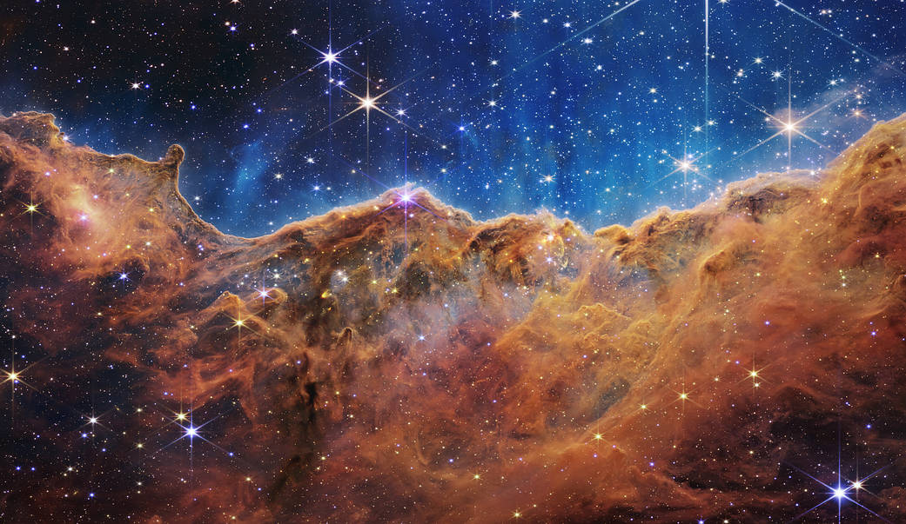
The evolution of low and intermediate-mass stars
XXth Russbach School on Nuclear Astrophysics
Pilar Gil-Pons

Slide 2
Questions we will try to answer
Why are non-massive stars important?
How do they live?
How do they end their lives?
Why are they important for element formation?
Why the embarrassing uncertain mass-limits in the definition of different types?
What do we still have to understand?

Slide 3
Motivation
The Sun.
They are very abundant.
They have an important role in nucleosynthesis.
They are relevant for the understanding of the history of the Galaxy structure and Galactic chemical evolution.
Explosion sites.
Great nuclear physics laboratories.
Challenging objects.

Slide 4
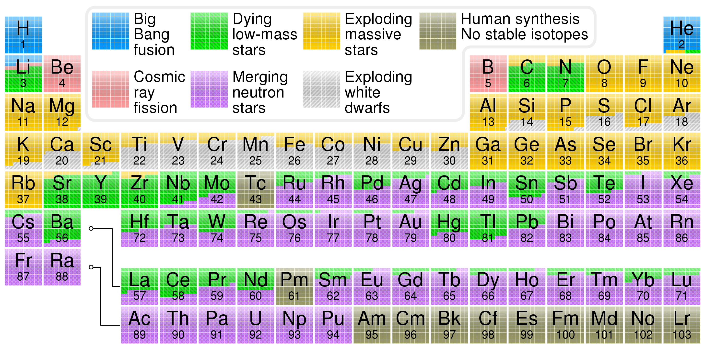
Periodic table showing origin of elements in the Solar System, based on data by Jennifer Johnson at Ohio State University. © Cmglee, CC BY-SA 3.0, https://commons.wikimedia.org/w/index.php?curid=31761437

Slide 5
Outline
Fundamentals
Low-mass stars
Intermediate-mass stars (subgroups here)

Slide 6
What do I intend to convey?
It does matter how long they live and what elements they are able to form.
But also how these elements that are formed inside stars are transported inside the stars and then ejected to the interstellar medium.

Slide 7
Can it burn H significantly?
Brown dwarf (M ≲ 0.08 M⊙
No
Yes
Can it burn He?
Red dwarf 0.08 ≲ M/M⊙ ≲ 0.5
No
Yes
Does it avoid
core He-flash?
Low-mass star 0.5 ≲ M/M⊙ ≲ 2-2.25
No
Yes
Does it avoid advanced central burning?
Intermediate-mass star 2-2.5 ≲ M/M⊙ ≲ 8-10
No
Yes
Massive star

Slide 8
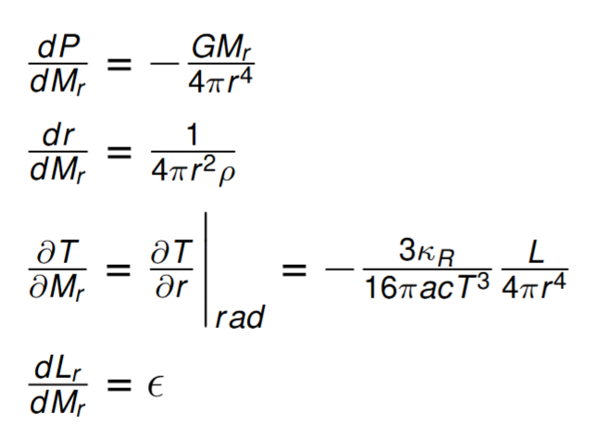
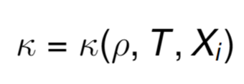
Fundamentals
Stellar structure
Stability against convection
Chemical composition evolution
Constitutive relations

Slide 9
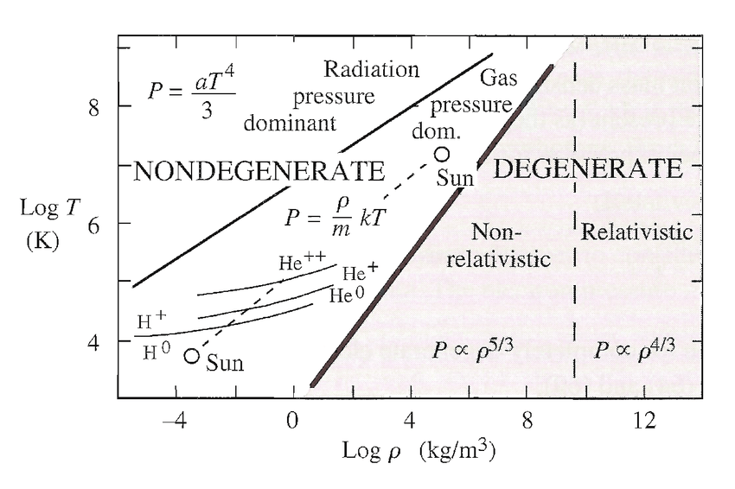
Fundamentals: Equation of state
West, 2011

Slide 10
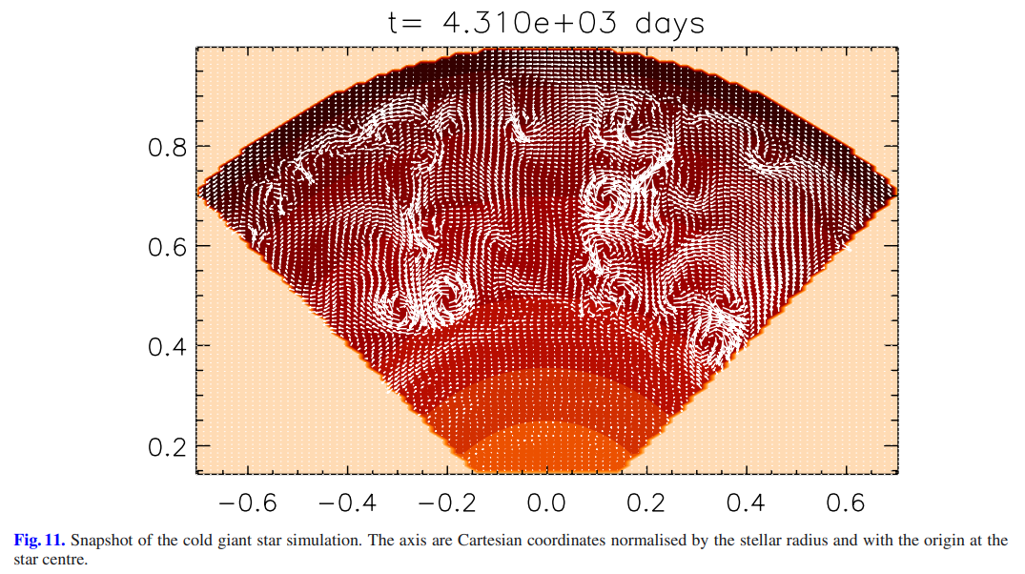
Tools: stellar evolution codes
Stellar evolution codes (big clans & families):
1DIM:
EVOLVE, EVOLN, FRANEC, GARGHING, GENEVA, LPCODE, MESA, MONSTAR, PARSEC, STARS, TYCHO,...
Multi-DIM:
DJEHUTY, FLASH, MUSIC, PPMSTAR, SHIVA,...
Viallet+ 2011

Slide 11
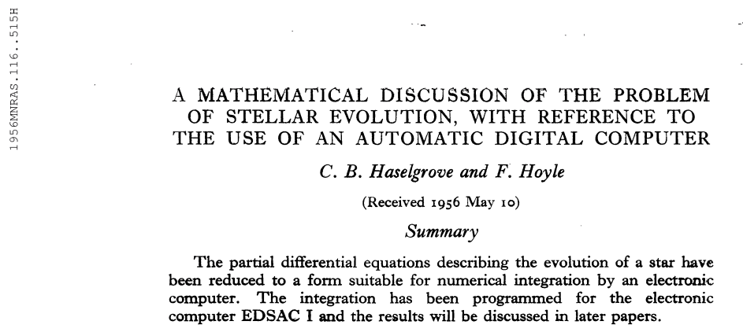
Tools: the earliest stellar evolution codes
1955
1956
Weigert, Iben, Paczynski, Eggleton (from 1960’s)

Slide 12
Tools: codes and observations
Stellar evolution codes (big clans & families):
1DIM:
EVOLVE, EVOLN, MONSTAR, FRANEC, STARS, LPCODE, GARGHING, GENEVA, MESA,...
Multi-dimensional:
DJEHUTY, MUSIC, FLASH, SHIVA,PPMSTAR,...
Synthetic evolution:
Groenewegen & de Jong, Marigo, Izzard...
Observations

Slide 13
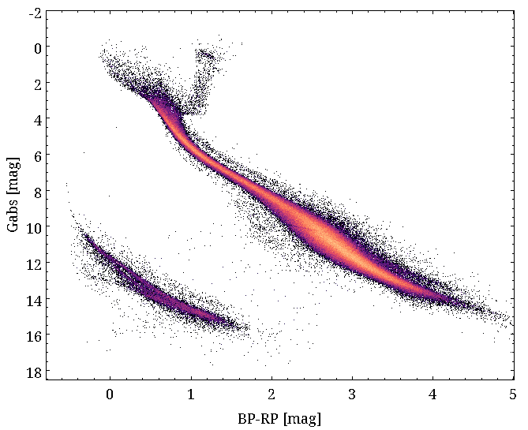
Observations: Color-Magnitude Diagram from GAIA
Color-Magnitude Diagram from GAIA,
100 pc
Good signal-to-noise objects.
Álex Santos, priv. comm.

Slide 14
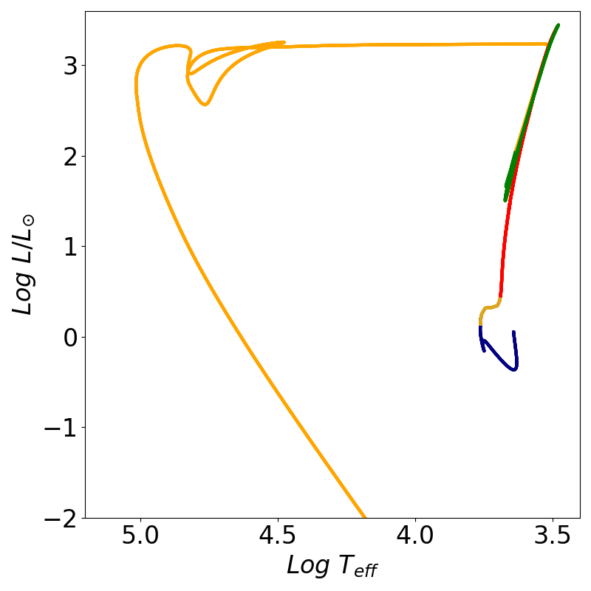
Observations: Color-Magnitude Diagram from GAIA
Hertzsprung-Russell Diagram
Giant Branch
Giant Branch
Main Sequence
White Dwarf
Main Sequence
White Dwarfs

Slide 15
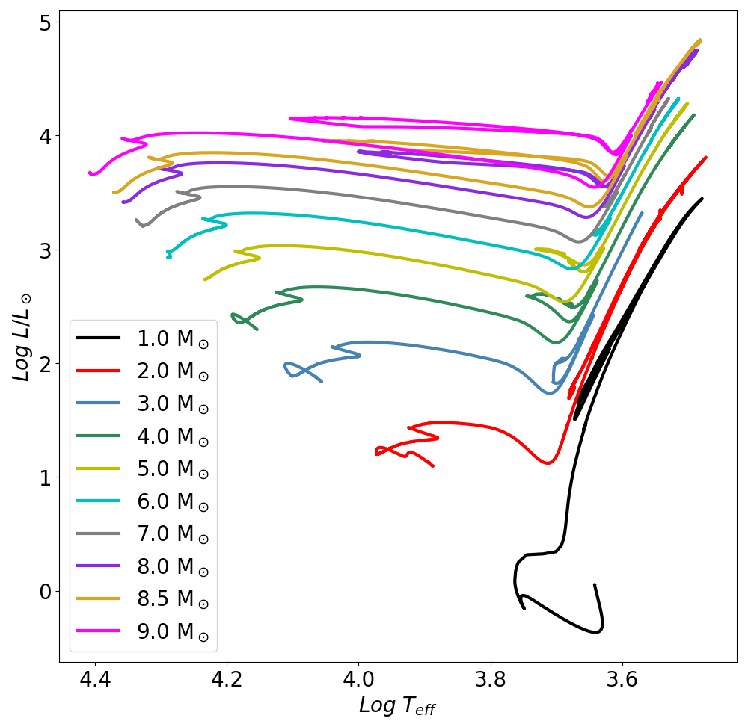
Observations: Color-Magnitude Diagram from GAIA
Hertzsprung-Russell Diagram
Giant Branch
Main Sequence
White Dwarfs

Slide 16
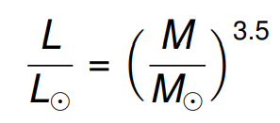
Observations: Color-Magnitude Diagram from GAIA
Main sequence lifetimes
Main Sequence

Slide 17
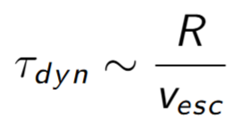
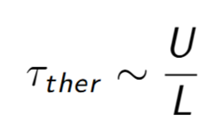
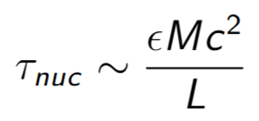
Relevant timescales
Dynamical timescale
< 30 min for the Sun
$$⇒$$
Main sequence lifetimes
(nuclear)
Thermal (Kelvin-Helmholtz) timescale
Approx. 30 Myr for the Sun
M_{ini}(M_{sun}) | T_{nuc}(yr)
0.5 | 10¹¹
1.0 | 10¹⁰
5.0 | 10⁸
10.0 | 10⁷
50.0 | 10⁶
$$⇒$$
Nuclear timescale: ≈ 10¹⁰ yr for the Sun
$$⇒$$

Slide 18
Just some mild deuterium burning + lithium (most massive) R ≈ R_{Jup}
Brown dwarfs
M/M⊙ ≲ 0.08
Helling and Casewell, 2014

Slide 19
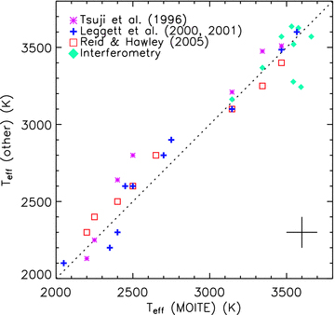
Red dwarfs
0.08 ≲ M/M⊙ ≲ 0.3
Core H-burning.
Type M, effective temperatur-es approx. 2000-3500 K.
Very long lives > trillions years.
They will develop a helium core.
Important to assess the IMF at lowest masses (Li+ 2023, Nature) + great labs for convection and magnetic fields (Bice and Toomre, 2022).
Casagrande+2008

Slide 20
Red dwarfs
0.08 ≲ M/M⊙ ≲ 0.3
Question:
Given the extremely lowng lifetimes of red dwarfs, how can we observe He white dwarfs?
Core H-burning.
Type M, effective temperatures approx. 2000-3500 K.
Very long lives > trillions years.
They will develop a helium core.
Important to assess the IMF at lowest masses (Li+ 2023, Nature) + great labs for convection and magnetic fields (Bice and Toomre, 2022).
Casagrande+2008

Slide 21
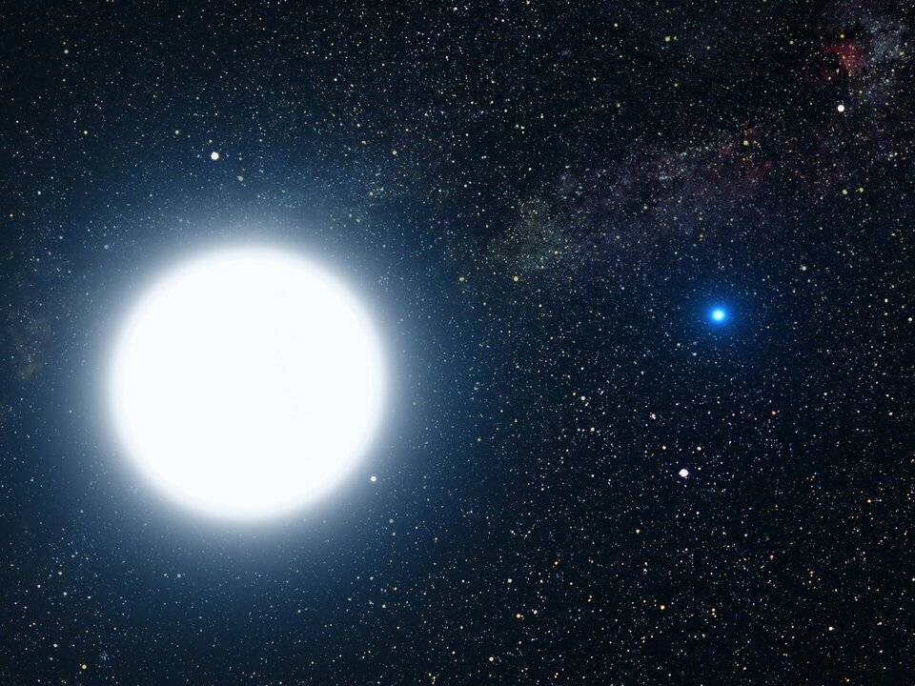
Red dwarfs
0.08 ≲ M/M⊙ ≲ 0.3
Question:
Given the extremely lowng lifetimes of red dwarfs, how can we observe He white dwarfs?
Core H-burning.
Type M, effective temperatur-es approx. 2000-3500 K.
Very long lives > trillions years.
They will develop a helium core.
Important to assess the IMF at lowest masses (Li+ 2023, Nature) + great labs for convection and magnetic fields (Bice and Toomre, 2022).
Casagrande+2008

Slide 22
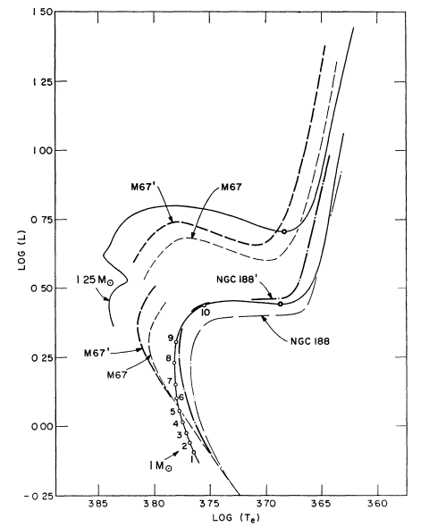
0.3 ≲ M/M⊙ ≲ 2-2.25
Low-mass stars
Does it avoid
core He-flash?
Low-mass star
No
Early comparisons between theoretical sequence results and observations.
Iben (1967)
Charbonnel and Lagarde (2010)
Cantiello and Langer (2010)

Slide 23
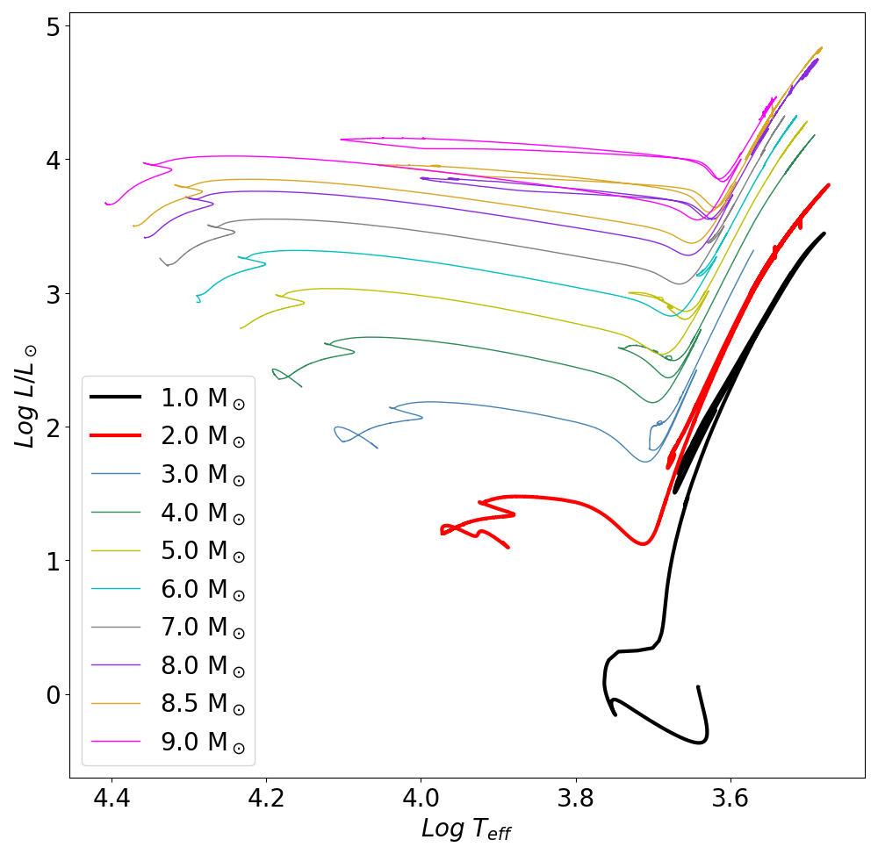
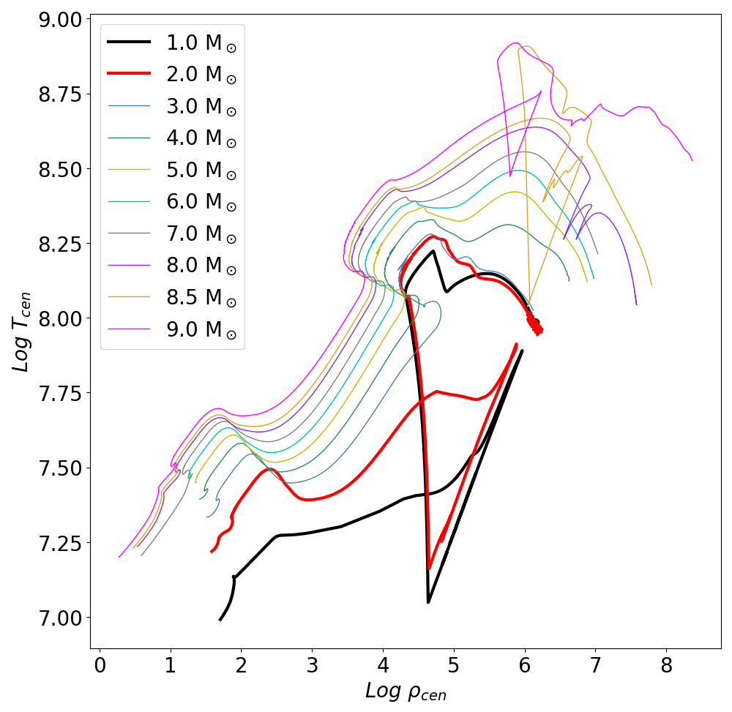
Low-mass stars: overall evolution
HR-diagram
Log ρ_{c}-Log T_{c}

Slide 24
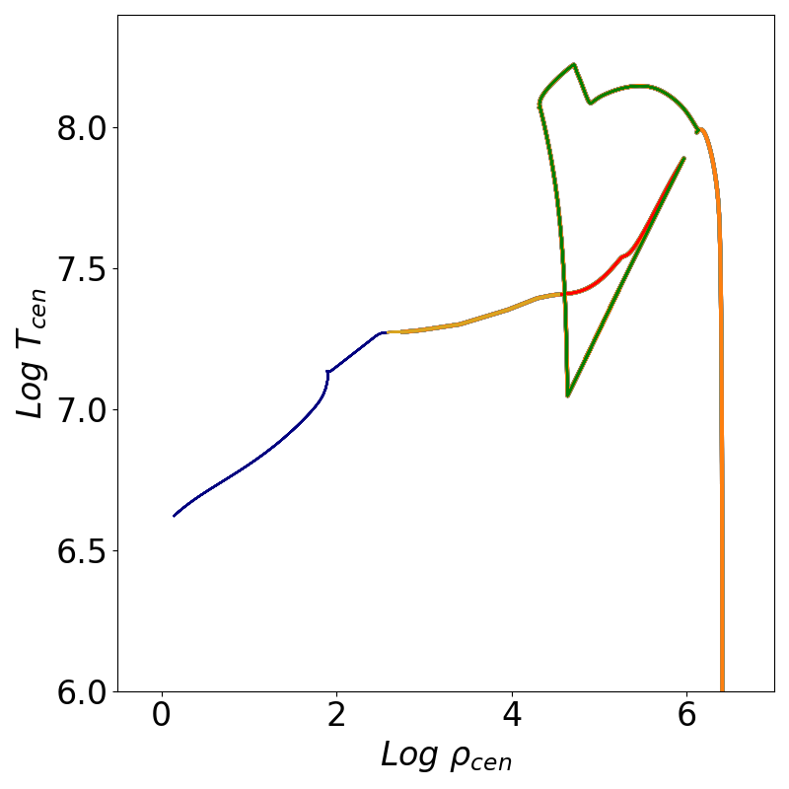
Low-mass stars: overall evolution
Surface
Centre
4: Core He-flash/
CHeB
Core He-flash/
CHeB
6: Late thermal pulse
Red Giant
AGB
5: AGB
Hertzprung gap
3:Red Giant
2: Hertzprung gap
1: Pre- and
main sequence/
CHB
Pre- and main sequence/
CHB
WD
7:WD

Slide 25
Low-mass stars: Main sequence/ core H-burning
Mini (Msun) | T_{CHeB} (yr)
0.08 | 15x10⁹ yr > τ_{Hubble}
1.00 | 10x10⁹ yr
1.50 | 4x10⁹ yr
2.00 | 2x10⁹ yr
1: Main sequence/
CHB

Slide 26
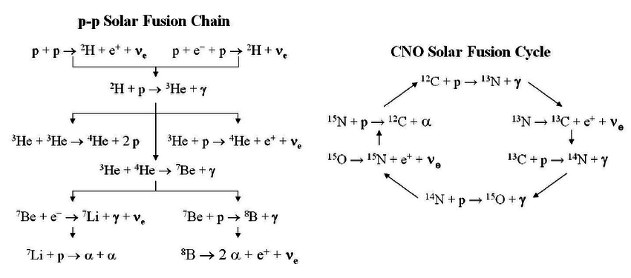
Low-mass stars: Main sequence/ core H-burning
Credit: Calaprice, 2015
Core H-burning: pp-chains and CNO-cycle

Slide 27
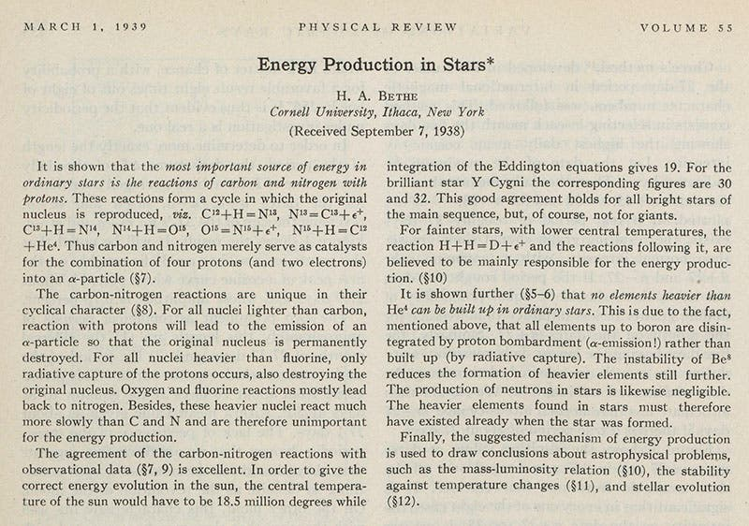
Low-mass stars: Main sequence/ core H-burning
1939

Slide 28
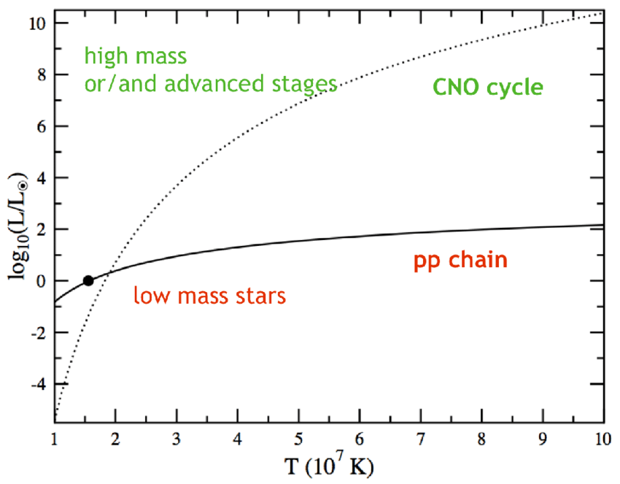
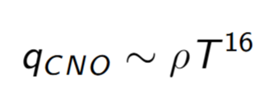
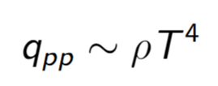
Low-mass stars: Main sequence/ core H-burning
CNO
Some activity starting at 15 M.
Dominant at 17 MK.
Characteristics of stars M/M⊙ ≥ 1.1-1.2.
Strong temperature dependance.
pp
Some activity starting at 4 MK.
Efficient at 10 MK.
Mild temperature dependance:
Alderberger+, 2011

Slide 29
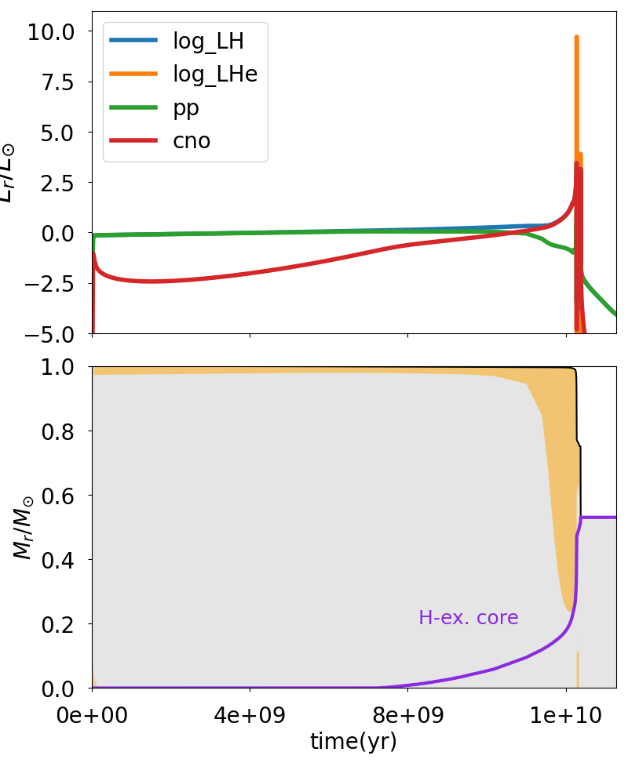
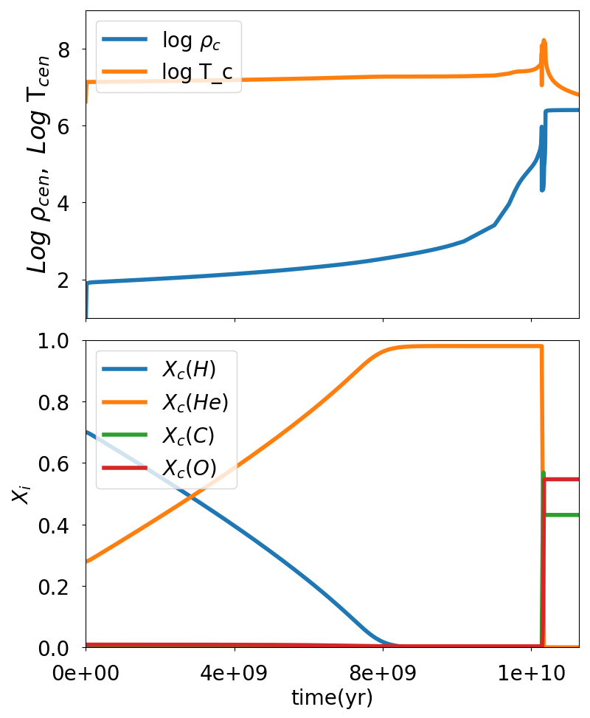
Low-mass stars: Overall evolution of a 1 M⊙ star

Slide 30
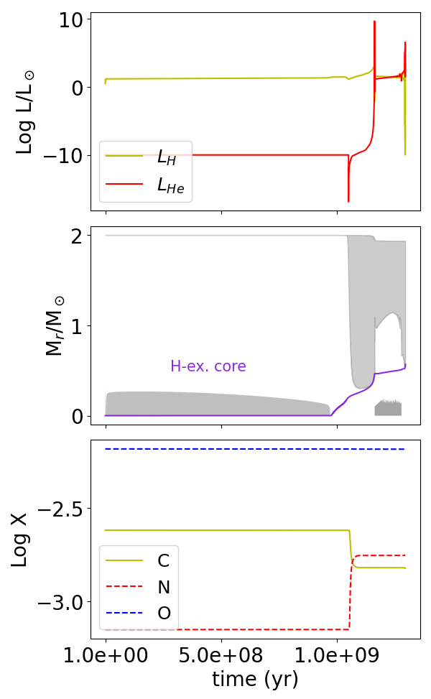
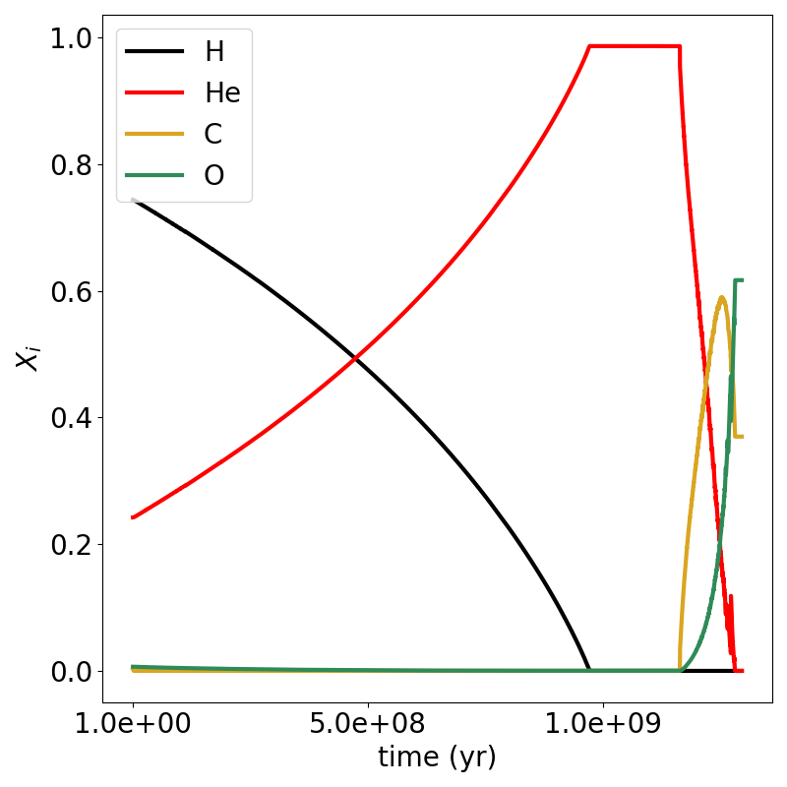
Low-mass stars: Overall evolution
A 2 M⊙ star behaves in a very similar way
(although CNO-cycle and convection in core)

Slide 31
Low-mass stars: Red giant branch
Core He-flash/
CHeB
Core exhausts H →
→ Gravity temporarily takes over: contraction.
→ H-burning develops in a shell around the core.
→ H-burning shell through efficient CNO
→ The He-core grows.
→ The He core reaches its maximum stable mass.
→ Schonberg-Chandrasekhar instability
→ Faster contraction.
→ Envelope expansion: Red Giant Branch.
Late thermal pulse
AGB
Red Giant
Hertzprung gap
Main sequence/
CHB
WD
MS => RG transition is very fast (τ_{ther}).
→ Hertzspring gap.

Slide 32
Low-mass stars: Red giant branch
Do we really understand the ascent of the RGB?
D. Prialnik’s book
Stancliffe+ 2009.
Core He-flash/
CHeB
Late thermal pulse
AGB
Red Giant
Hertzprung gap
Main sequence/
CHB
WD

Slide 33
Low-mass stars: Red giant branch
Question:
Do all low- and intermediate-mass stars go through the RG phase?
Core He-flash/
CHeB
Late thermal pulse
AGB
Red Giant
Hertzprung gap
Main sequence/
CHB
WD

Slide 34
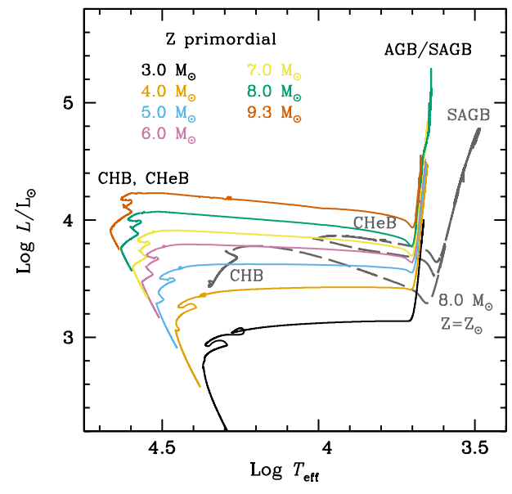
Low-mass stars: Red giant branch
Question:
Do all low- and intermediate-mass stars go through the RG phase?
Core He-flash/
CHeB
Late thermal pulse
AGB
Red Giant
Hertzprung gap
Intermediate-mass very metal-poor stars (Z ≲10⁻⁴) avoid the first giant and burn central He very shortly after core H-burning.
Main sequence/
CHB
WD

Slide 35
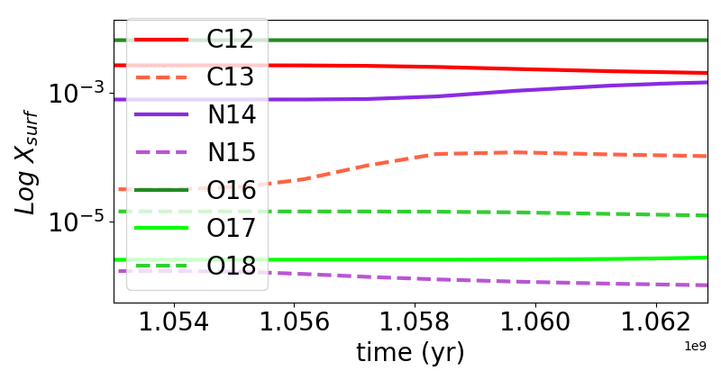
Low-mass stars: Red giant branch and the 1st dredge-up
Enhancement
Depletion
H, C¹³, N¹⁵, O¹⁶
He⁴, C¹³, N¹⁴, O¹⁸
2 M⊙ star
1e9

Slide 36
Low-mass stars: Core Helium flash
1 M⊙ star
As the core contracts, it enters the degeneracy regime.
density increases while temperature barely altered.
rho-T conditions for He- burning are reached off center => flash(es).
Core He-flash/
CHeB
Red Giant
Hertzprung gap
Main sequence/
CHB

Slide 37
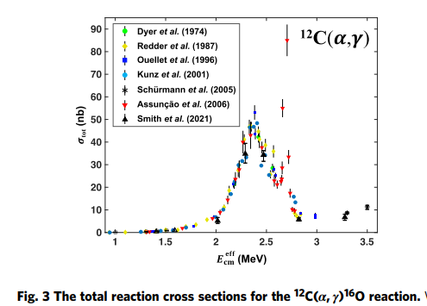
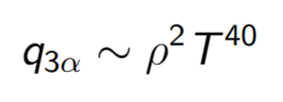
Low-mass stars: Helium burning
De Boer+ 2017, 2020.
Smith+ 2021 (Nature).
Helium-burning develops through the triple-alpha reaction.
The product is ¹²C.
The temperature dependance is very strong:
At the last stages:
Very important and very challenging to determine experimentally and theoretically.
Additional alpha-captures on ¹⁶O, ²⁰Ne, ²⁴Mg,…

Slide 38
Low-mass stars: Helium burning
There is a feedback between stellar evolution and nuclear physics.
Nuclear physics is crucial for stellar evolution, but stellar evolution can also help to constrain rates.

Slide 39
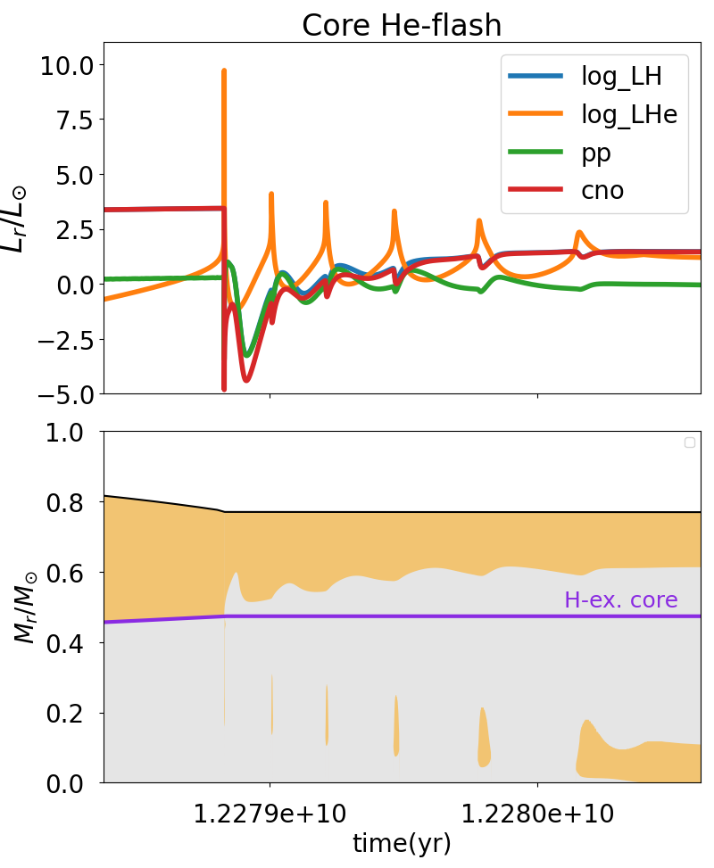
Low-mass stars: Core Helium flash
Mocak+ (2008, 2009, 2010).
Dearborn+ (2006).
Deupree (1981, 1983, 1984, 1986, 1987).
Cole and Deupree (1980).
Paczynsky and Tremaine (1977).
Iben (1967).
1 M⊙ star

Slide 40
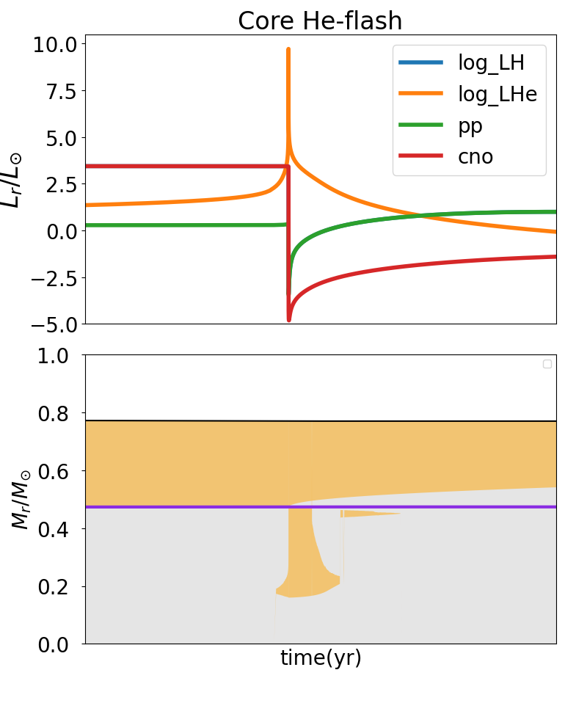
Low-mass stars: Core Helium flash
≈ 10s yr
Evolution on dynamical timescales.
Limitation of 1-dimensional codes?
≈ 400 yr
Mocak+ 2008
≈ 2000 yr

Slide 41
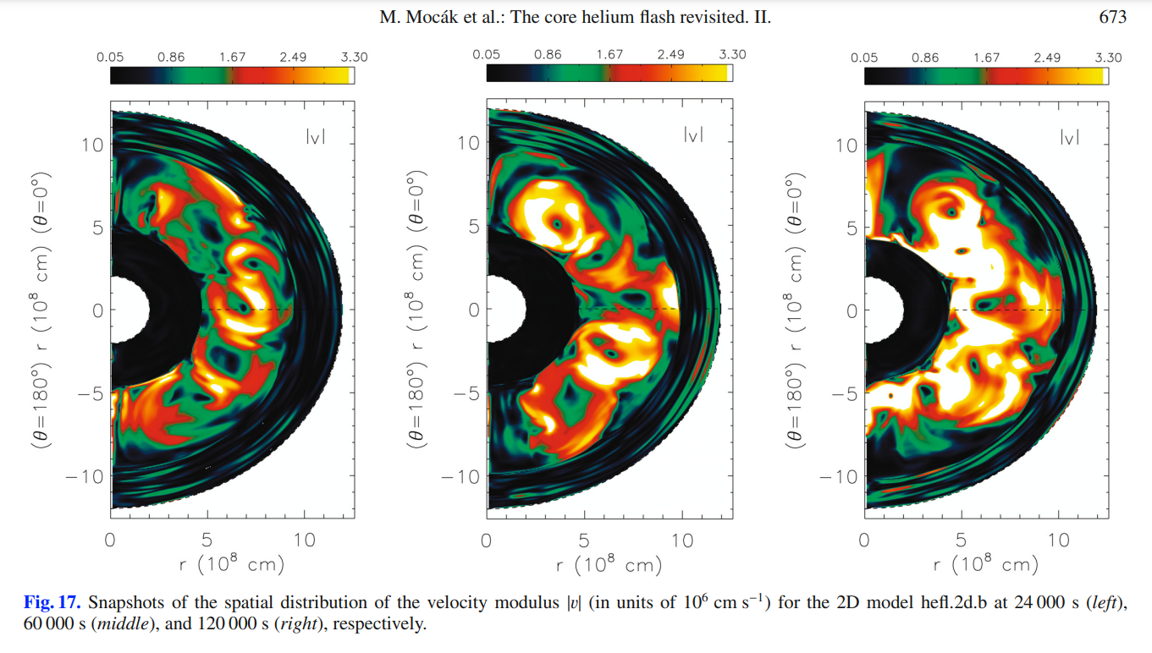
Low-mass stars: Core Helium flash
3D hydro results showed nn-explosive behaviour, but core of convective envelope on dynamical timescales and variations in temperature gradients with respect to the mixing-length recipes.

Slide 42
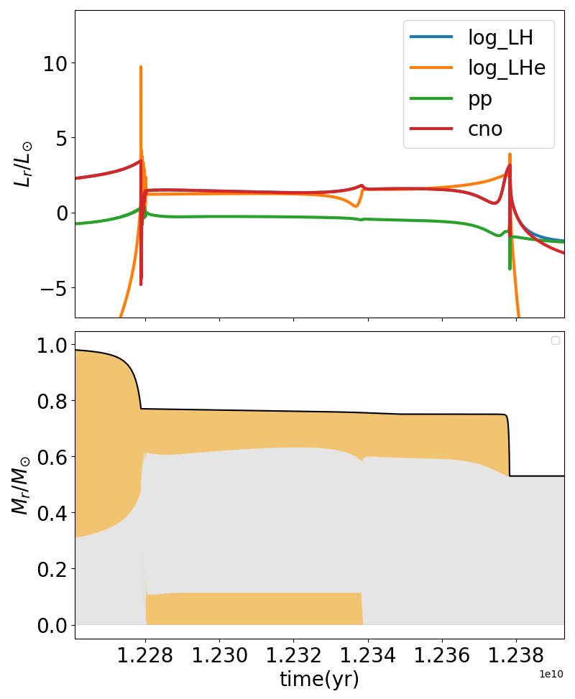
Low-mass stars: Quiescent He-burning
The last helium flash drives a flame that advances towards the center.
Central He is then burnt quiescently.
The core expands and the surface radius expands. The star’s luminosity remains approximately constant => T_{eff} increases.

Slide 43
Intermediate-mass stars: TP-AGB
Central He exhaustion →
→ Gravity temporarily takes over: contraction.
→ He-burning develops in a shell around the core.
Eventually the He-burning shell thins , H-burning shell takes over.
H-burning piles up He + thin-shell instability
→ expansion accompanied by rise in temperature: He-flash/pulse.
Very high release of energy →
→ Local energy transport by convection (pulse-driven convective zone)
→ Expansion and cooling of outer layers: H-burning shell temporarily switches off.
Convective envelope advances downwards to dredge-up He-burning processed matter:
Third dredge-up (TDU).
H-burning shell recovers and the process repeats:
→ Thermally-pulsing Asymptotic Giant Branch (TP-AGB).

Slide 44
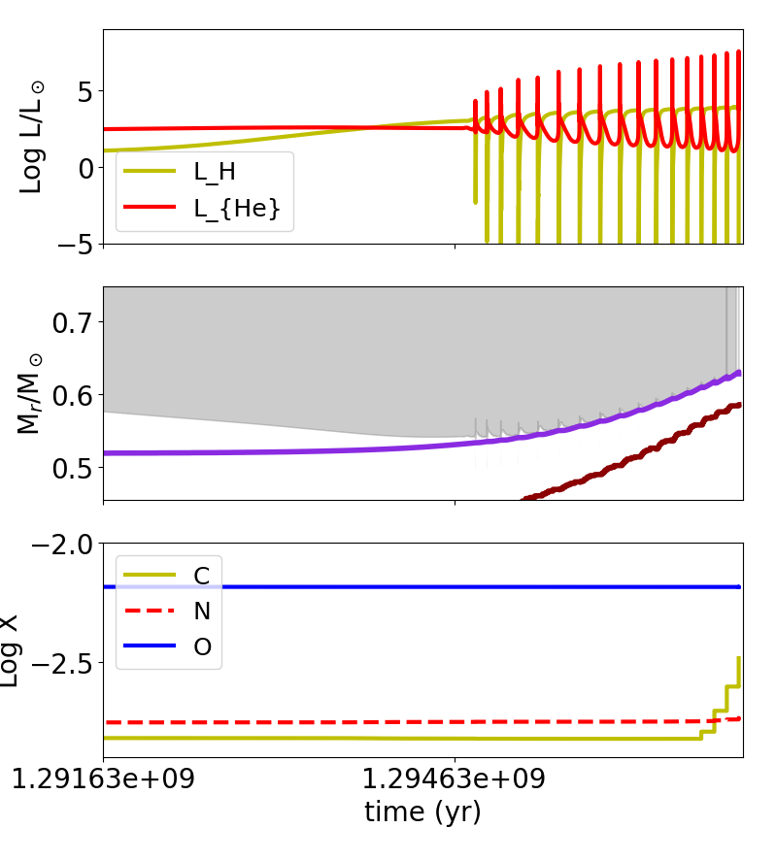
Intermediate-mass stars: TP-AGB
Central He exhaustion →
→ Gravity temporarily takes over: contraction.
→ He-burning develops in a shell around the core.
Eventually the He-burning shell thins , H-burning shell takes over.
H-burning piles up He + thin-shell instability
→ expansion accompanied by rise in temperature: He-flash/pulse.
Very high release of energy →
→ Local energy transport by convection (PDCZ)
→ Expansion and cooling of outer layers: H-burning shell temporarily switches off.
Convective envelope advances downwards to dredge-up He-burning processed matter:
Third dredge-up (TDU).
H-burning shell recovers and the process repeats:
→ Thermally-pulsing Asymptotic Giant Branch (TP-AGB).
2 M⊙ star

Slide 45
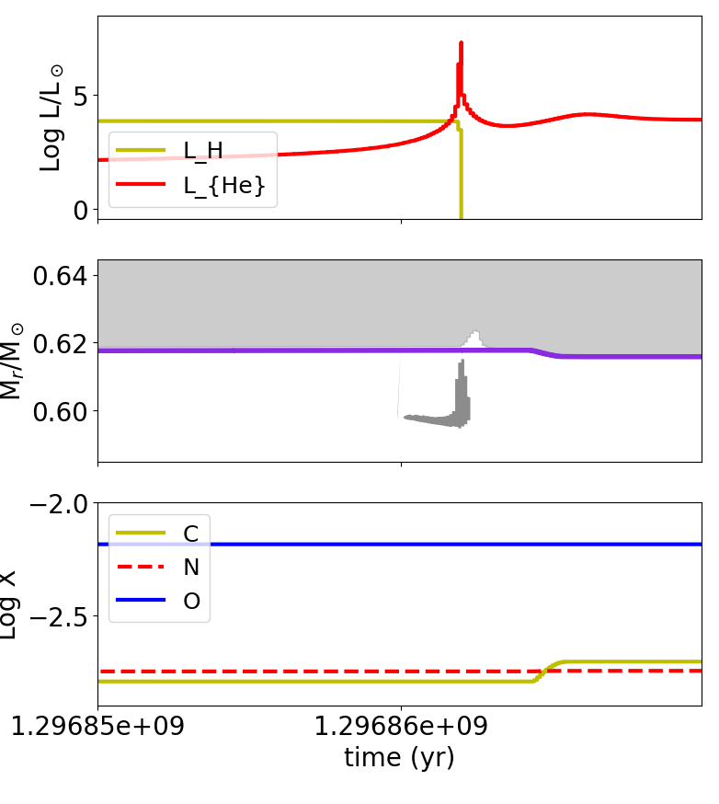
Intermediate-mass stars: TP-AGB
A closer look at a thermal pulse
Third Dredge-Up episode
inner convective shell
Transport to the surface of H and He-burning products
(C/ O ↑, ¹²C/ ¹³C ↑)
+ s-process elements.
C/O ↑ star may become a C-star.
Δt ≈ 1000 yr

Slide 46
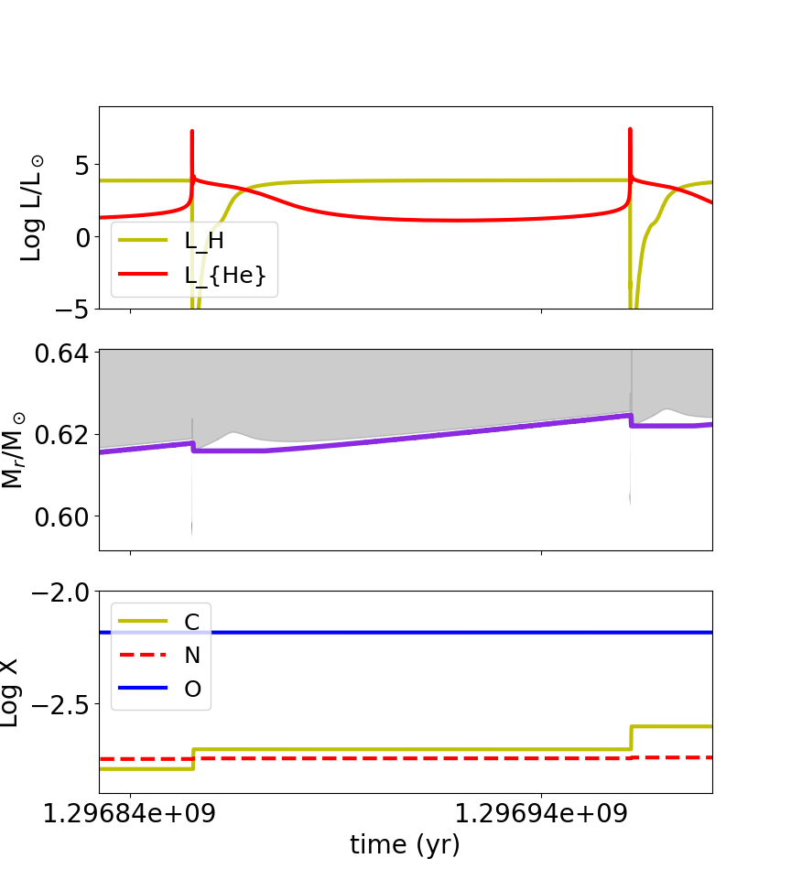
Intermediate-mass stars: TP-AGB
A closer look at an interpulse
Δt ≈ 10⁵ yr

Slide 47
Intermediate-mass stars: TP-AGB
The dredge-up efficiency parameter λ.
Dredge-up efficiency strongly depends on the treatment of convective boundaries, that is not well understood.
$$λ=\frac{M_{DU}}{M_{c}}$$
M_{DU}
ΔM_{c}

Slide 48
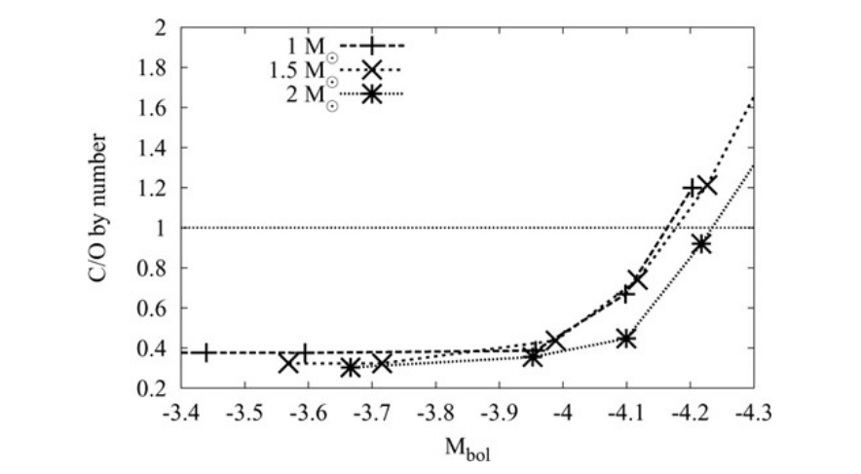
Intermediate-mass stars: TP-AGB
Stancliffe+ (2005)
Data for LMC

Slide 49
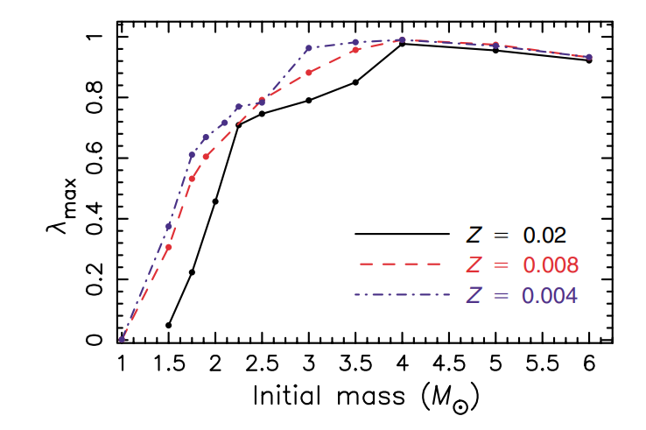
Intermediate-mass stars: TP-AGB
A proper understanding of the the Third Dredge-Up (TDU) is crucial to understand the evolution of surface abundances, stellar yields and how Low and Intermediate-Mass stars contribute to Galactic Chemical Evolution.
But its efficiency is not completely well understood. It depends strongly on the determination of convective boundaries, and even on numerical code issues.
And convection has many limitations in 1D ☹ .
Karakas (2006) presented a parametrization of the TDU. We know it depends on initial mass and metallicity.

Slide 50
Low-mass stars: winds during the RGB and the AGB
Stellar winds
As the stellar radius increases vastly during the RGB and the AGB, the outermost parts of the envelope become very loosely bond.
Radiation pressure on dust grains and pulsations drive very efficient winds.
We do not completely understand stellar winds on first principles, and rely on ‘recipes’, e.g.:
Reimers (1975),
Vassiliadis and Wood (1993),
Blocker (2005),
Schröder and Cuntz (2006),…

Slide 51
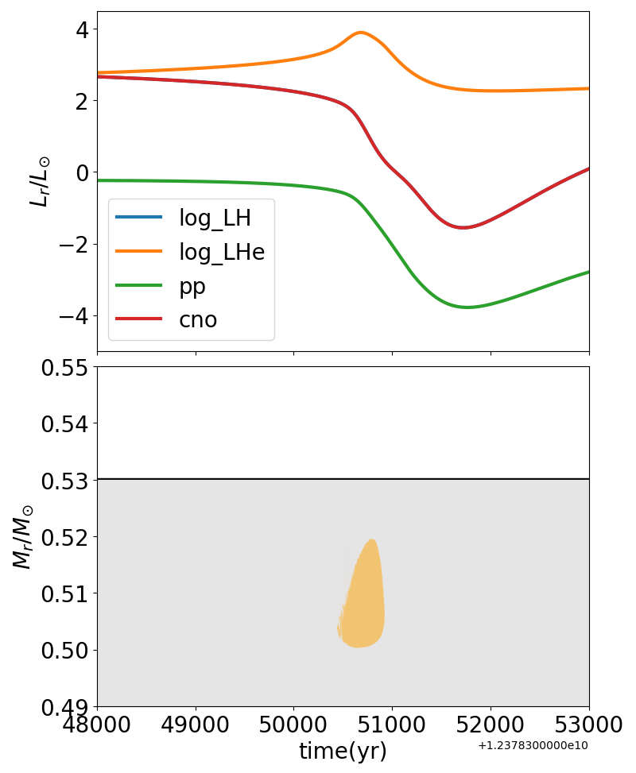
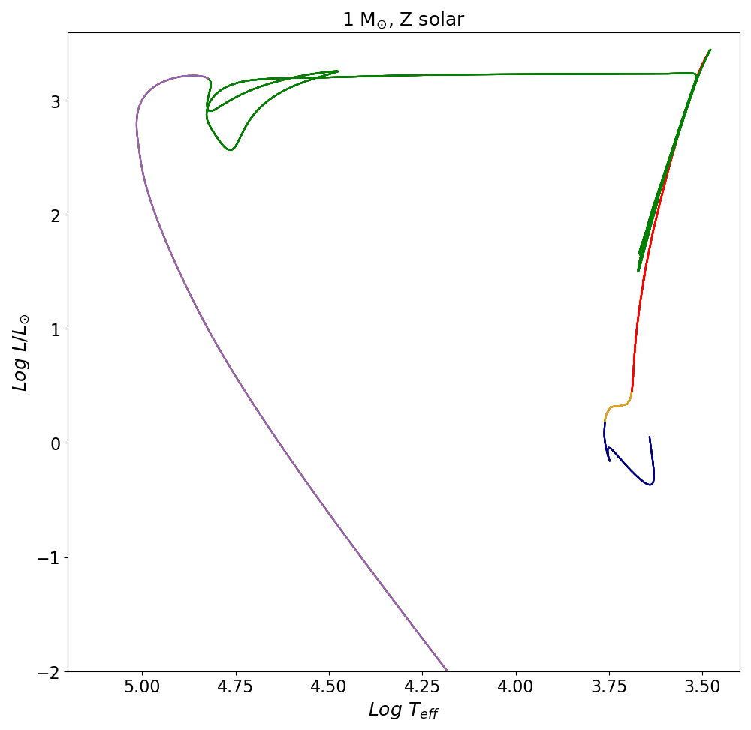
Low-mass stars: Late-He flash

Slide 52
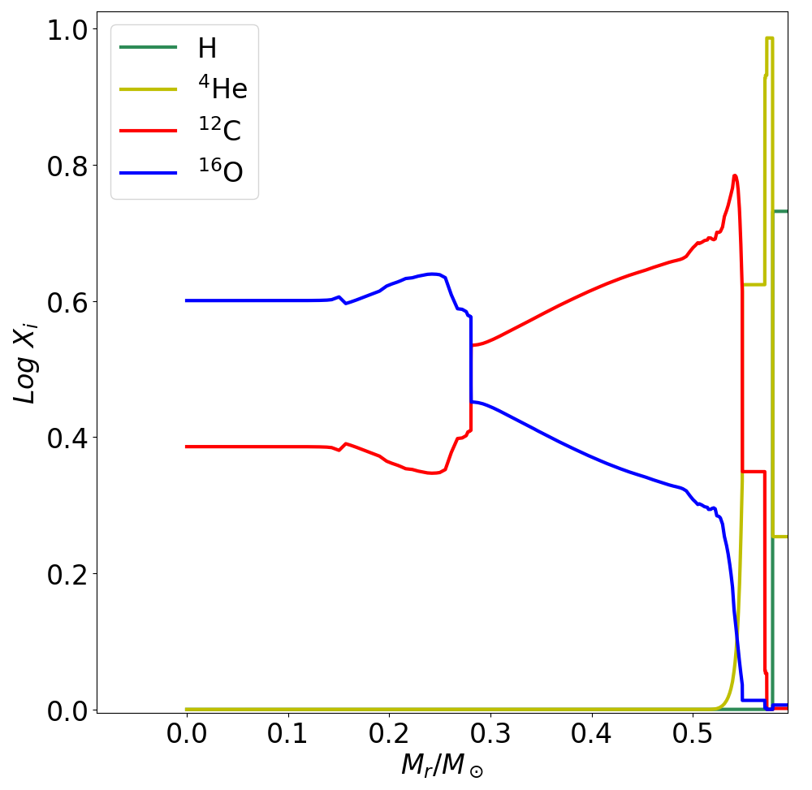
Low-mass stars: progress to WD
Planetary nebula
Stellar winds.
Practically bare CO core at the end of the AGB.
CO WD

Slide 53
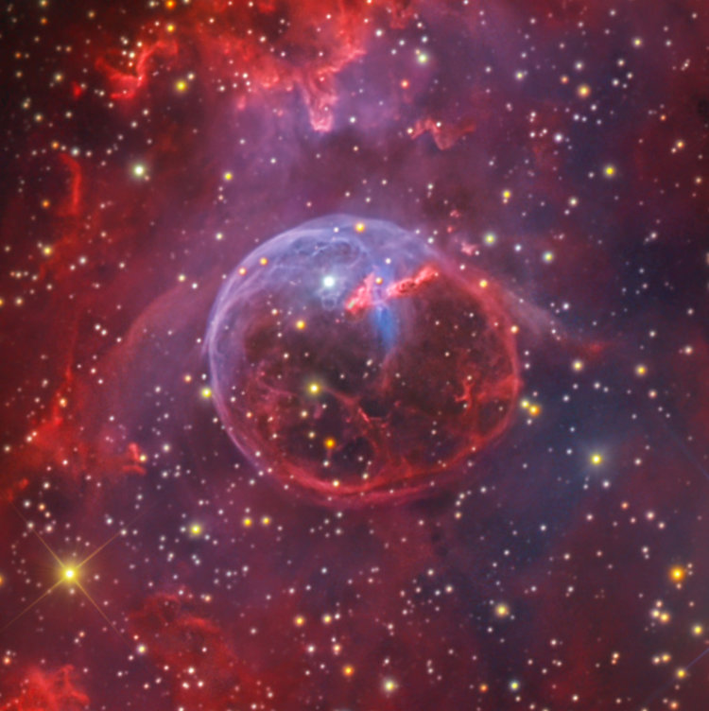
Low-mass stars: progress to WD
Stellar winds.
Practically bare CO core at the end of the AGB.
Planetary nebula
CO WD

Slide 54
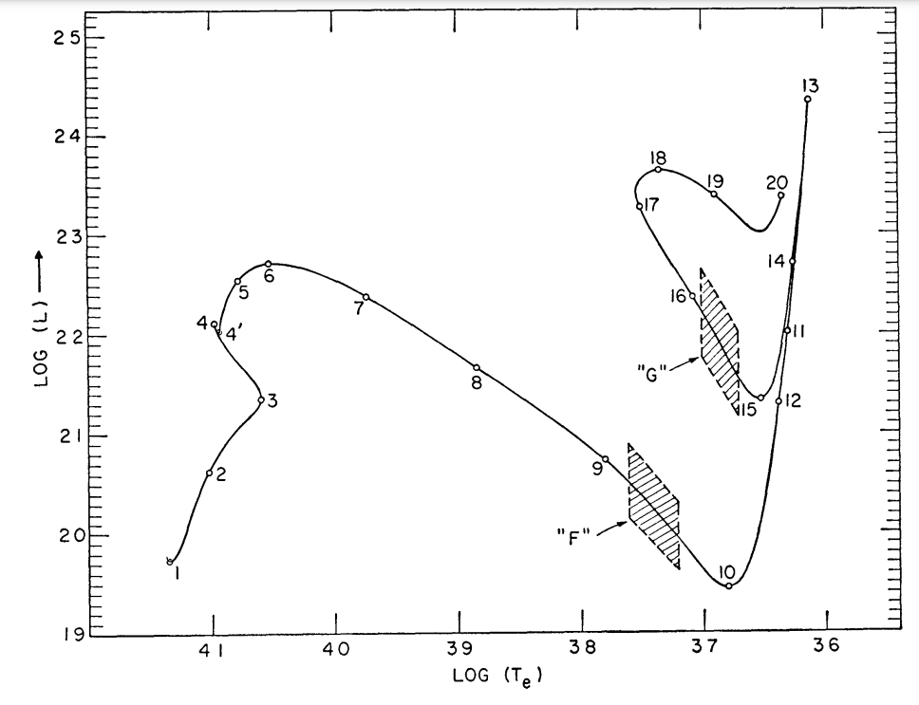
Intermediate-mass stars: 2 ≲ M/M⊙ ≲ 8-10
Iben (1965)

Slide 55
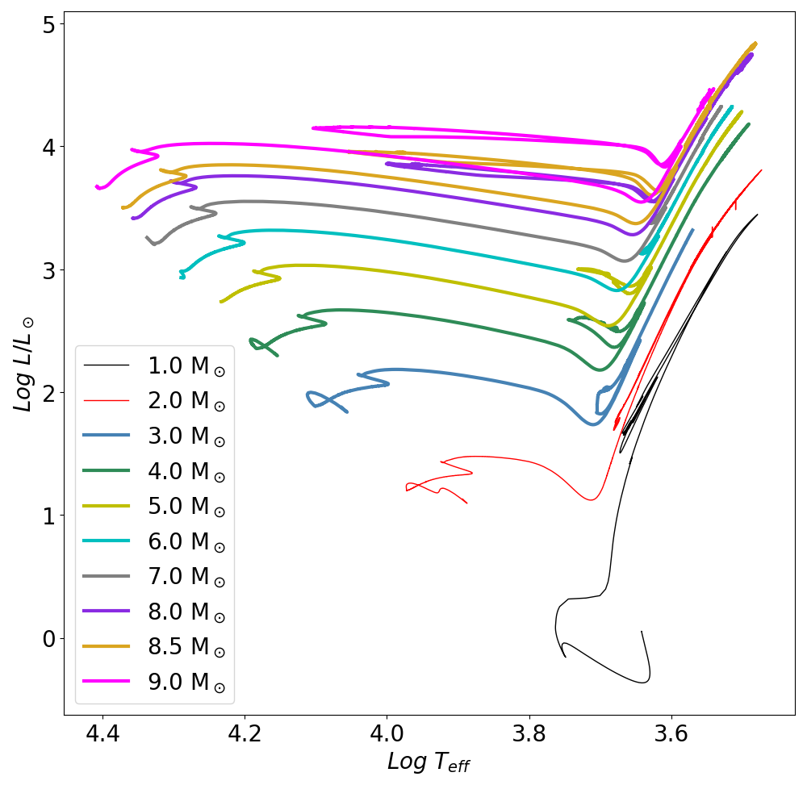
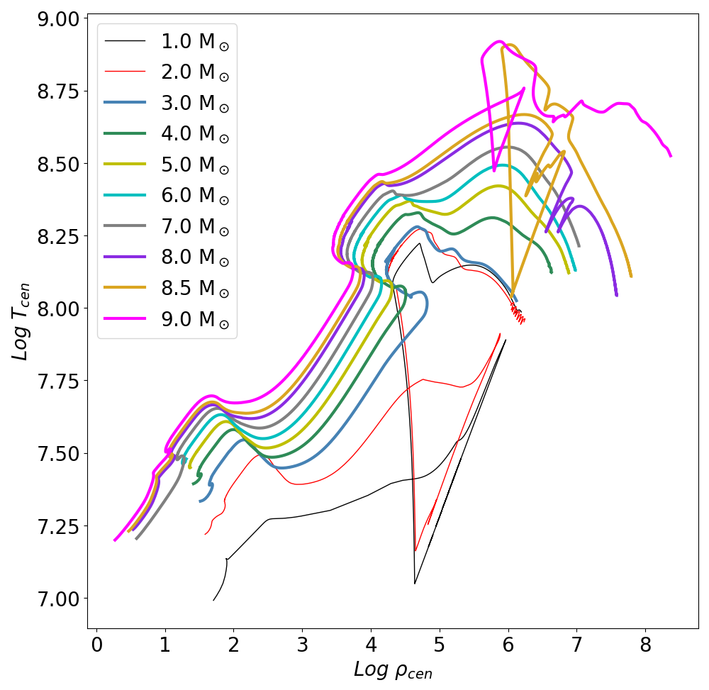
Intermediate-mass stars: 2 ≲ M/M⊙ ≲ 8-10

Slide 56
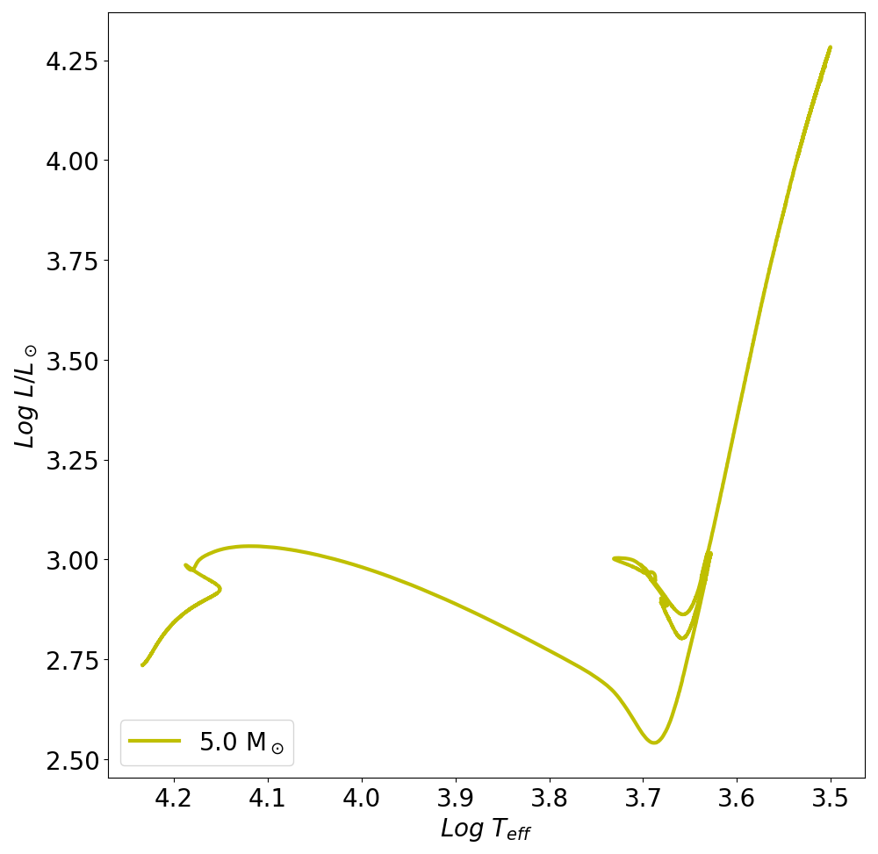
Intermediate-mass stars: Main sequence
Mini (Msun) | T_{MS} (yr)
3.0 | 5x10⁸
4.0 | 2x10⁸
5.0 | 1x10⁸
6.0 | 8x10⁷
7.0 | 5x10⁷
8.0 | 4x10⁷
9.0 | 3x10⁷
Main
sequence

Slide 57
Intermediate-mass stars: RGB and First dredge-up
Main
sequence
RGB

Slide 58
Intermediate-mass stars: RGB and First dredge-up

Slide 59
Intermediate-mass stars: Core He-burning
Triple-alpha reaction
At the last stages:
Main
sequence
Blue loop

Slide 60
Intermediate-mass stars: EAGB and Second Dredge-Up
Second Giant Branch after core He-burning.
Second dredge-up => typical CNO product enhancement + importance of its extent.
AGB
Main
sequence
Blue loop
RGB
Doherty, Gil-Pons+ 2015

Slide 61
Intermediate-mass stars: TP-AGB
AGB
Main
sequence
Blue loop
RGB

Slide 62
Intermediate-mass stars: TP-AGB and Third dredge-up
Similar to low-mass stars. But dredge-up efficiency depends on initial mass and metallicity (Karakas 2002):

Slide 63
Intermediate-mass stars: TP-AGB nucleosynthesis
TP-AGB structure
Hot-bottom burning:
In stars of initial mass ≳ 4 M ⊙ , the base of the convective envelope is so hot (T ≥ 40 MK) that the CNO-cycle operates.
Convective envelope
H-burning shell
CNO-processed matter is quickly transported to the star’s surface by convection.
Intershell
He-burning shell (inactive)
⁴He, ¹³C, ¹⁴N, ¹⁷O, ¹⁸O ↑
H, ¹²C, ¹⁵N, (¹⁶O) ↓
Inert CO-core

Slide 64
Intermediate-mass stars: Hot-bottom burning
See HBB switching-off at the end of the TP-AGB and TDU taking over.
Lithium is formed during the early TPs and quickly depleted during the advanced TP-AGB.
⁷Li
¹⁴N
¹⁶O
¹²C
Ventura+ 2022

Slide 65
Intermediate-mass stars: Some words on lithium
It is a very fragile and interesting isotope.
There is a discrepancy between Big-Bang predictions and metal-poor stars (Spite plateau).
Stars should destroy it during FDU, but Li-rich giants exist.
Cameron-Fowler (1971) mechanism:
Its destruction/formation depends strongly on code details and timesteps to treat thermohaline mixing in the RG.
Lattanzio+ 2014

Slide 66
Intermediate-mass stars: Some words on lithium
Potential sites for Li-enricment:
AGBs (e.g. Cameron & Fowler, 1971),
Novae (e.g., Starrfield et al. 1978; 2020)
Rotationally induced mixing (Denissenkov & Herwig 2004);
Magnetic buoyancy (e.g., Busso et al. 2007; Nordhaus et al. 2008, Guandalini+2009;
planetary engulfment or interaction with substellar companions (e.g., Alexander 1967; Siess & Livio 1999a, 1999b; King et al. 1997).
Sayeed+ 2024
Li-enhancement associated to rotation, belonging to red clump, and effects of binarity... But under certain conditions.

Slide 67
Intermediate-mass stars: TP-AGB nucleosynthesis
Hot-bottom burning (throughout interpulses) and third dredge-up may happen in consecutive episodes.
Remember: TDU: C↑, HBB: C↓, N↑
Adapted from Gil-Pons, Doherty+ 2013
Doherty, Gil-Pons+ 2014

Slide 68
Intermediate-mass stars: TP-AGB nucleosynthesis
T_{HBB} ≥ 40 MK => NeNa cycle: ²⁰Ne ↑ , ²¹Ne, ²²Ne, ²³Na ↓
T_{HBB} ≥ 80 MK => MgAl chains ²⁶Al, ²⁷Al, ²⁷Si ↑,
²⁴Mg, ²⁵Mg, ²⁶Mg ↓
Doherty, Gil-Pons+ 2014, 2015

Slide 69
We know a bit about Li (?), C, N, the rest?

Slide 70
Intermediate-mass stars: s-process, ¹³C neutron source
Low-mass AGBs
Neutron-source: ¹³C =>
¹³C(α, n) ¹⁶O
Herwig, 2005

Slide 71
Intermediate-mass stars: s-process, ¹³C neutron source
Low-mass AGBs: neutron-source: ¹³C via ¹³C(α, n) ¹⁶O
¹³C pockets: some codes/models need an artificially formed pocket. Others do not. Both cases are quite successful at reproducing s-process patterns.

Slide 72
Intermediate-mass stars: s-process, ¹³C neutron source
Massive AGBs (>5-6 Msun):
During pulse, neutron-source:
²²Ne(α, n) ²⁵Mg

Slide 73
Intermediate-mass stars: s-process, neutron sources
Neutron-source: ¹³C
Neutron-source: ²²Ne
Pb
Ba
Sr
Gil-Pons+ in prep.
[Fe/H] = -5
Karakas and Lattanzio 2014, Lugaro+ 2012

Slide 74
Intermediate-mass stars: Fates
Planetary nebula
Stellar winds.
Practically bare CO core at the end of the AGB.
CO WD
Gil-Pons+ 2007

Slide 75
Intermediate-mass stars: TP-AGB, uncertainties
Overshooting/convective boundary mixing.
Wagstaff+ 2020

Slide 76
Intermediate-mass stars: TP-AGB, uncertainties
Remember: We do not completely understand stellar winds on first principles, and rely on ‘recipes’, e.g.:
Vassiliadis and Wood (1993),
Blocker (2005),
Schröder and Cuntz (2006),…
Some calibration is possible for solar or nearly-solar metallicity models, but wind rates at very low metallicities are very uncertain.
Uncertain to the point that it is difficult to assess the fates of the most metal-poor intermediate-mass stars.
Doherty, Gil-Pons+ 2014

Slide 77
Intermediate-mass stars: TP-AGB, uncertainties
The effects of rotation
And uncertainty effects are entangled!

Slide 78
Massive intermediate-mass stars: 8 ≲ M/M⊙ ≲ 10

Slide 79
Intermediate-mass stars: Carbon burning
Stars of initial masses ≳ 7.5-8-8.5 M⊙ develop degenerate CO cores of masses ≥ 1.05 M⊙.
Conditions for C-burning are reached off-center (due to neutrino cooling).
C-burning occurs in flashes, similarly to He-burning in low-mass stars, followed by a flame that advances towards the core.
C-burning

Slide 80
Intermediate-mass stars: Carbon burning
Nomoto, 1984.
García-Berro, Iben and Ritossa (1994, 1995, 1996, 1999).
Siess (2006, 2007, 2008, 2009, 2010).
Gil-Pons and García-Berro (2001, 2002, 2003, 2005, 2007).
Poelarends+ (2006, 2008).
Doherty, Gil-Pons and Lattanzio (2010, 2014a,b, 2015, 2017).
Ventura+, 2010, 2012,...
Jones+ (2013, 2015).
Heger and Woosley, 2013.
Limongi+, 2024.
C-burning

Slide 81
Intermediate-mass stars: Carbon burning
T ≥ 6x10⁸ K

Slide 82
Intermediate-mass stars: Carbon burning
C-burning behaves pretty consistently at different metallicities.
← Z=0
Look at the different times at which the SDU is happening.
And there is a dredge-out at the highest mass case.
Gil-Pons+ 2018

Slide 83
Intermediate-mass stars: Carbon burning
CO-core prior to C-burning
Resulting ONe- core
Doherty, Gil-Pons+ 2014

Slide 84
Intermediate-mass stars: Carbon burning
TP-Super-AGB ensues after C-burning.
Stars may go through (many) hundreds of thermal pulses.
Siess, 2010

Slide 85
Fates of low and intermediate-mass stars: M_{up},M_{n},M_{mass}
No C-burning
C-burning
M_{up}
M_{n}
M_{mass}
No explosion (single)
Explosive end
Low and intermediate-mass stars
Massive stars
M_{up} : Minumum mass for carbon-burning.
M_{n} : Minimum mass to undergo electron-capture supernova.
M_{mass} : Minimum mass to go through all central burning to Fe and explode as SN.

Slide 86
Fates of low and intermediate-mass stars: M_{up},M_{n},M_{mass}
Poelarends+ 2007
Doherty, Gil-Pons+ 2015

Slide 87
Fates of low and intermediate-mass stars: M_{up},M_{n},M_{mass}
Straniero, Piersanti and Cristallo 2016

Slide 88
Fates of low and intermediate-mass stars: M_{up},M_{n},M_{mass}
Limongi+
2024

Slide 89
Intermediate-mass stars are an inhomogeneous group
s-process (²²Ne)
s-process (¹³C)
HBB
TDU
DO
C-burn
SDU
FDU
 | 1 | 2 | 3 | 4 | 5 | 6 | 7 |  | 8 |  | 9 |  | 10
M_{ini}/M_{sun}

Slide 90
Intermediate-mass stars are an inhomogeneous group
Low-mass IMS
Intermediate-mass IMS
Massive
IMS
s-process (²²Ne)
s-process (¹³C)
HBB
TDU
DO
C-burn
SDU
FDU
 | 1 | 2 | 3 | 4 | 5 | 6 | 7 |  | 8 |  | 9 |  | 10
M_{ini}/M_{sun}

Slide 91
Fates of low and intermediate-mass stars
Can it burn He?
Red dwarf
No
Yes
Does it avoid
core He-flash?
Low-mass star: CO WD
No
Yes
Does it avoid advanced central burning?
Intermediate-mass star
No
Yes
Yes
CO WD
Massive star
Does it avoid degenerate C-burning?
No
ONe WD?

Slide 92
Fates of low and intermediate-mass stars
Does it avoid advanced central burning?
Intermediate-mass star
No
Yes
CO WD
Yes
Massive star
Does it avoid degenerate C-burning?
Does it avoid e-capture SN explosion?
No
Yes
No
ONe WD
EC-SN
Image
S.Wilkinson/
Las Cumbres Observatory.

Slide 93
Conclusions Intermediate-mass stars are an heterogeneous group: - many phenomena involving stellar evolution theory, observations, nuclear physics... + different effects are usually entangled. Super-AGB stars exist and they are very interesting. Old theory and still many unknowns. And we have not discussed binarity and extremely metal-poor cases! Stars are complex, present highly non-linear behaviour, and we need to rely on parametrized treatments. Feedback between nuclear physics, stellar evolution theory and observations are naturally crucial.

Slide 94
Did we get some clues?
Why are non-massive stars important?
How do they live?
How do they end their lives?
Why are they important for element formation?
Why the embarrassing uncertain mass-limits in the definition of different types?
What do we still have to understand?

Slide 95
Thanks :)

