Slide 1
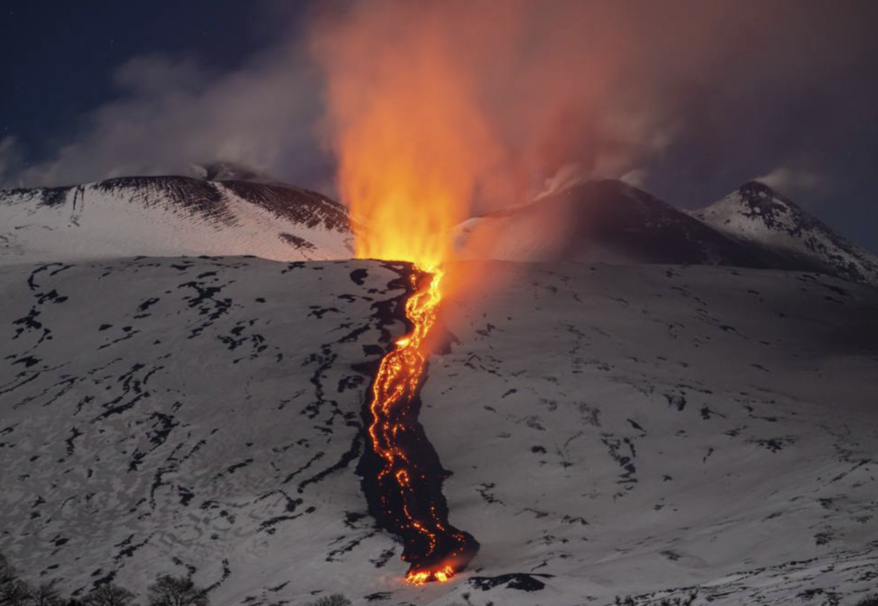

Nuclear reactions for Astrophysics and the opportunity of indirect methods
Marco La Cognata
20th Russbach School on Nuclear Astrophysics

Slide 2
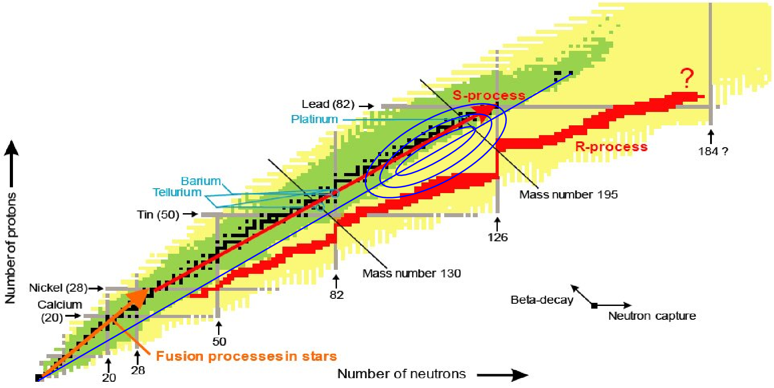
Astrophysical Scenarios
Fusion processes
  nucleosynthesis H → Fe
  (p-p chain, CNO cycle(s) and Hot CNO cycles, triple alpha, C fusion up to “silicon” burning)
  Also: gamma process, i-process and many others
Neutron induced processes
  nucleosynthesis Fe → …
  r-process: rapid, occurs in explosive scenarios, proceeds along the neutron drip line;
  s-process: slower, proceeds along valley of stability;

Slide 3
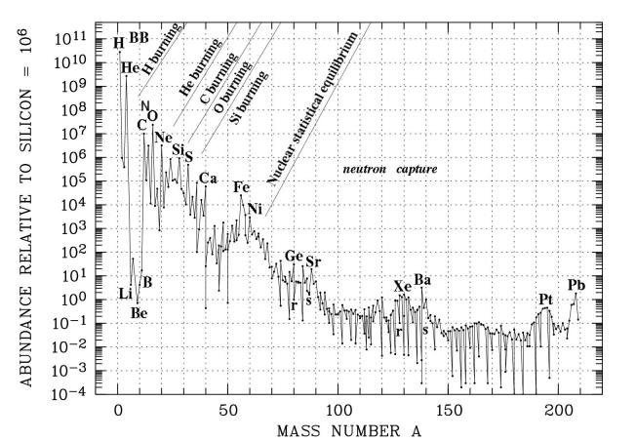
Astrophysical Scenarios
Fusion processes
  nucleosynthesis H → Fe
  (p-p chain, CNO cycle(s) and Hot CNO cycles, triple alpha, C fusion up to “silicon” burning)
  Also: gamma process, i-process and many others
Neutron induced processes
  nucleosynthesis Fe → …
  r-process: rapid, occurs in explosive scenarios, proceeds along the neutron drip line;
  s-process: slower, proceeds along valley of stability;

Slide 4
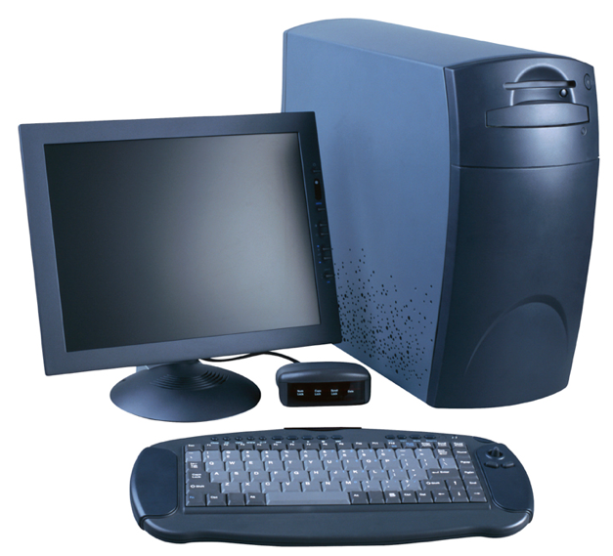
Nuclear astrophysics input
Nuclear parameters (cross sections, …)
Elemental yield → comparison with abundances observed in stars and meteorites to validate models
The purpose of nuclear astrophysics is to provide reliable nuclear physics input
Astrophysical models: how a star works
Model input parameters: magnetic field, metallicity, …
Change the model until observables are matched by predictions
Astrophysical models are very complex: assumptions on stellar structure and on stellar parameters (age, mass…) → need of multiple independent constrain
Key point: all ingredients must be well balanced… now observations are way more accurate than nuclear physics data (JWST, PLANCK, SNO…)

Slide 5
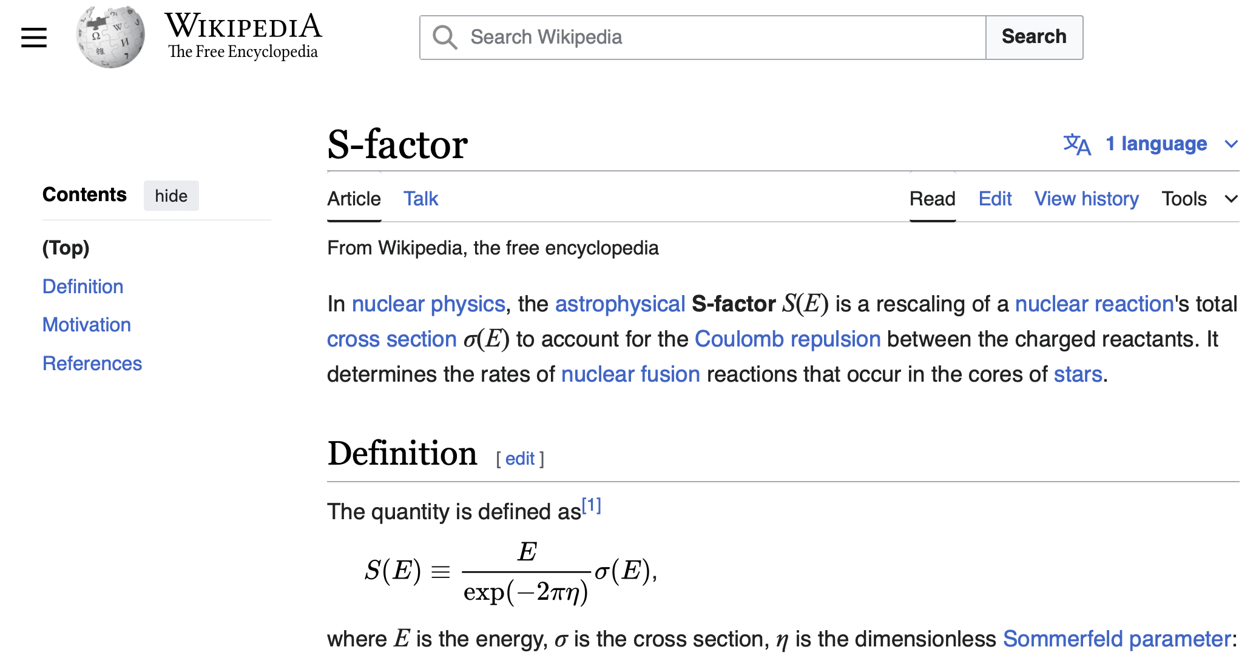
Nuclear astrophysics input
Nuclear parameters (cross sections, …)
Elemental yield → comparison with abundances observed in stars and meteorites to validate models
The purpose of nuclear astrophysics is to provide reliable nuclear physics input
Astrophysical models: how a star works
Model input parameters: magnetic field, metallicity, …
Change the model until observables are matched by predictions
Astrophysical models are very complex: assumptions on stellar structure and on stellar parameters (age, mass…) → need of multiple independent constrain
Key information: how does the mixing mechanism work? Mixing of the produced nuclides from stellar inner layers to the surface where they are observed

Slide 6
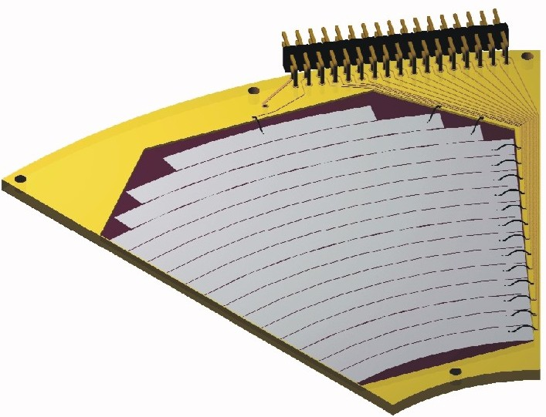
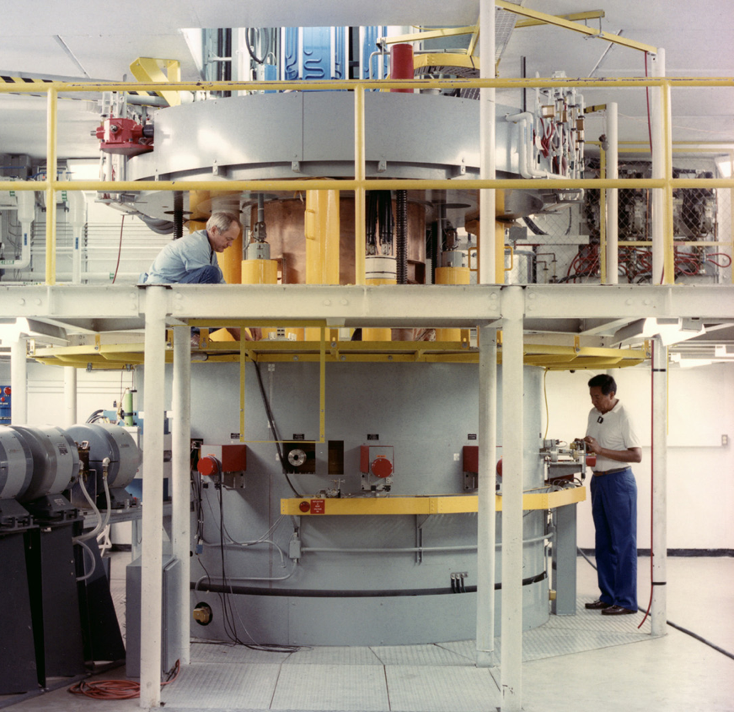
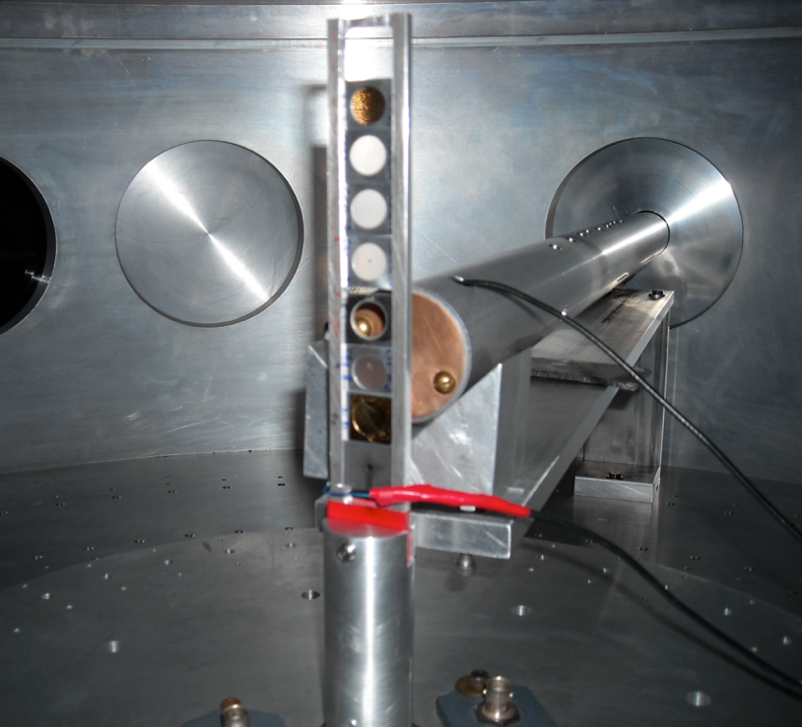
Recipe for direct measurements
How to measure the A+x→c+C reaction in a direct way?
Detector → kinematic observables
- Energy
- Emission angle
+ Particle identification
Reaction
product (c)
Beam (x)
Target (A)
It looks quite simple!

Slide 7
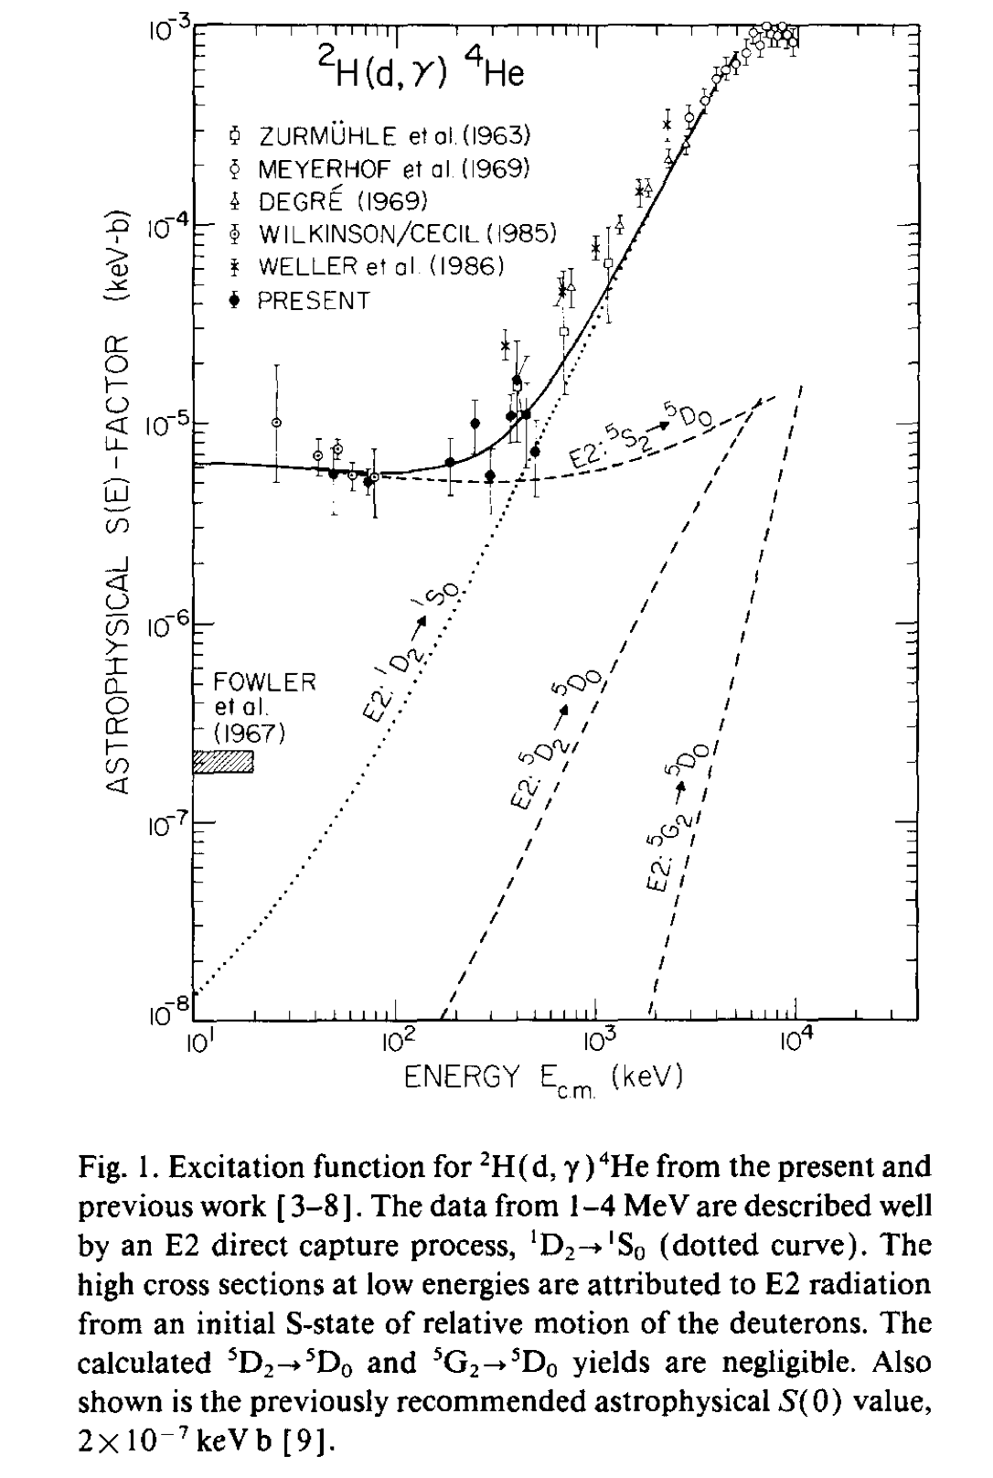
RISK of EXTRAPOLATION (or the prejudice of consistency)
How would you extrapolate if only data from Zurmuhle et al would have been available?
You would be probably happy with a E2 transition from the L = 2 scattering state in the d + d system into the (L =0, S=0) component of the He ground state.
However, it was found [Barnes et al. PLB 197, 315 (1987)] that the cross section was strongly enhanced compared with what is expected for this case.
When the new experimental data became available they undoubtedly indicated the existence of a D-state component in the He ground state.

Slide 8
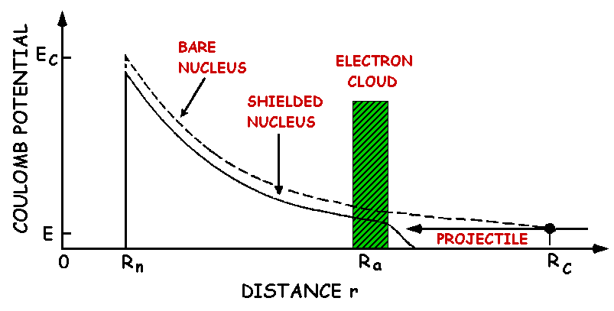
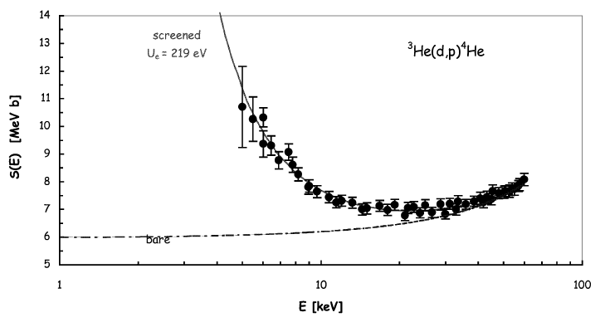
The electron screening effect.
Thanks to recent experimental developments, measurements have been extended to the energies of interest for several reactions.
This leads to the discovery of electron screening: a such low energies atomic degrees of freedom cannot be neglected.
Pictorial view: Experimentally:
Exponential enhancement!
∝
The electron cloud shields the nuclear charge thus the projectile meets a reduced Coulomb barrier → enhancement of the reaction probability as tunneling is more likely.
Bracci et al., NPA 513 (1990) 316
Rolfs & Rodney, Cauldrons in the Cosmos (Univ. Chicago Press) 1988
Strieder et al., Naturwissenschaften 88 (2001) 461

Slide 9
Direct vs. indirect measurements
Indirect measurements:
Complicated but rewarding
High energy experiments: up to several hundreds MeV
→ no Coulomb barrier suppression → possibility to measure angular distributions
→ negligible straggling → no need to rely on stopping power models
→ no electron screening → no need to make assumptions for extrapolation
Indirect measurements are the only ones allowing you to measure down to astrophysical energies with the present day facilities
Nuclear reaction theory required
→ cross checks of the methods needed
→ possible spurious contribution
→ additional systematic errors (is the result model independent?)
... Indirect techniques are complementary to direct measurements
Examples: Coulomb dissociation, ANC and Trojan horse method, surrogate reactions…

Slide 10
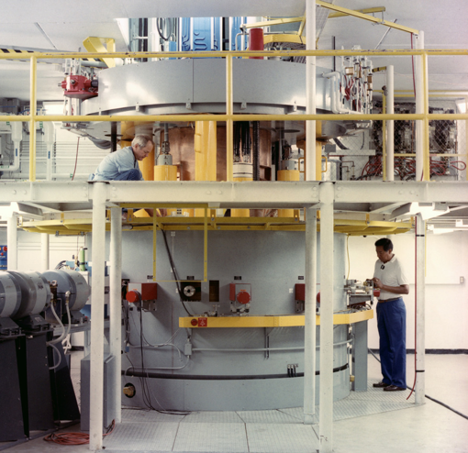
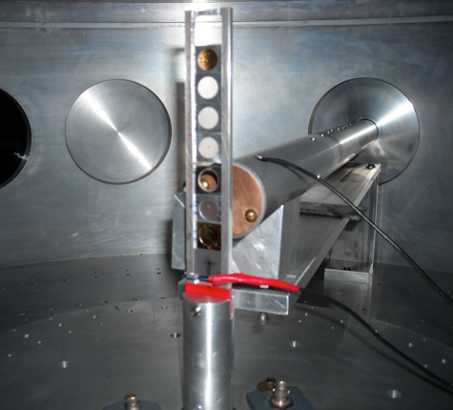
Indirect Techniques: a cartoon
Several reaction mechanisms link the two channels
Entrance channel:
A+a
Reaction products
C+c+…
Only one reaction mechanism has to be selected, for which the reaction theory we have developed applies. A careful experimental & theoretical investigation is necessary
To recall the previous sketch:
Nuclear reaction theory
R. Tribble et al., Rep. Prog. Phys. 77 (2014) 106901

Slide 11
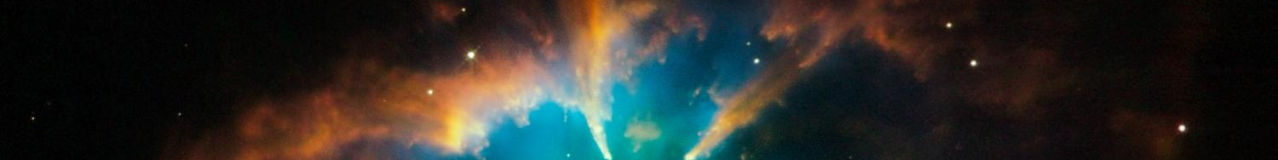
Indirect methods and RIBs
Reactions involving unstable nuclei → additional problems!
lower beams intensities
→ reaction yield even smaller at astrophysical energies (E<1 MeV in explosive scenarios where unstable nuclei take part to nuclear reactions)
poorer energy resolution
presence of contaminants in the beam, background...
Indirect studies would dramatically increase the yield thanks to
→ the experimental setup (e.g. thicker targets)
→ the suppression of Coulomb barrier
Moreover
Some reactions cannot be measured with present-day facilities such as:
- Neutron-induced reactions on exotic nuclei
- Reactions among unstable nuclei
As a first step, validation of the approach is needed to test how accurate is
This is accomplished by investigating reactions with stable beams

Slide 12

Indirect techniques: a comparison
In the Coulomb dissociation, a virtual photon beam is used to a photodisintegration reaction; the detailed balance principle is then used to recover the cross section of the relevant radiative capture reaction
a
a
γ
c
A
C
a
s
In the Asymptotic Normalization Coefficient (ANC) approach, a transfer reaction to a bound state is measured to deduce the normalization constant of the bound state wave function, prop. to the A(x,γ)F c.s.
x
A
F
a
s
In the Trojan Horse Method, a transfer reaction to an unbound system is used to measure the c.s. of the A(x,c)C process. C and c can be charged or neutral particles (no photons)
x
c
A
F*
C

Slide 13

The Trojan Horse Method
Coulomb barrier → exponential suppression of the cross section at astrophysical energies
+ electron screening
→ low-energy, bare-nucleus cross section is experimentally available only through extrapolation OR indirect measurements
From
A+a(x⊕s) → b+B+s @ 10-60 MeV
A + x → b + B @ 5-20 keV
By selecting the QF contribution
a
direct break-up
s
THM reaction
x
b
Though E_{A} >> V_{Coul} it is possible to measure at the Gamow peak since:
E_{c.m.}=E_{A-x}-Q_{x-s}
A
B
2-body process
Additional advantages:
● reduced systematic errors due to straggling, background…
More than 30 reactions studied in the last 30 years.
See Annu. Rev. Nucl. Part. Sci. 2021.71:345–76 for a recent review
But...
● off-shell cross section deduced (x → virtual particle)
● no absolute units (also an advantage)

Slide 14
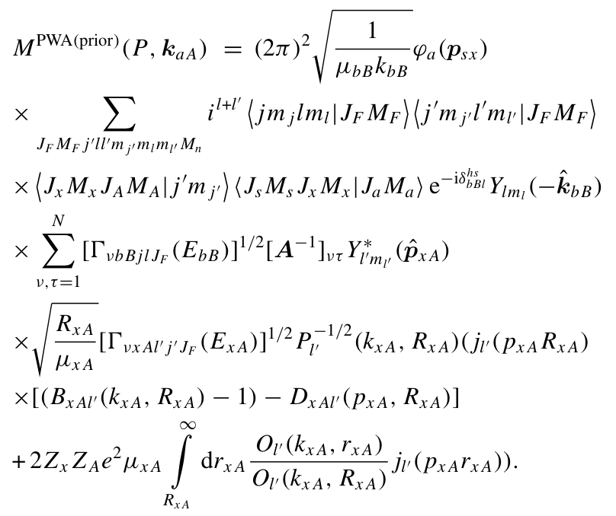
The full THM: the complicate formula
a
s
R. Tribble et al., Rep. Prog. Phys. 77 (2014) 106901
x
In the latest years, large efforts were made to give a quantitative justification of THM, to estimate the uncertainties and improve the description of the 2→3 cross section
b
A
F*
B
Fourier transform of the s-x relative motion wave function
Amplitude of the TH reaction
Same R-matrix term as in OES cross section but for the appearence of the inverse penetration factor making it possible to observe suppressed resonances at low energies
Inverse penetration factor

Slide 15


THM: Basic features
Plane Wave Impulse Approximation:
● beam energy >> a = x ⊕ b breakup Q-value
● projectile wavelength k⁻¹ << x – b intercluster distance
+ plane waves in the entrance and exit channel
➔ the 3-body cross section factorizes:
From the experiment
Evaluated through a MC code
HOES 2-body cross section
● KF kinematic factor
● φ(p_{b})² spectator momentum distribution
● dσ^{off}/dΩ off-shell cross section
or “nuclear” (N) cross section
dσ^{off}/dΩ → dσ/dΩ (on shell)
The penetration factor P_{l} has to be introduced:

Slide 16



THM vs. OES astrophysical factor
Direct data:
THM data:
Remember that:
is the formal partial resonance width for the decay of this level into channel c=x+A or c=b+B.
Where:
It can be calculated (DWBA, CDCC, PWBA…) or taken from measurements
The matrix D⁻¹ and VνcC(EcC) are the same in the TH and OES astrophysical factors.
The THM S-factor does not contain the penetration factor, which has to be inserted for comparison with direct data

Slide 17




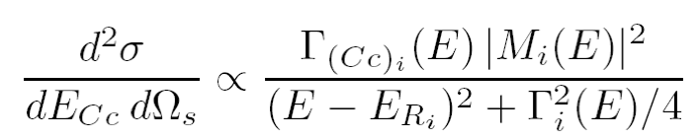
Moreover: exploring negative energies with the THM
Using the kinematics of three body reactions:
s-x Fermi motion
s-x binding energy
It is possible to achieve negative energies in the A-x channel
How to deal with negative energies? what is their meaning?
Standard R-Matrix approach cannot be applied to extract the resonance parameters of the A(x,c)C reaction because x is virtual —> Modified R-Matrix is introduced instead (A. Mukhamedzhanov 2010)
At negative energies M² is given by the product of the Whittaker function and the ANC of the F state populated in the transfer reaction
Merging together ANC and THM —> deep connection of these two indirect methods

Slide 18


And for narrow resonances?
When narrow resonances dominate the S-factor the reaction rate can be calculated by means of the resonance strength:
(¹⁸O(p,α)¹⁵N case)
Where:
Ĵ=2J+1
Γ_{(AB)} is the partial width for the A+B channel
Γ_{i} is the total with of the i-th resonance
E_{Ri} is the resonance energy
What is its physical meaning?
Area of the Breit-Wigner describing the resonance
  no need to know the resonance shape
In the THM approach:
Where:
ω_{I} = Ĵ_{i} / Ĵ_{p} Ĵ_{18O} statistical factor
N_{i} = THM resonance strength
M_{i} = transfer amplitude
Advantages:
possibility to measure down to zero energy
No electron screening
No spectroscopic factors in the Γ_{(p18O)} / |M_{i}|² ratio
The Astrophysical Journal, Volume 708, Issue 1, pp. 796-811 (2010).

Slide 19
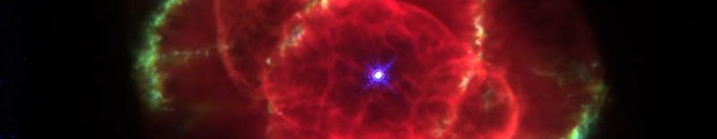
Asymptotic Normalization
Coefficients (ANC)
Radiative p (α) capture at stellar energies
Classical barrier penetration problem
Direct radiative capture
R. Tribble et al., Rep. Prog. Phys. 77 (2014) 106901
+ very many references
Peripheral reaction
low energies ⇒ capture at large radii
very small cross sections
The cross section is determined by ANCs

Slide 20
Some equations...
M is:
Integrate over ξ:
ANC ⇒ amplitude for tail of overlap function
Low B.E.:
Outside the nuclear radius
Find:

Slide 21
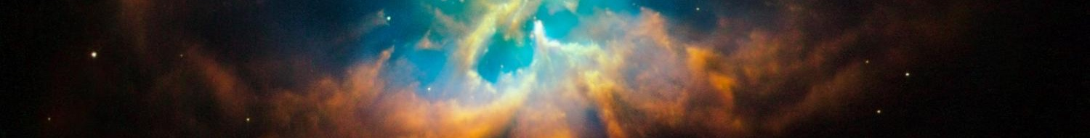
Where do we get the ANCs from?
Transfer reactions
Transition amplitude:
Peripheral transfer:
The transfer cross section is proportional to the needed ANCs
→ From a measurement @ several tens of MeV one can get the zero energy S-factor for a radiative capture reaction

Slide 22




ANC vs. THM
THM: in the case of resonant reactions a
metastable state is formed in the lower vertex:
a
s
c
An intermediate unbound system F escapes the nuclear interaction region later decaying to c+C
x
A
C
F
TRANSFER TO THE CONTINUUM
ANC => Transfer to a bound state
In both cases peripherality has to be enforced

Slide 23
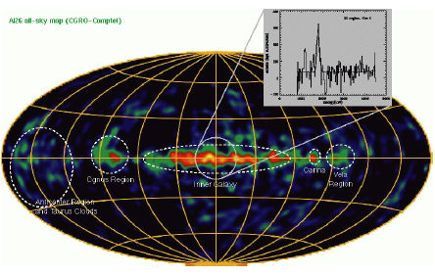
The narrow resonance case: ²⁷Al in massive stars
MgAl cycle in massive stars
²⁶Al/²⁷Al abundance ratio
It is ignited at temperatures > 0.03 GK and it is important to determine the abundances of medium mass nuclei
²⁶Al abundance is used to estimate the number of Galactic neutron stars and, therefore, of neutron star mergers (sources of GW)
The ²⁶Al/²⁷Al is generally
estimated, so it is
influenced by ²⁷Al
abundance predictions

Slide 24
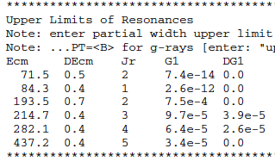
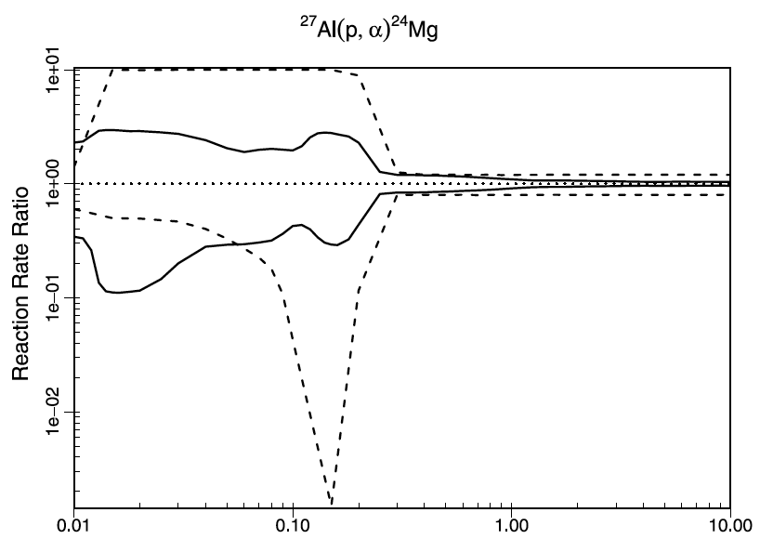
²⁷Al(p,α)²⁴Mg status of the art
The most recent review [Iliadis et al. (2010)] shows that for most low-energy resonances only an upper limit is known
→ These resonances are the most influent for astrophysics
Up to one order of magnitude uncertainty

Slide 25
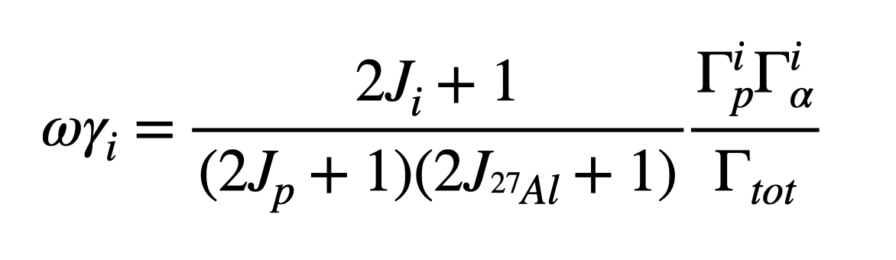
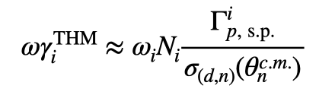
The TH method applied to ²⁷Al destruction
²H
n
When narrow resonances dominate the S-factor the reaction rate can be calculated by means of the resonance strengths and resonance energies only. Both can be deduced from the THM cross section.
Let’s focus on resonance strengths
p
⁴He
²⁷Al
²⁴Mg
The strengths are calculated from resonance partial widths
In the THM approach we determine the strength in arb.units. Normalization to a known resonance is necessary
What is its physical meaning?
Area of the Breit-Wigner describing the resonance
Advantage:
no need to know the resonance shape (moderate resolution necessary)

Slide 26
Data analysis: channel selection
Then the Qvalue spectrum is reconstructed
A=1 from the fit
First the mass of the undetected particle is deduced:
Y=E_{beam}-E_{A}-E_{C}
X=p_{A}²/2u
Two peaks for ²⁴Mg gs and 1st excited
Arrows: theoretical Qvalues

Slide 27
Data analysis: relative energy spectra
²⁴Mg-𝛼 relative energy → ²⁸Si excitation energies → This is the spectrum of astrophysical interest
²⁴Mg-n relative energy → ²⁵Mg excitation energies → background (sequential decay)
⁴He+n relative energy → ⁵He excitation energies → background (sequential decay)
d
𝛼
²⁹Si
²⁷Al
²⁵Mg
d
⁵He
²⁹Si
²⁷Al
²⁴Mg

Slide 28
Data analysis: selection of QF process
²H
n
B-D
A-C + B-D
p
⁴He
²⁷Al
²⁴Mg
When the breakup is quasi-free, n retains the same momentum as inside d (adiabatic process). So n-momentum distribution should be the same as in d
We gate on a 50 keV energy window to keep the cross section constant
The red curve is the theoretical one: normalization is the only fitting parameter

Slide 29
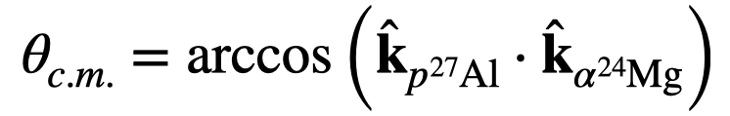
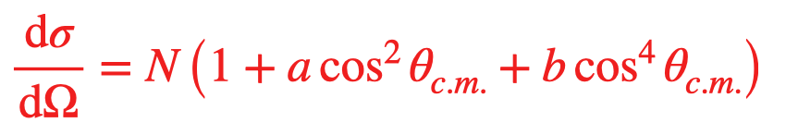
Angular distributions
Data analysis: angular distributions
Angular distributions for each peak in the E_{cm} spectra [(a)-(e) in order of increasing energy] were deduced
Each peak is the superposition of many resonances, so only the dominant wave can be deduced
A-B & C-D show the same trend
The region around 𝝿/2 is covered, which is the most influential for angular integration
Red line:
Region (a) corresponds to about 100 keV: would you imagine extracting angular distributions at this energy, where you have 10 counts in direct experiments?

Slide 30
Extraction of the resonance strengths
Gamow window for 50 MK
Black dots: sum over the two spectra for A-C and B-D
Following discussion in APJ 708 (2010) 796 the red line is a fit with a sum of Gaussian functions, with fixed energies and fixed widths (from MC). Heights are proportional to strengths
The most intense resonances in STARLIB were all included in the fit down to about 200 keV
Tails of higher energy resonances affects the region above 1.5 MeV

Slide 31
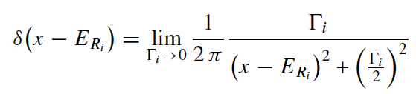
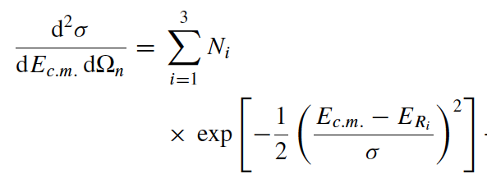
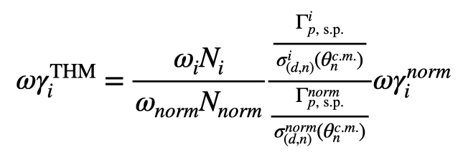
A bit of theory (from APJ 708 (2010) 796)
For narrow resonances:
The THM cross section can be fitted using the equation:
𝞒_{s.p.} is calculated using the potential model
𝞼(𝞱) is calculated in PW using the same well & w.f.
n
The double ratio ensures an extra small model dependence (6%)

Slide 32
Average values
Energy in cm (keV) [from STARLIB] | Jpi | Strength (eV) [from STARLIB] | error (eV) | Strength (eV) [from THM] | error (eV)
71.5 | 2+ | 2.47E-14 | up lim | 8.23E-15 | up lim
84.3 | 1- | 2.60E-13 | up lim | 1.67E-14 | 3.2E-15
193.5 | 2+ | 3.74E-07 | up lim | 2.50E-07 | up lim
214.7 | 3- | 1.13E-07 | up lim | 4.36E-08 | up lim
486.74 | 2+ | 0.11 | 0.05 | 0.107 | 0.021
609.49 | 3- | 0.275 | 0.069 | 0.245 | 0.054
705.08 | 1- | 0.52 | 0.13 | 0.261 | 0.065
855.85 | 3- | 0.83 | 0.21 | 0.61 | 0.35
903.54 | 3- | 4.3 | 0.4 | 4.20 | 0.38
1140.88 | 2+ | 79 | 27 | 73 | 14
1316.7 | 2+ | 137 | 47 | 124 | 28
1388.8 | 1- | 54 | 15 | 61 | 12
We take the weighted average of the strengths obtained from the two normalizations procedure to reduce systematics errors

Slide 33
The full calculation using STARLIB (by Philip Adsley)
The green line is the THM recommended rate
We run the full code (for STARLIB and STARLIB+THM replacing our results in the standard input)
Is the upper limit for the resonance at about 200 keV overestimated?

Slide 34
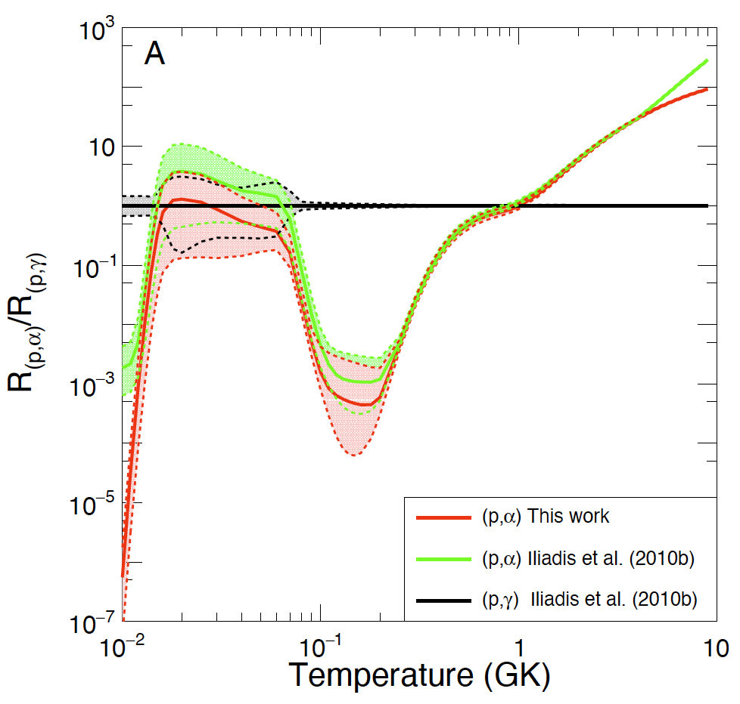
Some astrophysical consequences
Closure of the MgAl cycle
→ THM data seem to strengthen the fact that no closure of the cycle is to be expected, but uncertainties are large
More work necessary
Need of more accurate p,γ S-factor

Slide 35
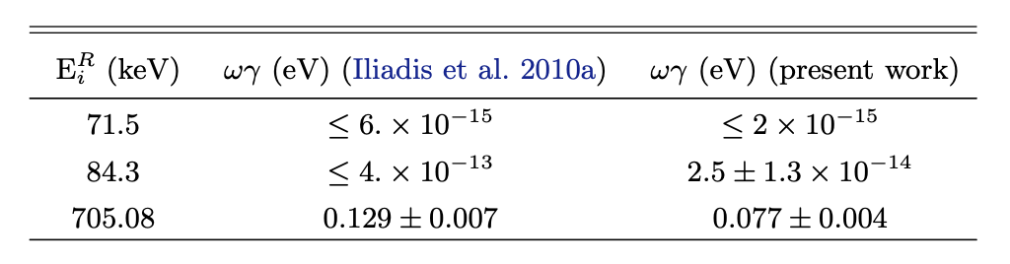
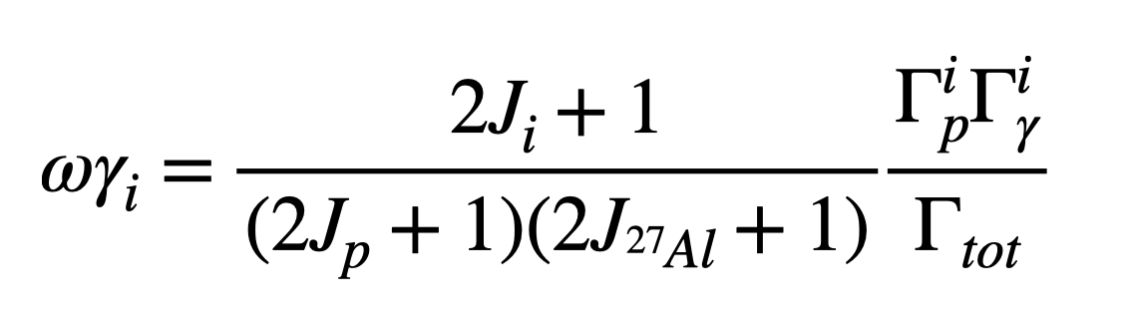
The (p,γ) channel
When narrow resonances dominate the S-factor the reaction rate can be calculated by means of the resonance strengths and resonance energies only. This applies only in the cases direct capture is negligible
Let’s focus on resonance strengths
At astrophysical energies, in the case of some resonances it happens that: Γp << Γγ << Γα
This chain of inequations
leads to a resonance strength ωγ of the (p, α) channel that is directly proportional to Γp through the statistical factor ω.

Slide 36
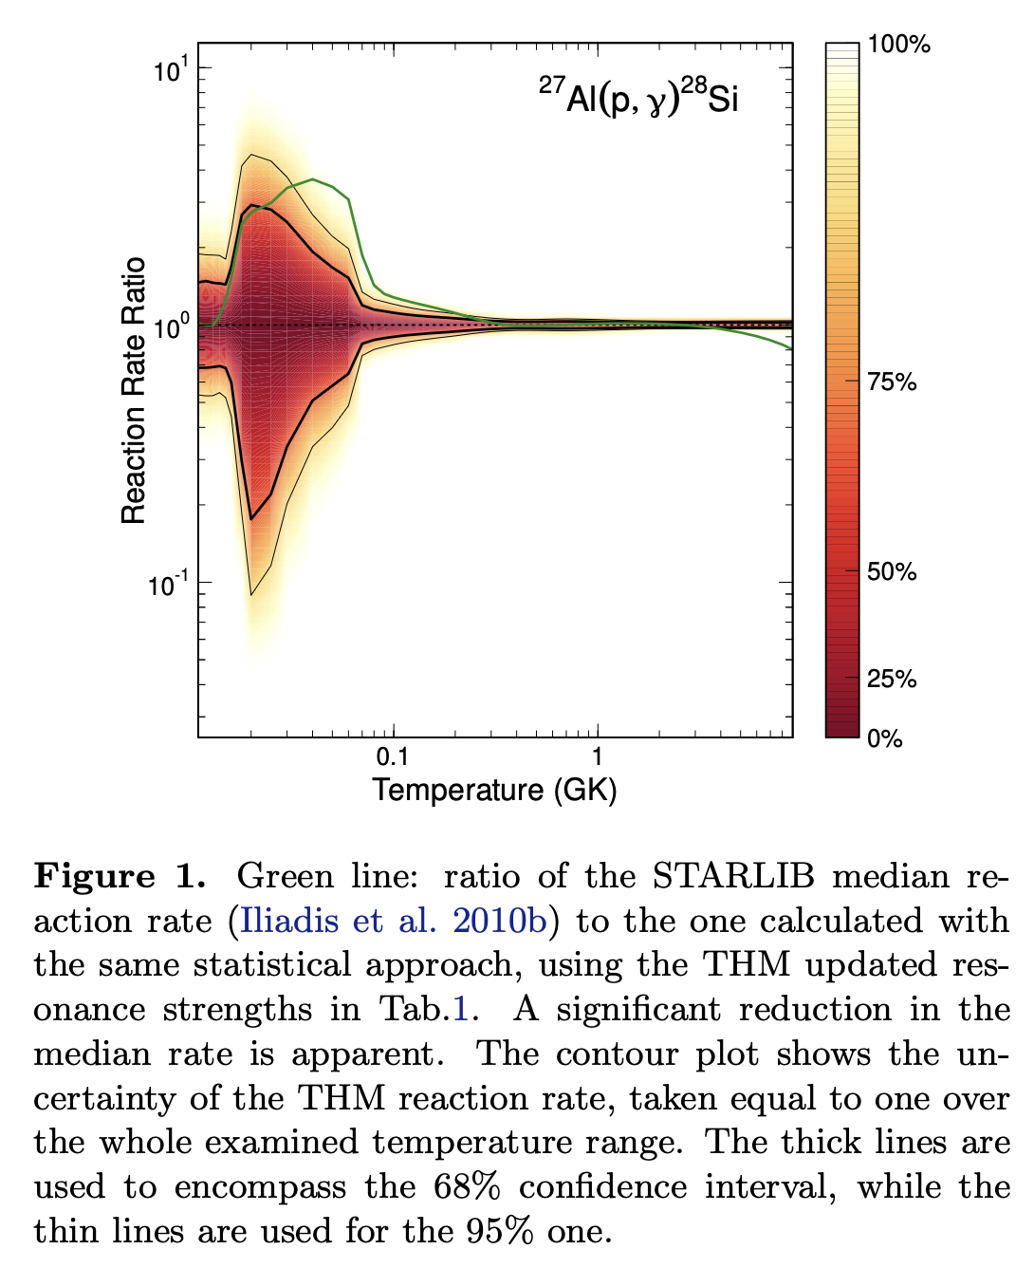
The (p,γ) channel
At astrophysical energies, in the case of some resonances it happens that: Γp << Γγ << Γα
This chain of inequations
leads to a resonance strength ωγ of the (p, α) channel that is directly proportional to Γp through the statistical factor ω.

Slide 37
Let’s move to ANC: we will talk about ⁷Be

Slide 38
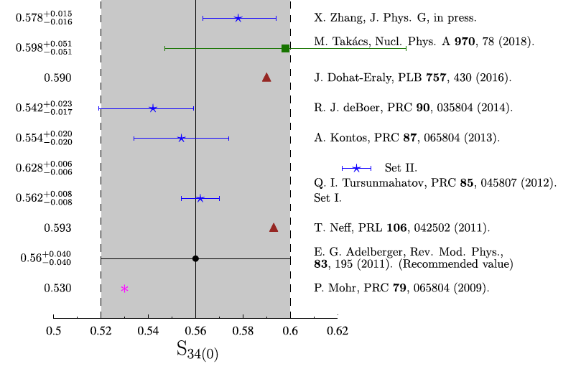
The ³He(α,γ)⁷Be and the ⁶Li(p,γ)⁷Be scientific cases
The detection of the neutrinos coming directly from the core of the Sun became more and more precise after the construction of larger and more efficient neutrino detectors
Neutrinos are released in the β decay of the ⁷Be, ⁸B, ¹³N, ¹⁵O isotopes produced in the p−p chain and in the CNO cycle.
The flux of the p−p neutrinos was measured with a precision of about 3.4% by the BOREXINO, SNO and Super-Kamiokande collaborations
The precise neutrino flux measurements can constrain the Standard Solar Model (SSM)
However, at present the uncertainties on cross sections are far too high, typically of the order of 5-8% contrary to the 3% precision required
The ANC approach has the opportunity
The zero-energy astrophysical factor of the ³He(α,γ)⁷Be shows a very large scatter. There is no general agreement between measurement (prompt vs activation) and calculations → NEED OF NEW INDEPENDENT DATA

Slide 39
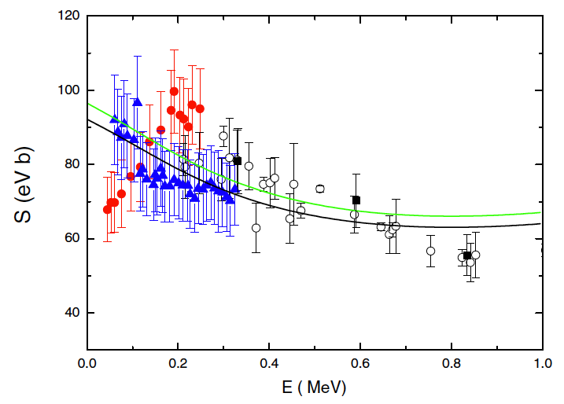
The ³He(α,γ)⁷Be and the ⁶Li(p,γ)⁷Be scientific cases
⁶Li(p,γ)⁷Be total S-factor
Lithium is a key elements in astrophysics as big bang nucleosynthesis models coupled to chemical evolution models fail to find an agreement between predictions and observations.
⁷Li is the most abundant isotope, produced in the BBN and in stars
⁶Li is almost exclusively produced by cosmic rays and the possibility of a primordial ⁶Li plateau, like the one for ⁷Li, is not presently confirmed
Since the production mechanism of ⁶Li and ⁷Li are completely different, the ⁶Li/⁷Li isotopic ratio can be used either to constrain the lithium production mechanisms and/or the galactic enrichment processes
→ an accurate determination of the ⁶Li(p,γ) ⁷Be astrophysical S factor is needed.
Blue solid triangles → D. Piatti et al., Phys. Rev. C 102, 052802(R) (2020) (including systematic error)
Red filled circles → J. J.He et al., Phys. Lett. B 725, 287
(2013)
Direct measurements show a totally different low energy trend

Slide 40
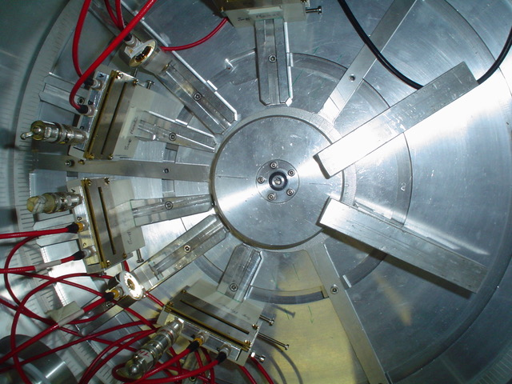
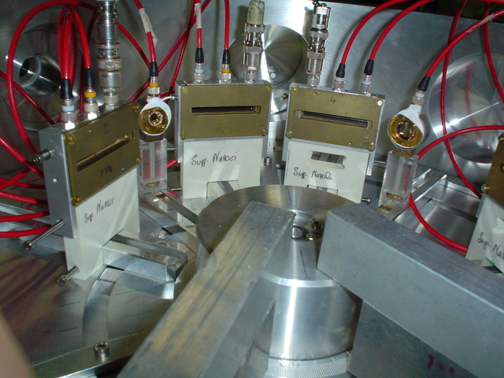
The ⁶Li(³He,d)⁷Be measurement
Experimental setup
³He beams by: singletron accelerator @ Department of Physics and Astronomy (DFA) of the University of Catania (Italy) and FN tandem accelerator @ John D. Fox Superconducting Accelerator Laboratory at Florida State University (FSU), Tallahassee (FL), USA
Angular distributions were measured at E_{lab} = 3 MeV and E_{lab} =5 MeV using silicon DE-E telescopes on a turntable. Additional monitor detectors were placed at symmetric angles with respect to the beam axis to check target thickness and for normalization.
⁶LiF (enriched in ⁶Li by 95%) and pure ⁶Li targets (enriched in ⁶Li by 98%) were used
³He beam
³He
d
p
⁶Li
⁷Be
Proton transfer: forward-peaked angular distributions

Slide 41
The ⁶Li(³He,d)⁷Be measurement
Experimental setup
³He beams by: singletron accelerator @ Department of Physics and Astronomy (DFA) of the University of Catania (Italy) and FN tandem accelerator @ John D. Fox Superconducting Accelerator Laboratory at Florida State University (FSU), Tallahassee (FL), USA
Angular distributions were measured at E_{lab} = 3 MeV and E_{lab} =5 MeV using silicon DE-E telescopes on a turntable. Additional monitor detectors were placed at symmetric angles with respect to the beam axis to check target thickness and for normalization.
⁶LiF (enriched in ⁶Li by 95%) and pure ⁶Li targets (enriched in ⁶Li by 98%) were used
³He beam
⁷Be
³He
α
d
⁶Li
Alpha transfer: backward-peaked angular distributions

Slide 42
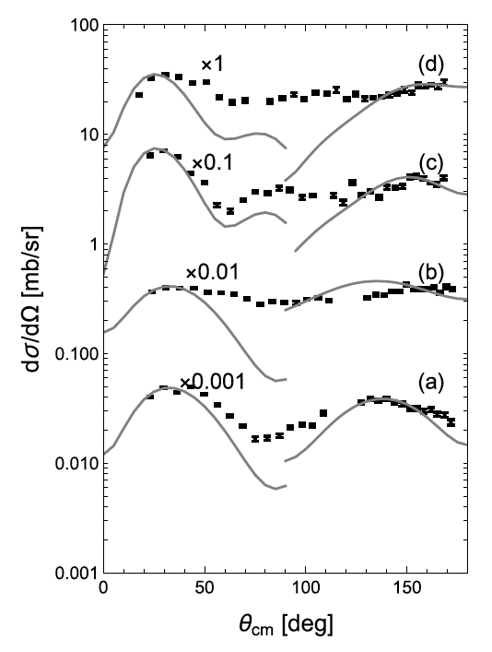
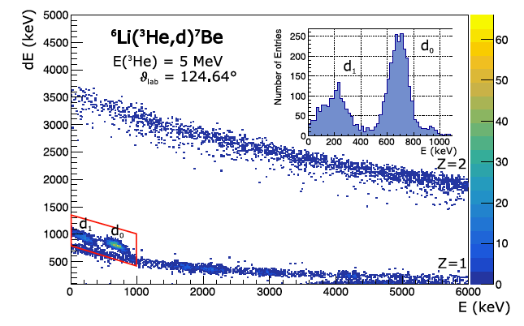
Experimental spectra
G.G. Kiss et al. Physics Letters B 807 (2020) 135606
G.G. Kiss et al. Physical Review C 104 (2021) 015807
DE−E spectrum measured with a silicon telescope
The peaks: d₀ and d₁
Very clean d ID
Observation of both ⁷Be gs and 1st excited state
Angular distributions of the ⁶Li(³He,d)⁷Be reaction populating the ground ((a) and (c)) and first (0.429 MeV) excited ((b) and (d)) states of ⁷Be at the projectile ³He energies of 3 ((a) and (b)) and 5 ((c) and (d)) MeV.
Gray lines are the calculated angular distributions, for p−and α−transfer (forward and backward hemisphere, respectively) → possibility to deduce the ANC’s for both channels (no interference at the peaks)

Slide 43
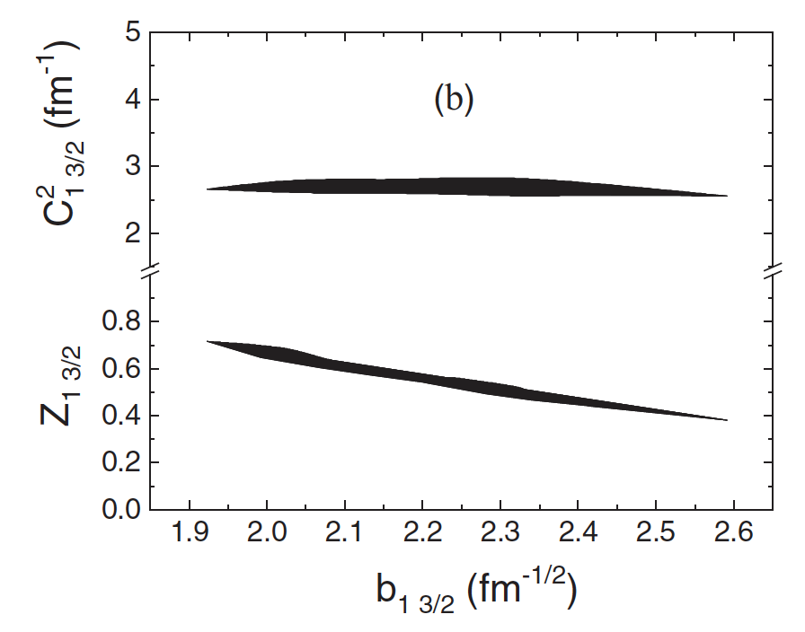
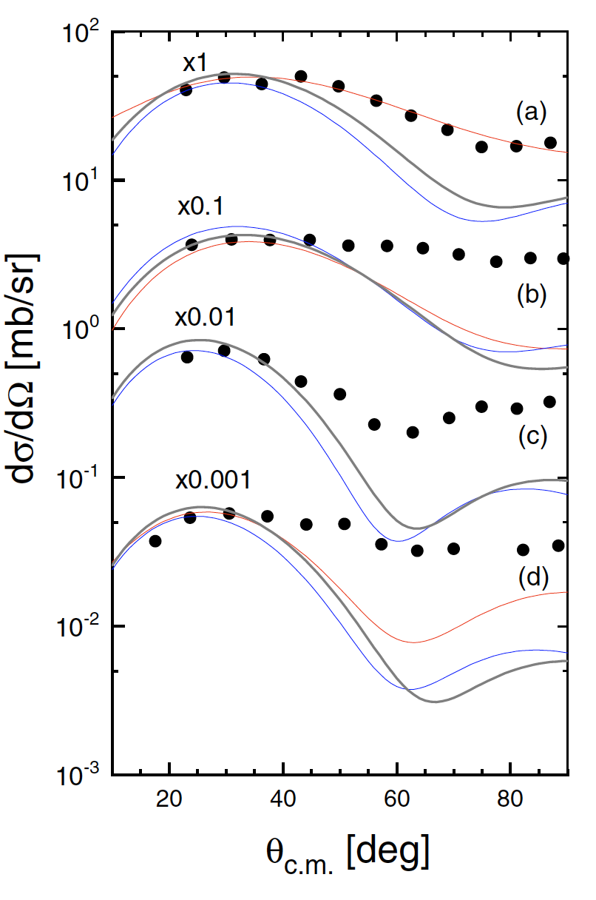

Test of the model dependence
Nuclear reaction theory in indirect approaches may introduce systematic errors
The gray lines indicate the calculated angular distributions including coupled-channel effects for p transfer off 3He. The red and blue curves are the same calculations, but with other optical potentials
While the spectroscopic factor Z depends on the choice of the optical model potential parameters (lower band), the ANC C² is almost independent (upper band). The dependence is given by the width of the band

Slide 44
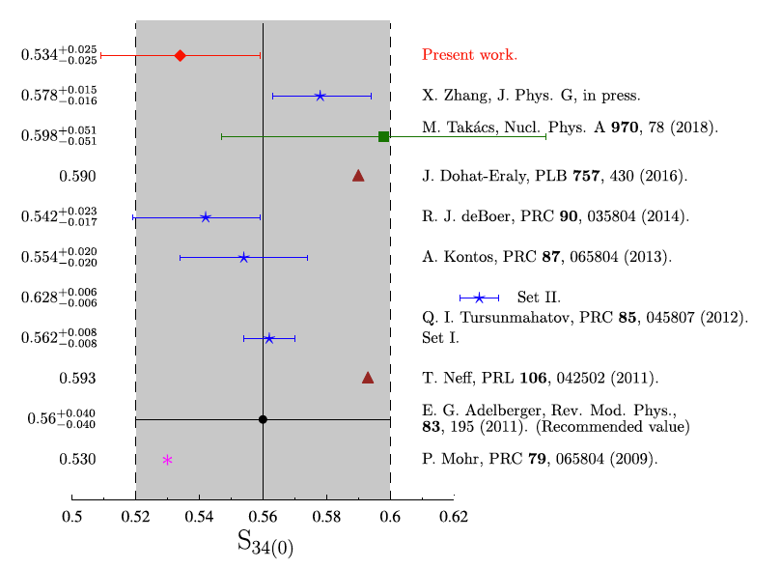

The ³He(α,γ)⁷Be S₃₄(0) using ANC
The post-form DWBA calculation contains:
s-wave ANC values for the d+p →³He and the d+α→⁶Li channels
Test of the dependence on the choice of the optical potentials
Test of the peripheral nature of the reaction
channels coupling effects (CCE)
Further improvements to be implemented:
Test one-step process in modelling the transfer
Test the coupling between ground and excited states of ⁶Li and ⁷Be
Perform full coupled-channel analysis to derive the ³He+⁴He and the p+⁶Li ANCs
Lower S₃₄(0) values favored, with a total uncertainty equal to 4.7%.
More than 50% of the error budget is due to the non-peripherality of the transfer process
³He(α,γ)⁷Be
PLB 807 (2020) 135606

Slide 45

The ⁶Li(p,γ)⁷Be astrophysical factor
Two approaches:
the weighted means of the ANCs from the analysis of the ⁶Li(³He,d)7Be transfer were used to calculate the total astrophysical S factor for the ⁶Li(p,γ)⁷Be reaction using the modified two-body potential method [Igamov and R. Yarmukhamedov (2019)]. In the calculation M1 and E2 are neglected as their contribution is lower than 1% at these energies
the ANCs for the ⁶Li+p→ ⁷Be(g.s.) and ⁶Li+p→ 7Be(0.429 MeV) channels were derived from the experimental total astrophysical S factor and the branching ratios of Piatti et al. (2020) and then (after checking the actual agreement), we also calculated the astrophysical factor of the ⁶Li(p,γ)7Be reaction within the MTBPM
Green line: astrophysical S factor obtained by using the weighted average ANC values from the near-barrier proton transfer ⁶Li(³He,d)⁷Be reaction at E_{beam} = 3 and 5 MeV
Black line: astrophysical S factor obtained from the analysis of the ⁶Li(p,γ )⁷Be S-factor of Piatti et al. (2020)
Our result strongly disfavors the resonant trend claimed by He et al. (2014)
⁶Li(p,γ)⁷Be
PRC 104 (2021) 015807

Slide 46
Summary
- What are indirect methods? Why are they needed?
- Some theory about the THM and ANC methods
- THM for broad and narrow resonances
- ANC determinations and cross section calculations
Thanks for your attention

