Slide 1
The impact of the first stars in two ultra-faint dwarf galaxies: Grus II and Tucana IV
Valentina Verdiani – 1° year PhD student
Supervisor: Ása Skúladóttir
20° Russbach School on Nuclear Astrophysics – 20/03/2025

Slide 2
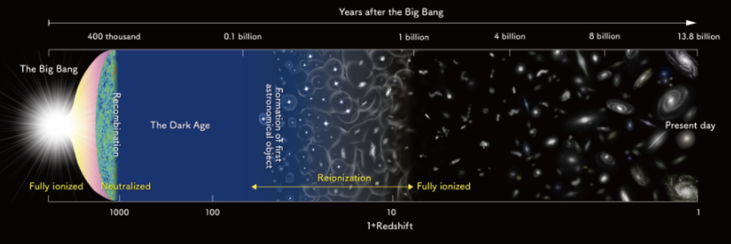
Why the first stars?
Bromm et al. 2002, Hirano et al. 2015
First stars
(Z=0)
First supernovae (SNe)
2° generation stars
H, He
After few Myr
Chemical enrichment
The impact of the first stars in two ultra-faint dwarf galaxies: Grus II and Tucana IV – Valentina Verdiani

Slide 3
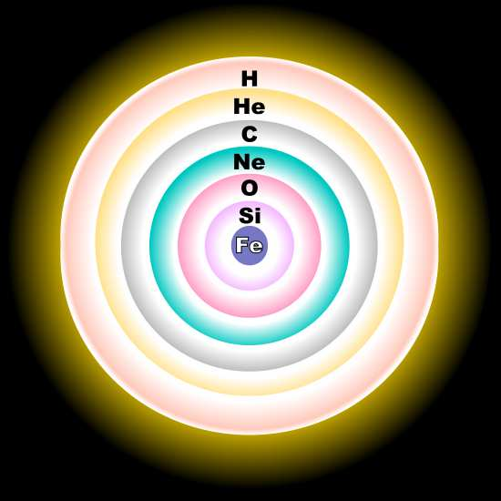
The first chemical enrichment
Stars with ${M>8 M}_{⊙}$ explode as supernovae and release the products of the stellar nucleosynthesis into the gas in the interstellar medium (ISM)
The low energy SNe (‘faint’) mainly release lighter elements, such as carbon
2° generation stars born from the ejecta of faint SNe will have high [C/Fe] and are called
carbon-enhanced metal-poor stars (CEMP, [C/Fe]>0.7)
The impact of the first stars in two ultra-faint dwarf galaxies: Grus II and Tucana IV – Valentina Verdiani

Slide 4
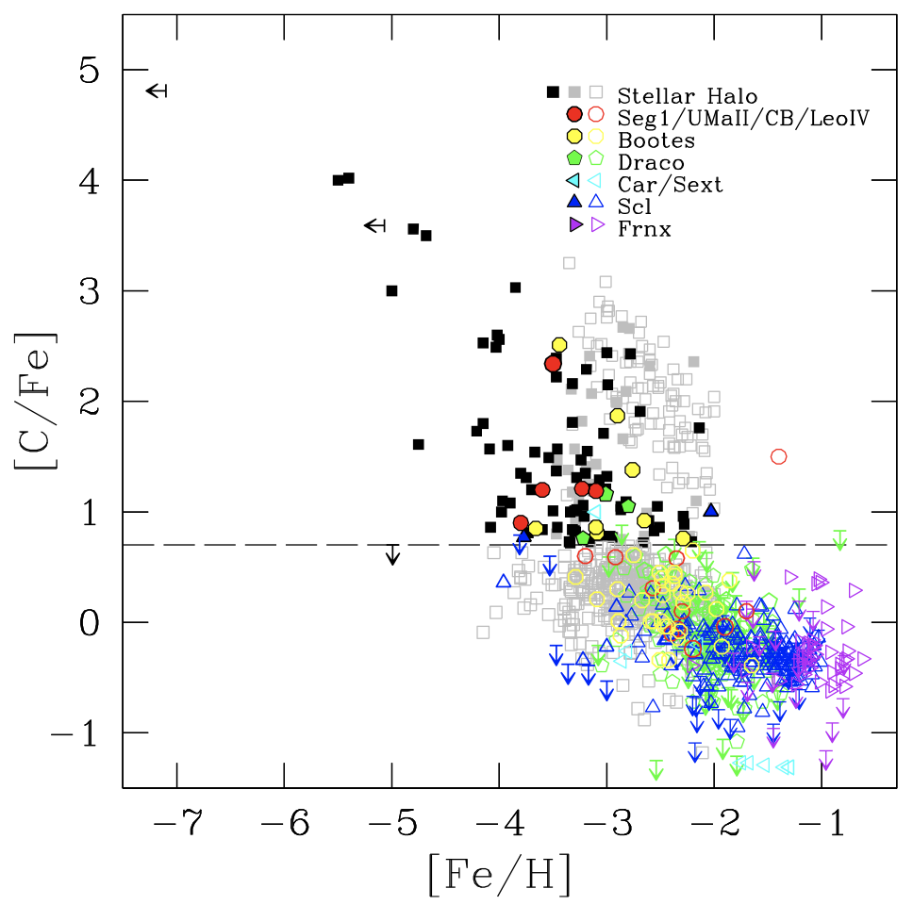
CEMP-no stars in the Milky Way and its dwarf galaxies
CEMP stars
$$M_{∗}$$
CEMP-s
CEMP-no
CEMP-no stars descendants of the first stars
CEMP-s stars
binary transfer
from AGB (high Ba)
More pristine stars
from Salvadori+15
The impact of the first stars in two ultra-faint dwarf galaxies: Grus II and Tucana IV – Valentina Verdiani

Slide 5
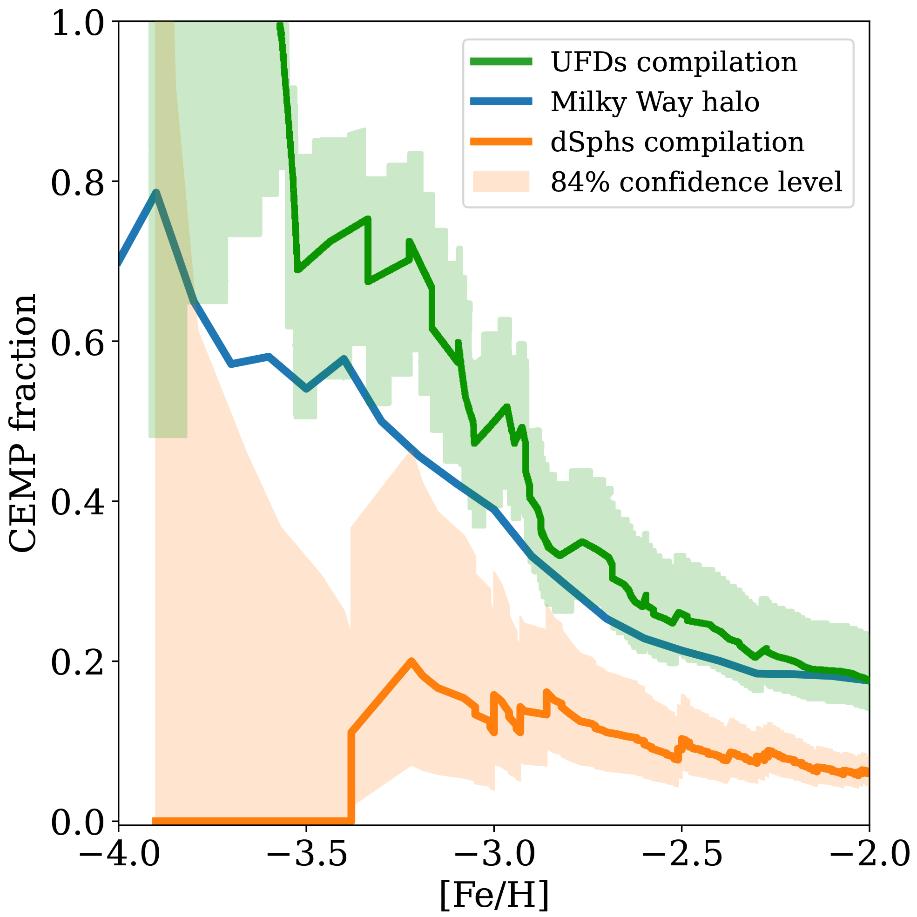
Open questions
from Lucchesi+24
Different results in different environments!
We focused on CEMP in UFDs
The impact of the first stars in two ultra-faint dwarf galaxies: Grus II and Tucana IV – Valentina Verdiani

Slide 6
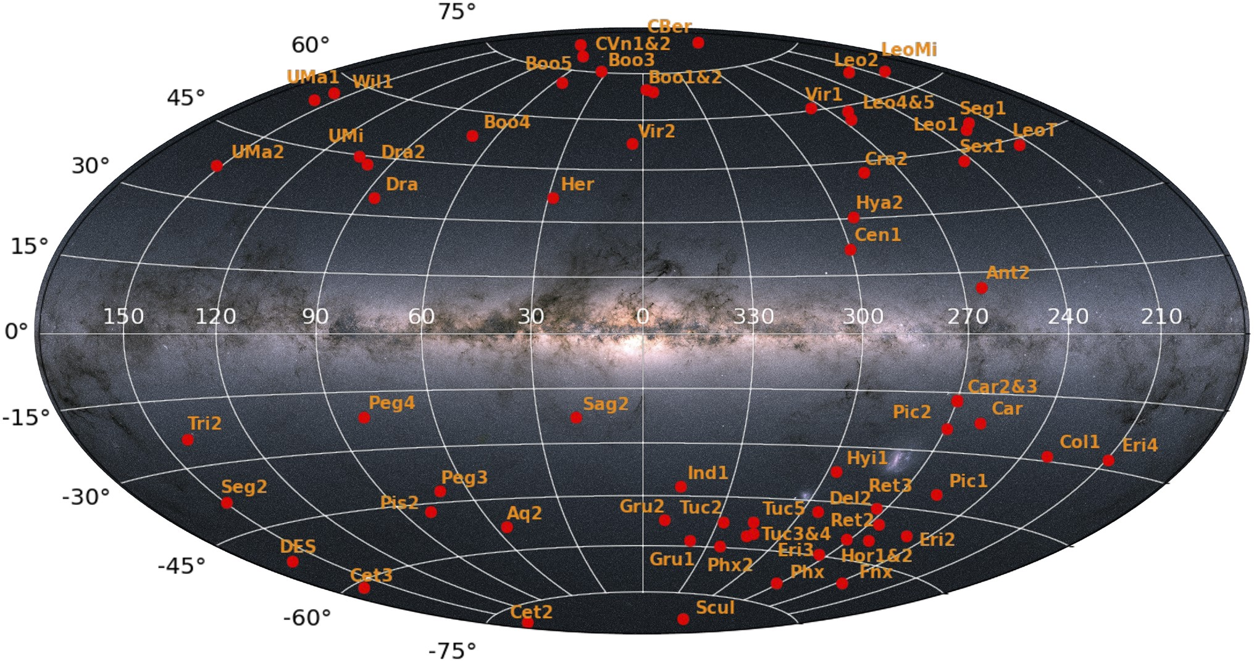
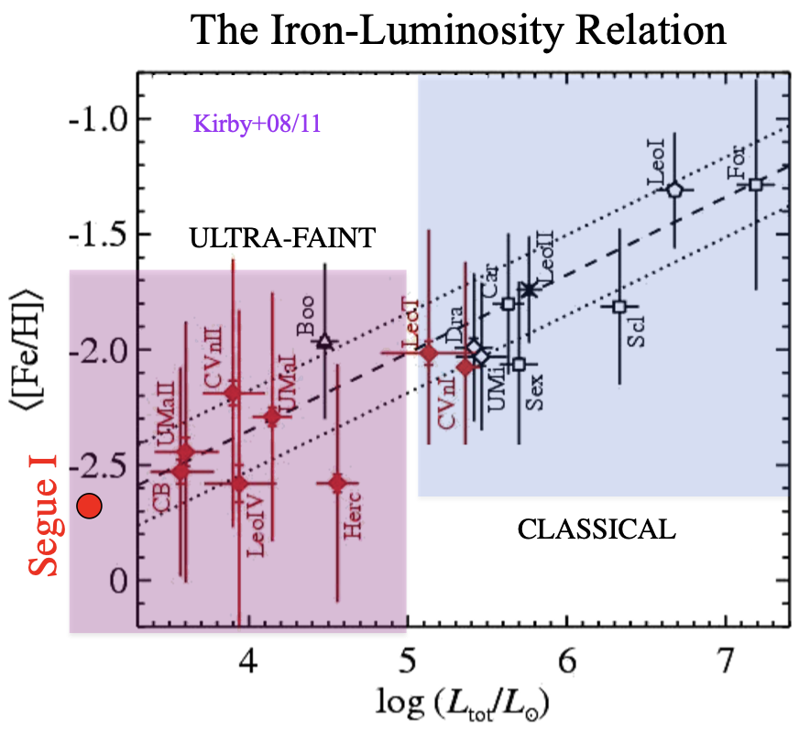
Why ultra-faint dwarf galaxies?
The ultra-faint dwarf galaxy (UFDs) satellites of
the Milky Way are old and very metal-poor
They are the perfect targets to find the descendants of the first stars
Grus II
$$M_{∗}=3.4∙{10}^{3}M_{⊙}$$
$$\log\left(\frac{L}{L_{⊙}}\right)=3.5$$
$$d=53 kpc$$
Tucana IV
$$M_{∗}=2.2∙{10}^{3}M_{⊙}$$
$$\log\left(\frac{L}{L_{⊙}}\right)=3.3$$
$$d=48 kpc$$
-3.
The impact of the first stars in two ultra-faint dwarf galaxies: Grus II and Tucana IV – Valentina Verdiani

Slide 7
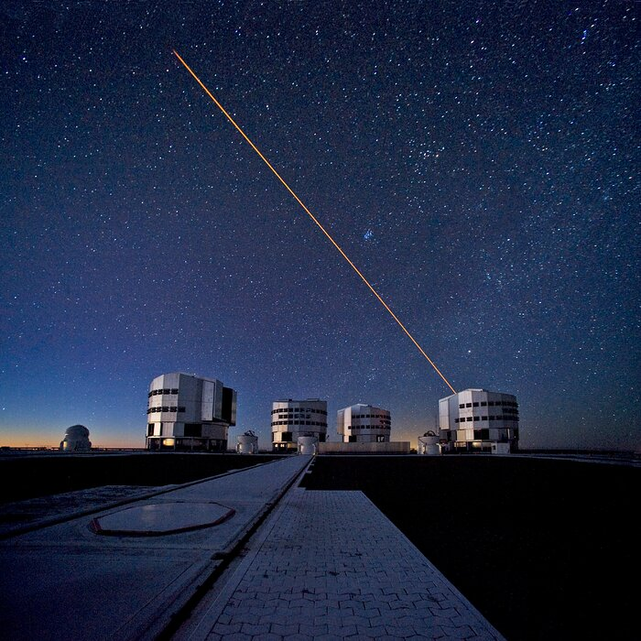
Observational data
FLAMES on the Very Large Telescope
provides the spectra in the red band which covers the Calcium triplet region (8498 Å, 8542 Å, 8662 Å) and in the blue band where the CH-band is present (4300 Å)
GAIA (ESA)
provides the position of the stars with very high precision, the proper motion and the magnitude in different bands
The impact of the first stars in two ultra-faint dwarf galaxies: Grus II and Tucana IV – Valentina Verdiani

Slide 8
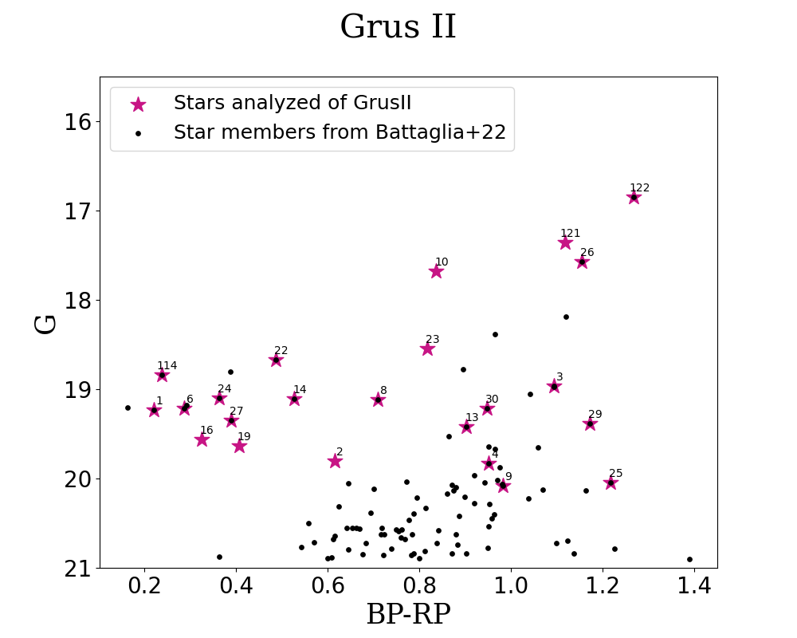
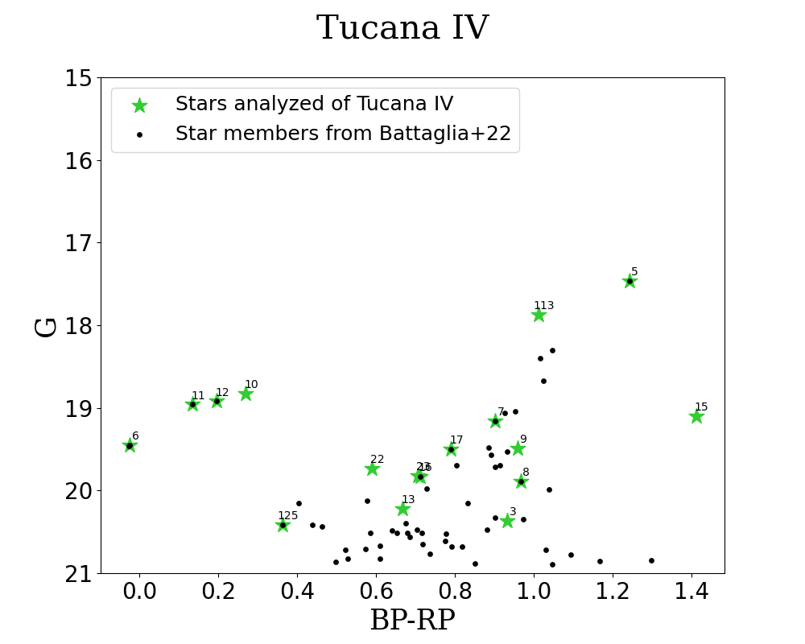
The color-magnitude diagrams
Brighter stars
Red Giant Branch
RGB
Horizontal Branch
HB
Redder, cooler stars
The impact of the first stars in two ultra-faint dwarf galaxies: Grus II and Tucana IV – Valentina Verdiani

Slide 9
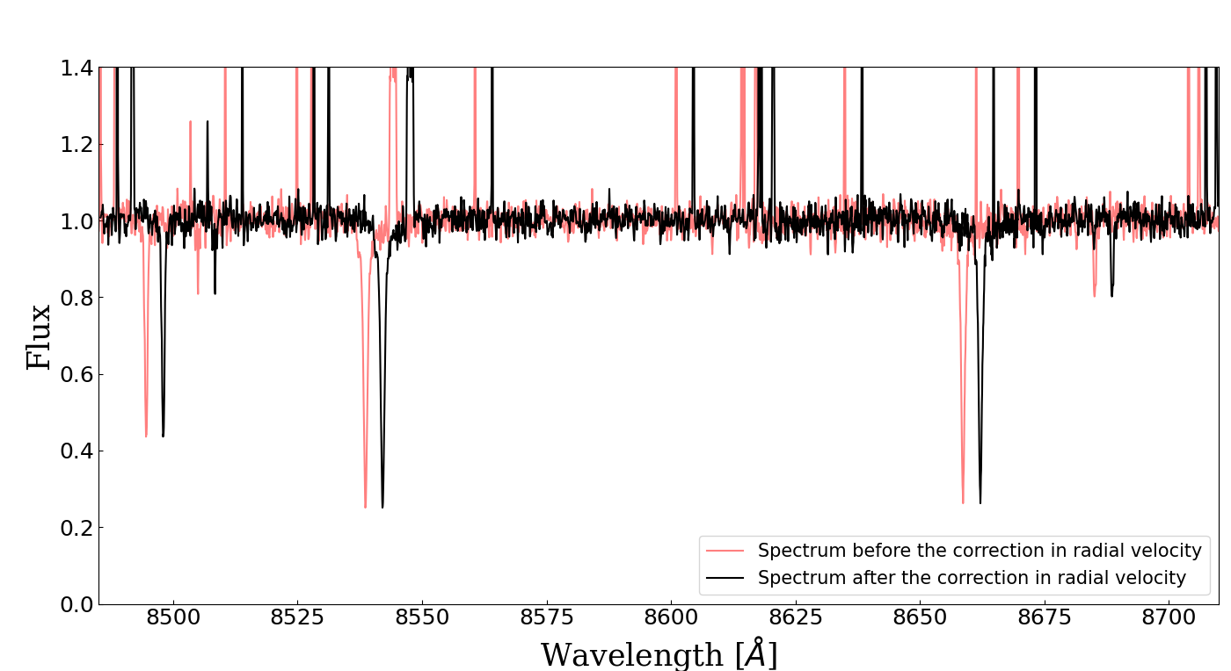
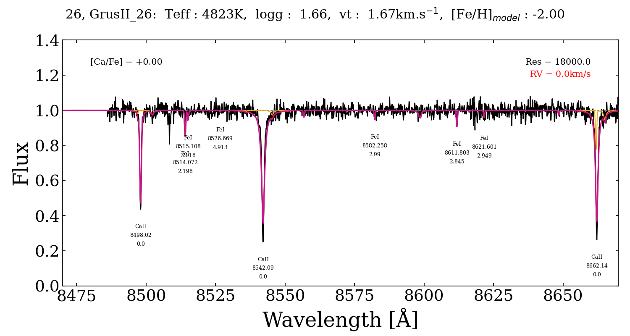
Radial velocity measurements
The radial velocity is the velocity’s component of the star along the line-of-sight and it is fundamental to establish the membership
The impact of the first stars in two ultra-faint dwarf galaxies: Grus II and Tucana IV – Valentina Verdiani

Slide 10
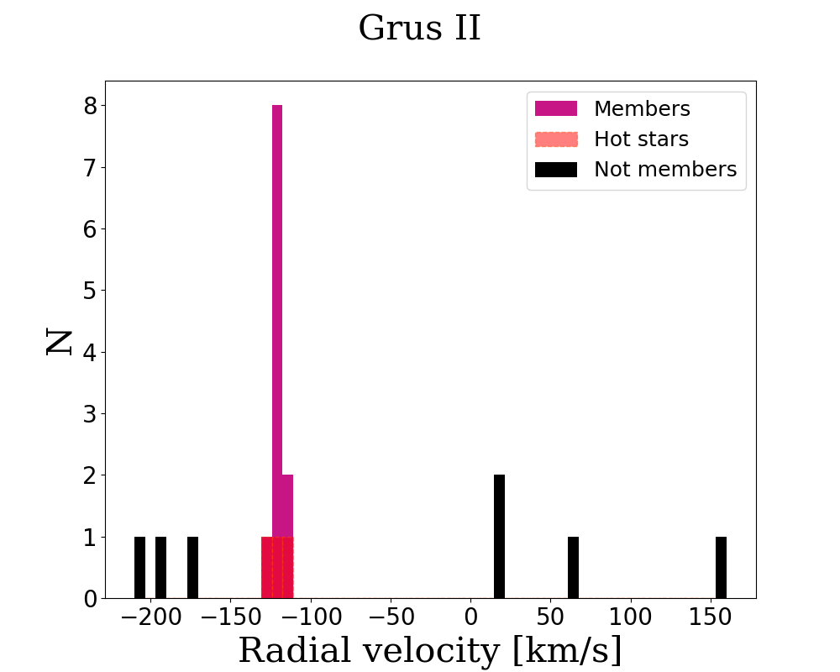
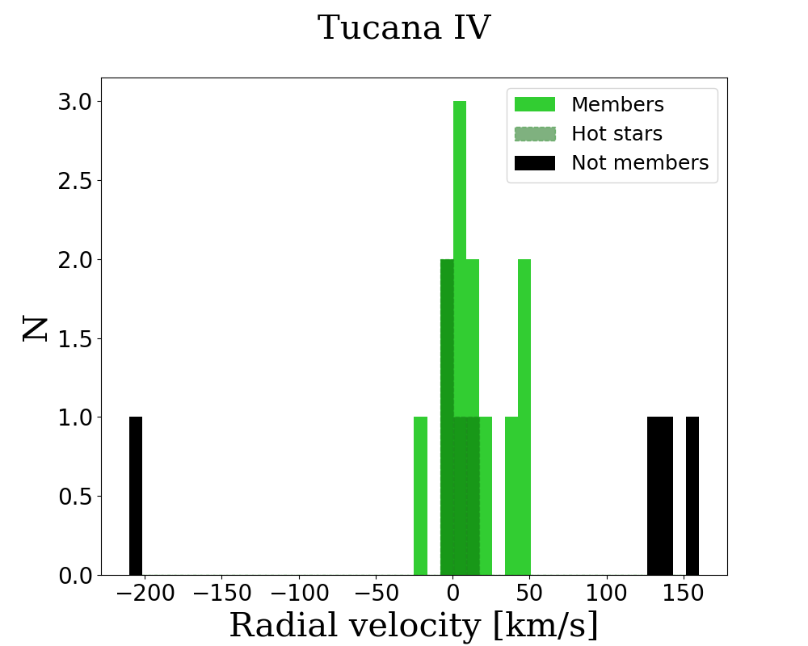
Radial velocity distributions
The impact of the first stars in two ultra-faint dwarf galaxies: Grus II and Tucana IV – Valentina Verdiani

Slide 11
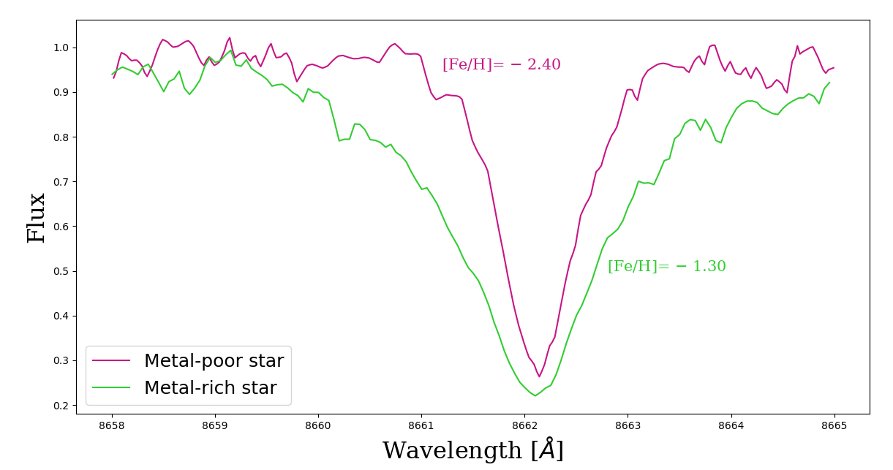
Metallicities measurements
There is an empirical relation between the EWs of the Ca triplet in the red and the [Fe/H]
(from Starkenburg+10)
The impact of the first stars in two ultra-faint dwarf galaxies: Grus II and Tucana IV – Valentina Verdiani

Slide 12
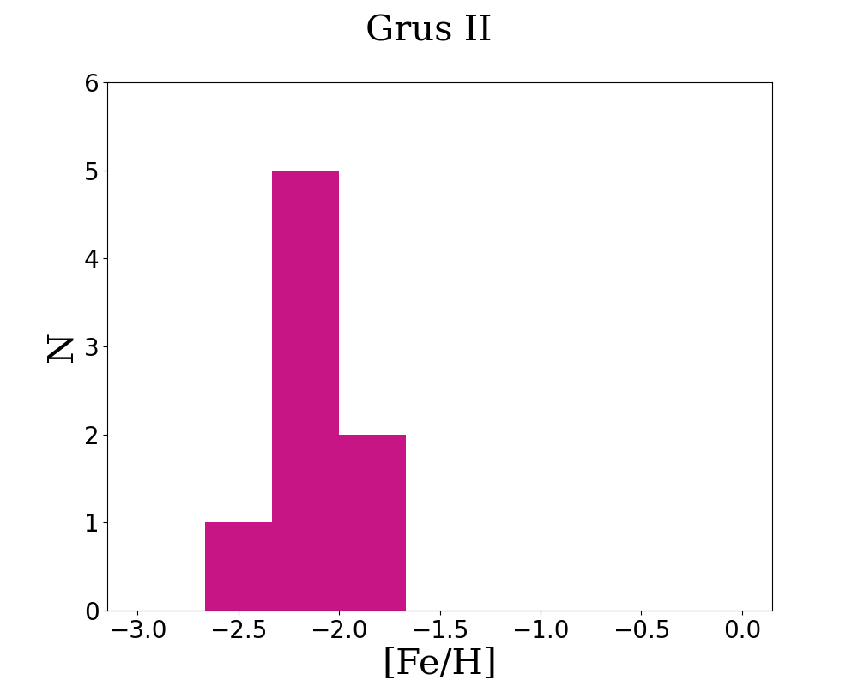
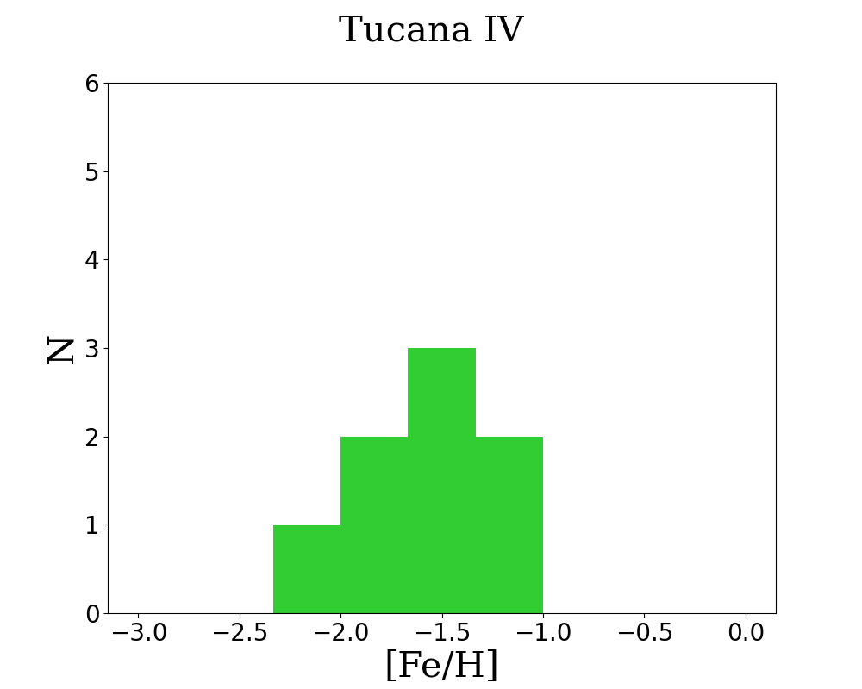
Metallicity distribution functions
The impact of the first stars in two ultra-faint dwarf galaxies: Grus II and Tucana IV – Valentina Verdiani

Slide 13
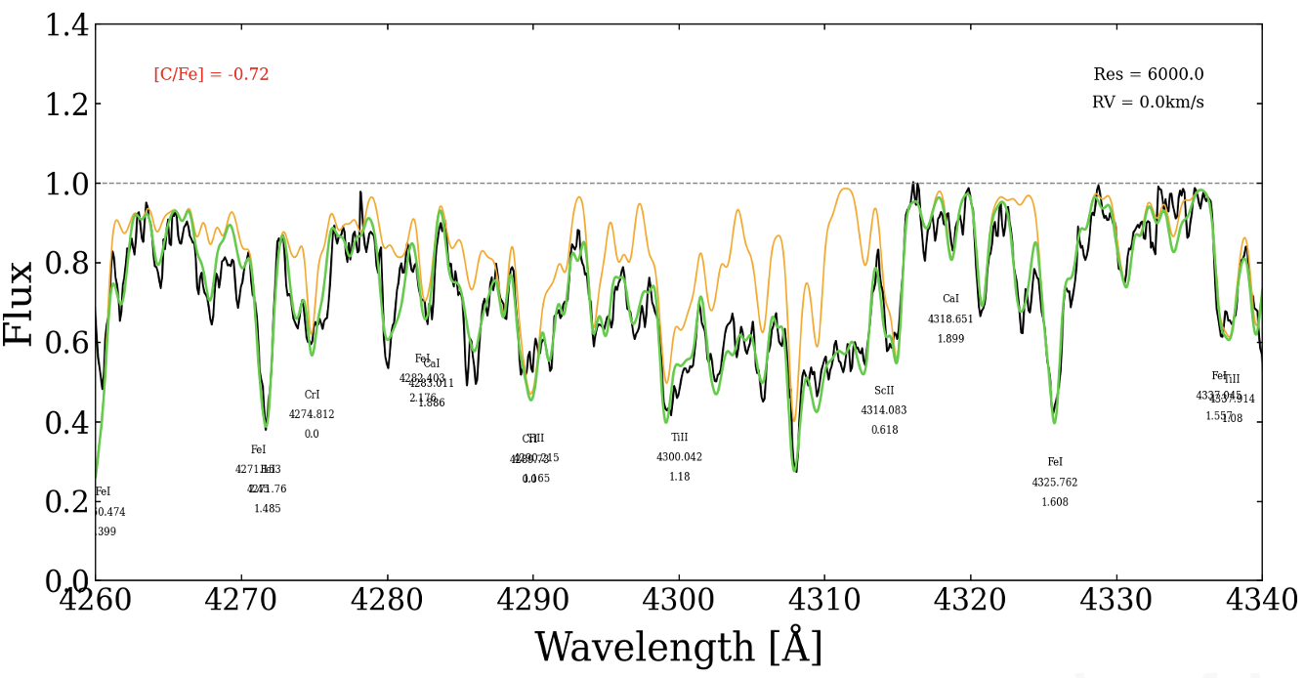
Carbon measurements
The [C/Fe] is derived with Turbospectrum, by searching for the synthetic spectrum which represents the best fit
The C abundance needs to be corrected in RGB stars for the internal mixing
[C/Fe]= - 0.72
observed spectrum
synthetic spectrum
spectrum without C
(from Placco+14)
C
N
The impact of the first stars in two ultra-faint dwarf galaxies: Grus II and Tucana IV – Valentina Verdiani

Slide 14
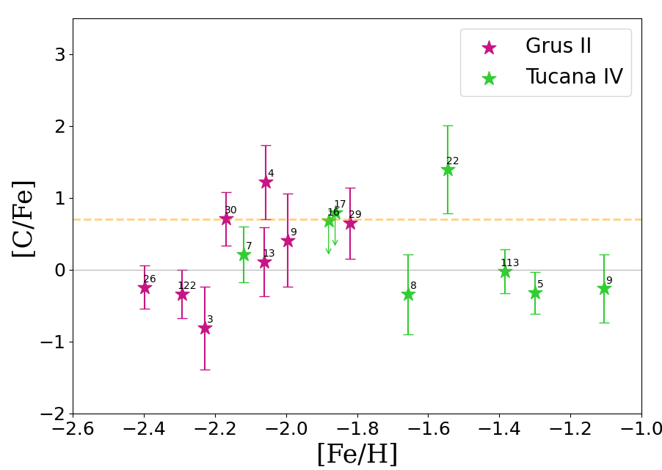
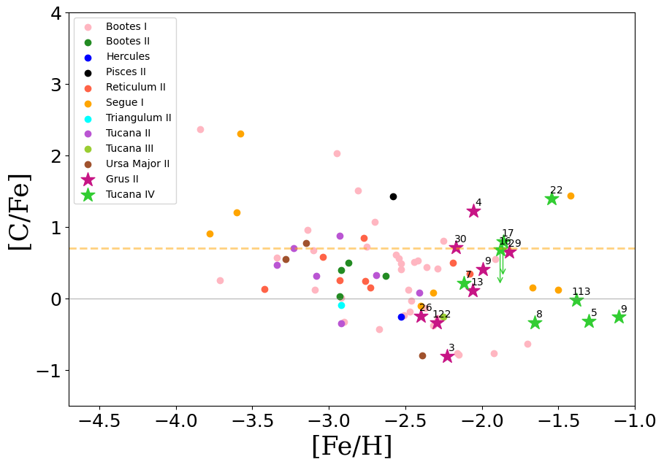
Carbon measurements
CEMP-no?
CEMP-s?
[C/Fe]=0.7
The impact of the first stars in two ultra-faint dwarf galaxies: Grus II and Tucana IV – Valentina Verdiani

Slide 15
Conclusions
We analyzed spectra of stars in two UFDs, Grus II and Tucana IV, establishing the membership
For the RGB members, we deriving the metallicity and the C abundaces
Two possible descendants of the first stars in Grus II and one CEMP-s star in Tucana IV
This analysis increases the available [C/Fe] measurements in UFDs by ~20% (Saga database)
CEMP-no?
CEMP-s?
[C/Fe]=0.7
The impact of the first stars in two ultra-faint dwarf galaxies: Grus II and Tucana IV – Valentina Verdiani

Slide 16
Thank you for the attention!
Valentina Verdiani – 1° year PhD student
20° Russbach School on Nuclear Astrophysics – 20/03/2025
This project has received funding from the European Research Council (ERC) under the European Union’s Horizon 2020 research and innovation programme (TREASURES - grant agreement No. 101117455).
The impact of the first stars in two ultra-faint dwarf galaxies: Grus II and Tucana IV – Valentina Verdiani

Slide 17
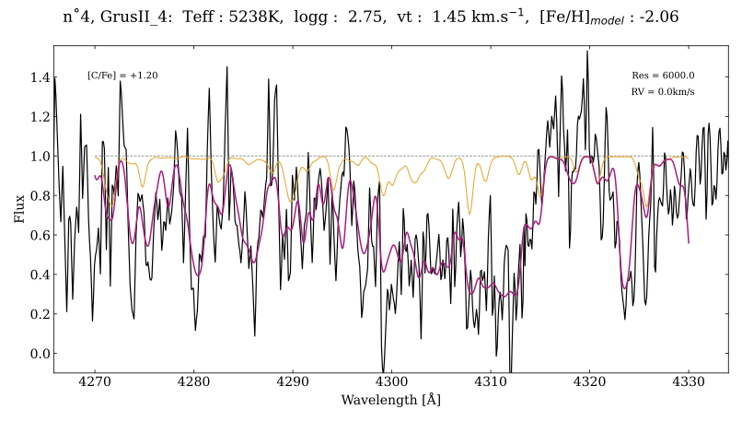
CEMP-no spectrum
[C/Fe]= + 1.20
observed spectrum
synthetic spectrum
spectrum without C
The impact of the first stars in two ultra-faint dwarf galaxies: Grus II and Tucana IV – Valentina Verdiani

Slide 18
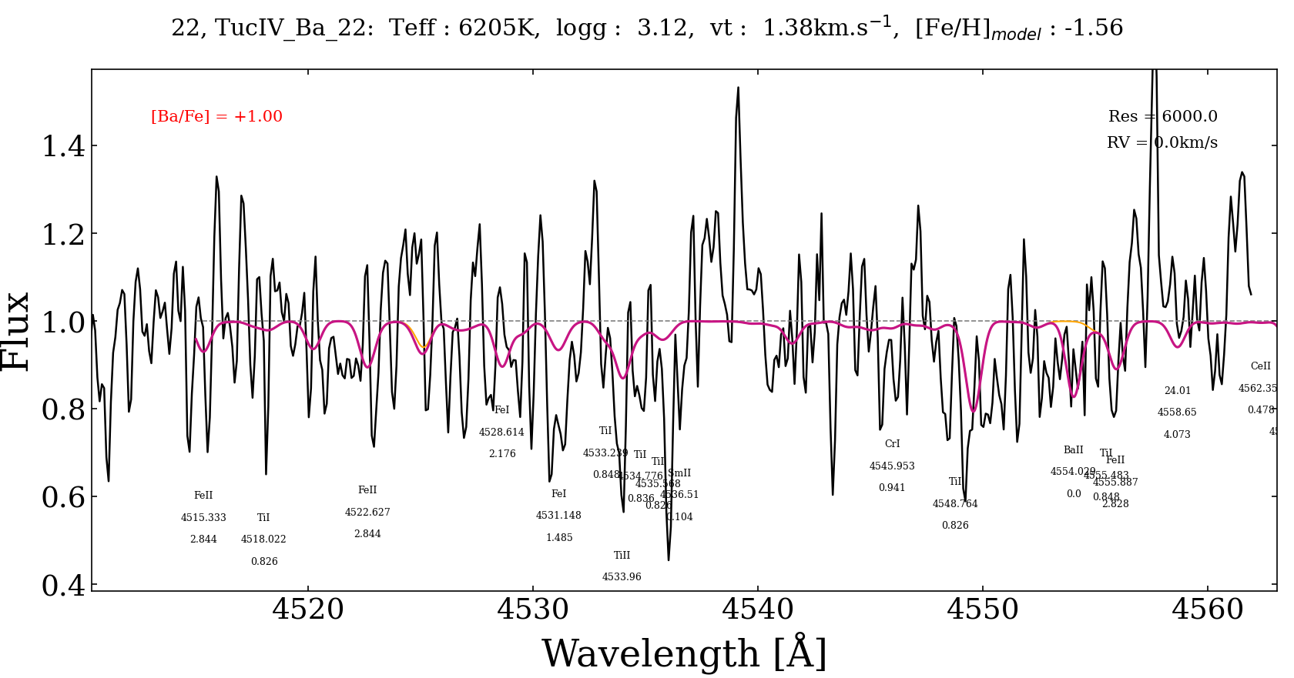
Update – Ba measurements
Only upper limits for the CEMP stars 4 and 30 in Grus II and 22 in Tucana IV
[Ba/Fe$]_{(4)} <$0.6
$\text{[}\text{Ba}\text{/}\text{Fe}]_{(30)}<$0.7
$\text{[}\text{Ba}\text{/}\text{Fe}]_{(22)}<$1
The impact of the first stars in two ultra-faint dwarf galaxies: Grus II and Tucana IV – Valentina Verdiani

Slide 19
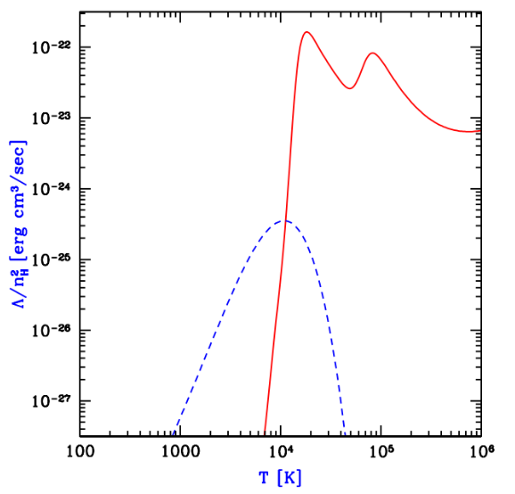
Cooling channel
In primordial conditions the cooling of the protostellar gas cloud relies on the roto-vibrational transitions of $H_{2}$ only
The temperature is higher in primordial clouds than the metal-rich ones because of the non-efficient cooling process
The Jeans mass of the fragments is bigger and the mass accretion rate in more efficient, leading to higher mass of the first stars
The impact of the first stars in two ultra-faint dwarf galaxies: Grus II and Tucana IV – Valentina Verdiani
30

Slide 20
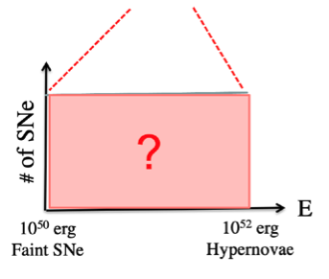
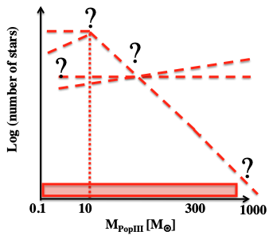
What we know about the first stars?
${10}^{50}$erg
Faint SNe
${10}^{53}$erg
PISN
Initial mass function (IMF)
of the first stars
Energy distribution function (EDF)
of the first SNe
The impact of the first stars in two ultra-faint dwarf galaxies: Grus II and Tucana IV – Valentina Verdiani

Slide 21
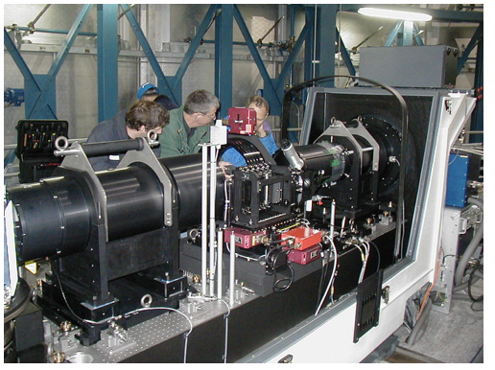
Giraffe from eso.org
Observational data
Multi-object spectrograph FLAMES/Giraffe
Exposure time for every Observing Block is 3600 s: some stars in Grus II were observed for 2 h and 4 h, the stars of Tucana IV for 4 h
The stars observed belong the Red Giant Branch (RGB), i.e. the stellar evolution phase where the stars are brighter, and to the Horizontal Branch (HB)
Red spectra with HR21 R = $\frac{λ}{Δλ}$ = 18 000
Blue spectra with LR2
R = $\frac{λ}{Δλ}$ = 6 000
The impact of the first stars in two ultra-faint dwarf galaxies: Grus II and Tucana IV – Valentina Verdiani

Slide 22
Stellar atmospheric parameters
Model Atmospheres with a Radiative and Convective Scheme (MARCS)
The model’s parameters are:
The effective temperature $T_{eff}$:
$θ=b_{0}+b_{1}C+b_{2}C^{2}+b_{3}[\text{Fe}\text{/}\text{H}\text{] }+b_{4}{\text{[}\text{Fe}\text{/}\text{H}\text{]}}^{2}+b_{5}\text{[}\text{Fe}\text{/}\text{H}\text{]}C$
The surface gravity of the star log(g):
log(g)= ${\log\left(\text{g}\right)}_{⊙}+\text{log}\left(\frac{M_{∗}}{M_{⊙}}\right)+4\text{log}\left(\frac{T_{eff}}{T_{eff,⊙}}\right)+0.4(M_{bol,∗}−M_{bol,⊙})$
The microturbolence velocity $v_{turb}$: $v_{turb}=2.0 −0.2 \text{log}\text{(}\text{g}\text{)}$
The metallicity [Fe/H]
$$T_{eff}=\frac{5040}{θ}$$
(from Mucciarelli+20)
(e.g. Skúladóttir+24)
(from Antony-Twarog+13)
The impact of the first stars in two ultra-faint dwarf galaxies: Grus II and Tucana IV – Valentina Verdiani

Slide 23
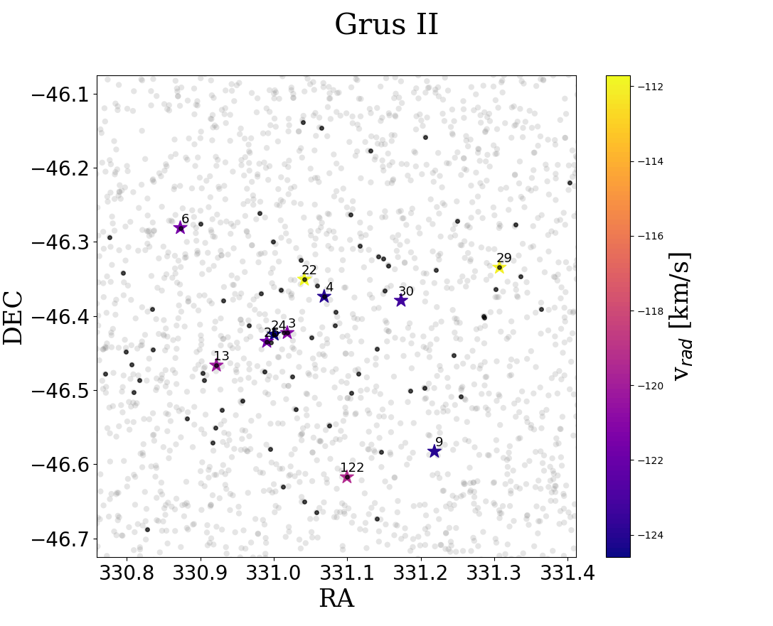
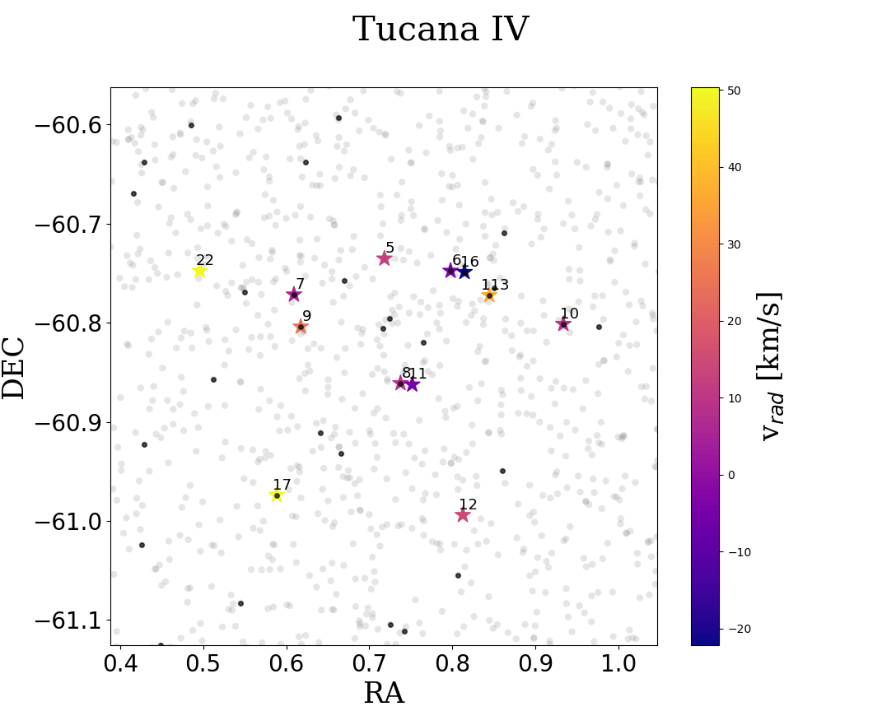
Proper motions
The impact of the first stars in two ultra-faint dwarf galaxies: Grus II and Tucana IV – Valentina Verdiani

Slide 24
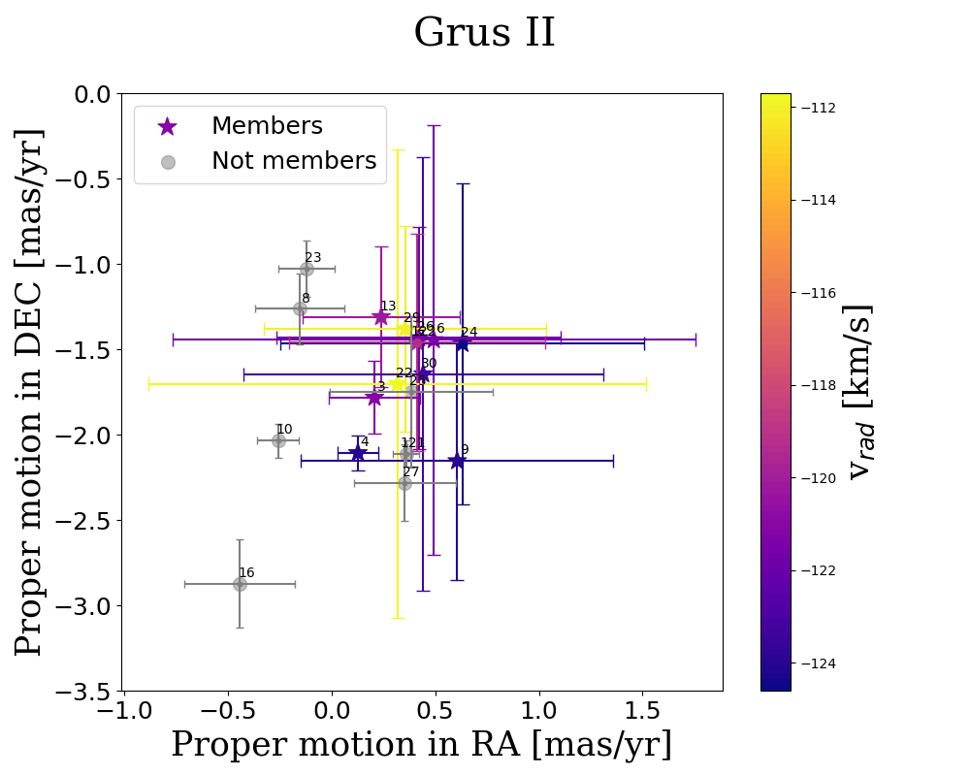
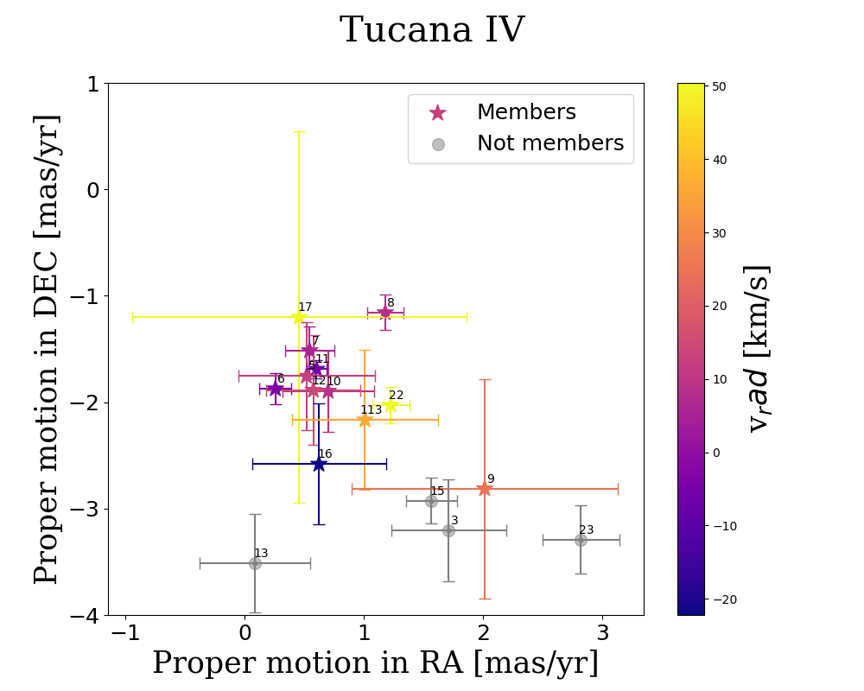
Proper motions
The impact of the first stars in two ultra-faint dwarf galaxies: Grus II and Tucana IV – Valentina Verdiani

Slide 25
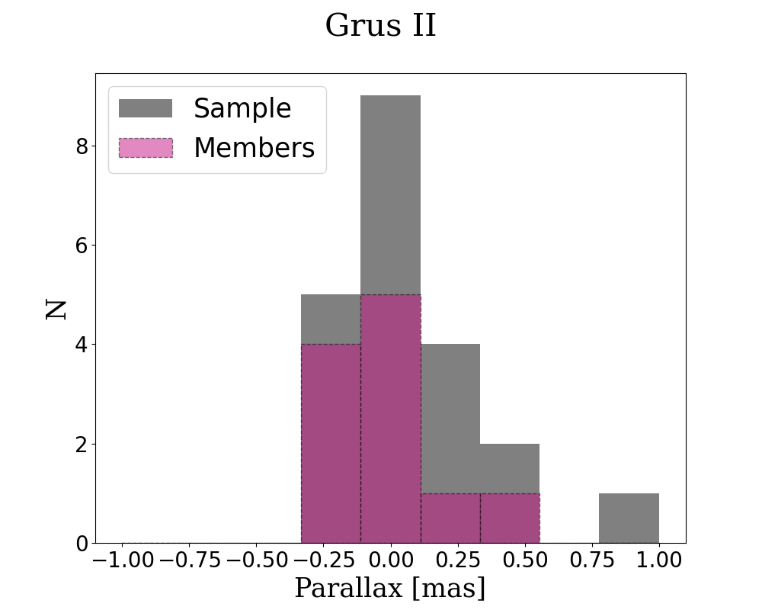
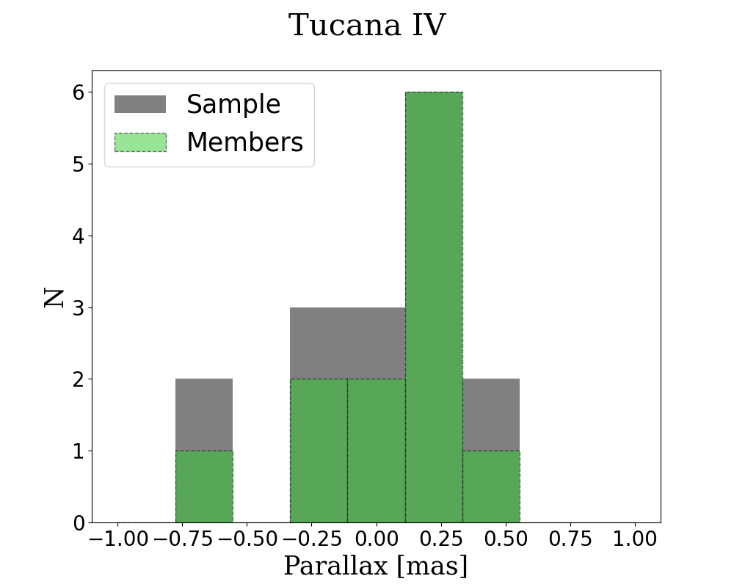
Parallax
The impact of the first stars in two ultra-faint dwarf galaxies: Grus II and Tucana IV – Valentina Verdiani

Slide 26
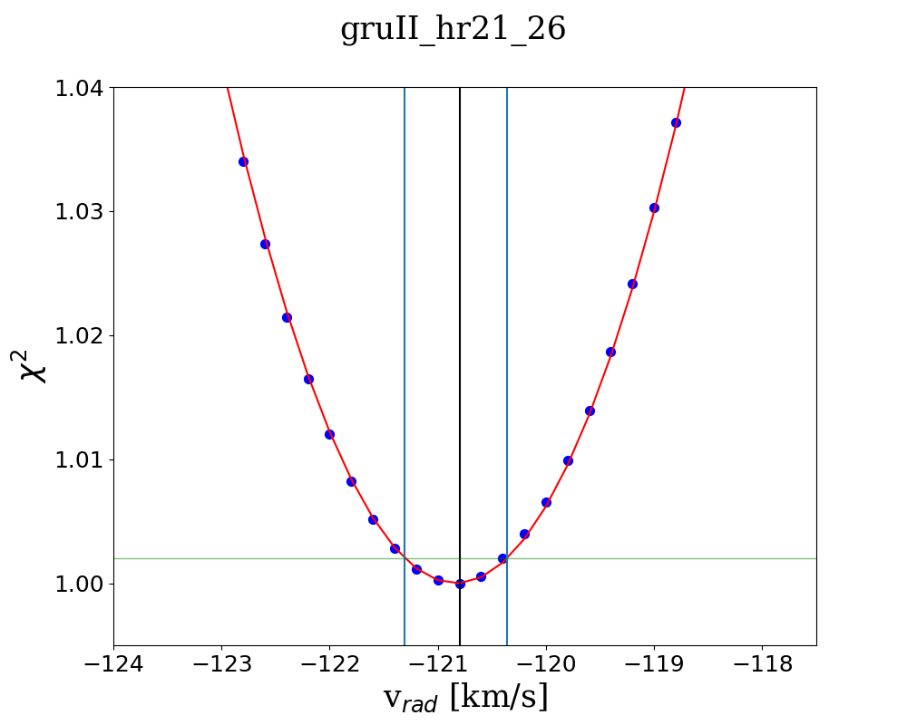
Uncertainties on radial velocity
The $χ^{2}$ of every iteration is saved, allowing us to do a polynomial fitting of the curve
A fixed factor f is used to derive the error on the radial velocity $σ_{v}$
The line y=f identify two intersection with the curve
$σ_{v}$ is the difference between this two values divided by 2
$$σ_{v}$$
f
Best fit
The impact of the first stars in two ultra-faint dwarf galaxies: Grus II and Tucana IV – Valentina Verdiani

Slide 27
Uncertainties on radial velocity
The f is determined by using 3 representative stars where their error is estimated by varying radial velocity of the synthetic spectrum until is inconstistent with the observed spectrum
Using a fixed f for all stars ensures homogenous error estimation
$$σ_{v}$$
f
Best fit
The impact of the first stars in two ultra-faint dwarf galaxies: Grus II and Tucana IV – Valentina Verdiani

Slide 28
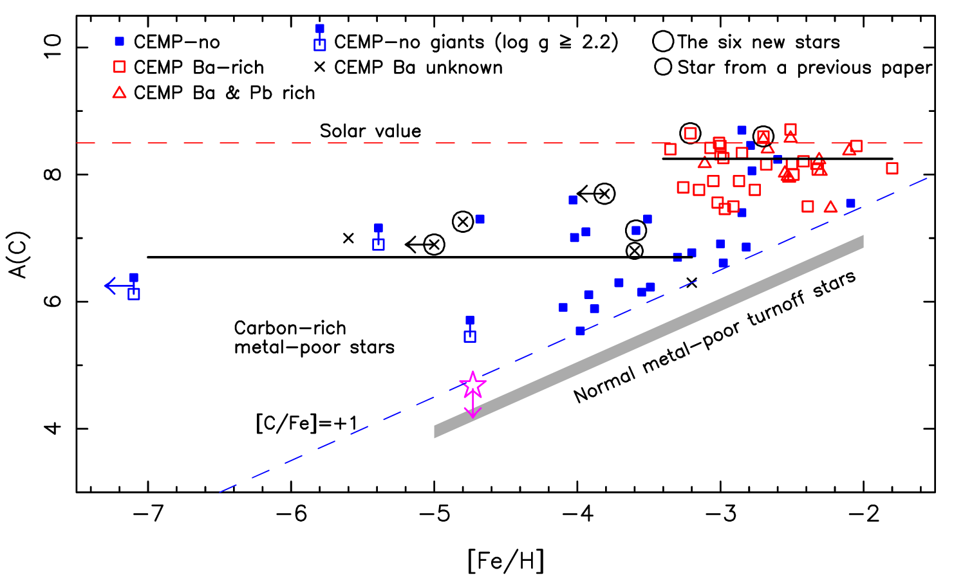
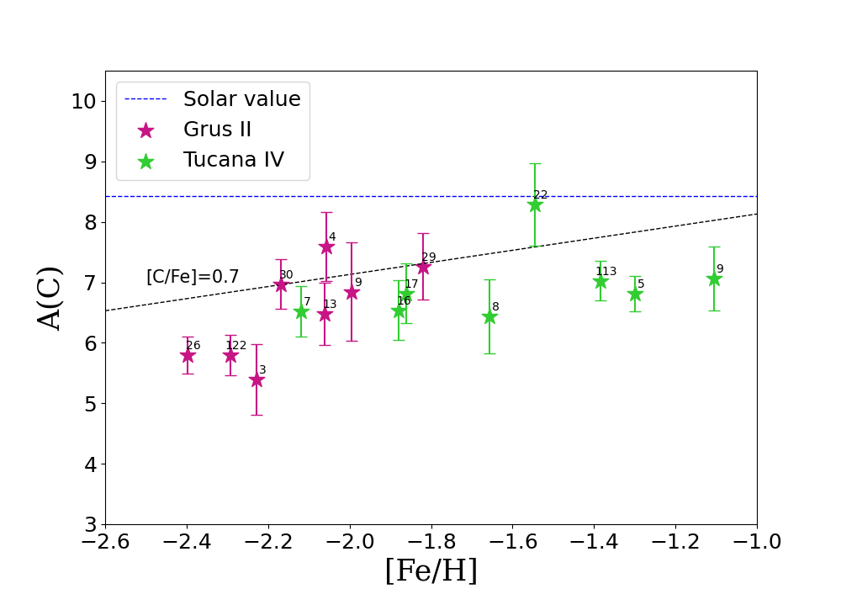
Absolute C abundance
From Bonifacio+15
The absolute carbon abundance A(C) is derived from $\text{A}\text{(}\text{C}\text{)= [}\text{C}\text{/}\text{H}\text{]+}\text{A}{\left(\text{C}\right)}_{⊙}$,
where $\text{A}{\left(\text{C}\right)}_{⊙}=8.43$ is the solar value
The CEMP-no stars belong to the low C-band (A(C)<7.4), while the CEMP-s stars belong to the high C-band (A(C)=7.4-8.9)
The impact of the first stars in two ultra-faint dwarf galaxies: Grus II and Tucana IV – Valentina Verdiani

