Slide 1
Constraining the Neutron Capture Reaction on Zr Isotopes for Astrophysical Processes
Amal Sebastian

Slide 2
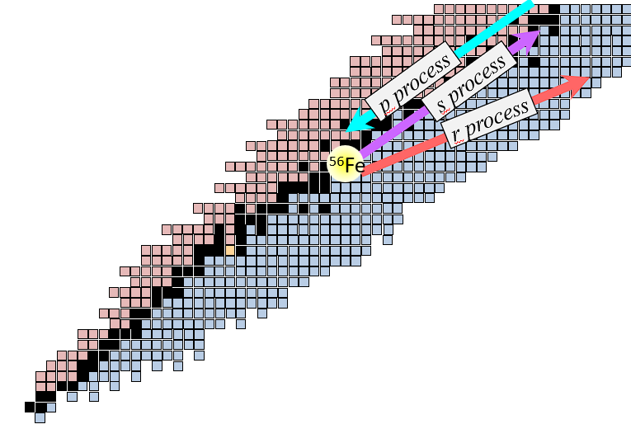
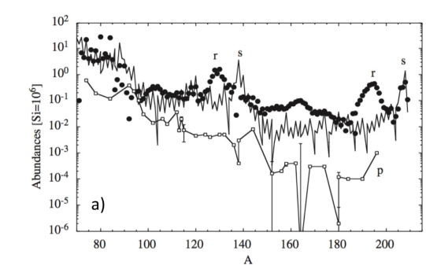
Introduction - Nucleosynthesis
Formation of elements?
Proton-capture process(p-process)
Slow-neutron capture process(s-process)
Rapid-neutron capture process(r-process)
Constraining the reaction rate is essential in describing the abundance pattern.
Fusion up to iron
M. Arnould et al. ,Physics Reports 450 (2007) 97– 213
C J Horowitz et al. ,J. Phys. G: Nucl. Part. Phys. 46 (2019) 083001

Slide 3
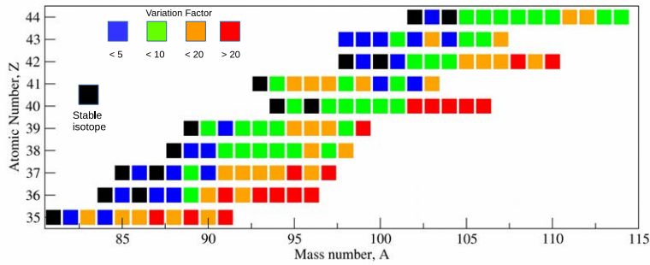
Uncertainties in Theoretical Models
Variation in predictions of theoretical calculation of neutron capture reaction rate
There is a need for experimental methods to constrain these neutron capture reaction rates.
Pavel Denissenkov et al., 2018 J. Phys. G: Nucl. Part. Phys. 45 055203

Slide 4
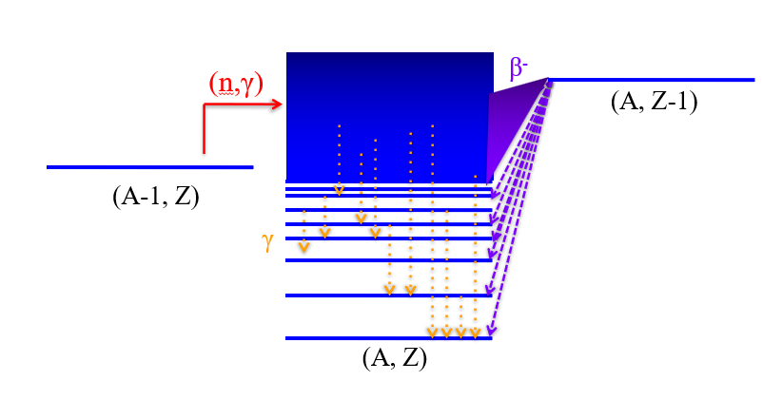
How do we constrain the (n, γ) reaction rate?
Direct neutron capture reactions are extremely challenging.
Need to rely on indirect techniques to provide experimental constraints.
T_{1/2}= 2 s
⁹⁹Zr
¹⁰⁰Zr
β⁻
(n,γ)
¹⁰⁰Y
Reactions
Indirect method
Based on Compound Nucleus Theorem.
Gives out Nuclear Level Density(NLD) and γ-Ray Strength Function(GSF).
NLD and GSF are used in the calculation of neutron capture reaction rate.
, Slide 4
Amal Sebastian

Slide 5
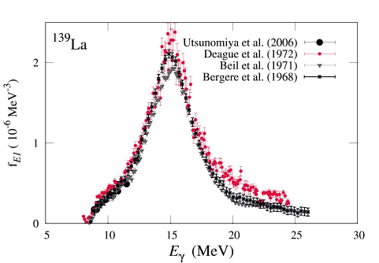
γ-Ray Strength Function
An important input for calculating neutron capture reaction rates is the γ-ray strength function (GSF).
γ-ray strength function- It measures the average, reduced γ-decay probability of the nucleus.
S.Goriely et al., Eur.Phys.J.A(2019) 55:172

Slide 6
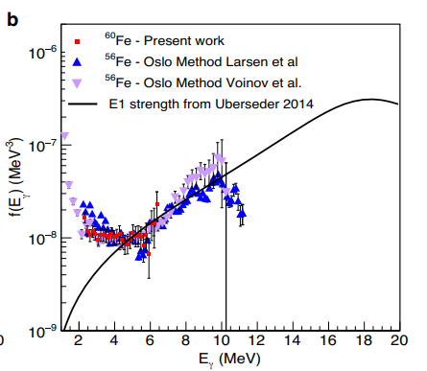
Enhancement in the Low-Energy region
Reason for Low-Energy Enhancement (LEE)/upbend?
How does this upbend evolve in neutron-rich isotopes?
What is the impact of the upbend on neutron capture reaction rates?
A. Spyrou et al., Nat Communications 15, 9608 (2024)

Slide 7
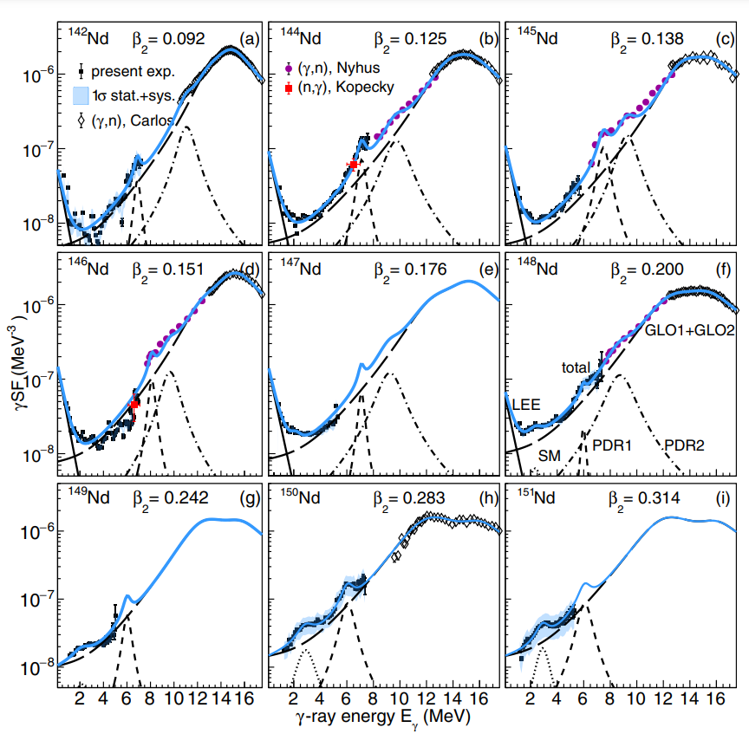
Evolution of upbend in neutron-rich isotopes
Deformation in nucleus
spherical
deformed
β₂= 0.092
β₂= 0.109
β₂= 0.125
β₂= 0.138
β₂= 0.151
β₂= 0.176
β₂= 0.200
β₂= 0.242
β₂= 0.283
Giant Dipole Resonance peak evolution?
LEE evolution?
β₂= 0
β₂ > 0
M. Guttormsen et al., Physical Review C 106, 034314 (2022)
, Slide 7
Amal Sebastian

Slide 8
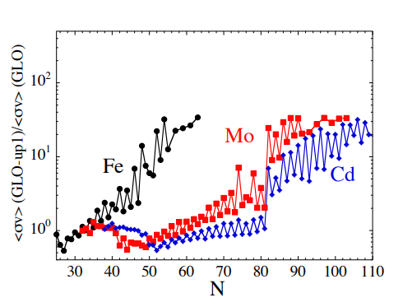
Impact of the upbend on reaction rate
The ratio of neutron capture reaction rate with upbend and without upbend
Close to stability, the impact of upbend on the reaction rate is small.
On the neutron-rich side, the impact of upbend on the reaction rate is relatively large.
A.C Larsen et al., Phys. Rev. C 82, 014318, (2010)

Slide 9
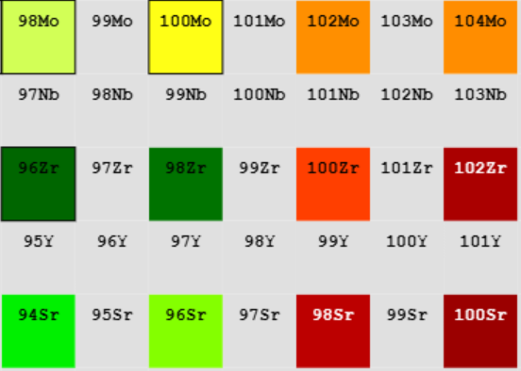
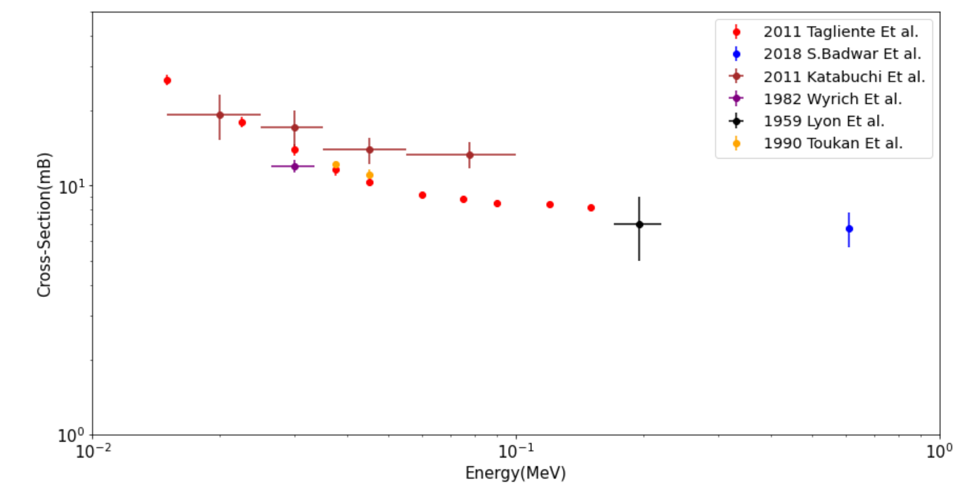
Why Zr isotopes ?
Abrupt deformation pattern compared to Nd isotopes
How does the upbend evolve?
How does it impact neutron capture reaction rate?
Cross section of ⁹⁶Zr(n, γ)⁹⁷Zr
Analysis of isotopes ⁹⁷Zr, ⁹⁸Zr and ¹⁰⁰Zr
No experiments have measured the cross-sections of ⁹⁷Zr and ⁹⁹Zr neutron captures.
⁹⁶Zr (n, γ) ⁹⁷Zr cross-section serves as a validation for the indirect method.
Slide 9
Amal Sebastian,

Slide 10
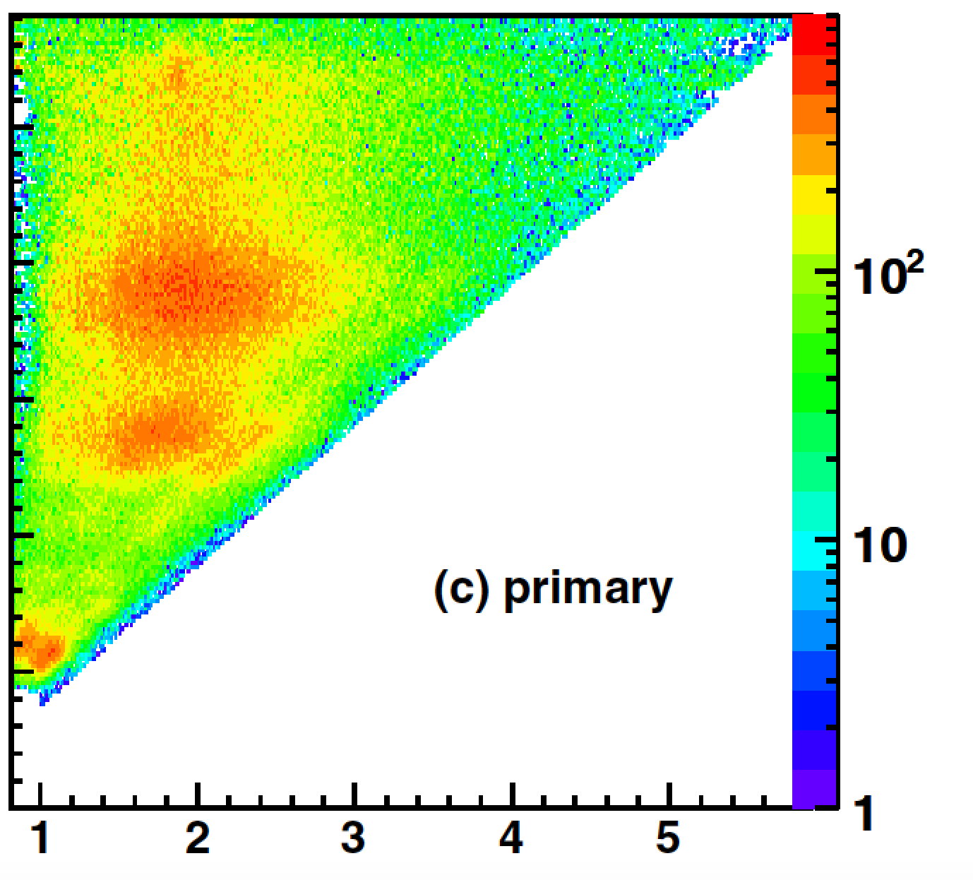
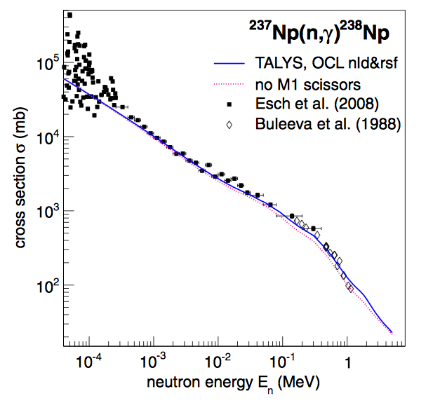
Methodology - Oslo Method
Excitation energy
γ
Gamma energy (MeV)
Use reaction to populate compound nucleus of interest.
Measure excitation and γ-ray energy.
Extract level density and γ-ray strength function (normalization).
Calculate “semi-experimental” neutron capture cross-section.
A. Schiller et. al, Nucl. Instrum. Methods Phys. Res. A 447 (2000) 498

Slide 11
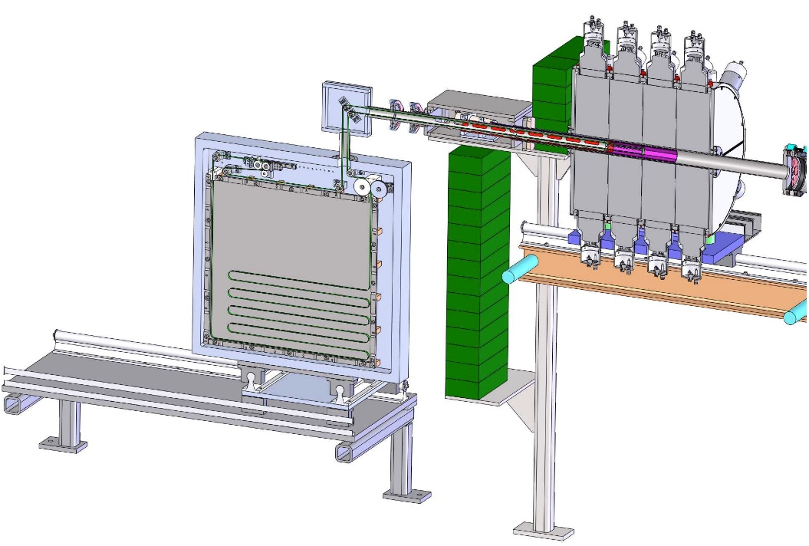
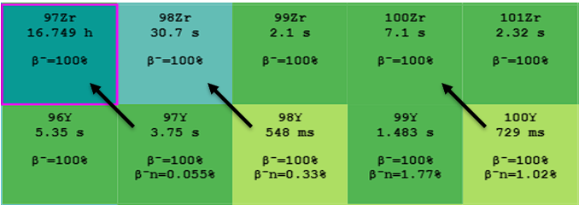
Experimental Setup – SuN Detector
SuNTAN Tape Transport System
SuN detector
Contains 8 segments of 3 PMTs each
Almost a geometric coverage of 4π
High efficiency (>85% for 1 MeV photon)
Total Absorption Spectroscopy
(TAS) can be done.
Fiber detector – β-detection
A. Simon et al. Nuclear Instruments and Methods in Physics Research A 703 (2013)

Slide 12
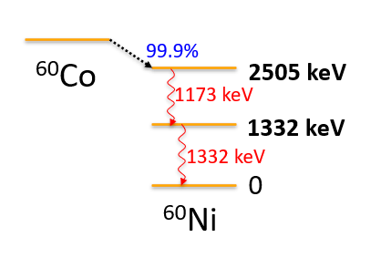
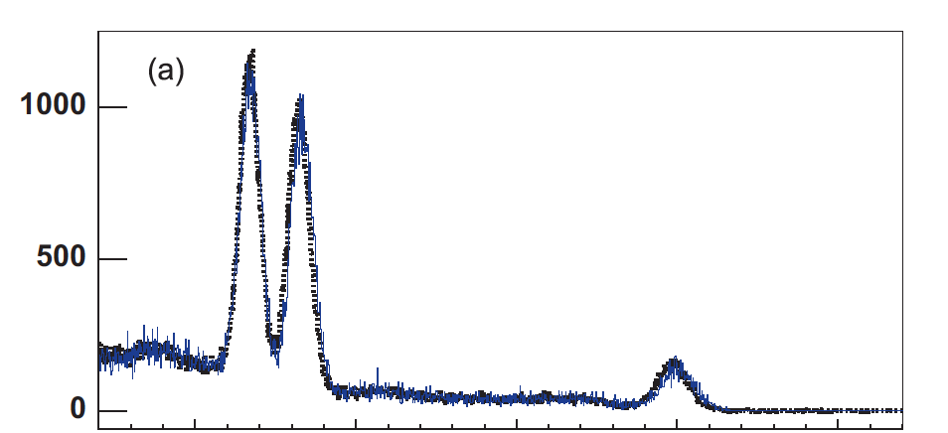
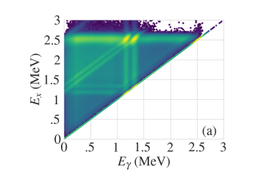
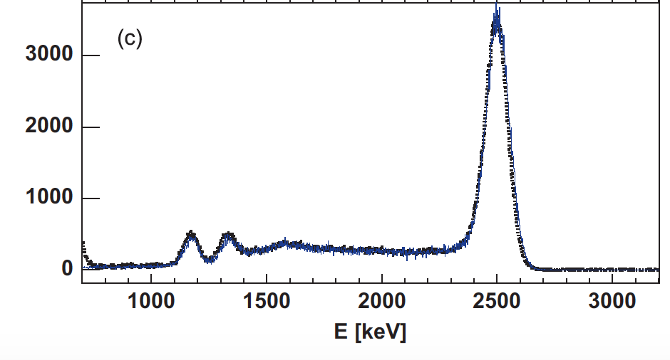
Total Absorption Spectroscopy
SuN segment
SuN total
A. Simon et al. Nuclear Instruments and Methods in Physics Research A 703 (2013)

Slide 13
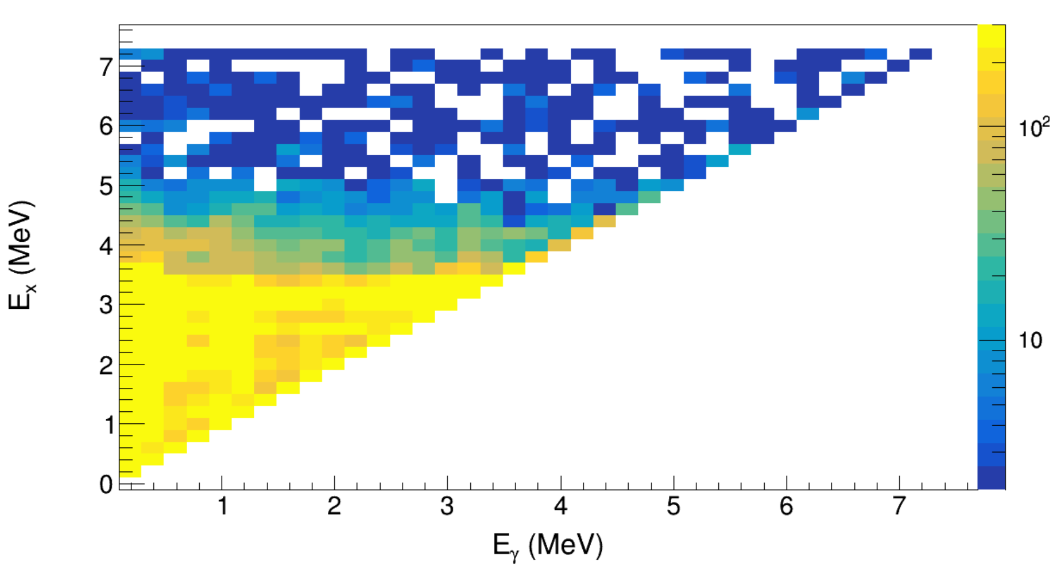
Results and Analysis
T_{1/2}= 2.29x10¹⁹ yrs
⁹⁶Zr
⁹⁷Zr
From the highlighted extraction region, level density and γ-ray strength function simultaneously obtained
β⁻
(n,γ)
⁹⁷Y
Raw matrix for β-oslo analysis
γ
⁹⁷Y-> ⁹⁷Zr
Q_{β} = 6.8 MeV
S_{n} =5.56 MeV
, Slide 13
Amal Sebastian

Slide 14
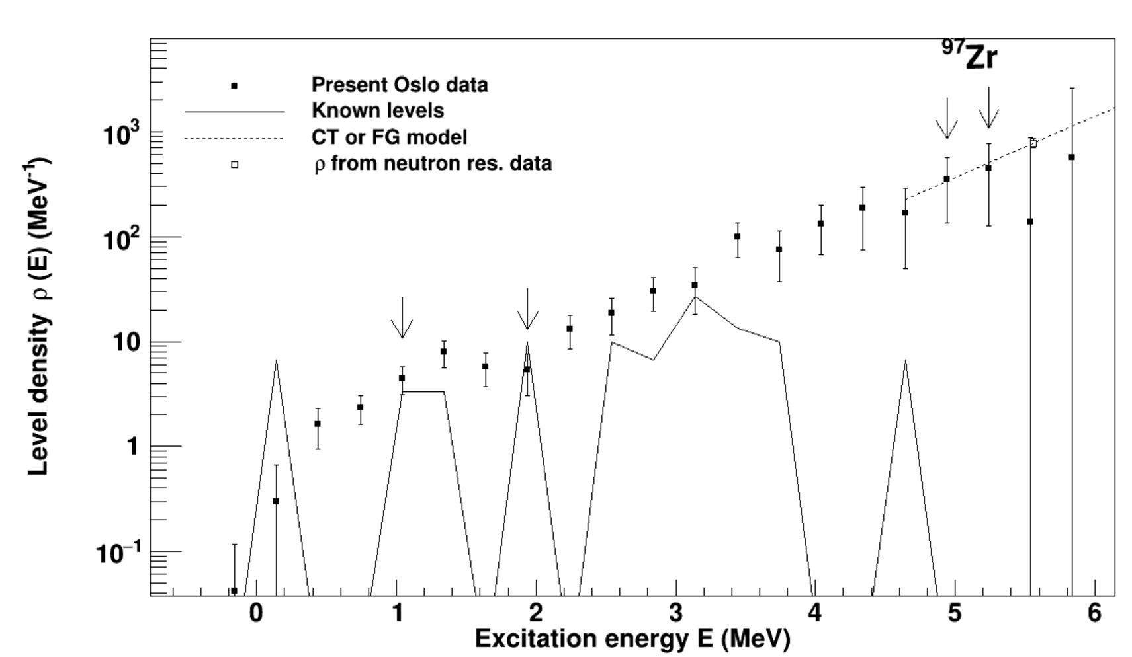
Extracted Nuclear Level Density
ρ(S_{n}) = 787 /MeV
Level density normalized using
Low-lying discrete levels.
Levels near neutron separation
energy.

Slide 15
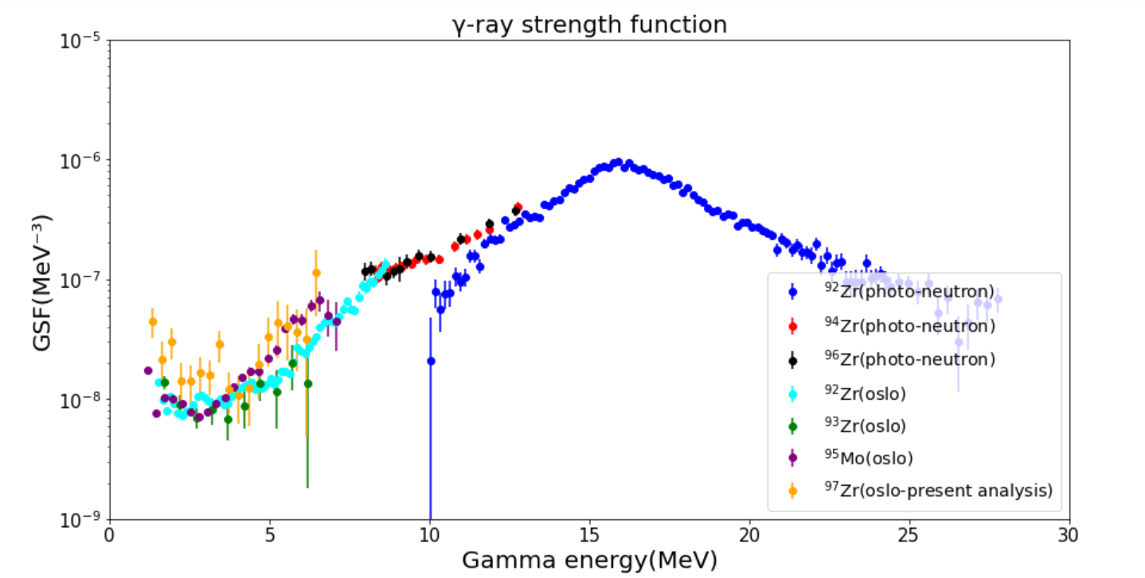
Extracted γ-ray strength function
The GSF was normalized using the average radiative width of levels near neutron separation energy.
S. Goriely et al., The European Physical Journal A 55, 172 (2019)

Slide 16
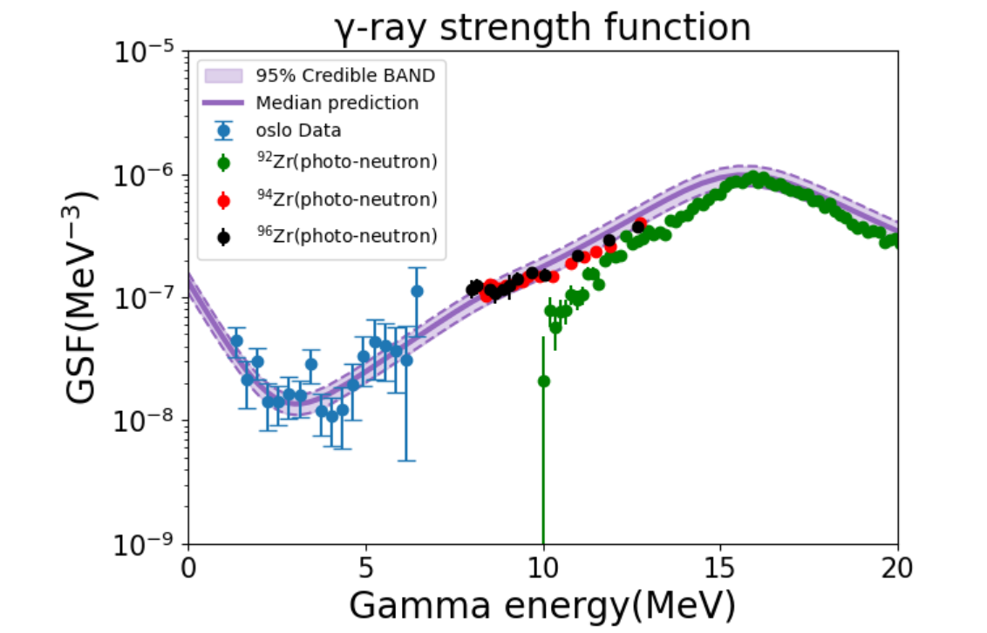
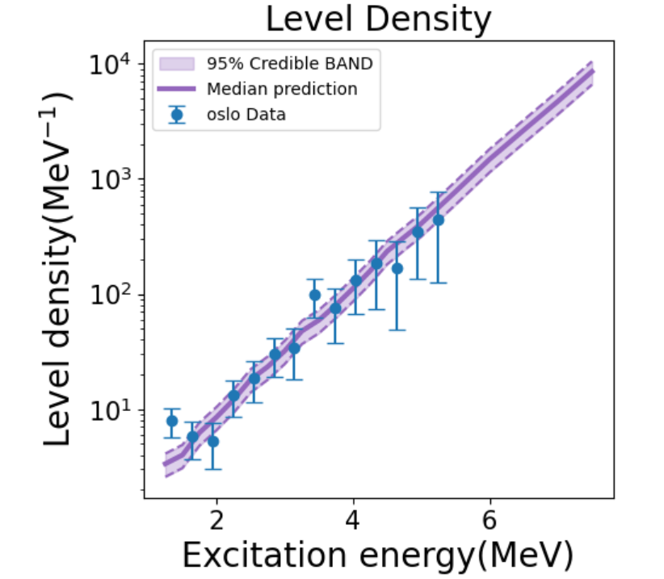
Talys Models for NLD and GSF
Preliminary
, Slide 16
Amal Sebastian,

Slide 17
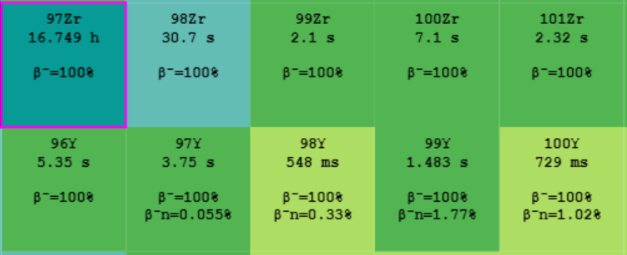
Summary and Future Directions
We found the NLD and GSF for ⁹⁷Zr.
Finding the uncertainty band for cross-section and applying it to
get the reaction rates.
Apply the same analysis to ⁹⁸Zr and ¹⁰⁰Zr to study the evolution of GSF with deformation.
Constrain their reaction rates.

Slide 18
Thank you!

Slide 19
Acknowledgement
Bosmpotinis, Konstantinos;
Sebastian, Amal;
Tsantiri, Artemis;
Berg, Hannah;
Smith, Mallory;
Harris, Caley;
Cade Dembski <cdembski@nd.edu>;
Good, Erin C <erin.good@pnnl.gov>;
Owens-Fryar, Gerard Jordan;
Coil, Sydney
Bosmpotinis, Konstantinos;
Sebastian, Amal;
Tsantiri, Artemis;
Berg, Hannah;
Smith, Mallory;
Harris, Caley;
Cade Dembski <cdembski@nd.edu>;
Good, Erin C <erin.good@pnnl.gov>;
Owens-Fryar, Gerard Jordan;
Coil, Sydney
Bosmpotinis, Konstantinos;
Sebastian, Amal;
Tsantiri, Artemis;
Berg, Hannah;
Smith, Mallory;
Harris, Caley;
Cade Dembski <cdembski@nd.edu>;
Good, Erin C <erin.good@pnnl.gov>;
Owens-Fryar, Gerard Jordan;
Coil, Sydney
PI : Artemis Spyrou
SuN Group
Mallory Smith
Sivahami Uthayakumar
Hannah Berg
Caley Harris
Konstantinos Bosmpotinis
Artemis Tsantiri
Jordan Owens-Fryer
Kyle Taft
Sydney Coil
Hershini Gadaria

