Slide 1
Extraction of Nuclear Level Densities and γ-ray strength functions for ⁸⁵Rb compound nucleus relevant to the astrophysical p-process
[Konstantinos Bosmpotinis] [Russbach school 2025 ]

Slide 2
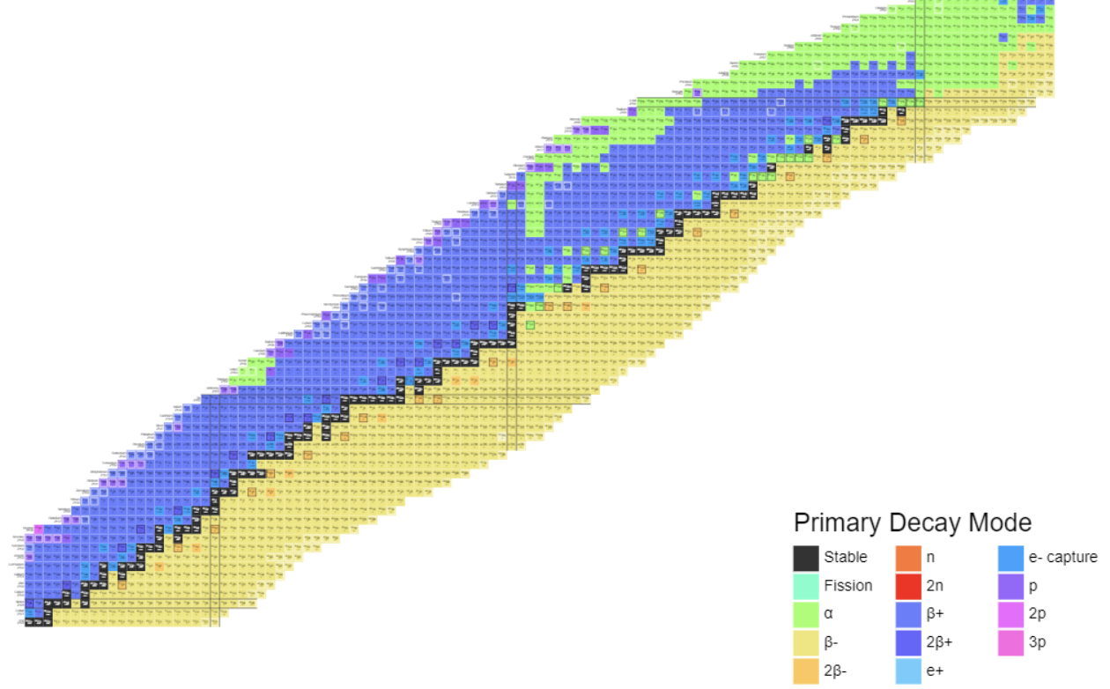
Introduction
How are the elements created?
How to explain the observed abundances?
Nucleosynthesis beyond iron peak?
What is needed from a nuclear physics standpoint?
N= 126
γ process
N= 82
r- process
s- process
N= 50

Slide 3
γ process
p-nuclei shielded by s and r-processes
Initially thought to be produced mainly through (p,γ) reactions [1]
Coulomb barrier high for proton captures
Solution → (γ,n), (γ,p) & (γ,α)
(γ,n) slower for more proton-rich nuclei
[1]E. M. Burbidge, G. R. Burbidge, W. A. Fowler, and F. Hoyle, Rev. Mod. Phys. 29, 547 (1957).
Branching point
[2]T Rauscher et al, Rep. Prog. Phys. 76 066201, (2013)

Slide 4
γ process
The p- process possible sites:
Type II Supernovae
Type Ia Supernovae
Short time scales ~ 1 sec
2 < T< 3.5 GK
Nuclear network
Consists of approximately 20.000 reactions on stable and radioactive isotopes → Direct cross-section measurements are challenging.
Competition between these can determine the p-process nucleosynthesis path → Branching point elements.
T Rauscher et al, Rep. Prog. Phys. 76 066201, (2013)
Branching point

Slide 5
Motivation
Why ⁸⁵Rb is so important for the p-process network?
Listed as a branch point between the ⁸⁵Rb(γ,p)⁸⁴Kr and ⁸⁵Rb(γ,n)⁸⁴Rb [1]
Potentially affect the production of ⁷⁸Kr p-nucleus.
⁸⁴Kr(p,γ)⁸⁵Rb measured.
⁸⁴Rb is unstable → Theoretical calculations to obtain ⁸⁵Rb(γ,n)⁸⁴Rb
(γ,n)
(γ,p)
[1]Raucher, T. (2006). Branchings in the γ-process path revisited. Physical Review C.

Slide 6
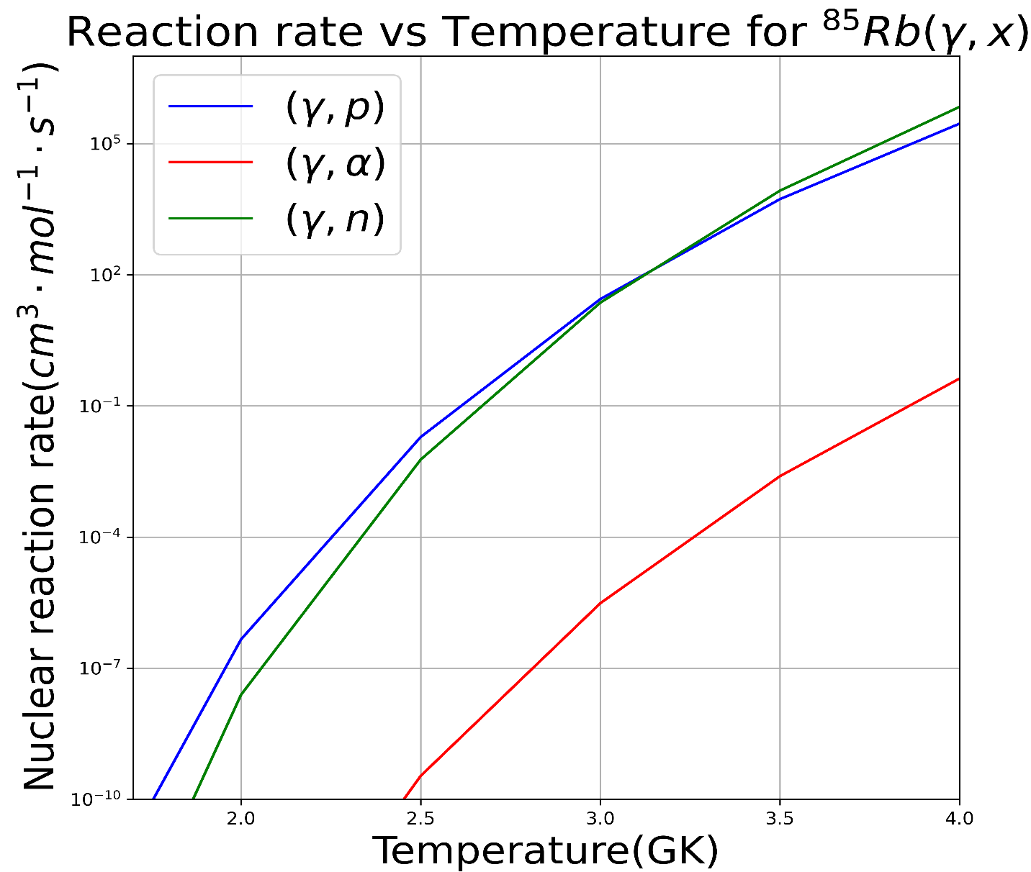
Theoretical reaction rates
Calculations based on theoretical models→Large uncertainties
(γ,n)
(γ,p)
JINA REACLIB Database

Slide 7
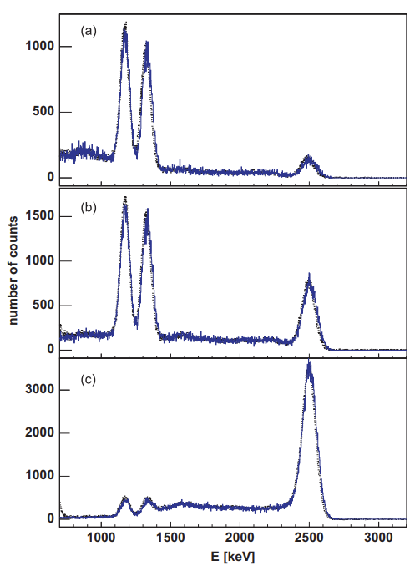
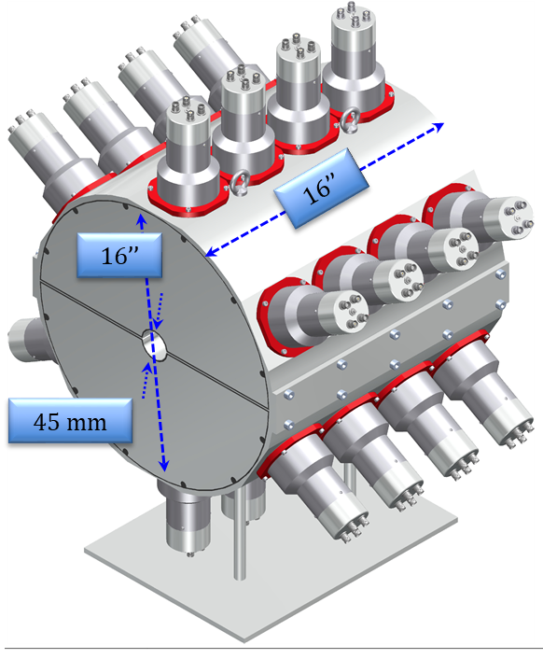
SuN detector
⁶⁰Co
SuN (Summing NaI)
24 PMTs
8 segments
45 mm in diameter borehole
Almost 4π geometric coverage
High efficiency (>85% for 1 MeV photon)
Perform Total Absorption Spectroscopy (TAS): Obtain information about total excitation energy.
Obtain information about individual gamma rays.
⁶⁰Co peaks at 1173 keV & 1332 keV
Single-segment
β⁻
2505 keV
1173 keV
Top half
1332 keV
⁶⁰Ni
Whole SuN detector
A. Simon, S.J. Quinn, Artemis Spyrou, et al., Nucl. Instr. Meth A 703, 16 (2013)

Slide 8
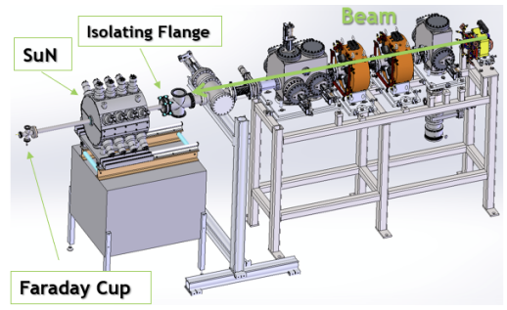
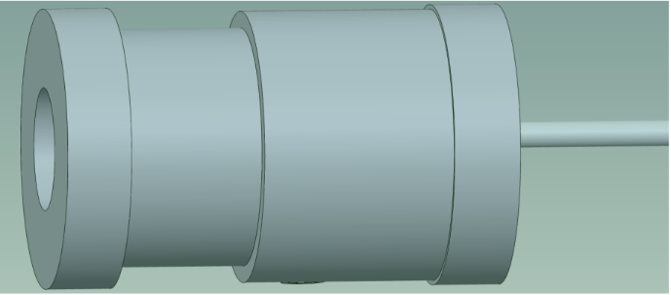
Experimental Set up
The experiment was performed at NSCL at Michigan State University.
A beam of stable ⁸⁴Kr impinged onto a gas hydrogen target (inverse kinematics).
Beam energies 2.7 MeV/u, 3.1 MeV/u, 3.4 MeV/u, 3.7 MeV/u.
Gas cell target
4cm
A. Palmisano et al, 2022, Phys. Rev. C 105.065804

Slide 9
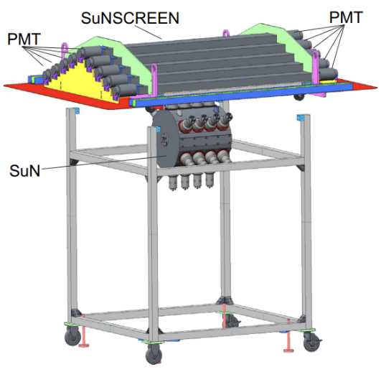
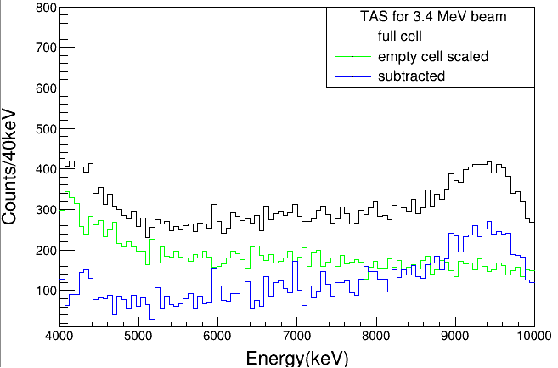
Background subtractions
Veto detector for cosmic background radiation.
Pulsed beam of 100μs every 200 ms
Record room background
Record beam-induced background
Empty gas cell
Full gas cell
E. Klopfer et al, Nucl. Instrum. Meth. Phys. Res. A 788, 5 (2015)

Slide 10
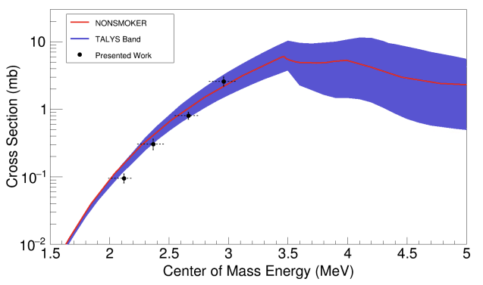
Experimental cross section
Goal: Use the experimental spectra to constrain the statistical properties of ⁸⁵Rb
[1]A. Palmisano et al, 2022, Phys. Rev. C 105.065804

Slide 11
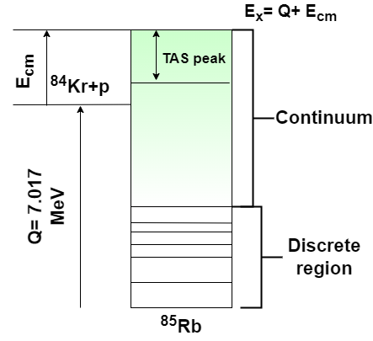
Methodology
RAINIER
G4
Simulated spectra
Fitting
RAINIER [1] code was used to simulate the deexcitation of the compound nucleus.
Excitation energy varied in the energy range 8.4 MeV to 10.6 MeV with 400keV step.
Use all the level densities and gamma-ray strength functions (with and without upbend) implemented in TALYS.
Feed RAINIER spectra to GEANT to account for SuN response.
Perform chi-square minimization in TAS, SoS, Mul spectra
[1]L.E. Kirsch, L.A. Bernstein, A simulation tool for distributions of excited nuclear states and cascade fluctuations, Nucl. Instrum. Meth. Phys. Res. A (2018)

Slide 12
Preliminary TALYS calculations
Consider only the last data point → Higher sensitivity in NLD and gSF
Calculate the chi square for TALYS
Use chi square from the chi-square minimization of the spectra
Accept models that have a chi2 value less than one standard deviation

Slide 13
Summary
High sensitivity in the Sum of Segments spectra →information about the individual gamma-rays emitted from the compound nucleus.
Use the statistical chi-square criterion to obtain NLD and gSF model combinations that best fit our data within 1σ.
Use our results to constrain the ⁸⁵Rb(γ,p) and ⁸⁵Rb(γ,n) reaction rates.

Slide 14
Acknowledgements
Palmisano^{1,2,3}, A. Spyrou^{1,2,3}, A. Tsantiri^{1,2,3}, H. Berg^{1,2,3}, P. A. DeYoung⁴, A. Dombos^{1,2,3}, P. Gastis^{3,5}, O. Gomez⁶, E. Good^{2,3}, C. Harris^{1,2,3}, S. Liddick^{2,3,7}, S. M. Lyons^{1,2,3}, P. Mohr⁸, J. Pereira^{1,2,3}, A. L. Richard^{1,2,3}, A. Simon^{3,6}, M. K. Smith^{1,2}, R. Zegers^{1,2,3}
¹ Department of Physics and Astronomy, Michigan State University,
² Facility for Rare Isotope Beams, Michigan State University,
³ Joint Institute for Nuclear Astrophysics - Center for the Evolution of the Elements,
⁴ Physics Department, Hope College,
⁵ Department of Physics, Central Michigan University,
⁶ Department of Physics, University of Notre Dame,
⁷ Department of Chemistry, Michigan State University,
⁸ Institute for Nuclear Research (Atomki), H-4001 Debrecen, Hungary

Slide 15
Thank you for your attention!

