Slide 1

Storage Rings for Nuclear Astrophysics
Carlo G. Bruno
Russbach Winter School, 18 March 2025

Slide 2
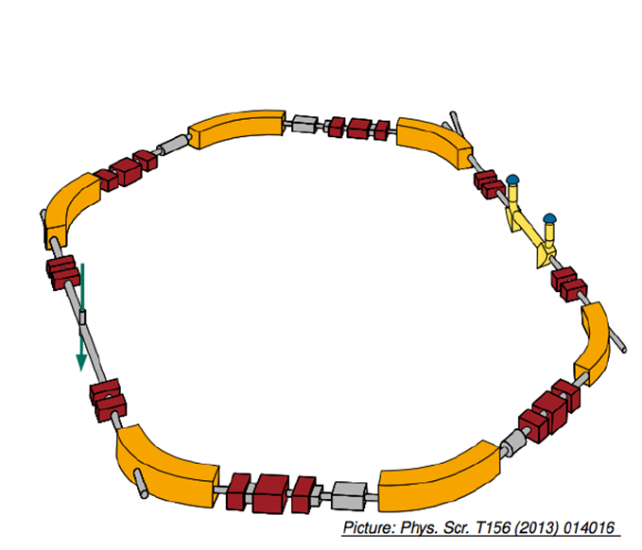
Heavy ion storage rings
ESR (GSI, Germany)
(Experimental Storage Ring)
Beam in
Un-reacted beam
is recycled
Internal target
Beam circulates

Slide 3
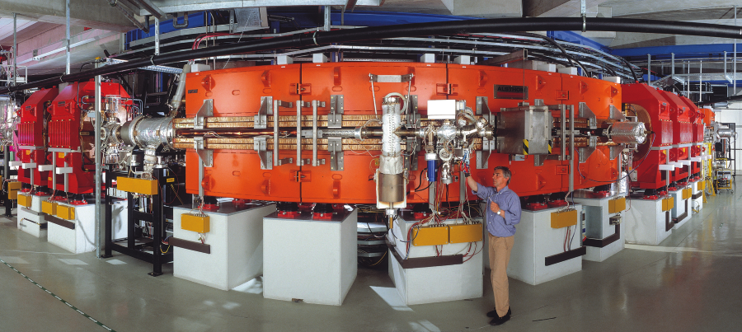
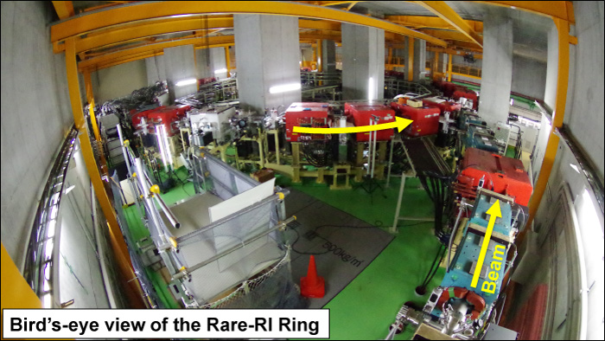
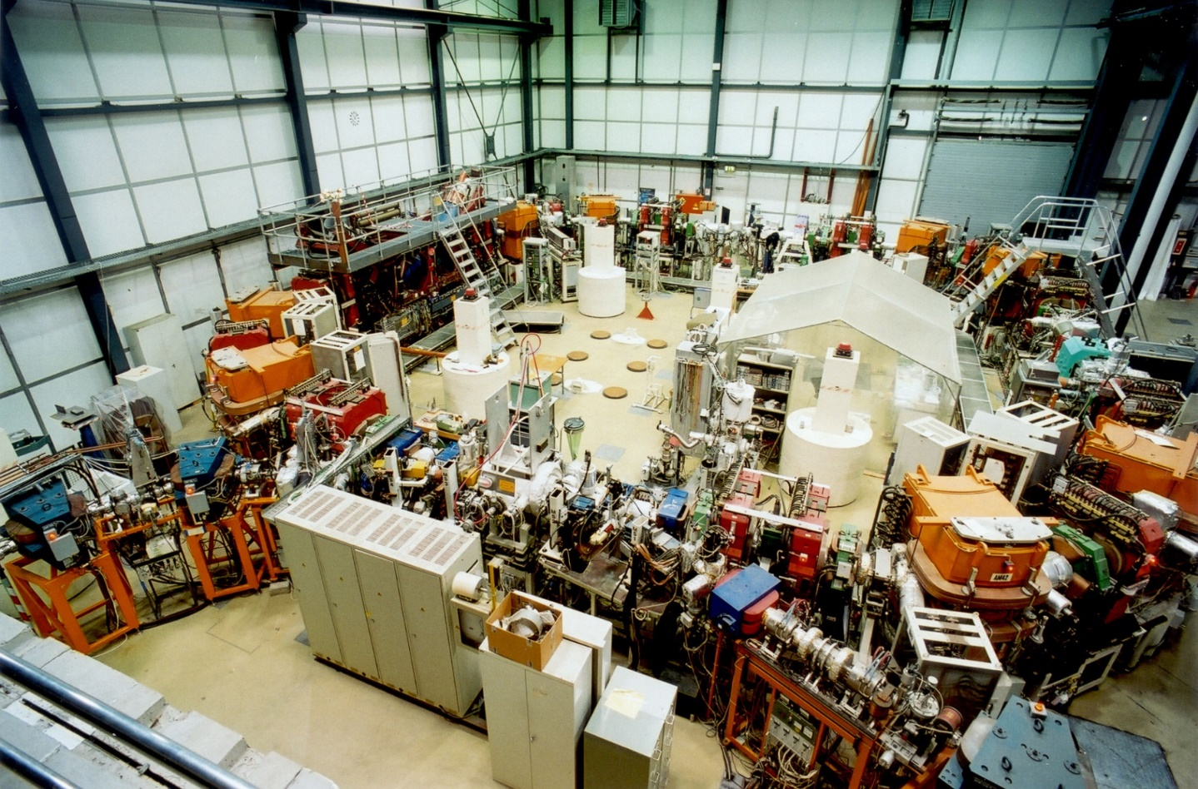
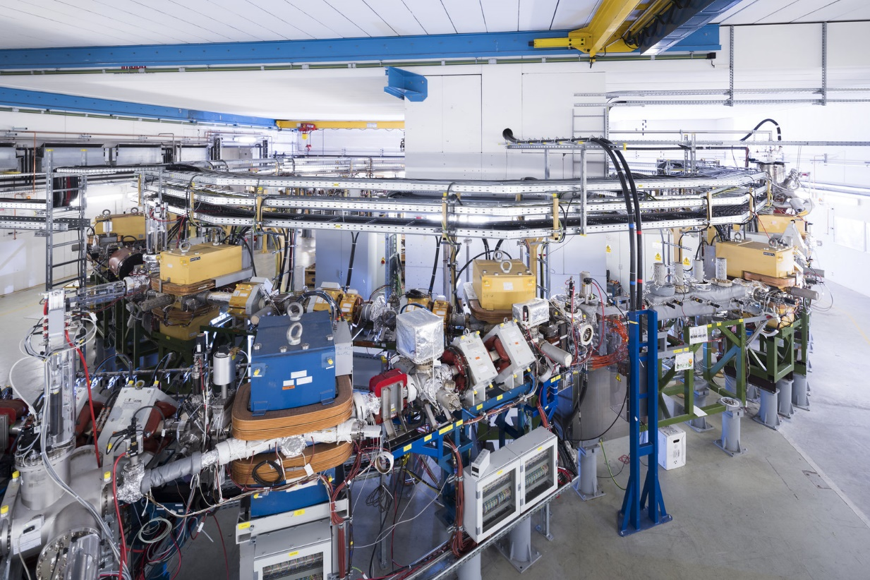

Slide 4

ESR
CRYRING
R3
CSRe

Slide 5
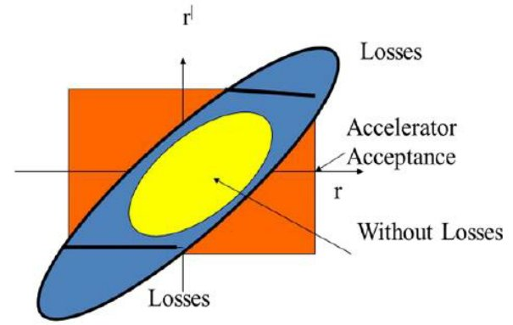
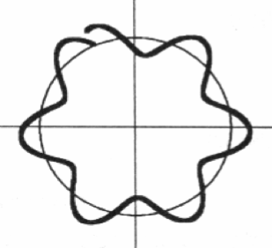
Storing ions – Definitions
Magnets rigidity: Bρ = mv / q​
Storage rings have a limited acceptance usually expressed
in terms of the beam emittance ε or momentum spread Δp
ε = π α Δp (α - angular divergence)
These two limit the maximum and minimum energy that can be stored, depending on q and m.
Betatron oscillations occur around the design orbit
The ratio of the betatron wavelength to the ring circumference is the tune. Key parameter in ring construction! Influences beam optics emittance, luminosity, storage stability, and many more parameters.

Slide 6
Storing ions – storage time
Can ions keep circulating indefinitely?
No – the question is why?

Slide 7
Storing ions – storage time
1. Energy losses
Let us assume: ²³⁸U⁷³⁺ stored at 50 MeV/A at the ESR
ESR circumference: 108 m, Pressure: 10⁻⁷ mbar
Let us assume the residual gas is N₂
---
Energy loss per revolution: 84 eV (SRIM)
50 MeV/A -> v = 7E7 m/s (ignore relativity)
Revolution frequency: v /circumference = 9E5 Hz
Energy loss per second 75 MeV/s (~1%)
Is it an issue?
Yes.

Slide 8
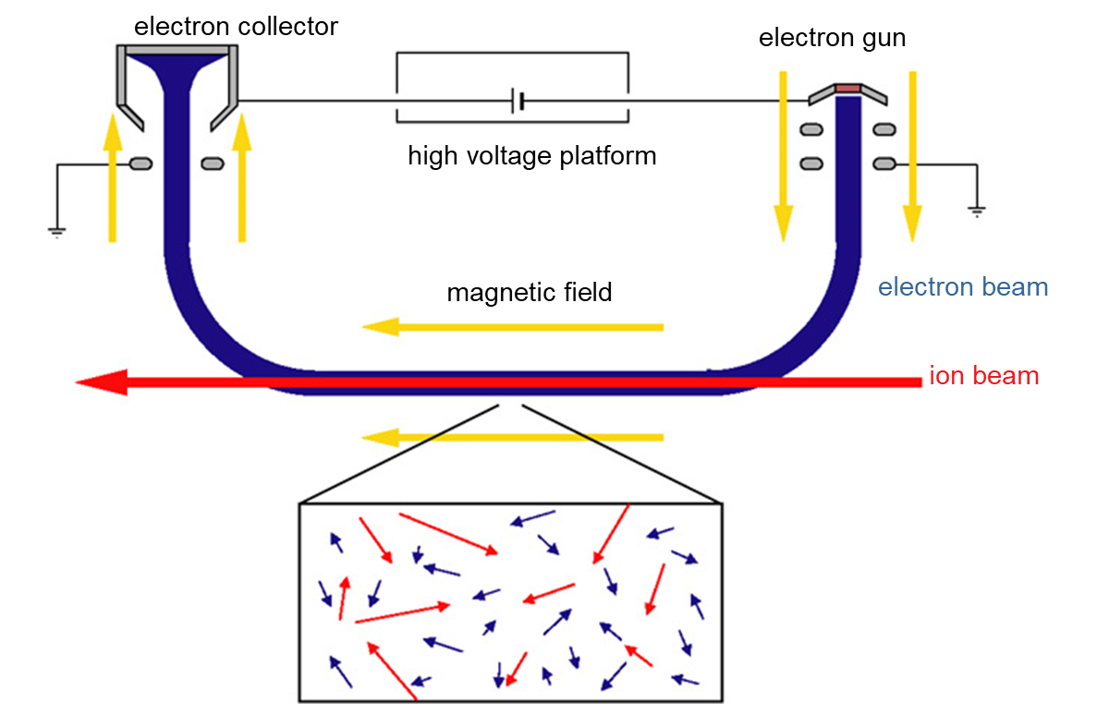
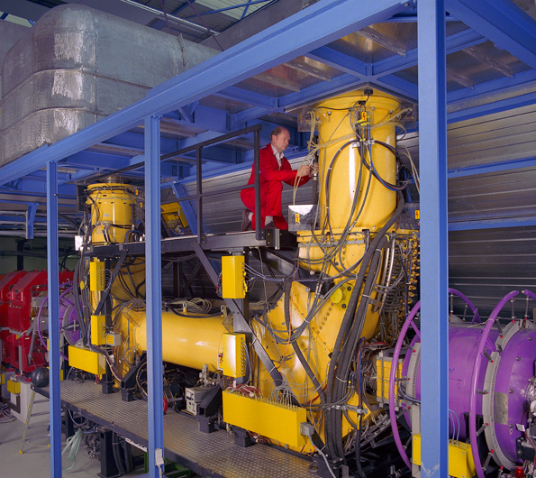
Electron Cooler
  Electron beam in overlap with ion beam
  Cool electrons interact with hot ions
  (temperature exchange though collisions)
  Necessary when the target is on!!

Slide 9

Storing ions – storage time
2. Electron capture
As the (ionised) beam travels through the ring, it may capture an electron
Change in charge state -> change in orbit -> lost ion!
Cross section (some simplifying assumptions)
Where q and E are the charge and energy of the beam.
Z is the atomic number of the residual gas or the target
Cross-section in barn
Same assumptions as before (²³⁸U⁷³⁺ at 50 MeV/A, N₂ gas): 50 kbarn
Even if the vacuum is 10⁻¹¹ mbar, lifetime is a few hundred seconds!
$$σ_{EC}=1.1∙{10}^{−16}\frac{q^{3.9}Z_{gas}^{4.2}}{E^{4.8}}$$

Slide 10
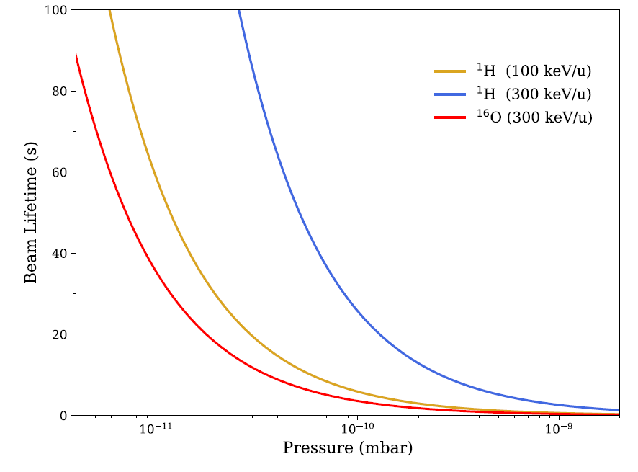
Storing ions – storage time
Other effects
3. Rutherford scattering at angles higher than acceptance
4. Electron stripping
Many more …
Conclusions
Need Ultra/Extreme High Vacuum
10^{-10~12} mbar
Need electron cooler
High beam energies are better
Low Z targets are better
The in-ring target cannot be too thick

Slide 11
Scientific applications

Slide 12
Mass measurements

Slide 13
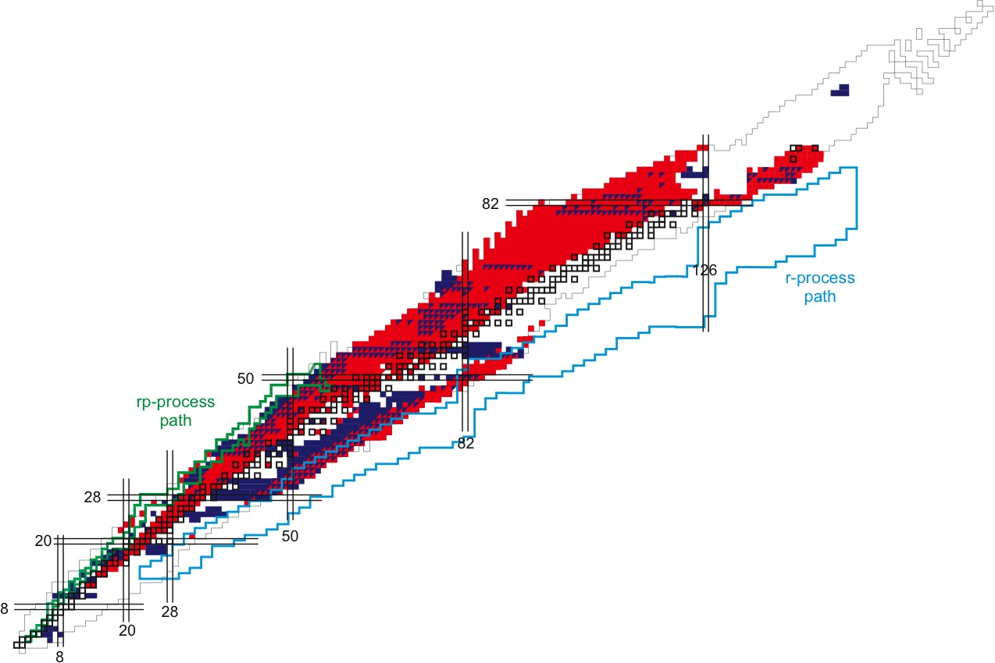
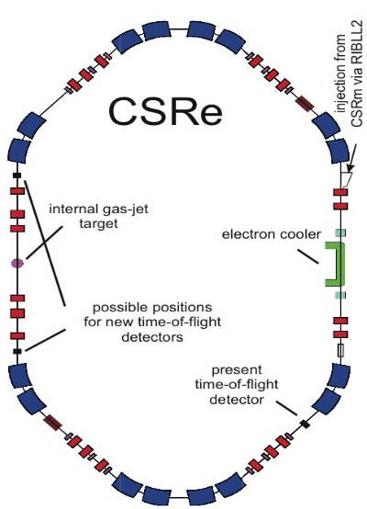
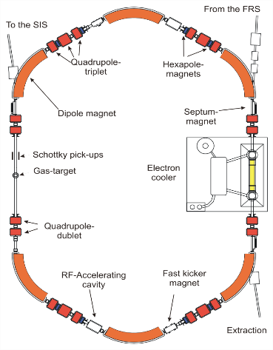
Exotic mass measurements
  ESR
Storage Ring
measurements

Slide 14
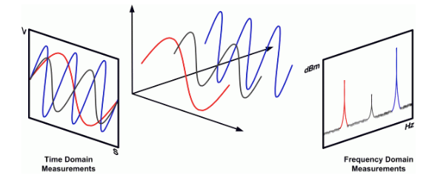
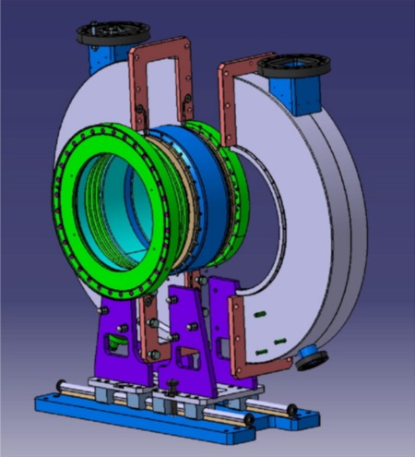
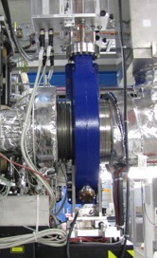
Shottky Resonators
Sophisticated non-destructive beam diagnostic
  Tiny mirror charge signals are detected by different types of “pick-ups”
  Fast-Fourier Transformation provides ion frequency
  Schottky detector performance
    non-destructive technique
    frequency measurement
    single ion sensitivity
  Schottky resonator

Slide 15
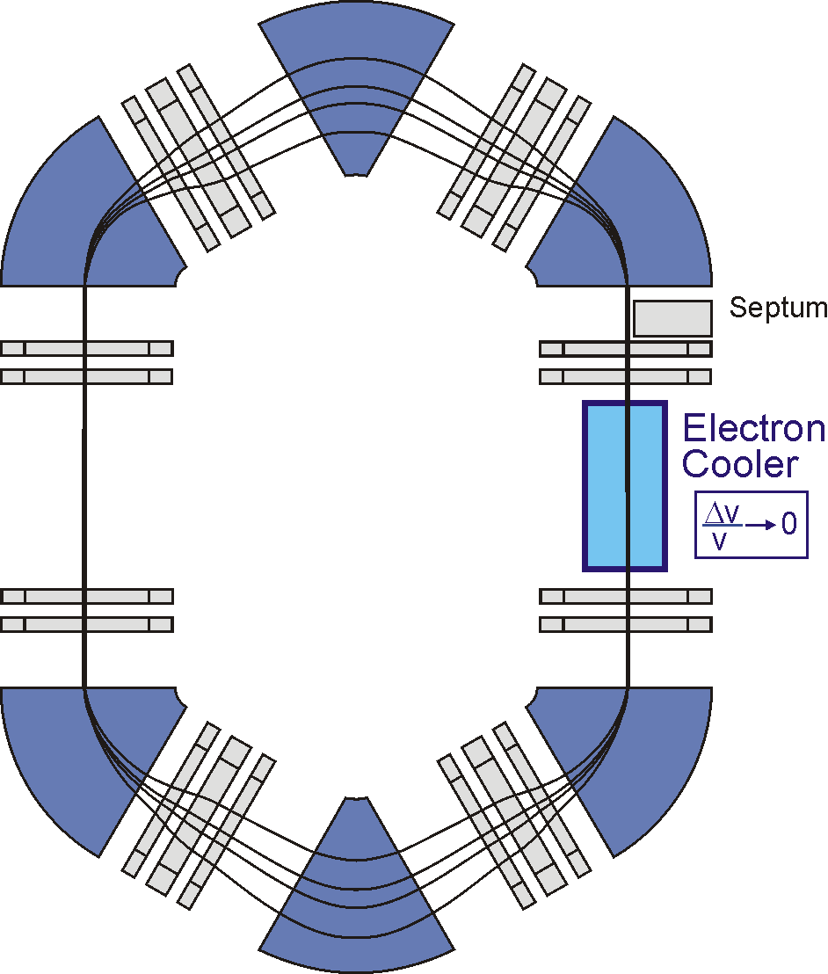






Shottky
4 particles with different m/q
time
“normal mode”
orbit length depends on ion momentum
beam cooling

Slide 16
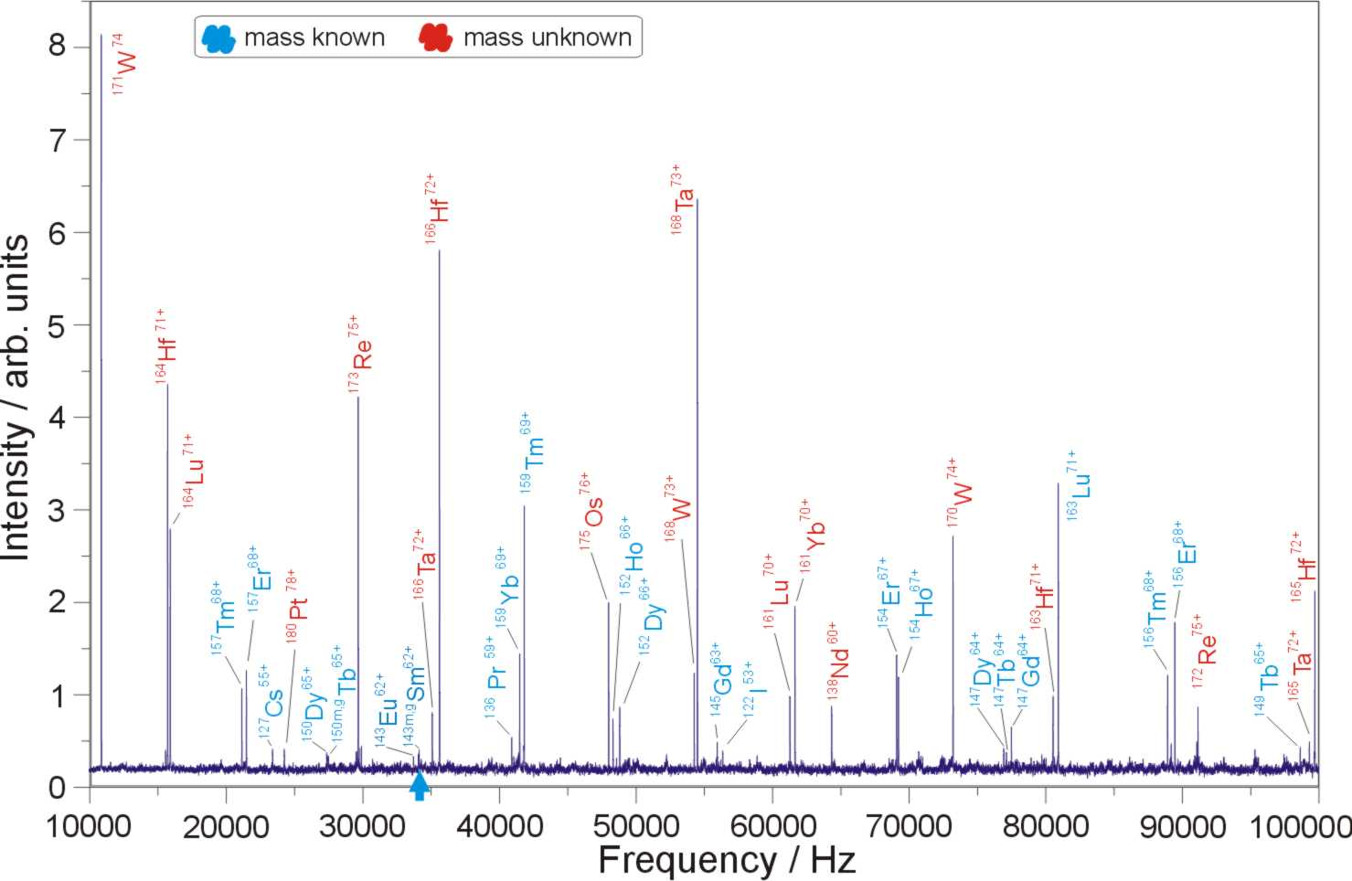
Notes:
Single particles, Errors are determined by systematics and not statistics

Slide 17
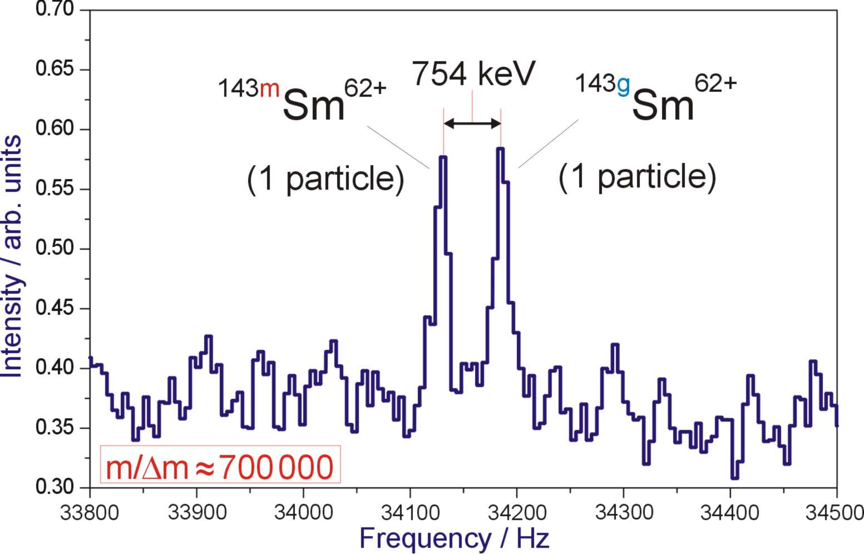
Notes:
Single particles, Errors are determined by systematics and not statistics

Slide 18
Decay properties

Slide 19
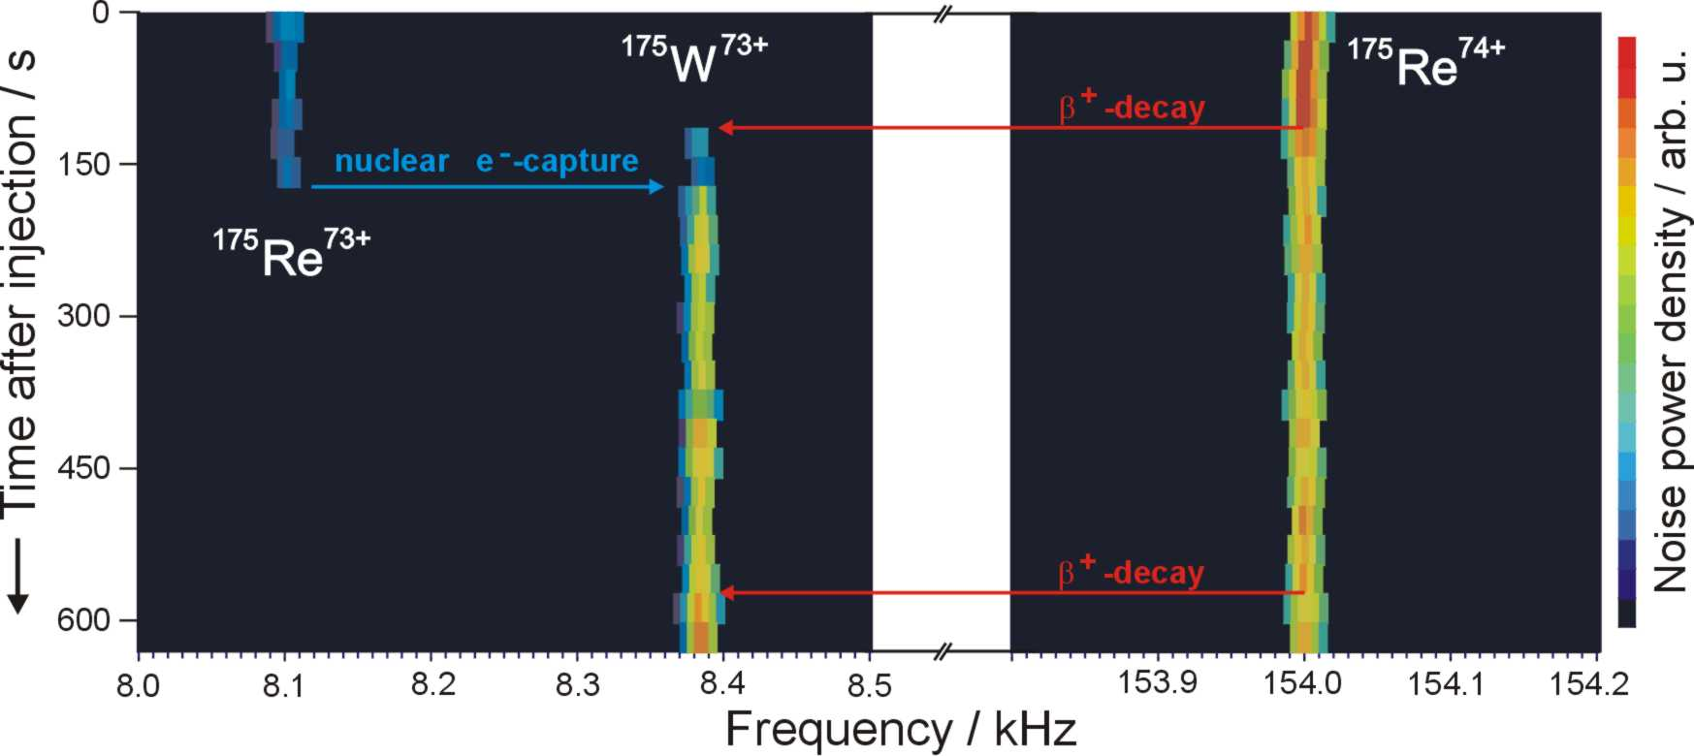
Shottky Decay Spectroscopy

Slide 20
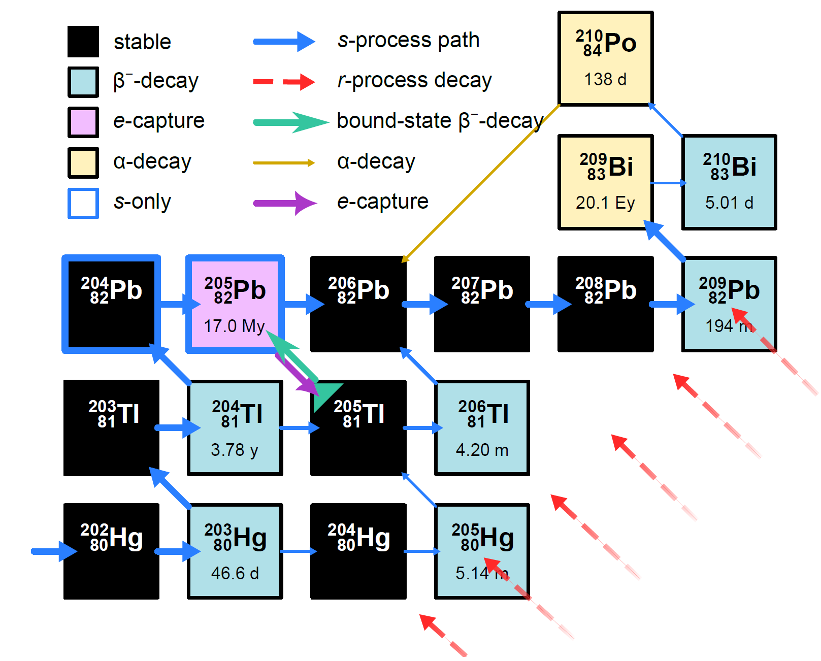
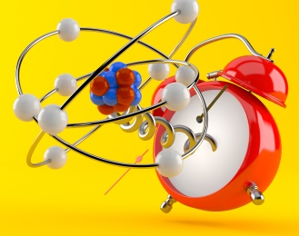
The case of ²⁰⁵Pb
The s process includes ²⁰⁵Pb with a half-life of ~17 My (relatively short-lived).
It is a nuclear clock for solar history estimation of the isolation time of solar system from its parent cloud.
It can be created, among others, via bound state beta- decay. What is that?

Slide 21
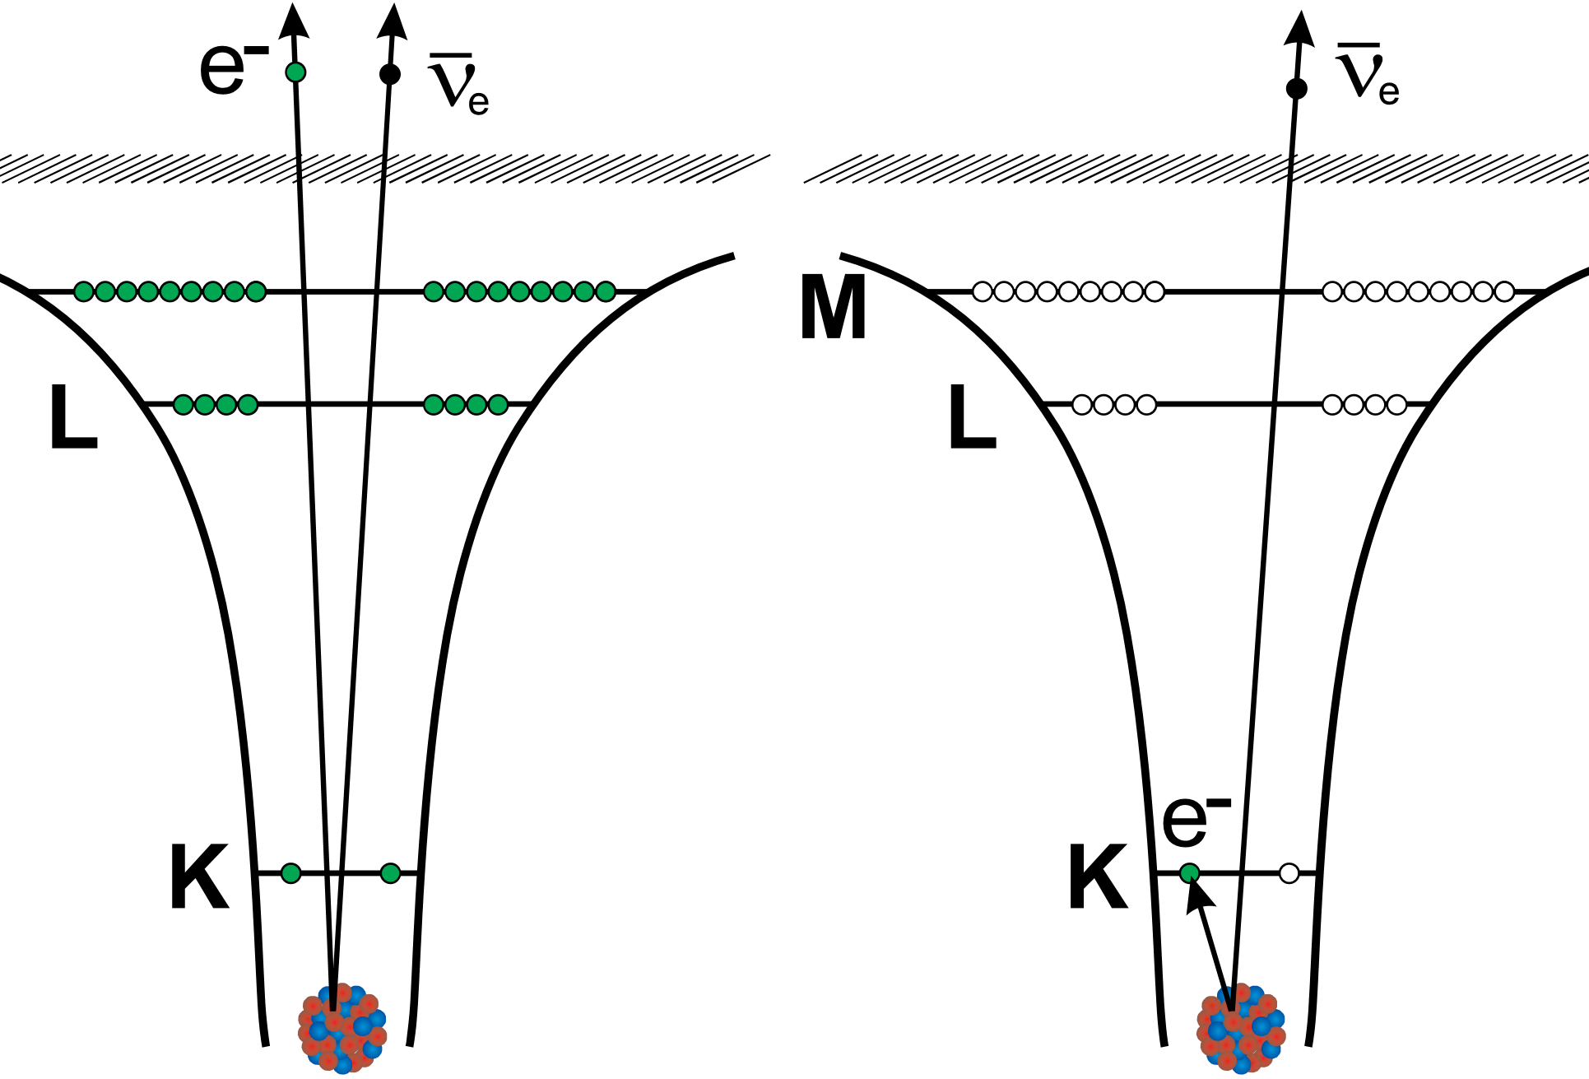

What is bound-state $β$ decay?
binding energy of K-electron is available!
continuum β⁻ decay
bound β decay
neutral atom:
electron emission
to continuum
fully ionized:
electron emission
to K-shell vacancy
highly-charged case
neutral case

Slide 22
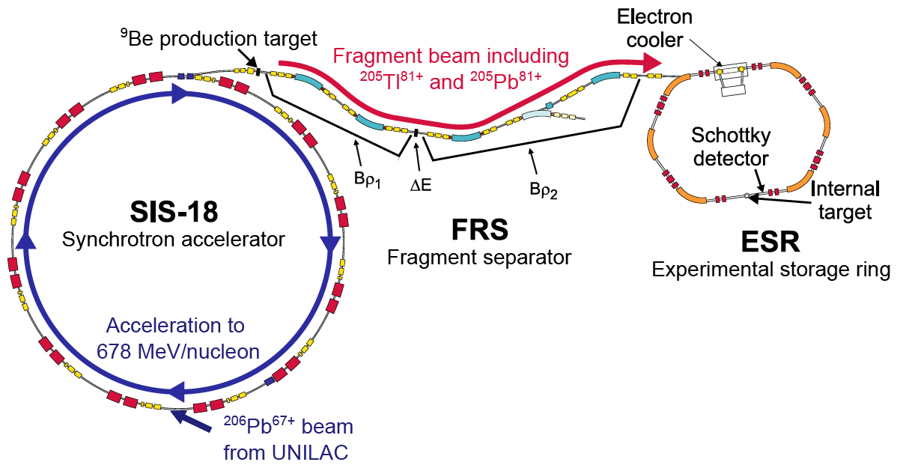
Bound-state beta-decay of ²⁰⁵Tl⁸¹⁺ at GSI
First proposal 1992: not possible
because of Tl toxicity
Only solution: create ²⁰⁵Tl⁸¹⁺ by projectile fragmentation

Slide 23
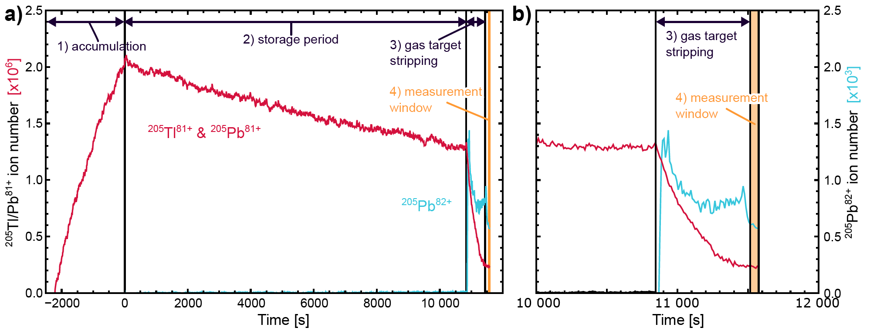
Produce ²⁰⁵Tl⁸¹⁺ ions, accumulate via stacking, and store for variable times
Wait for ²⁰⁵Tl⁸¹⁺ to decay to ²⁰⁵Pb⁸¹⁺
Even with Shottky we cannot tell them apart
Turn on gas target, stripping the ions
Tl⁸¹⁺ cannot be stripped, but Pb⁸¹⁺ can
Measure ²⁰⁵Pb⁸²⁺

Slide 24
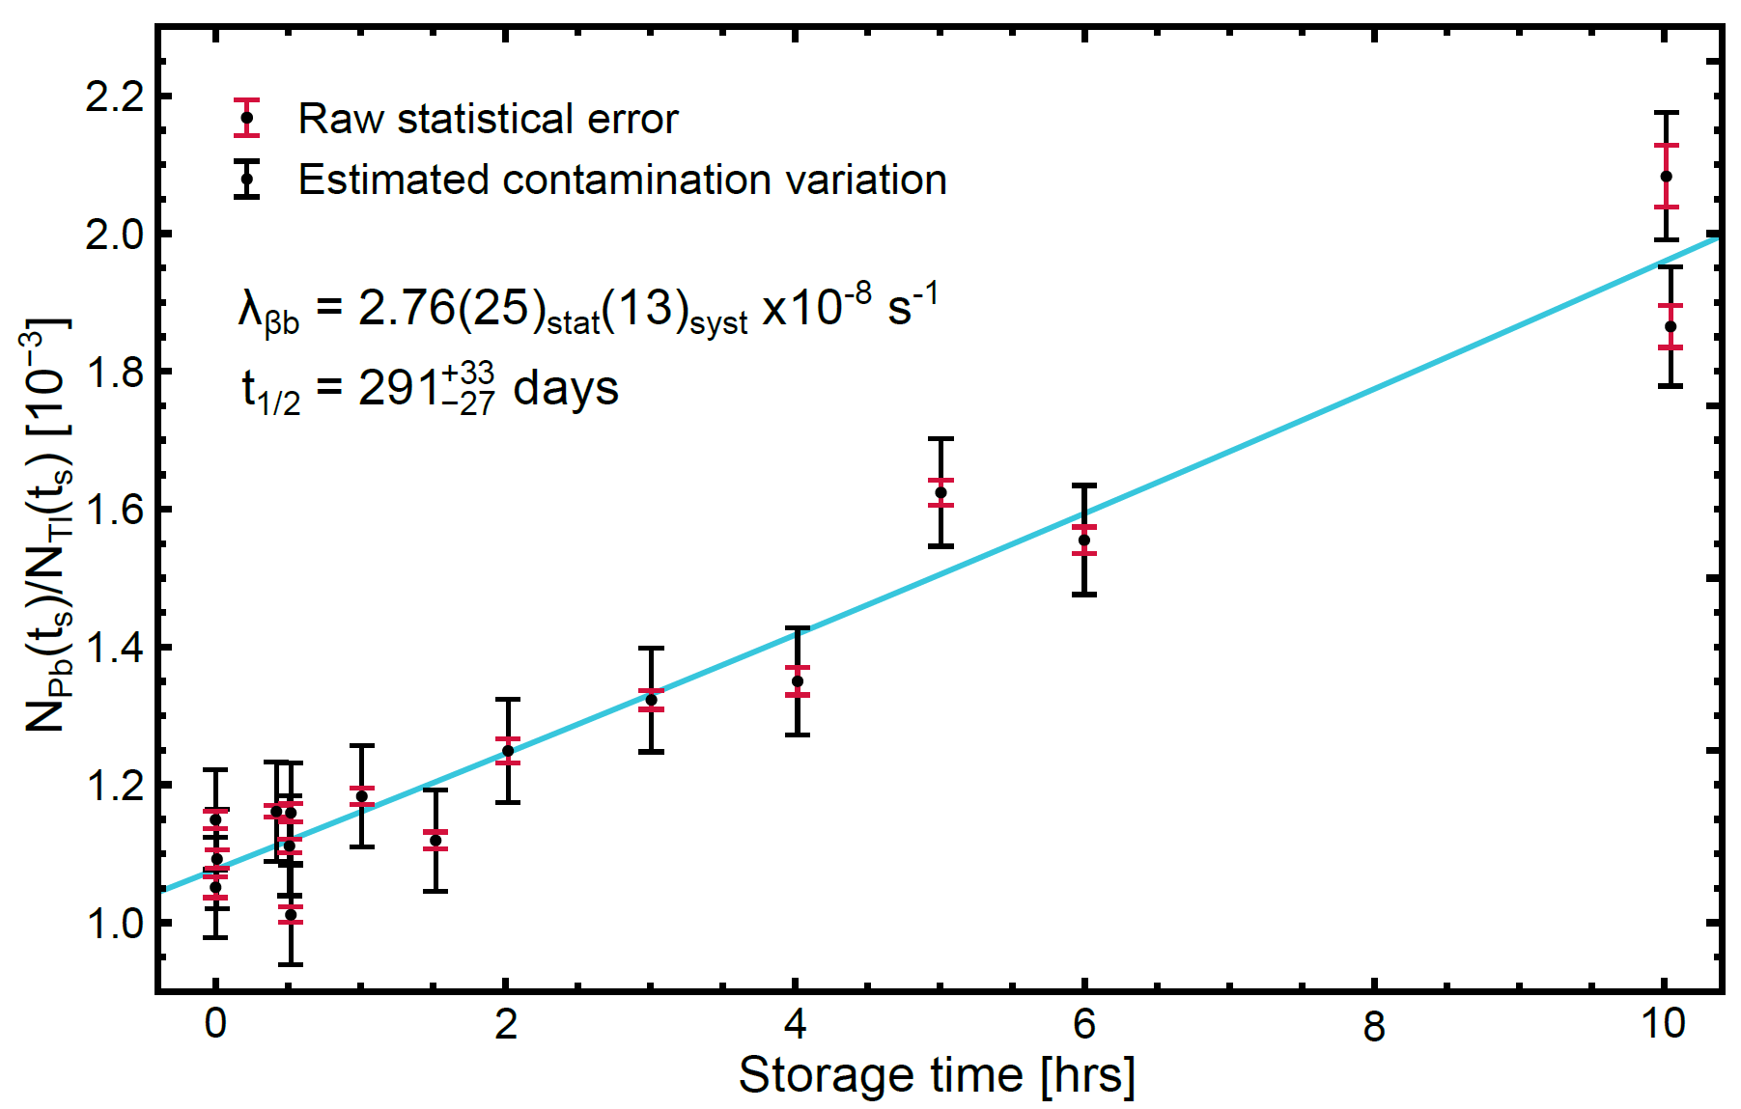
Linear fit gives half-life: larger than systematics

Slide 25
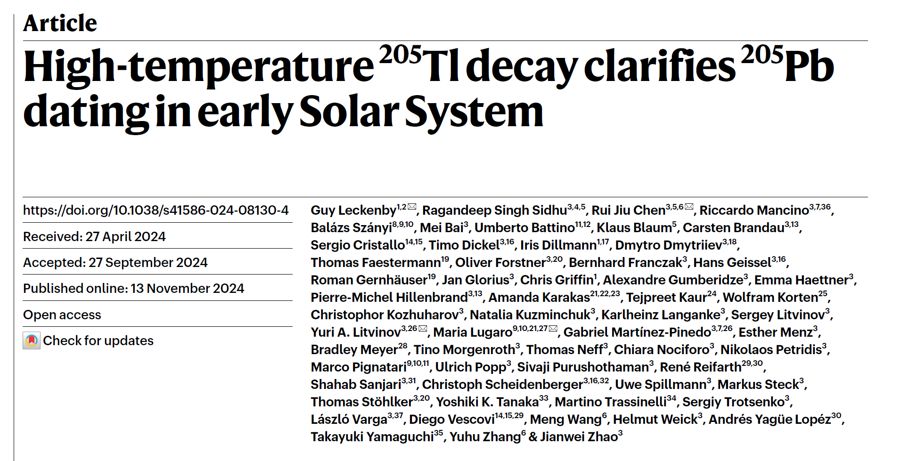

Slide 26
Nuclear Reactions

Slide 27
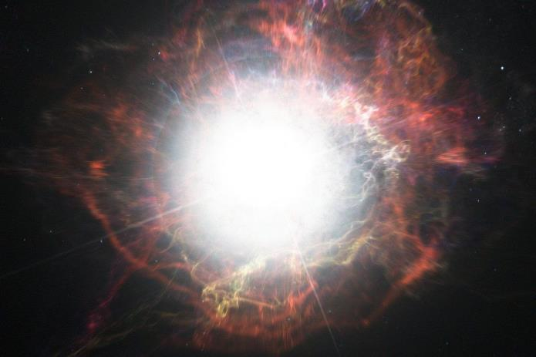
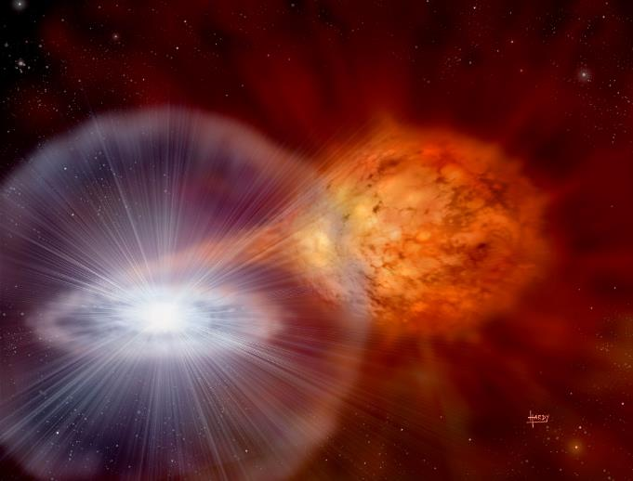
The Challenge
In stellar explosions – reactions involve radioactive isotopes
In a laboratory - challenges
How to produce the radioisotopes of interest?
Short lifetimes – cannot make radioactive target

Slide 28
Radioactive beams
Some typical values
Cross-section: ~10⁻⁶ barn
Experiment target thickness: 10¹⁸ atoms/cm²
Beam intensity: 10⁸ pps (ISOL), 10⁶ pps (In-flight)
Reaction
products
Ion beam
Detector(s)
Target
(solid or gas)
Yield = N_{projectiles} x N_{target} x Cross-section x Det. efficiency
= 10⁶⁻⁸ pps x 10¹⁸ cm⁻² x 10⁻³⁰ cm² x 100% (charged particles)
= 1-100 counts/week

Slide 29
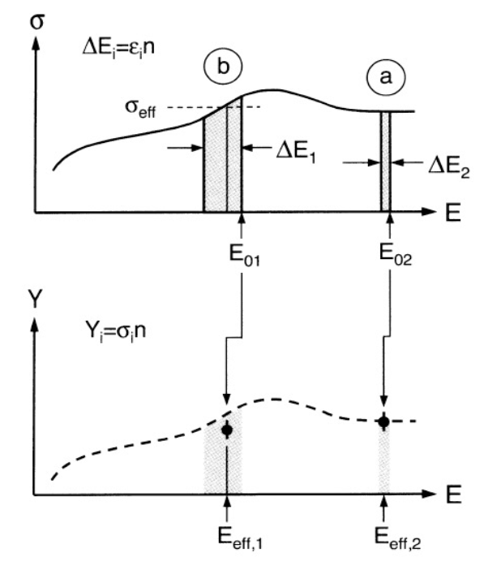
Why don’t we increase the target thickness?
Thicker target = more counts. You can almost always just make a target thicker. What is stopping us?
As the target gets thicker, reactions will occur over a wider range of energies.
Frequently, there is no way to tell which events we detect correspond to which energy.
Even if we can, we are getting events for different energies. For a given energy we are not seeing more events!

Slide 30
Rings vs. Single-pass experiments
Advantages
Recirculation increases intensity by a factor ~100,000
Recirculation improves beam isotopic purity
Cooling improves beam emittance and quality at every turn
Beam energy is kept constant
Disadvantages Challenges!
Need extremely good vacuum to keep the beam circulating
Limits to what detectors / materials can be used
The target must be available as a gas
Maximum useful thickness ~10¹³⁻¹⁴ atoms/cm², thinner than usual

Slide 31
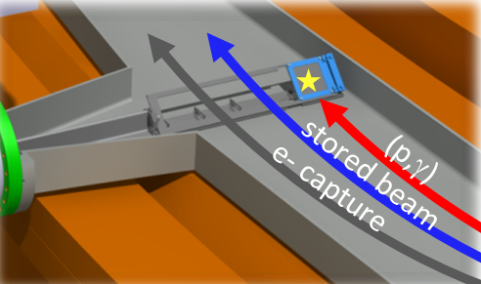
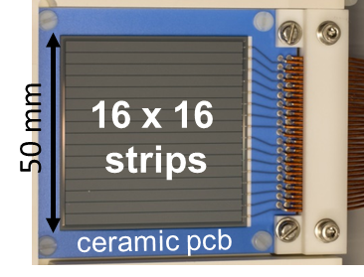
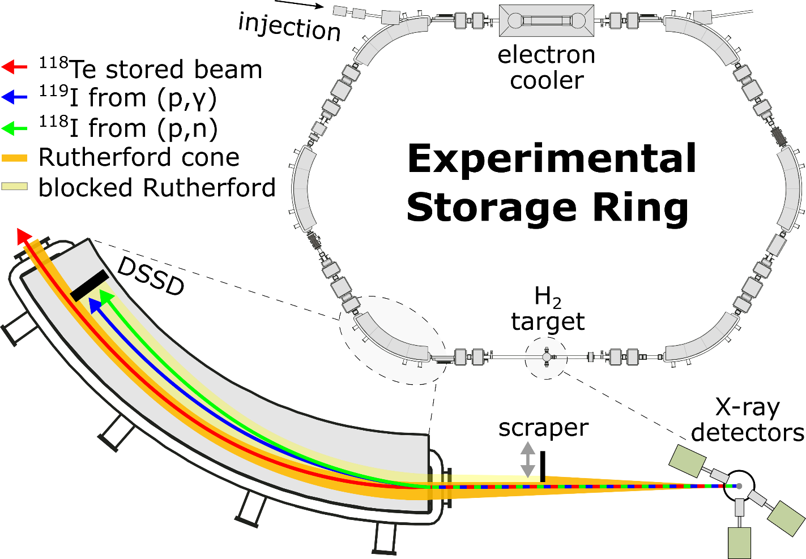
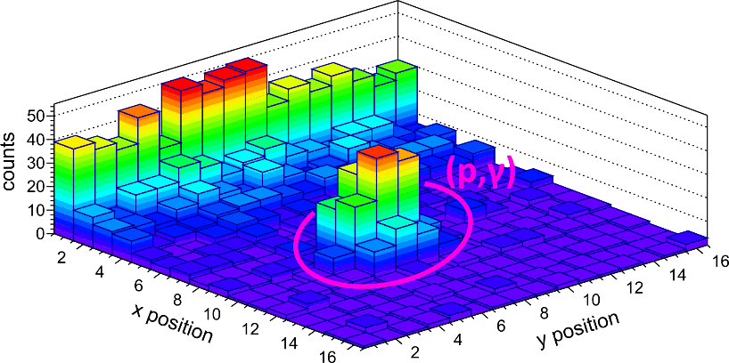
Nuclear reactions in the ESR
double-sided silicon
strip detector
for ultra-high
vacuum use
  High energy production of radioactive beams in FRS
  most efficient RIB technique available
  Deceleration to energies below 10 MeV/u
  access to the Gamow window for physics of stellar explosions
  Inverse-kinematics and large ring acceptance
  simple recoil detection scheme with 100% efficiency
detection
in the dipole
recoil separation
in the dipole field
DSSD hit map
for
¹¹⁸Te + p
7 MeV/u
(2021)

Slide 32
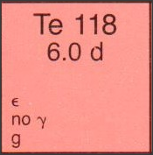
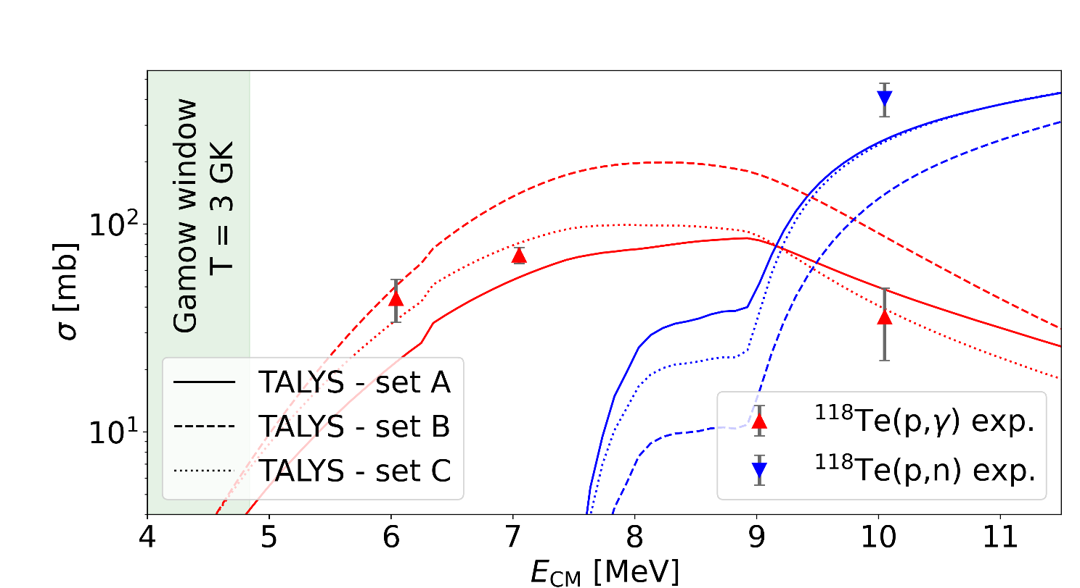
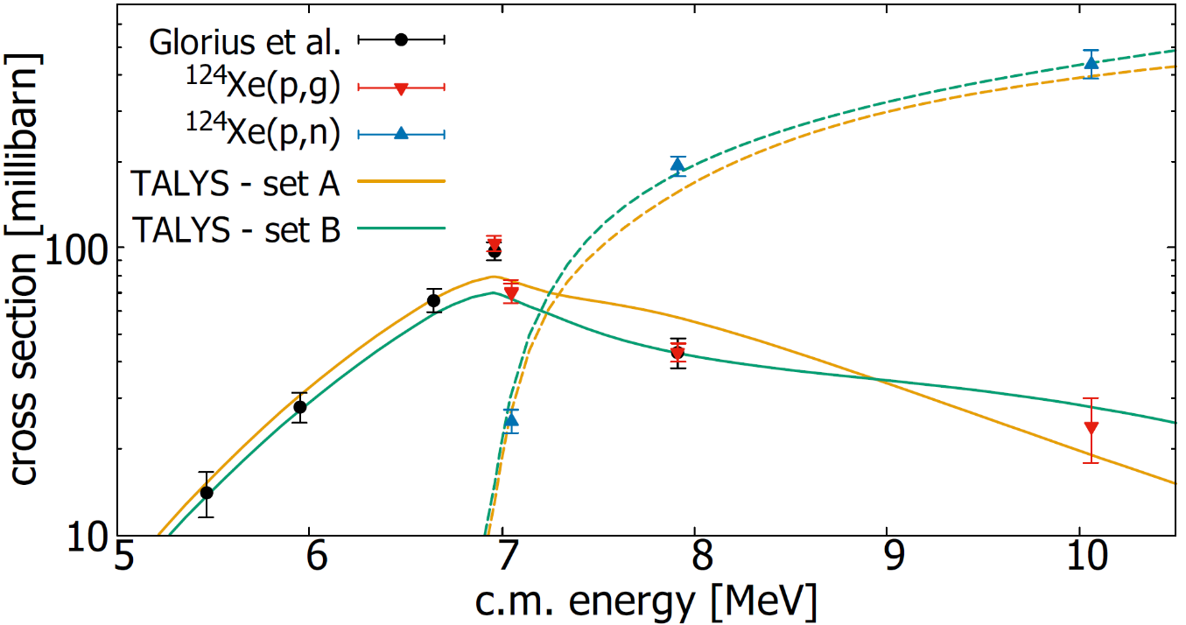
Some reaction studies at the ESR
¹²⁴Xe + p
Glorius et al. PRL 122 (2019) 092701
¹¹⁸Te + p
Varga et al. PRL (2025) in accepted
Dellmann et al. PRL accepted
A complete dataset for ¹²⁴Xe
(p,g) and (p,n) reaction channel measured
very strong constraints for theory
solid reaction rate for nucleosynthesis
1st measurement with radioactive ¹¹⁸Te beam
10⁶ ions of ¹¹⁸Te⁵⁴⁺ stored in ESR
world record:
heaviest RIB used for astrophysical reaction study

Slide 33
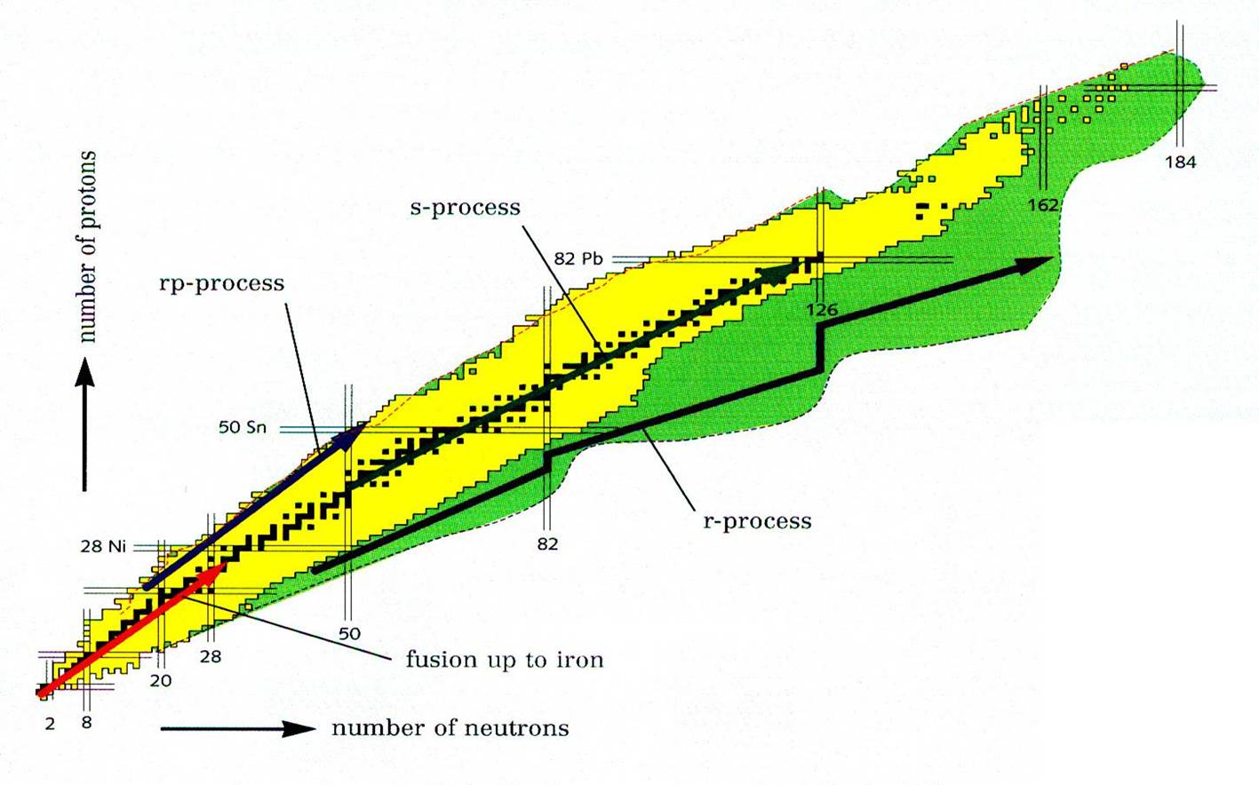
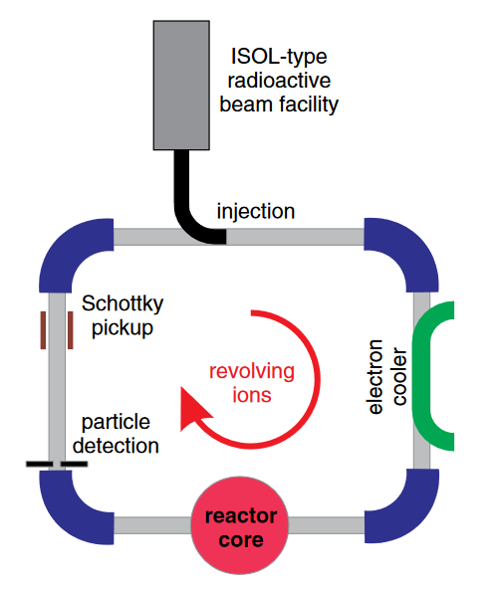


NECTAR - Nuclear rEaCTions At storage Rings
Neutron-induced reactions in inverse kinematics
  s process, r process
  and i process
the direct approach: build a neutron target
  combine storage ring and reactor
the indirect approach: the surrogate technique
  NECTAR project (ERC advanced grant)
  PI: B. Jurado, Bordeaux
Reifarth & Litvinov Phys. Rev. ST Accel. Beams 17, 014701 (2014)

Slide 34
CARME @ CRYRING

Slide 35
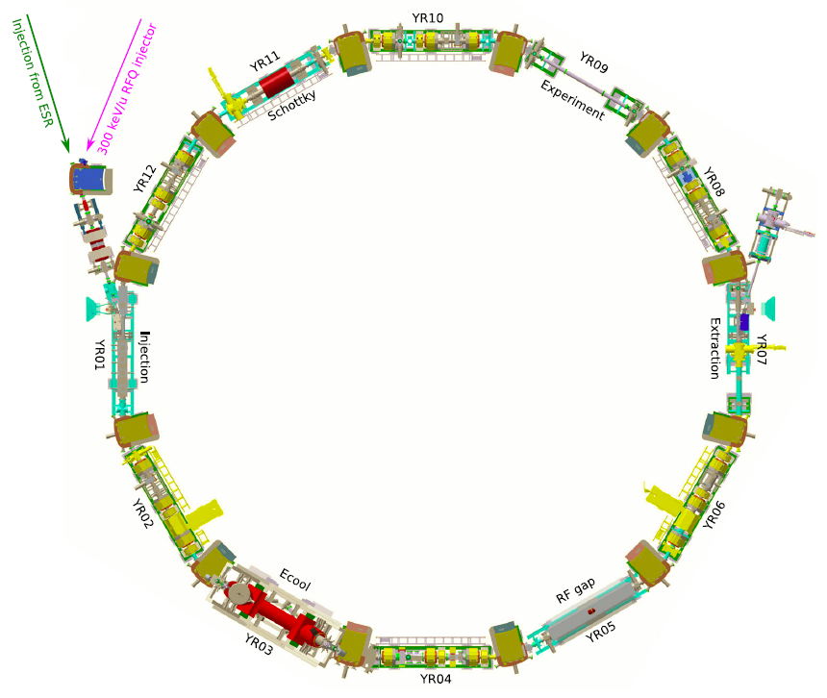
CRYRING @ FAIR/GSI
Beam injected via local ion source, or radioactive beam via the ESR
Exactly half the size of the ESR. It has one straight section for experiments with an internal cryogenic microdroplet target.
To exploit this novel possibility, we built a new detection array called CARME, mounted here
Radioactive beam from ESR
Stable beam from local source
Target
revolving ions
Can store ions at uniquely low energy E<10 MeV/u, ideal for nuclear astrophysics.
The ring operates in XHV (~ 2x10⁻¹¹ mbar)

Slide 36
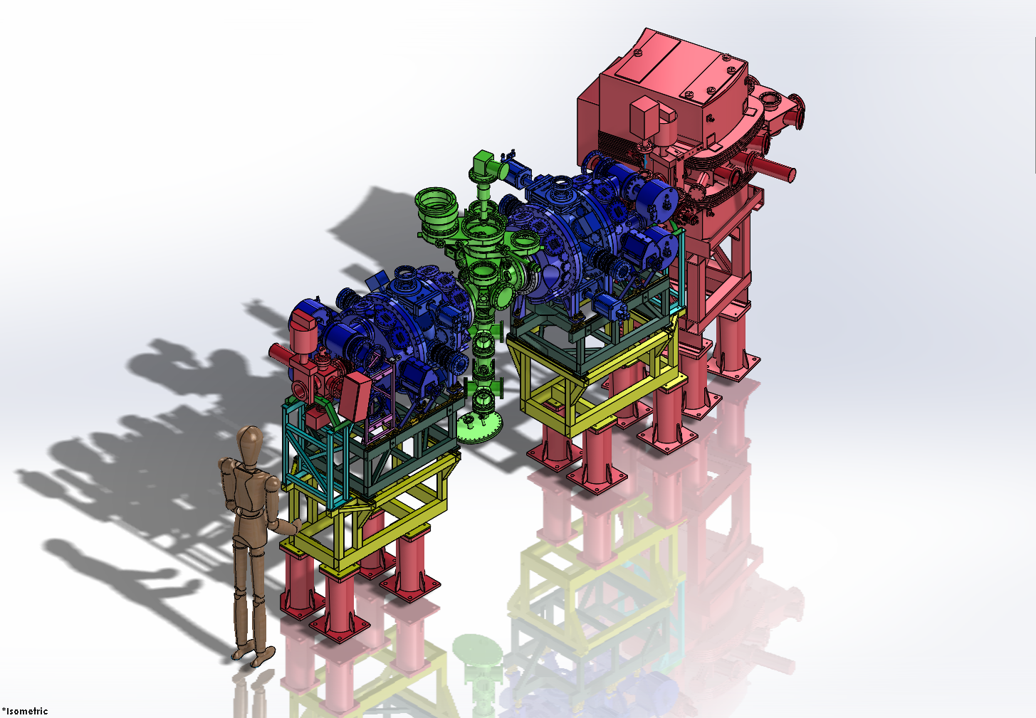

Slide 37
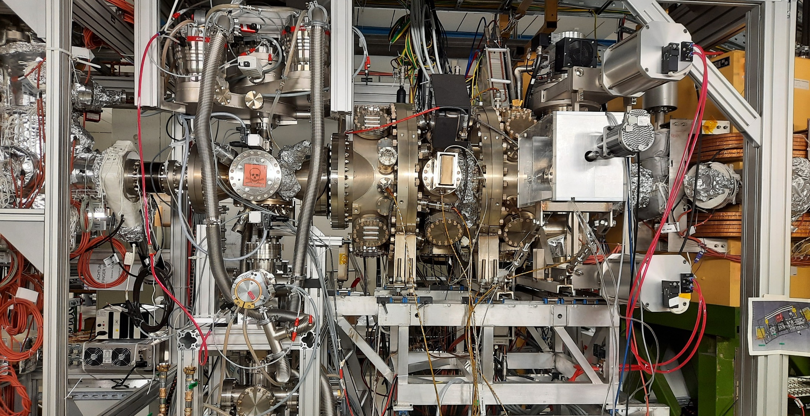
CARME
Cryring Array for Reaction MEasurements
Mounted downstream of the internal target
Internal target
Beam
Actuator arm

Slide 38
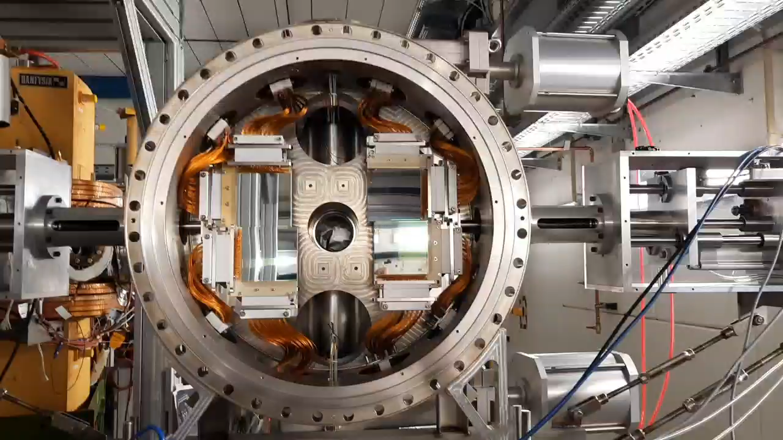
Placed directly under XHV (no pockets)
Can move under XHV – avoid uncooled beam

Slide 39
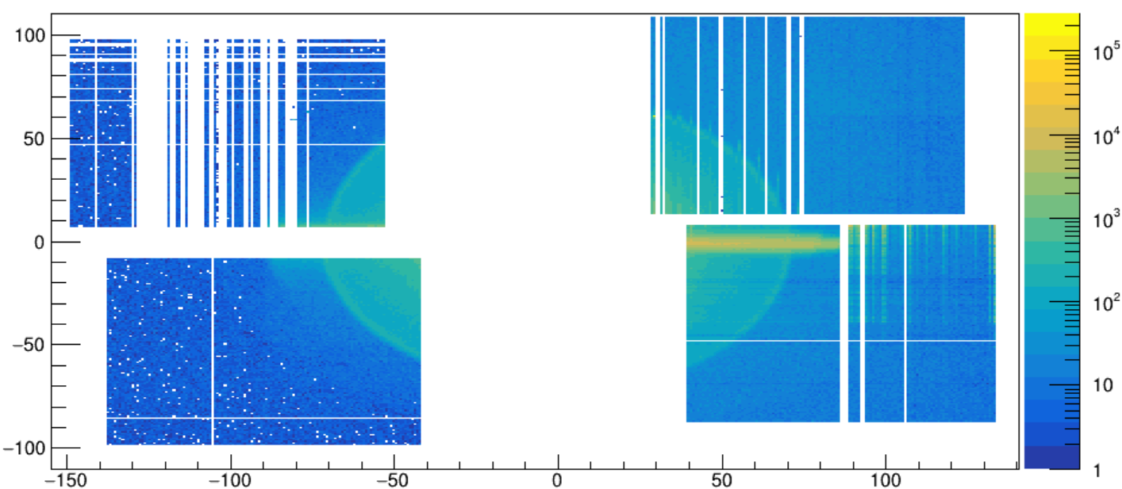
Y position (mm)
X position (mm)

Slide 40
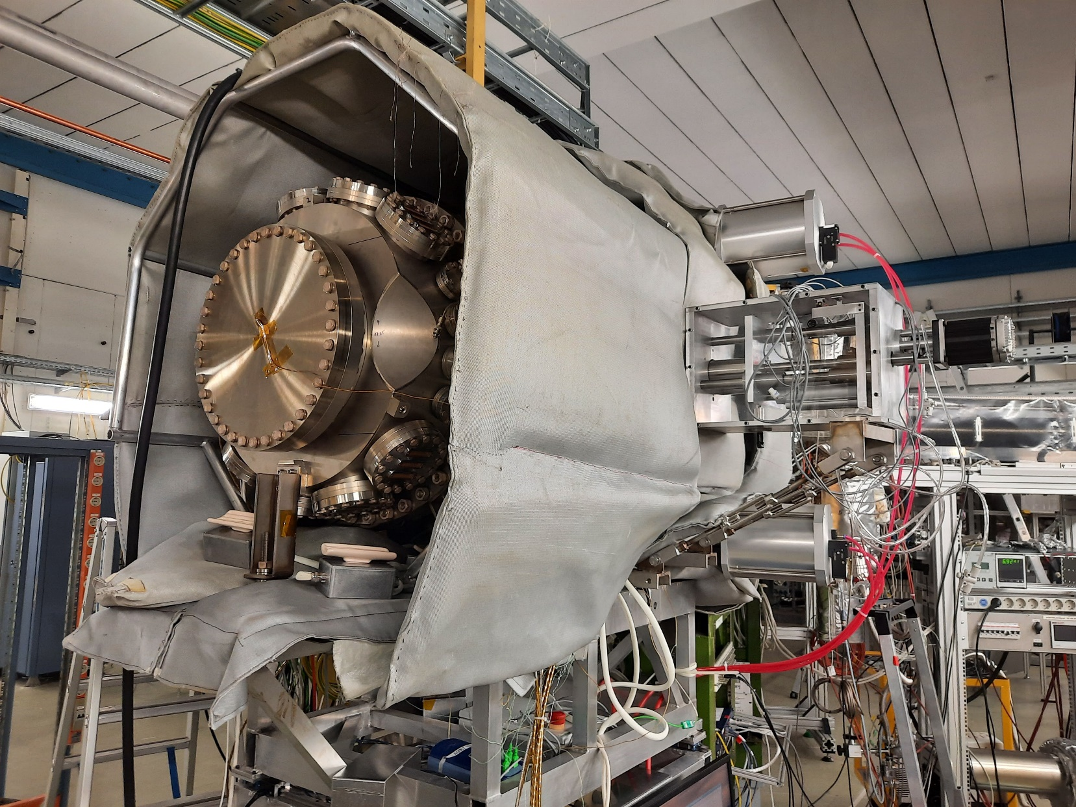
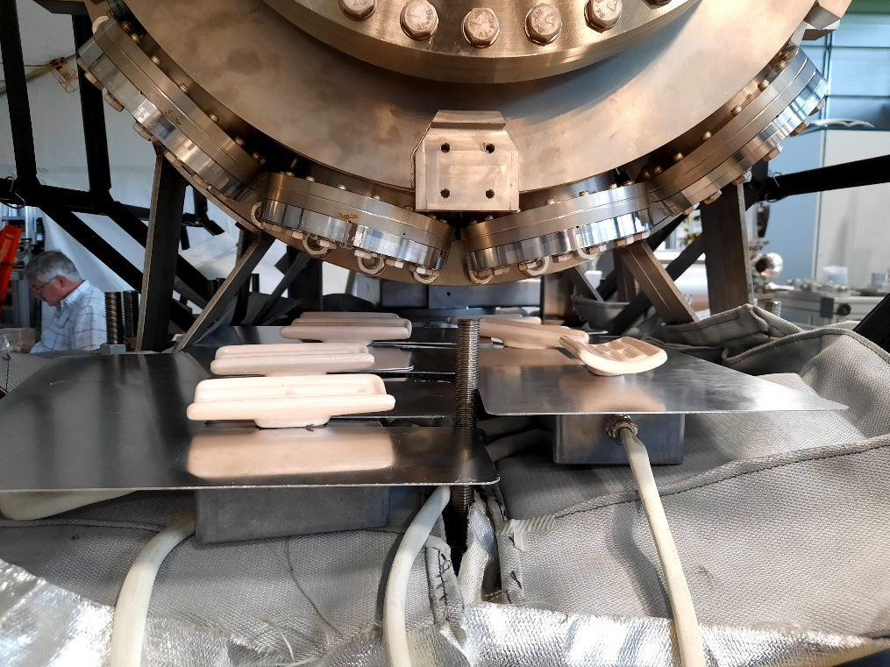
Reaching XHV

Slide 41
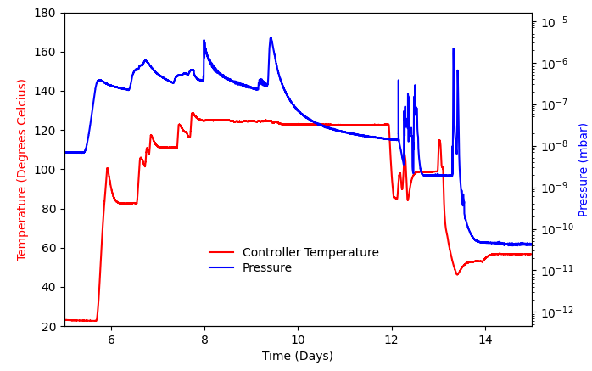
Reaching XHV
Pressure increases as temperature goes up
NEG activation
XHV achieved

Slide 42

ELDAR
burning questions on the origin of the Elements in the Lives and Deaths of stARs
CARME will be used for high resolution charge particle reaction studies for nuclear astrophysics including:
  1. Direct astrophysical reaction measurements e.g. (α,p)
  2. Indirect reactions probing key resonance properties e.g. (d,p)

Slide 43
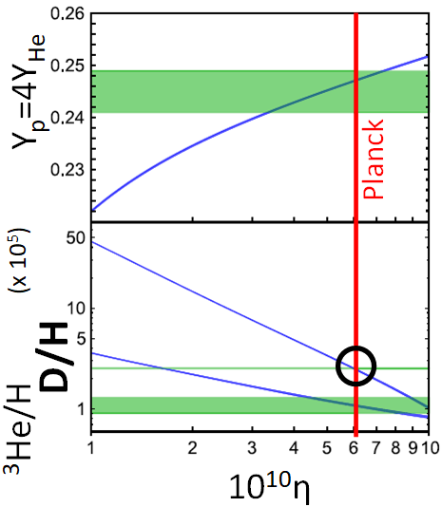
Big Bang Nucleosynthesis
Elements up to lithium were synthesised during the Big Bang
Compare astronomical observations in ancient stars vs. Standard Model predictions
Predictions have a single free parameter
Comparing results allows for test of the Standard Model
Deuterium has lowest uncertainty
Deuterium burning via ²H+²H is a key reaction for Big Bang prediction uncertainty

Slide 44
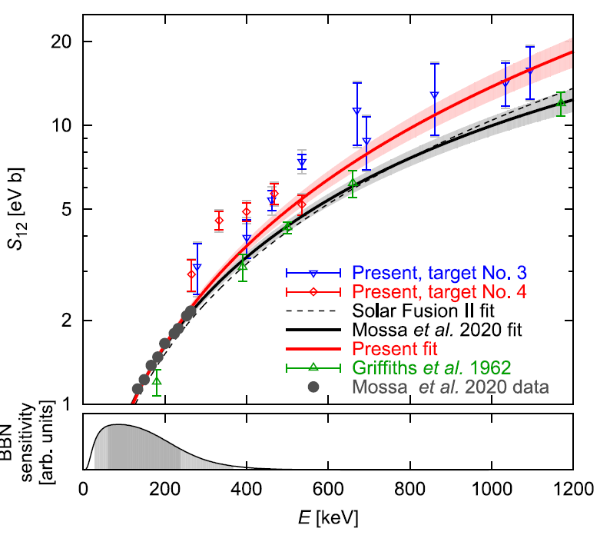
Some issues remain open: e.g. disagreement at high energies, angular distributions
Measure ²H(p,γ)³He directly at Big Bang energies at CRYRING using CARME
Turkat et al., PRC, 2021

Slide 45
How does it work?
Deuterium is stable, but unwelcome (produces D and T).
Injected into from local ion source. 10⁸ ions per injection, once in 10 seconds or so, filling the ring.
Beam is accelerated / decelerated as required, and cooled
Deuterium target turned on (10¹³ atoms/cm2)
CARME detectors move in
Measure – beam is lost due to interaction with target
After a few seconds-minutes (depends on energy!) not much beam left.
Dump the beam.
Refill, restart.

Slide 46
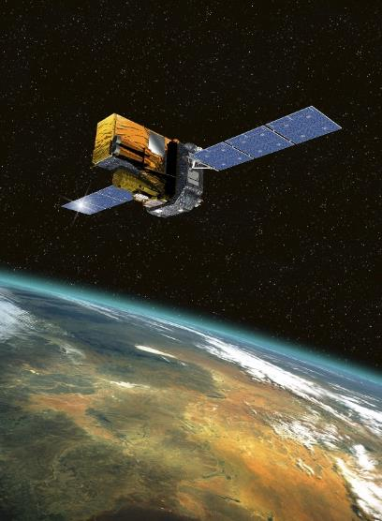



Nova explosions
Space gamma telescope
Gamma ray
Gamma astronomy
Optical
Nova pre-solar grains
Notes:
Observables from nova explosions
… if you would like to know more, please ask

Slide 47

Experimental procedure
Some radioactive beams (e.g. ³⁰P) are very difficult to obtain using conventional techniques, but can be obtained with good intensities at CRYRING. Others (e.g. ¹⁸F) can be obtained, but the intensity is not sufficient for our purposes.
Primary stable beam (~500 MeV/u) -> to FRS
Secondary beam from FRS -> to ESR
Cool down & stack beam in ESR -> to CRYRING
Measure in CRYRING & stack beam in ESR

Slide 48

Electron screening
-
Target
-
+
+
-
-
Projectile
(beam ion)
-
Electron cloud
In the laboratory, target electrons shield nuclear potential
Orders of magnitude effect!
No reliable models. Very long standing issue.
Screening is different in the laboratory vs. a star
Unknown uncertainty affecting all quiescent scenarios including our Sun
Notes:
48

Slide 49

First ever bare nuclear reaction studies
Revolving ions
CRYRING
CARME
FISIC ion source
Transverse ion beam
FISIC: U. Sorbonne major atomic physics project at CRYRING
FISIC+CARME could perform the first bare cross-section measurements at stellar energies
Some delays, but should be mounted ~next year

Slide 50
Conclusions
Heavy ion storage rings are complex but incredibly useful devices to carry out nuclear physics and nuclear astrophysics measurements
Great for mass measurements and decay measurements
Very effective way to use radioactive ions for nuclear reaction measurements
Unique challenges (target, vacuum) but also unique advantages (recirculation, beam purity)
Relatively new field, lots of advances and progress has been made in the last few years
Many unique measurements possible

Slide 51
Thank you for your attention!

Slide 52

ISOL (Isotope Separation On-Line)
Light beam on thick target (e.g. protons on SiC)
Radioisotopes produced by nuclear reactions
Isotopes diffuse out of target (hot chemistry)
Separate, reaccelerate at energies of interest
Good isotopic purity
Good energy resolution
Good intensity
Available radioisotopes limited by chemistry

Slide 53

In-flight fragmentation
Smash heavy beam on light, thin target (e.g. Pb on Be)
Produce a cocktail of radioisotopes
Select those of interest and direct on experiment target
No re-acceleration! Produced at E >> MeV
Poor isotopic purity
Poor energy resolution
Poor intensity vs. ISOL
No limitations on isotope production

