Slide 1
GenAI / Transformers Workshop
Overview, Internals and Insights
Caus Danu

Slide 2
Background
This resource is intended to introduce neural networks, generative AI at a high abstract level and subsequently focus on explaining Transformers in more depth to a scientific audience.
Transformers will be presented in the broader context of AI, building the stage from zero, step by step.
I will act therefore as a synthesizer of many resources created by the broader AI community.
Hence, many thanks! to all the creators of the helper material. All credits and references are visible on the last slide.
Same references are also given in the footnotes section of each individual slide, which is not visible in presentation mode, but will be useful for referencing at home for extra study if need be.
Slide content
(visible in presentation mode)
Footnote URL / reference
(not visible during presentation)

Slide 3
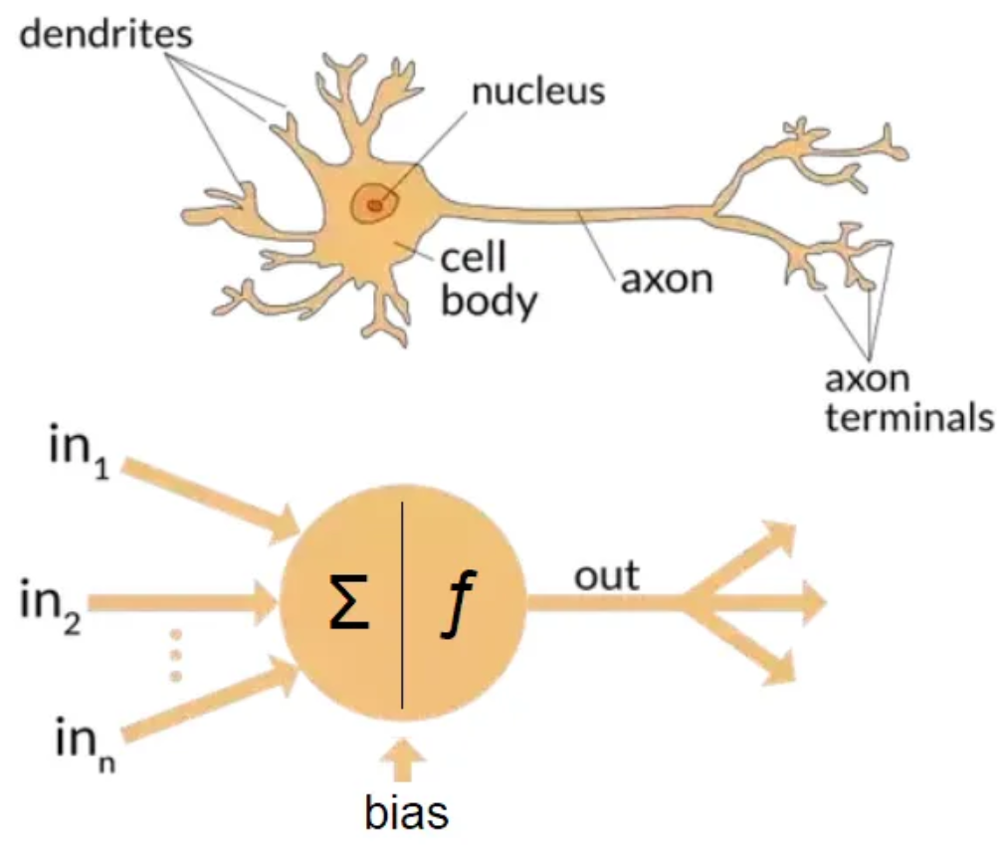
Artificial Neural Nets and Brain Parallels
Notes:
https://towardsdatascience.com/the-differences-between-artificial-and-biological-neural-networks-a8b46db828b7

Slide 4
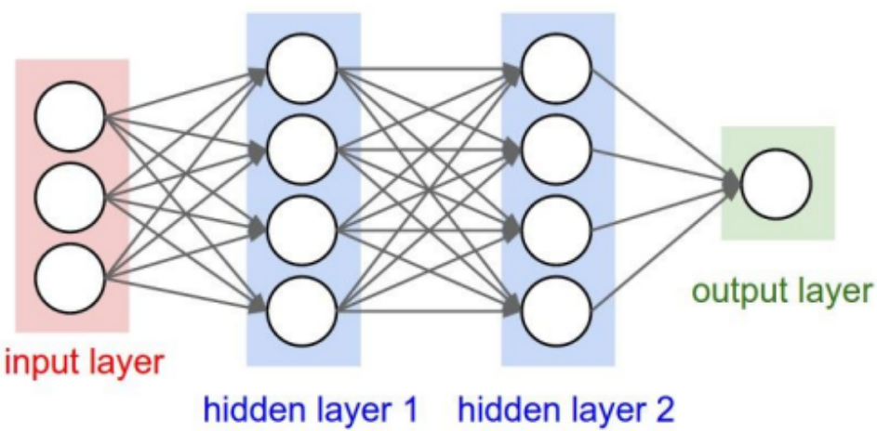
Artificial Neural Networks (ANNs)
CS231n course from Stanford University
Notes:
http://cs231n.stanford.edu/slides/2019/cs231n_2019_lecture04.pdf

Slide 5
Backpropagation
Feed-forward / Inference
Training using Backpropagation
CS231n course from Stanford University
Notes:
http://cs231n.stanford.edu/slides/2019/cs231n_2019_lecture04.pdf

Slide 6
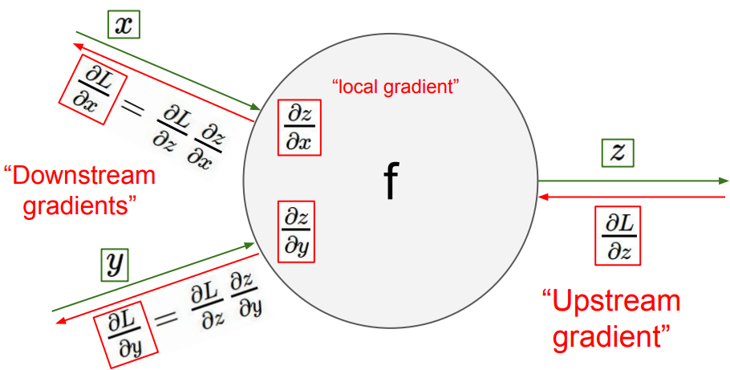
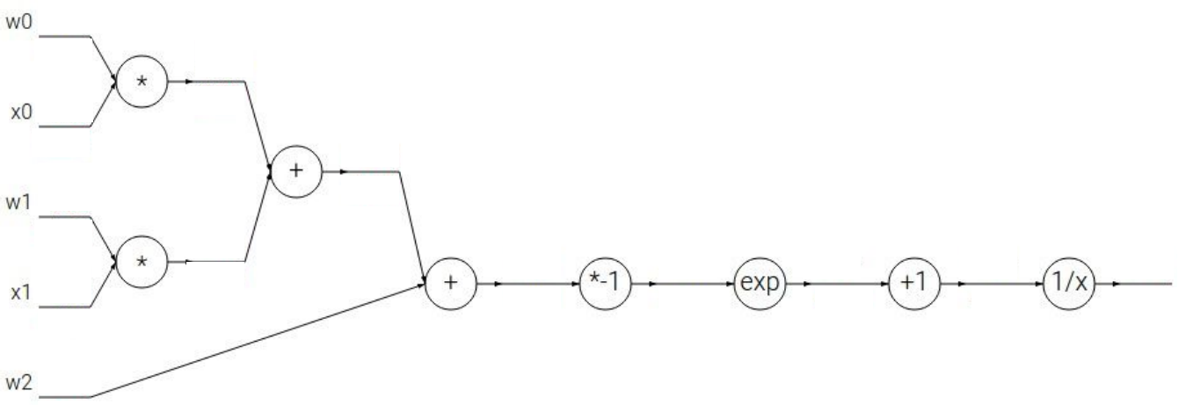
Backpropagation using Local Gradients and Chain Rule
The Chain Rule is implemented with the help of local gradients.
We recursively multiply the local derivatives.
Backpropagation is a recursive application of the chain rule backwards through the computation graph.
CS231n course from Stanford University
Notes:
http://cs231n.stanford.edu/slides/2019/cs231n_2019_lecture04.pdf

Slide 7
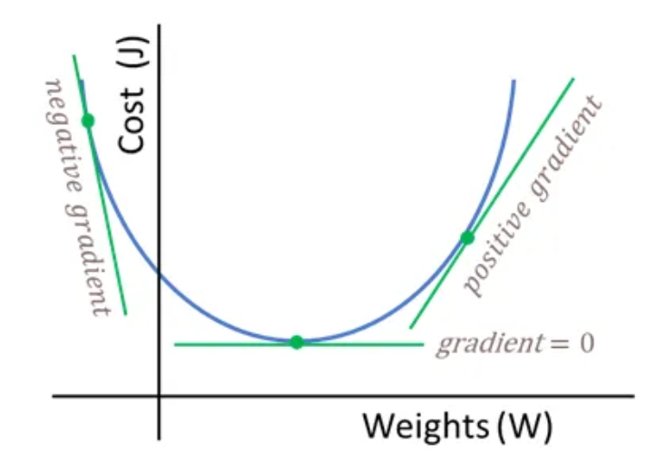
Cost function
Literature naming conventions: Cost / Loss / Error function
Notes:
https://towardsdatascience.com/neural-networks-backpropagation-by-dr-lihi-gur-arie-27be67d8fdce

Slide 8
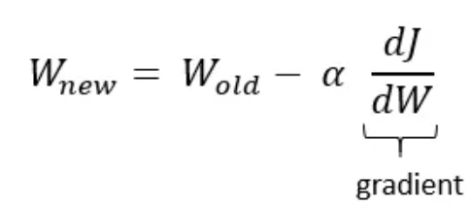
Weights update
J and L are usual notations for the Loss / Error / Cost function, i.e. the difference between what the model predicts and what it should predict according to the ground truth.
The weights are updated in the direction of the negative gradient, so that the cost function is minimized as much as possible.
Notes:
https://towardsdatascience.com/neural-networks-backpropagation-by-dr-lihi-gur-arie-27be67d8fdce

Slide 9
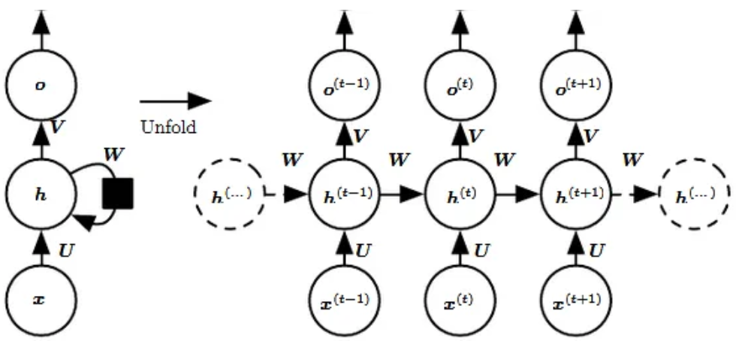
Sequential nature of Recurrent Neural Networks (RNNs)
By unfolding the feedback loop in time, we become aware of the complexity of these networks. It is as if we train a very deep network and that is why they are harder to train.
With RNNs things are done sequentially => deep graph structure.
With Transformers things happen in parallel => broad graph structure.
Transformers might simply be easier to train stably, and maybe that is why they have better results.
Notes:
https://towardsdatascience.com/recurrent-neural-networks-rnns-3f06d7653a85

Slide 10
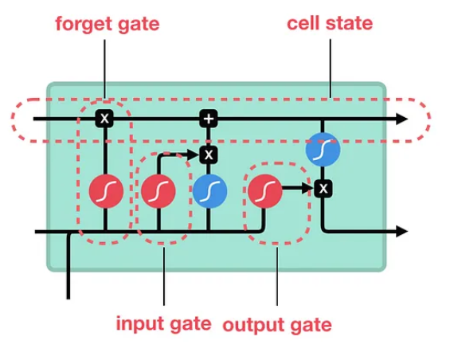
Long short-term memory (LSTMs)
Contains special gates that address the problem of vanishing gradients.
Addresses the problem of exploding gradients.
Notes:
https://medium.com/towards-data-science/illustrated-guide-to-lstms-and-gru-s-a-step-by-step-explanation-44e9eb85bf21

Slide 11
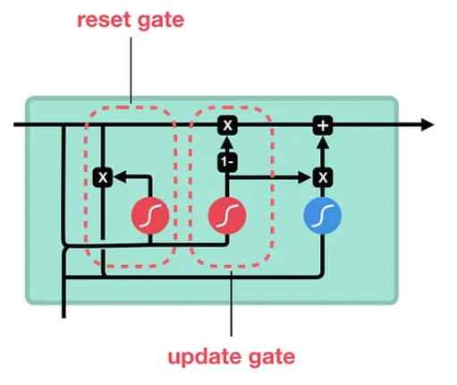
Gated Recurrent Units (GRUs)
Generally considered faster than LSTMs.
In practice => similar outcomes to what LSTM provides.
Notes:
https://medium.com/towards-data-science/illustrated-guide-to-lstms-and-gru-s-a-step-by-step-explanation-44e9eb85bf21

Slide 12
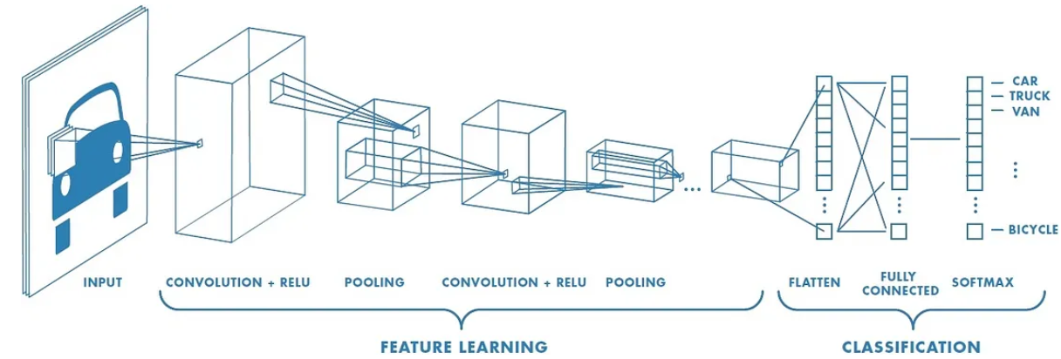
Convolutional Neural Networks (CNNs)
Generally applied in computer vision tasks, i.e. 2D image focused, not time sequence data.
We can use 3D CNNs to handle sequences of data, where 3rd dimension is time. Here we talk about a cube kernel, instead of a plane 2D kernel.
CNNs are very amenable to parallelism.
Notes:
https://medium.com/@RaghavPrabhu/understanding-of-convolutional-neural-network-cnn-deep-learning-99760835f148

Slide 13
Modeling Spectrum in the current AI Era
Discriminative models
[older established approach]
Generative models
[newer trend]
Best of both worlds predictions => Inductive bias + Data
Use a lot of training data / throw a lot of data at the problem task and let the network figure it out
Predictions are limited to the training data domain, i.e. tied to the train dataset statistics, hence poor out of distribution predictions
Is capable of out of domain generalization
Lots of inductive bias, a priori knowledge is injected / enforced as a guide during training
More creative than discriminative models

Slide 14
Main Generative AI models
Generative Adversarial Networks / GANs -> Adversarial training / Arms race
Variational Autoencoders / VAEs -> Autoencoder, but with latent space
Flow-based models -> Invertible mapping between distributions
Diffusion models -> Markov chain for denoising intermediate states
Transformers -> we will focus on them in this workshop

Slide 15
Generative Adversarial Networks / GANs
Two networks: Generator and Discriminator play a min-max game
Generator aims at producing realistic outputs to trick the Discriminator
Discriminator strives to improve its ability to discern true from fake data
Notes:
https://lilianweng.github.io/posts/2018-10-13-flow-models/

Slide 16
Variational Autoencoders / VAEs
Note -> Re-parametrization trick
Inspired from traditional autoencoders that compress data into vector codes
Variational autoencoders will learn a latent distribution function instead
The latent distribution can be sampled, resulting in variable latent samples
The samples are decoded, resulting in a variety of realistic reconstructions
Notes:
https://ducspe.github.io/masterthesis_danucaus/ -> page 18

Slide 17
Flow-based models
Use invertible neural networks to learn the data distribution
Enable exact log-likelihood directly thanks to one-to-one invertibility
More computationally expensive than VAEs, due to invertibility requirements
Notes:
https://lilianweng.github.io/posts/2018-10-13-flow-models/

Slide 18
Diffusion models
P / forward distribution
Q / backward distribution
Markov chain of states, where each state is a noisy version of the other
The original input X₀ is diffused into pure noise Z over several steps
The model learns the noise that needs to be removed from a state at time t, to get to an earlier state
Notes:
https://lilianweng.github.io/posts/2021-07-11-diffusion-models/

Slide 19
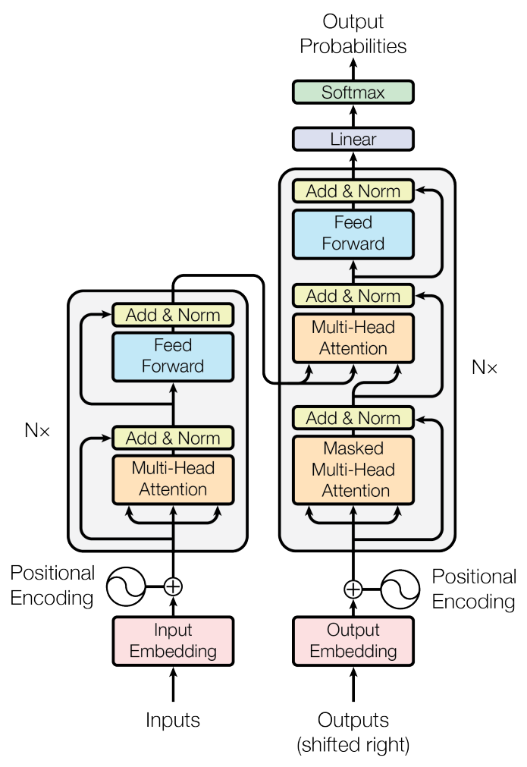
Transformers
“Attention is all you need” paper from 2017 by Vaswani et al.
Notes:
Figure 1 taken from the paper “Attention is all you need” by Vaswani et al. -> https://arxiv.org/pdf/1706.03762.pdf

Slide 20
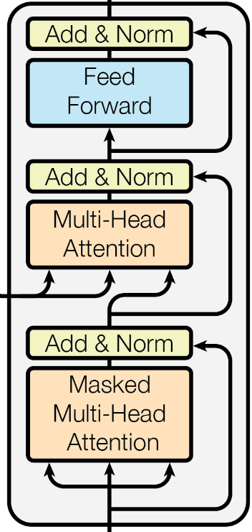
Transformer Block
2. Secondly, a Multilayer Perceptron (MLP) crunches the data that was communicated amongst tokens in the previous self-attention phase.
First the tokens communicate between themselves / they attend to each other (self-attention).

Slide 21
Self-Attention
. . .
Token 1
Token 2
Token 3
Token N
All tokens communicate with one another.
This is computationally expensive because each token has to look at every other token to compute an attention score / attention weight.

Slide 22
Key, Query and Value Embeddings
Key -> “What do I contain”.
Token
Value ->
“If you find me interesting, this is what I will communicate to you”.
Query ->
“What am I looking for”.

Slide 23
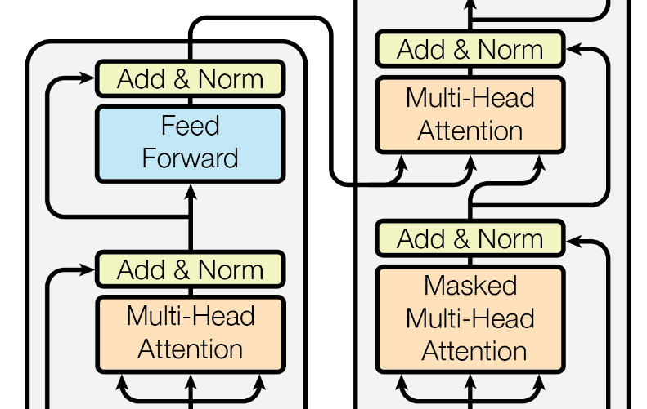
Self-Attention vs Cross-Attention
Cross-Attention -> the queries come from the decoder, whereas the keys and values are from the encoder side.
Self-attention -> the key, query and value vectors are related to the same entity, either the encoder, or the decoder.

Slide 24
Mathematically Expressing Self-Attention
The dot product Query ・ Key is the attention score, where Query and Key are embedding vectors.
Dot product measures similarity between vectors => Attention can be interpreted as the alignment between the Key and the Query vectors (i.e. two tokens find each other interesting).
Instead of the dot product, other measures can be used, like the cosine similarity for example (Swin Transformer Version 2 paper).

Slide 25
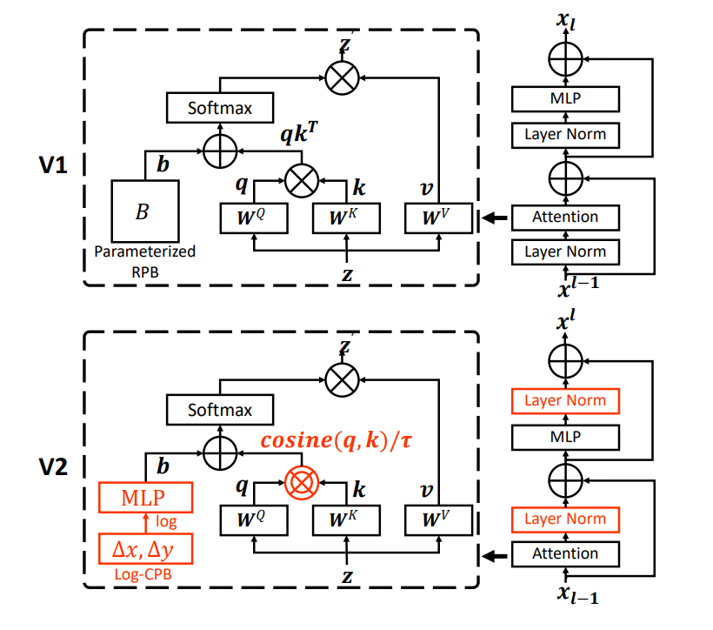
Cosine similarity
Notice the pre-Layer Norm
vs
post-Layer Norm
switch.
“Swin Transformer V2: Scaling Up Capacity and Resolution” by Liu et al.
Notes:
Figure 1 from “Swin Transformer V2: Scaling Up Capacity and Resolution” paper by Liu et al. -> https://arxiv.org/abs/2111.09883

Slide 26
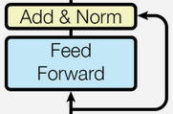
Computation Phase / Feed-Forward MLP
After the communication between tokens is finished, an MLP has to “think” on what was “said” during the self-attention phase.
This basically means that new features are computed / derived as a result of the communication.
Let’s fast forward back to what we’ve already seen

Slide 27
Positional encoding
The transformer treats the tokens as a Bag of Words (BoW).
We need to give each token a label that specifies its position in the form of a counter ID for instance.
It is interesting that the positional encoding information is literally added by a “+”/ plus operation.
There are various encoding schemes such as for example absolute encoding, relative encoding, that have a significant impact on how the transformer performs in the end. Check out the Swin Transformer paper for empirical proof.

Slide 28
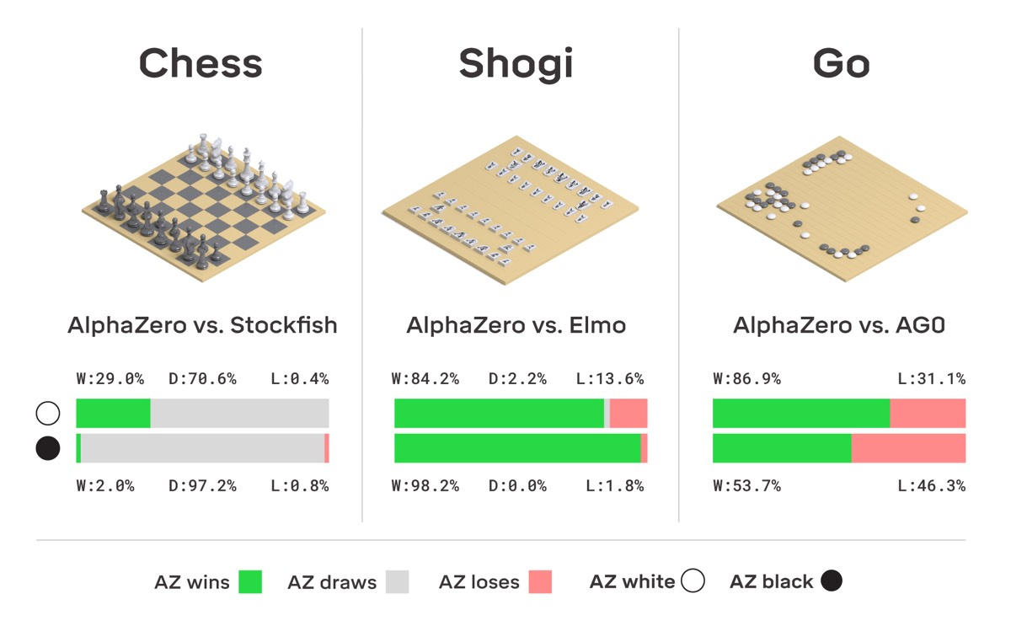
ChatGPT Pipeline
Pretraining the base model.
Supervised Fine-Tuning (SFT).
Reward Modeling / RM.
Reinforcement Learning / RL (Very much research territory at the moment).
Personal opinion: ChatGPT works so well, because it borrowed many insights from the AlphaZero games playing engine from back in 2016. Words are the new chess pieces that have to be smartly arranged.
DeepMind subsequently created AlphaStar and AlphaFold using similar principles.
Notes:
https://arstechnica.com/science/2018/12/move-over-alphago-alphazero-taught-itself-to-play-three-different-games/

Slide 29
Pretraining the Foundational Model
Use raw data to train a Base Model.
The dataset is huge => potentially low quality in some places, but very large quantity.
We obtain a document completer in the end.
Thousands of GPUs work in parallel (ex: 1000-2000 A100 GPUs).

Slide 30
Supervised Fine Tuning (SFT stage)
Low quantity, but very high quality data: ~ 100K (prompt, response) tuples.
Domain Specialists / Contractors have to scrutinize the dataset so that close to ideal (prompt, response) tuples are assembled.
Less GPUs are required than in step 1 (ex: 1-100).
The outcome is the so-called SFT model.

Slide 31
Reward Modeling
Ask the SFT model to produce multiple answers per prompt.
Ask contractors to carefully rank these answers.
Train a reward model on these rankings.
Order of 1 to 100 GPUs for training.
The outcome is the so-called Reward Model / RM => Evaluates token trajectories.
Token 01 | Token 02 | Reward 1
Token trajectory 1
Token 11 | Token 12 | Token 13
Token 14 | Token 15 | Reward 2
Token trajectory 2
Token 21 | Token 22 | Token 23
Token 24 | Token 25 | Token 26
Token 27 | Token 28 | Reward 3
Token trajectory 3

Slide 32
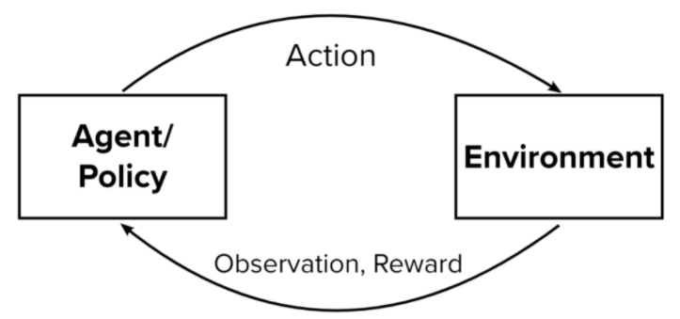
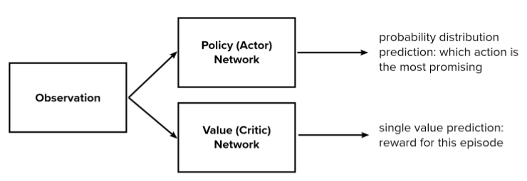
Reinforcement Learning
Train a PPO algorithm (Proximal Policy Optimization).
Use the previously trained reward model to evaluate the reward.
PPO will have the task of generating token “trajectories” that will have a very good overall score.
Order of 1 to 100 GPUs for training.
The outcome is the so called RL model / RLHF (reinforcement learning with human feedback).
Notes:
https://odsc.com/blog/reinforcement-learning-with-ppo/

Slide 33
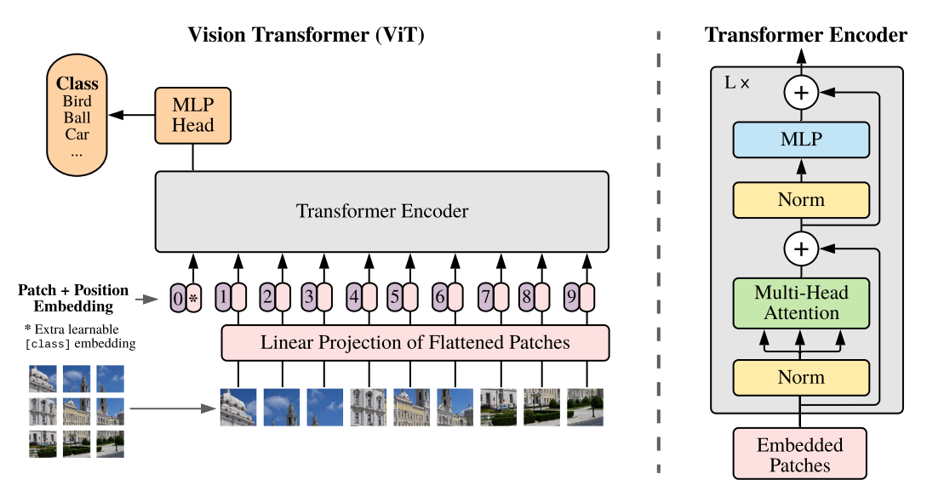
Vision Transformer / ViT
“An Image is Worth 16x16 Words: Transformers for Image Recognition at Scale” by A. Dosovitskiy et al. (2021)
Notes:
Figure 1 from the paper “An image is worth 16x16 words: Transformers for image recognition at scale” by A. Dosovitskiy et al. -> https://arxiv.org/pdf/2010.11929v2.pdf

Slide 34
Swin Transformer
“Swin Transformer: Hierarchical Vision Transformer using Shifted Windows” by Liu et al. (2021)
Notes:
Figure 3 from the paper “Swin Transformer: Hierarchical Vision Transformer using Shifted Windows” by Liu et al. -> https://arxiv.org/pdf/2103.14030.pdf

Slide 35
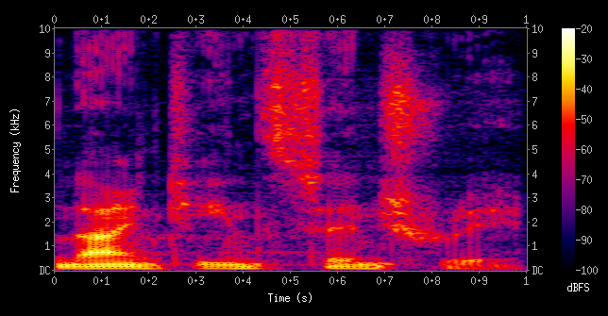
Audio Transformer
Raw sound waves can be mapped to a different space using STFT (Short-time Fourier Transform).
Here time series become images => problem is adapted to be tackled by the ViT / Swin Transformer.
Notes:
https://en.wikipedia.org/wiki/Short-time_Fourier_transform#/media/File:Spectrogram-19thC.png

Slide 36
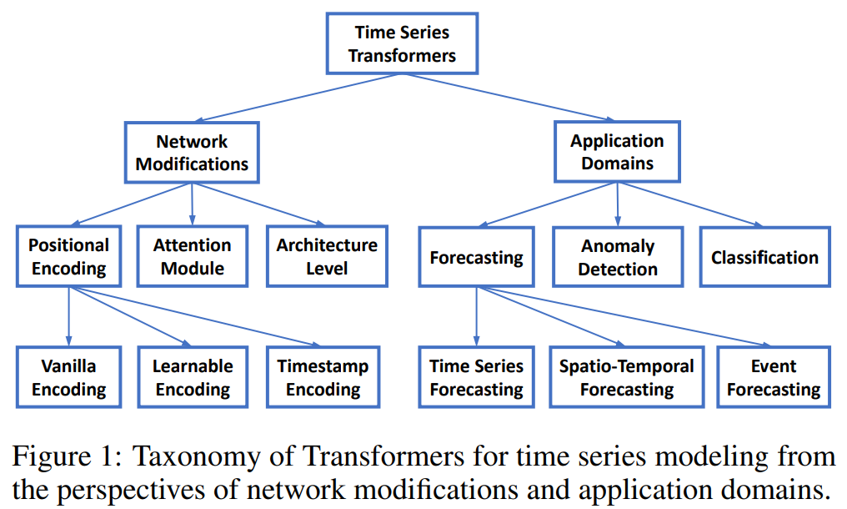
Time Series Transformer (TST)
Continuous data is sampled and quantized into discrete tokens.
Implementations available at: https://huggingface.co/docs/transformers/model_doc/time_series_transformer
“Transformers in Time Series: A Survey” paper, by Wen et al. [2023]
Notes:
Figure 1 from the “Transformers in Time Series: A Survey” paper, by Wen et al. -> https://arxiv.org/pdf/2202.07125.pdf ; https://github.com/qingsongedu/time-series-transformers-review

Slide 37
Code example: Self-Attention Snippet Version 1
torch.Size([4, 8, 2])
tensor([[ 1.9269, 1.4873],
[ 0.9007, -2.1055],
[ 0.6784, -1.2345],
[-0.0431, -1.6047],
[-0.7521, 1.6487],
[-0.3925, -1.4036],
[-0.7279, -0.5594],
[-0.7688, 0.7624]])
tensor([[ 1.9269, 1.4873],
[ 1.4138, -0.3091],
[ 1.1687, -0.6176],
[ 0.8657, -0.8644],
[ 0.5422, -0.3617],
[ 0.3864, -0.5354],
[ 0.2272, -0.5388],
[ 0.1027, -0.3762]])
# Version 1:
# We want x[b,t] = mean_{i<=t} x[b,i]
xbow = torch.zeros((B,T,C))
for b in range(B):
for t in range(T):
xprev = x[b,:t+1] # (t,C)
xbow[b,t] = torch.mean(xprev, 0)
print(x[0])
print(xbow[0])

Slide 38
Code example: Self-Attention Snippet Version 2
torch.Size([4, 8, 2])
tensor([[ 1.9269, 1.4873],
[ 0.9007, -2.1055],
[ 0.6784, -1.2345],
[-0.0431, -1.6047],
[-0.7521, 1.6487],
[-0.3925, -1.4036],
[-0.7279, -0.5594],
[-0.7688, 0.7624]])
tensor([[ 1.9269, 1.4873],
[ 1.4138, -0.3091],
[ 1.1687, -0.6176],
[ 0.8657, -0.8644],
[ 0.5422, -0.3617],
[ 0.3864, -0.5354],
[ 0.2272, -0.5388],
[ 0.1027, -0.3762]])
Are xbow and xbow2 the same? -> True
# Version 1
# We want x[b,t] = mean_{i<=t} x[b,i]
xbow = torch.zeros((B,T,C))
for b in range(B):
for t in range(T):
xprev = x[b,:t+1] # (t,C)
xbow[b,t] = torch.mean(xprev, 0)
print(x[0])
print(xbow[0])
# Version 2
wei = torch.tril(torch.ones(T, T))
wei = wei / wei.sum(1, keepdim=True)
xbow2 = wei @ x # (B, T, T) @ (B, T, C) ---> (B, T, C)
print("Are xbow and xbow2 the same? -> ", torch.allclose(xbow, xbow2))

Slide 39
Code example: Self-Attention Snippet Version 3
torch.Size([4, 8, 2])
tensor([[ 1.9269, 1.4873],
[ 0.9007, -2.1055],
[ 0.6784, -1.2345],
[-0.0431, -1.6047],
[-0.7521, 1.6487],
[-0.3925, -1.4036],
[-0.7279, -0.5594],
[-0.7688, 0.7624]])
tensor([[ 1.9269, 1.4873],
[ 1.4138, -0.3091],
[ 1.1687, -0.6176],
[ 0.8657, -0.8644],
[ 0.5422, -0.3617],
[ 0.3864, -0.5354],
[ 0.2272, -0.5388],
[ 0.1027, -0.3762]])
Are xbow/xbow2 equal to xbow3? -> True
# Version 2
wei = torch.tril(torch.ones(T, T))
wei = wei / wei.sum(1, keepdim=True)
xbow2 = wei @ x # (B, T, T) @ (B, T, C) ---> (B, T, C)
print("Are xbow and xbow2 the same? -> ",
# Version 3: using Softmax
tril = torch.tril(torch.ones(T,T))
wei = torch.zeros((T,T))
wei = wei.masked_fill(tril == 0, float('-inf'))
wei = F.softmax(wei, dim=-1)
xbow3 = wei @ x
print("Are xbow/xbow2 equal to xbow3? -> ", torch.allclose(xbow, xbow3))

Slide 40
Takeaways
Generative AI is the art of encoding complex real world distributions, such that we can generate creative results later via sampling from the encoded distribution.
Transformers are powerful neural networks that borrow the best ideas from prior models in the AI ecosystem and combine them together for a synergistic effect.
Self-attention and Feed-Forward MLP are the major conceptual components of a Transformer block.
Self-attention is essentially a communication graph where tokens exchange information stored in channels amongst themselves.
The Feed-Forward MLP is used for the computation phase to learn embeddings. Better embeddings means better abstract “meanings” are learned in a high dimensional space, resulting in better predictions.
Residual connections and pre- / post-normalization are other important attributes to help towards successful training and faster convergence.

Slide 41
References
Slide 3: https://towardsdatascience.com/the-differences-between-artificial-and-biological-neural-networks-a8b46db828b7
Slide 4, 5, 6: http://cs231n.stanford.edu/slides/2019/cs231n_2019_lecture04.pdf
Slide 7, 8: https://towardsdatascience.com/neural-networks-backpropagation-by-dr-lihi-gur-arie-27be67d8fdce
Slide 9: https://towardsdatascience.com/recurrent-neural-networks-rnns-3f06d7653a85
Slide 10, 11: https://medium.com/towards-data-science/illustrated-guide-to-lstms-and-gru-s-a-step-by-step-explanation-44e9eb85bf21
Slide 12: https://medium.com/@RaghavPrabhu/understanding-of-convolutional-neural-network-cnn-deep-learning-99760835f148
Slide 15, 17: https://lilianweng.github.io/posts/2018-10-13-flow-models/
Slide 16: https://ducspe.github.io/masterthesis_danucaus/ -> (page 18)
Slide 18: https://lilianweng.github.io/posts/2021-07-11-diffusion-models/
Slides 19, 20, 23, 26, 27 Transformer components were taken from “Attention is all you need” paper, by Vaswani et al.
Slide 25: “Swin Transformer V2: Scaling Up Capacity and Resolution” paper, by Liu et al.
Slide 28: https://arstechnica.com/science/2018/12/move-over-alphago-alphazero-taught-itself-to-play-three-different-games/
Slide 32: https://odsc.com/blog/reinforcement-learning-with-ppo/
Slide 33: “An image is worth 16x16 words: Transformers for image recognition at scale” paper, by Dosovitskiy et al.
Slide 34: “Swin Transformer: Hierarchical Vision Transformer using Shifted Windows” paper, by Liu et al.
Slide 35: https://en.wikipedia.org/wiki/Short-time_Fourier_transform#/media/File:Spectrogram-19thC.png
Slide 36: “Transformers in Time Series: A Survey” paper, by Wen et al.

