Slide 1
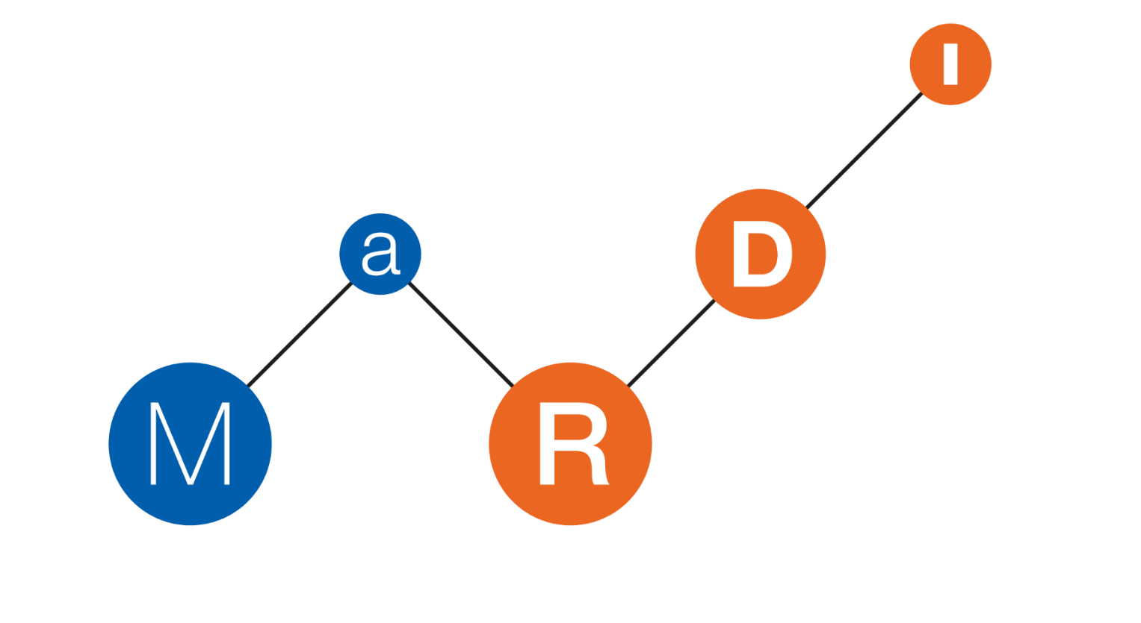
Analyzing the reproducibility of research-related Jupyter notebooks
at scale
🔄
Daniel Mietchen (FIZ Karlsruhe & MaRDI & KGI4NFDI) & Sheeba Samuel (TU Chemnitz)
SE25, 26 February 2025 -
DOI: 10.5281/zenodo.14678155 (slides) / 10.18420/se2025-07 (proceedings)

Slide 2
Outline
What did we do?
Why did we do this?
How did we do this?
Results
What’s next?
Discussion

Slide 3
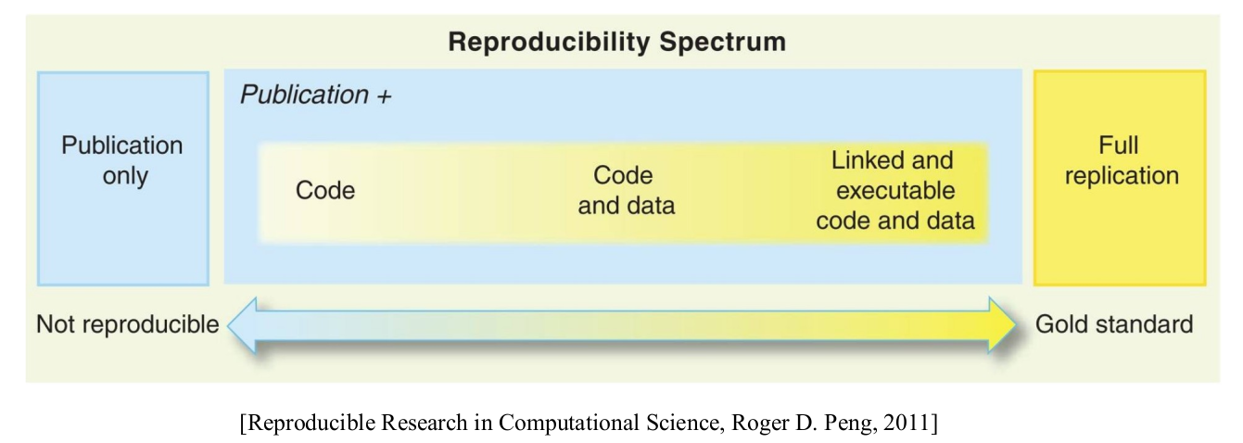
What did we do?
We studied
the computational reproducibility
of 27,271 Jupyter notebooks
from 2,660 public GitHub repositories
associated with 3,467 peer-reviewed biomedical publications
from 740 journals
Key concepts here
computational reproducibility
Jupyter notebook
GitHub repository
peer-reviewed publication
PubMed Central
full-text XML of biomedical papers
https://pmc.ncbi.nlm.nih.gov/

Slide 4
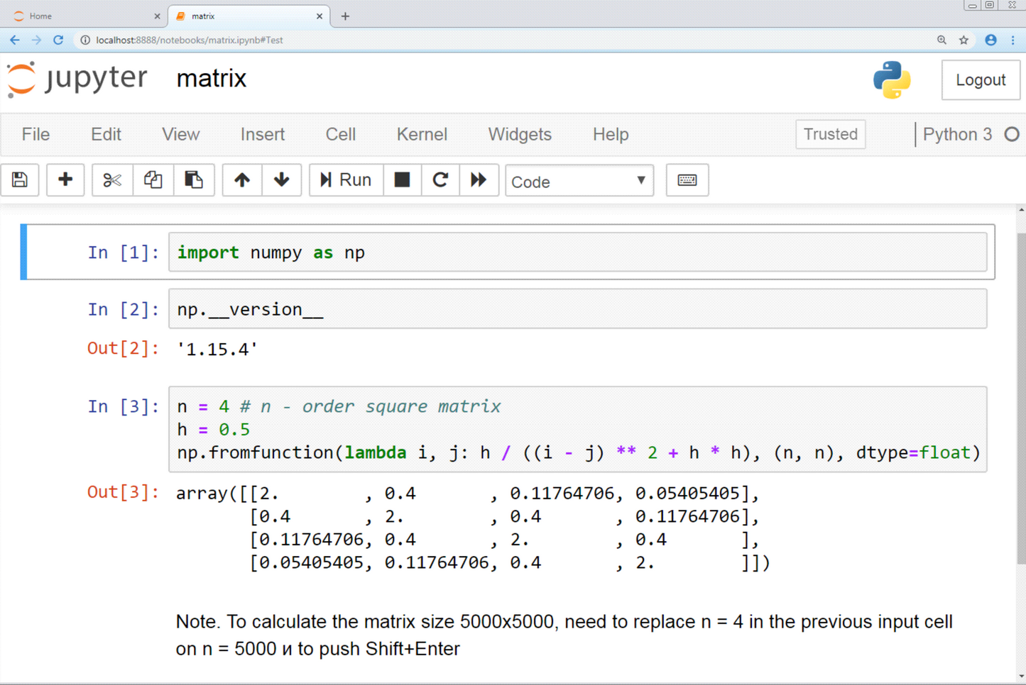
What are Jupyter notebooks?
They
provide a shared environment for
code
code execution
code comments
Markdown-based documentation
run on free and open-source software
can be shared conveniently
have been the subject of guidelines
can assist in enhancing computational reproducibility
prior studies found problems for generic Jupyter notebooks
perhaps this works better for Jupyter notebooks associated with peer-reviewed papers?

Slide 5
Why did we do this?
We wanted to find out
How does the computational reproducibility of Jupyter notebooks work in practice?
What are common issues?
What are best practices?
How does computational reproducibility vary
by research field
by journal
over time
…
because insights into these questions might affect research and education around
computational reproducibility
scientific reproducibility
(research) software engineering
software documentation
and related matters

Slide 6
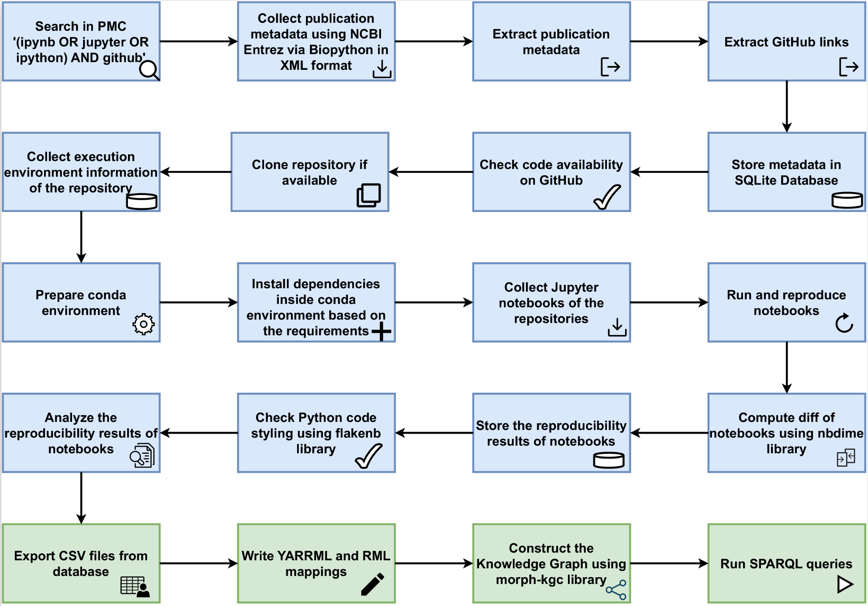
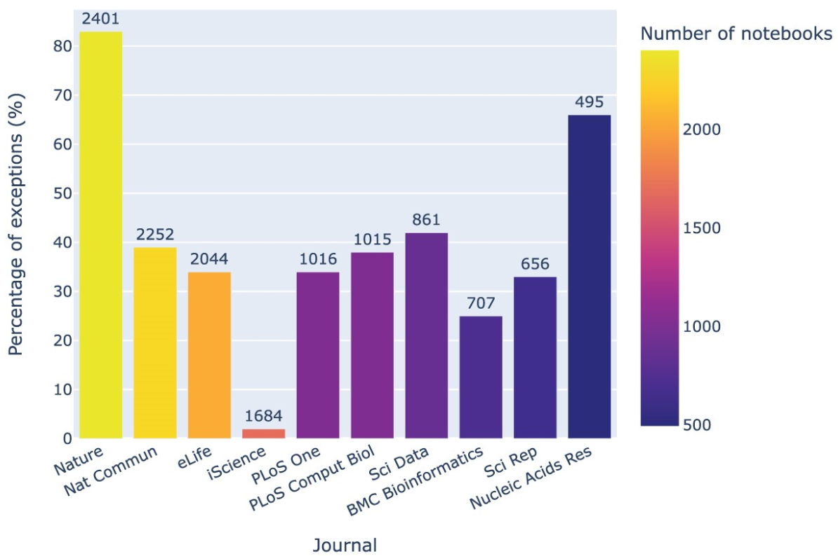
How did we do it?
43 days

Slide 7
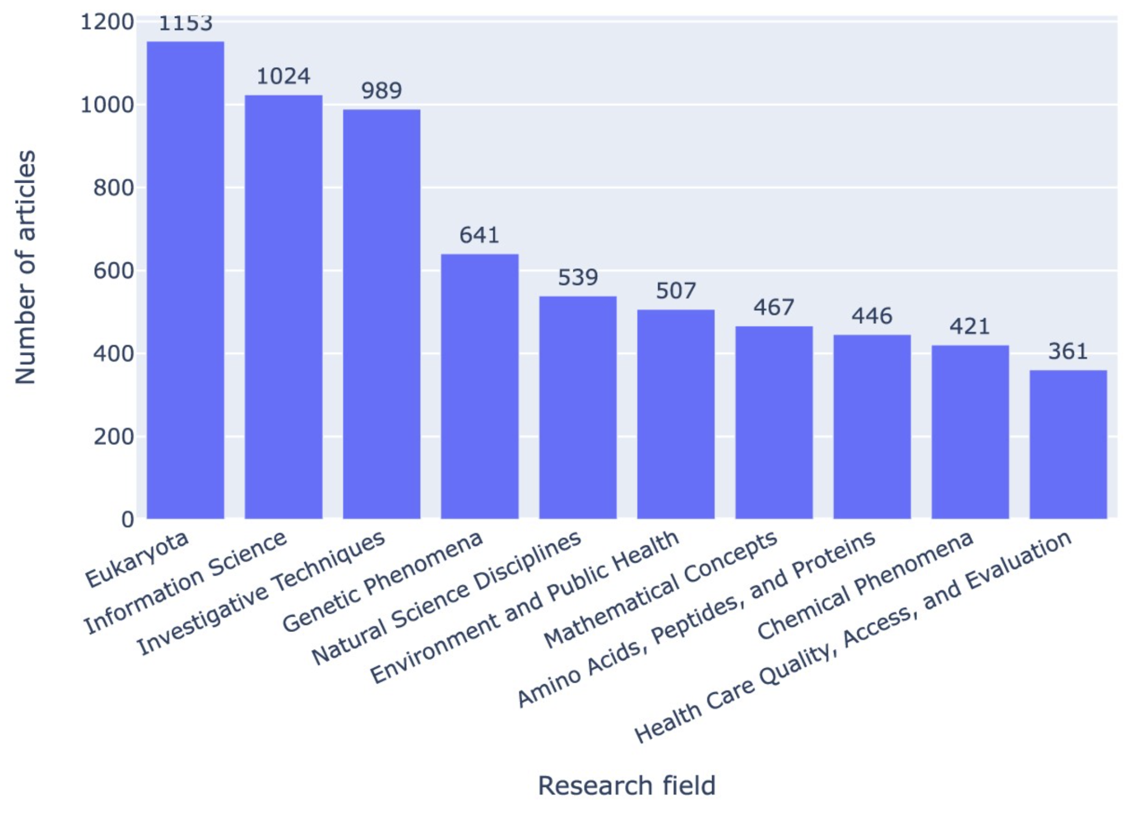
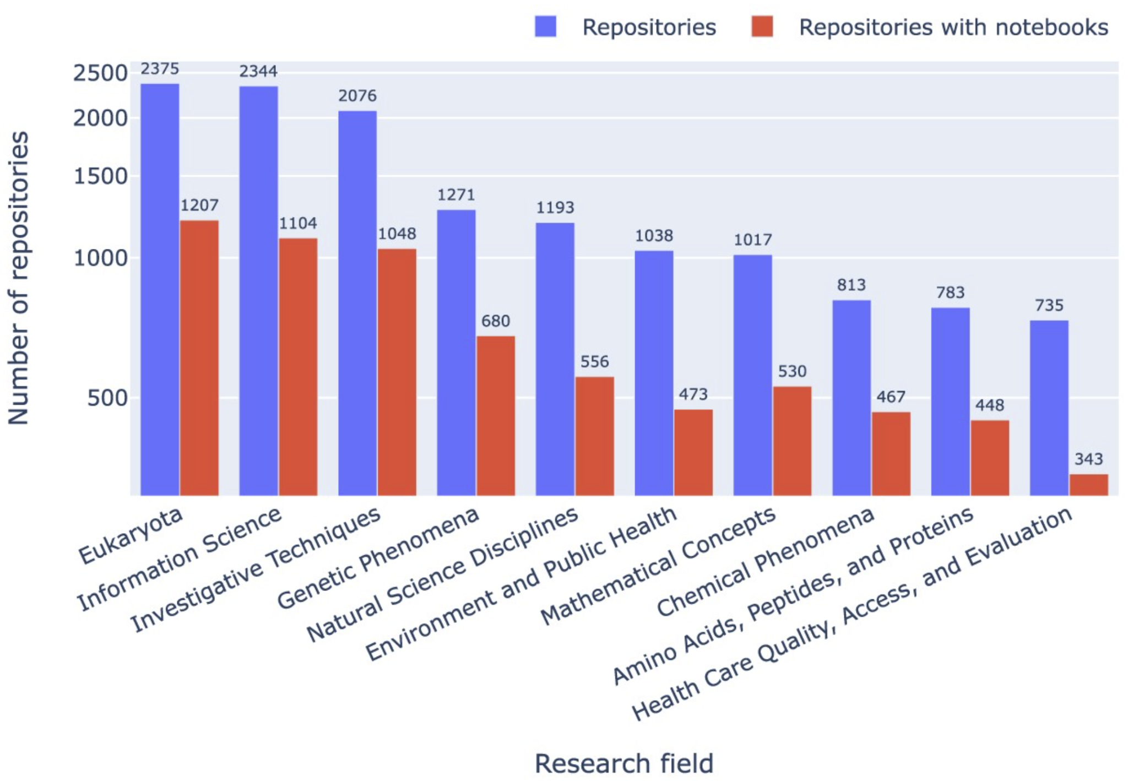
Results - Research Field
SPARQL Query to reproduce the figure:
Research articles by research field
SPARQL Query: Research field (MeSH terms) by the number of GitHub repositories that contain at least one Jupyter notebook.

Slide 8
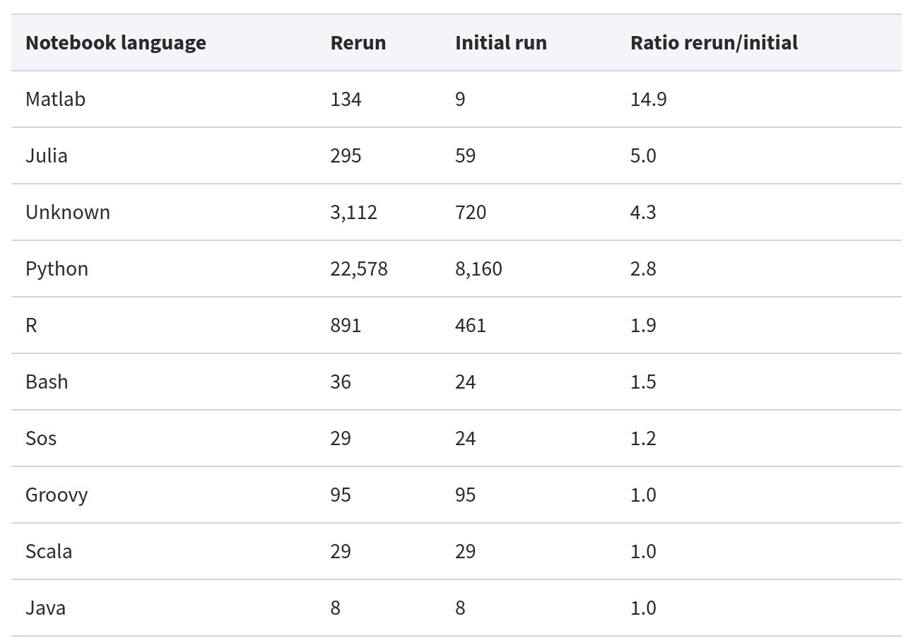
Results - Programming Languages of Jupyter notebooks

Slide 9
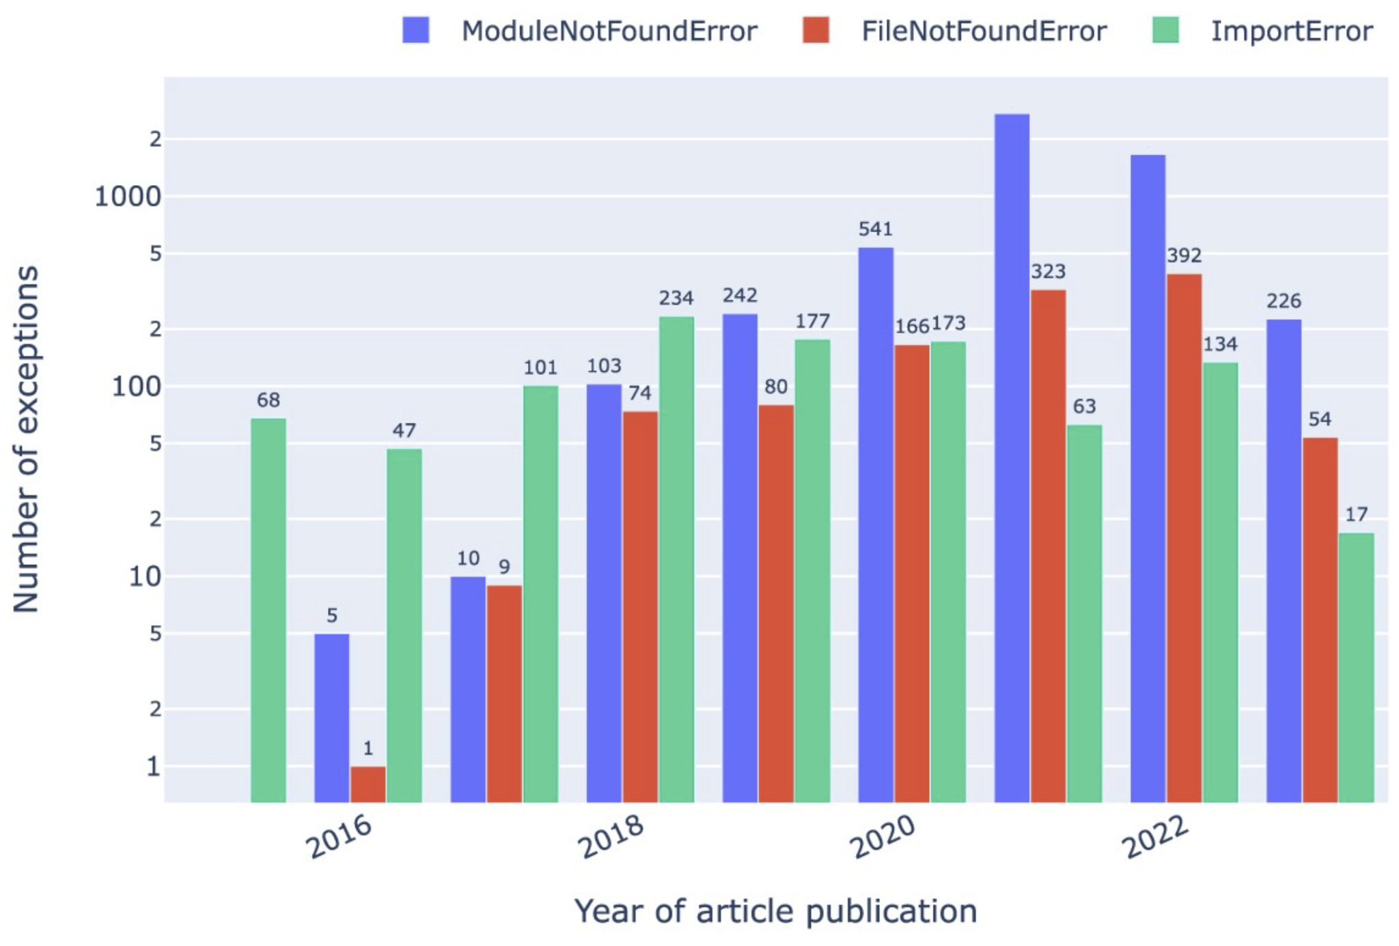
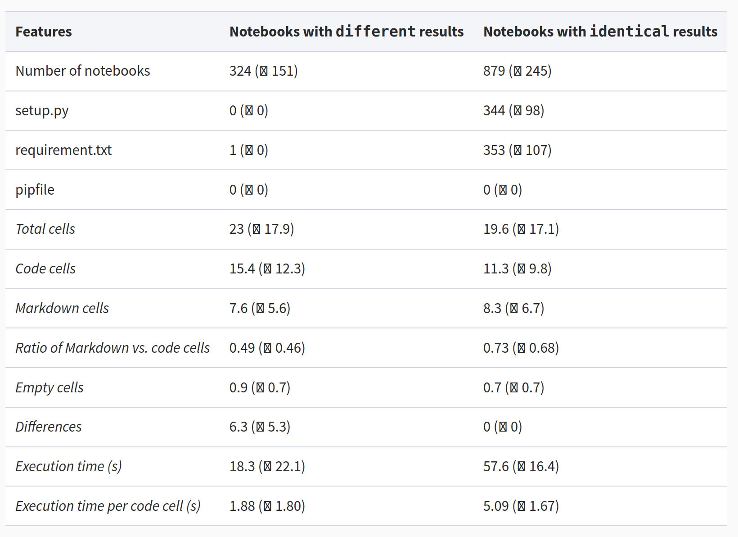
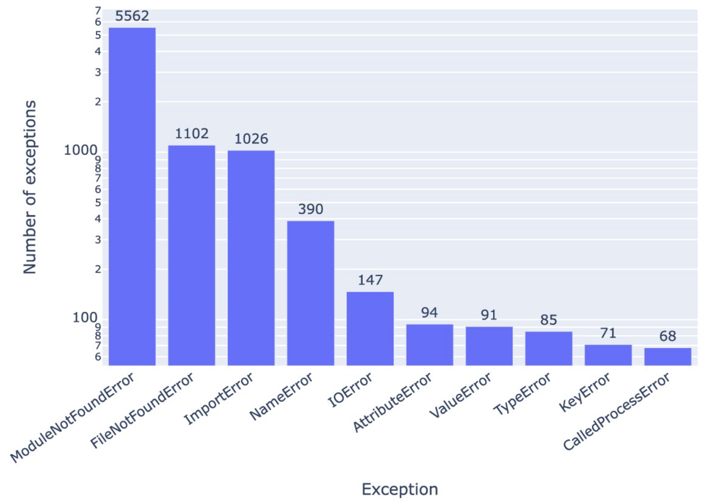
Results - Notebook Reproducibility
SPARQL Query: Exceptions occurring in Jupyter notebooks in our corpus.

Slide 10
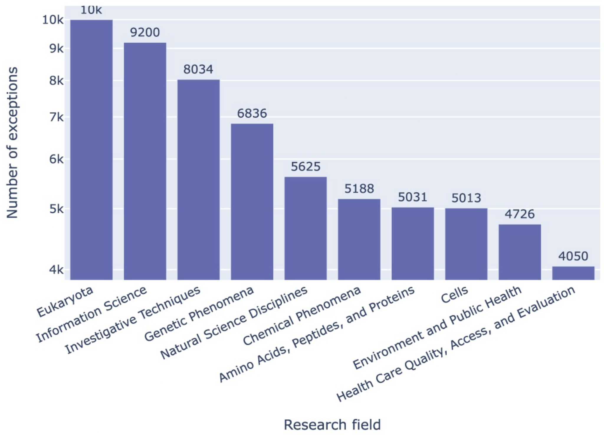
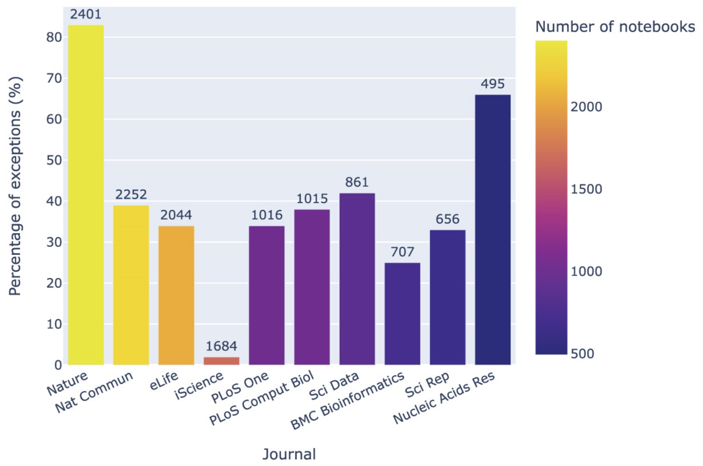
Results - Notebook Reproducibility
SPARQL Query: Jupyter notebook exceptions by research field, taking as a proxy the highest-level MeSH terms of the article associated with the notebook.
Effect of peer review and editorial workflows:
Nature has about 50 percent more notebooks than iScience, but Nature’s fail about 40 times more often

Slide 11
Environmental Footprint
Simplified calculation: carbon footprint = energy needed * carbon intensity
(http://calculator.green-algorithms.org/)
373.78 kWh
65.97 Wh
126.58 kg CO2e
7.33 g CO2e

Slide 12
Limitations
only computational reproducibility
only for Jupyter notebooks from articles available through PubMed Central
only ran notebooks written in Python
fully automated pipeline not using LLMs, ignoring non-FAIR instructions
stops at first error, does not attempt fixes
ecological footprint only assessed for running the pipeline, not developing it

Slide 13
Further details
Analyzing the reproducibility of research-related Jupyter notebooks at scale
Initial Run
2021
Preprint: https://doi.org/10.48550/arXiv.2209.04308
Rerun
2023
Code : https://github.com/fusion-jena/computational-reproducibility-pmc
Data : https://doi.org/10.5281/zenodo.8226725
Paper : https://doi.org/10.1093/gigascience/giad113
Knowledge graph (see also deRSE25 talk today at 16:00)
Website: https://w3id.org/fairjupyter
SPARQL Endpoint: https://reproduceme.uni-jena.de/#/dataset/fairjupyter/query
Knowledge Graph Browser: https://reproduceme.uni-jena.de/fj/
Sample query: PLOS Comp Bio articles and associated GitHub repos and Jupyter notebooks
Preprint: https://doi.org/10.48550/arXiv.2404.12935
Paper: https://doi.org/10.4230/TGDK.2.2.4

Slide 14
What’s next?
Assessments of Jupyter notebooks in single GitHub repos
focus here is on evaluations before submission to journals/ conferences
Assessments of dockerized Jupyter notebooks
Assessments of non-Python notebooks
Assessments of Jupyter notebooks from publications not in PubMed Central
Software/ Data Carpentry course based on FAIRJupyter
FAIRJupyter as a continuous service
Your ideas here - collaborations welcome

Slide 15
Thank you
German Research Foundation (DFG), TRR-386, project number 514664767
Alfred P. Sloan Foundation under grant number G-2021-17106.
Ara Cluster of Friedrich Schiller University Jena under DFG grants INST 275/334-1 FUGG and INST 275/363-1 FUGG.
BASE4NFDI/KGI4NFDI: DFG 521453681
Contact: sheeba.samuel@informatik.tu-chemnitz.de & daniel.mietchen@fiz-karlsruhe.de
SE25, 26 February 2025
DOI: 10.5281/zenodo.14678155 (slides) / 10.18420/se2025-07 (proceedings)

