Slide 1
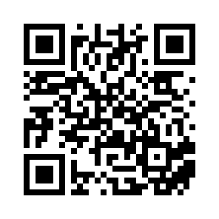
🚀Time to launch: Making the “Standard Template for the Efficient Development of Research Software” accessible
Bernadette Fritzsch, Carina Haupt, Sebastian Nielebock, Bernhard Rumpe, Alexander Struck, Inga Ulusoy
DOI: 10.18420/2025-gi_de-rse
Notes:
Intro to BoF session: Inga
Slide: Bernhard

Slide 2
Outline
0 min
30 min
70 min
90 min
Presentation and Q&A:
Target Audience
Purpose of the guidelines
Content of the guidelines
Steps to adoption
Dissemination, incentives and feedback channels
Breakout sessions:
Incentives for decision makers and researchers
Reporting back
Summary and call for actions
Notes:
Slide: Bernhard

Slide 3
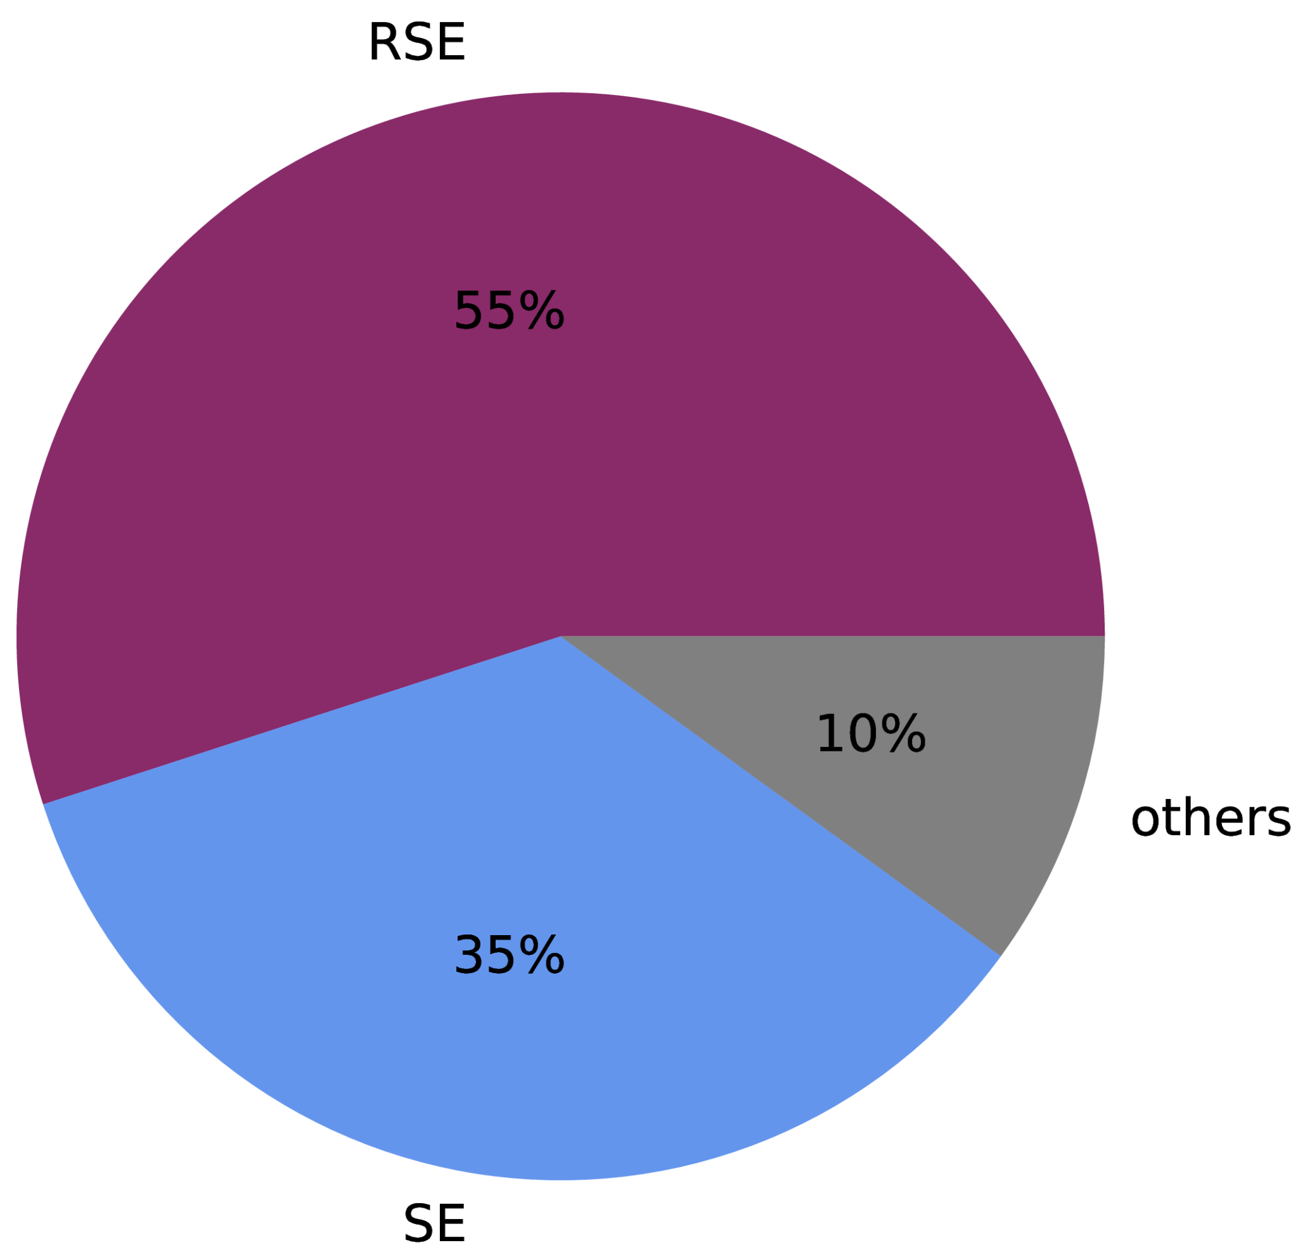
Muster-Leitlinie für die effiziente Entwicklung von Forschungssoftware
Authors:
Andreas Czerniak, Universität Bielefeld
Adrian Ehrenhofer, TU Dresden
Bernadette Fritzsch, Alfred-Wegener-Institut, Bremerhaven
Maximilian Funk, Max-Planck-Gesellschaft e.V., München
Florian Goth, Universität Würzburg
Reiner Hähnle, TU Darmstadt
Carina Haupt, Deutsches Zentrum für Luft- und Raumfahrt (DLR)
Marco Konersmann, RWTH Aachen
Jan Linxweiler, TU Braunschweig
Frank Löffler, Friedrich-Schiller-Universität Jena
Alexander Lüpges, RWTH Aachen
Sebastian Nielebock, OVGU Magdeburg
Bernhard Rumpe, RWTH Aachen
Ina Schieferdecker, TU Berlin
Tobias Schlauch, Deutsches Zentrum für Luft- und Raumfahrt (DLR)
Robert Speck, Forschungszentrum Jülich GmbH
Alexander Struck, Humboldt-Universität zu Berlin
Jan Philipp Thiele, Weierstrass Institut Berlin
Matthias Tichy, Universität Ulm
Inga Ulusoy, Scientific Software Center, Universität Heidelberg
… and many more commentators💪🙌
Focus Group RSE Software Development Guidelines (special interest group of GI topic area RSE / of de-RSE)
The authors come from an …
… background.
Notes:
Slide: Bernhard

Slide 4
Target audience
Notes:
Slide: Bernhard

Slide 5
“The manager/decision maker”
“The maker”
Research institutions
Research Software Engineers
Research departments or consortia
Scientists-who-code
Researchers
Further stakeholders
users of research software
legal and administrative departments
core facilities of research institutions (libraries, computing facilities, research data units)
funding agencies
Notes:
Slide: Bernhard

Slide 6
Purpose of the guidelines
Notes:
Slide: Bernhard

Slide 7
Purpose of the Guideline
Requirements of the development, management, and distribution of research software
Foundation for researchers for research software development
Practical and organizational processes in RSE
Decision basis for choosing licenses
Research Software Engineering Support for scientists
Notes:
Slide: Bernhard

Slide 8
Content of the guidelines
Notes:
Slide: Sebastian

Slide 9
Template-Guideline for Efficient Development of Research Software
Table of Contents:
Executive Summary (for decision makers)
Introduction
Research Software Development
Categorization of Research Software
Minimal Requirements for Research Software Development
Licensing
Research Software Engineering Support
Technical Support
Technical Services
Appreciation
Financial Support
Available (in German): https://dl.gi.de/handle/20.500.12116/45663
and https://fg-rse.gi.de/
Notes:
Slide: Sebastian

Slide 10
Chapter 3: Research Software - Categorization
Categorization Options
Type
State of Use
Technology Readiness Levels (TRLs)
Application Classes
e.g., simulation, embedded control
e.g., individual, technical infrastructure
e.g., exploration, development, operational
e.g., personal/no distribution,
large user base/ long-term usage
Status of Research Software
Software Lifecycle
Other influences (e.g., community, criticality,...)
Notes:
Slide: Sebastian

Slide 11
Chapter 3: Research Software Development - Minimum Requirements
Categorization as foundation for Methodology Choices for Research Software Development
Technology Readiness Levels (TRLs) | Description
TRL 1-3 | Exploration and “Prototyping”
TRL 4-6 | Development and Hardening
TRL 7-9 | Deployment and Usage
SWEBOK - Activities | TRL 1-3 | TRL 4-6 | TRL 7-9
Software Requirements | + | + | +
Software Design | + | + | ++
Software Construction | ++ | ++ | ++
Software Testing | + | ++ | ++
[...] | [...] | [...] | [...]
Notes:
Slide: Sebastian

Slide 12
Chapter 3: Research Software Development - Foundations
Methodical Foundations
Technical Foundations
Software Development Process
Quality Management (Testing, Validation, etc.)
Requirements
Software-Architecture
Software Modelling
Versioning
Concept and Automation of Testing
Management of software-related data and data foundation
Best Practices, Design Pattern, Issue-Tracking, Coding Guidelines
Git Version Control System
Continuous Integration / Continuous Delivery
Testing Frameworks
Dissemination
Software Discovery
Notes:
Slide: Sebastian

Slide 13
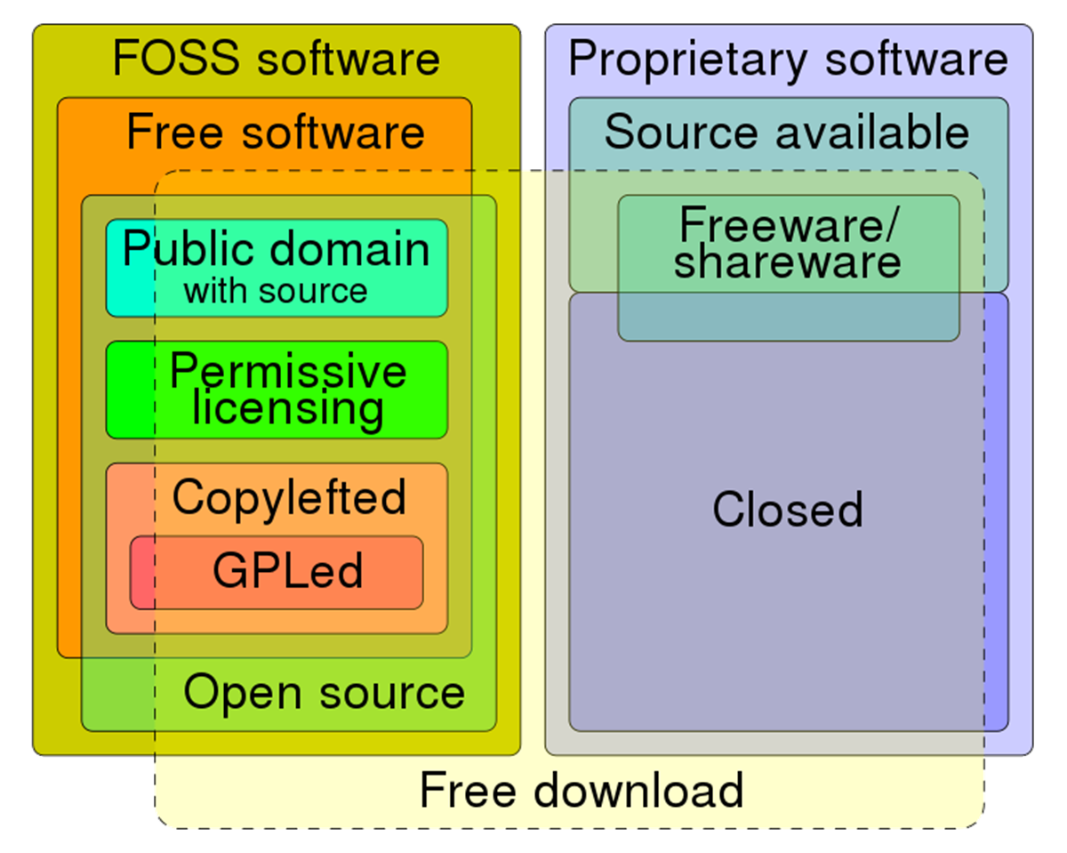
Chapter 4: Licensing of Research Software
Rules for Scientific and Economic Exploitation of Research Software
Types of Licenses
Types of Consulting
Open Source (Permissive vs. Copy-left)
Proprietary
Legal Department
Best Practices
(Re-)use of research software from third parties
Rights and Duties
License Compatibility
https://commons.wikimedia.org/wiki/File:Software_Categories_expanded.svg (CC0 1.0)
Notes:
Slide: Sebastian

Slide 14
Chapter 5: Research Software Engineering Support
Technical Support
Technical Services
Consulting on Research Software Development
Development Support
Long-term Maintainance
Development Training
Consulting Licensing/Exploitation
Central Version Control System/Code Repositories
FAIR4RS Principles with long-term software archiving
Research Data Management
Appreciation of Research Software Engineering
Financial Support
Research Software as Research Output
Research Software Engineering Prices
Shared Authorships
Part of research project fundings
Shared RSE
Centralized vs. Decentralized RSEs
Notes:
Slide: Sebastian

Slide 15
Steps to adoption
Notes:
Slide: Bernhard

Slide 16
Variant-rich template
// Redaktionelle Anmerkungen
[[Anmerkung für Leitlinienerstellende/Hochschullleitungen: … ]]
Main text body plus
Elective sections [[Option A]]
Alternative sections (ie. research software classification, recommended licensing) [[Variant A1]] / [[Variant A2]]
Lists of services
Choice of dedicated RSE department or de-centralized support only
Every institution should select and adapt according to their preferences!
// Auswählbare Alternativen
[[Variante A1]]
Text Passage 1
[[Variante A2]]
Text Passage 2
[[Variante A Ende]]
// Optionale Ergänzung
[[Option B]]
Optional nutzbarer Text
[[Option B Ende]]
Notes:
Slide: Bernhard

Slide 17
Possible adoption workflow
Institution selects task force
→Representatives of the different stakeholders at the institution:
decision makers
RSEs
researchers
collaborating core facilities
Adaptation of guidelines, selection of options and variants
Approval of institution (topics, legal, funding aspects)
Guidelines template
Official guidelines for this institution
yes
no
Feedback
no
Put into practice:
RSE website
RSE center/de-centralized support
Publicize at university
Guidelines are practical and need no further adaptation
Research groups adapt practices
yes
Notes:
Slide: Bernhard

Slide 18
Critical steps in the adoption workflow
incentives and accessibility!!!
Institution selects task force
→Representatives of the different stakeholders at the institution:
decision makers
RSEs
researchers
collaborating core facilities
Adaptation of guidelines, selection of options and variants
Approval of institution (topics, legal, funding aspects)
Guidelines template
Official guidelines for this institution
yes
no
Feedback
no
Put into practice:
RSE website
RSE center/de-centralized support
Publicize at university
Guidelines are practical and need no further adaptation
Research groups adapt practices
yes
Notes:
Slide: Inga

Slide 19
Critical steps in the adoption workflow
Institution selects task force
→Representatives of the different stakeholders at the institution:
decision makers
RSEs
researchers
collaborating core facilities
Adaptation of guidelines, selection of options and variants
Approval of institution (topics, legal, funding aspects)
Guidelines template
Official guidelines for this institution
yes
no
Feedback
no
Put into practice:
RSE website
RSE center/de-centralized support
Publicize at university
Guidelines are practical and need no further adaptation
Research groups adapt practices
yes
incentives and accessibility!!!
Notes:
Slide: Inga

Slide 20
Dissemination, incentives and feedback channels
Notes:
Slide: Inga

Slide 21
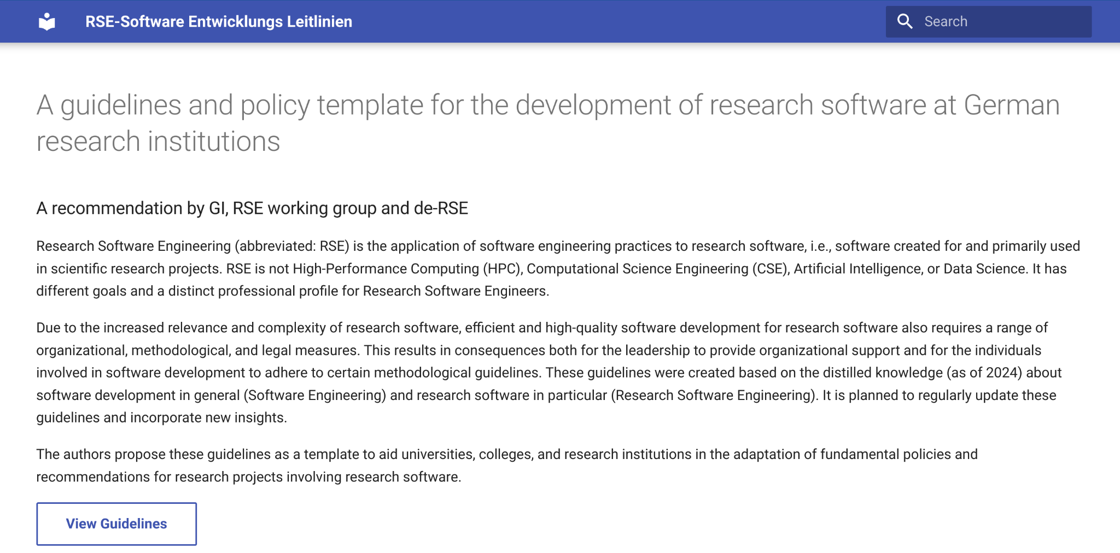
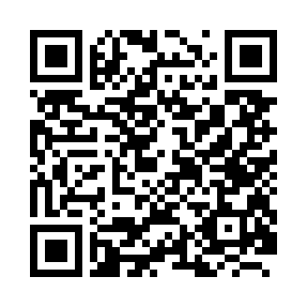
Availability
DOI 10.18420/2025-gi_de-rse
GitHub
https://github.com/gi-ev/RSE-software-entwicklungs-leitlinien
Notes:
Slide: Inga

Slide 22
Dissemination and incentives
Funding agencies?
Research Software Engineers
Earn badges for your institution / research software: Build trust
GI / de-RSE
Research software and research visibility
NFDI
Research process and output crucially dependent on research software
Influential decision-makers
(politicians, funders, research foundations)
Notes:
Slide: Inga

Slide 23
Breakout sessions
Notes:
Slide: Inga

Slide 24
Breakout group A: Adoption at the institutional level
How do you incentivize adoption? (maybe more precise question with options, ie badges, recognition on guidelines website, etc)
How do you make the adaptation of the variant-rich template user-friendly?
How do you understand what is missing in your institution and how to ramp up to fulfill the guidelines?
What can support during adoption look like and who can give it? (i.e. community-driven)
How can the right level of organisation be determined, at which the guidelines should be adopted (whole university? each institute separately? research cluster or consortium? …)
Who are the right stakeholders at the institution that need to be addressed for adopting the guidelines?
Which other resources regarding research software quality are you aware of and how can this be connected?
Tooling? ie.
website (click-and-select)
decision trees
carpentries-style short course
Notes:
Slide: Inga
Groups:
Moderation Alexander Struck
Support Bernhard Rumpe
Documentation Tobias Schlauch

Slide 25
Breakout group B: Accessibility of guidelines for RSEs/SWCs
How do you understand if your development process is compliant with guidelines?
How do you understand if your code is compliant with guidelines?
What steps do you need to take to align better with the guidelines?
Tooling to determine strategies for your targeted level of development (AK/TRL)?
Which level of expertise can be expected from readers? Are additional info materials like a glossary needed to make them understandable? Or is it okay to rely on people reading up on topics on their own? Will and how can the RSE center / de-centralized RSE section provide (communal) support for guidelines compliance?
Is additional specific information needed for making the guidelines easily applicable?
Which sections require more/less information? Please elaborate.
Tooling? ie.
carpentries-style short course
workflows that check for compliance (GH actions)
Interactive website highlighting relevant strategies for selected application class/TRL of the software
Notes:
Slide: Inga
Groups:
Moderation Inga Ulusoy
Support Sebastian Nielebock
Documentation Dmitrii Kapitan

Slide 26
Reporting back: Outcomes from the groups
Notes:
Slide: Alexander & Inga, supported by Bernhard & Sebastian

Slide 27
Summary and call for actions
Notes:
Inga, all

Slide 28
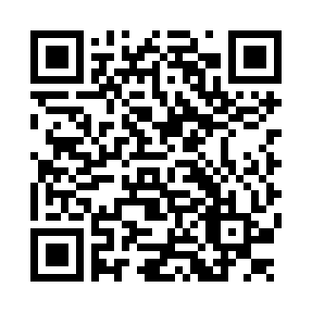
Time for a survey?

