Slide 1
A short introduction to Nextflow: Bring your data science pipelines to the next level
Marie Lataretu & Paul Wolk
deRSE25 – 26.02.2025

Slide 2
Why Workflow Managers?
Workflow managers provide a framework for the creation, execution, and monitoring of pipeline. <...>
They simplify pipeline development, optimize resource usage, handle software installation and versions, and run on different compute platforms, enabling workflow portability and sharing.
Wratten et al. (2021) Nature Methods
→ More portable, efficient, reproducible

Slide 3
Why Workflow Managers?
Execute a single command with the input and parameters
The workflow manager
Writes bash scripts for you
Executes jobs in optimal order for you
Handles file transfer between scripts for you
Handles writing of sbatch scripts for you
Handles re-execution of failed jobs for you
You wait for an email or notification saying success 🎉

Slide 4
Why Nextflow?
Write code in any language
Define software dependencies via containers or conda
Built-in version control with Git
Highly configurable
Execute it anywhere!
aws, slurm, Kubernetes, HPC and many more!
To run any Nextflow pipeline, you only need 3 things:

Slide 5
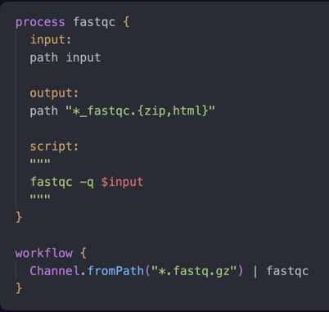
Why Nextflow?
Define process input, output and script
Run it in a workflow
Done!

Slide 6
nf-core - the Nextflow community
Prepared pipelines, subworkflows and modules in a standardized format for you to use
Mostly biological, but first non-biological pipeline release „rangeland“ and more in development
Earth sciences, astronomy, economics…
>11000 slack members, >1200 github organization members
Organization of events like trainings and hackathons
→ for more information, visit nf-co.re

Slide 7
nf-test
Specific test framework for Nextflow pipelines
end-to-end tests
Process tests
Function tests
Expandable with third party libraries
Used by nf-core for every pipeline and module
→ for more information, visit nf-test.com

Slide 8
Hands on!
Open your work environment / start your gitpod now!
„Hello Nextflow“ version 2.0
-> https://training.nextflow.io/2.0/hello_nextflow/

Slide 9
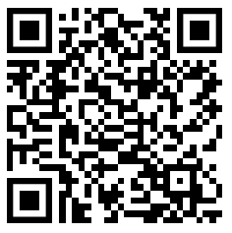
Nextflow Training Week
March 10, 2025 - March 14, 2025
Self-paced online training with real-time support

Slide 10
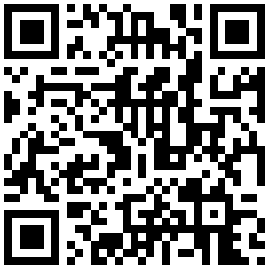
The upcoming nf-core-Hackathon
March 24, 2025 - March 26, 2025
Help developing nf-core pipelines, subworkflows and modules together with other Nextflow enthusiasts
Either online or at a local side
German local sides in Heidelberg, Tübingen, Munich and Berlin
Registration for local sides end on March 9th
Specific nf-core training available in Berlin
Of course it‘s free!

Slide 11
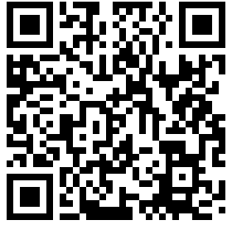
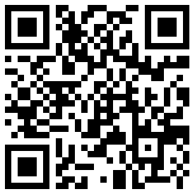
Questions?
Marie Lataretu Paul Wolk
Nextflow ambassador
Any Nextflow questions after this workshop? Reach us here:
lataretum@rki.de wolkp@rki.de
or on LinkedIn
Thank you to James Fellows Yates and Maxime U. Garcia for the slides!

