Slide 1
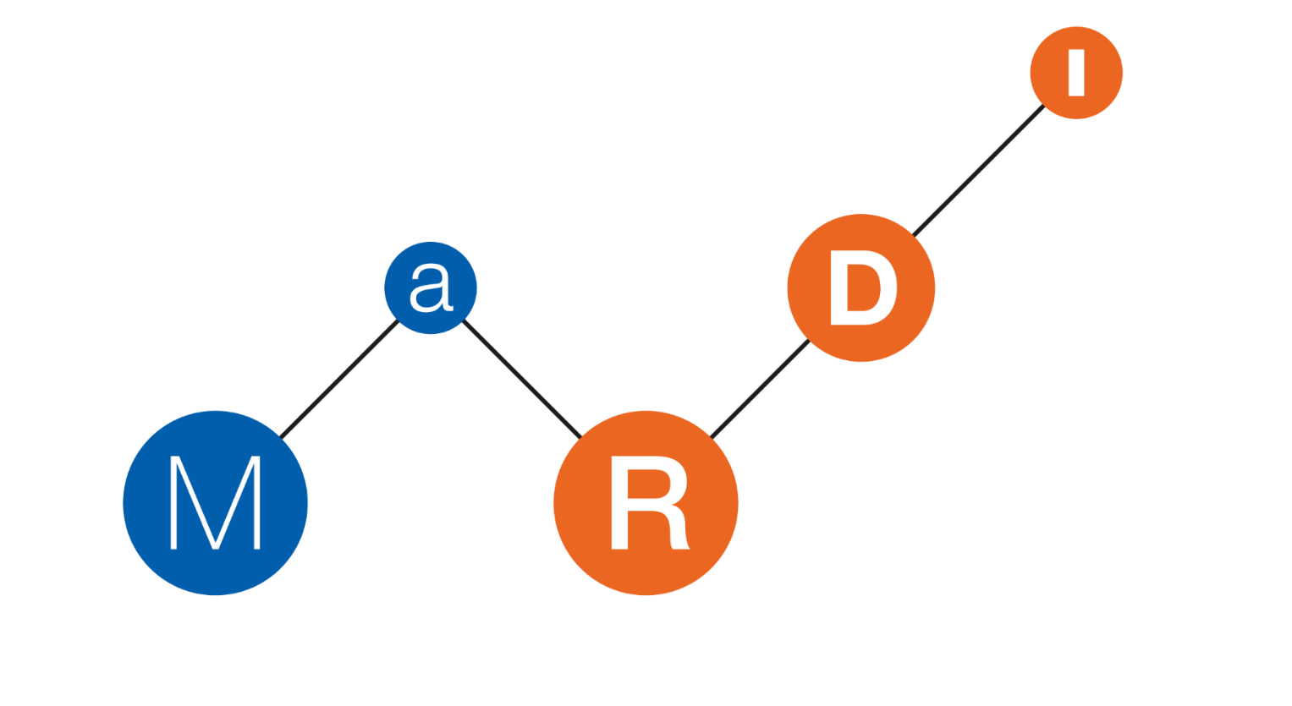
Fine-grained exploration of the reproducibility of research-related Jupyter notebooks at scale
🔄 🔀
Daniel Mietchen (FIZ Karlsruhe & MaRDI & KGI4NFDI) & Sheeba Samuel (TU Chemnitz)
deRSE25, 26 February 2025 - DOI: 10.5281/zenodo.14678185

Slide 2
Outline
Motivation
FAIR Jupyter
Results
Future Work

Slide 3
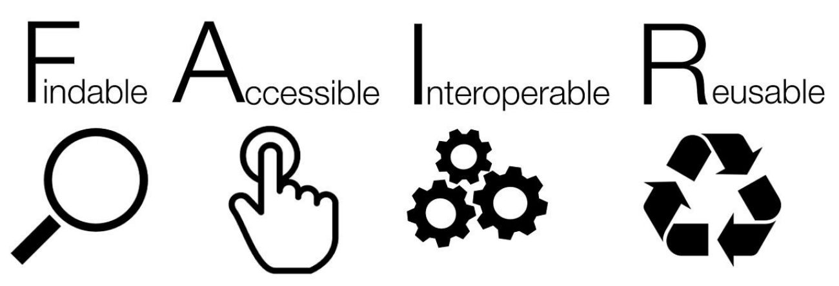
Motivation
Enhancing Research & Education:
Provide example queries for diverse research software engineering and educational use cases.
Profiling Content Types:
Demonstrate how such query sets can profile content by type or class.
FAIR Principles:
Improve findability, accessibility, interoperability, and reusability of datasets.
Semantic Data Sharing:
Enable better identification, communication, and reuse of complex datasets.
Quality & Best Practices:
Support standardization, reproducibility, and best practices in research software.

Slide 4
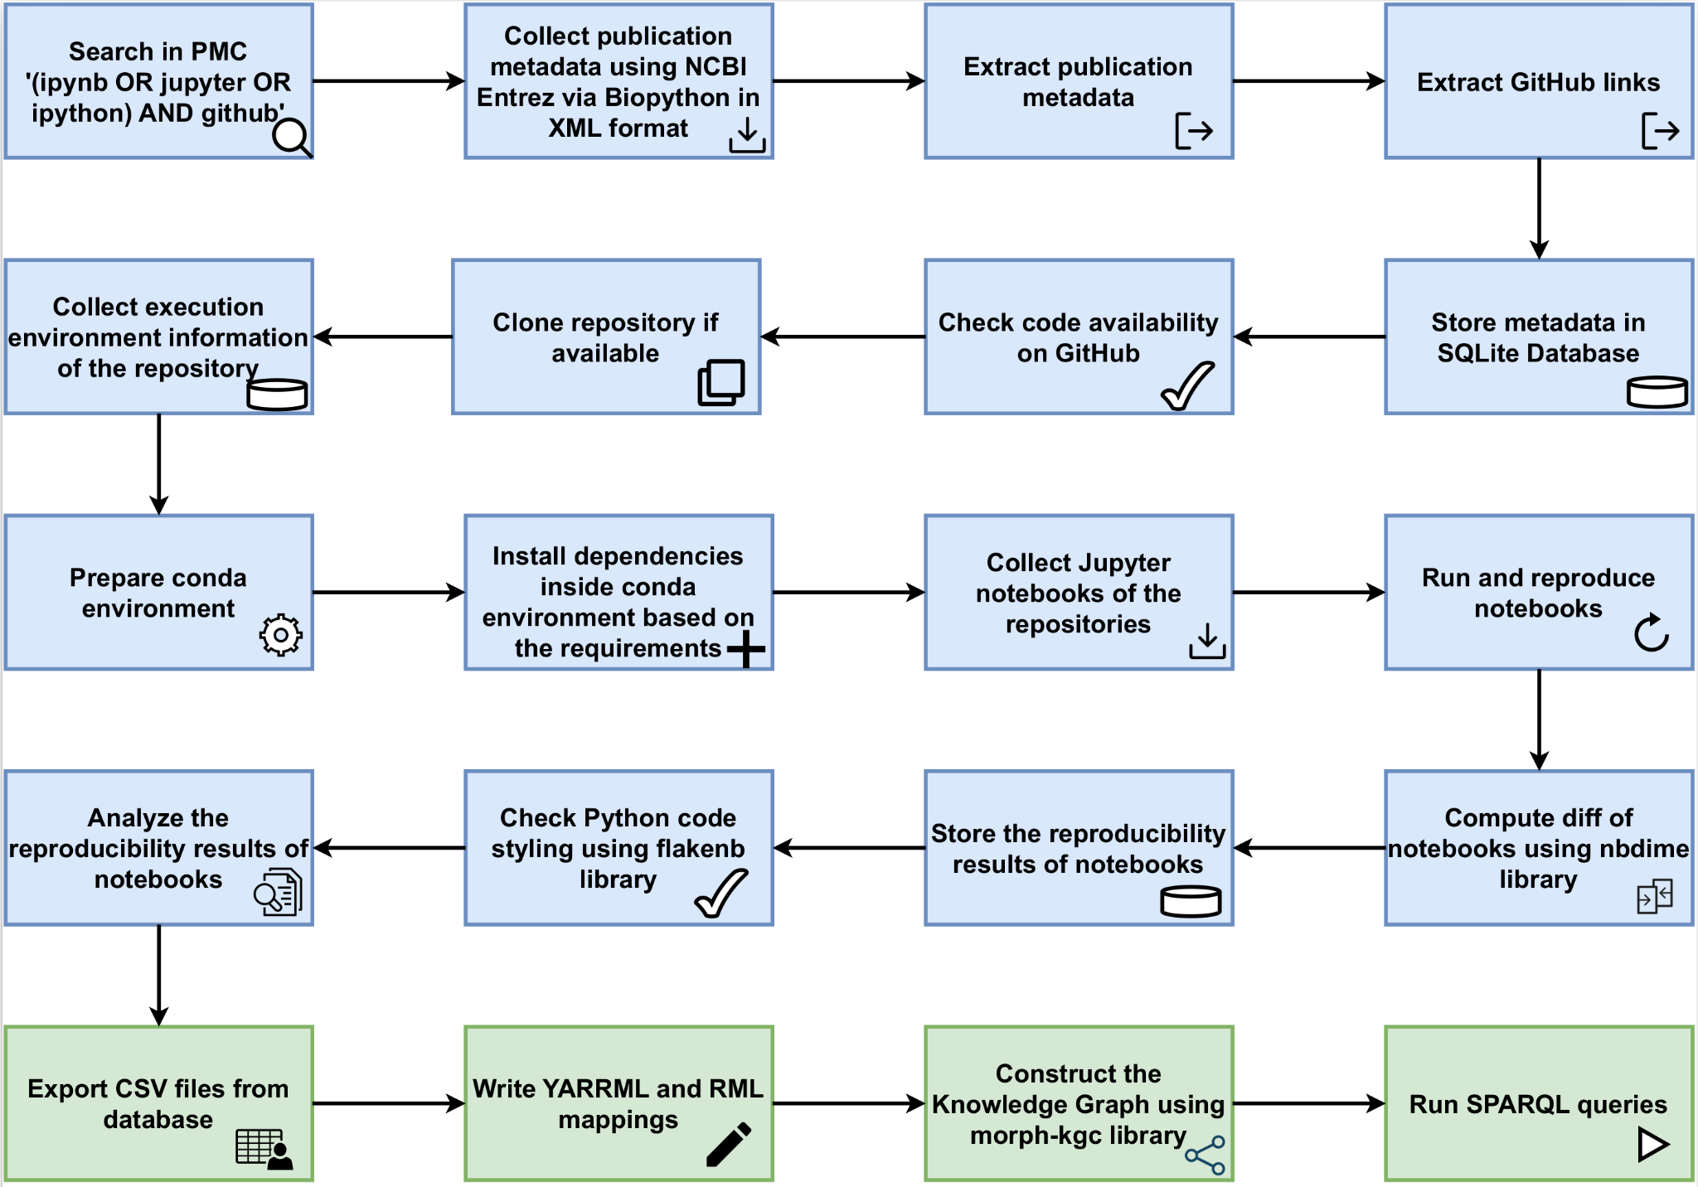
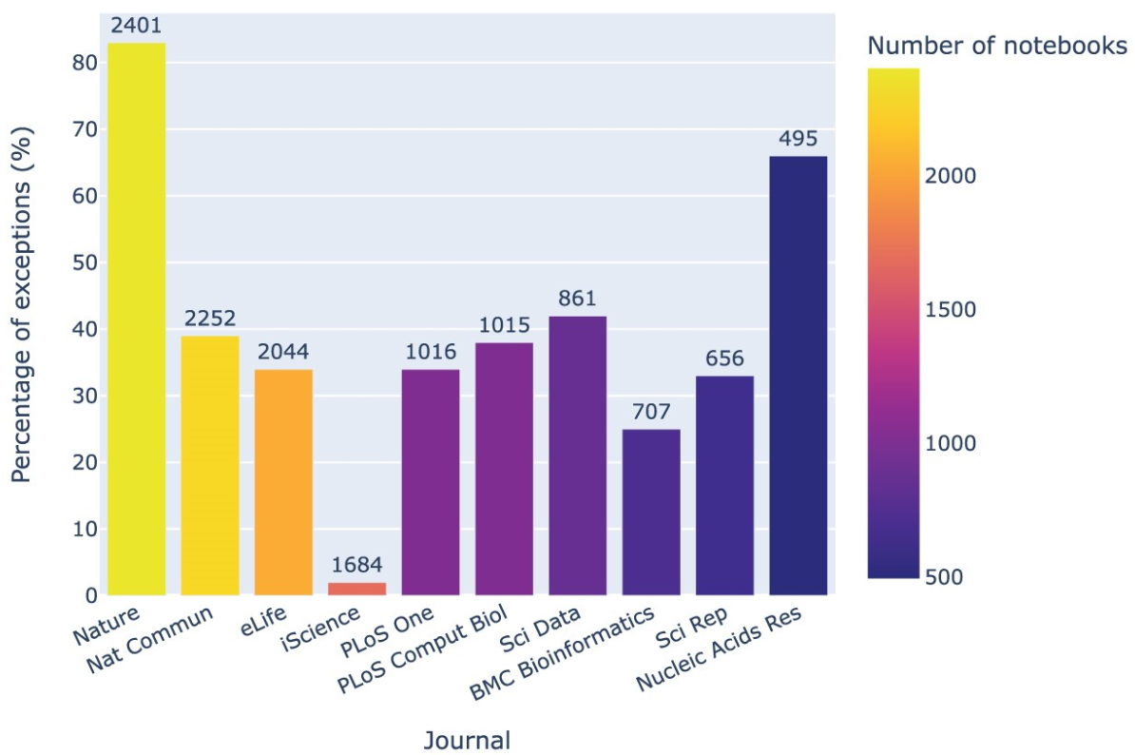
FAIR Jupyter
Overview
190 million triples

Slide 5
FAIR Jupyter
A knowledge graph approach to semantic sharing and granular exploration of a computational notebook reproducibility dataset
Initial Run
2021
Preprint: https://doi.org/10.48550/arXiv.2209.04308
Rerun
2023
Code : https://github.com/fusion-jena/computational-reproducibility-pmc
Data : https://doi.org/10.5281/zenodo.8226725
Paper : https://doi.org/10.1093/gigascience/giad113 (see also SE25 session today at 11:00)
Knowledge graph
Website: https://w3id.org/fairjupyter
SPARQL Endpoint: https://reproduceme.uni-jena.de/#/dataset/fairjupyter/query
Knowledge Graph Browser: https://reproduceme.uni-jena.de/fj/
Sample query: PLOS Comp Biology articles and associated GitHub repos with Jupyter notebooks
Paper: https://doi.org/10.4230/TGDK.2.2.4

Slide 6
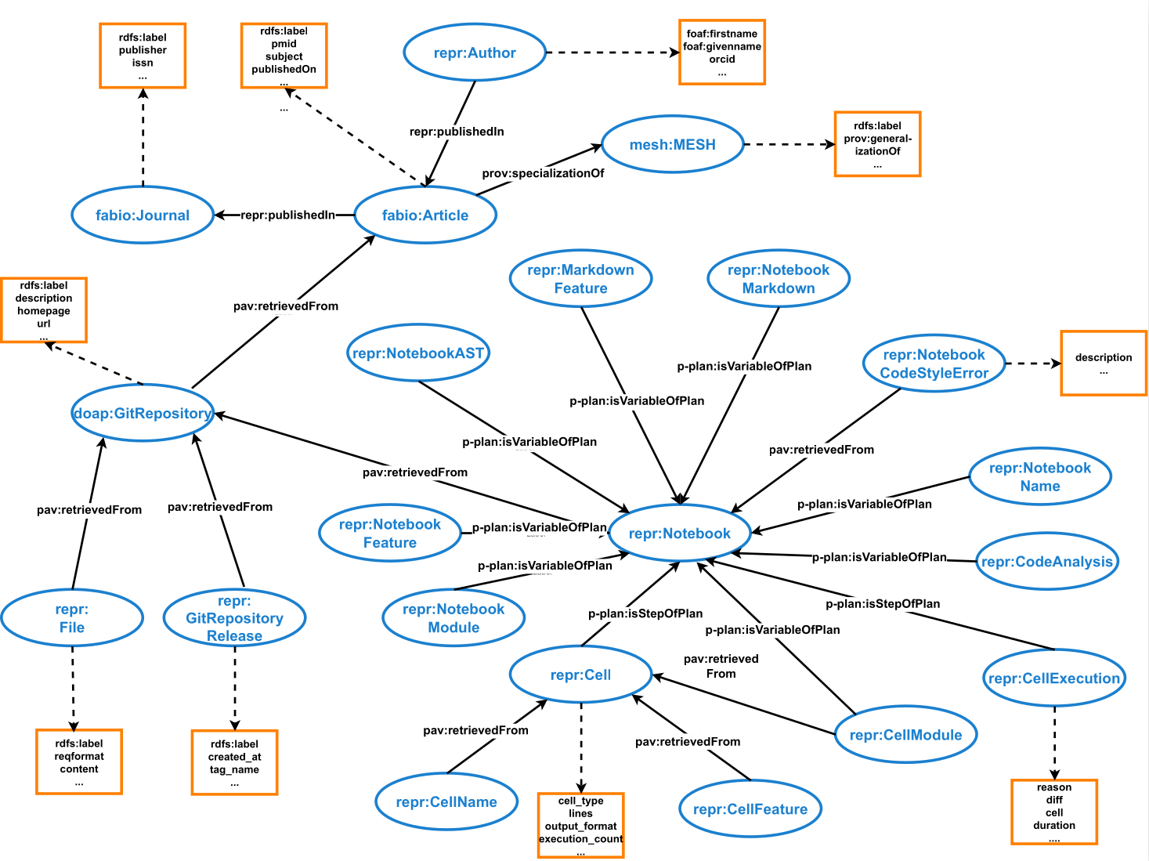
FAIR Jupyter
Ontology

Slide 7
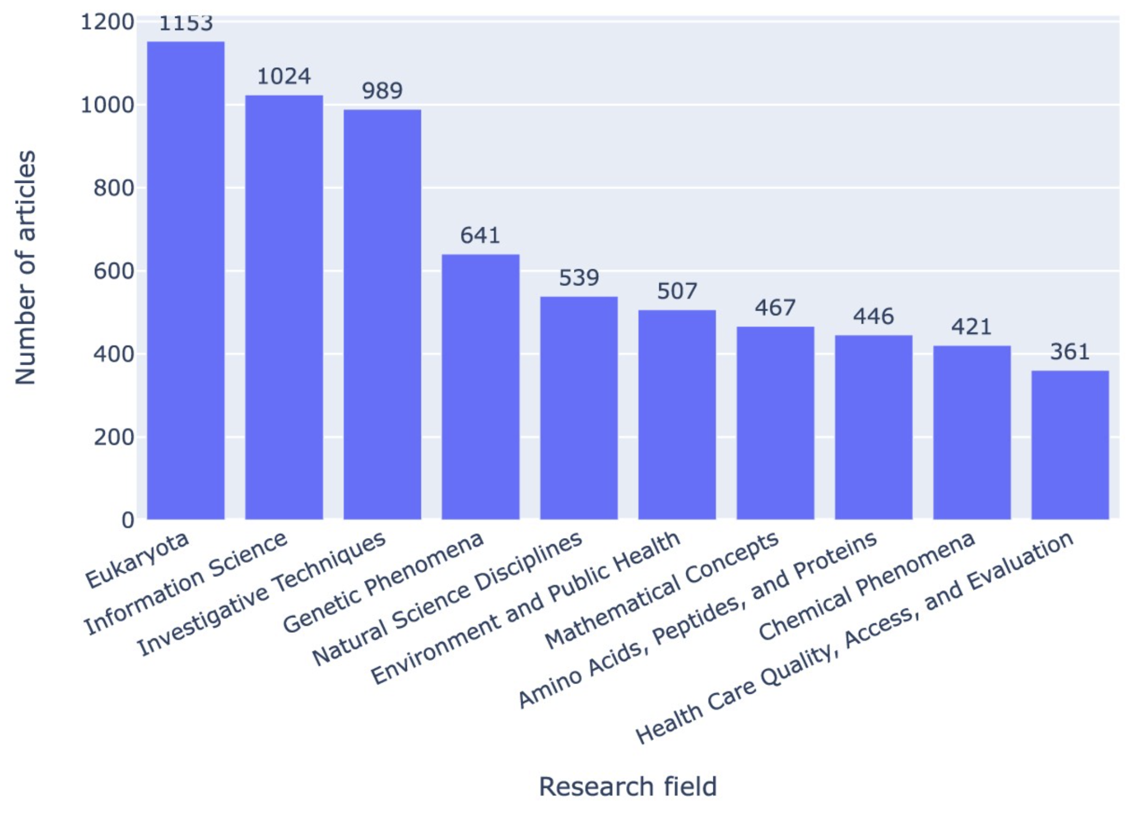
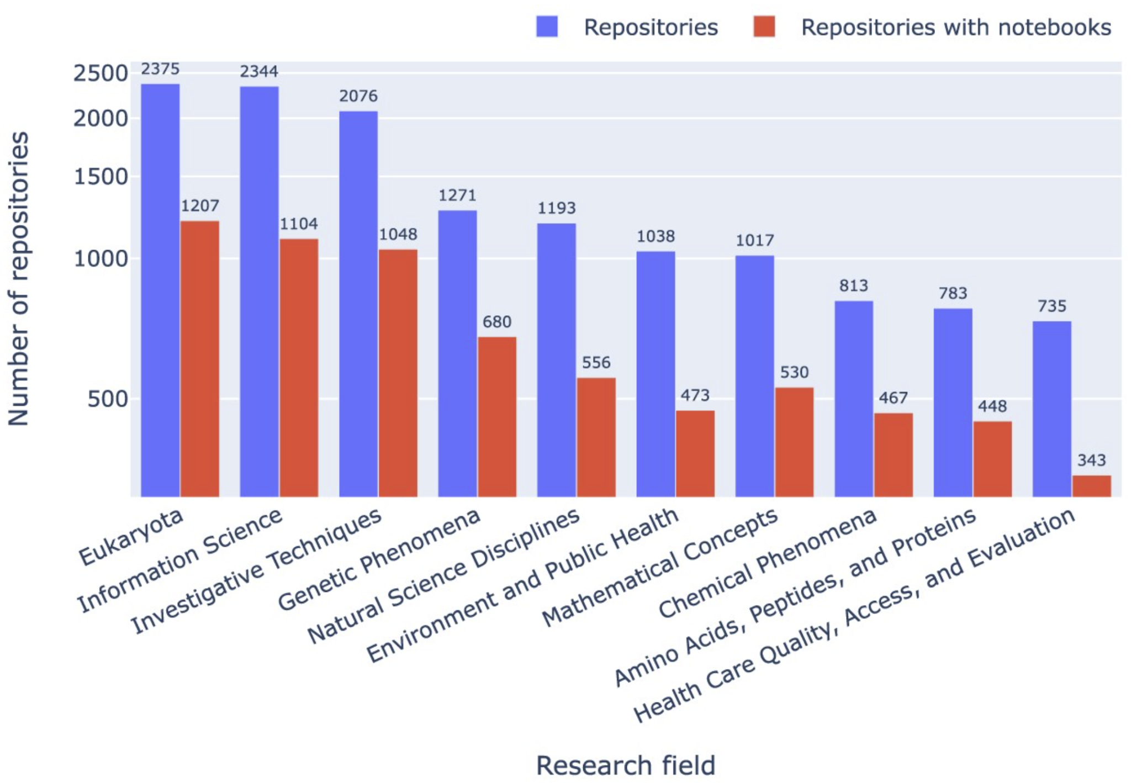
Results - Research Field
SPARQL Query: Research articles by research field
SPARQL Query: Research field (MeSH terms) by the number of GitHub repositories that contain at least one Jupyter notebook.

Slide 8
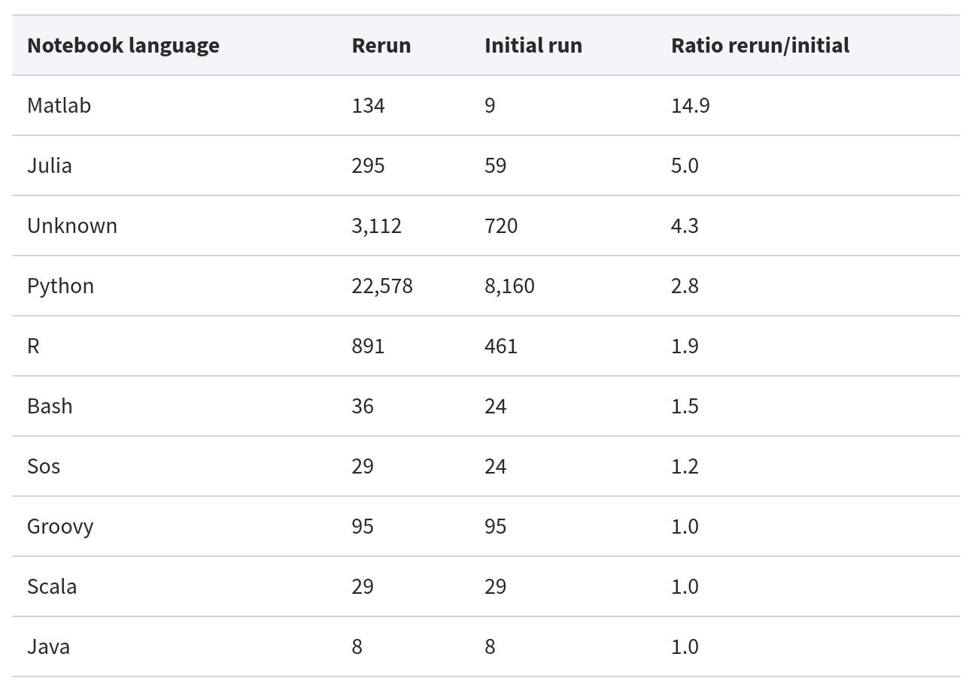
Results - Programming Languages

Slide 9
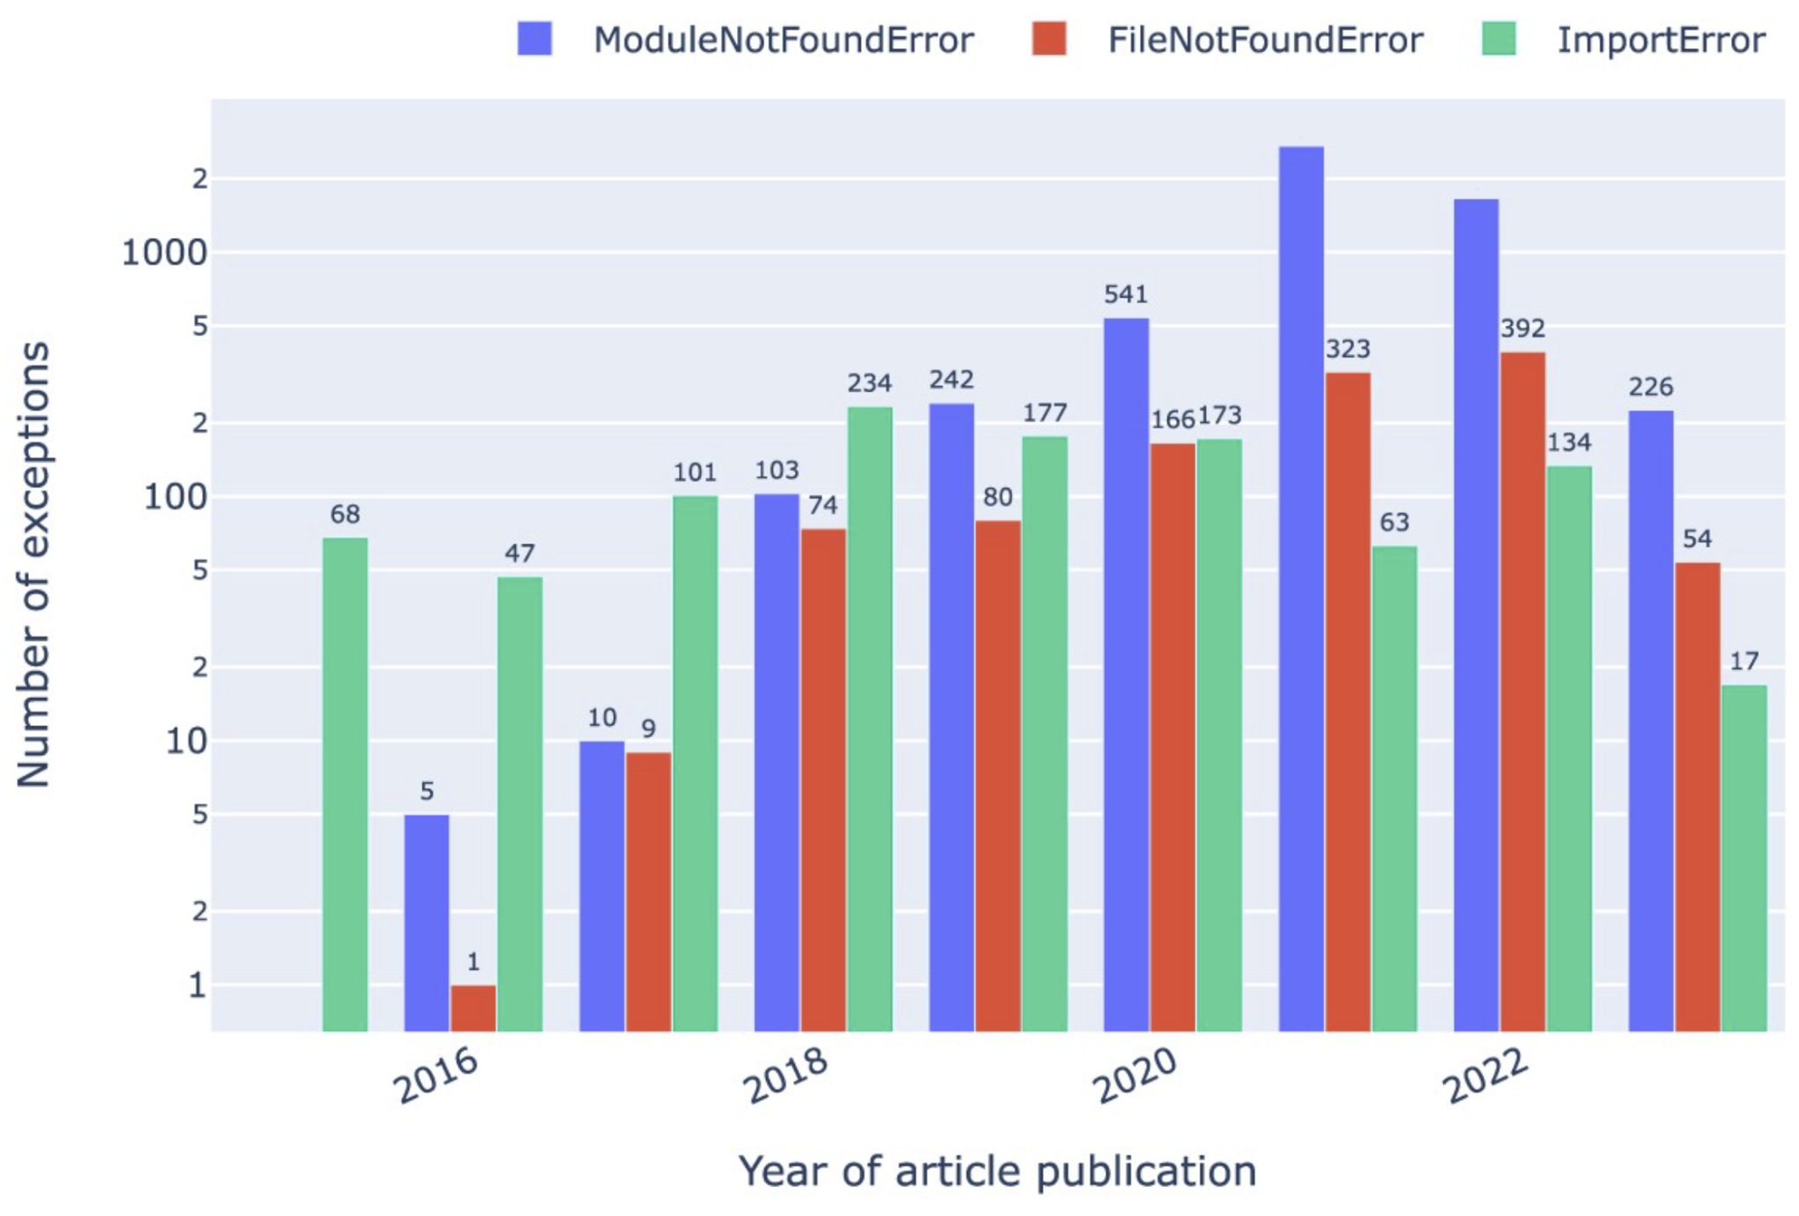
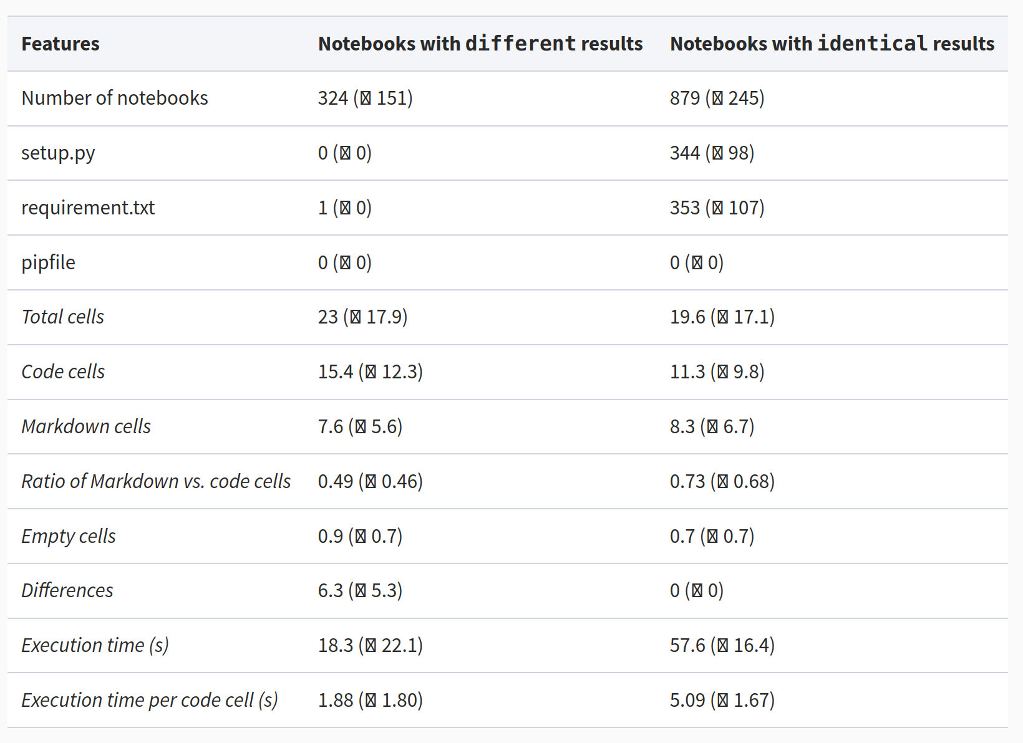
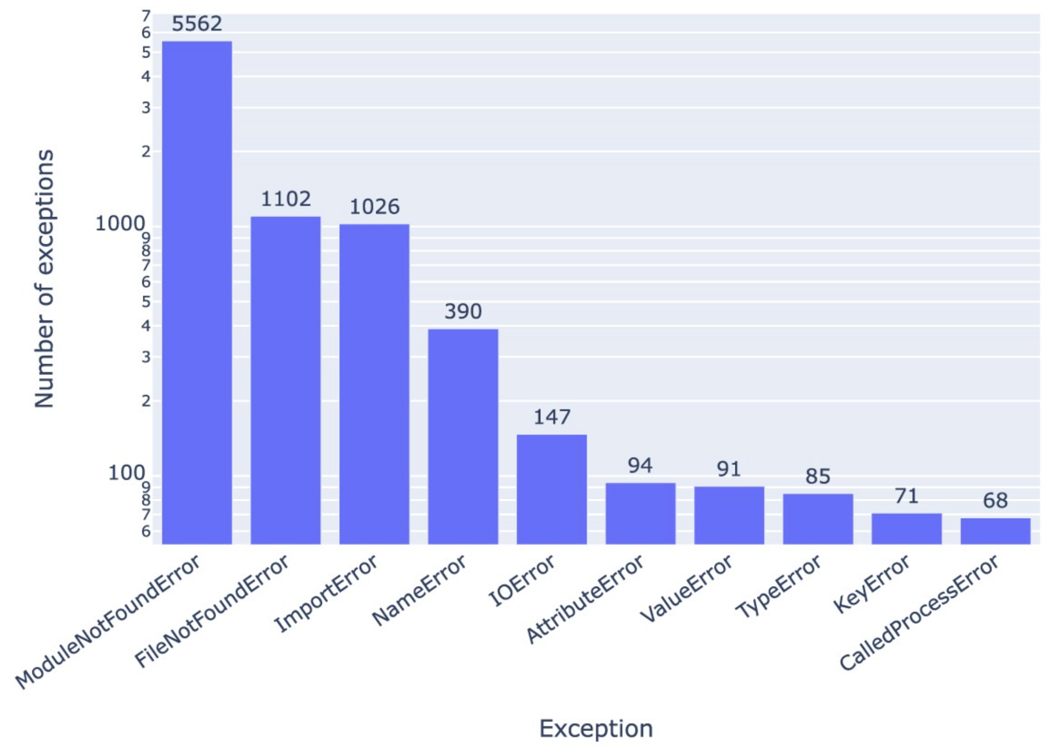
Results - Notebook Reproducibility
SPARQL Query: Exceptions occurring in Jupyter notebooks in our corpus.

Slide 10
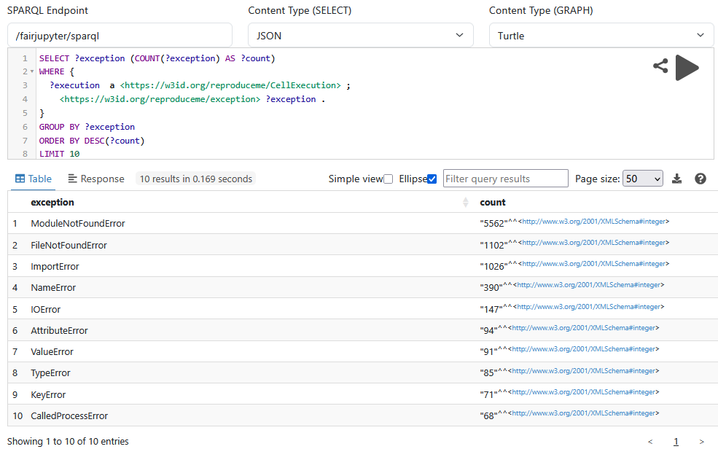
Results - Notebook Reproducibility
SPARQL Query: Exceptions occurring in Jupyter notebooks in our corpus.

Slide 11
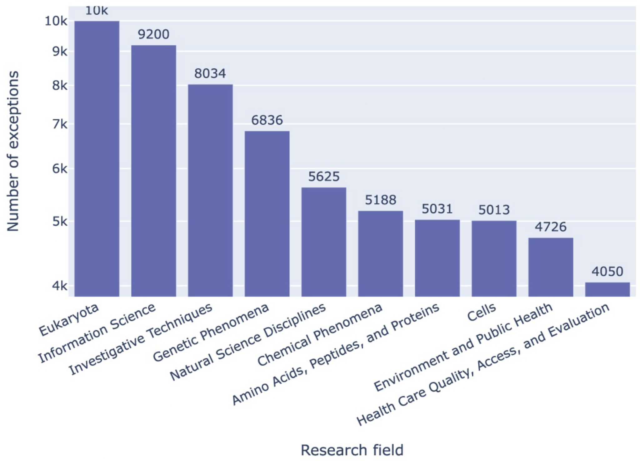
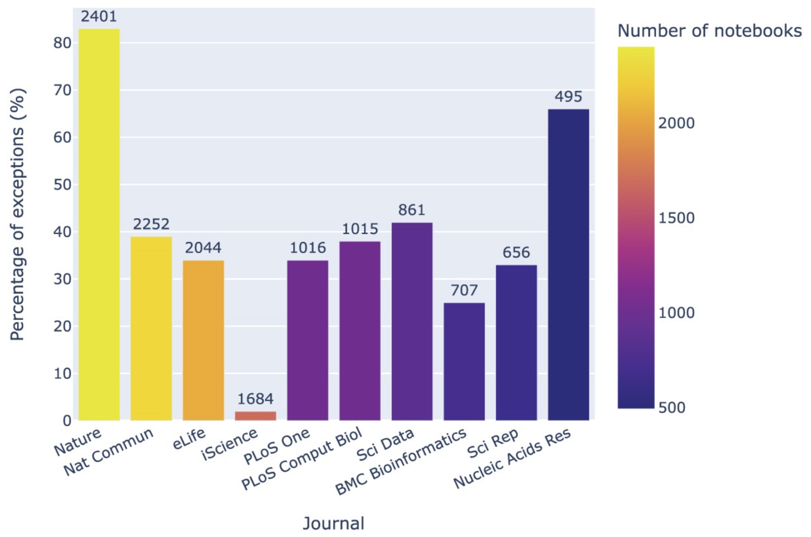
Results - Notebook Reproducibility
SPARQL Query: Jupyter notebook exceptions by research field, taking as a proxy the highest-level MeSH terms of the article associated with the notebook.
Effect of peer review and editorial workflows:
Nature has about 50 percent more notebooks than iScience, but Nature’s fail about 40 times more often

Slide 12
Example queries
Local
Notebooks by search term: ‘immun’ AND (‘stem’ OR ‘differentiation’)
Article by keywords, e.g., ‘open source’
Most common errors in immunology
Most common errors in Nature journal
MeSH terms ranked by ‘ModuleNotFoundError’ frequency
GitHub repositories
GitHub repositories by their stargazers count
GitHub repositories and their Software Heritage snapshot
https://doi.org/10.5281/zenodo.12806151
Articles and repositories with notebooks in Julia
Federated
Match articles between FAIR Jupyter and Wikidata via DOI
Match articles between FAIR Jupyter and NFDI/MaRDI via DOI and get co-used software

Slide 13
Impact of FAIR Jupyter on Research Software Engineering
Enhancing Reproducibility:
Provides insights into the computational reproducibility of Jupyter notebooks in research software.
Metadata-Driven Analysis:
Captures dependencies, execution environments, and versioning to improve software reliability.
Knowledge Graph Integration:
Enables structured exploration of software repositories, aiding in dependency management and best practices.

Slide 14
Impact of FAIR Jupyter on Research Software Engineering
FAIR Principles Applied:
Findability: Links software, notebooks, and publications for better discoverability.
Accessibility: Public SPARQL endpoint allows open data exploration.
Interoperability: Supports integration with external resources and standards.
Reusability: Encourages best practices in research software development.
Driving Open Science & Software Quality:
Identifies trends in dependency usage and failures.
Supports sustainable and transparent software engineering practices.

Slide 15
Future Work: FAIR Jupyter for SE & Education
Educational Applications
Use FAIR Jupyter to teach best practices in reproducible research and software development.
Enable hands-on learning with real-world datasets and reproducibility challenges.
Enhancing Software Quality & Standards
Analyze trends in software dependencies, versioning, and execution environments.
Develop guidelines for improving reproducibility in research software.
Expanding the Knowledge Graph
Link FAIR Jupyter with other open-source datasets to provide a broader view of software engineering practices.
NFDIs: FAIR Jupyter / KGI4NFDI / nfdi.software / …
Community Engagement & Collaboration
Foster open science initiatives by engaging researchers, educators, and developers.
Encourage contributions to enhance FAIR Jupyter’s utility in software engineering.

Slide 16
Thank you
German Research Foundation (DFG), TRR-386, project number 514664767
Alfred P. Sloan Foundation under grant number G-2021-17106.
Ara Cluster of Friedrich Schiller University Jena under DFG grants INST 275/334-1 FUGG and INST 275/363-1 FUGG.
BASE4NFDI/KGI4NFDI: DFG 521453681
Contact: sheeba.samuel@informatik.tu-chemnitz.de & daniel.mietchen@fiz-karlsruhe.de
deRSE25, 26 February 2025 - DOI: 10.5281/zenodo.14678185

