Slide 1
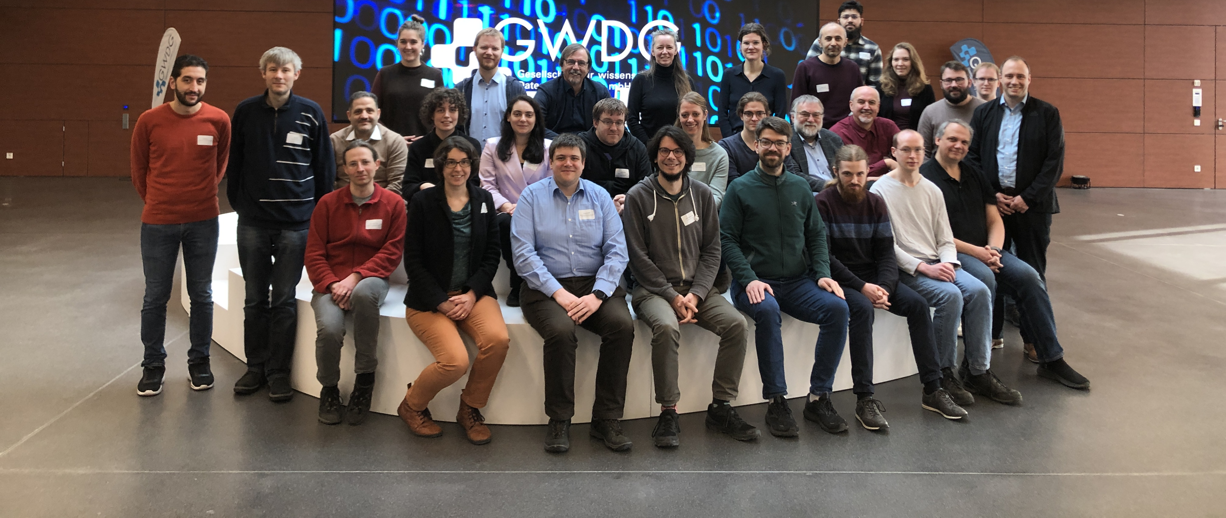
NFDIxCS: Guarantee Levels of the Research Data Management Container (RDMC)
Safial Islam Ayon, Dr Firas Al Laban, Jan Bernoth, Michael Goedicke

Slide 2
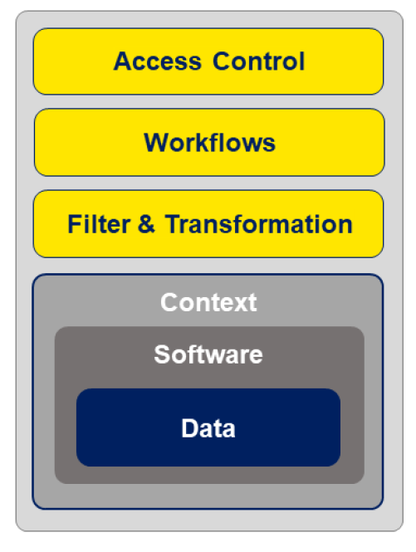
Research Data Management Container (RDMC)
Central Hypothesis of NFDIxCS:
Research Data and Research Software are not the same but it is linked together with its research context
Solution Concept:
Design a Research Data Management Containers (RDMC) as a time capsule for research data and software
Digital, referenceable object
Describable with Metadata
Manage access and workflow
Additionally design and implement a hosting platform RDMCs

Slide 3
RDMC Reusable Execution Environment
NFDI(xCS) Platform
Download
Download
Reference
Reusable Execution Environment
Copy data/software

Slide 4
Connecting Active Containers: Integration with Services and Infrastructure
Interact with platform for e.g. artifact review processes
Use metadata to connect to knowledge graphs
Create an execution environment to run the software with its data
Integrate quality metrics by providing guarantee levels
Notes:
* Creation Process: Was is created manually (error prone) or with automation (from a platform or template)

Slide 5
Guarantee in Research Software Engineering
Research software is iterative and improves over time.
Guarantee is important for future development.
Verification ensures:
Functional correctness.
Alignment with system requirements.
Potential for reusability and reproducibility.
Confidence Through Guarantees:
Data and Software behaves as expected.
Supports validation, feedback, and requirements.

Slide 6
Why Integrate Guarantees into RDMC?
Flexibility for Diverse Needs:
Guarantees are shaped by chosen standards and methodologies.
Not all containers need long-term preservation or full standardization.
Encourages Best Practices:
Guarantee responsibility lies with RDMC creators.
Choice of metadata, sealing, and tools impacts long-term quality.
Structured and well-documented artifacts enhance research integrity.
Hashing and sealing to maintain data quality over time.
Controlled access mechanisms help maintain quality and security.

Slide 7
Why Integrate Guarantees into RDMC? (2)
Informs About Missing Dimensions:
Highlights areas for improvement.
Provides opportunities to integrate best practices.
Transparency for Container Readiness:
The guarantees of an RDMC depends on the methods and standards chosen by its creator.
RDMC ensures transparency but does not enforce specific guarantee levels.
Supporting Decision-Making:
RDMC helps users make informed decisions by showing how well processes are followed.
Stakeholders can evaluate an RDMC’s trustworthiness based on creator-provided guarantees.

Slide 8
Stakeholders' Interaction with RDMC Guarantees
Stakeholders
Users
Policy Makers
Decision Makers
Creators (Owner)

Slide 9
Owner's Benefits in RDMC Guarantees
Stakeholders
Users
Policy Makers
Decision Makers
Creators (Owner)
Understand how RDMCs are created and the quality of services used.
Compare RDMCs with best practices.
Identify gaps and improve reliability.
Improve RDMCs by learning from guarantees.

Slide 10
User’s Benefits in RDMC Guarantees
Stakeholders
Users
Policy Makers
Decision Makers
Creators (Owner)
Users get easy access to well-documented, structured data.
Ensures trust about quality of artifacts.

Slide 11
Policy Maker’s Benefits in RDMC Guarantees
Stakeholders
Users
Policy Makers
Decision Makers
Creators (Owner)
Provides a provable foundation for policy development.
Supports efficient allocation of funding.
Aligns with FAIR principles, promoting open science.
Ensures legal and best practice standards.

Slide 12
Decision Maker’s Benefits in RDMC Guarantees
Stakeholders
Users
Policy Makers
Decision Makers
Creators (Owner)
Supports legal and ethical standards and FAIR data policies.
Promotes transparency in research management.
Supports KPI evaluation through accumulated metadata

Slide 13
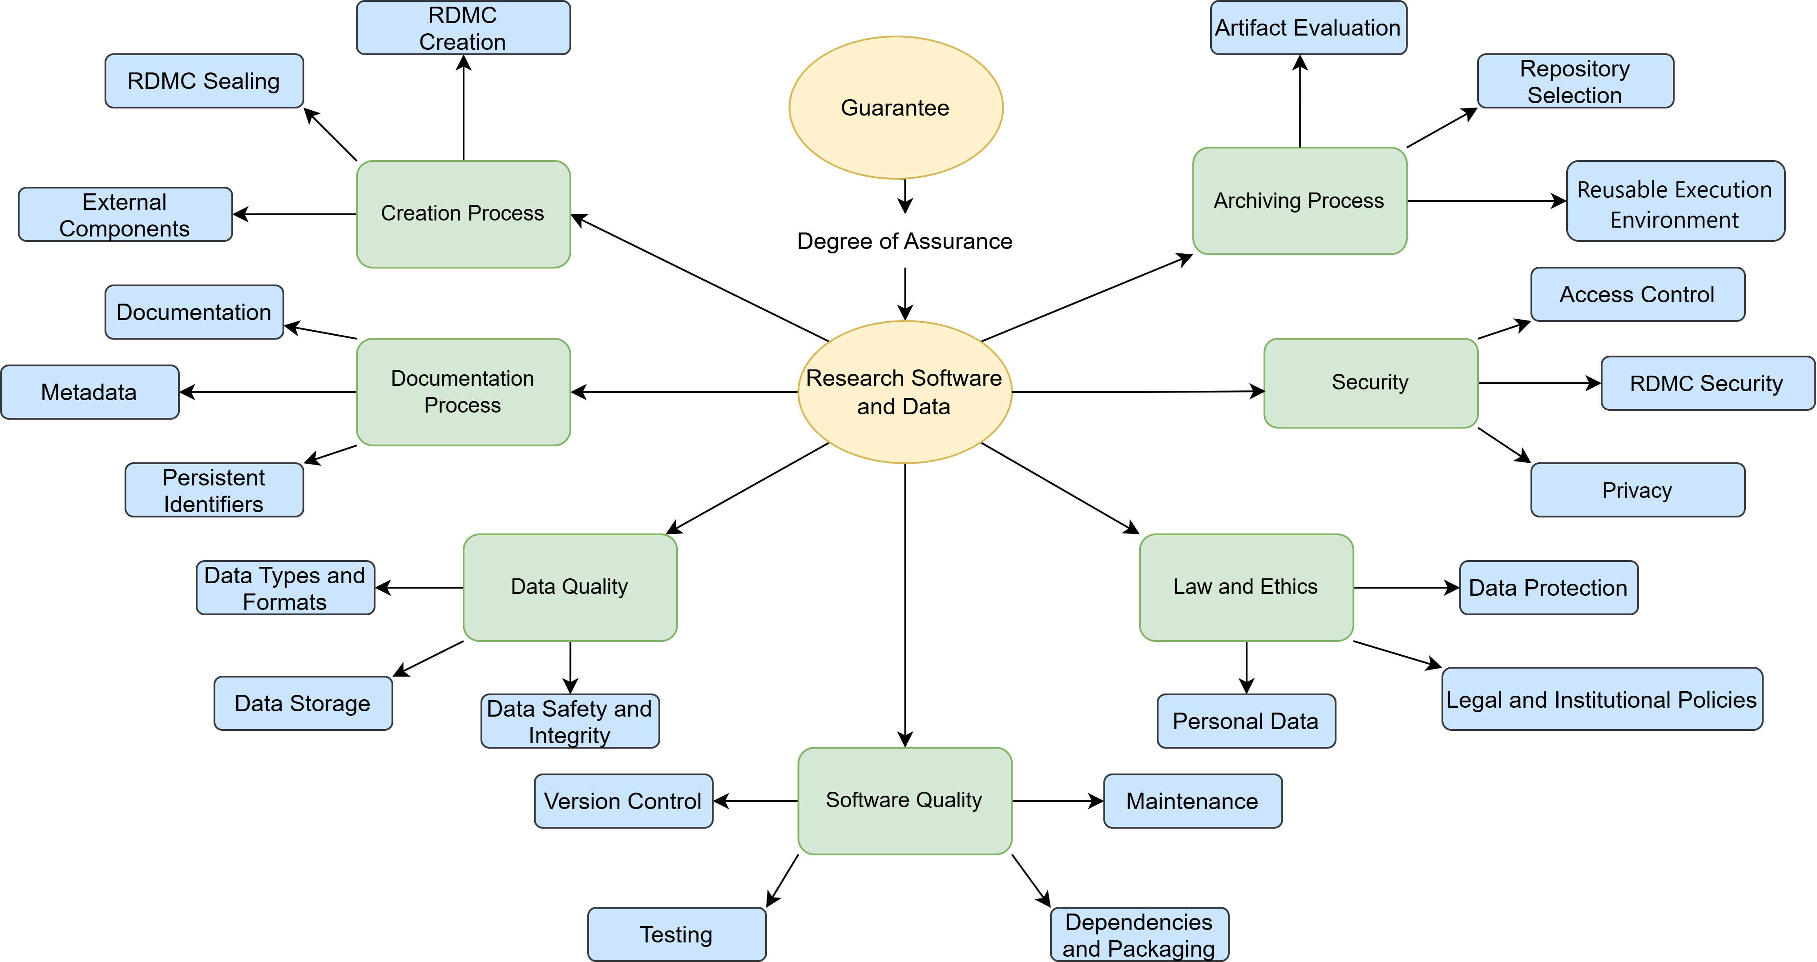
(Possible) Guarantee Dimensions in RDMC

Slide 14
Guarantee Dimensions – Sealing & Metadata
Not Sealed
Server Side
Hashing (Public and Private key)
Sealing
No Standardization
Minimal Standardized (Dublin core, DataCite)
Full Standardized (CodeMeta, schema.org, DCAT)
Customize Metadata Standard
Metadata

Slide 15
What Comes Next?
Developing methods to define and implement guarantees
Identifying key starting points for integration
Developing evaluation criteria for guarantees
Identifying key dimensions to be considered for comprehensive guarantees
Understanding the relationship between different guarantee dimensions (e.g., how sealing guarantees affect metadata quality)

Slide 16
Summary
Guarantee measures define the quality and consistency of RDMCs
They ensure reliable, secure data management across research projects.
Different dimensions of guarantee provide flexibility to balance effort and security.
Guarantees make RDMCs adaptable for diverse research needs and environments.
They play a key role in enhancing the trustworthiness and long-term usability of RDMCs.

Slide 17
Safial Islam Ayon
Research Assistant,
NFDIxCS
University of Potsdam
safial.islam.ayon@uni-potsdam.de

Slide 18
Appendix

Slide 19
RDMC Creation Process

Slide 20
Guarantee Dimensions – RDMC Creation
RDMC
Security
Sealing
Metadata
Manual Creation
Use Existing Artifacts
Automatic Process
Guided Wizard
External Components
Artifact Evaluation
Reusable Environment
RDMC Creation

Slide 21
Guarantee Dimensions - Artifact Evaluation
RDMC
Security
Sealing
Metadata
No Badge
Artifacts Evaluated (Functional and Reusable)
Artifacts Available
Results Validated (Reproduced and Replicated)
RDMC Creation
External Components
Reusable Environment
Artifact Evaluation

Slide 22
Guarantee Dimensions - Security
RDMC
Sealing
Metadata
No security, no encryption
Minimal security, possible encryption
Full encryption, secure access
Artifact Evaluation
RDMC Creation
External Components
Reusable Environment
Security

Slide 23
Guarantee Dimensions - External Components
RDMC
Security
Sealing
Metadata
External links only
Some local, some external
All resources stored locally
Artifact Evaluation
RDMC Creation
Reusable Environment
External Components

Slide 24
Guarantee Dimensions - Reusable Environment
RDMC
Security
Sealing
Not Includes
Recording
Docker
Ngnix
Metadata
RDMC Creation
Artifact Evaluation
External Components
Reusable Environment

Slide 25
Future dimensions that can be consider
Cross-platform integration
Community-based reviews & feedback
Automated metadata extraction
Scalability (for handling large datasets or complex workflows).
Interdisciplinary compatibility.
Data management plan and Software management plan.

Slide 26
Future Prospects of Guarantee Services in RDMC
Adaptability:
RDMCs remain flexible to future advancements.
Integration with New Standards:
Adaptation to new tools and standards.
Continuous Improvement:
Enable ongoing improvements in security and quality.
Reliable Research Outcomes:
Standardized guarantees will support consistent and verifiable results.
Facilitated Collaboration:
Guarantees enable researchers to confidently share and reuse data.

