Slide 1
Maintaining Open Source BIMserver through Enhanced Contributor Support
Zaqi Fathis, Helga Tauscher
Fakultät Geoinformation
Notes:
- ZIM project - openfabtwin

Slide 2
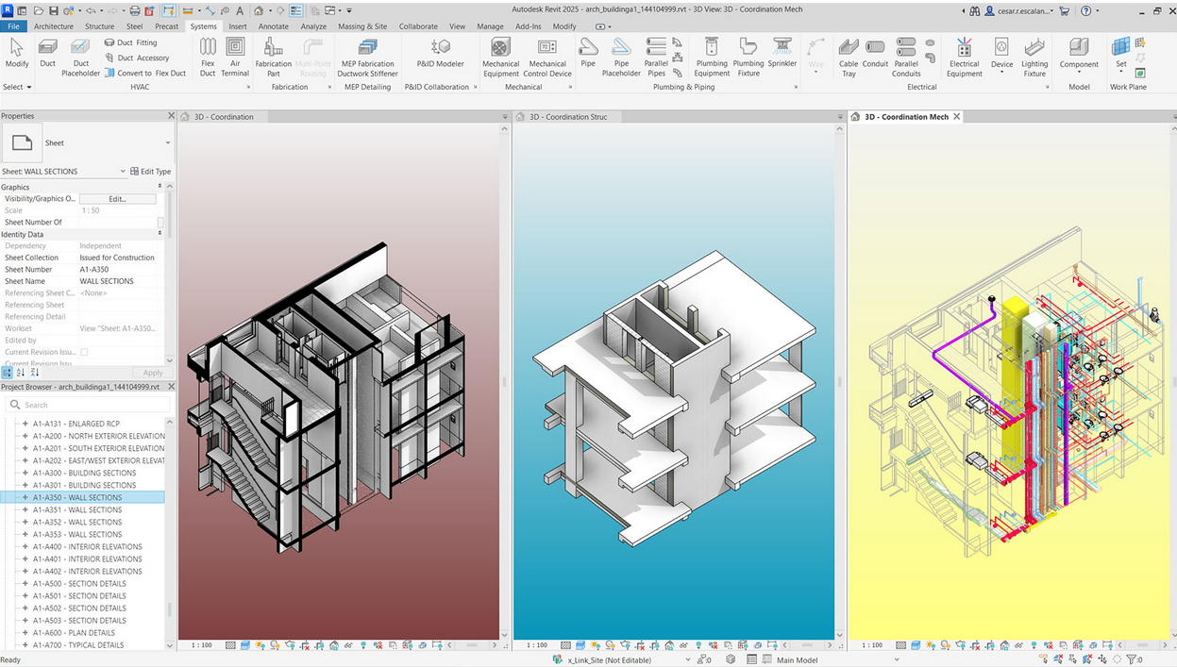
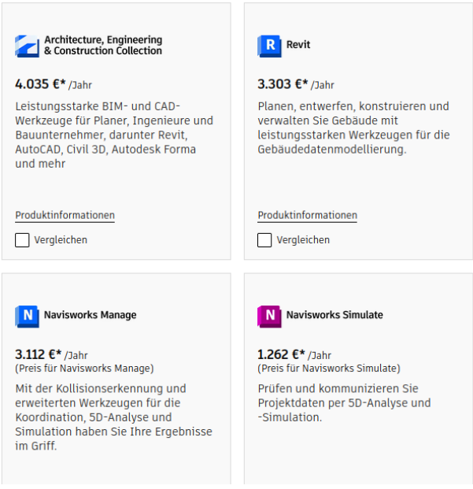
Building Information Modelling
BIM with Autodesk Revit : https://www.autodesk.de/products/revit/features
Autodesk products : https://www.autodesk.de/products
Notes:
allow collaboration among stakeholder in AEC industry to optimize processes throughout the design, construction, and operation of buildings
Design, construction, archive phase
Building Information Modelling (BIM) = model + information,
Most of the few existing commercial implementations are built on the basis of general purpose STEP or PLM/PLCS technologies. Req additional commercial software for allowing collaboration

Slide 3
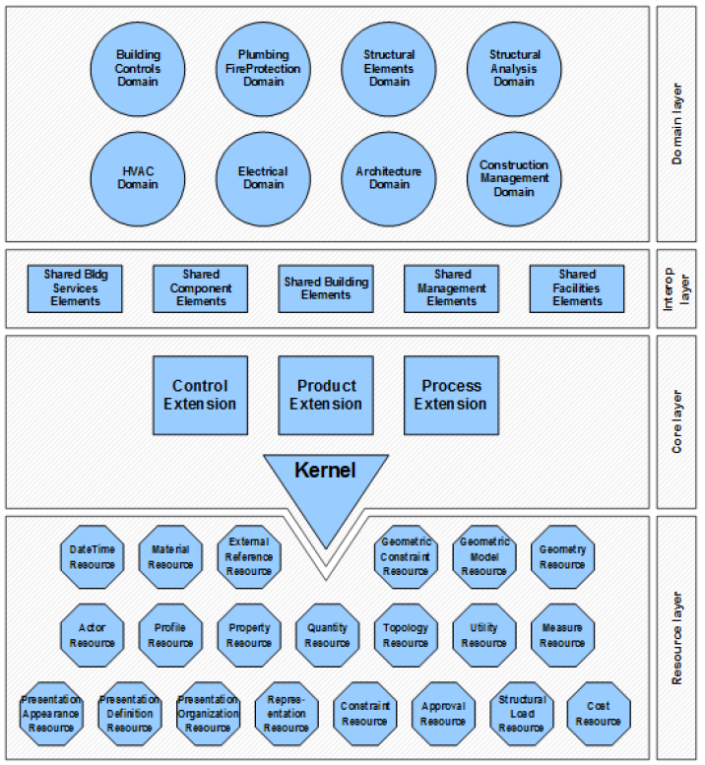
Industry Foundation Classes
Source: https://technical.buildingsmart.org/
Notes:
is a open and international standard, digital description of the built environment, including buildings and civil infrastructure.
(from buildingsmart.org) the IFC schema is a standardized data model that codifies, in a logical way… the semantic, the attributes, and relationship of object, abstract concept, process, and people(owners,..)
The data schema architecture of IFC defines four conceptual layers, each individual schema is assigned to exactly one conceptual layer.

Slide 4
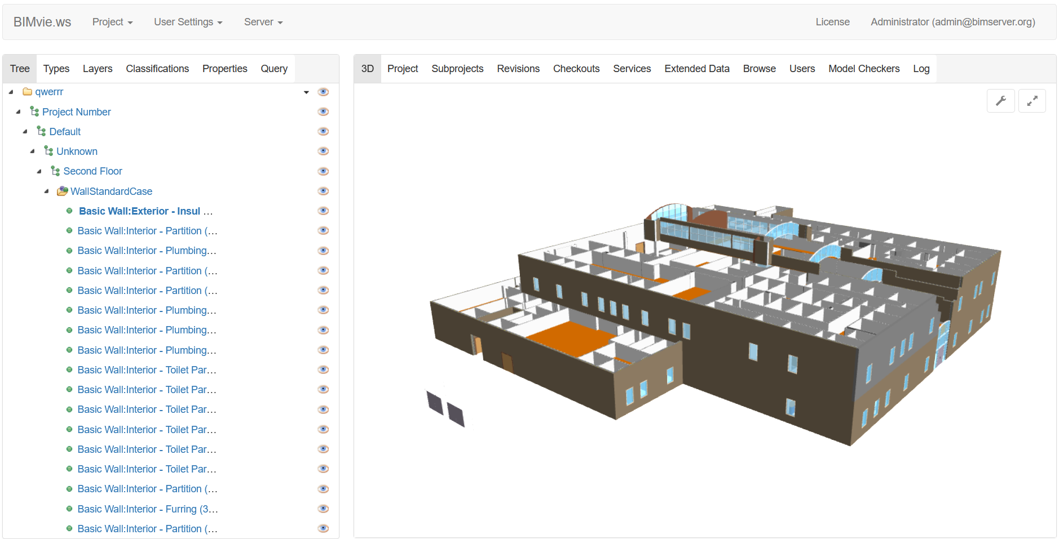
Opensource BIMserver
Open source server software which store building information in IFC format.
Developed by TNO, the Dutch Organization for Applied Scientific Research
Notes:
it remains a challenge to ensure all stakeholders have access to accurate, up-to-date and consistent information.
Lost in translation
The Opensource BIMserver plays a vital role in facilitating information exchange in construction project.

Slide 5
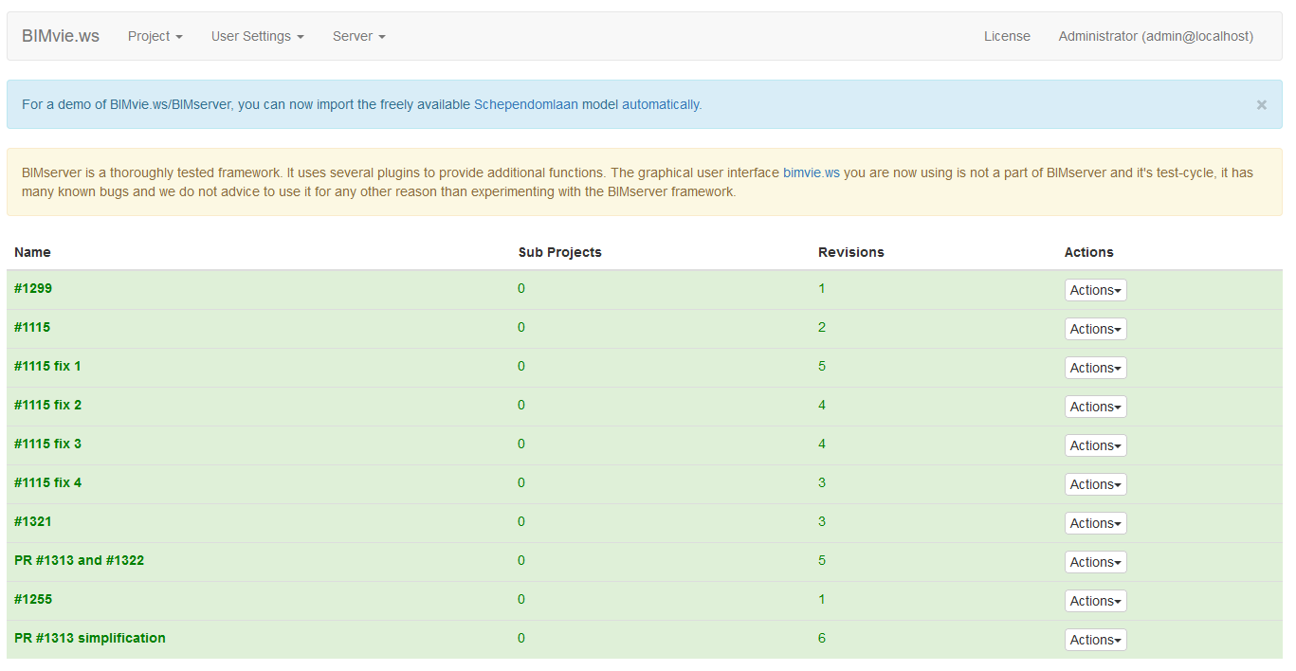
Opensource BIMserver | Features
Projects

Slide 6
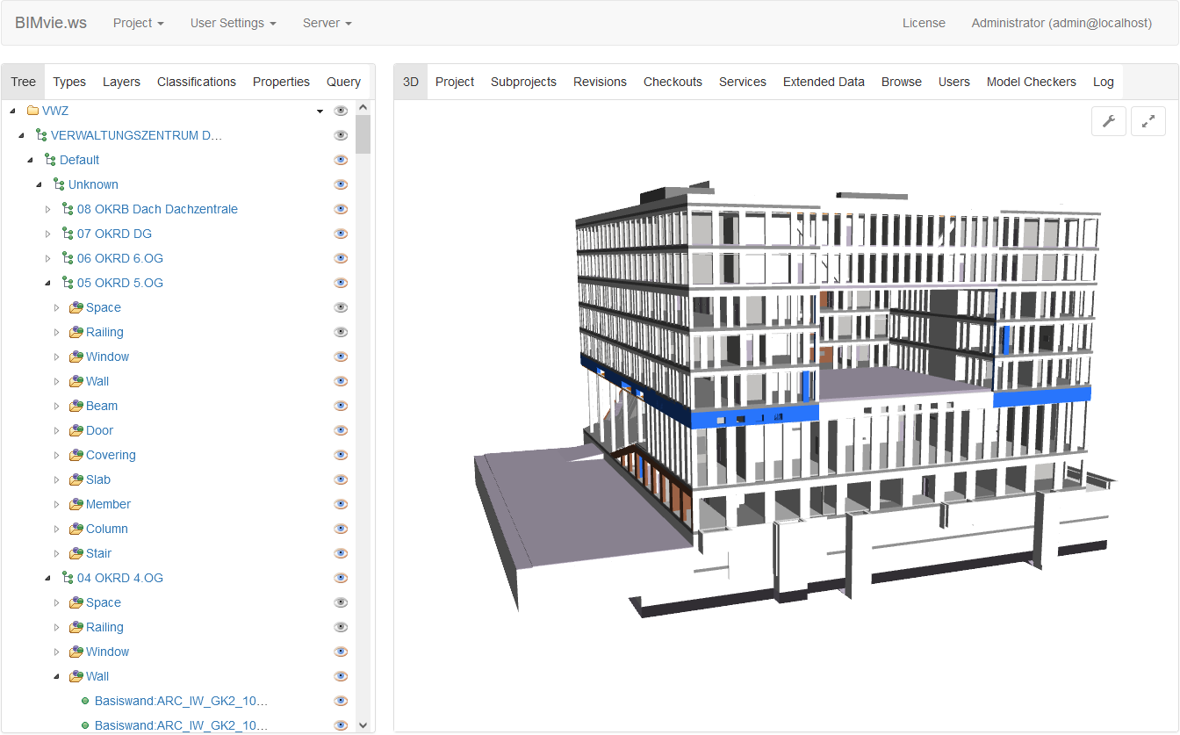
Opensource BIMserver | Features
Projects
3d view
Spatial structure

Slide 7
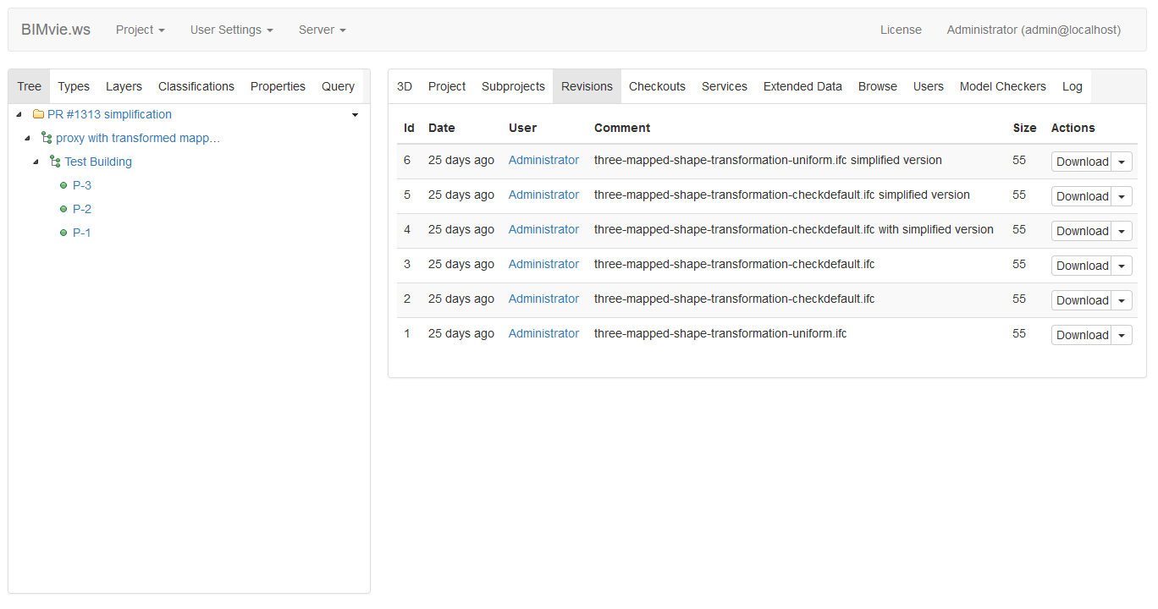
Opensource BIMserver | Features
Projects
3d view
Spatial structure
Revisions

Slide 8
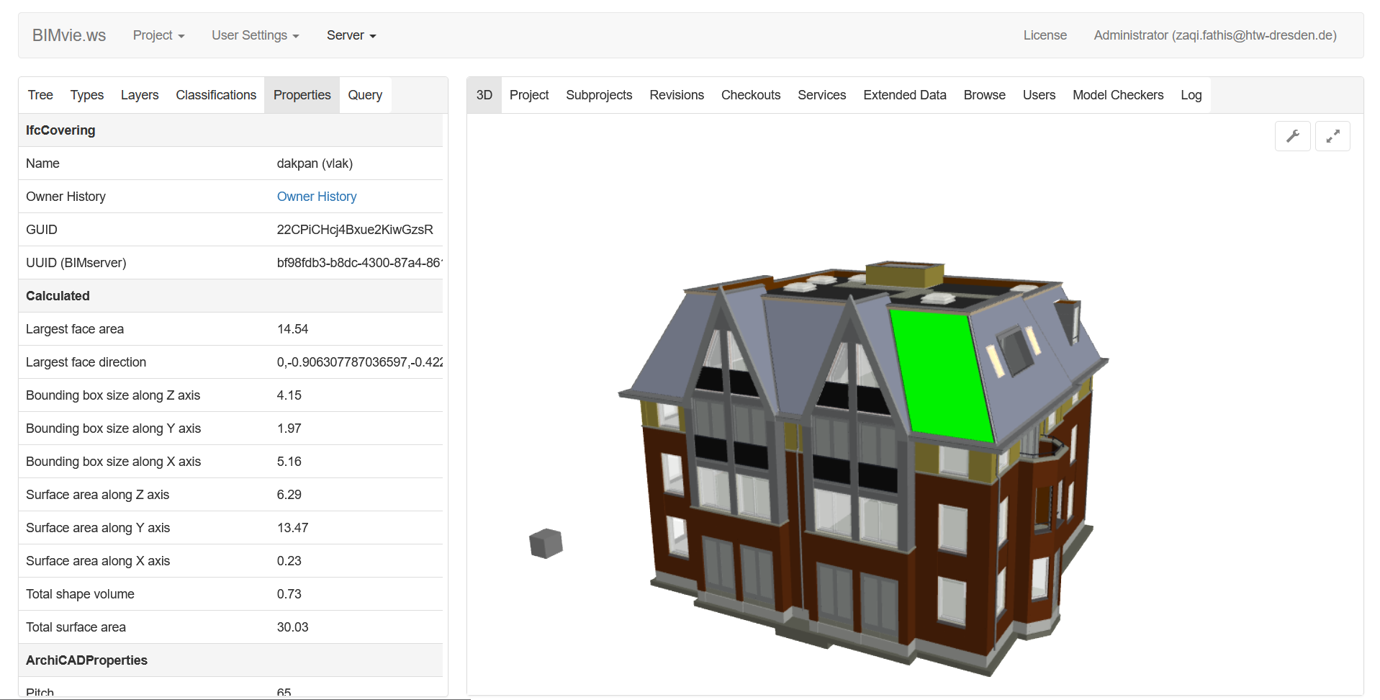
Opensource BIMserver | Features
Projects
3d view
Spatial structure
Revisions
Properties

Slide 9
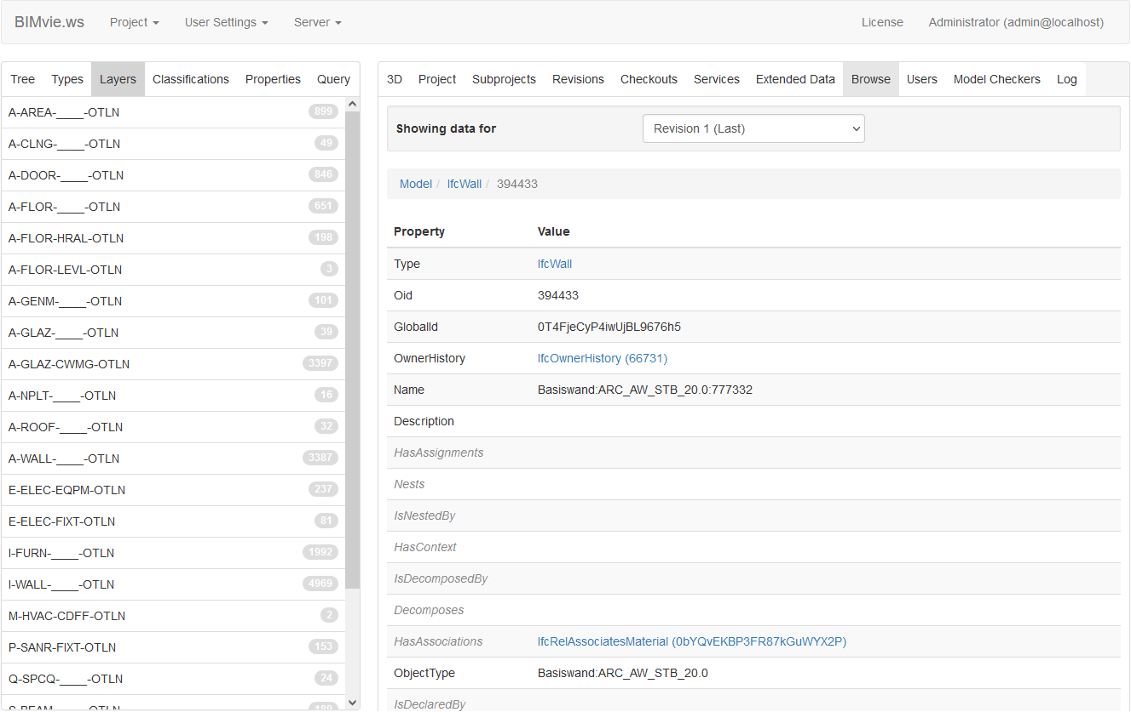
Opensource BIMserver | Features
Projects
3d view
Spatial structure
Revisions
Properties
Browse

Slide 10
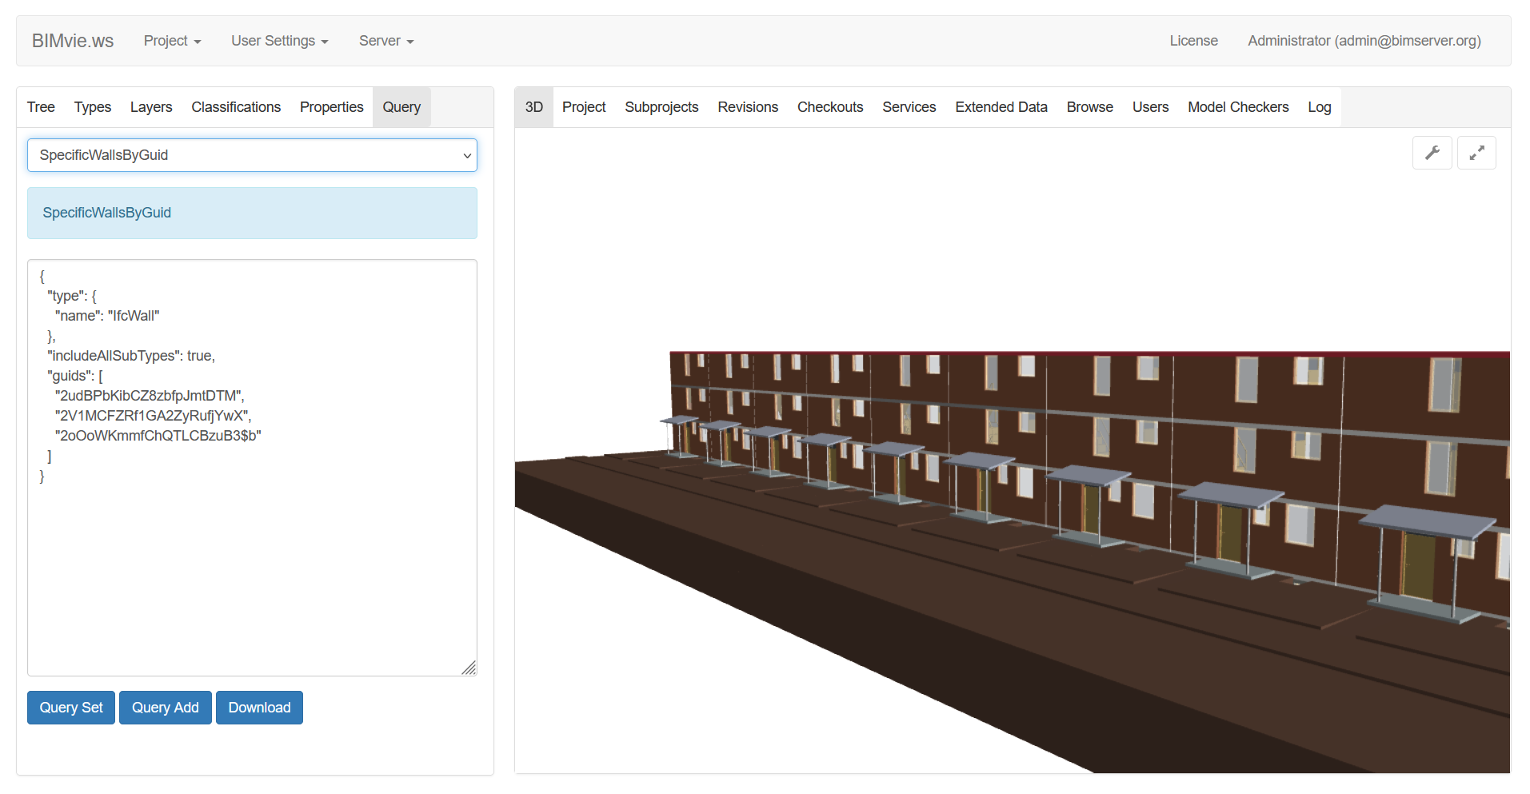
Opensource BIMserver | Features
Projects
3d view
Spatial structure
Revisions
Properties
Browse
Query

Slide 11
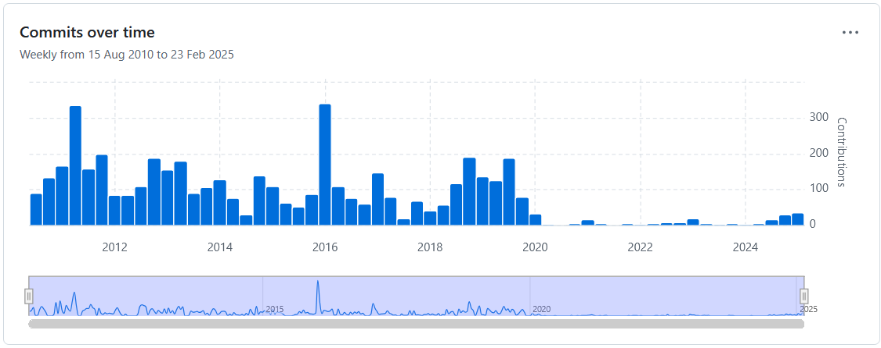
Maintaining BIMserver | challenges and strategies
Notes:
Codebase is 15 years

Slide 12
Maintaining BIMserver | challenges and strategies
Challenges:
Limited resources for regular updates on codebase, existing features improvements, documentation, user support.
Large and complex codebase:
approximately 6000 Java classes (and 4000 generated classes in addition)
approximately 2.7 million lines of code (and 1.3 million lines of generated code)
Documentation
Issue tracking
Dependency updates
Automated testing
Notes:
- How to enhances new contributor to actively participate in the project, providing them with the necessary resources to contribute effectivelly
- where to start as a new contributor?

Slide 13
Documentation
Getting started
Deployment
Clients
Developers
Requirements
Installation
Ubuntu installation
Window installation
Memory
Security
Performance
Communication with BIMserver
Interfaces for interaction with BIMserver
Queries
Plugin development
Notes:
primary medium of communication between core developers and the community, as well as the on-boarding process for new contributors
Start with the simple part
Check if the docs reflect with the latest version

Slide 14
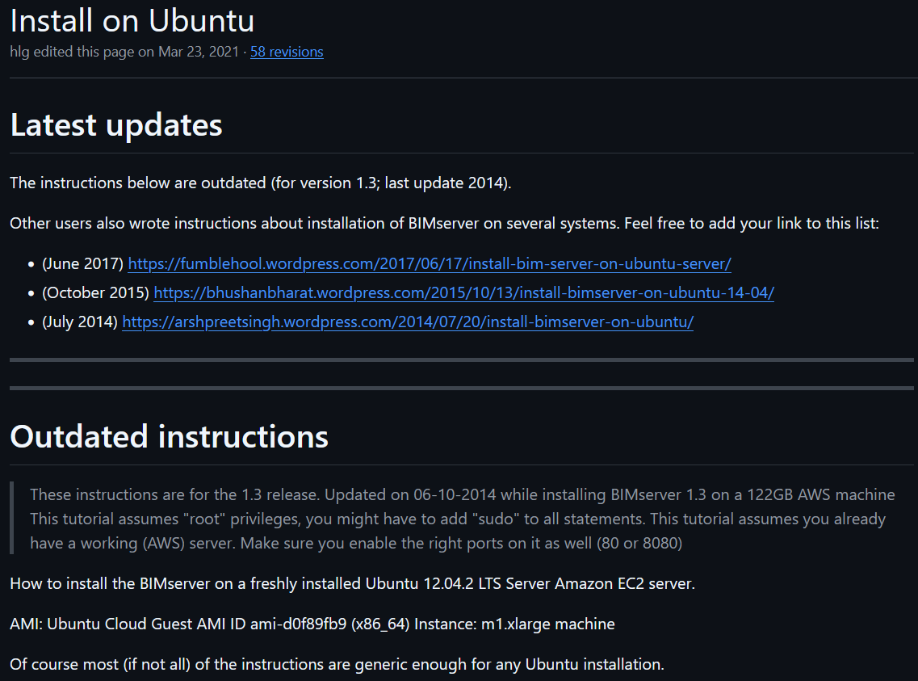
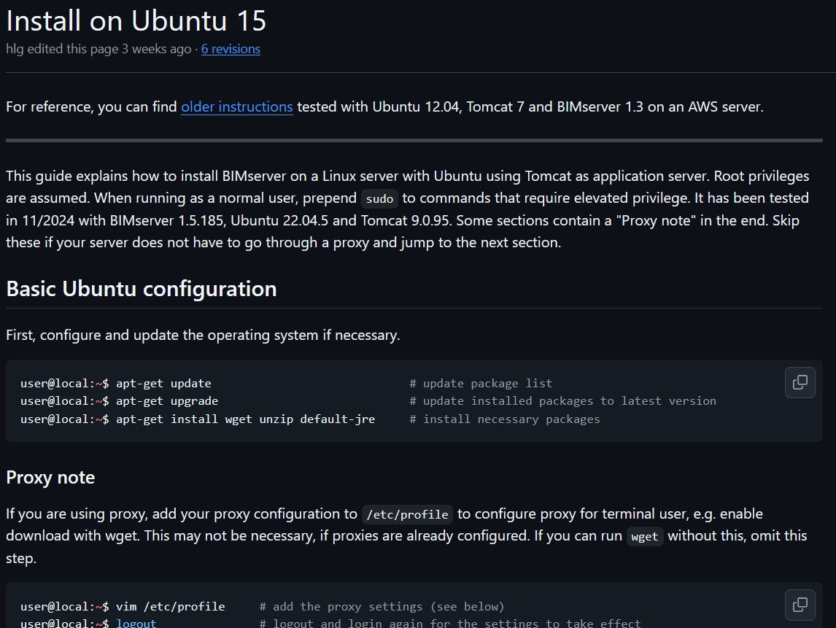
Documentation
Outdated documentation
Updated documentation
Notes:
E.g. update with the latest version

Slide 15
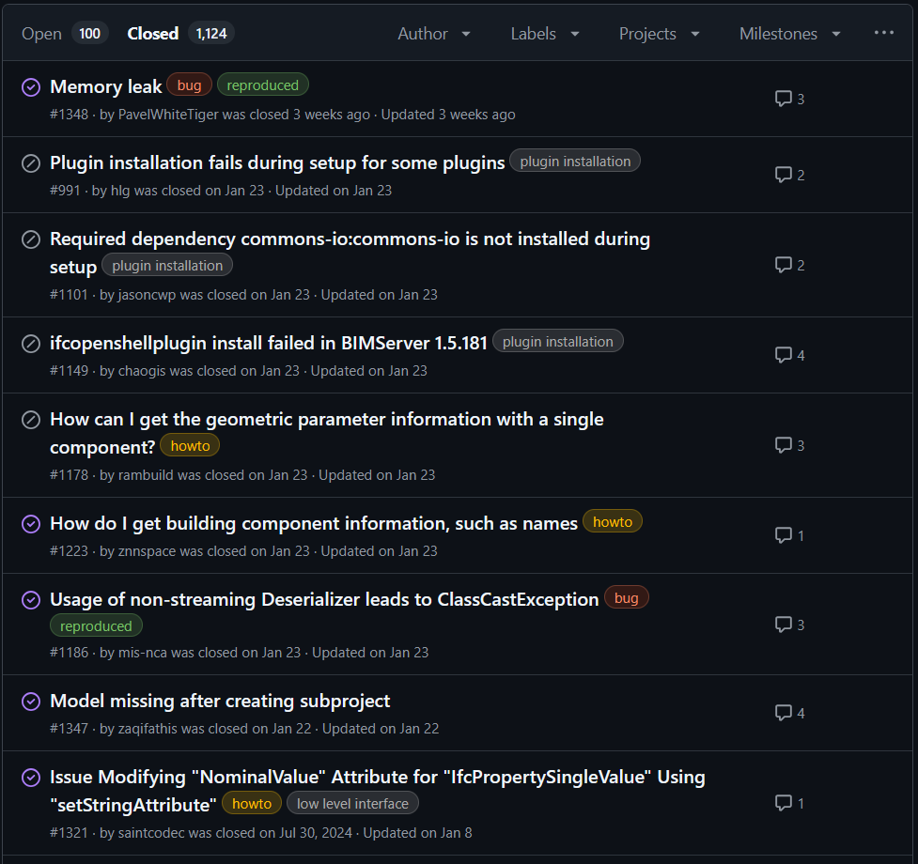
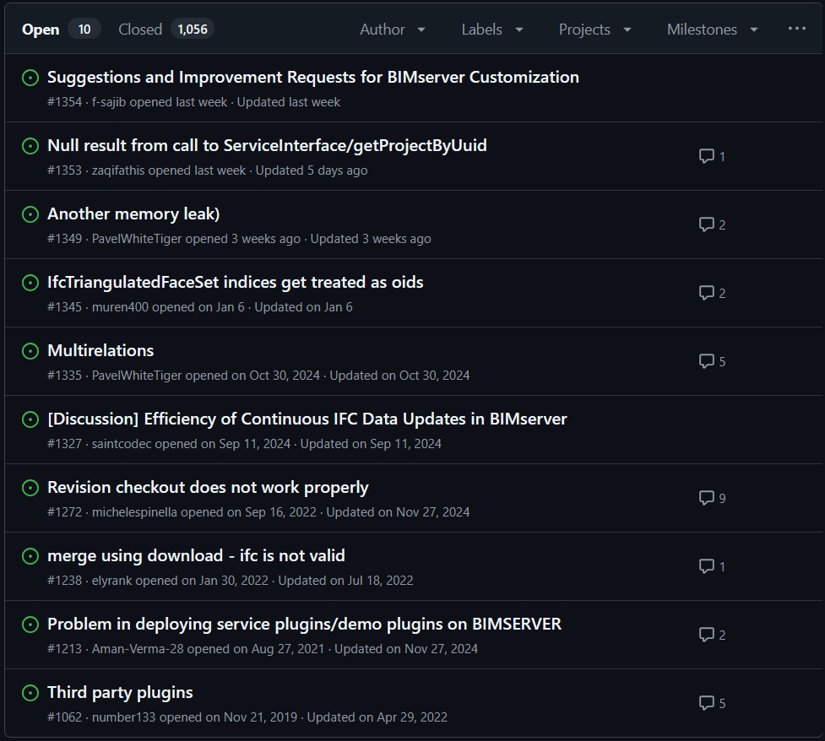
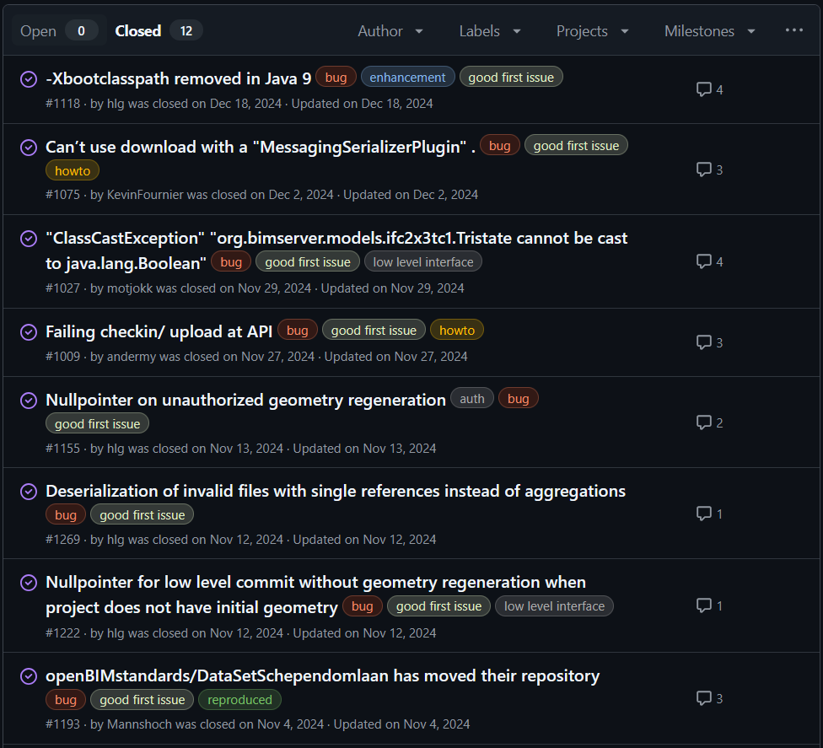
Handling issues
Closed outdated issues
Issues classification
Fix small programming error
Notes:
Role of contributor: Triage – manage issue (label, edit/hide comment, manage pull request) – limited access
It is good to hand in hand while working on documentation on the specific topic (installation, client, query,…)

Slide 16
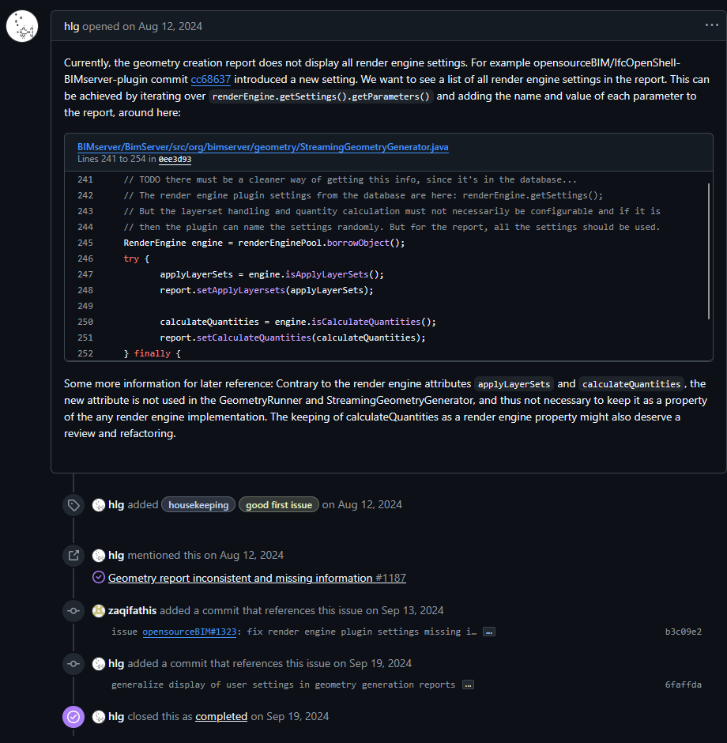
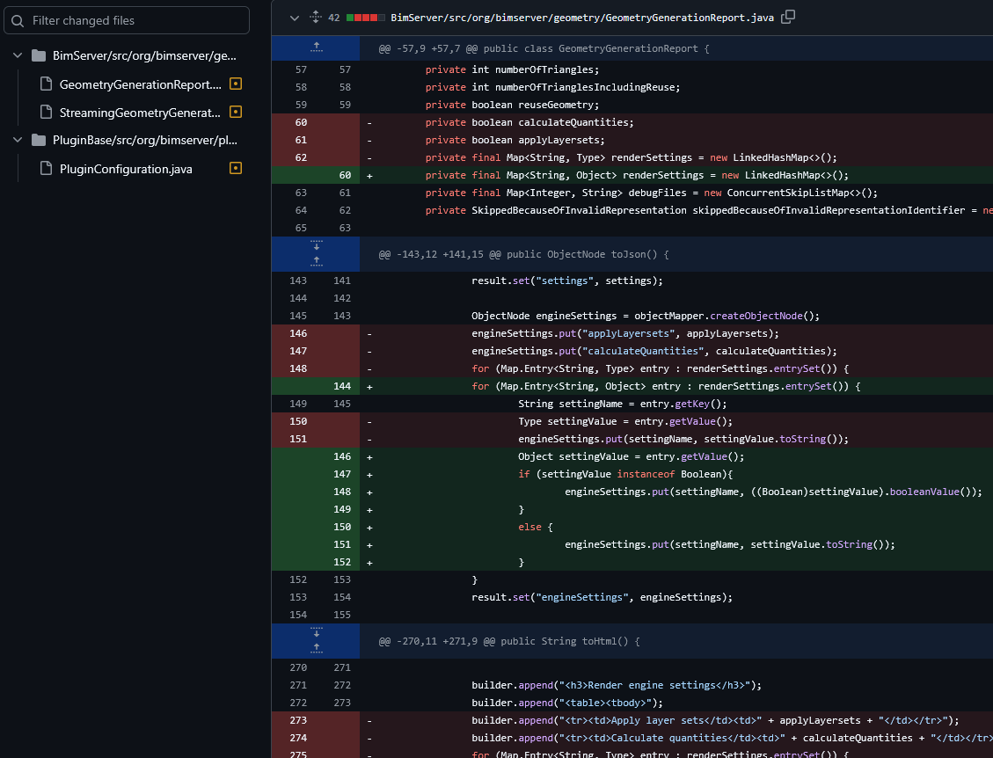
Handling issues
Fix small programming error
Notes:
- e.g.

Slide 17
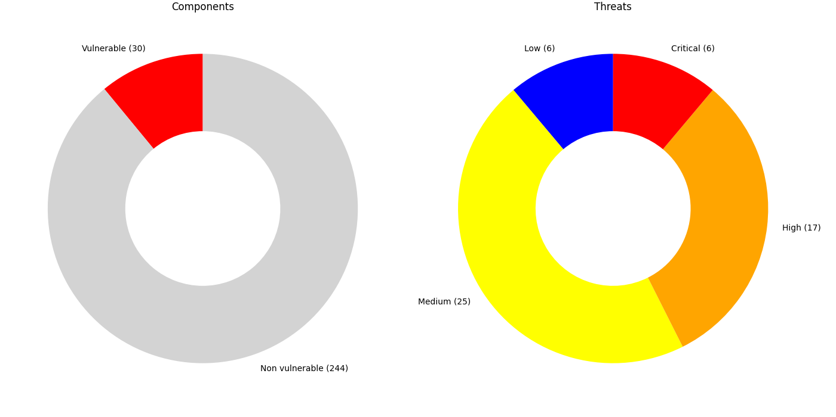
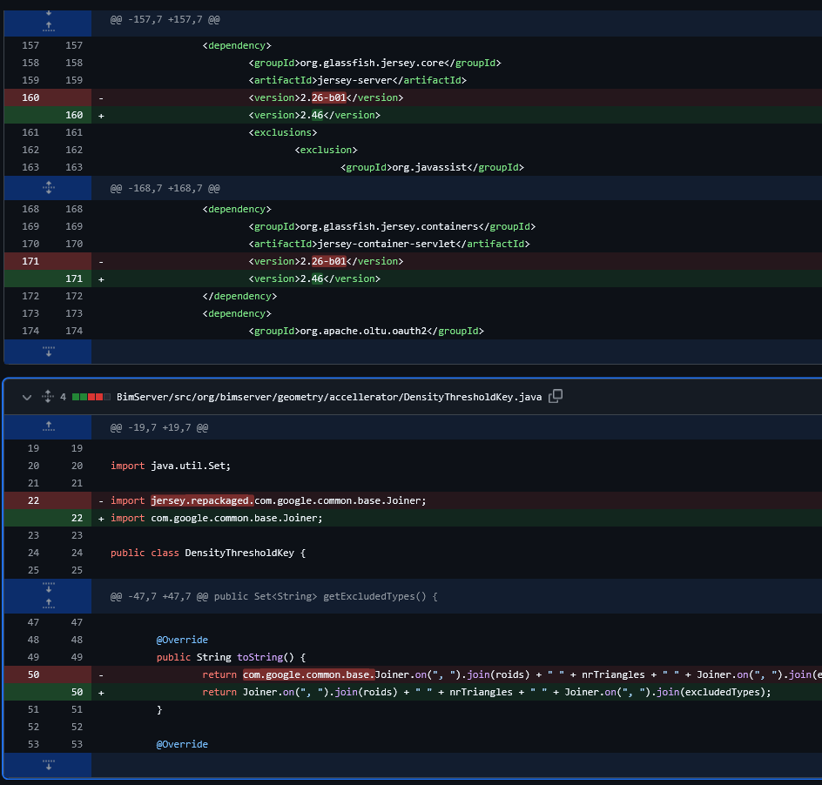
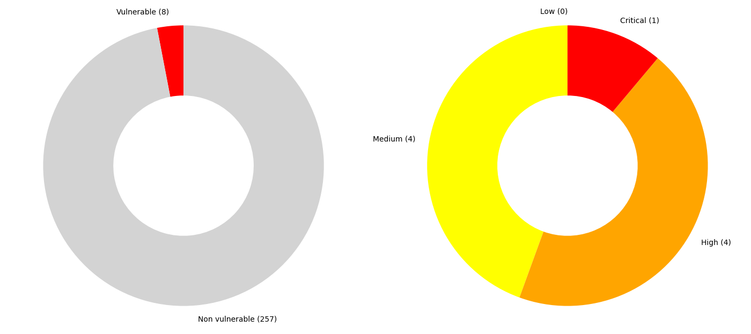
Dependency updates
Version 1.5.186
Version 1.5.187
Notes:
Part of updating the codebase
Goal: check vulnerable dependency that poses threat.
Some dependency are still under maintenance,
Context: use Java 8
2 steps: latest Java 8 compatibility support, update regardless Java 8

Slide 18
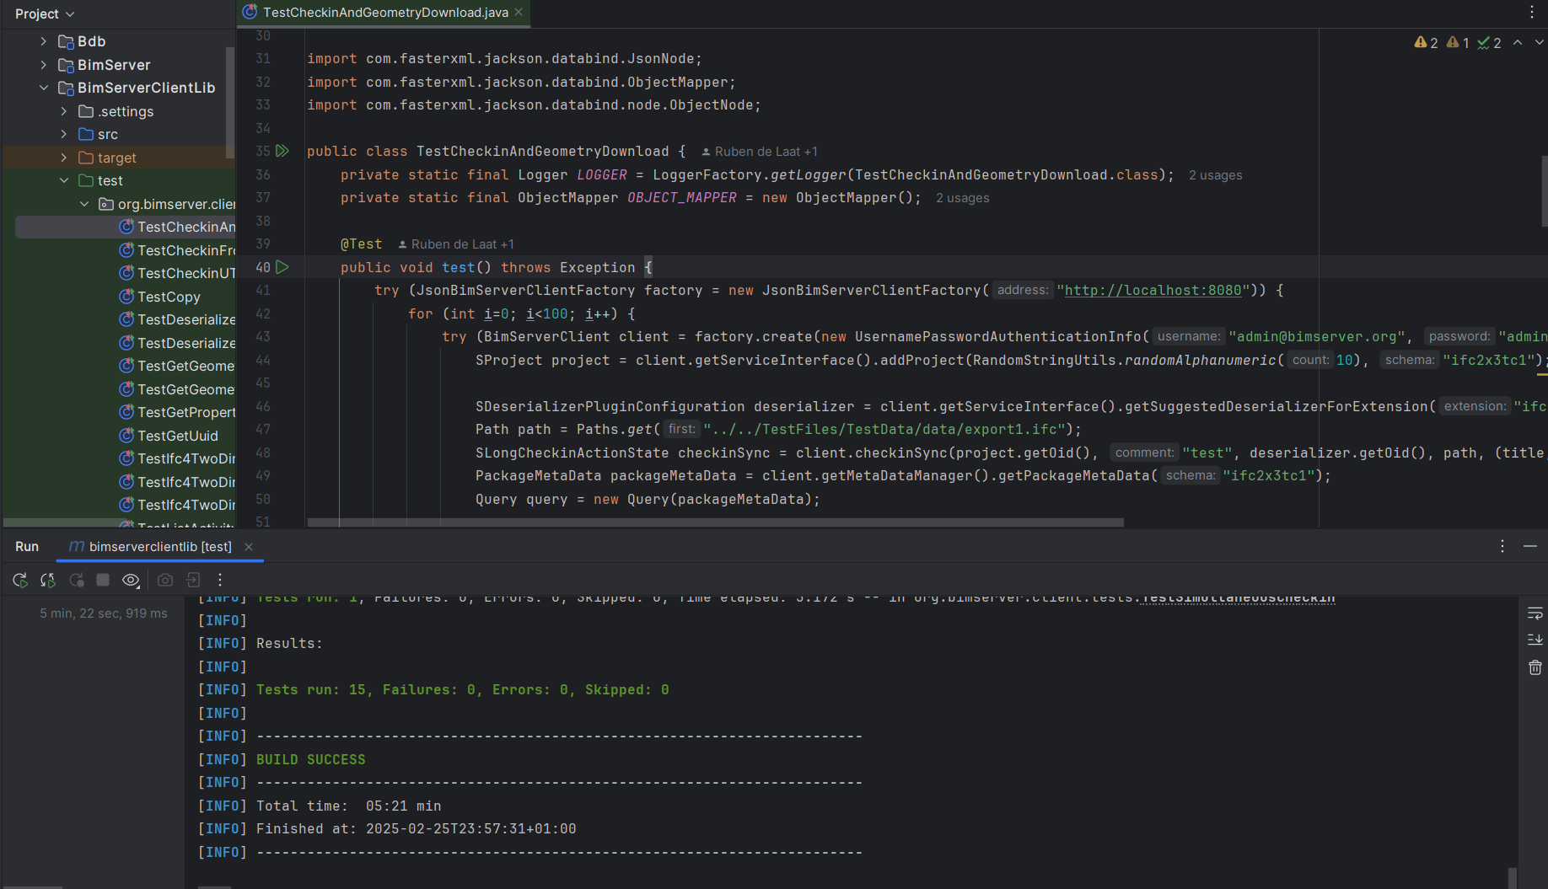
Testing
Improve test coverage
Automated test
Notes:
Test in general, how test is viewed within software development
Short term vs long term
Test overview in BIMserver:
Automated test
Need a external bimserver or embedded in the test
Failed during the time as sometime new features has been introduced,

Slide 19
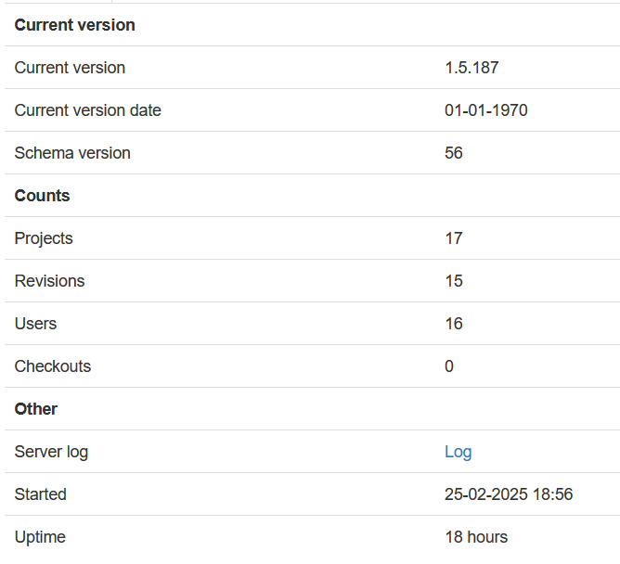
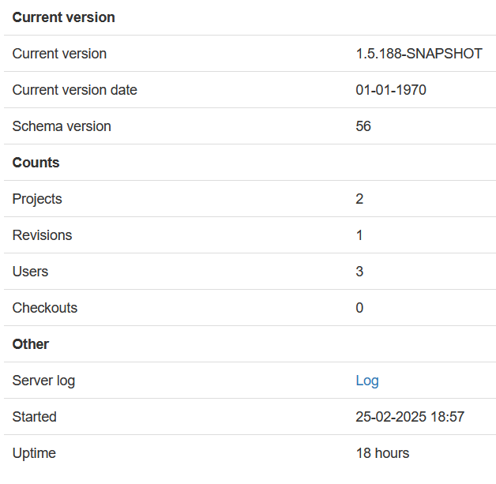
Testing
Deployment on test server (stable – experiment)

Slide 20
OpenFabTwin
Distributed information management (openBIM) in the virtual twin of a factory
zaqi.fathis@htw-dresden.de
TODO@htw-berlin.de
bimserver@opensourcebim.org
Source, release, and documentations:
https://github.com/opensourceBIM/BIMserver

