Slide 1
The OpenQDA
Project
A Software for Collaborative Qualitative Analysis
and
Sustainable Open Research

Slide 2
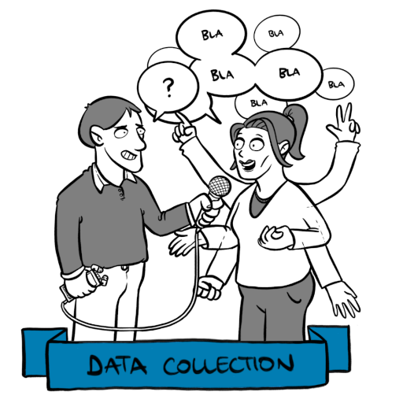
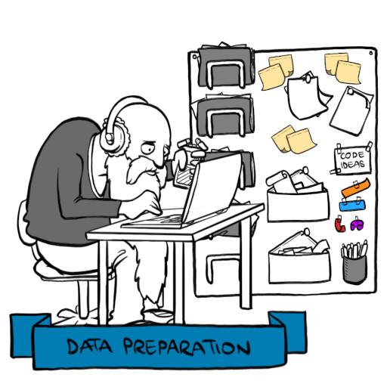
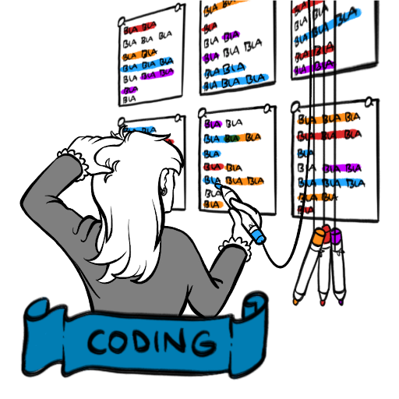
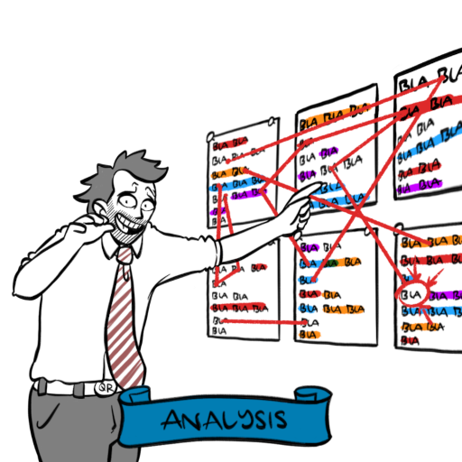
Qualitative Research, QDA and CAQDAS

Slide 3
Market Situation I
early 2000s quantitative data analysis
commercial CAQDAS: MaxQDA, f4analyse, NVivo, Dedoose & Atlas.ti
expensive (300 – 600 € / Seat)
lock-in & proprietary data silos
complex GUIs
closed source

Slide 4
Market Situation III
AI models are fixed and intransparent
MaxQDA AI Assist runs on OpenAI services hosted on Azure
Open Source CAQDAS
TAMS, QCODER, RQDA, CATMA, ReQual, QualCoder, Taguette
very limited scope and not sustainable (maintenance, single user repos)
„free“ closed source projekts (QCAMap, QDACity)
neither open nor do they have a sustainable business or financing model
On-Premise hosting mostly not even considered

Slide 5
How OpenQDA is different?
Collaborative
On Premise
Open Exchange
Custom AI/ML
Custom Visualizations
Auditable
Custom Visualizations
Plugins and
Services
AGPL 3
Custom Analysis

Slide 6
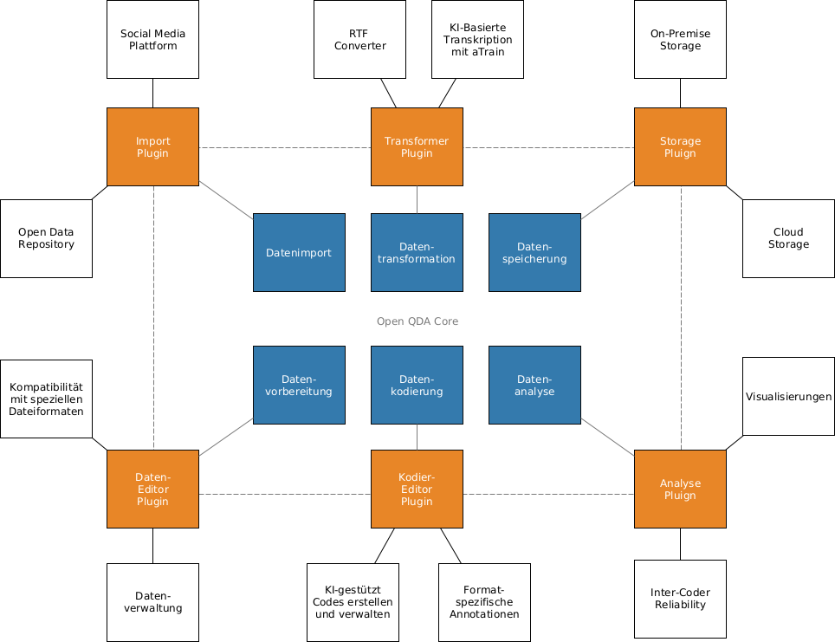
Open Architecture

Slide 7
OpenQDA Roadmap
2023
2023
2024
2025
2026
2027
Prototype1
UI/UX Redesign
Full plugin specs
OT vs CRDT
for full collab
Prototype2
1.0.0
2.0.0
Alpha
Visualization plugins
Beta
Live Collab vs
Inter-Coder reliability mode
Kickoff
Concept
Market-
Analysis
Co-Creation Workshops
(QDA Workflows)
Team up with Weizenbaum Institute
Host @Weizenbaum
Establish global
community
Foundation
Team up with more Partners
Prepare for DFG application
Submit DFG application

Slide 8
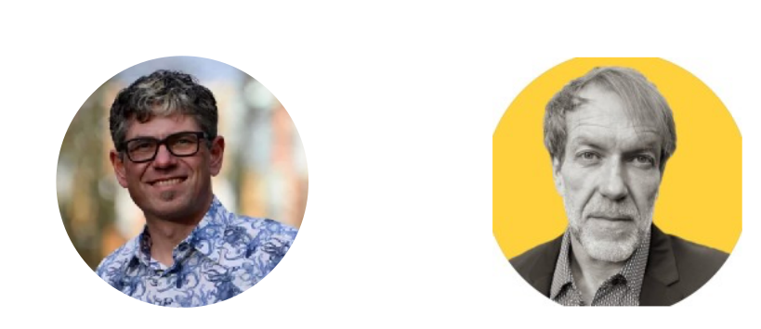
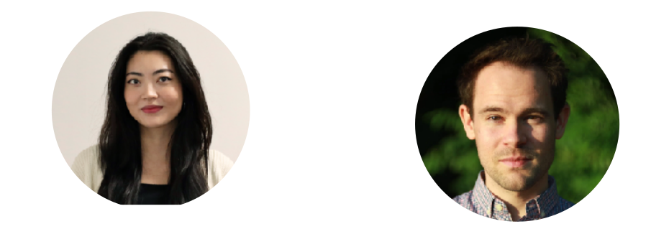
The OpenQDA Core Team
Project Lead
Prof. Dr. Andreas Hepp &
Prof. Dr. Karsten D. Wolf
Research Software Engineers
Alessandro Belli & Jan Küster
Content Experts, Community Building,
QA, Support, UX-Testing
Florian Hohmann & Dr. Philip Sinner
UX-Design
Leila Matayeva

Slide 9
Thank you!
https://openqda.org
https://github.com/openqda/
Join the DEMO + Q&A today at 6pm

