Slide 1
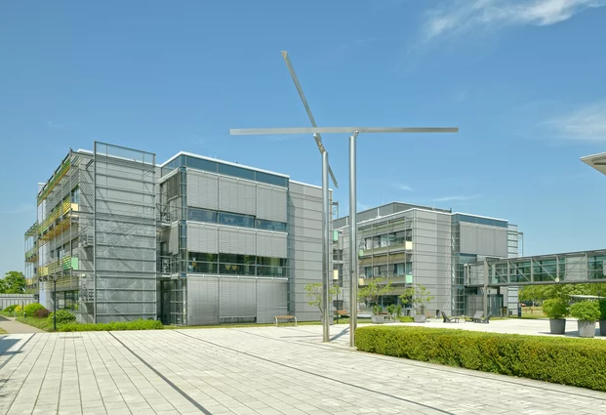
Phenotyper - a software tool for collection and management of phenotypic data using controlled vocabulary
Jürgen Gremmels
Notes:
Hello everyone and thank you very much for giving me the opportunity to present my software project here.

Slide 2
Cultivation facilities
Field site
5.4 ha
Sandy soil, drip irrigation
Phytotron hall (climate chambers)
20 walk-in and 80 reach-in growth chambers
Climate-controlled Greenhouse
1600 m², 16 cabins
Artificial light
Temperature and humidity control
Summergreenhouse
2000 m²
Notes:
First a few words about the institute where I am working....
As the name of the institute says, we are investigating the metabolism of plants on a molecular level. For this purpose, we offer a variety of cultivation possibilities.
All these plants are cultivated for beeing examined. Also by simply looking at the plants and writing down the observed properties.

Slide 3
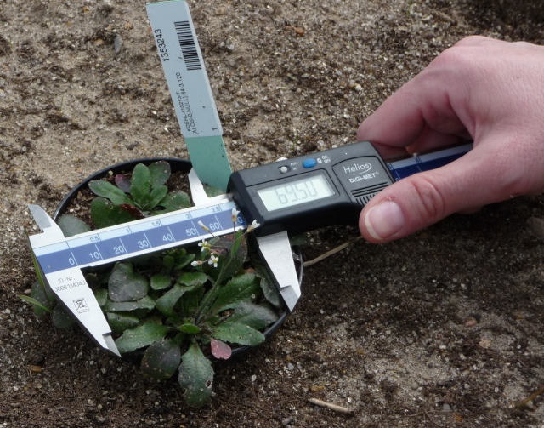
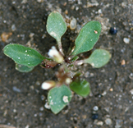
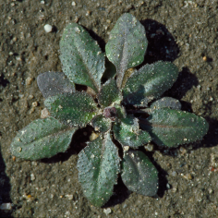
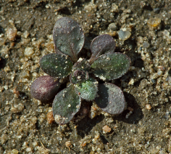
Phenotyping
Measurement of features of an organism produced by interaction between genome and environment.
Plant height
Disease score
Seed number
Flower color
Relative water content
Proline concentration
CO₂ fixation rate
}
example:
absolute width of rosette
field / greenhouse
}
laboratory
example:
anthocyanin content
Notes:
This description process is called phenotyping
What is phenotyping? „Measurement of…“
easily measureable properties (height, width, length)
traits detected by counting (number of seeds, flowers, leaves)
categorical properties (color, disease score)
qualities which are determined by more complex analyses (water content, C02 fixation rate, proline concentration)
As an example which you will meet several times during this talk we look at the determination of the absolute width of an arabidopsis rosette and it‘s anthocyanin content

Slide 4
The goal
Plant description (phenotyping)
Fast and precise
Reproducible and independent of user
...and, by the way: not restricted to plants!
Standardised data storage for rapid evaluation
Controlled vocabulary
Long-term data storage
Tamper-proof
Intellectual property right guarded
Can be done automatically, but not affordable for many research institutes and breeders.
Notes:
All this has to done fast and precise where the results have to be reproducible and independent of the user.
I am working at a institute focused on plant research, but of course other things can be described like this as well
Furthermore, for scientists and breeders with lower budget it is essential that this can be done without spending too much money.
Especially for comparison of data it is important to use controlled vocabulary which also allows standardised data storage and rapid statistical evaluation.
The data itself should be protected against later change (like on paper). It should also be possible to guard intellectual property rights.

Slide 5
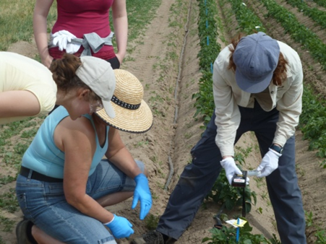
Workflow
schemes
(XML)
results
(XML)
https://www.istockphoto.com
https://www.istockphoto.com
office
office
https://www.istockphoto.com
field/greenhouse
phenotyping schemes – available whereever web is available
Workflow
programs for further processing
web application
mobile device
database
(controlled vocabulary,
e.g. plant ontology)
transfer of files
ODBC
ODBC
transfer of files
phenotyping schemes
<XML>
result files
<XML>
database
(phenotyping schemes)
database
(Results, Metadata)
Notes:
To overcome these problems we had the idea to establish a kind of „improved phenotyping light“.
This slide shows you an overview about the main features in this project. Don‘t be afraid - every detail will be explained later in this talk.
First, the user decides which properties he or she would like to measure. This is usually done in the office by creating a so-called phenotyping scheme. The phenotyping scheme is a simple text file in extended markup language (XML) format which is now copied to the mobile terminal.
The actual phenotyping is done on the fieldsite or in the greenhouse. The number on the plant label can either be entered into the mobile terminal by scanning the barcode or by typing. The measured or observed values are entered by typing or selecting.
Back in the office, the results which are stored again in XML text files are copied to the computer for further processing.
The scheme at the bottom of the slide shows some more details:
Phenotyping schemes are created by using a web application. That means that this can be done wherever internet is available. Both the controlled vocabulary and the phenotyping schemes are stored in a database, where new controlled vocabulary can be obtained from another public database (e.g. the plant ontology).
You see again that the data exchange is done by simple exchange of XML files.
Finallay the results can be processed by other tools and are stored to another database where the may be linked to other data (at our institute this would be the LIMS database or the Golm metabolome database). Of course it is also possible to store the phenotyping schemes and the results in one single database.

Slide 6
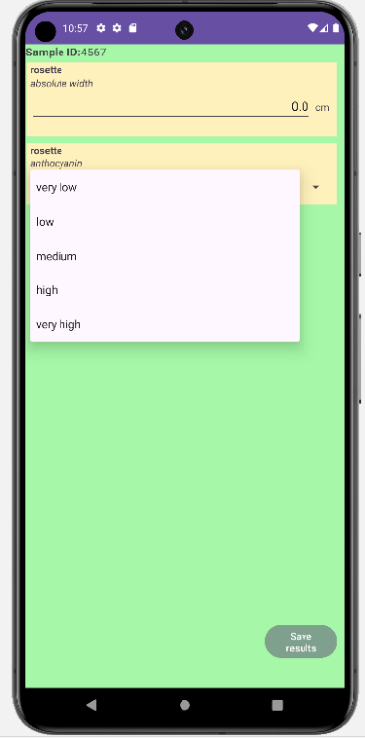
Mobile app
Notes:
Now let‘s have a look at the mobile app (currently implemented in Android), especially at its graphical user interface.
We see again our example with the Arbidopsis leaf rosette.

Slide 7
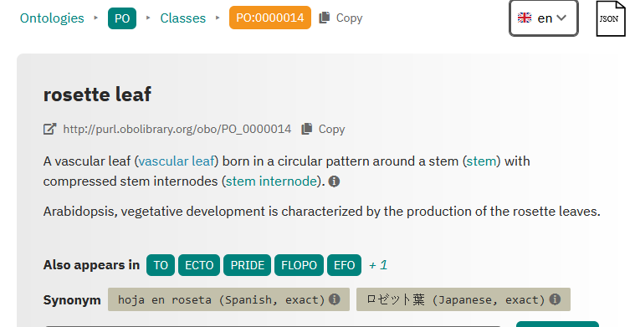
Controlled vocabulary
“standardized, restricted set of defined terms designed to reduce ambiguity in describing a concept”.
Berardini et al. 2004 Functional annotation of Arabidopsis Genome using controlled vocabularies. Plant Phys. 135
Ontologies: defined terms and structured vocabularies to describe molecular function, biological process, and cellular component,
Gene ontology consortium (2001)Genome Res 11: 1425-1433
(https://www.ebi.ac.uk/ols4/)
Rosette leaf
Rosette
rosette leaf
Leaf
Leav
Blatt
Blätter
Bl
Blaetter
Rosettenbl
Rosettenbl.
BL
Bl.
Notes:
As I said during the introduction of the project, an important part of our system is the use of so-called controlled vocabulary
Controlled vocabulary means a standardized, restricted set of defined terms designed to reduce ambiguity in describing a concept.
Controlled vocabulary is mostly provided by ontologies. Ontologies contain defined terms and structured vocabularies to describe molecular function, biological process, and cellular component.
A main advantage of this practise will become clear regarding the following example. A scientist, doing some phenotyping on rosette leaves of a plant wants to describe the object of his examinations. On the left side you see a selection of possibilities - including orthographic variations - how this can be done. – You see that it can be very difficult to realize that two scientists in two different institutes are talking about the same thing.
When controlled vocabulary is used, a rosette leaf is every time declared like this. Additionally every ontology term has a unique ID which makes it possible to use other languages.

Slide 8
Entity value concept
controlled vocabulary
Objecttype
Plant
Object ID
Datetime
Entity
Value: attribute;value
23150
12.08.2023 13:00
rosette
absolute width: cm; 12.5
anthocyanin content: 2; low
23151
12.08.2023 13:01
plant
viability: 9; dead
23150
30.08.2023 10:24
rosette
absolute width: cm; 14.0
anthocyanin content: 3; medium
inflorescence
absolute height: cm; 20.4
One table with all measured parameters for all plants (or other objects)
- considerable amount of redundancy
+ almost no empty data fields
+ simple data structure (no relations between several tables)

Slide 9
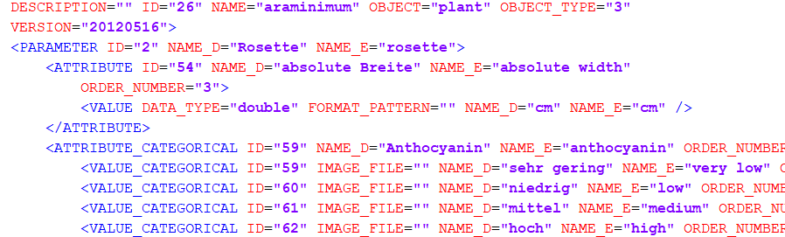
Data exchange via XML
Phenotyping Scheme with name araminimum: We are measuring the absolute width of the rosette in cm and we look at the anthocyanin content.
Result of a measurement using phenotyping scheme araminimum: The rosette of plant with number 1234 has the absolute width of 12 cm; the anthocyanin content is low Measurement was done on 2024-10-24.
Notes:
During explanation of the general workflow I mentioned that the files for data exchange are in XML format – what does this mean?
The main advantage is the high level of unambiguousness guaranteed by the highly nested structure. Furthermore its wide distribution including software which is able to handle this format.
Here you see the XML representation of a phenotyping scheme. It describes the examination of the arabidopsis rosette you saw at the beginning of my talk.
The scheme has the name „araminimum“ and we are measuring the „absolute width“ of the „rosette“ in „cm“. You may also see that this format supports the use of more than one language. All entities and values are stored both in English and German. The programmer can decide which language will be shown to the user respectively lets the user decide which language he or she would like to use.
The structure of the result file is very similar to the structure of the scheme. The main difference is that it contains the ID of the examined object along with a time stamp and of course the measured value – here 12 cm. And concerning the anthocyanin content the user selected the option „low“.
The extensibale markup language is a markup language that defines a set of rules for encoding documents in a format that is both human-readable and machine-readable
We are using this format to encode both the phenotyping schemes and the result data. One great advantage is the unambiguousness compared to e.g. the comma separated value format.
Can be read by many applications. And furthermore there are useful possibilities to check if a file is maybe corrupted.

Slide 10
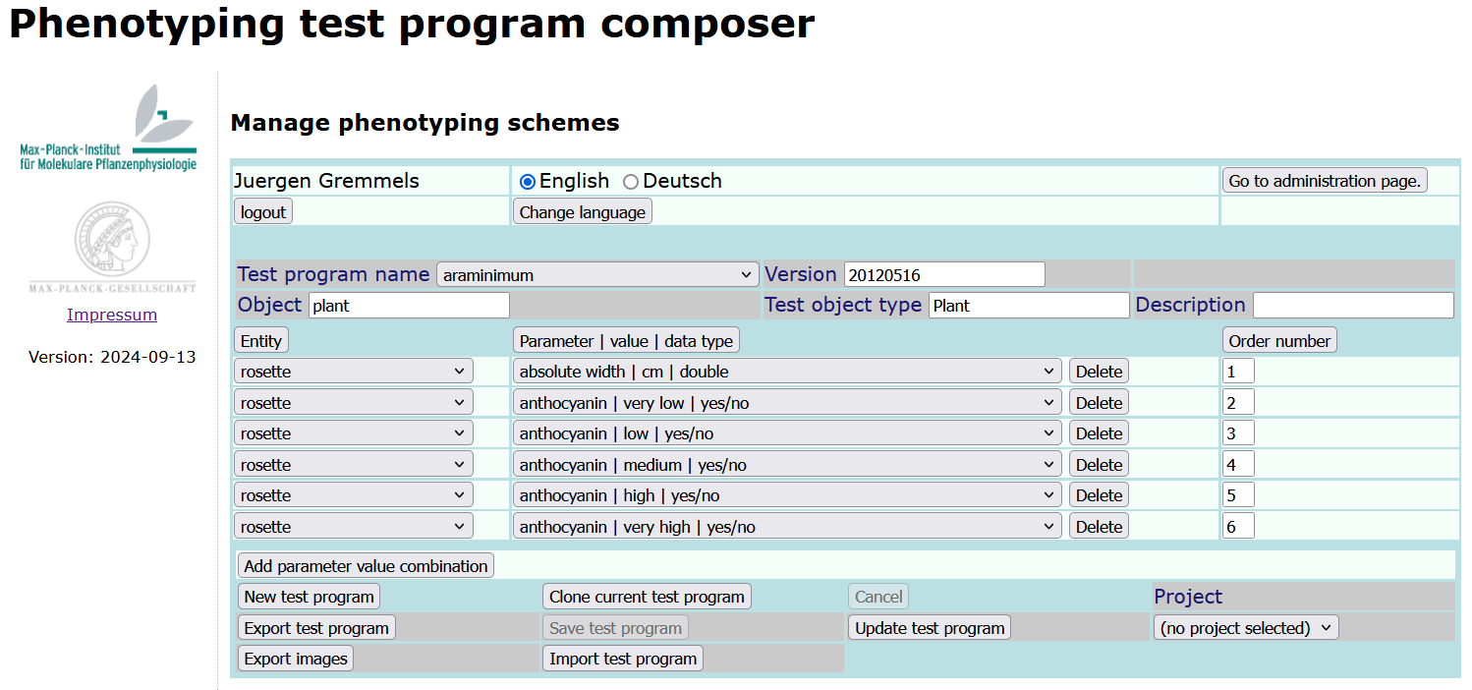
Generate and manage phenotyping schemes
Notes:
The first step when using the phenotyping system is to generate a phenotyping scheme (we also called it „test program“).
This can be done by a web application which you see on this slide. The usage is personalized – each user can create and manage own phenotyping schemes.
Here you can type in a unique name for the scheme along with some meta data like version, the regarded object, type of the object and a description. All these meta data will also appear in the result file.
It is also possible to edit an existing scheme, copying an existing scheme or even load a scheme file e.g. from another user.

Slide 11
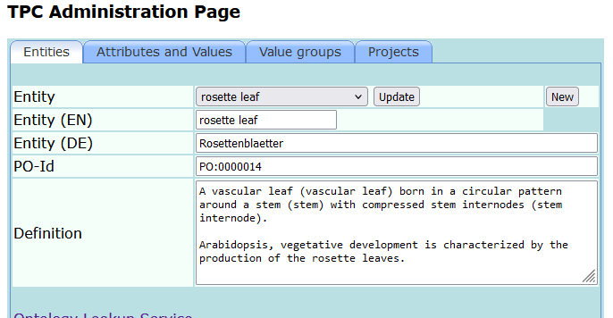
Manage controlled vocabulary
specify the unit
Notes:
Now I will show you how we can manage the controlled vocabulary in the web application for designing phenotpying schemes.
An important issue for improving data quality is that the values are provided in a defined unit which may also be done with the web application.

Slide 12
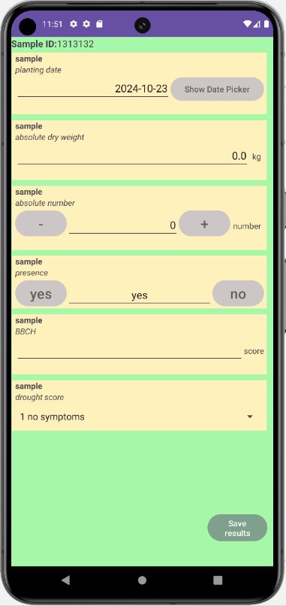
Data types (1)
date
floating number
integer
yes / no
other / text
categorized
Input fields are customized according to the data type defined in the phenotyping scheme.
Notes:
Both for simplifying the data input and for improving the data quality it is possible to predifine 6 different data types. This is done along with defining new measurement parameters which I will show you on the next slide.

Slide 13
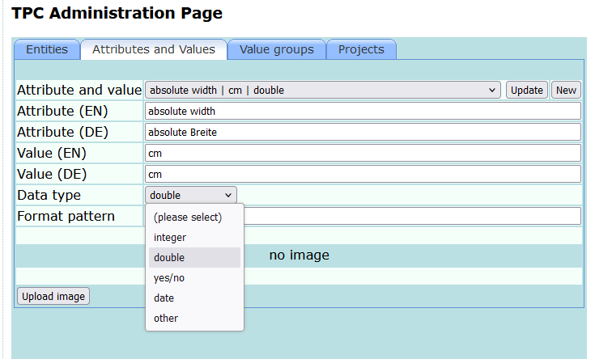
Data types (2) – define in web application
Allows validation of input data just after typing – and before saving.
Plan for the future: upper and / or lower thresholds for values.
improved data quality
format pattern: [A-Za-z]+[0-9]*
Location can be e.g.
CGWPhy0304
CGWCab0206
FGH03
but not:
34CGWCab
CGWCab0206C

Slide 14
Data types (3) – validate your input data
date
floating numbers
integers
quick input of (small) numbers

Slide 15
Data types (4) – validate your input data
„yes-no“ values
(validation is implicit)
free text
(validation possible with format pattern)
format pattern: [A-Za-z]+[0-9]*
(in-house example: location name)
categorized values
(validation is implicit)

Slide 16
What next?
Simplify the transfer of files to and from the mobile device.
(Re-) implement the possibility of scanning barcodes.
Show images to support examination of categorized values.
Take photos for additional documentation.
Program the app for Apple devices as well.
Notes:
Currently the phenotyping schemes as well as the result files have to be copied to an from the mobile device and it would be much more convenient if this could be done automatically.
Make it possible to scan barcodes (e.g. to register the label of the regarded sample).
Both result file transfer and scanning of barcodes are already implemented in a special version of our phenotyping app – but only for two use cases which have been hard-coded as well as the connection to the file server.

Slide 17
Acknowledgements
Karin Köhl
Dirk Walther
IT-Team
Toni Schreiber (Julius-Kühn-Institut)
The community for research software engineering at MPG
And you for your attention!

