Slide 1
Optimizing Job Scheduling In a Web Application For Real-Time MRI Analysis
Jonas Weber, Institute of Software Technology, German Aerospace Center (DLR)

Slide 2
Notes:
Heart filling with blood, contracting, pumping the blood through the body
Lung is expanding and shrinking because of respiration
Organs are moving around because of respiration

Slide 3
Notes:
Add color to segment the images
We see the left ventricle, right ventricle, myocardium and papillary muscles
This is done by a convolutional neural network (U-net to be precise)
What is this useful for?
MRI imaging for diagnosis is already established
Real-time MRI enables assessment of the influence of things like respiration, arrythmia and severe heart disease

Slide 4
Status Quo
Folder
Real-time MRI
nnUNet
Developer
Doctor
Some other folder
3D Slicer

Slide 5
Let‘s Automate This
Folder
Monitored folder
Real-time MRI
nnUNet
Developer
Rails server
Web browser
Doctor
Some other folder
3D Slicer

Slide 6
Let‘s Automate This
Folder
Monitored folder
Real-time MRI
nnUNet
Developer
Rails server
Web browser
Doctor
3D Slicer

Slide 7
High-Level Overview

Slide 8
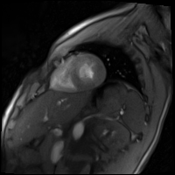
Life Cycle of an Image
Observed folder
Web browser

Slide 9
Life Cycle of an Image
Observed folder
Observer
Web browser

Slide 10
Life Cycle of an Image
Observed folder
Observer
Web browser
SolidQueue
ImportImage | 1

Slide 11
Life Cycle of an Image
Observed folder
Observer
ActiveRecord
Web browser
SolidQueue
ImportImage | 1
SQLite
ActiveStorage

Slide 12
Life Cycle of an Image
Observed folder
Observer
ActiveRecord
Web browser
SolidQueue
ImportImage | 1
SQLite
ActiveStorage

Slide 13
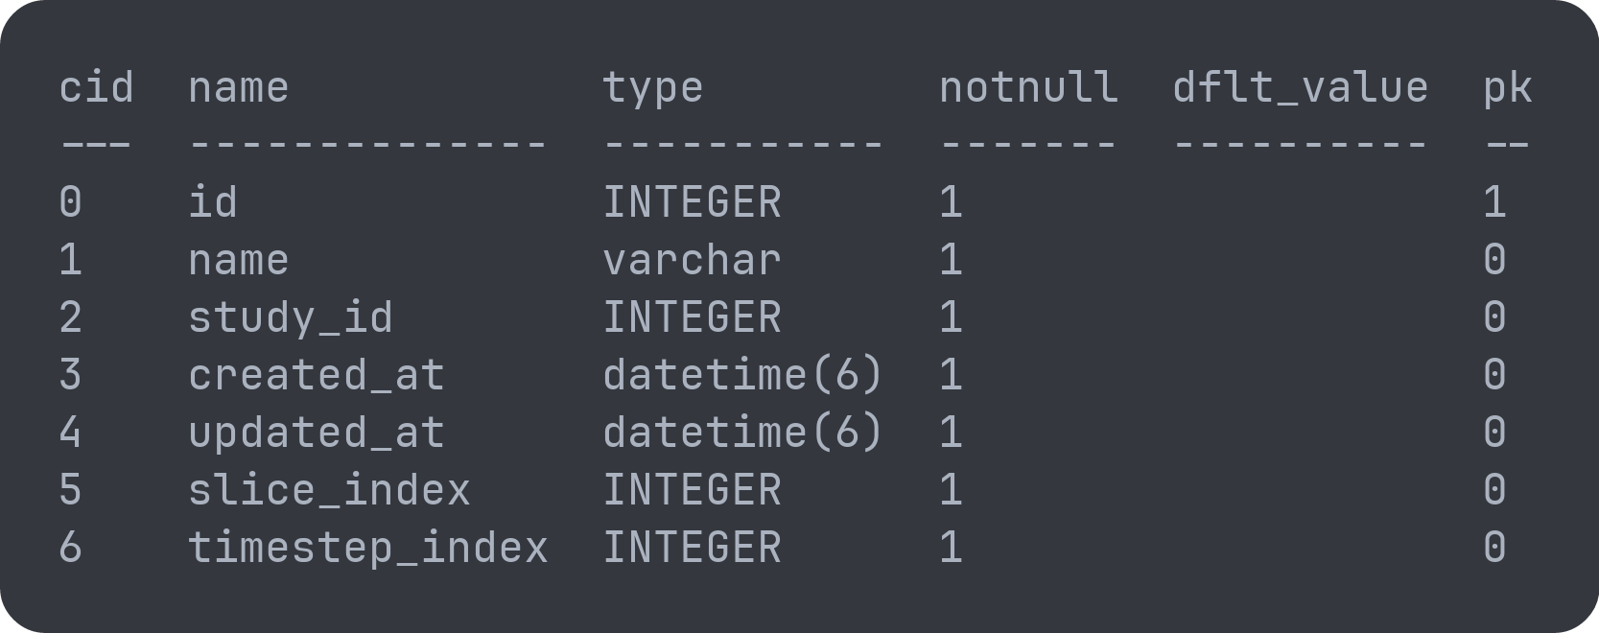
Life Cycle of an Image
Observed folder
Observer
ActiveRecord
Web browser
SolidQueue
ImportImage | 1
SQLite
ActiveStorage

Slide 14
Life Cycle of an Image
Observed folder
Observer
ActiveRecord
Web browser
SolidQueue
ImportImage | 1
SQLite
ActiveStorage

Slide 15
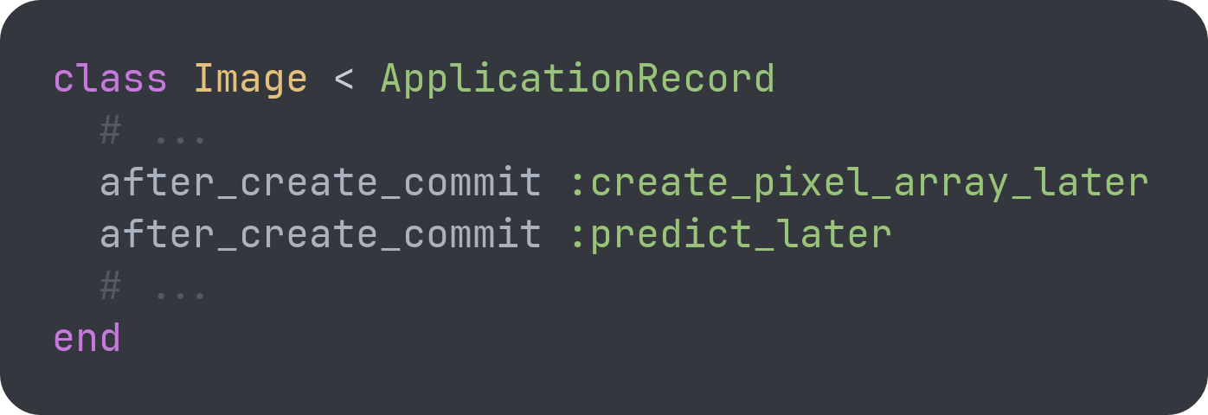
Life Cycle of an Image
Observed folder
Observer
ActiveRecord
Web browser
SolidQueue
ImportImage | 1
ImportImage | 1
PredictImage | 2
CreateImagePixelArray | 1
SQLite
ActiveStorage

Slide 16
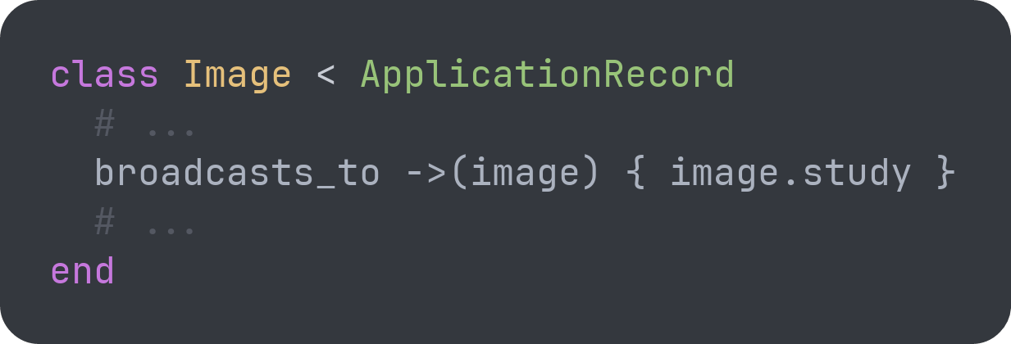
Life Cycle of an Image
Observed folder
Observer
ActiveRecord
Web browser
SolidQueue
ImportImage | 1
PredictImage | 2
CreateImagePixelArray | 1
ImportImage | 1
PredictImage | 2
CreateImagePixelArray | 1
ActionBroadcast | 2
SQLite
ActiveStorage

Slide 17
Life Cycle of an Image
Observed folder
Observer
ActiveRecord
Web browser
SolidQueue
ImportImage | 1
PredictImage | 2
CreateImagePixelArray | 1
ImportImage | 1
PredictImage | 2
CreateImagePixelArray | 1
ActionBroadcast | 2
SQLite
ActiveStorage

Slide 18
Life Cycle of an Image
Observed folder
Observer
ActiveRecord
Web browser
SolidQueue
ImportImage | 1
PredictImage | 2
CreateImagePixelArray | 1
ActionBroadcast | 2
SQLite
ActiveStorage

Slide 19
Life Cycle of an Image
Observed folder
Observer
ActiveRecord
Web browser
SolidQueue
ImportImage | 1
PredictImage | 2
CreateImagePixelArray | 1
ActionBroadcast | 3
SQLite
ActiveStorage

Slide 20
Life Cycle of an Image
Observed folder
Observer
ActiveRecord
Web browser
SolidQueue
ImportImage | 1
PredictImage | 2
CreateImagePixelArray | 1
ActionBroadcast | 3
SQLite
ActiveStorage

Slide 21
Life Cycle of an Image
Observed folder
Observer
ActiveRecord
Web browser
SolidQueue
ImportImage | 1
PredictImage | 2
CreateImagePixelArray | 1
ActionBroadcast | 3
SQLite
ActiveStorage

Slide 22
Life Cycle of an Image
nnUNet
Observed folder
Observer
ActiveRecord
Web browser
SolidQueue
ImportImage | 1
PredictImage | 2
CreateImagePixelArray | 1
ActionBroadcast | 3
SQLite
ActiveStorage

Slide 23
Life Cycle of an Image
nnUNet
Observed folder
Observer
ActiveRecord
Web browser
SolidQueue
ImportImage | 1
PredictImage | 2
CreateImagePixelArray | 1
ActionBroadcast | 3
SQLite
ActiveStorage

Slide 24
Life Cycle of an Image
nnUNet
Observed folder
Observer
ActiveRecord
Web browser
SolidQueue
ImportImage | 1
PredictImage | 2
CreateImagePixelArray | 1
ActionBroadcast | 3
SQLite
ActiveStorage

Slide 25
Life Cycle of an Image
nnUNet
Observed folder
Observer
ActiveRecord
Web browser
SolidQueue
ImportImage | 1
PredictImage | 2
CreateImagePixelArray | 1
ActionBroadcast | 3
SQLite
ActiveStorage

Slide 26
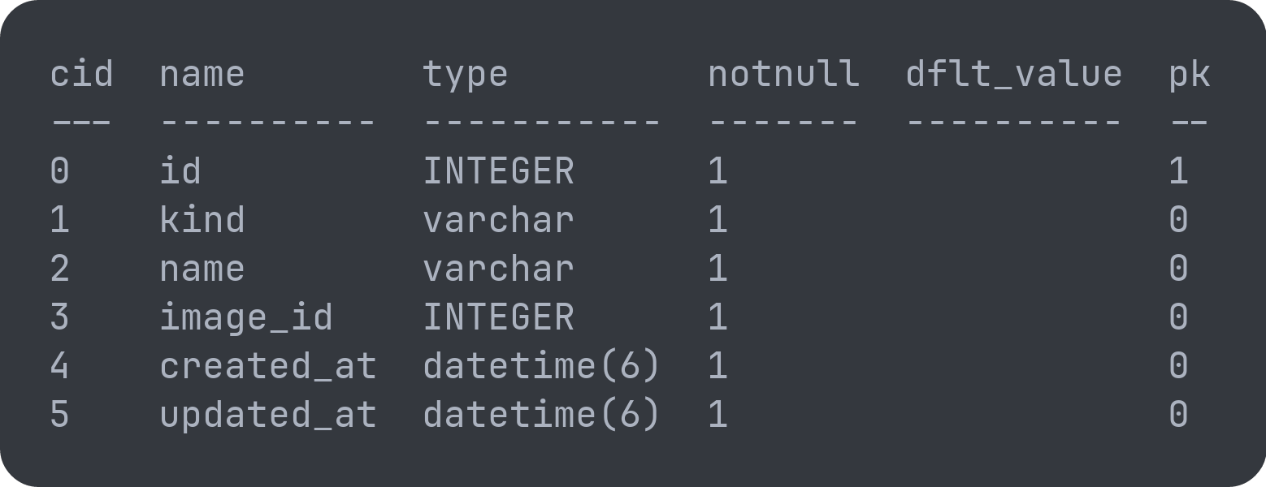
Life Cycle of an Image
nnUNet
Observed folder
Observer
ActiveRecord
Web browser
SolidQueue
ImportImage | 1
PredictImage | 2
CreateImagePixelArray | 1
ActionBroadcast | 3
SQLite
ActiveStorage

Slide 27
Life Cycle of an Image
nnUNet
Observed folder
Observer
ActiveRecord
Web browser
SolidQueue
ImportImage | 1
PredictImage | 2
CreateImagePixelArray | 1
ActionBroadcast | 3
SQLite
ActiveStorage

Slide 28
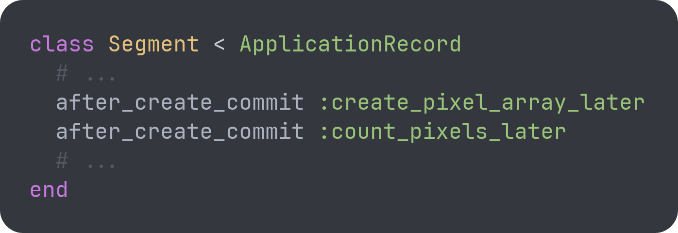
Life Cycle of an Image
nnUNet
Observed folder
Observer
ActiveRecord
Web browser
SolidQueue
ImportImage | 1
PredictImage | 2
CreateImagePixelArray | 1
ActionBroadcast | 3
SQLite
ActiveStorage

Slide 29
Life Cycle of an Image
nnUNet
Observed folder
Observer
ActiveRecord
Web browser
SolidQueue
ImportImage | 1
PredictImage | 2
CreateImagePixelArray | 1
ActionBroadcast | 3
ImportImage | 1
PredictImage | 2
CreateImagePixelArray | 1
ActionBroadcast | 3
CreateSegmentPixelArray | 5
CountSegmentPixels | 5
SQLite
ActiveStorage

Slide 30
Life Cycle of an Image
nnUNet
Observed folder
Observer
ActiveRecord
Web browser
SolidQueue
ImportImage | 1
PredictImage | 2
CreateImagePixelArray | 1
ActionBroadcast | 3
CreateSegmentPixelArray | 5
CountSegmentPixels | 5
ImportImage | 1
PredictImage | 2
CreateImagePixelArray | 1
ActionBroadcast | 8
CreateSegmentPixelArray | 5
CountSegmentPixels | 5
SQLite
ActiveStorage

Slide 31
Life Cycle of an Image
nnUNet
Observed folder
Observer
ActiveRecord
Web browser
SolidQueue
ImportImage | 1
PredictImage | 2
CreateImagePixelArray | 1
ActionBroadcast | 8
CreateSegmentPixelArray | 5
CountSegmentPixels | 5
SQLite
ActiveStorage

Slide 32
Life Cycle of an Image
nnUNet
Observed folder
Observer
ActiveRecord
Web browser
SolidQueue
ImportImage | 1
PredictImage | 2
CreateImagePixelArray | 1
ActionBroadcast | 8
CreateSegmentPixelArray | 5
CountSegmentPixels | 5
ImportImage | 1
PredictImage | 2
CreateImagePixelArray | 1
ActionBroadcast | 13
CreateSegmentPixelArray | 5
CountSegmentPixels | 5
SQLite
ActiveStorage

Slide 33
Life Cycle of an Image
nnUNet
Observed folder
Observer
ActiveRecord
Web browser
SolidQueue
ImportImage | 1
PredictImage | 2
CreateImagePixelArray | 1
ActionBroadcast | 13
CreateSegmentPixelArray | 5
CountSegmentPixels | 5
SQLite
ActiveStorage

Slide 34
Life Cycle of an Image
nnUNet
Observed folder
Observer
ActiveRecord
Web browser
SolidQueue
ImportImage | 1
PredictImage | 2
CreateImagePixelArray | 1
ActionBroadcast | 13
CreateSegmentPixelArray | 5
CountSegmentPixels | 5
SQLite
ActiveStorage

Slide 35
Life Cycle of an Image
nnUNet
Observed folder
Observer
ActiveRecord
Web browser
SolidQueue
ImportImage | 1
PredictImage | 2
CreateImagePixelArray | 1
ActionBroadcast | 13
CreateSegmentPixelArray | 5
CountSegmentPixels | 5
SQLite
ActiveStorage

Slide 36
Life Cycle of an Image
nnUNet
Observed folder
Observer
ActiveRecord
Web browser
SolidQueue
ImportImage | 1
PredictImage | 2
CreateImagePixelArray | 1
ActionBroadcast | 13
CreateSegmentPixelArray | 5
CountSegmentPixels | 5
ImportImage | 1
PredictImage | 2
CreateImagePixelArray | 1
ActionBroadcast | 18
CreateSegmentPixelArray | 5
CountSegmentPixels | 5
SQLite
ActiveStorage

Slide 37
Life Cycle of an Image
nnUNet
Observed folder
Observer
ActiveRecord
Web browser
SolidQueue
ImportImage | 1
PredictImage | 2
CreateImagePixelArray | 1
ActionBroadcast | 18
CreateSegmentPixelArray | 5
CountSegmentPixels | 5
SQLite
ActiveStorage

Slide 38
A Lot of Jobs
SolidQueue
ImportImage | 1
PredictImage | 2
CreateImagePixelArray | 1
ActionBroadcast | 18
CreateSegmentPixelArray | 5
CountSegmentPixels | 5

Slide 39
A Lot of Jobs
SolidQueue
ImportImage | 6000
PredictImage | 12000
CreateImagePixelArray | 6000
ActionBroadcast | 108000
CreateSegmentPixelArray | 30000
CountSegmentPixels | 30000

Slide 40
A Lot of Jobs – 192.000 To Be Precise
SolidQueue
ImportImage | 6000
PredictImage | 12000
CreateImagePixelArray | 6000
ActionBroadcast | 108000
CreateSegmentPixelArray | 30000
CountSegmentPixels | 30000

Slide 41
How To Manage So Many Jobs?
Reduce the number of jobs
Use batch processing in nnUNet
Prioritize certain images
Optimize SolidQueue
Number of workers
Queues
Number of processes/threads per worker
Polling interval
Use caching in the frontend
Switch the database implementation (SQLite -> PostgreSQL)
Felix Terhag, DLR-SC
Notes:
Prioritize certain images:
few images are required
to learn interesting things about the data
with error margins

Slide 42
Questions?

