Slide 1
SUS: A new language for efficient Hardware Design
Towards an RTL competitor to HLS
Lennart Van Hirtum 02. Month 2025

Slide 2
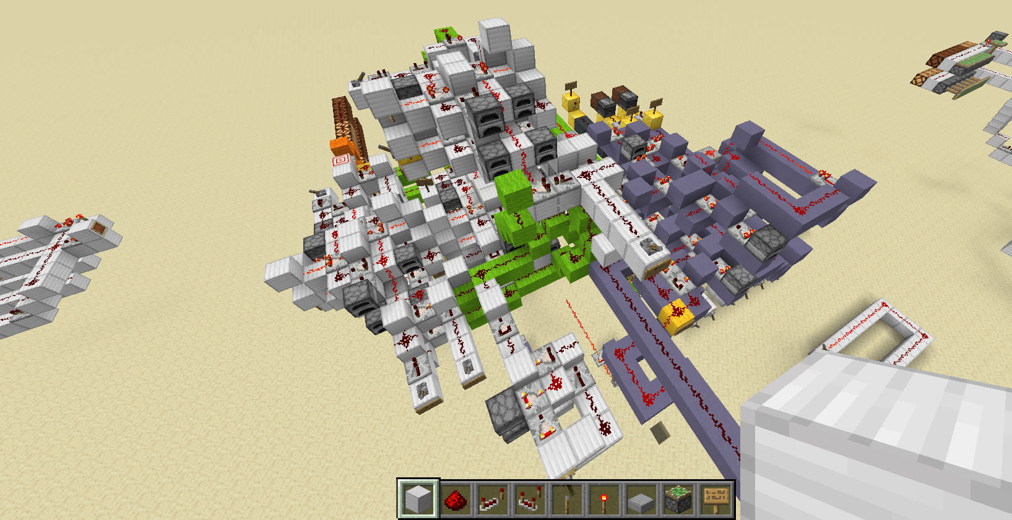
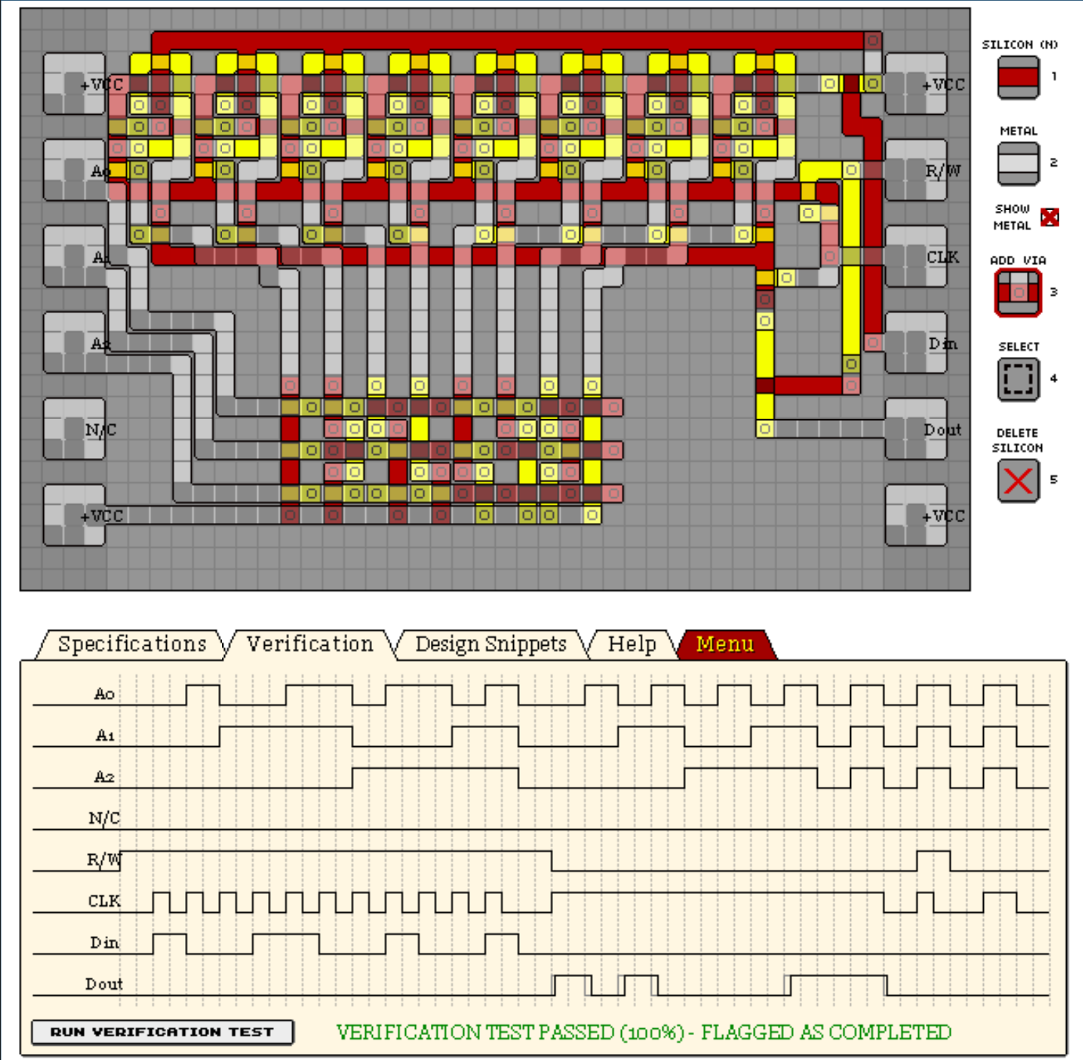
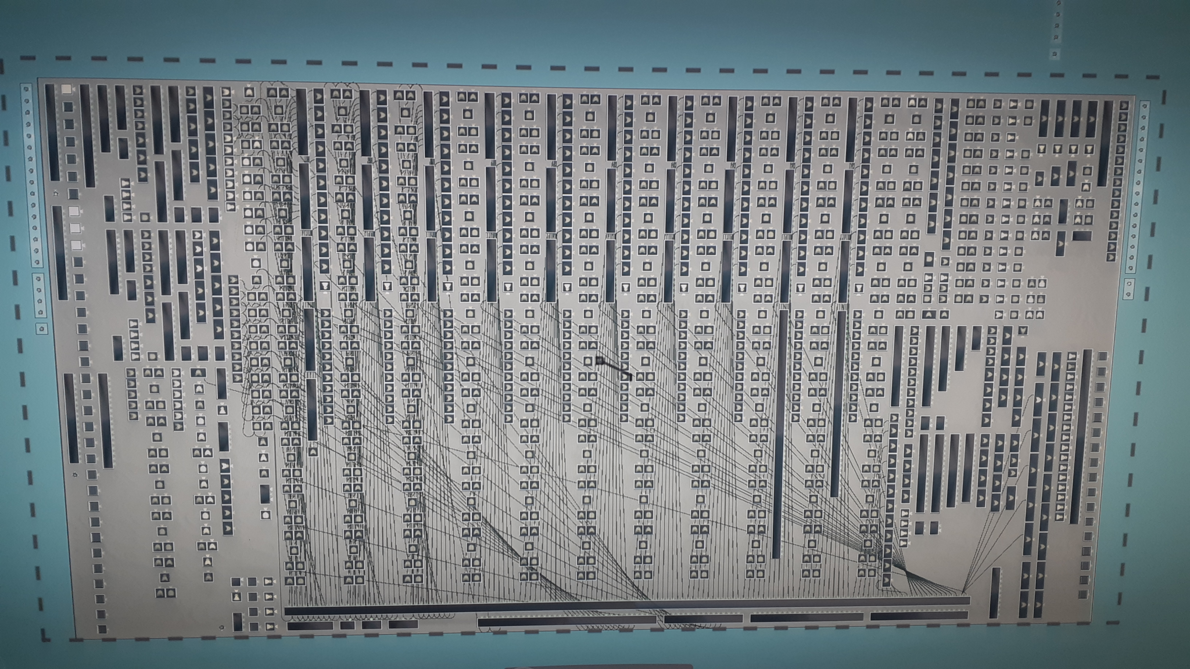

Slide 3
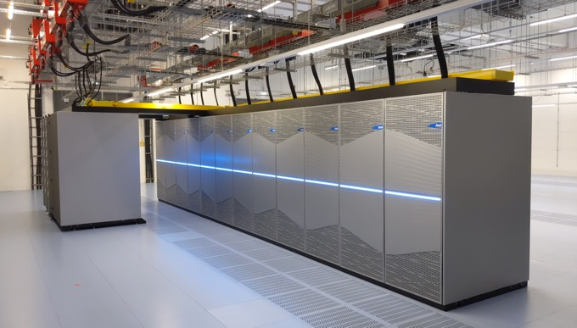
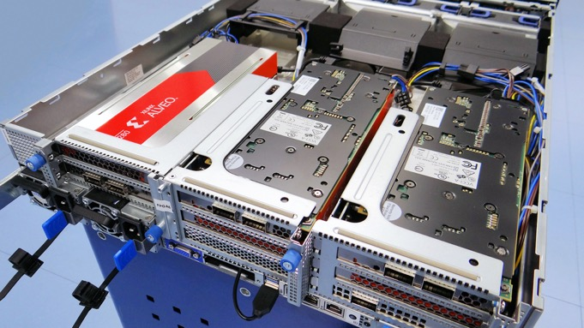
Noctua 2
1124 Server, AMD Milan CPUs with 128 Cores
128 NVIDIA A100 GPU Accelerators
48 Xilinx Alveo FPGA Hardware Accelerators
32 Intel Stratix 2800 GX FPGA Hardware Accelerators
Research
Shallow water simulation: finite element solver
Computational chemistry (CP2K): iterative matrix function computation
N-Body solver: strong scaling for small gravitational N-Body problems
Parallel HPC challenge benchmarks: (b_eff, FFT, GEMM, LINPACK, PTRANS, RandomAccess, Stream)
Libraries: stencils, matrix multiplication, 3D FFT
Discrete mathematics: Computing Dedekind Numbers

Slide 4
The promise of HLS
Write simple imperative code in C++
Clever compiler will turn it into efficient Hardware

Slide 5
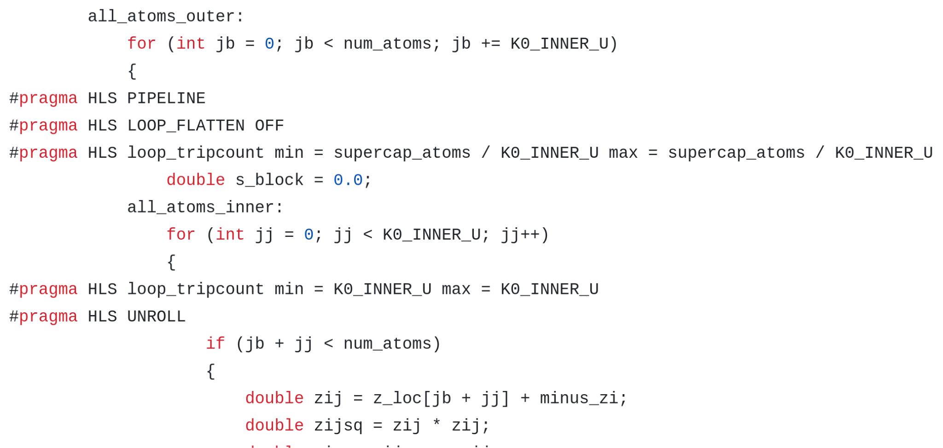
What Hardware Design at PC2 looks like right now

Slide 6
HLS is incredibly powerful
Automatic pipelining
Automatic control flow from imperative constructs
Test code as software first, then synthesize
But
It requires a LOT of tinkering and #pragmas to get right
Code does not intuitively map to generated hardware
Debugging timing failures is nearly impossible
I believe
It is possible to nearly match HLS in ease of use with an RTL language

Slide 7
So what would an RTL language need to replace HLS?
Pipelining
Must be nearly transparent
Submodules (Like FIFOs, BRAM Shift Registers etc) must be responsive to pipelining outside
Control flow
Submodules must be able to affect control flow in parent module
Need wide library of control flow primitives
Global data access (DDR, HBM, PCIe)
Cannot pass busses up and down the call stack
And so SUS was born!

Slide 8
Latency Counting

Slide 9
Registers
Notes:
State & Latency regs
Distinction is intention
State: clock cycles in logic function
Latency: pipelining/meeting timing
SUS creates a major abstraction by dividing the registers in two categories. State and latency registers. The distinction is programmer intention:
State registers are for when you want to move data across clock cycles as part of the logic’s function.
Latency registers are purely for pipelining and meeting timing. In the rest of the slides, state registers are blue, and latency registers yellow.

Slide 10
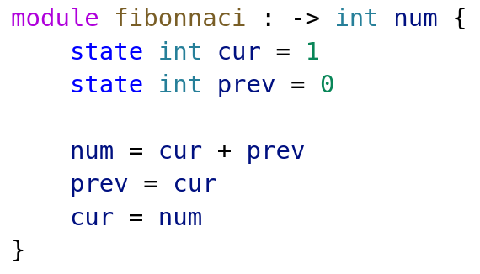
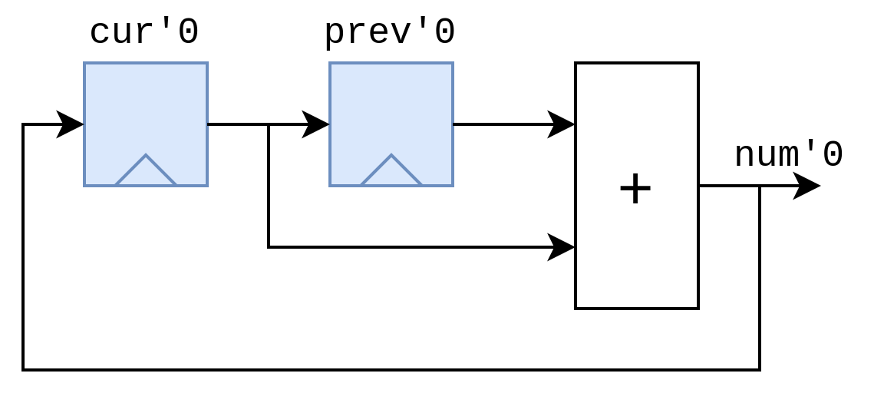
State registers
Notes:
Just state, same as normal
one elem per clock
explicit use of regs in logic
Here is a small example of just state registers. State registers are exactly the same as you would find in other HDLs like Verilog or VHDL.
This fibonacci module generates the sequence one element per clock cycle.
In this example we explicitly want to move data across clock cycles as part of the design’s functioning.

Slide 11
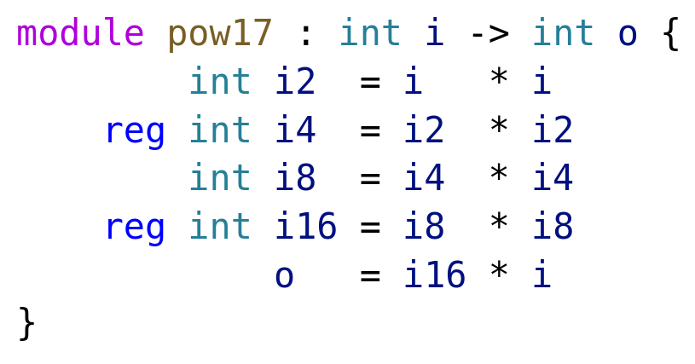
Latency Registers
Notes:
Latency used timing
Not allowed to affect functionality
17th pow i
i*i 4 times
multiply by original
add latency on one branch, compiler adds to sync
Most languages support this
Latency registers on the other hand, are exclusively used to meet timing. They are not allowed to affect the functionality of the design. (aside from the added latency of course).
In this case, we have a module that computes the 17th power of i. It multiplies i with itself four times, and then multiplies the original with that. We add some latency registers here and the compiler automatically adds extra registers to keep everything in sync.
It is implemented by keeping track of a value called “absolute latency”, which is increased for every latency register the code passes. That’s the number after the quote.
So far so good, this is a feature most pipeline design languages support.

Slide 12
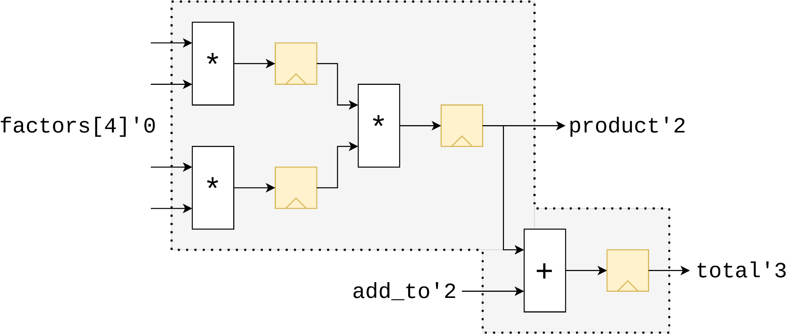
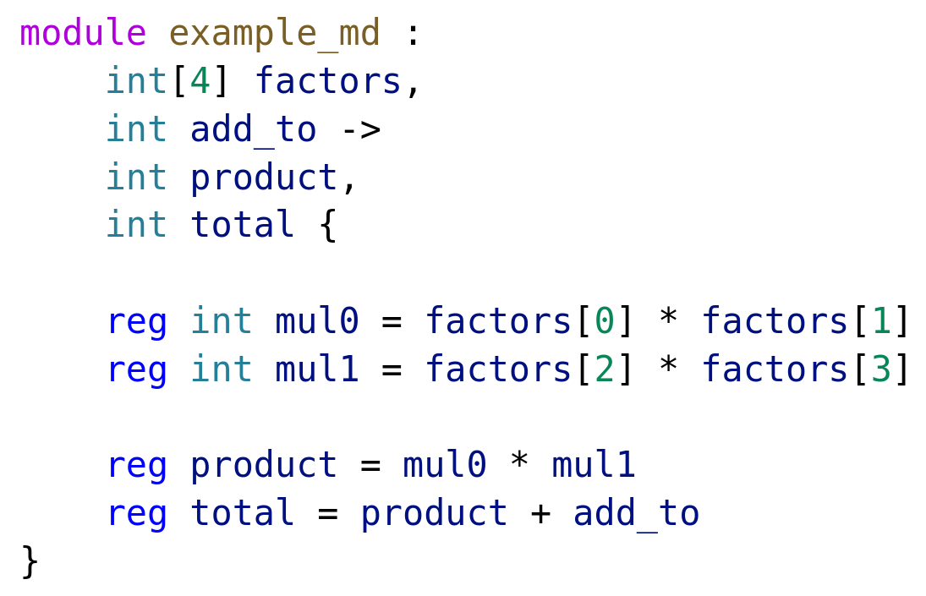
Port Latencies
Notes:
Design freedom -> ports differ latencies
factor list is 0, add_to 2 and so on
differences in port latencies used for counting for modules using it
latencies don’t need be specified, Latency Count infers them
inference makes latency count not as trivial as at a glance
To allow as much design freedom as possible, SUS allows ports to be at different latencies. For example in this case the factors list is at Absolute Latency 0, add_to 2, and so on. When the module is instantiated the port latencies are used in the parent module.
These latencies don’t need to be specified, as a big part of Latency Counting is inference of them. But this inference makes latency counting not as trivial of a problem as it might seem at first glance. What is important to see here is that any module has only one correct canonical representation.

Slide 13
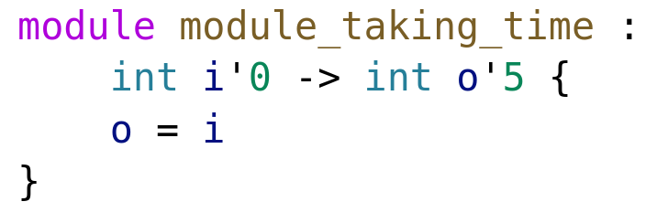
Latency Annotations
Notes:
Possible to override inferred
Forced to instantiate 5
ordinarily wire
It is however possible to override the inferred latencies with custom ones, as in this example. Here it is forced to instantiate 5 registers, where it would have ordinarily been a wire.

Slide 14
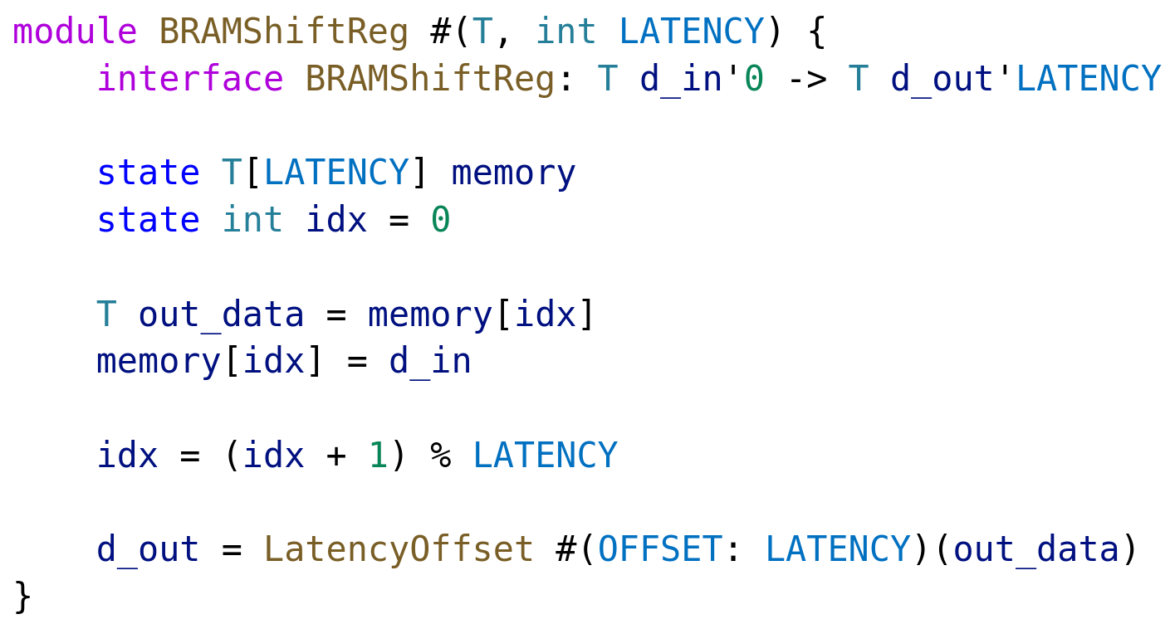
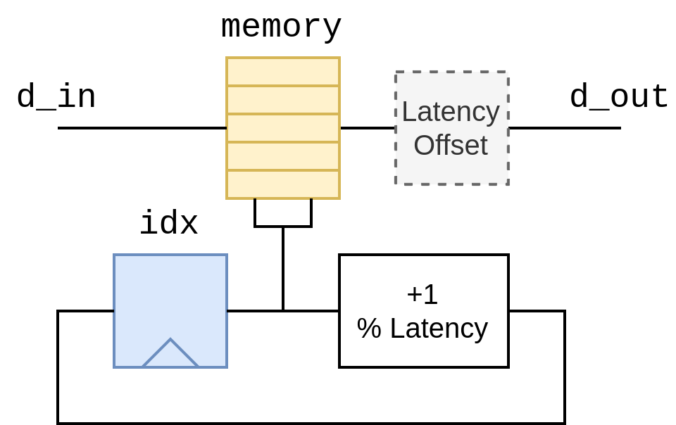
Latency Annotations in Practice

Slide 15
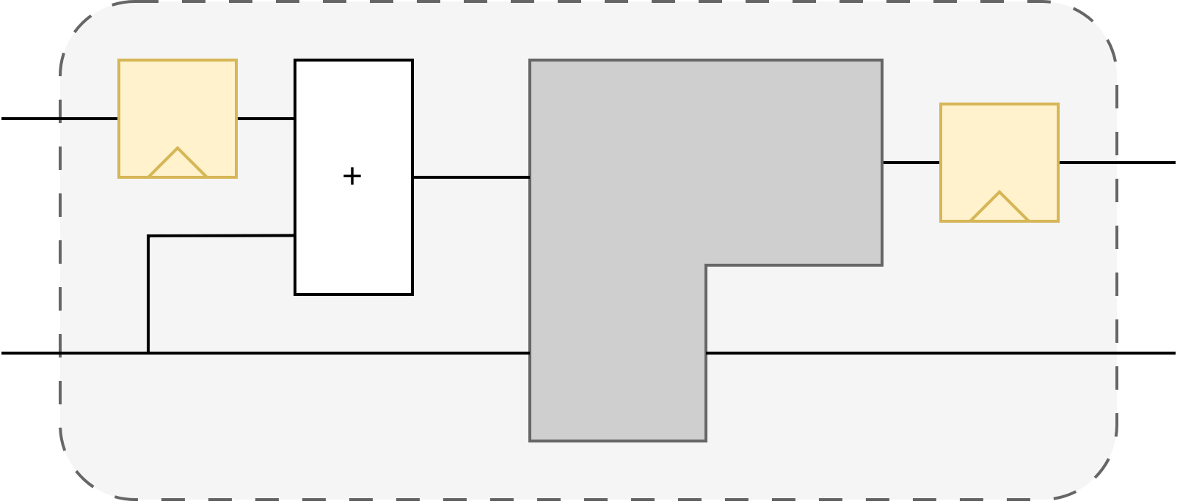
Latency Information travels up the hierarchy
‘-1
6 cycles
‘7
‘6
‘0
‘0
‘2
‘0
‘2

Slide 16
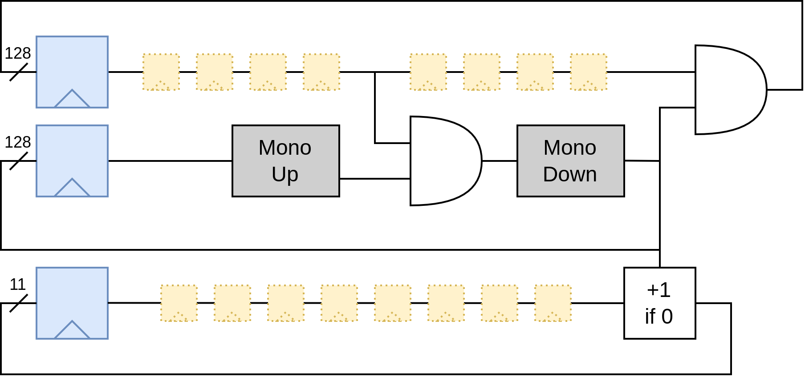
But can it travel down too?
(The answer is yes)
Infer the depth of BRAM shift registers from context

Slide 17
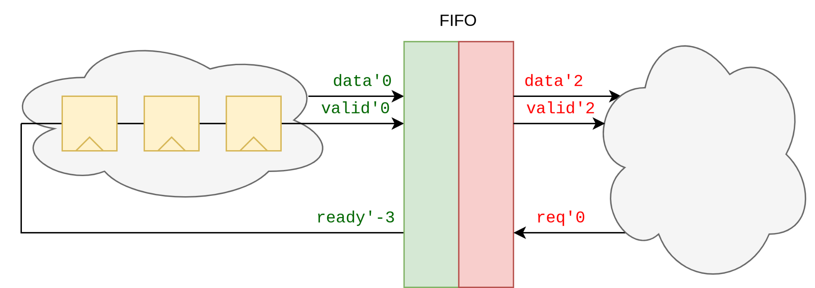
Why is Latency inference useful?
Notes:
Multiple interfaces
Each has latency “origin”
Interfaces are independent
Ports on write are “correlated”, no direct connection to read side
Modules can have multiple interfaces, each of which has its own latency ‘origin’. Interfaces are independent. Like in this example, all ports on the write side of the fifo are “correlated”, but they don’t have a direct connection to the ports in the read side.

Slide 18
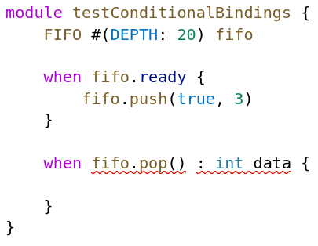
So what would an RTL language need to replace HLS?
Pipelining
Must be nearly transparent
Submodules (Like FIFOs, BRAM Shift Registers etc) must be responsive to pipelining outside
Control flow
Submodules must be able to affect control flow in parent module
Need wide library of control flow primitives
Global data access (DDR, HBM, PCIe)
Cannot pass busses up and down the call stack
Actions
Triggers
Queries
Conditional Bindings

Slide 19
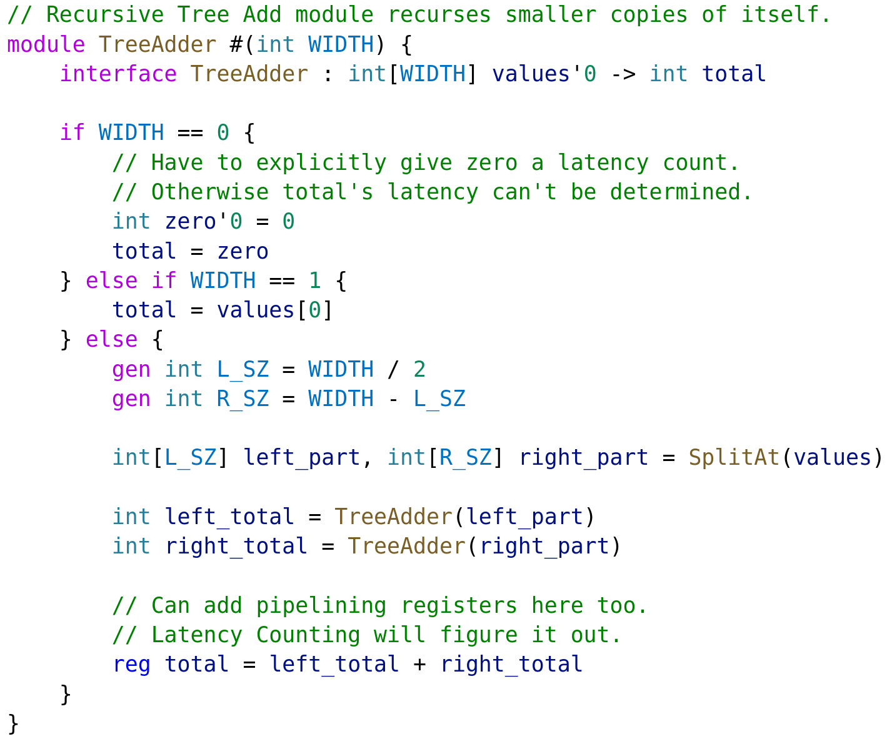
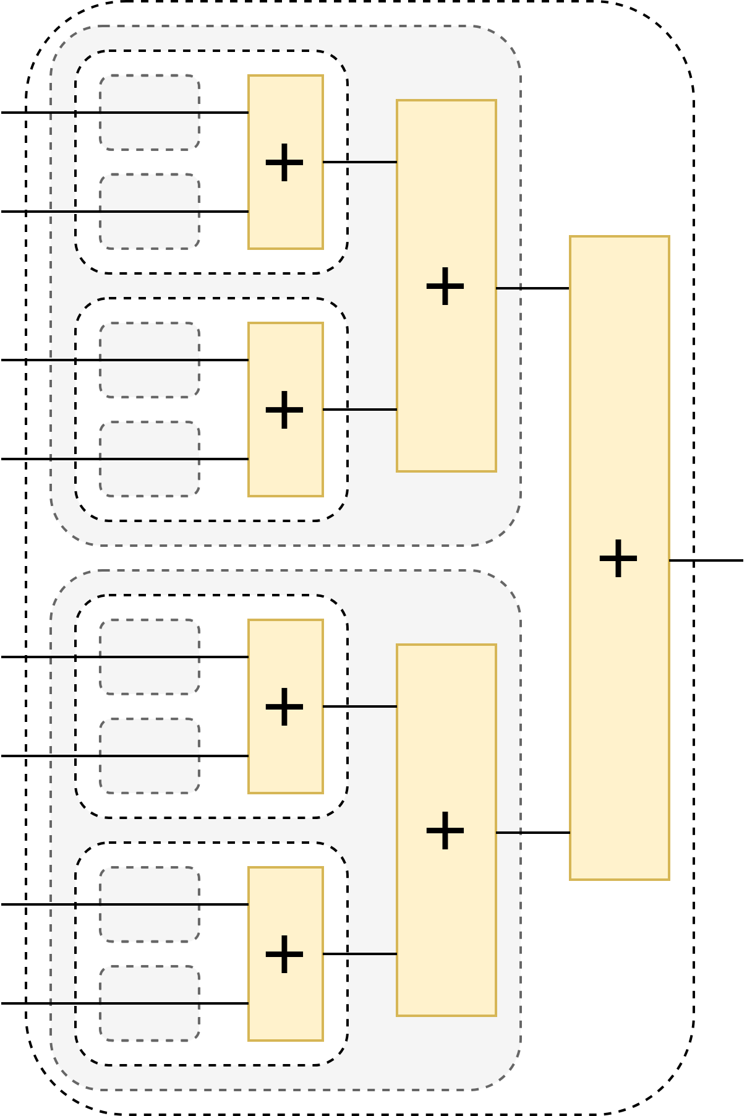
Recursive
Modules
Base cases
Recursive Calls

Slide 20
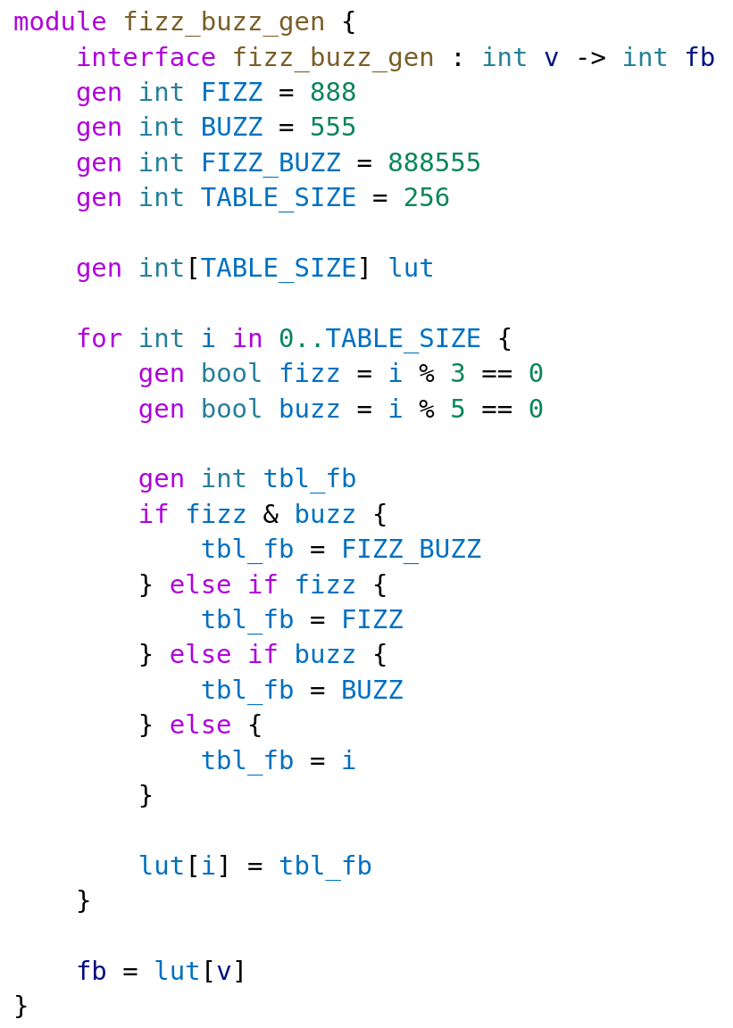
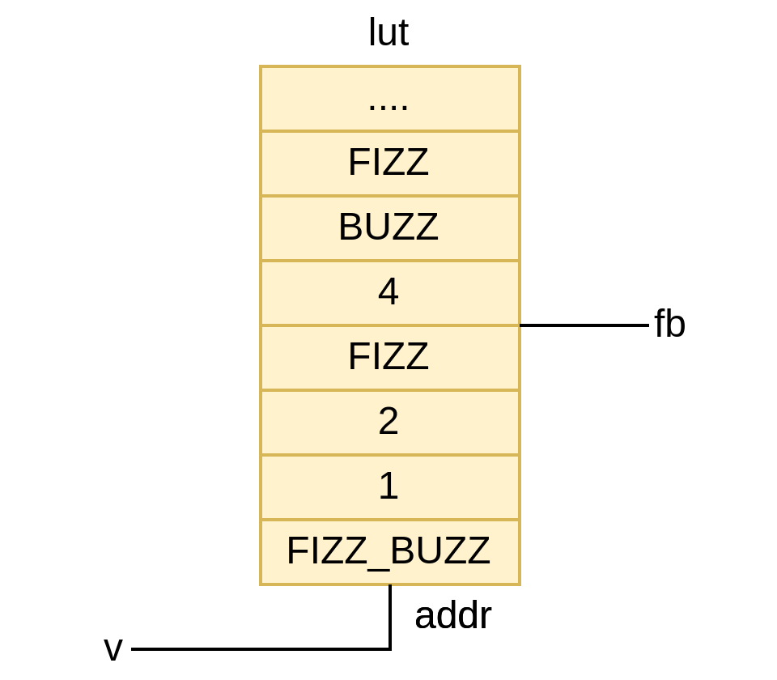
Generative FizzBuzz

Slide 21
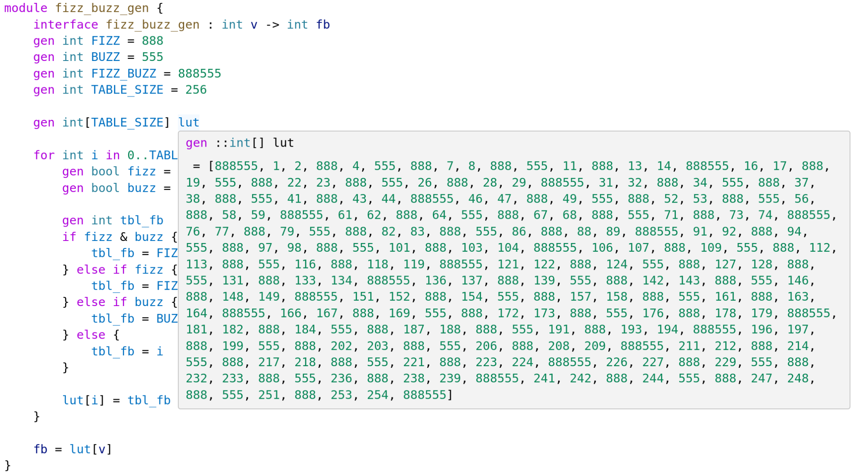
Generative FizzBuzz

Slide 22
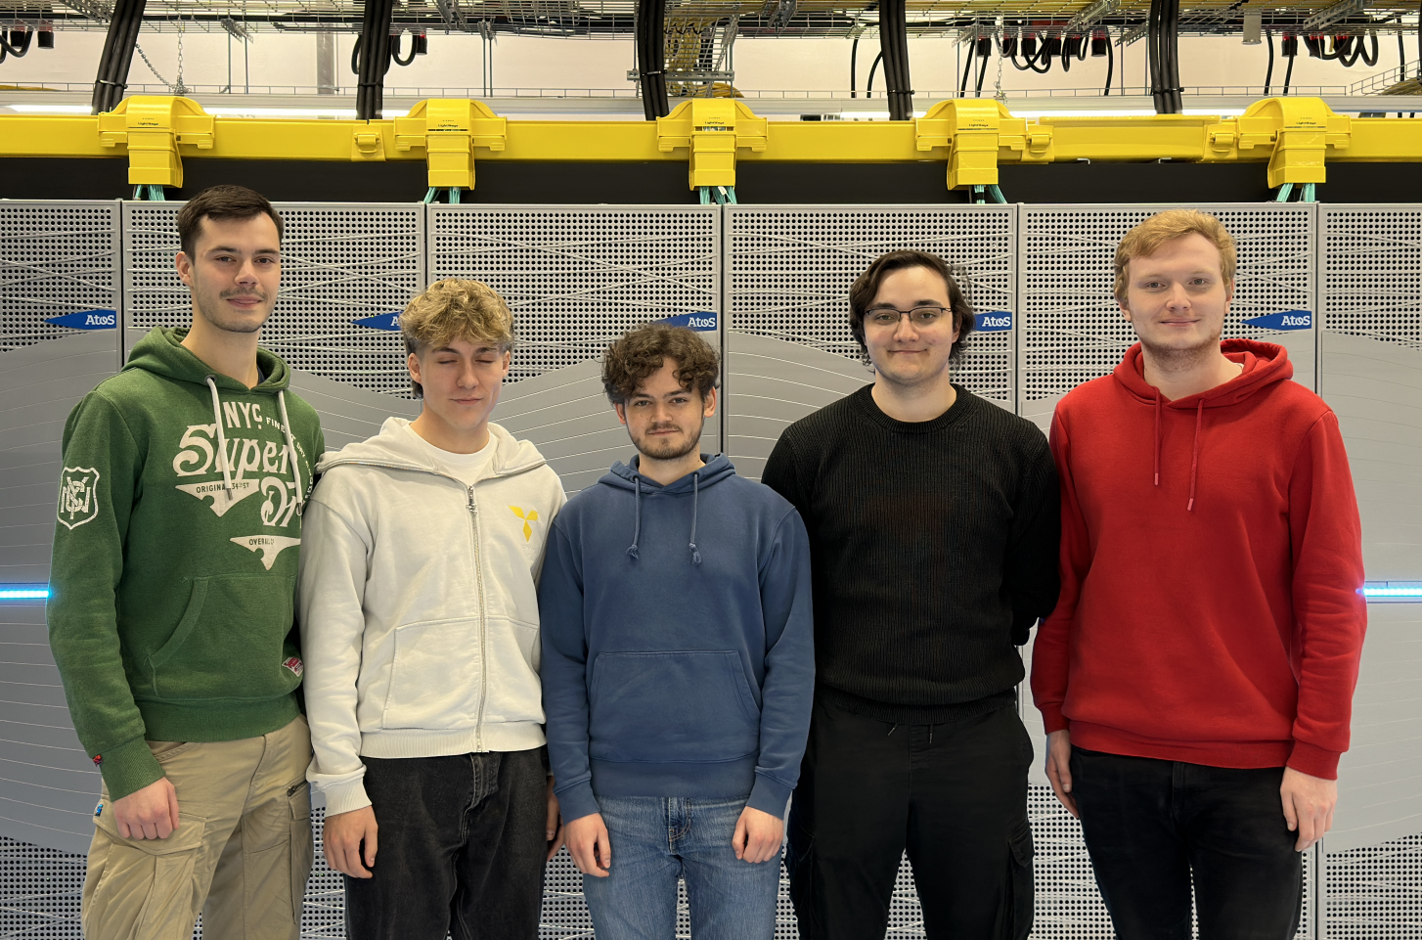
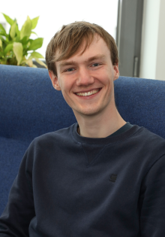
The Team
Fabian Segref Marc Jonas Geweiler Tom Skarabis Tobias Hodapp Tim Siebert Reem Lababidi @ Paderborn
Lennart Van Hirtum Lead Developer @ Paderborn (PC²)
Patrick Beart @ KU Leuven

Slide 23
cargo install sus_compiler
ext install LennartVanHirtum.sus-lsp
github.com/pc2/sus-compiler

