Slide 1
Open-Source toolchain to support building energy systems from digital planning to optimal operation
Fabian Wüllhorst and David Jansen

Slide 2















Motivation
Integral planning of buildings and their energy systems gets increasingly complex
Buildings account for 16 % of global emissions
Construction rate is low due to high costs
Renewable energies lead to complex interactions
Optimize emissions and costs during planning and operation
Waterfall planning
Integral planning
1
1
2
3
6-9
2
4
5
3
5
6-9
4
Integral planning of architecture, electrical systems,
heating/cooling systems, etc. using BIM-based digital tools

Slide 3





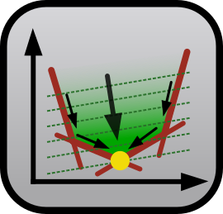




Approach for digital, integral planning of building and energy system using software tools from EBC
Planning Phase
1
2
3
4
5
6-9
Building
Energy System
Blender+
Bonsai
ModelicaPyCI
MoCITempGen
EBCpy&VCLibPy

Slide 4
Approach for digital, integral planning of building and energy system using software tools from EBC
Planning Phase
1
2
3
4
5
6-9
Building
Energy System
Blender+
Bonsai
ModelicaPyCI
MoCITempGen
EBCpy&VCLibPy

Slide 5
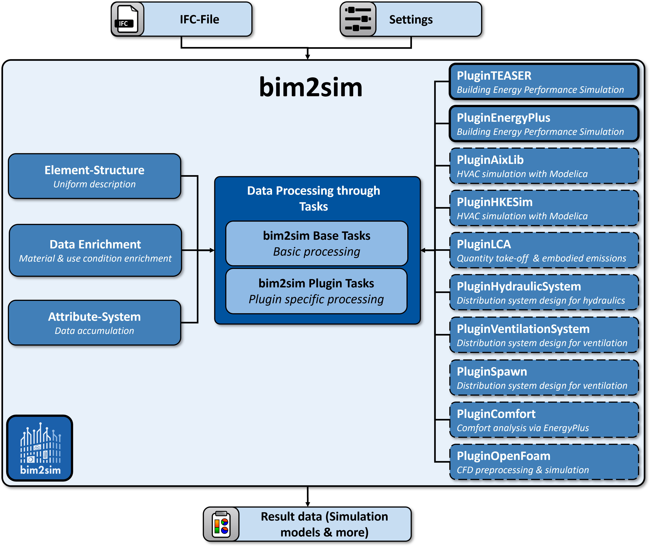
Workflow of the open-source bim2sim tool
Plugin System
  Enables simple extension for new environments
Workflows
  Combines plugin-spanning settings
Playground
  Enables the definition of tasks that
  need to be processed
Tasks
  Loading IFC data
  Simplification of topology
  Enrichment of data
Attribute system
  Core concept for processing non-uniformly
  defined data in IFC
Decisions
  Uniform interface for querying ambiguities in IFC

Slide 6
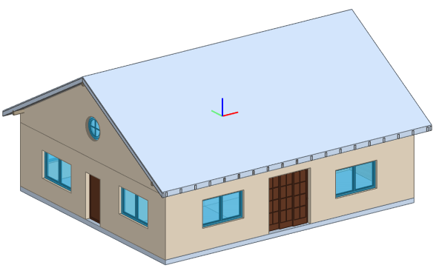
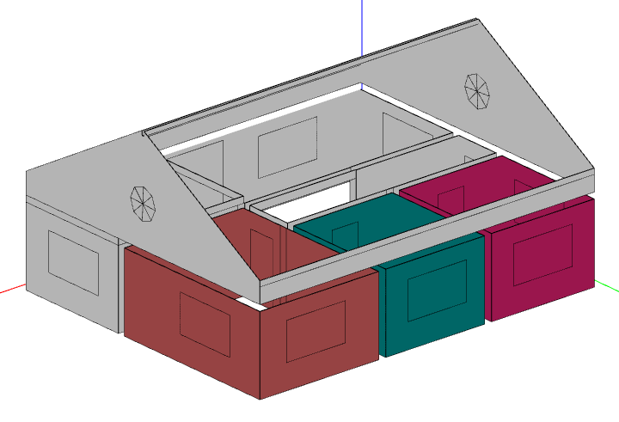
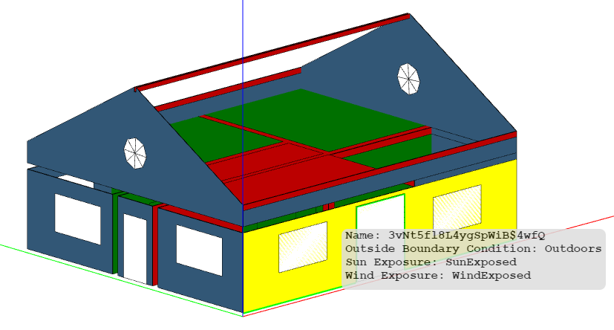
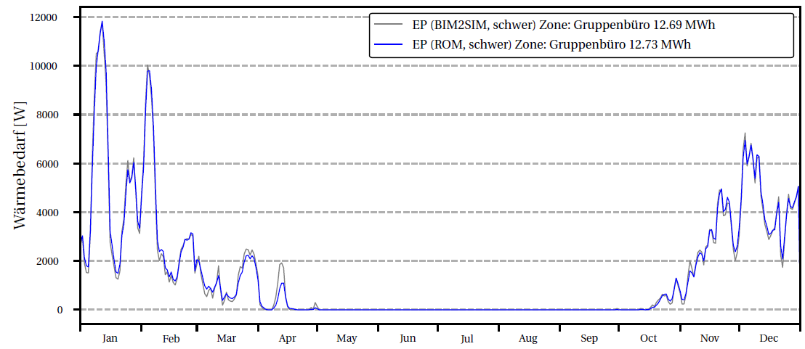
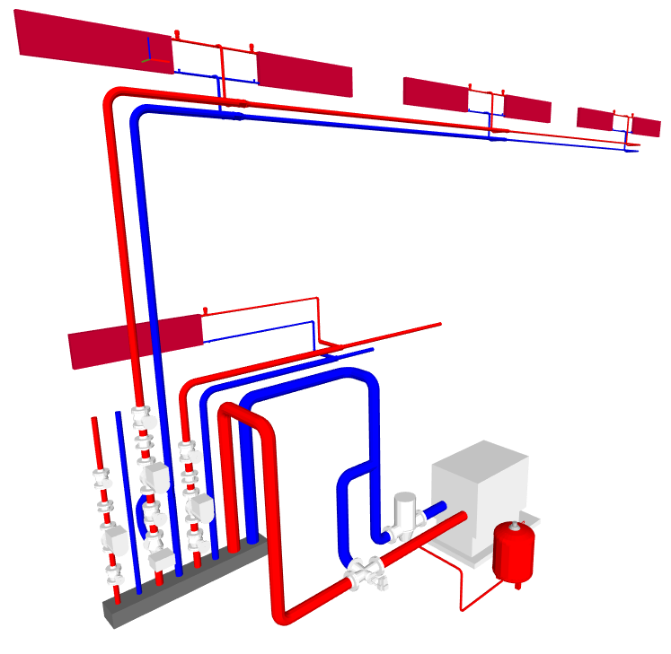
Automatic generation of simulation models based on IFC-Data provides direct feedback to planners
EnergyPlus (IDF)
Building design
Thermal Zones
Boundary Conditions
Simulation
Direct
Feedback
Energy System
Quellen: FZK-Haus (IFC4): Institut für Automation und angewandte Information / Karlsruher Institut für Technologie, FZK-Haus (IDF): BIM2SIM-Projekt,
IFC-Viewer: BIMvision, IDF-Viewer: OpenStudio V2.9.0

Slide 7
Approach for digital, integral planning of building and energy system using software tools from EBC
Planning Phase
1
2
3
4
5
6-9
Building
Energy System
Blender+
Bonsai
ModelicaPyCI
MoCITempGen
EBCpy&VCLibPy

Slide 8


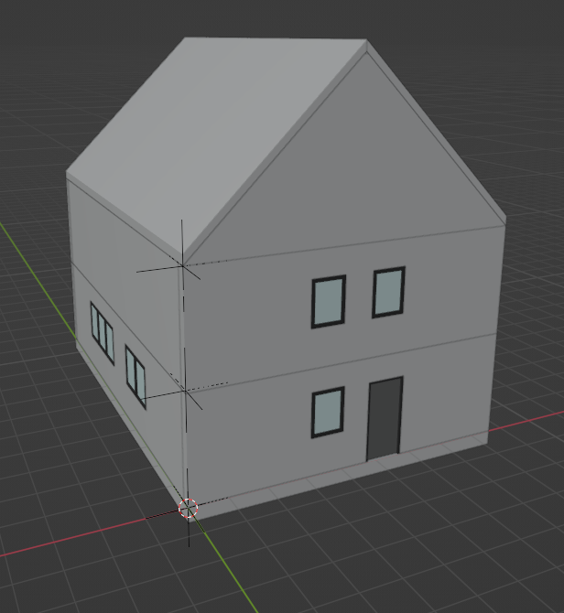
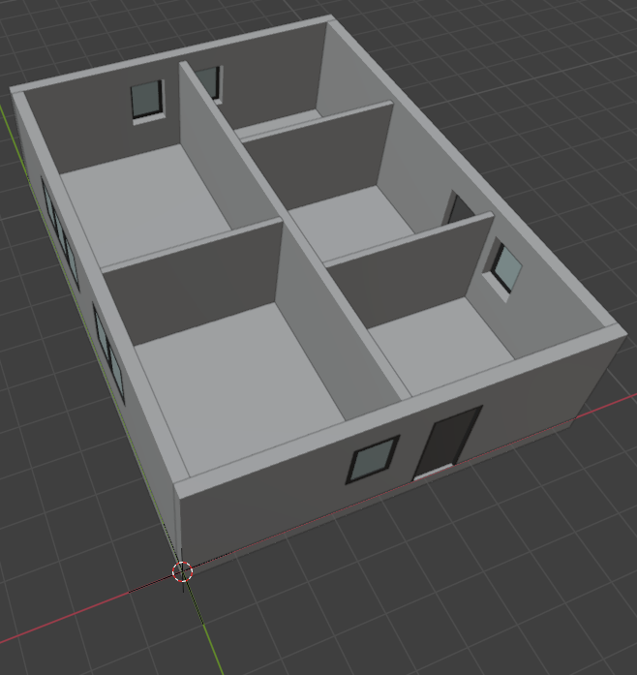
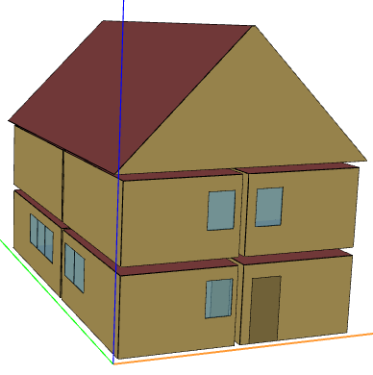
Generation of a building envelope models using open-source software
Tool
Visualization
Result
bim2sim^{[6]} coupled to Blender^{[4]}
with Add-On Bonsai^{[5]} via REST-API
OpenStudio^{[7]}
3D-Model in IFC-Format with export to IDF
3D-Viewer
[4] Blender: https://www.blender.org/
[5] Bonsai: https://extensions.blender.org/add-ons/bonsai/
[6] bim2sim: https://github.com/BIM2SIM/bim2sim
[7] OpenStudio: https://openstudio.net/

Slide 9
Approach for digital, integral planning of building and energy system using software tools from EBC
Planning Phase
1
2
3
4
5
6-9
Building
Energy System
Blender+
Bonsai
ModelicaPyCI
MoCITempGen
EBCpy&VCLibPy

Slide 10
TEASER – Tool for Energy Analysis and Simulation for Efficient Retrofit
Workflow for parametric building envelope models
Automatic generation of dynamic building envelope models in AixLib
Based on various datasources (BIM, CityGML, TABULA, IWU, own data, etc.)
Open-source and on pypi: https://github.com/RWTH-EBC/TEASER

Slide 11
Approach for digital, integral planning of building and energy system using software tools from EBC
Planning Phase
1
2
3
4
5
6-9
Building
Energy System
Blender+
Bonsai
ModelicaPyCI
MoCITempGen
EBCpy&VCLibPy

Slide 12

Parametric Building Simulation using TEASER and AixLib
Model is a reduction of the building to a thermal network
of capacitances and resistances
Model built according to VDI 6007 standard
Part of the EBC's AixLib Library
Advantage: Computes very quickly
Validated according to ASHRAE 140 and VDI 6007
Outer walls
Indoor heat exchange
Inner walls
Indoor air

Slide 13
Approach for digital, integral planning of building and energy system using software tools from EBC
Planning Phase
1
2
3
4
5
6-9
Building
Energy System
Blender+
Bonsai
ModelicaPyCI
MoCITempGen
EBCpy&VCLibPy

Slide 14







Mathematical optimization of energy system using Python and gurobi
Select energy system from various options
  Heat pump, Chillers
  CHP, Boiler
  PV, Battery
  …
Design the energy systems with interactions
to building envelope design
Usage of clustered dynamic input data
Consideration of various boundary conditions
  Subsidies
  Law requirements
  Availability of craftworkers
Technical
Data
User Behaviour
Weather
Economics
Buildings
Inputs
Optimization Model
Building and Energy System Interactions
Optimal
Insulation
Technology
Choices and Design

Slide 15
Approach for digital, integral planning of building and energy system using software tools from EBC
Planning Phase
1
2
3
4
5
6-9
Building
Energy System
Blender+
Bonsai
ModelicaPyCI
MoCITempGen
EBCpy&VCLibPy

Slide 16
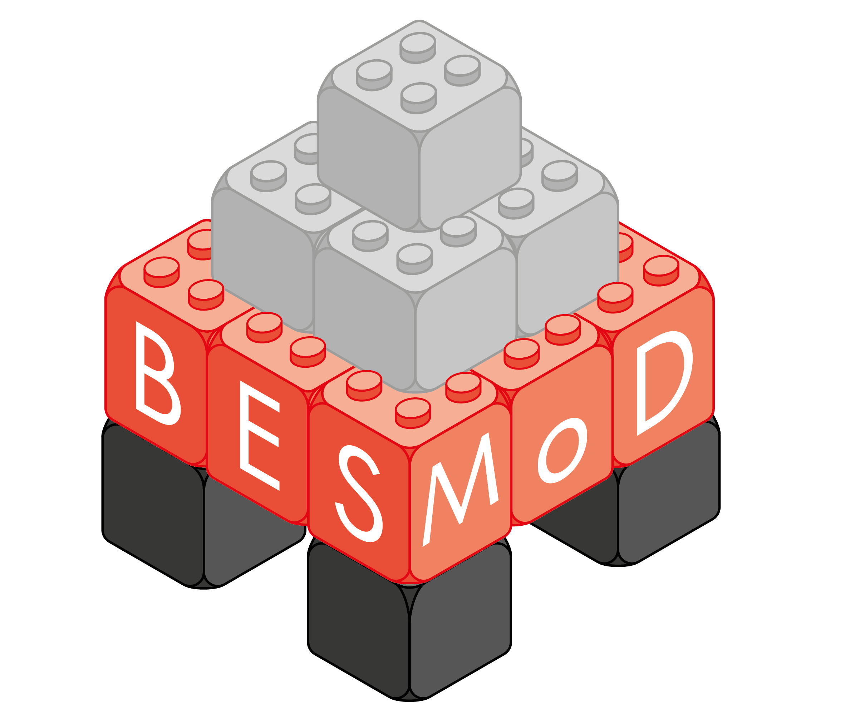




Detailed dynamic operation using BESMod, a Modelica Library for Building Energy System Modules
Coupled, detailed, dynamic simulation of building energy systems
Easy state-of-the-art parameterization
Based on: IBPSA, AixLib, TEASER
Electrical
Ventilation
User
Local
Control
Local
Control
Supervisory
Control
Weather
Generation
Distribution
Transfer
Distribution
Generation
Hydraulic
Legend:
System Parameters
Local
Control
Building
envelope
Information signal
Water
Thermal
Moist air
Electrical
Parameter Study
Inflow
Generation
Distribution
Transfer
DHW
Outflow
(Design direction)

Slide 17
Approach for digital, integral planning of building and energy system using software tools from EBC
Planning Phase
1
2
3
4
5
6-9
Building
Energy System
Blender+
Bonsai
ModelicaPyCI
MoCITempGen
EBCpy&VCLibPy

Slide 18
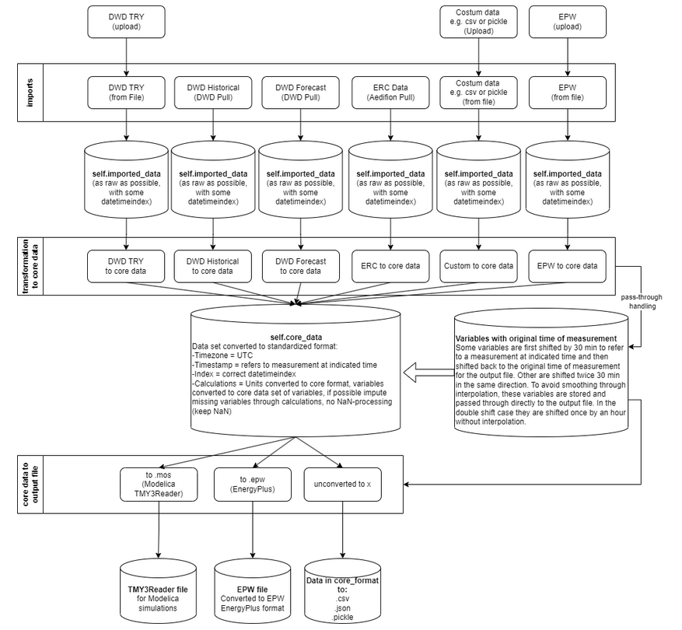
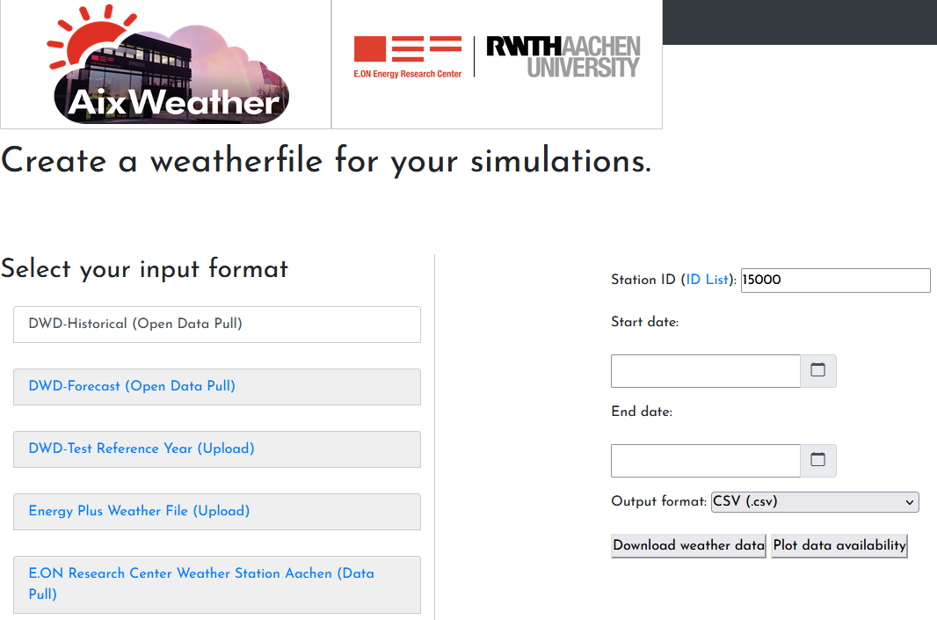
AixWeather provides weather data in all formats required for simulation and optimization
Get weather data for simulations
WebApp / Python (on pypi)
https://github.com/RWTH-EBC/AixWeather
https://aixweather.eonerc.rwth-aachen.de/

Slide 19
Approach for digital, integral planning of building and energy system using software tools from EBC
Planning Phase
1
2
3
4
5
6-9
Building
Energy System
Blender+
Bonsai
ModelicaPyCI
MoCITempGen
EBCpy&VCLibPy

Slide 20

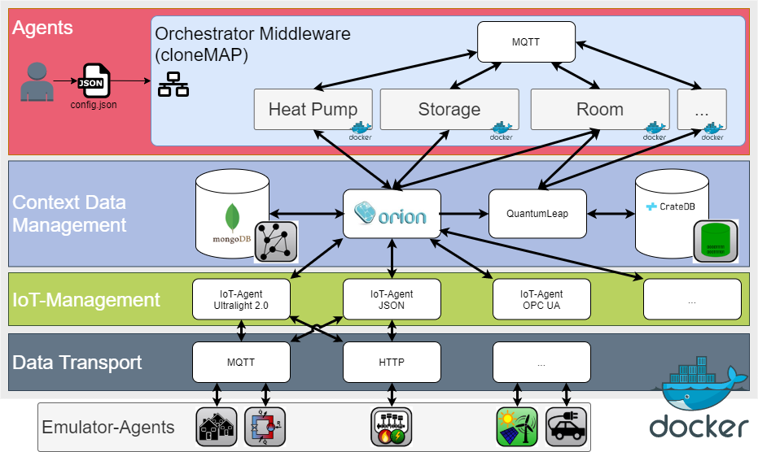
Couple operation using software agents and open-source IoT platforms
Run simulations or services in real-time
or in debug mode (fast)
Separate function from
communication with modular agents
Reuse code
Quickly build applications with modules
  FMUs
  Digital Twins
  MQTT
  MPC with AgentLib-MPC plugin
Coupled to FIWARE Platform (IoT)
using FiLiP (FIWARE library in Python)

Slide 21
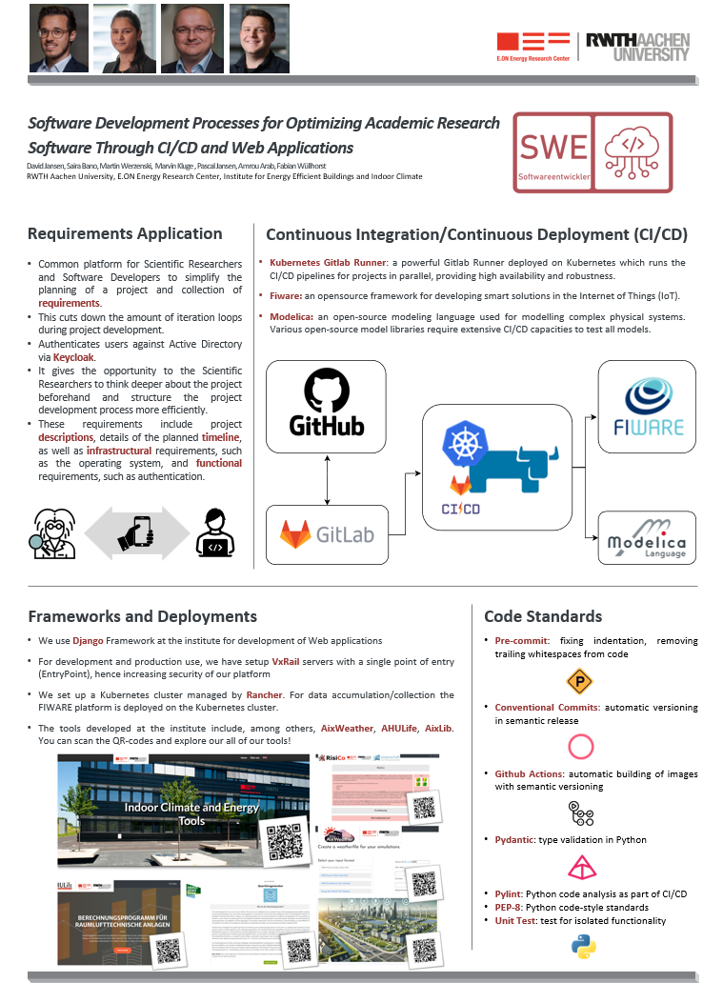
Challenges and future work
Separation of software
  useful to avoid dependencies
  makes development of single repository straight forward
  Challenging, as various interdependencies have to be considered
Tool development as researches
  Challenging, as funding favors new tools instead of maintenance of established tools, e.g. TEASER or AixLib
  Challenging, as life cycle of researchers is ~5 years
Future Work of software development team
  coordinate development of tools
  guides new researchers with good code standards
Come meet our software developer team in the poster session

Slide 23
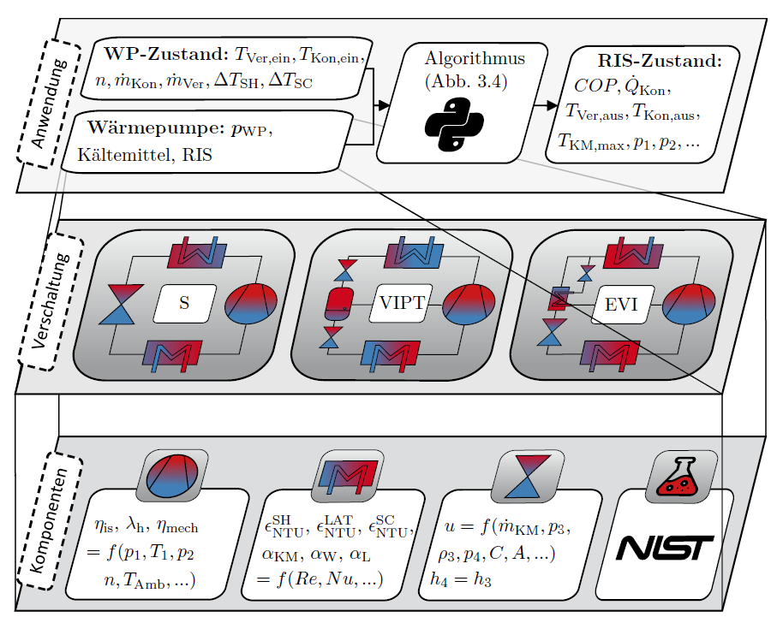
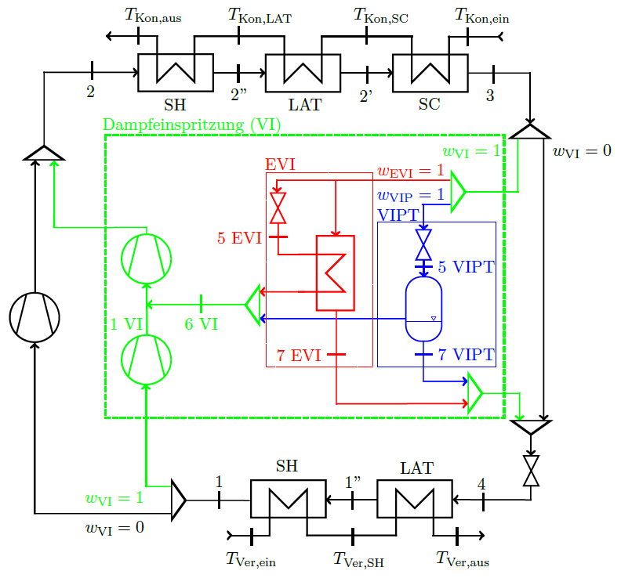
VCLibPy - Vapor Compression Library in Python
Steady-state vapor compression calculations
Performance-map generation

Slide 24
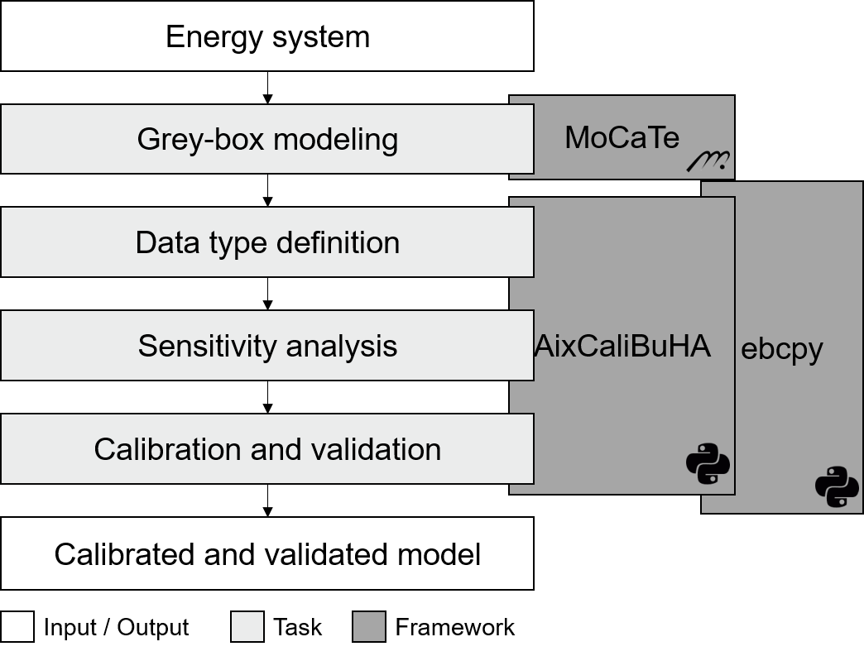
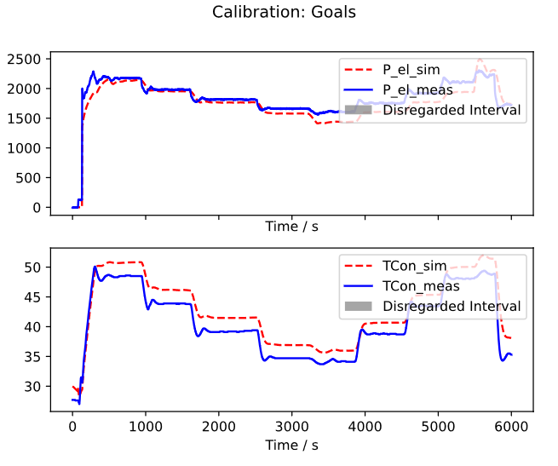
AixCaliBuHA – Aix Calibration for Building and HVAC Systems
Type: PyPI package
Use case: Automated calibration of dynamic black-box simulation models
Based on: ebcpy

Slide 25
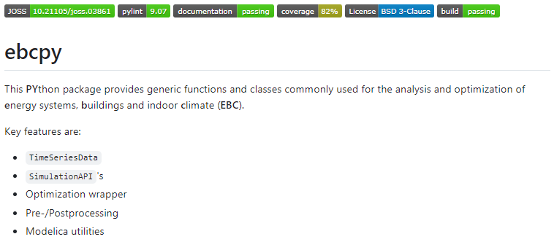
EBCPy – EBCPython package (=ModelicaSimulationPy)
Type: PyPI package
Use case: Python Scripts to automate/optimize/analyze simulation models

