Slide 1
RSE community buildup in Switzerland
Uwe Schmitt, ETH Zurich
12 Feb 2025

Slide 2
About me / us
Uwe Schmitt
I work as an RSE for https://sis.id.ethz.ch
We are around 50 people meanwhile.
”First contact”: Visited UK conference in 2023

Slide 3
RSE community @ ETH: first steps
Mail campaign on the 23rd of November 2023
Emails to both research and technical staff
Incredible response
Announced 1st online information event on 12th of December 2023

Slide 4
1st online information event
Around 120 participants
2 parts:
Talk by Prof. Simon Hettrick (Software Sustainability Institute UK)
Information on community building @ ETH
RSE community survey
Q&A

Slide 5
First on-site event: 1st of February 2024
Part 1: Lightning talks
Part 2: Talk by Mr. Peter Schmidt from the UK RSESoc
Part 3: Discussion rounds in small groups:
What do you expect from the RSE community?
What kind of role do you imagine for yourself in this community?
How can we build the community?

Slide 6
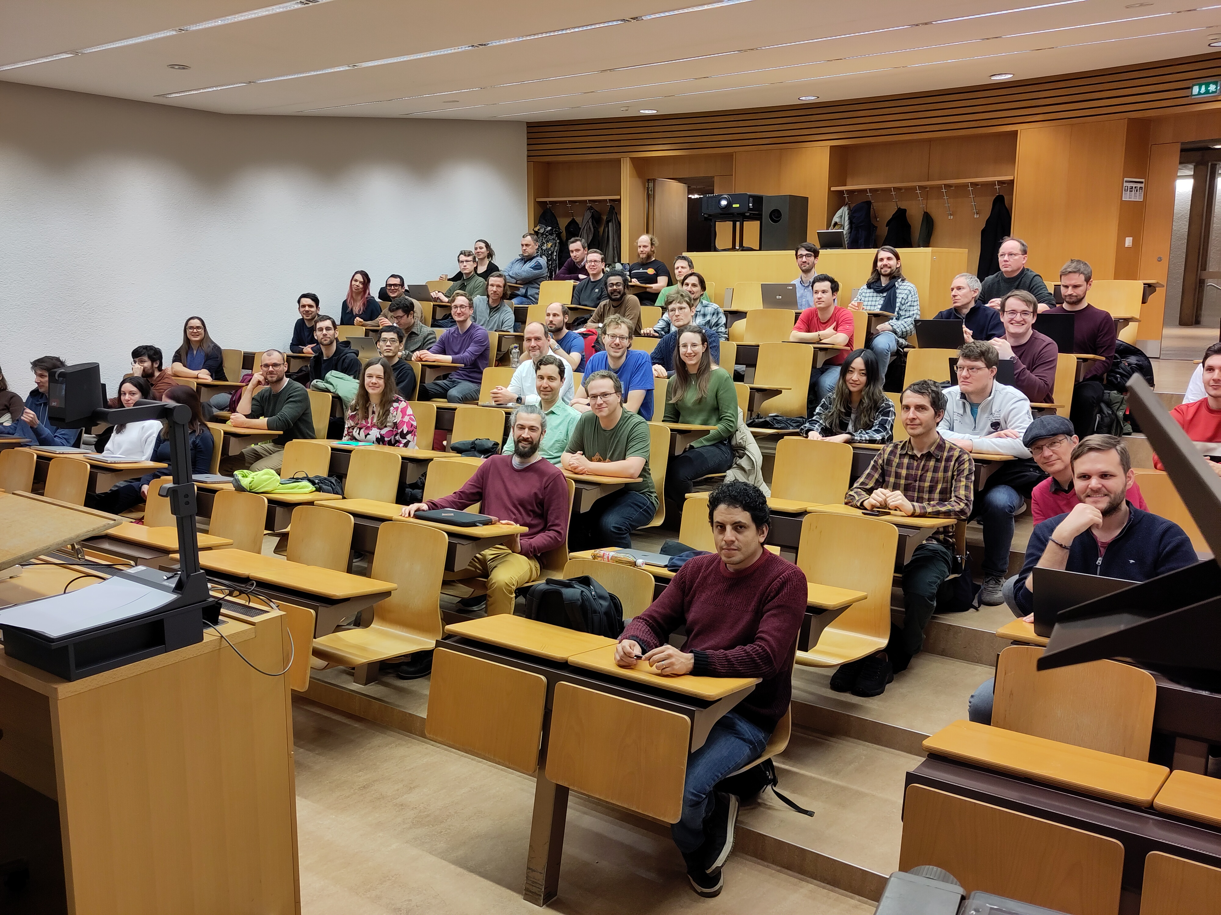

Slide 7
Reactions:
EPFL Lausanne: we also want to do something!
KOF Swiss Economic Institute: We were just about to set up something of our own!
>300 members on mailing list
~100 on matrix chat
~65 at first on-site event
Website https://rse.ethz.ch (could be https://rse.swiss soon)

Slide 8
What happened since then?
Zoom calls, Lighting talks in person
Small working group at ETH Zurich
Panel discussion about “Hiring RSEs”
https://rse.ethz.ch/blog/2024_10_26_rse_job_panel/
Got funding!

Slide 10
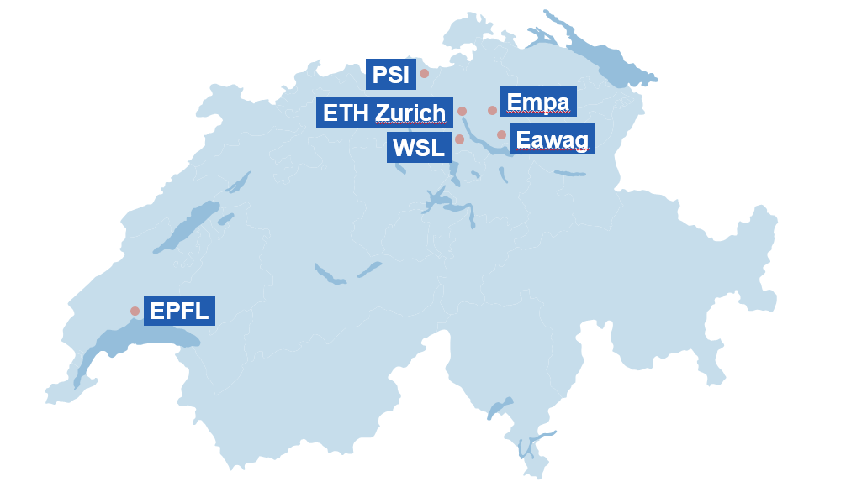
ETH Domain

Slide 11
Funding: RSE4ORD
(https://open-research-data-portal.ch/services-projects/rse4ord-building-a-research-software-engineering-community-to-promote-open-science/)
Building a research software engineering community to promote FAIR principles for research software.
With all institutes from ETH domain:
ETH Zurich, EPFL + 4 RIs (EAWAG, EMPA, WSL, PSI)
250k CHF in total for 2 years for 9 people

Slide 12
RSE4ORD
Build up local communities
Promote FAIR principles for research software
RSE Survey
Evaluate options for a Swiss RSE association
Final event / workshop
State as of now:
Initial communities at ETHZ, EPFL, EMPA and EAWAG
First meetup at WSL last week
PSI in planning

Slide 13
Upcoming call for RSE ambassadors
Sponsored by EnhanceR (https://www.enhancer.ch/)
Association / Network of Swiss Research IT groups
5-10k for one year
Goal: build RSE communities beyond RSE4ORD
Details: https://rse.ethz.ch/blog/2025_02_21_call_for_ambassodors/

Slide 14
In the pipeline
Lighting talks / meetup
Zoom presentations
Hackathon with https://opendata.ch and other stake holders
Ideas:
Panel discussion “RSE education”
international online Book club?

Slide 15
Summary
We are very pleased with what we have accomplished so far.
But also challenges:
Could need more funding
Keep the community engaged

Slide 16
Contact: Uwe Schmitt, uwe.schmitt@id.ethz.ch
License: https://creativecommons.org/licenses/by-nc/4.0/

