Slide 1
Institute for Parallel and Distributed Systems
Data Model Creation with MetaConfigurator
Felix Neubauer
Notes:
"Thank you for the introduction! Today, I’m going to talk about MetaConfigurator, an open-source tool for creating and editing data models."

Slide 2
The Team
Initial Student Project Team
Supervision
Felix Neubauer
Paul Bredl
Jürgen Pleiss
Benjamin Uekermann
Continues the Project in PhD
Partners
Keyuri Patel
Minye Xu
Cluster of Excellence SimTech, Stuttgart Center for Simulation Science
University of Stuttgart, Institute for Biochemistry and Technical Biochemistry

Slide 3
“Have you ever struggled with data interoperability?”
Notes:
Start with audience interaction: "Quick show of hands—who here has worked with structured data formats like JSON, XML, or YAML?” – probably everyone
"Now, who has ever struggled with ensuring that data from different sources actually fits together?"
"Schemas are supposed to help with this—but creating and maintaining them is not as easy as it should be."

Slide 4
Content
Data Models (what is it and why does it matter?)
The Problem
The Solution
Live Demo
Conclusion

Slide 5
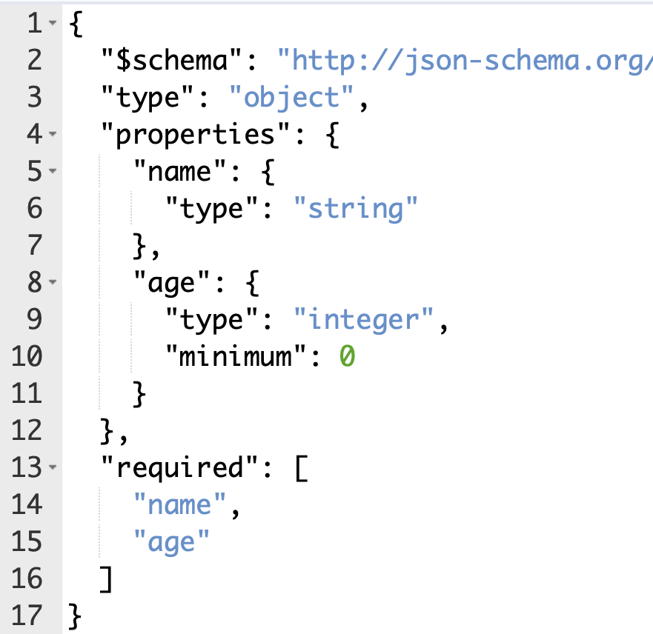
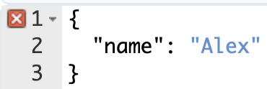
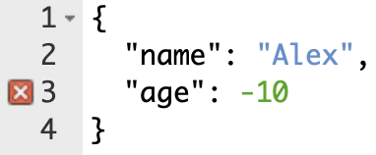
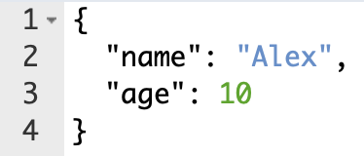
What is a Data Model?
A data model defines the structure and constraints of data
Notes:
A data model defines the structure and constraints of data
Specifies required properties, data types, and relationships
Ensures consistency, validation, and interoperability
Analogy: Like a blueprint for data
"However, despite their advantages, schemas are often neglected. Many researchers and developers still rely on ad-hoc structures, leading to incompatibility and inefficiencies."
todo data sample

Slide 6
Why Data Models Matter
Without a Data Model
With A Data Model
Inconsistent structures
Data duplication
Hard to validate
Manual effort needed
→ No FAIR¹ness
Defined structure
Interoperability
Automatic validation
Easier analysis and automation
→ Enables FAIR¹ness
¹: Findable, Accessible, Interoperable and Re-Usable [1]
[1]: WILKINSON, Mark D., et al. The FAIR Guiding Principles for scientific data management and stewardship. Scientific data, 2016, 3. Jg., Nr. 1, S. 1-9.

Slide 7
Challenges in Creating Data Models
High technical barrier (e.g., JSON Schema syntax)
Lack of easy-to-use tools
Fragmentation between different teams and organizations
Notes:
"Even when organizations recognize the need for schemas, creating and maintaining them is a challenge.”
"It requires significant expertise, and manually writing schemas can be slow, error-prone, and frustrating."

Slide 8
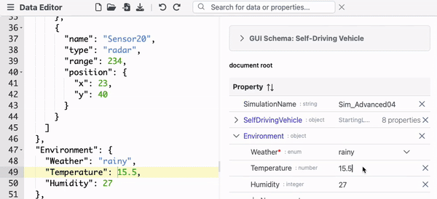
Introducing MetaConfigurator
MetaConfigurator [2] is an open-source tool for creating and editing data models (schemas) and data for JSON/YAML.
[2]: NEUBAUER, Felix, et al. MetaConfigurator: A User-Friendly Tool for Editing Structured Data Files. Datenbank-Spektrum, 2024, S. 1-9.
Notes:
"To tackle these challenges, we developed MetaConfigurator: a tool that simplifies schema creation and editing, making it accessible to a wider audience.”
"It offers a unified interface combining a GUI and a text editor, supporting advanced schema features like conditions and constraints.”
”It also allows for editing data according to a schema, as shown in this GIF.”
“For today, the creation and editing of data models (schemas) is the focus, which I will show in a live demonstration”

Slide 9
The Solution
Key Features of MetaConfigurator
Different synchronized views (Text Editor, GUI, Diagram)
Integrated Validation and Syntax Highlighting
Supports also advanced JSON schema features (composition, conditionals, constraints)
Graphical Schema View (UML-like visualization)
CSV Import
Schema Inference
Snapshot Sharing for Collaboration
More to come soon!
Notes:
"MetaConfigurator isn’t just a schema editor—it includes features to make schema creation faster, more intuitive, and collaborative.”
Briefly explain each feature

Slide 10
LIVE DEMO
www.metaconfigurator.org
With a dataset² from Chemistry: Metal Organic Framework (MOF) synthesis
They put chemicals together in certain conditions to produce new chemical
Goal: reach certain characteristics in produced chemical
Big dataset in Excel
²: Dataset provided by Esengül Çiftçi, Max Planck Institute for Solid State Research
Notes:
in case of technical issues, fall back on pre-recorded demo
"Enough talking—let me show you how MetaConfigurator works!”
Walk through a real-world use case (e.g., creating a schema for a research dataset)
Highlight how MetaConfigurator reduces complexity compared to manual JSON Schema writing
Demo:
Show Excel Table and explain
Import CSV in MetaConfigurator
Show resulting JSON
Show resulting GUI and then data model
Add enum for mass units
Show change in the data view
More?
Download both schema and data
Quickly run a script that validates data based on the schema and show it works

Slide 11
What to do with our new Data Model?
Formal specification of our desired data structure
Can be communicated or published
Automatic validation
Code generation
Script that processes the data
Enriching the compound entries with chemical information from PubChem
Learning algorithm to optimize the synthesis
Notes:
Now we have structured data and a forma specification of the data model. now we can build on top of this
Can be communicated or published
Automatic validation
Code generation
For example, we have another user who wrote a python script to add additional data from a public database to the dataset
What we are working on right now is a learning algorithm to optimize the synthesis

Slide 12
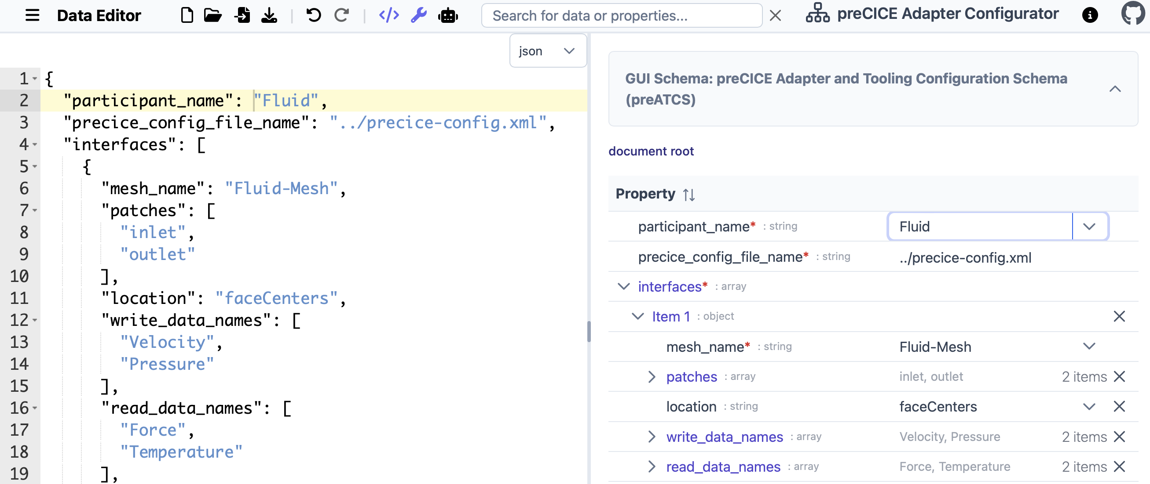
Example 2: preCICE Adapter Configurator
Notes:
Now we have structured data and a forma specification of the data model. now we can build on top of this
Can be communicated or published
Automatic validation
Code generation
For example, we have another user who wrote a python script to add additional data from a public database to the dataset
What we are working on right now is a learning algorithm to optimize the synthesis

Slide 13
Future Directions
Generating JSON Schema from an Ontology
Generation of source code from schemas (e.g. Python API)
AI integration
Large scale user study
More documentation, tutorials
Feedback & Early Adopters are very welcome!
Notes:
"We’re constantly improving MetaConfigurator. Upcoming ideas include [list a few planned improvements]."

Slide 14
Takeaways
Data models enable interoperability, validation and integration of data across domains and teams → making data more FAIR
MetaConfigurator supports in creation and maintenance of data models
Try it out yourself!
https://github.com/MetaConfigurator/meta-configurator/
Notes:
"MetaConfigurator simplifies data modeling, making schemas easier to create, edit, and share.”
"If you work with structured data, I’d love for you to try it out!"

Slide 15
Institute for Parallel and Distributed Systems
Felix Neubauer
e-mail
felix.neubauer@ipvs.uni-stuttgart.de
www.
logende.org
University of Stuttgart
Institute for Parallel and Distributed Systems
https://github.com/MetaConfigurator/meta-configurator/
Universitätsstraße 38, 70569 Stuttgart,

Slide 16
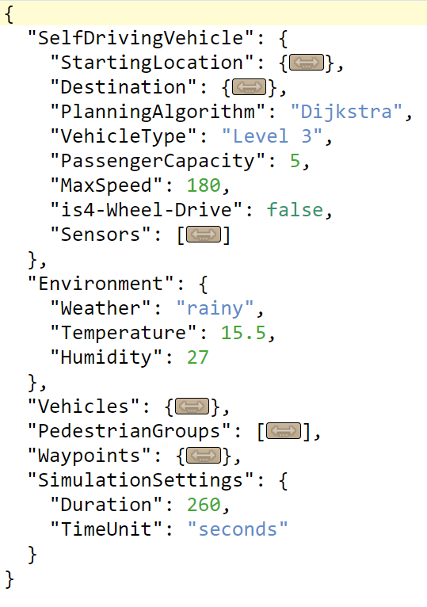
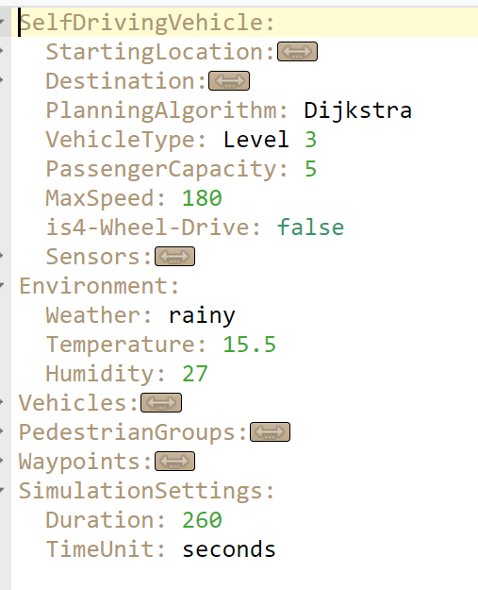
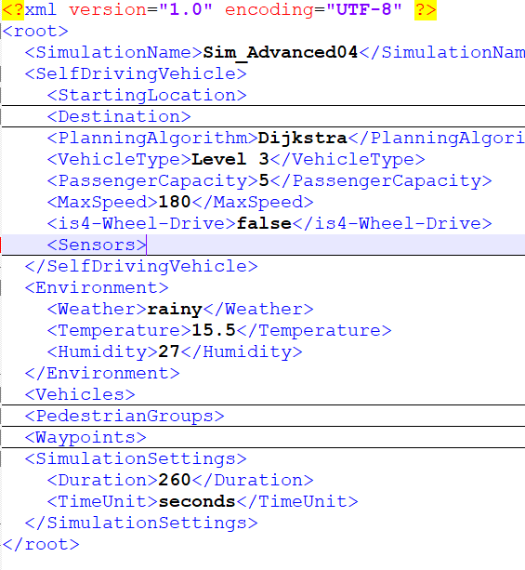
Backup
Data Formats
JSON
YAML
XML
Notes:
"MetaConfigurator simplifies data modeling, making schemas easier to create, edit, and share.”
"If you work with structured data, I’d love for you to try it out!"

Slide 17
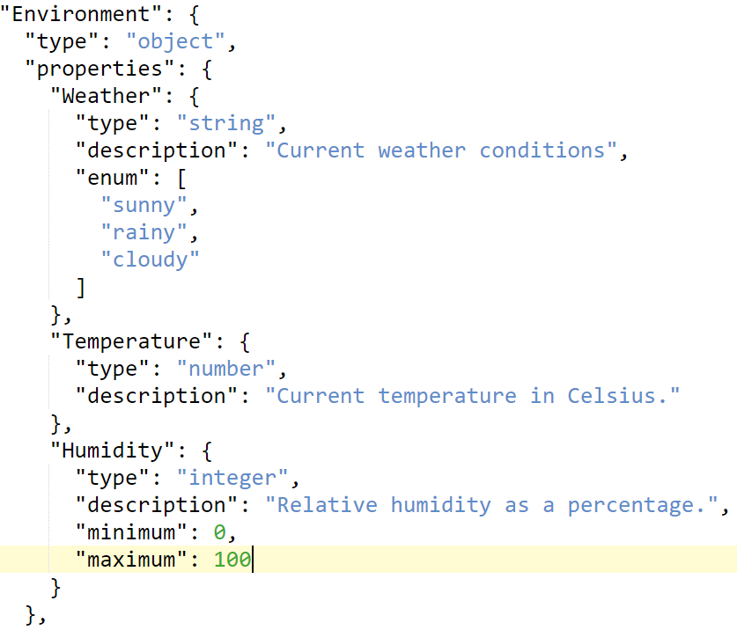
Backup
Data Models (= Schemas)
A schema defines…
the structure to which data needs to adhere to
constraints, conditions, etc.
metadata (e.g., attribute descriptions)
It enables…
data validation
communication of data models
common tooling

Slide 18
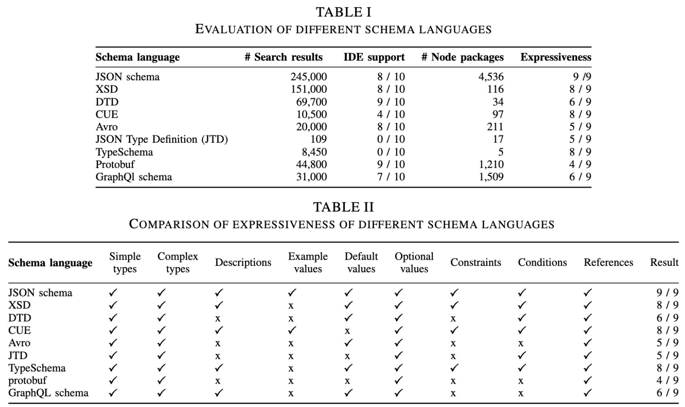
Backup
Schema Language Comparison

Slide 19
Backup
MetaConfigurator – Original Paper

Slide 20
Backup
Related Work
JSON Schema related research: schema inference [3, 4], validation [5], witness generation [6], schema matching [7], etc.
[3]: Čontoš, Pavel; Svoboda, Martin: JSON schema inference approaches. In: International Conference on Conceptual Modeling. Springer, pp. 173–183, 2020.
[4]: Baazizi, Mohamed-Amine; Colazzo, Dario; Ghelli, Giorgio; Sartiani, Carlo: Parametric schema inference for massive JSON datasets. The VLDB Journal, 28:497–521, 2019.
[5]: Attouche, Lyes; Baazizi, Mohamed-Amine; Colazzo, Dario; Ghelli, Giorgio; Sartiani, Carlo; Scherzinger, Stefanie: Validation of modern JSON schema: Formalization and complexity. Proceedings of the ACM on Programming Languages, 8(POPL):1451–1481, 2024.
[6]: Attouche, Lyes; Baazizi, Mohamed-Amine; Colazzo, Dario; Ghelli, Giorgio; Sartiani, Carlo; Scherzinger, Stefanie: Witness generation for JSON Schema. arXiv preprint arXiv:2202.12849, 2022.
[7]: Waghray, Kunal: JSON schema matching: Empirical observations. In: Proceedings of the 2020 ACM SIGMOD International Conference on Management of Data. pp. 2887–2889, 2020.

Slide 21
Backup
Related Work
Schema Editors: there exist different tools, such as JSON Editor Online², Adamant [8], or paid software, however less user-supporting features, such as tooltips or auto-completion or less JSON schema features supported
³: https://jsoneditoronline.org, accessed 2025/01/20.
[8]: Siffa, Ihda Chaerony; Schäfer, Jan; Becker, Markus M: Adamant: a JSON schema-based metadata editor for research data management workflows. F1000Research, 11, 2022.

Slide 22
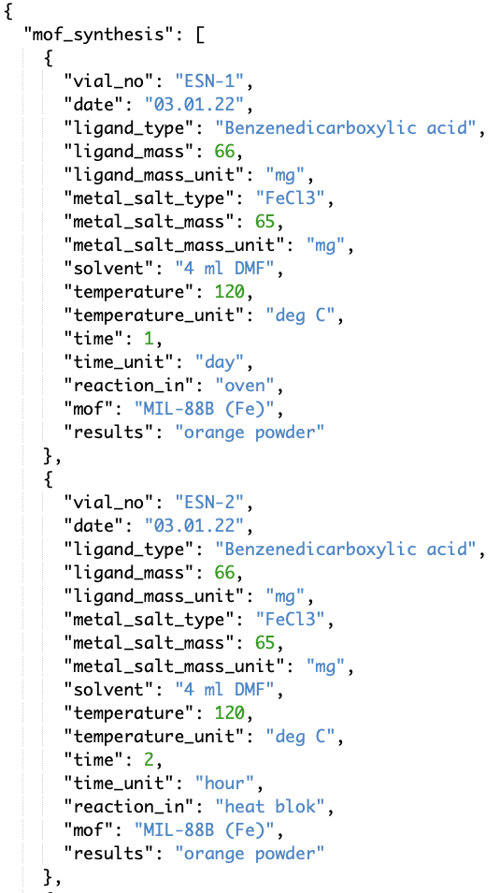
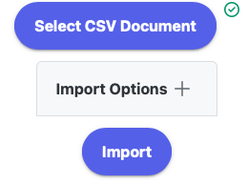
Backup
Feature: CSV Import
[…]

Slide 23
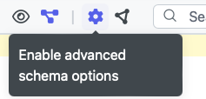
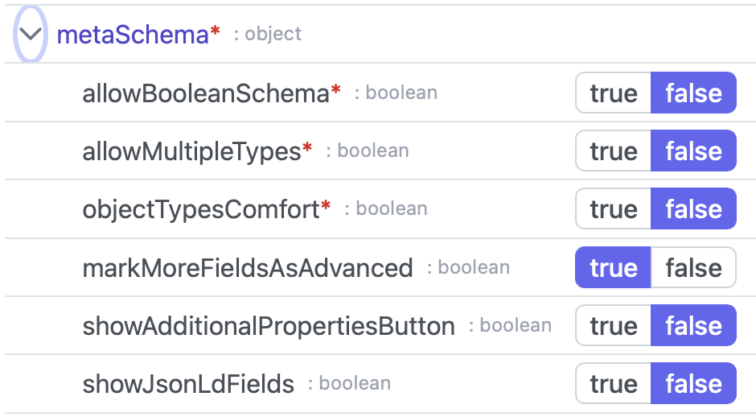
Backup
Feature: Meta Schema Builder
Dynamically builds meta schema based on user settings
Meta schema is responsible for complexity of schema editor
→ Advanced mode and beginner mode for schema editor

Slide 24
Backup
Feature: Snapshot Sharing

Slide 25
Backup
Feature: Ontology Integration

Slide 26
Backup
Application Case #1: MOF Synthesis (in Chemistry)
Scenario from Biochemistry department¹
About Metal-organic framework (MOF) synthesis data
Export Excel table² as CSV
Import of CSV into MetaConfigurator (+ automatic schema inference)
Changes in schema through intuitive schema editor diagram
External Python script³ for appending metadata to the synthesis data
→ Now data is in standardized format, interoperable. Schema can be shared with others, automatic validation possible. Easier maintenance of data through tools, such as MetaConfigurator.
¹In cooperation with Jürgen Pleiss
²The Excel document with synthesis data was provided by Esengül Ciftci
³The Python script queries data from the PubChem database, based on code from Torsten Gieß

Slide 27
Backup
Application Case #2: preCICE Adapter Configuration Schema
preCICE is a coupling library for partitioned multi-physics simulations¹
It has more than 10 different configuration files for different adapters and tools
Some are solver-specific but many more or less the same
Introduction of common Adapter Schema using MetaConfigurator
→ MetaConfigurator offers up-to-date web form showing the fields of the schema in discussion & allows for editing the schema (without prior experience needed)

Slide 28
Backup
User Study – Research Questions
RQ1: Which aspects of the tool can be improved?
RQ2: Are users able to perform particular types of tasks using the tool?
RQ3: Would people use the tool in practice?
GOAL:
To improve our tool with help of feedback
To gather information about user habits

Slide 29
Backup
User Study - Methodology
Small-scale: 5 Participants
Qualitative
Participants needed to solve example tasks:
Retrieving information
Editing data
Editing the schema
Participants were asked to share their opinion and improvement suggestions

Slide 30
Backup
User Study - Results
RQ1: Which aspects of the tool can be improved?
23 aspects identified: 20 addressed, 3 remain as future work
RQ2: Are users able to perform particular types of tasks using the tool?
90% of the tasks correctly without hints
100% of the tasks solved with giving small hints
RQ3: Would people use the tool in practice?
All participants responded they would potentially use MetaConfigutator in practice
Some recommended our tool to other people

