Slide 1
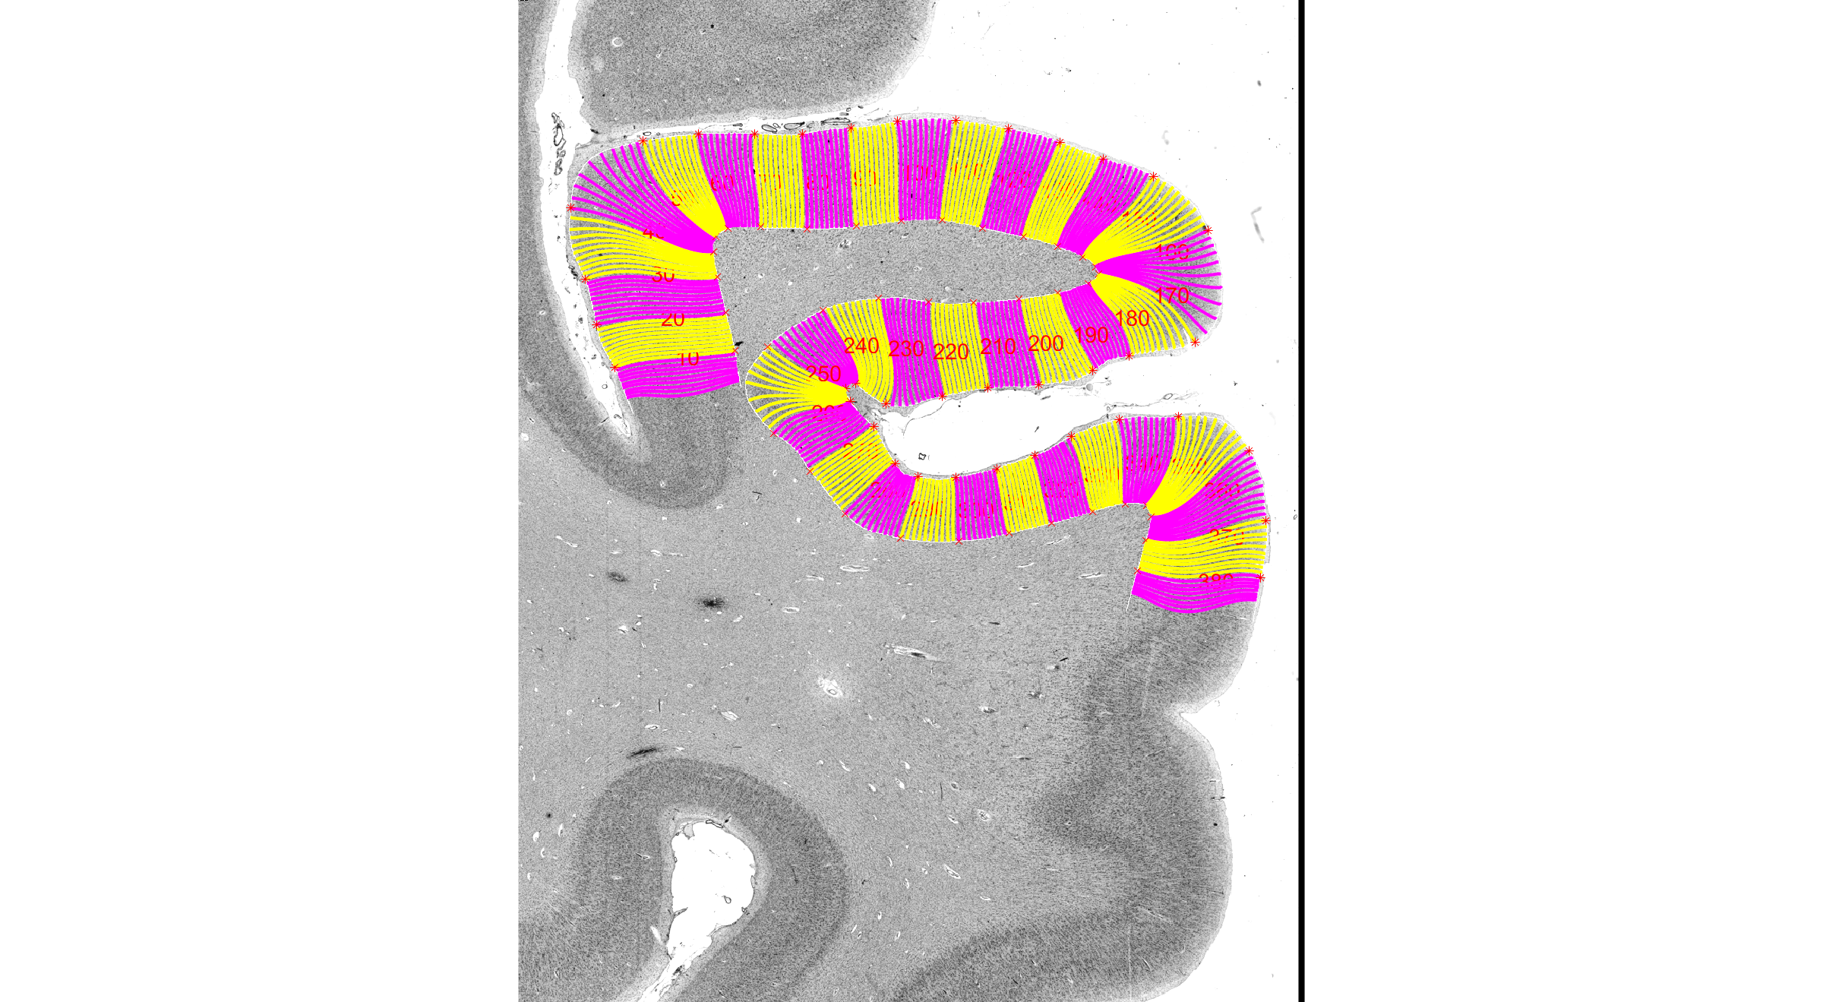
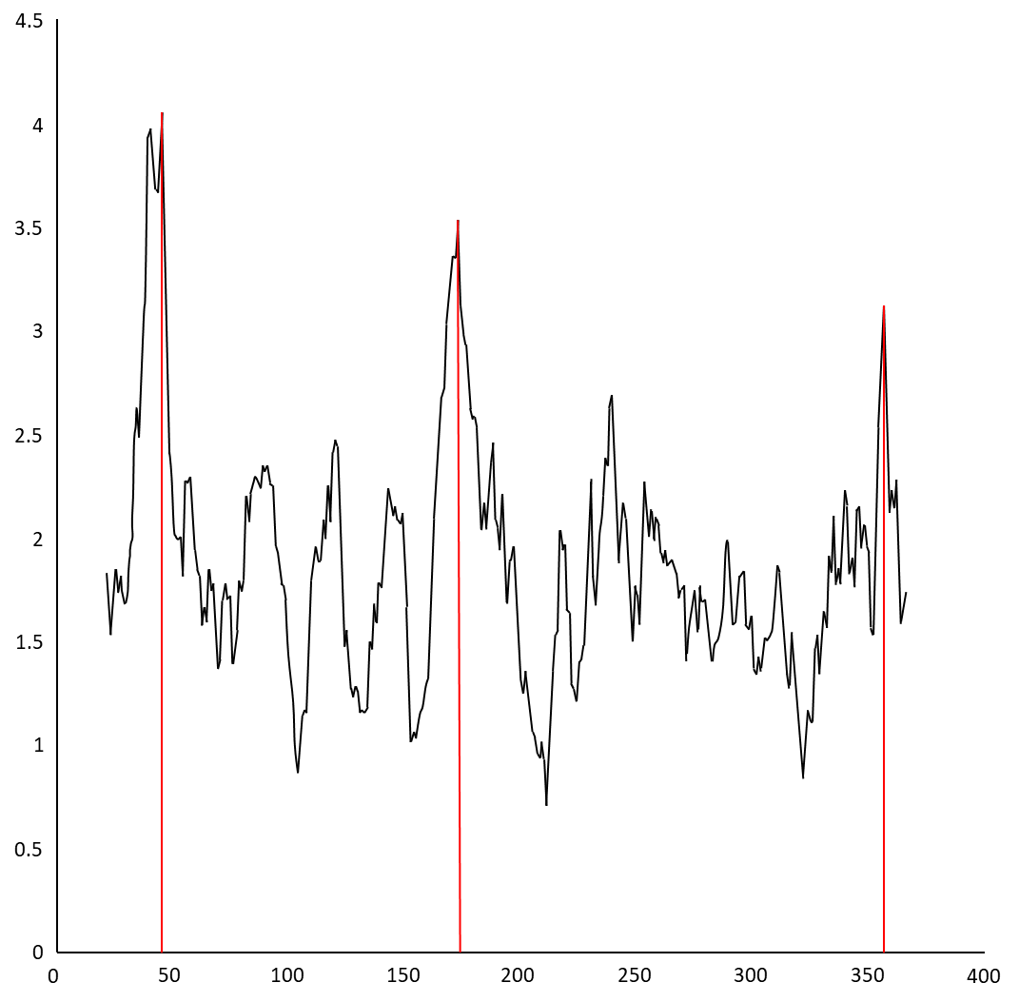
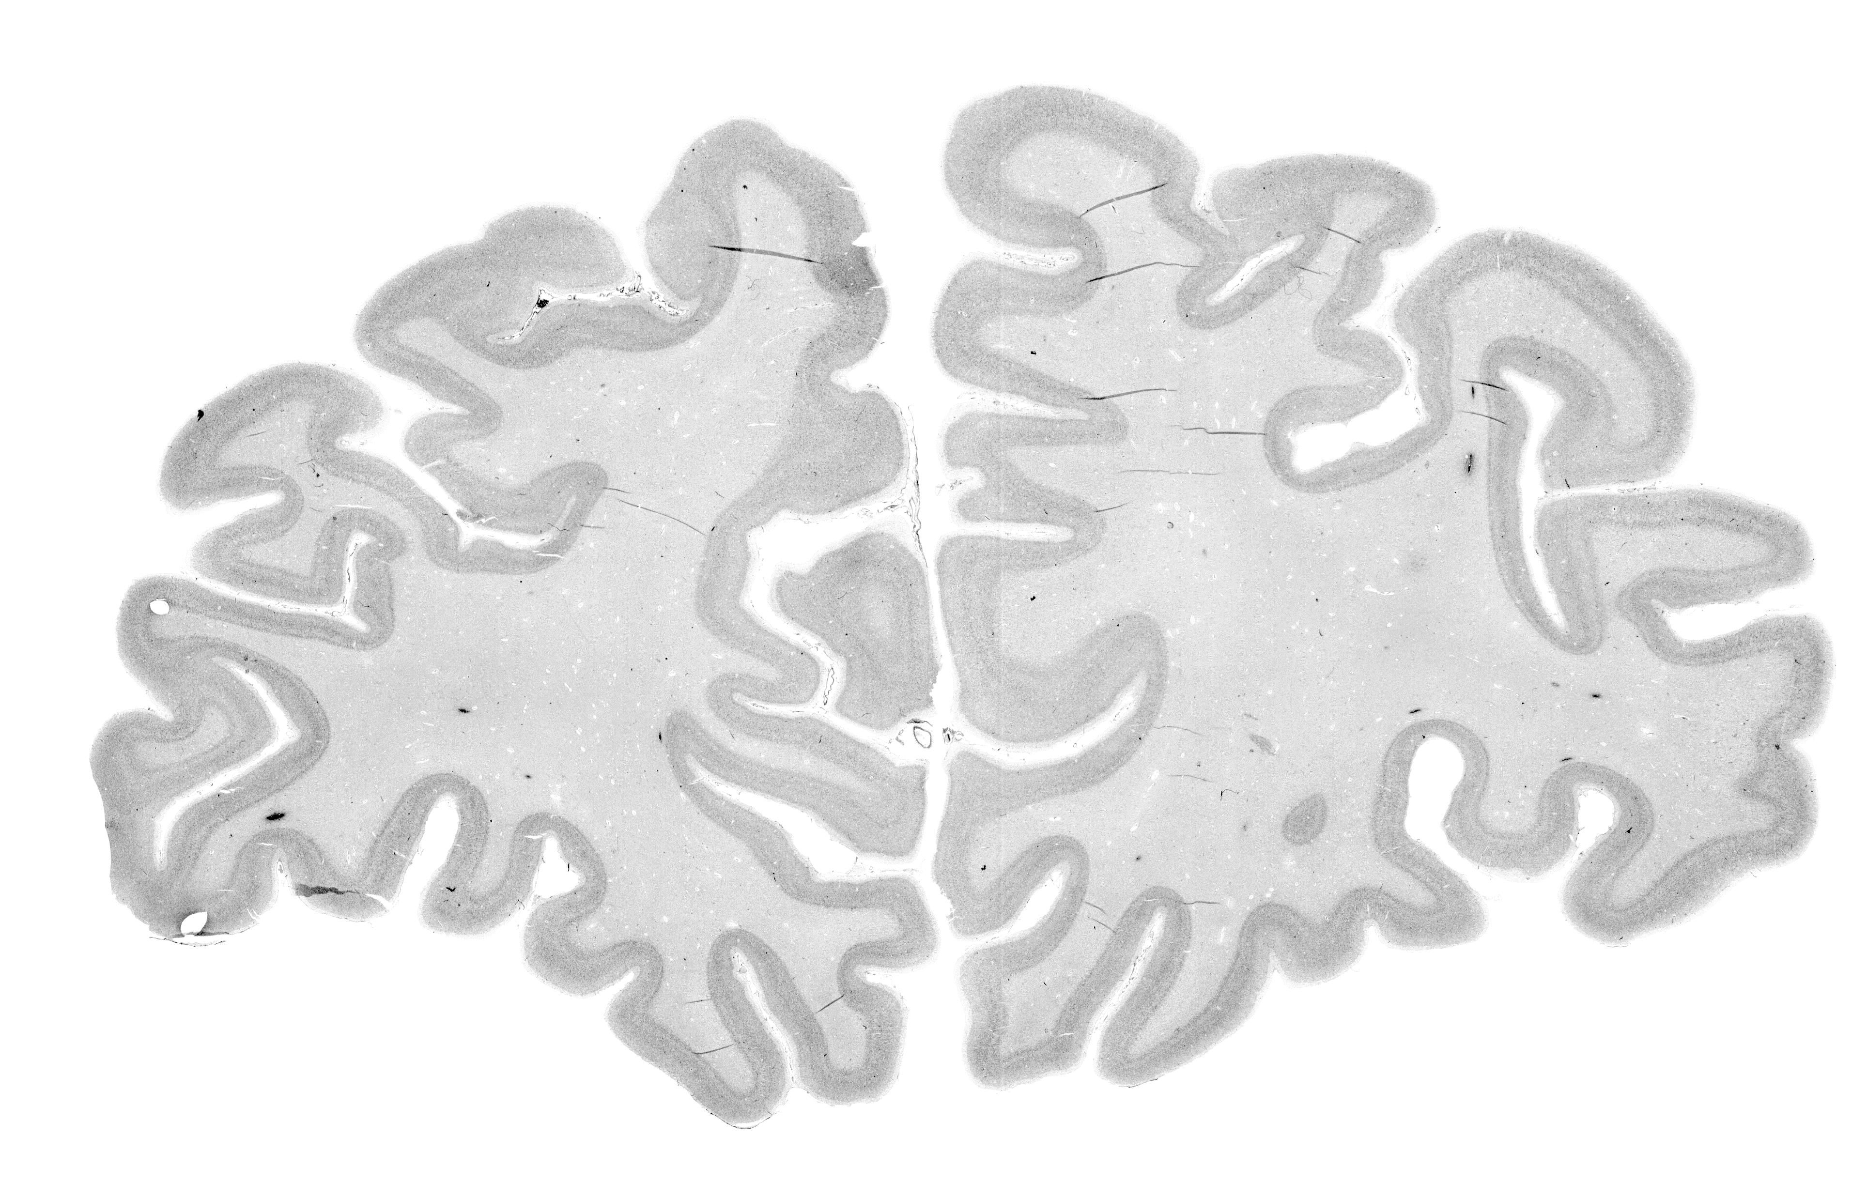
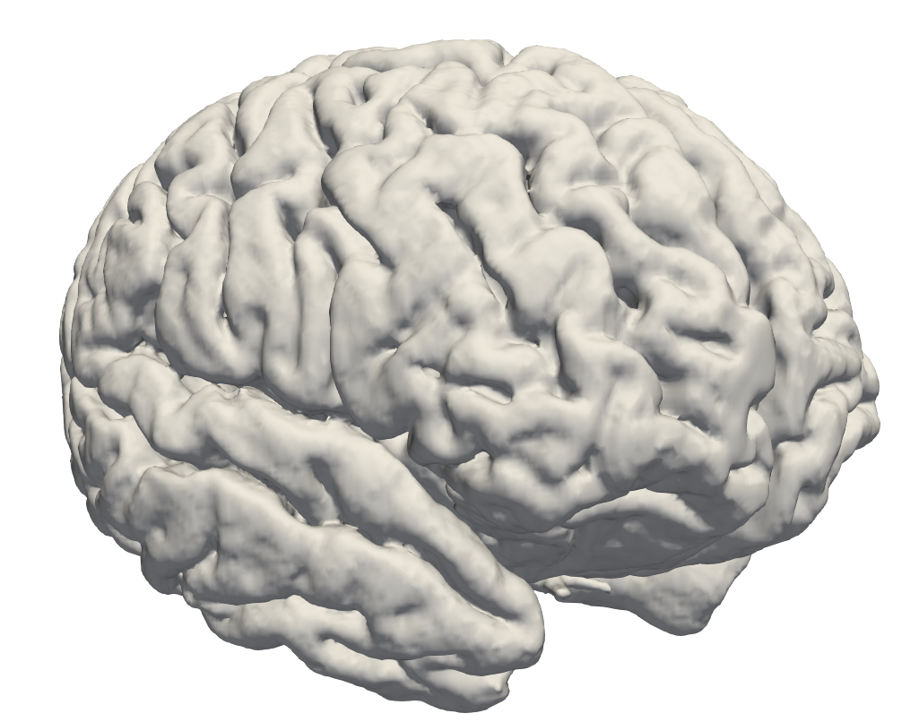
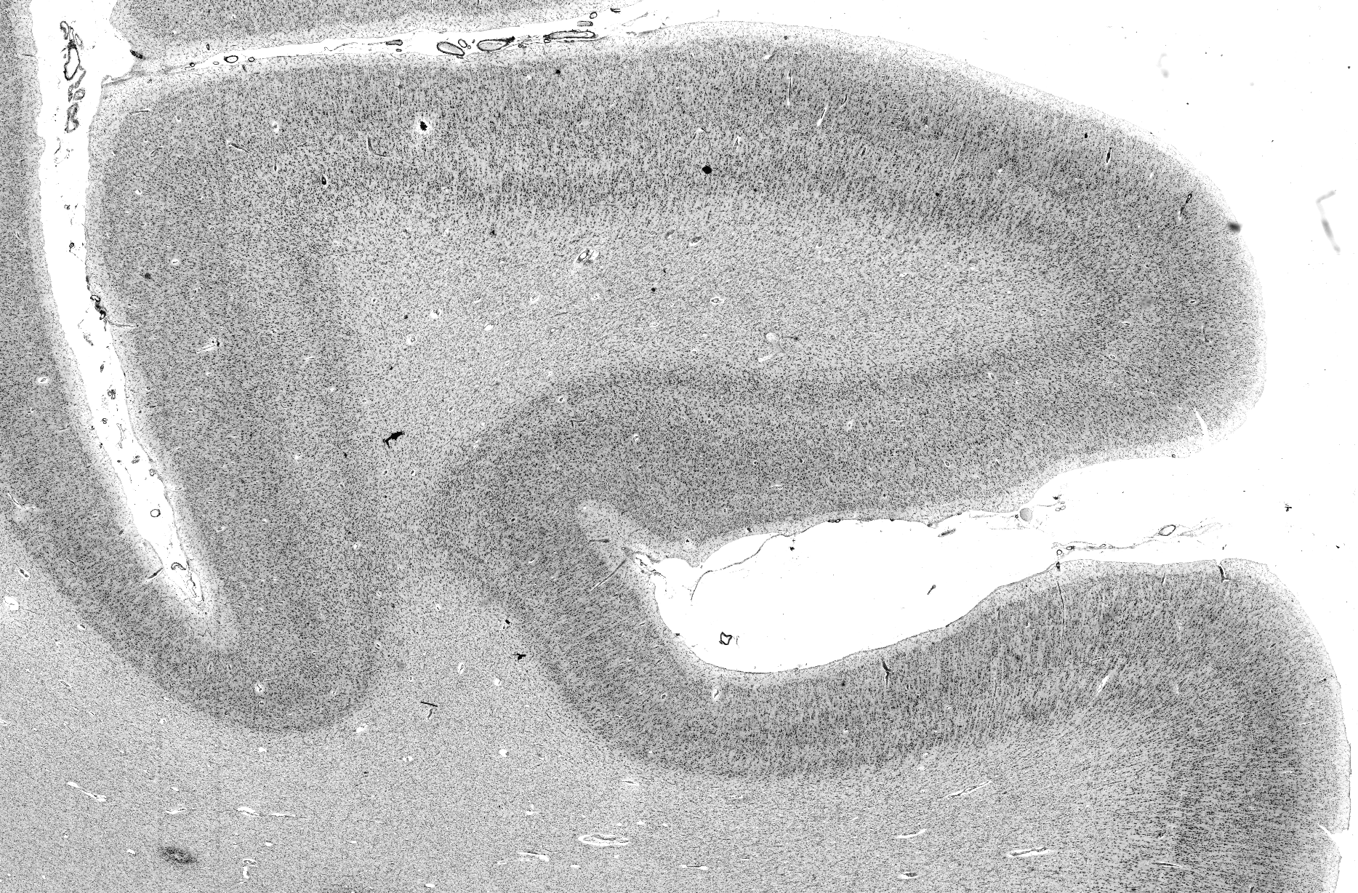
B
C
A
B
MFG3
Left
right
46
173
46
173
356
INFS1
IFG2
ROI
Mahalanobis distance
356
IFG1
INFS1
MFG3
IFG2
IFG1
Profile index
D
E
F
INFS1
MFG3
IFG2
IFG1
MFG3
IFMS1
INFS1
IFG2
dorsal
INFS1
MFG3
IFG2
IFG1
IFG1
posterior
anterior
ventral
Figure 1 Observer-independent mapping approach. Coronally cut section with cell body stained from one of the ten brains with rectangular region of interest (ROI, box) (A). The profiles of areas were extracted between the outer contour line and inner contour line (B). Significant maxima of the Mahalanobis distance (MD) were calculated with different block size (n=10-24) (D) and at profile numbers 46, 173, and 356 are plotted against the profile index (labeled with red circles) (C). These positions indicate the laminar pattern changes between INFS1, MFG3, IFG2 and IFG1(B, E). The corresponding maxima of the MD function are accepted as borders marked with black arrowheads (E). The overview of the five new areas in the anterior lateral prefrontal cortex (F). The area IFMS1, situated within the intermediate frontal sulcus, is not visible from a lateral surface perspective.

