Slide 1
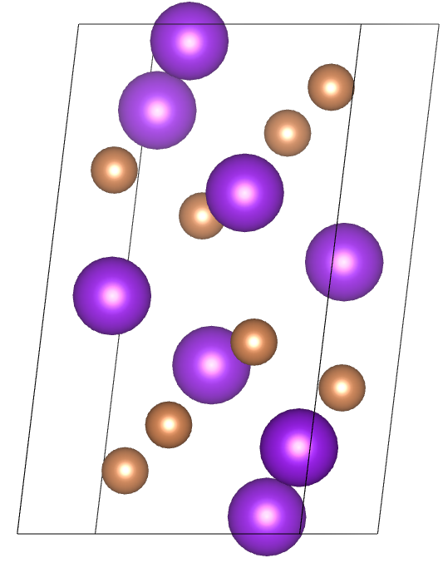
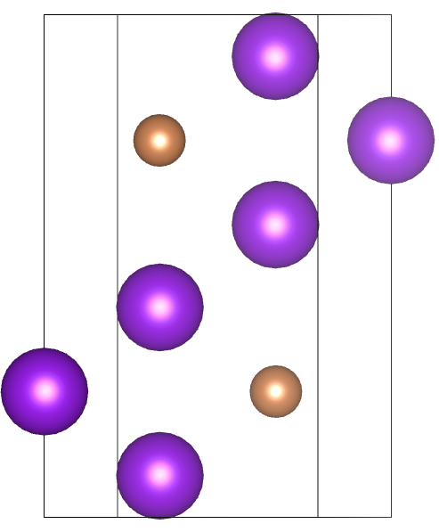
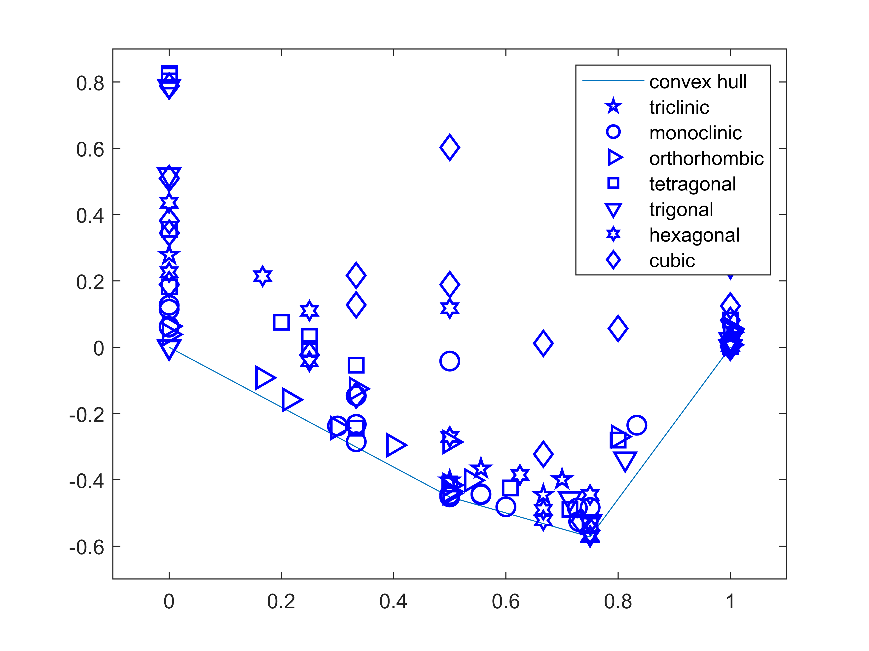
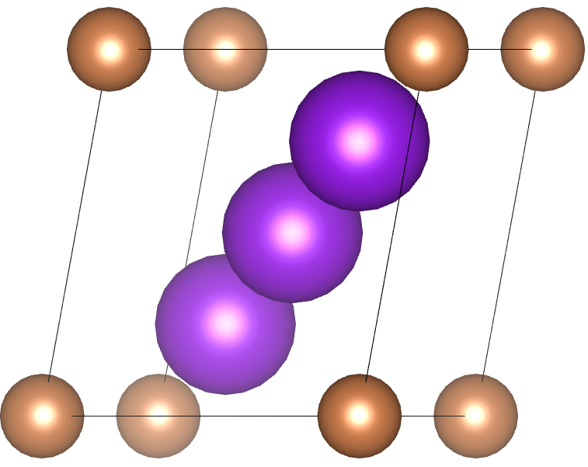
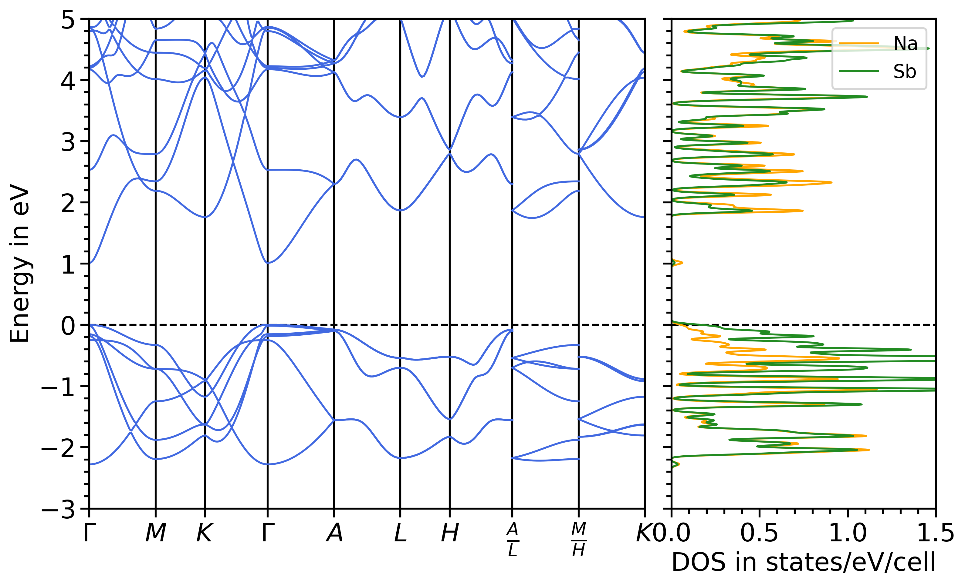
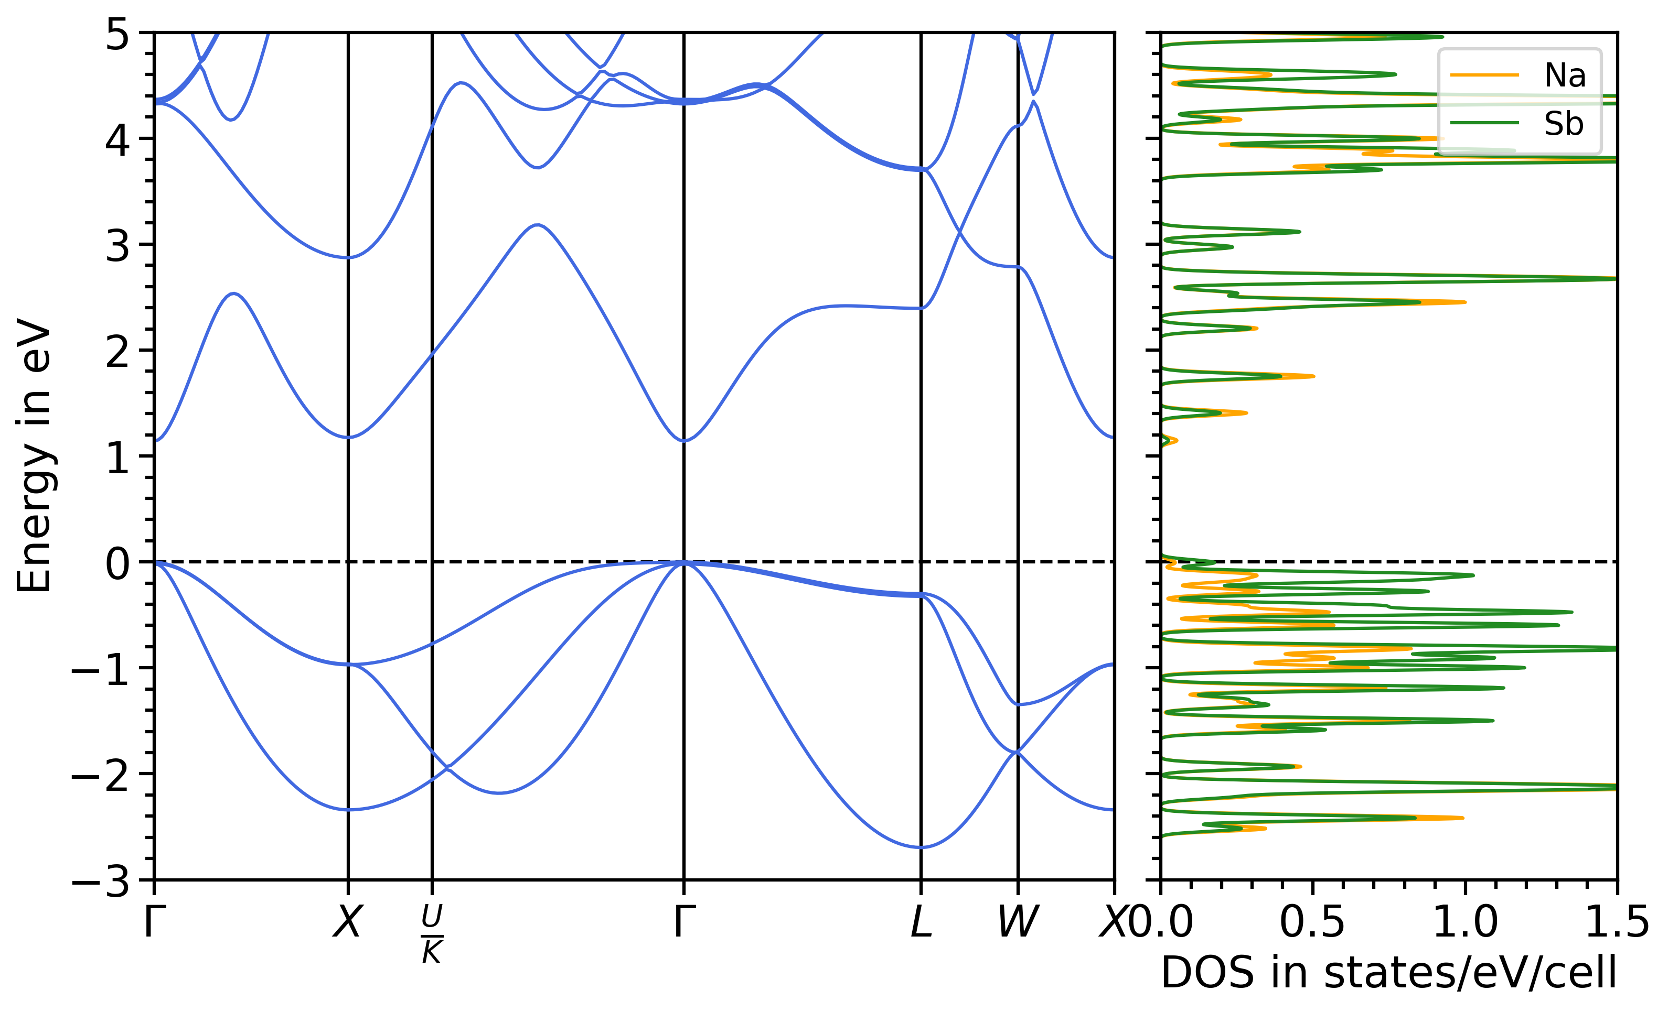
Stability and Electronic Properties of K-Sb and Na-Sb Binary Crystals from High-Throughput Ab Initio Calculations
Richard Schier, Daniel Guo, Holger-Dietrich Saßnick, and Caterina Cocchi
Structural properties
Structure pool
K-Sb / Na-Sb
Preliminary calculations
Energetic properties
Geometry Optimization
For stable systems
Electronic properties
Computational parameters / resources
Calculate further properties
Input
DFT Calculations
Output

