Slide 1
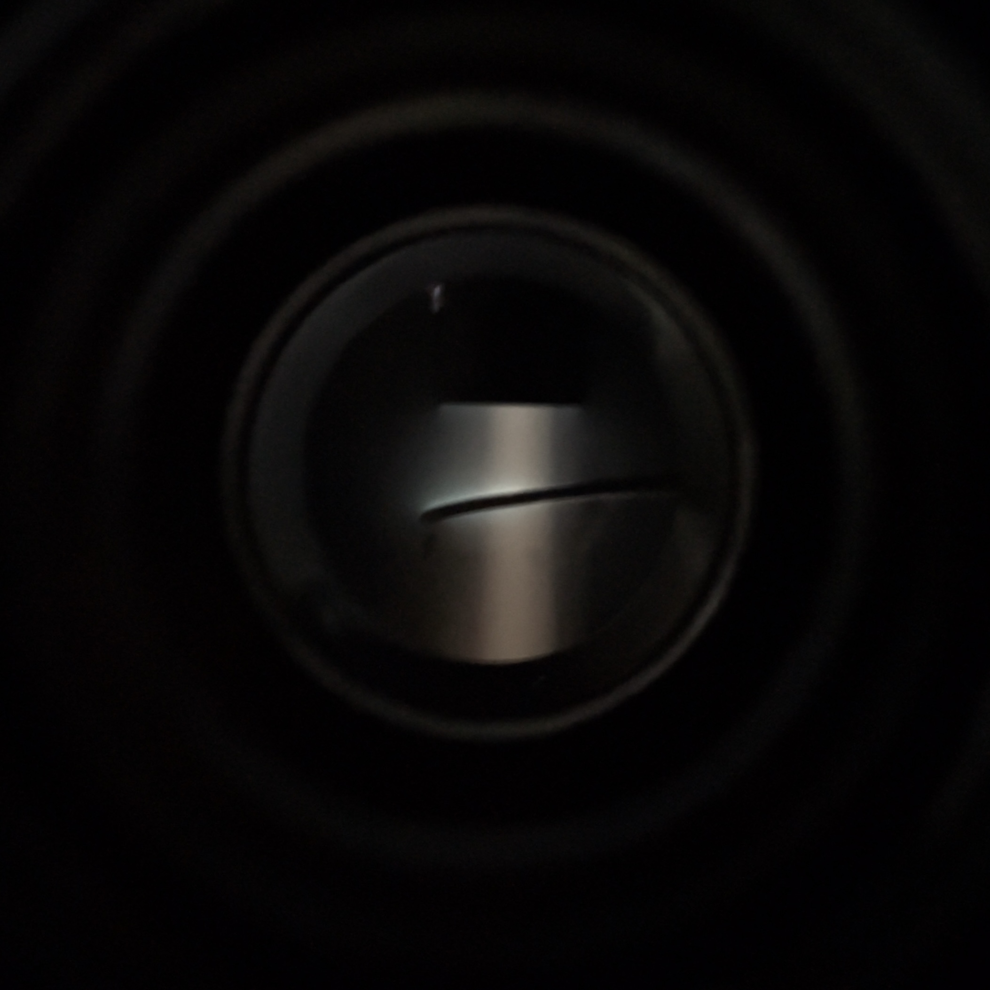
A Novel Method of TiN Thin-Film Deposition for Next-Generation Photocathodes
Dominic Sterland - University of Warwick
- Protect sensitive high-performance photocathodes from rapid degradation
- High chemical and physical resistance material
- TiN/TiO/TiC relative composition is tuneable
- Work function tuneable around existing materials
- Simple, MBE-like deposition system with 1-port solution
- Highly controllable crystalline film thickness
- Minimal effect on photocathode performance

