Slide 1
Activation studies for GaAs photocathodes at Photo-CATCH*
M. Herbert – J. Enders, M. Engart, M. Meier, J. Schulze, V. Wende, V. Winter
*Supported by BMBF (05H18RDRB1) and by DFG (GRK 2128 „AccelencE“, project-id 264883531)

Slide 2
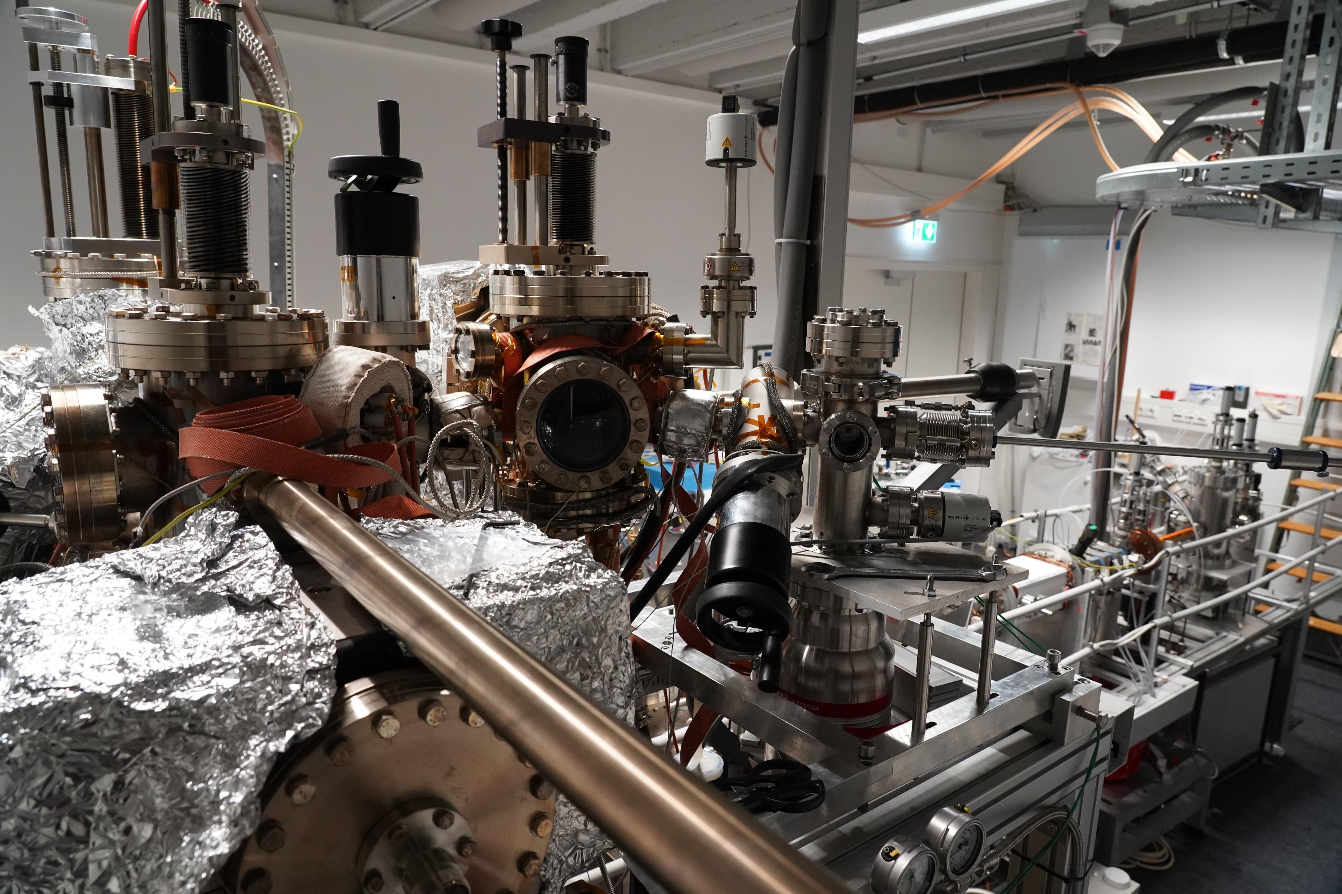
Motivation – Experimental Setup – Automated Activation – Li-enhancement – Conclusion & Outlook
GaAs photocathode research at Photo-CATCH
Laser-induced photo-emission
High degree of spin-polarization possible
XHV required (~ 10⁻¹¹ mbar)
used in DC HV guns
low- to medium-intensity electron beams
Challenge: high-intensity electron beams

Slide 3
Motivation – Experimental Setup – Automated Activation – Li-enhancement – Conclusion & Outlook
Emission of polarized electrons from GaAs:
E_{γ} < 1.76 eV or λ > 705 nm
Photoemission threshold for GaAs:
E_{th} > 5.52 eV or λ < 225 nm

Slide 4
Motivation – Experimental Setup – Automated Activation – Li-enhancement – Conclusion & Outlook
Emission of polarized electrons from GaAs:
E_{γ} < 1.76 eV or λ > 705 nm
Photoemission threshold for GaAs:
E_{th} > 5.52 eV or λ < 225 nm
Activation with NEA layer required to reduce work function!

Slide 5
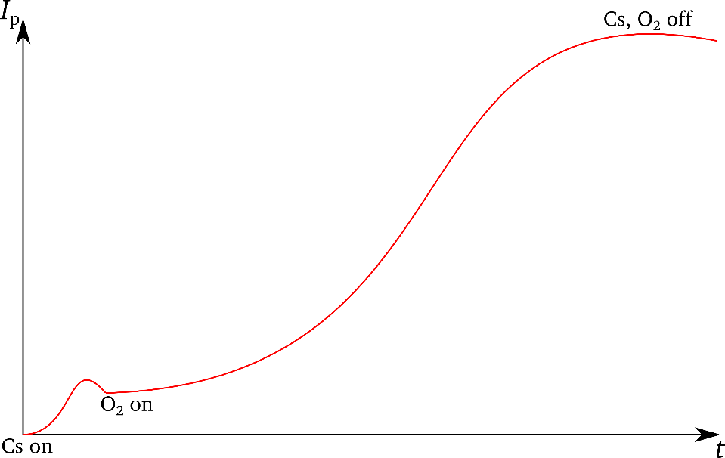
Motivation – Experimental Setup – Automated Activation – Li-enhancement – Conclusion & Outlook
Emission of polarized electrons from GaAs:
E_{γ} < 1.76 eV or λ > 705 nm
Photoemission threshold for GaAs:
E_{th} > 5.52 eV or λ < 225 nm
Activation with NEA layer required to reduce work function!
Co-Deposition (Co-De)

Slide 6
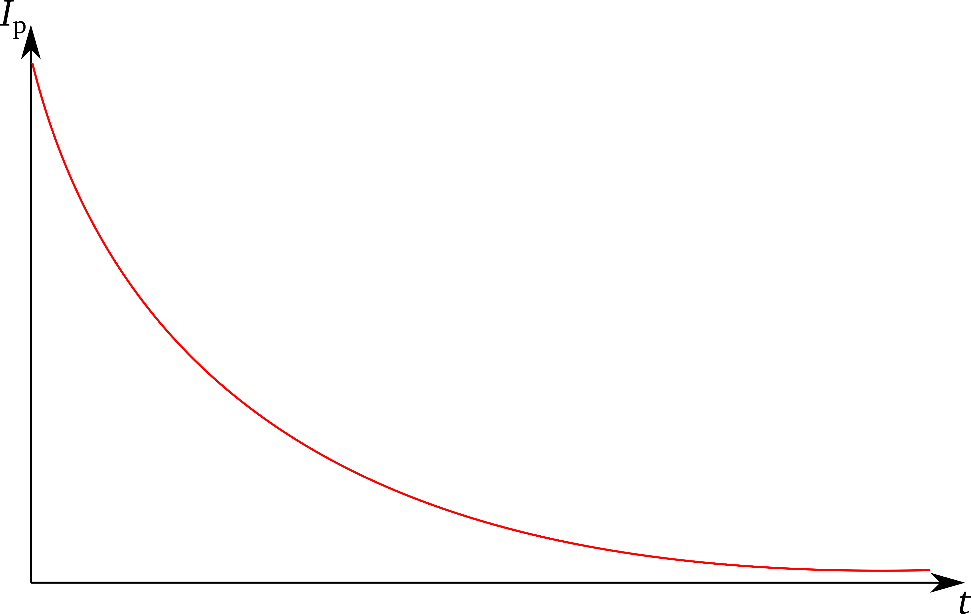
Motivation – Experimental Setup – Automated Activation – Li-enhancement – Conclusion & Outlook
Emission of polarized electrons from GaAs:
E_{γ} < 1.76 eV or λ > 705 nm
Photoemission threshold for GaAs:
E_{th} > 5.52 eV or λ < 225 nm
Main parameters: η₀, τ, Q(τ)
Activation with NEA layer required to reduce work function!
Surface layer decay

Slide 7
Motivation – Experimental Setup – Automated Activation – Li-enhancement – Conclusion & Outlook
Emission of polarized electrons from GaAs:
E_{γ} < 1.76 eV or λ > 705 nm
Photoemission threshold for GaAs:
E_{th} > 5.52 eV or λ < 225 nm
Main parameters: η₀, τ, Q(τ)
Activation with NEA layer required to reduce work function!
Surface layer decay
Outcome depends on operator input
Dedicated activation studies

Slide 8
Motivation – Experimental Setup – Automated Activation – Li-enhancement – Conclusion & Outlook
Photo-CATCH

Slide 9
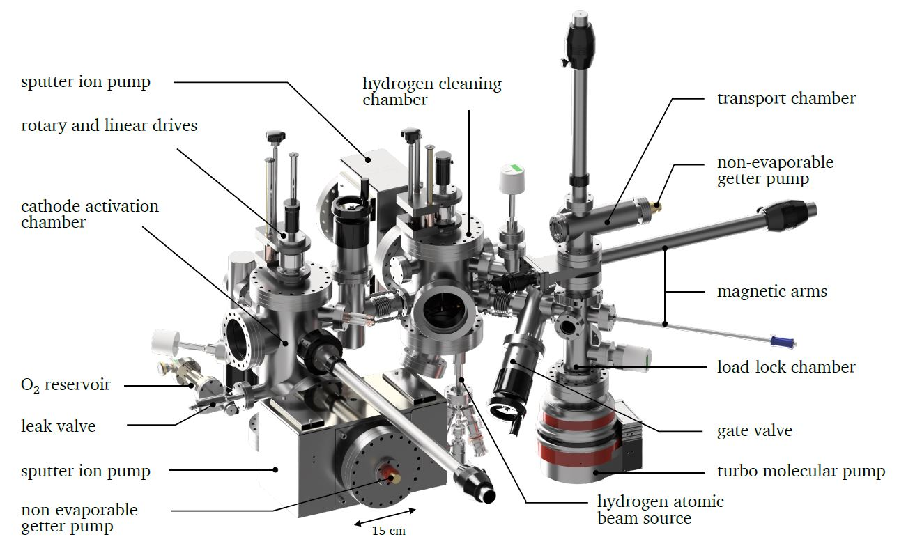
Motivation – Experimental Setup – Automated Activation – Li-enhancement – Conclusion & Outlook
Photo-CATCH
Activation & Cleaning System

Slide 10
Motivation – Experimental Setup – Automated Activation – Li-enhancement – Conclusion & Outlook
Activation Chamber
Activation & Cleaning System

Slide 11
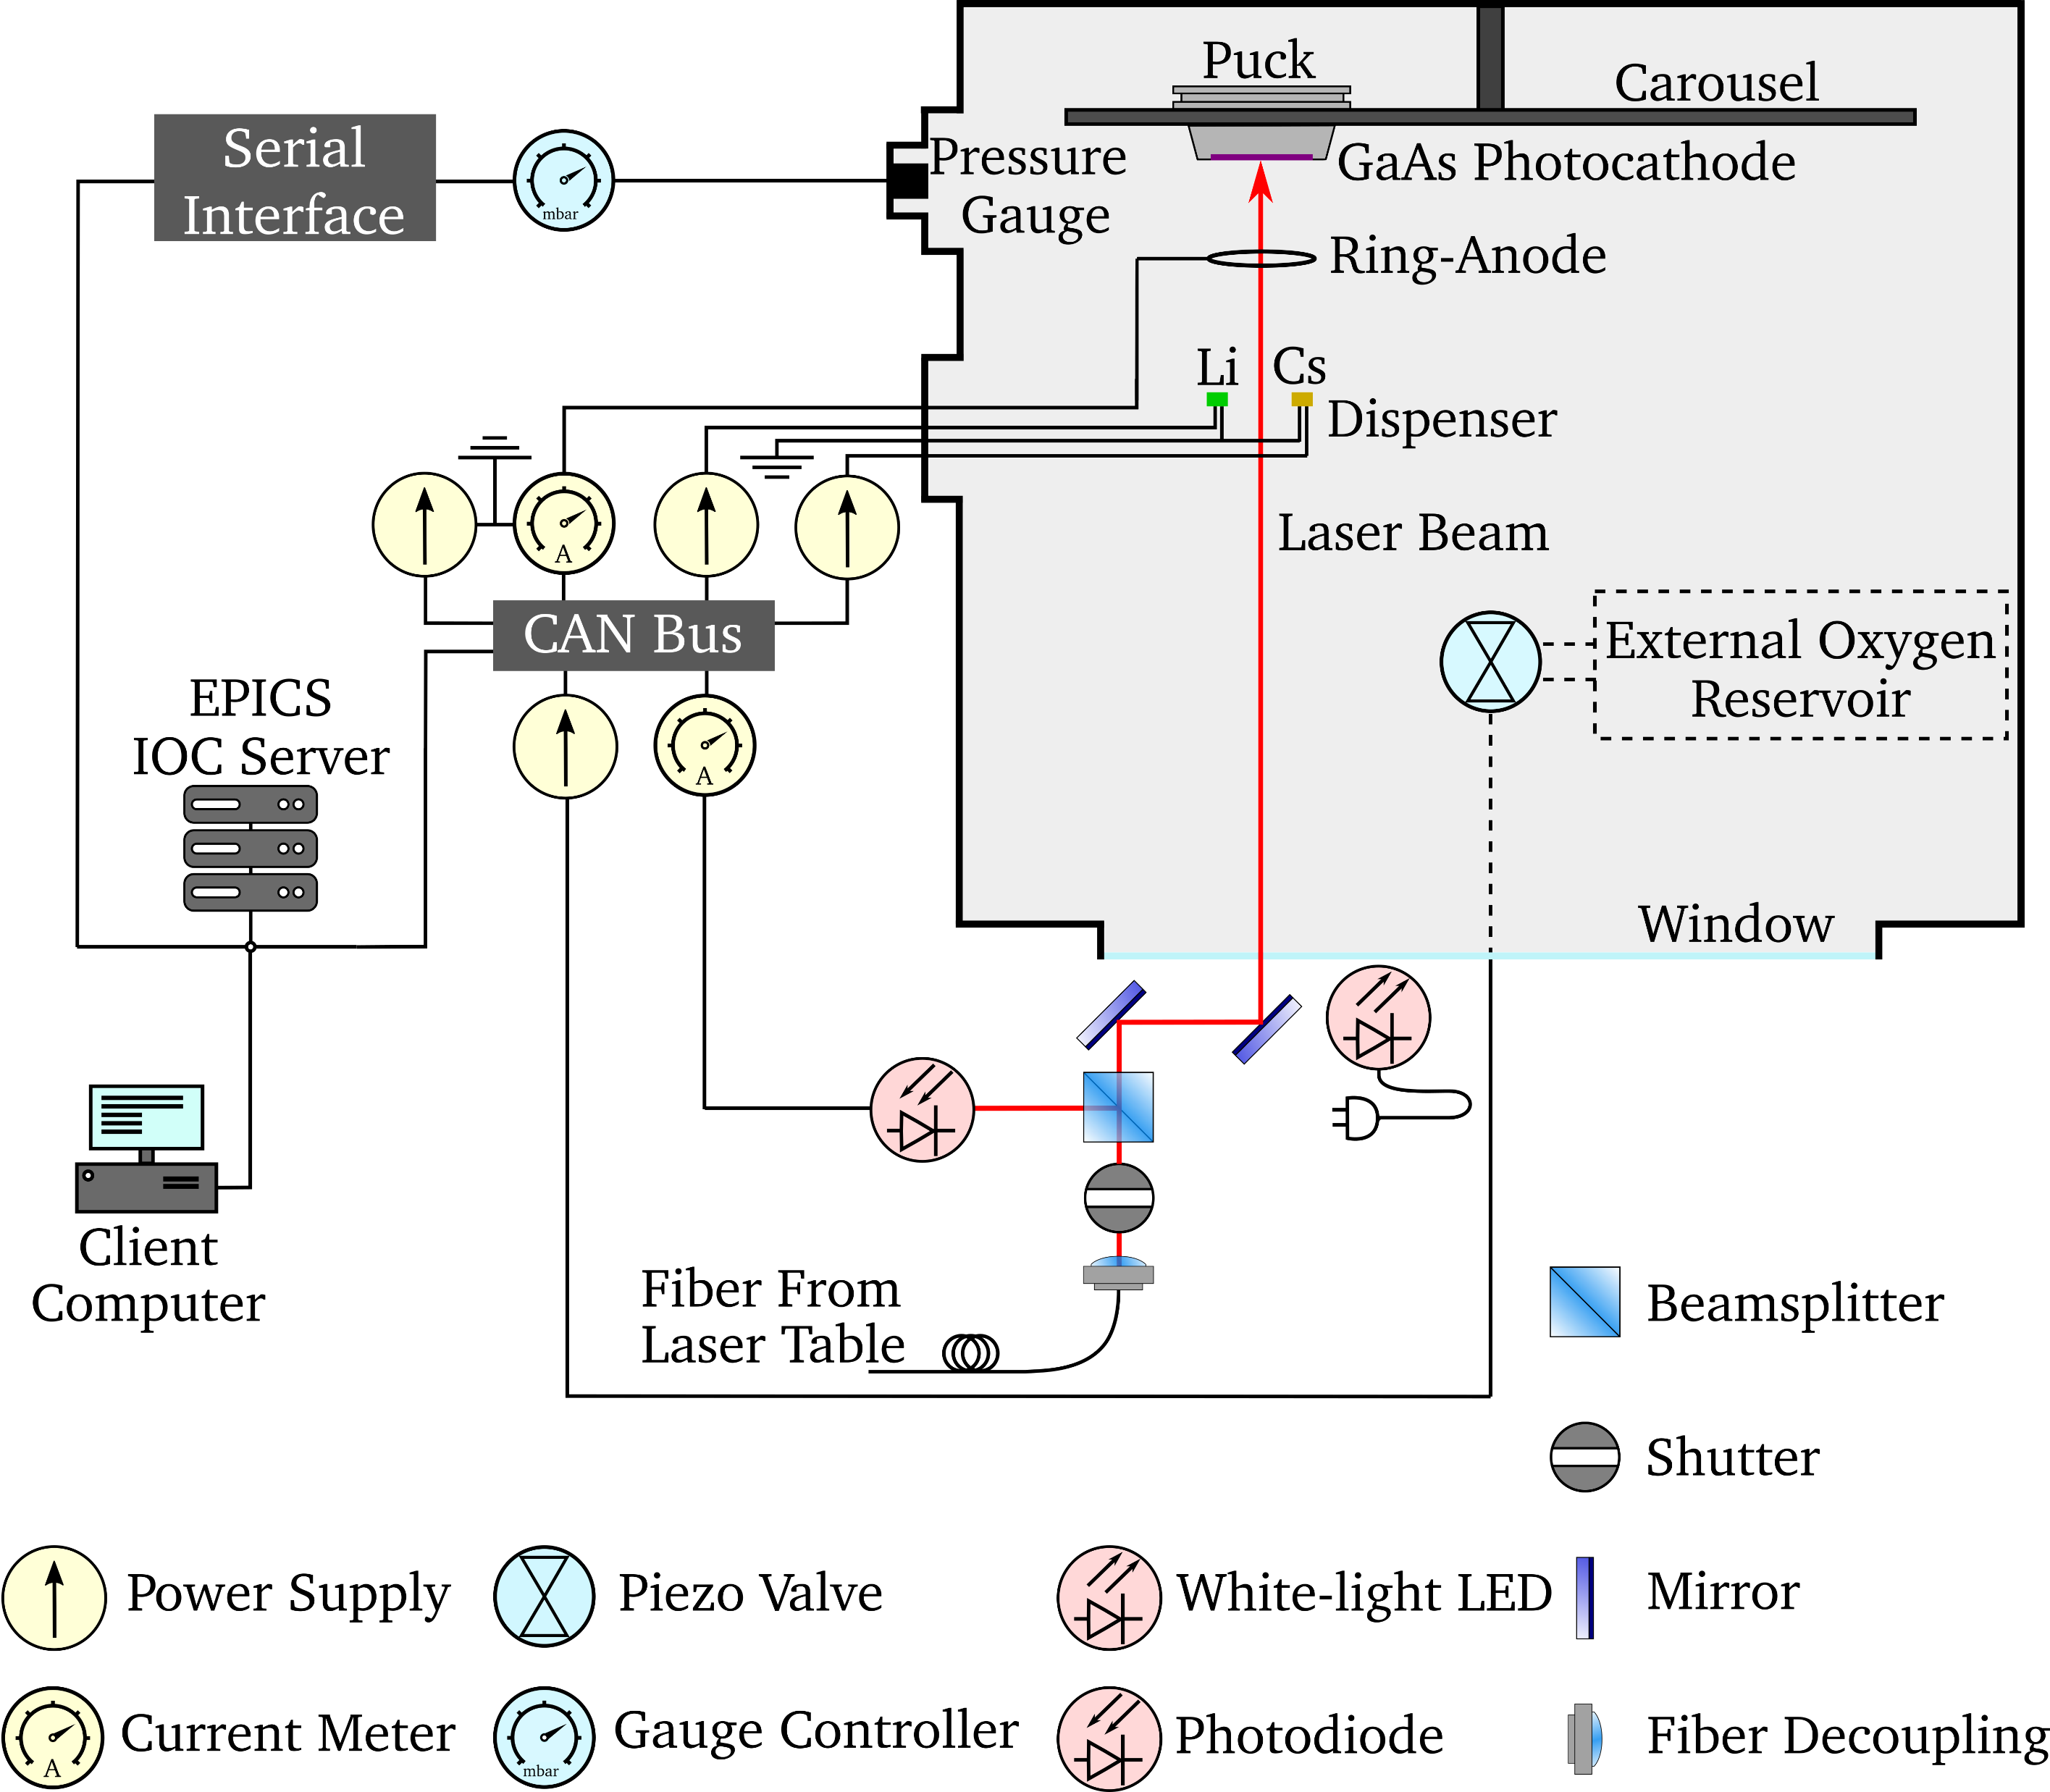
Motivation – Experimental Setup – Automated Activation – Li-enhancement – Conclusion & Outlook
Activation Chamber
Activation Setup

Slide 12
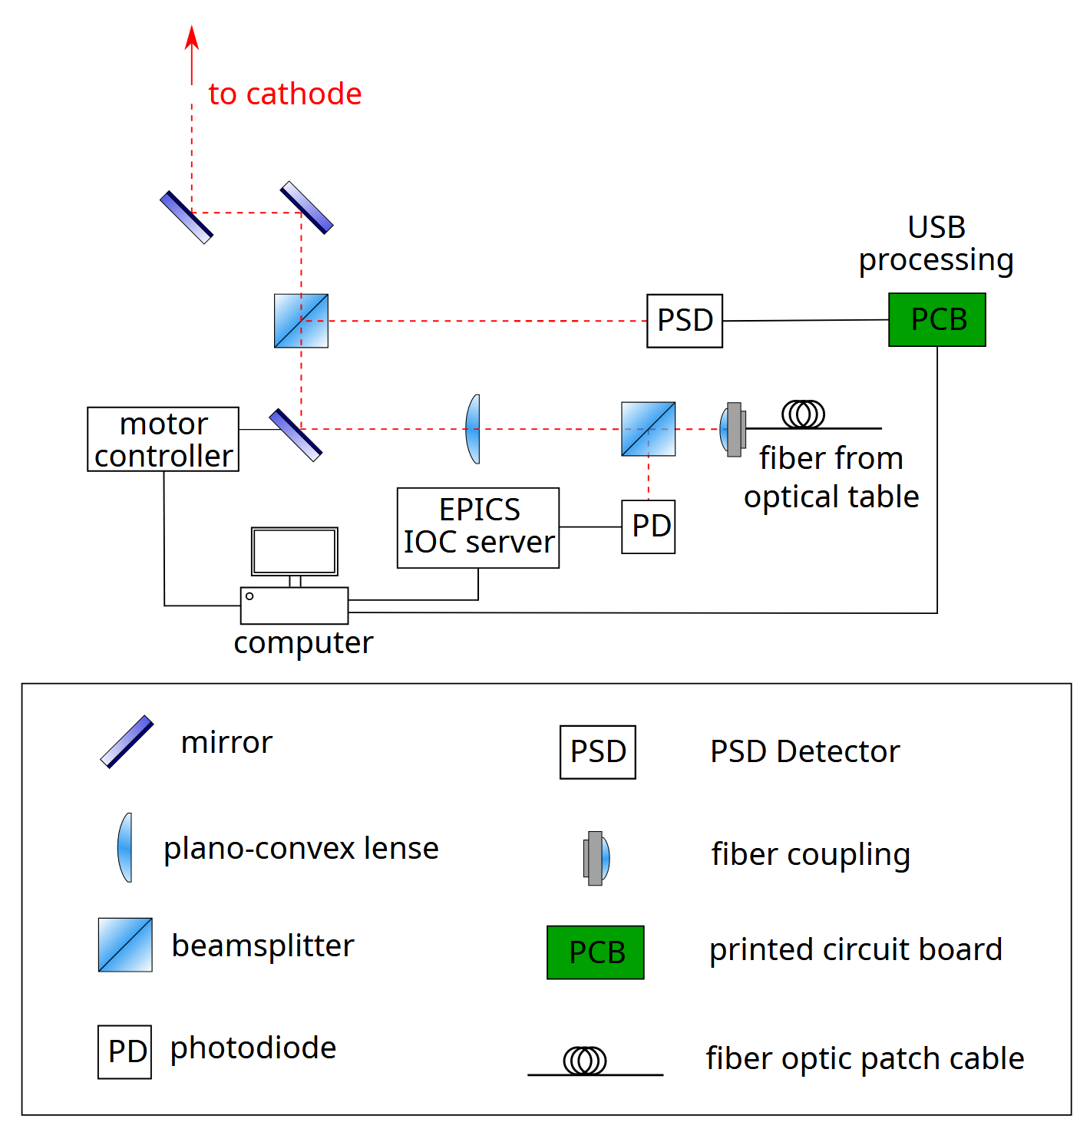
Motivation – Experimental Setup – Automated Activation – Li-enhancement – Conclusion & Outlook
QE scan setup
Measure QE distribution on photocathode surface
Dedicated laser beamline below activation chamber
Move laser-spot using piezo-electric mirror mount
Feedback position control via position-sensitive diode
Python-based

Slide 13
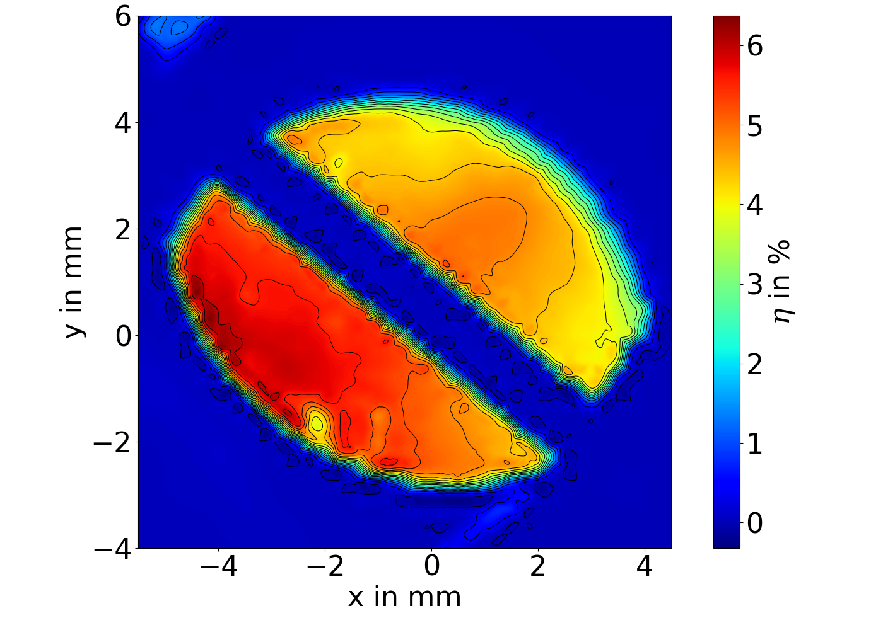
Motivation – Experimental Setup – Automated Activation – Li-enhancement – Conclusion & Outlook
QE scan setup
Implementation successful!

Slide 14
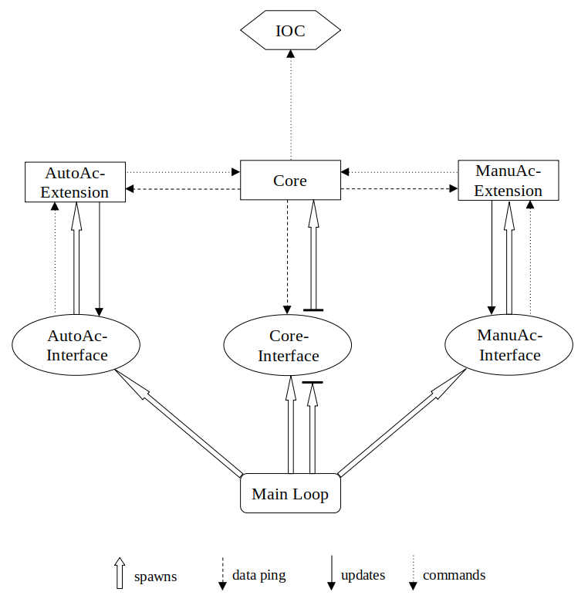
Motivation – Experimental Setup – Automated Activation – Li-enhancement – Conclusion & Outlook
Adaptive Automated Activation using PyCAT
Python Cathode Activation Terminal
Advanced development following successful preliminary, timer-based tests
Based on automatic curve analysis (python code)
Parameters derived in real time during activation process

Slide 15
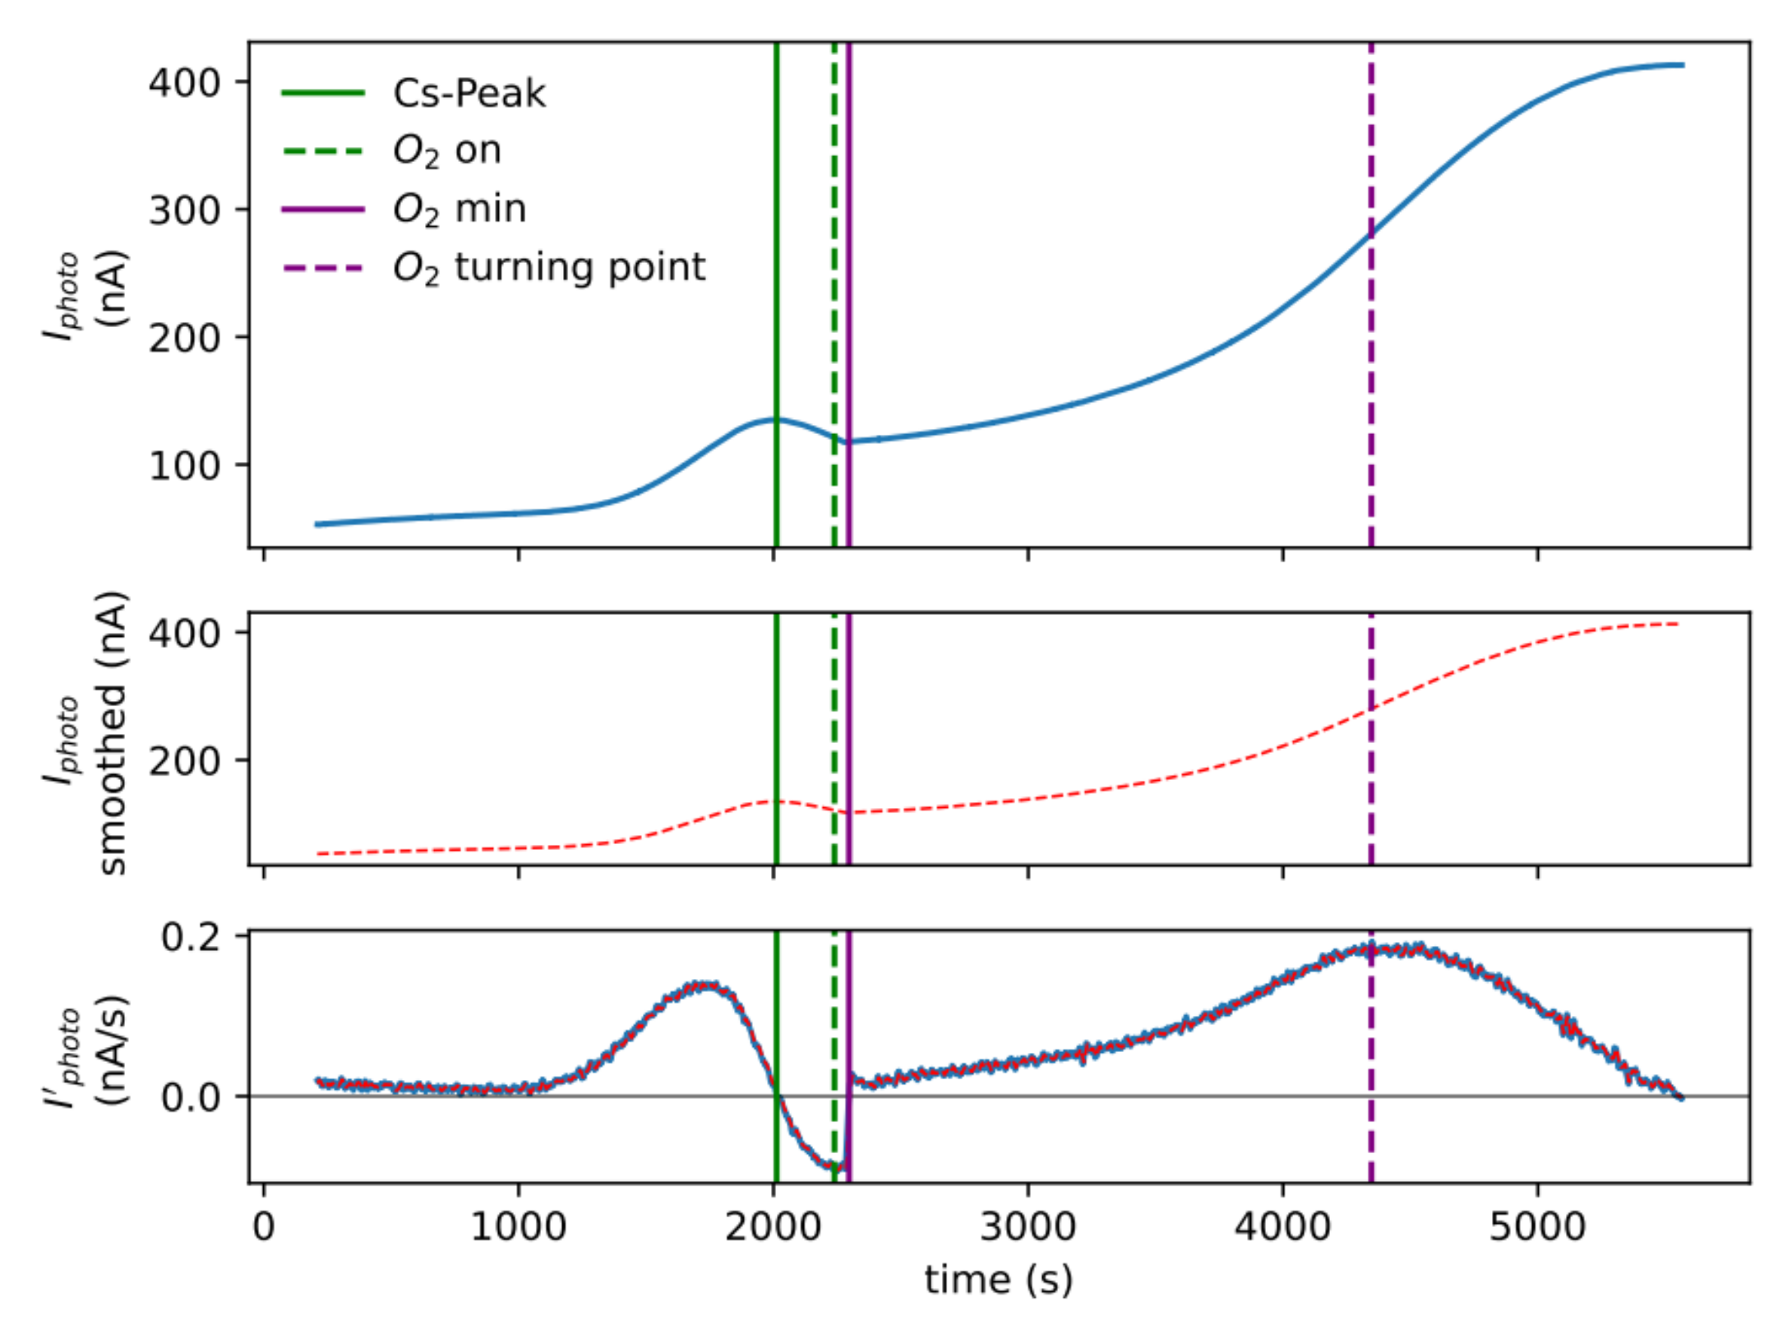
Motivation – Experimental Setup – Automated Activation – Li-enhancement – Conclusion & Outlook
Adaptive Automated Activation
Python Cathode Activation Terminal
data
smoothed
data
1st
derivative
first tests successful!

Slide 16
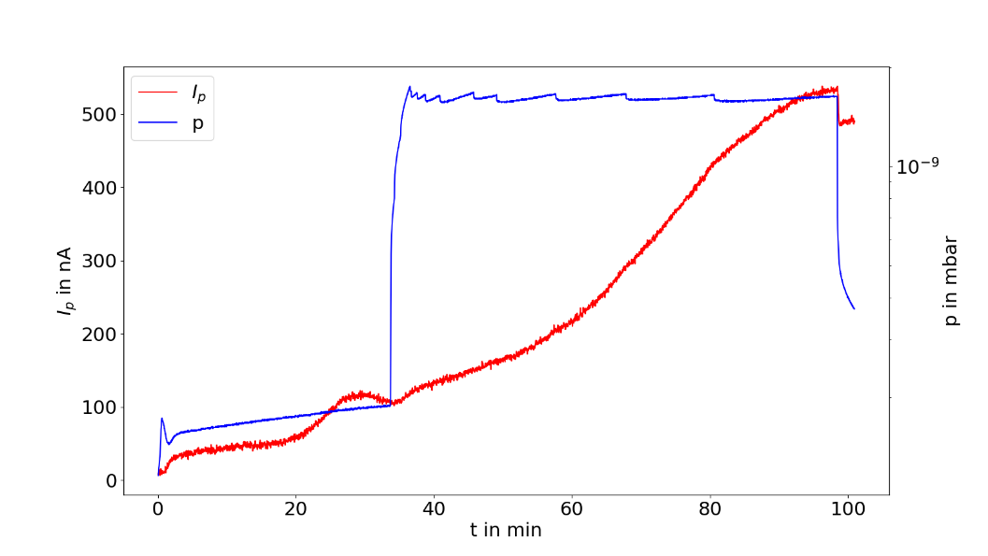
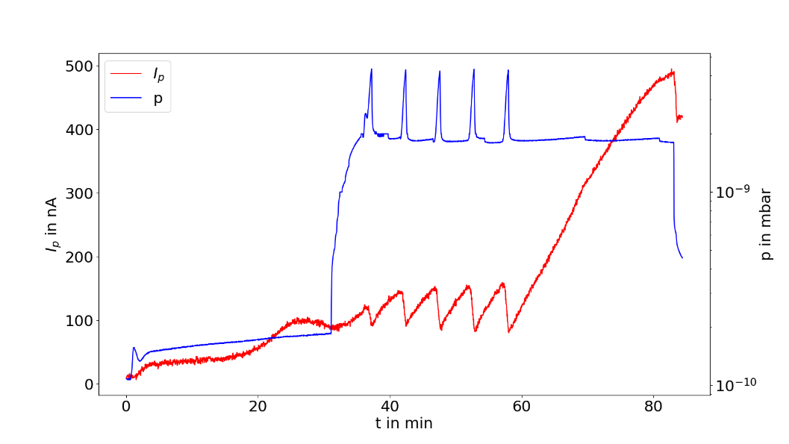
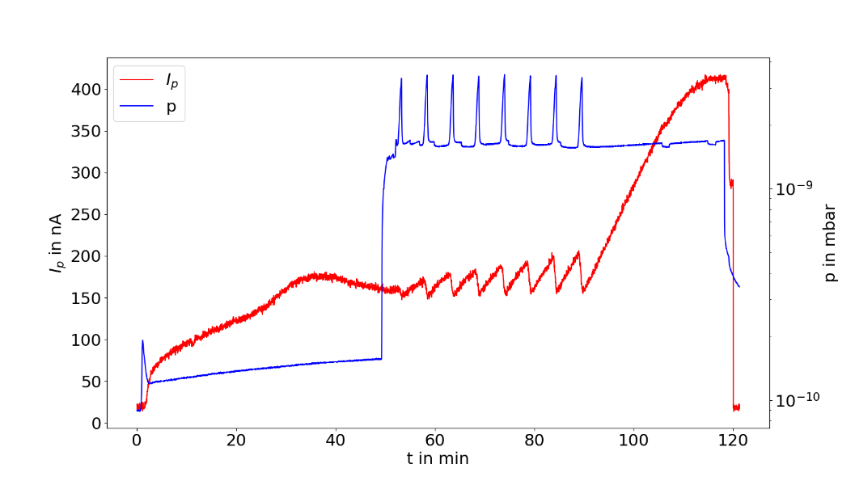
Motivation – Experimental Setup – Automated Activation – Li-enhancement – Conclusion & Outlook
Li-enhanced activation
Goal: enhanced lifetime
Co-De with pulsed Li, based on previous study
Scheme 1: Cs + O₂
Scheme 2a: Cs + O₂ + Li, 5 pulses
Scheme 2b: Cs + O₂ + Li, 8 pulses
Scheme 1
Scheme 2a
Scheme 2b

Slide 17
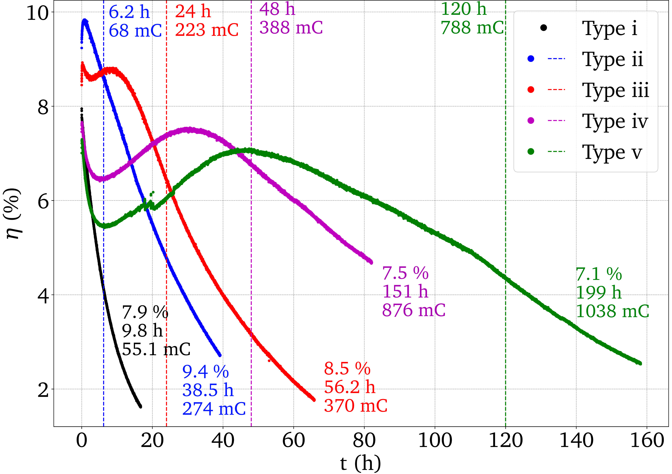
Motivation – Experimental Setup – Automated Activation – Li-enhancement – Conclusion & Outlook
Li-enhanced activation
QE & Lifetime measurements in activation chamber
P_{laser} = (50 ± 5) µW, λ = (785 ± 2) nm, U_{bias} = 100 V
5 types of activations:
Scheme 1, no prior scheme 2
Scheme 1, subsequent to scheme 2a
Scheme 2a, subsequent to scheme 1
Scheme 2b, subsequent to scheme 1
Scheme 2b, subsequent to scheme 2b
Effect of Li on subsequent activations observed
Paper submitted

Slide 18
Motivation – Experimental Setup – Automated Activation – Li-enhancement – Conclusion & Outlook
Li-enhanced activation
QE & Lifetime measurements in activation chamber
P_{laser} = (50 ± 5) µW, λ = (785 ± 2) nm, U_{bias} = 100 V
5 types of activations:
Scheme 1, no prior scheme 2
Scheme 1, subsequent to scheme 2a
Scheme 2a, subsequent to scheme 1
Scheme 2b, subsequent to scheme 1
Scheme 2b, subsequent to scheme 2b
Effect of Li on subsequent activations observed
Paper submitted
Significat increase in τ (up to factor 19) and Q(τ) (up to factor 16.5) observed!

Slide 19
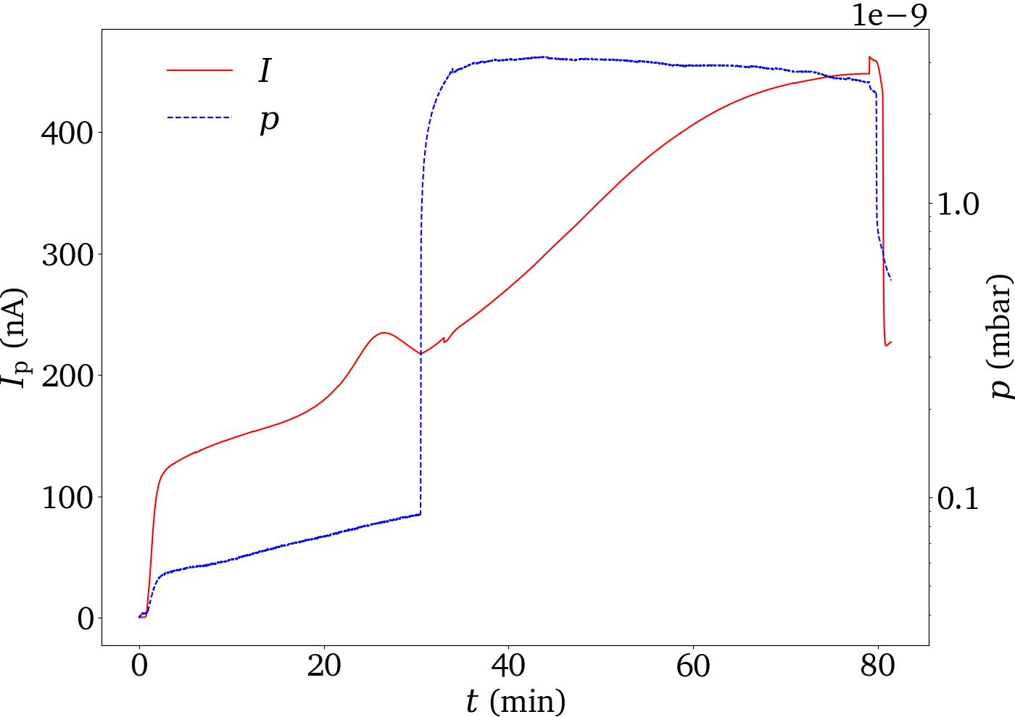
Motivation – Experimental Setup – Automated Activation – Li-enhancement – Conclusion & Outlook
Li-enhanced activation (cont.)
Idea: simultaneous co-deposition of Li along with Cs and O₂ instead of pulsed Li
First activation tests successful, QE comparable to Cs+O2 activation
BUT: first lifetime tests show no improvement
Additonal tests with higher Li dosage as well as comparison with pulsed scheme ongoing
Li off
Li on

Slide 20
Motivation – Experimental Setup – Automated Activation – Li-enhancement – Conclusion & Outlook
Conclusion
Implementation of QE-scan setup
Development of automated activation scheme
Implementation of Li-enhanced activation yielding significant increase in lifetime
Benchmark automated vs manual activation
Test of Li Co-Deposition
Additional lifetime measurements of Li-enhanced activation

Slide 21
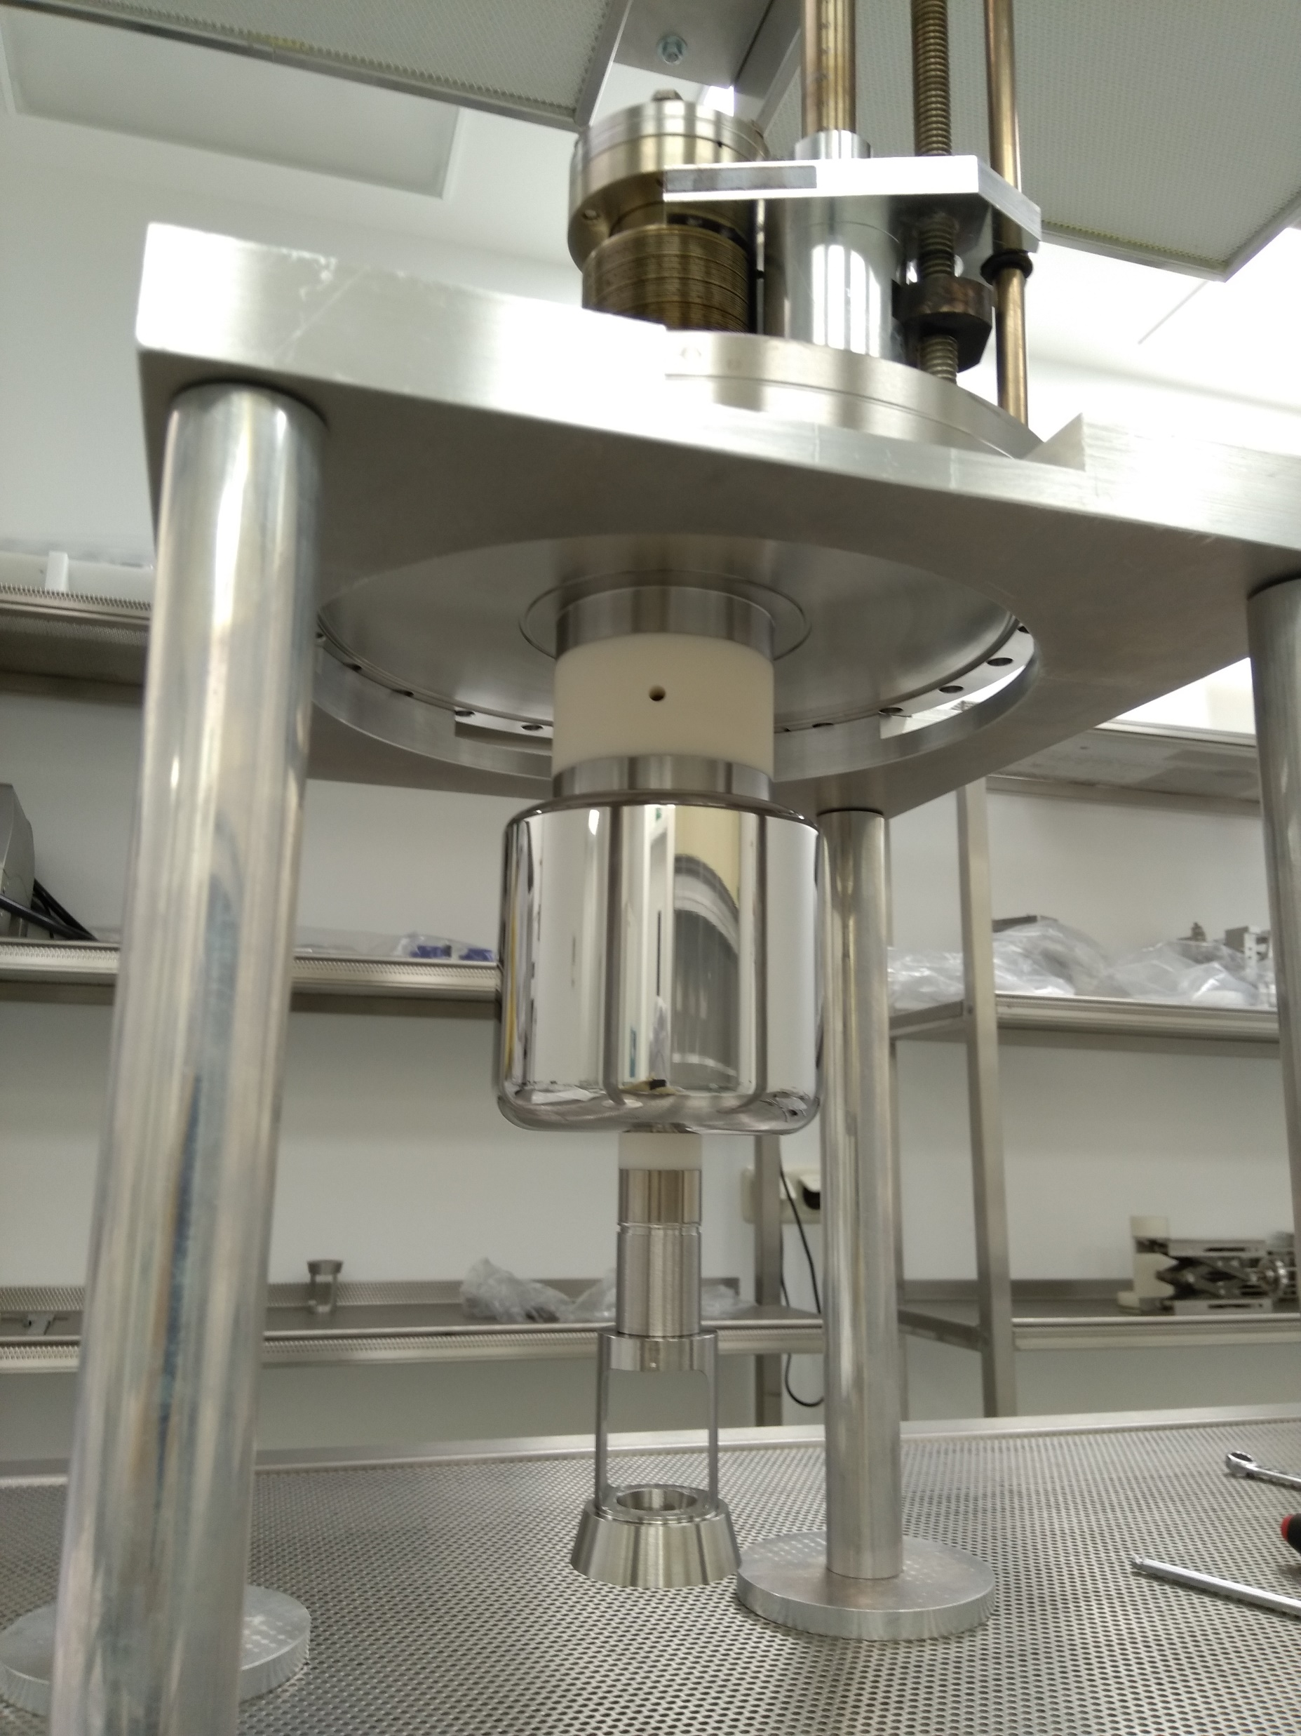
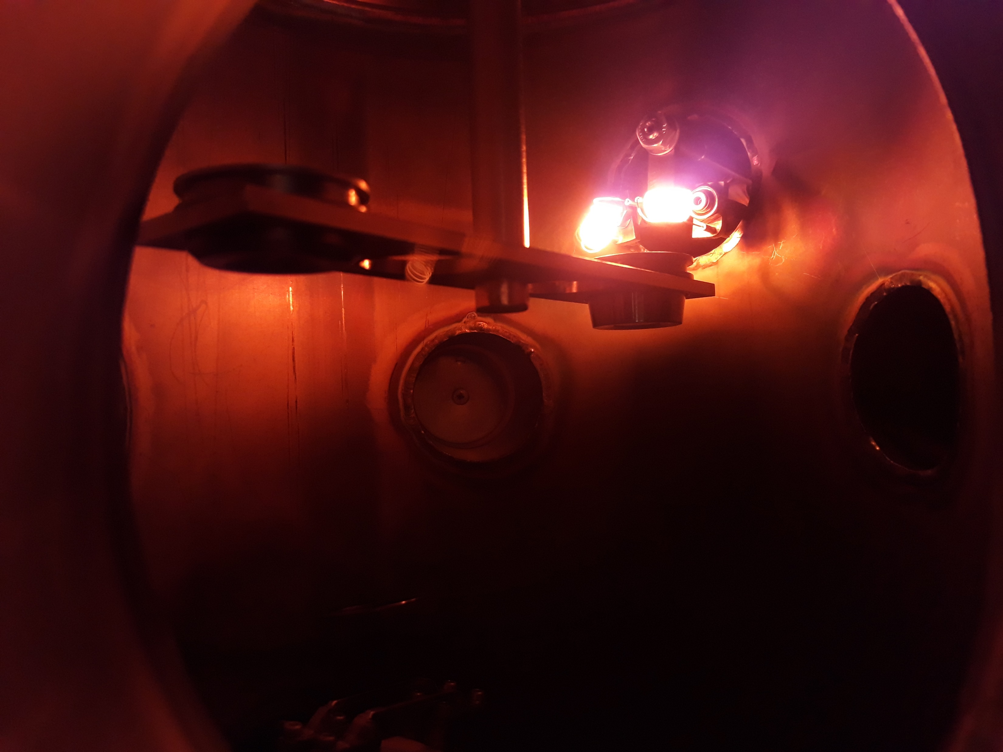
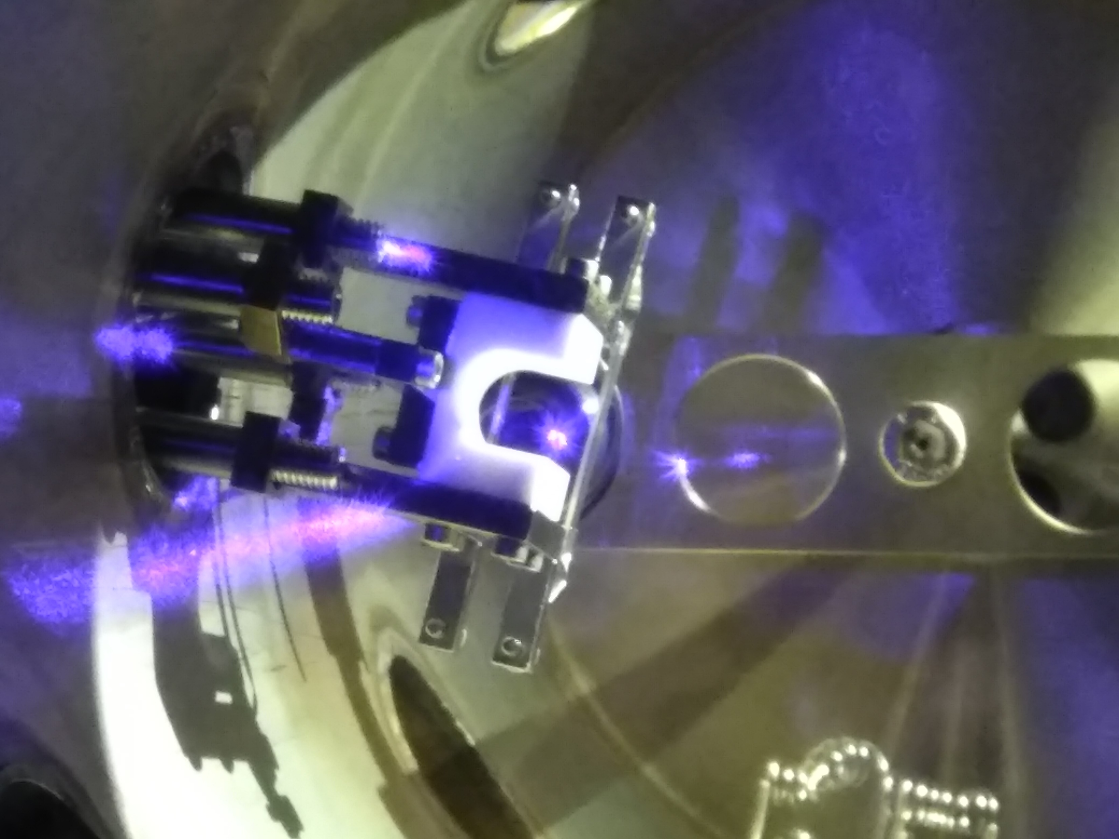
Motivation – Experimental Setup – Automated Activation – Li-enhancement – Conclusion & Outlook
Outlook
Additional studies with Li-enhanced activation
Further sophistication of automated activation scheme
Experiments with Photo-CATCH gun
High-polarization cathodes
Cryogenic gun development

Slide 22
Thank You!
AG Enders: Joachim Enders, Markus Engart, Maximilian Meier, Vincent Wende, Victor Winter Alumni: Tobias Eggert, Yuliya Fritzsche, Julian Schulze
S-DALINAC: Ruben Grewe, Felix Heyer Alumni: Manuel Steinhorst
IKP Electronics Workshop: Uwe Bonnes, Thomas Bickelhaupt, Roland Simon, Roland Veit
Financial Support: BMBF, DFG, GRK 2128 „AccelencE“

