Slide 1
EWPAA 2024
Dresden, Germany, September 17-19, 2024
UIC
Photocathode characterization using a UV-tunable ultrashort-pulse radiation source
W. Andreas Schroeder
Louis Angeloni and Ir-Jene Shan
Physics Department, University of Illinois Chicago
Theodore Vecchione
Stanford Linear Accelerator Consortium (SLAC)
Department of Energy
DE-SC0020387

Slide 2
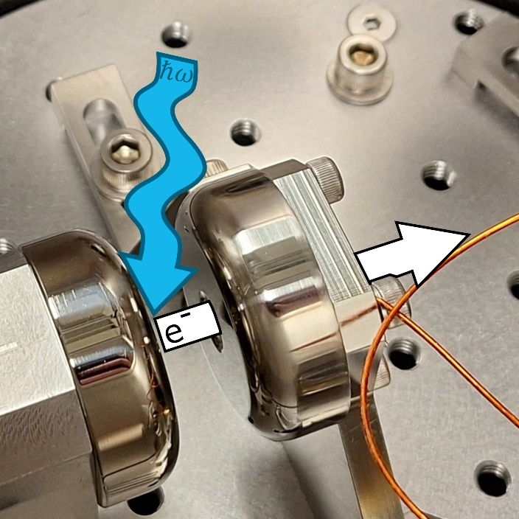
Outline
Part I: Photocathode characterization
system at UIC
− Design considerations
− Key components:
Tunable UV radiation source
DC gun
Electron (beam) detection
− Calibration and performance
Part II: UV laser cleaning (low power)
− Video!
− QE(t) & MTE(t) ⇒ φ reduction …
− φ: Experiment vs. Theory

Slide 3
Design Criteria
Tunable UV radiation source
− Ultrashort pulse laser system PLUS nonlinear optics
Simple 10-20kV DC gun design (+ drift region)
− Straightforward electron trajectory simulation
Sensitive calibrated electron detection
− Dual-plate MCP / P-43 phosphor + CMOS digital camera
Good optical spatial beam stability
− Pinhole / Fourier plane spatial filter (‘top hat’ and near Gaussian beams)
Eliminate intra-pulse space-charge effects
− Radiation source repetition rate > 10MHz
Enhance electron emission
− 60° AOI for p-polarized UV radiation to reduce reflection losses

Slide 4
Photocathode characterization system
− Laser / NLO based sub-picosecond tunable UV radiation source: 3.0 – 5.3eV (235-410nm)
20 W Yb:fiber laser
400 fs, 16.7 MHz, 1030 nm
15 W
0.5 W
THG
SHG
SHG
LBO
LBO
LBO
F
6 W 515 nm
Nonlinear fiber
(SC-3.7-975)
2ω
LBO
LBO
3ω
Continuum
(700-950 nm)
OPA 2
OPA 1
ω_{s,i}
BBO
Tunable UV (0.01-0.1mW)
Non-collinear
sum frequency
UV generation
Detector:
MCP & CMOS camera;
Faraday cup
-10 kV
Δp_{T} measurement

Slide 5
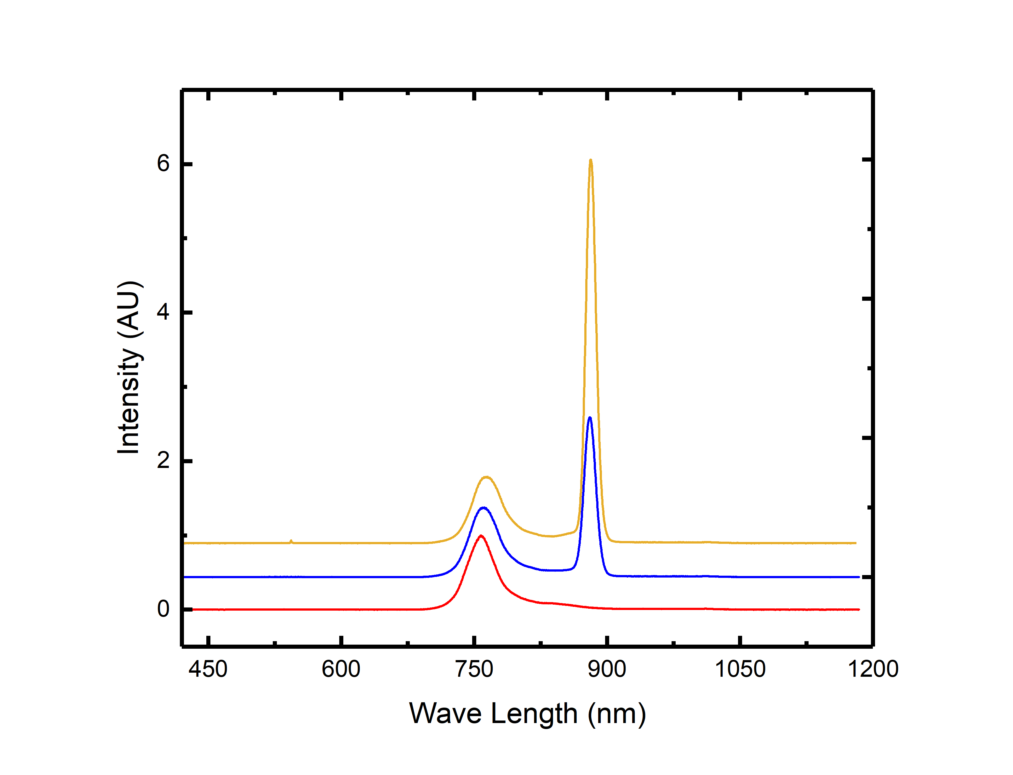
Optical parametric amplification
− OPA 1 and OPA 2 are temperature tuned LBO crystals (NCPM)
Signal wave amplification (721-946 nm)
⇒ ħω_{UV} = 4.92 - 5.33 eV (3ω SFG)
= 3.72 - 4.13 eV (2ω SFG)
Idler wave amplification (1.13-1.8 µm )
⇒ ħω_{UV} = 4.3 - 4.71 eV (3ω SFG)
= 3.1 - 3.51 eV (2ω SFG)
PLUS: 4ħω_{laser} = 4.81 eV
3ħω_{laser} = 3.61 eV
Amplification range
Intensity (a.u.)
OPA 2
OPA 1
Continuum
3.1 − 5.33 eV
UV radiation
(10-100 µW, ~0.5 ps)
Wavelength (nm)

Slide 6
Experiment: UV radiation delivery
− Laser / NLO based tunable UV radiation source: 3.0 – 5.3eV (235-410nm)
20 W Yb:fiber laser
400 fs, 16.7 MHz, 1030 nm
15 W
0.5 W
THG
SHG
SHG
Tunable UV (0.01-0.1mW)
LBO
LBO
LBO
F
6 W 515 nm
Nonlinear fiber
(SC-3.7-975)
2ω
LBO
LBO
f = 38cm
OAP
3ω
Continuum
(700-950 nm)
100-200μm aperture
OPA 2
OPA 1
ω_{s,i}
BBO
Tunable UV (0.1-1mW)
λ/2
f = 50cm
Non-collinear
sum frequency
UV generation
Detector:
MCP & CCD camera;
Faraday cup
Detector:
MCP & CMOS camera;
Faraday cup
-10 kV
-10 kV
Δp_{T} measurement
Δp_{T} measurement

Slide 7
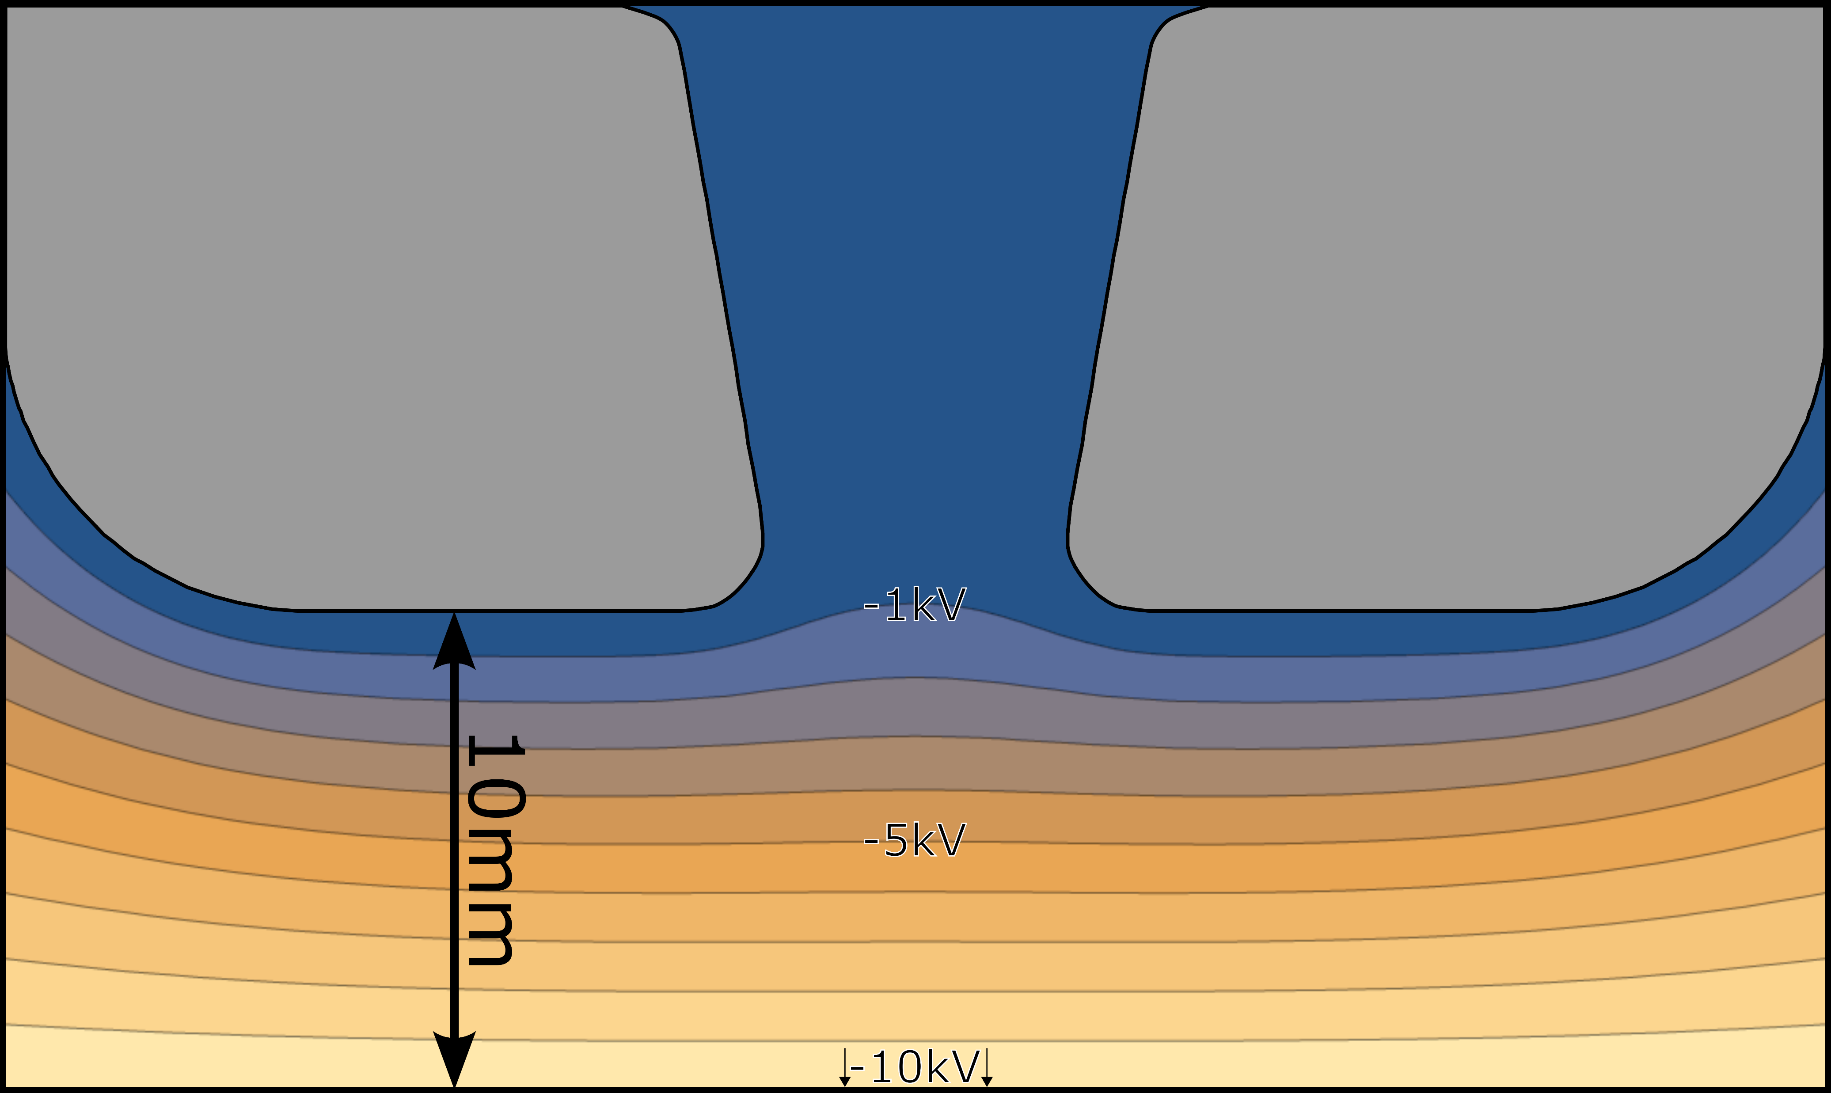
DC photoelectron gun design
Anode
(0V)
10-20kV DC gun based on design of Togawa et al.
− Simple, proven, and readily fabricated design
− Minimal anode lensing
Material: Polished 316 SS
d = 1cm ⇒ E_{DC} = 1-2MV/m
Gun geometry yields uncomplicated E(r,φ,z) evaluation
⇒ Straightforward photoelectron
trajectory simulation
e⁻
6mm φ
Cathode
(-10kV)
Photocathode
K. Togawa et al., Phys. Rev. ST Accel. Beams 10 (2007) 020703

Slide 8
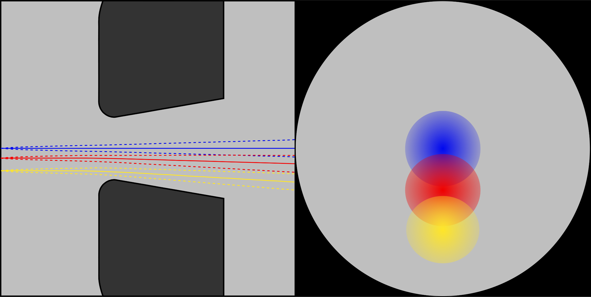
MTE calibration
− Electron trajectory simulations using E(r,φ,z)
Electron trajectory simulation results:
Minimal (and well understood) negative anode lensing
Negligible beam distortion within 0.5mm radius of DC gun axis
(c.f. laser beam size ~100μm)
On detector, near gun axis at 10kV;
p_{T} calibration = 0.445 $\sqrt{m_{0}.eV}/mm$
Trajectory simulations in agreement with Analytical Gaussian (AG) electron pulse propagation model
DC gun
Drift region
Detector screen
Photocathode
1cm
42cm
J.A. Berger and W.A. Schroeder, J. Appl. Phys. 108 (2010) 124905

Slide 9
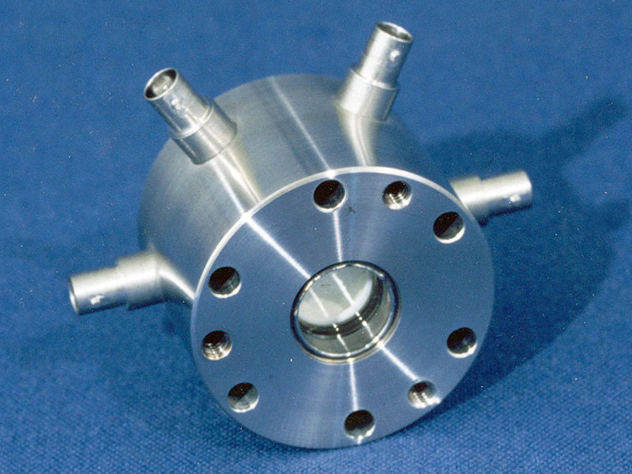
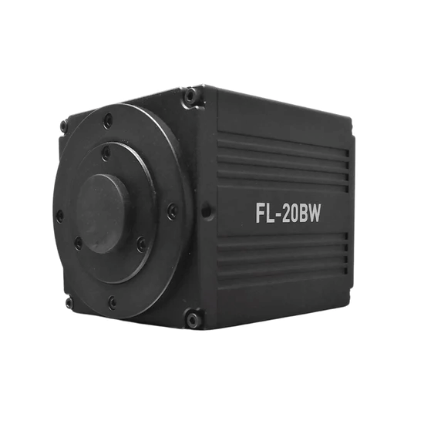
Electron beam detection
BOS-18 beam imaging system
− Dual-chevron 10μm-pore MCPs: 10² − 10³ gain/plate
(voltage-controllable gain)
− P-43 phosphor screen: 25μm PSF @ 2keV
⇒ Intrinsic MTE resolution of ≤ 1meV
for 10keV electrons
2.4μm-pixel CMOS digital camera
(FL-20BW; Axiom Optics)
− >80% peak QE @ P-43 phosphor emission
− f₁:f₂ = 5:8 magnification reduction to camera
⇒ Overall PSF ≤ 20μm (around 8 pixels)
https://beamimaging.com/product/bos-18/

Slide 10
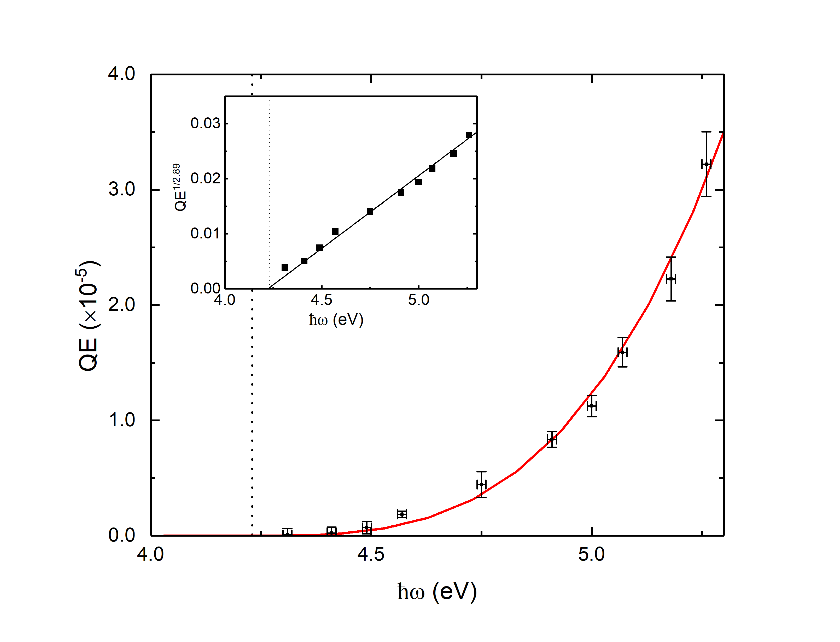
QE calibration
Uses ‘canonical’ Rh(110) photocathode
− Theoretical QE dependence
QE = A(ħω−φ)^{2.89}
consistent with measurements
Absolute calibration using Faraday cup
PLUS:
Voltage/gain calibration of MCPs
⇒ QE detection floor of ~10⁻¹⁰
G. Adhikari, P. Riley, and W.A. Schroeder, AIP Advances 9 (2019) 065305
G.W. Gobeli and F.G. Allen, Phys. Rev. 137 (1965) A245-A254

Slide 11
UV laser cleaning: Rh(110)
Laser parameters:
λ = 257nm (ħω = 4.81eV)
P_{UV} ≈ 1W/cm²
16.7MHz, 250fs pulses
⇒ P_{peak} ≈ 200kW/cm²
∴ No surface melting
(ΔT < 10K)
20-minute video in 25 seconds

Slide 12
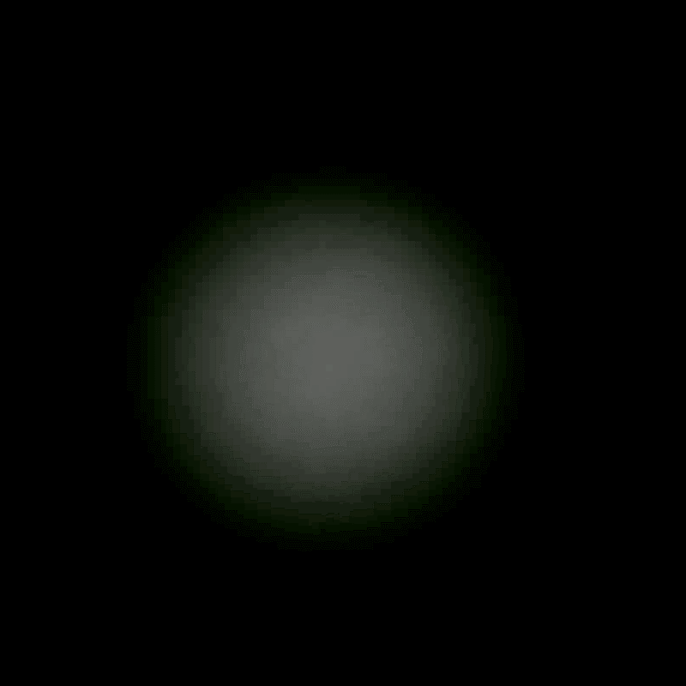
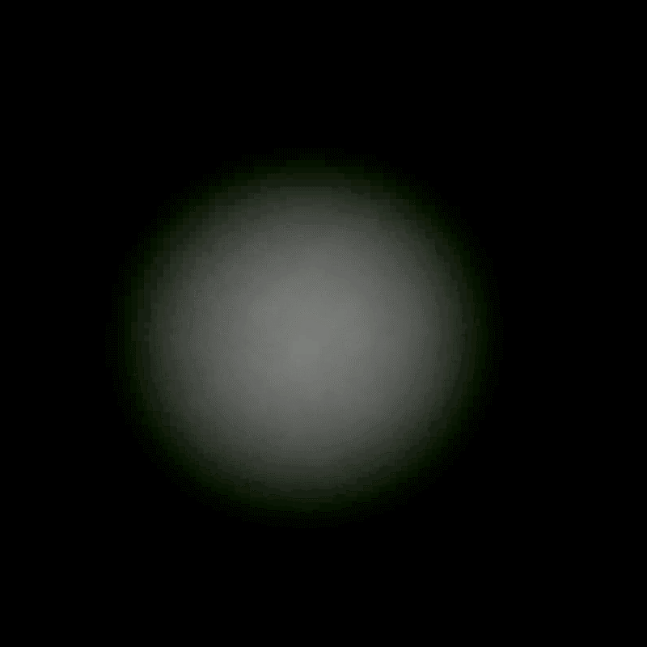
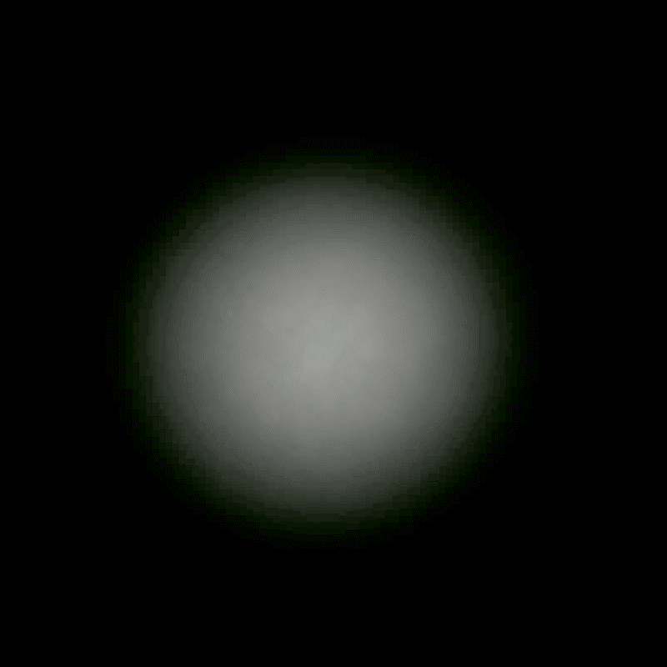
Laser cleaning: Synopsis
− Seven selected frames from video
Rapid changes for t < 30s
Slow changes for t > 60s
t = 0s
t = 5s
t = 10s
t = 30s
t = 360s
t = 900s
t = 1146s
Is laser cleaning of photocathode surface simply reducing φ?

Slide 13
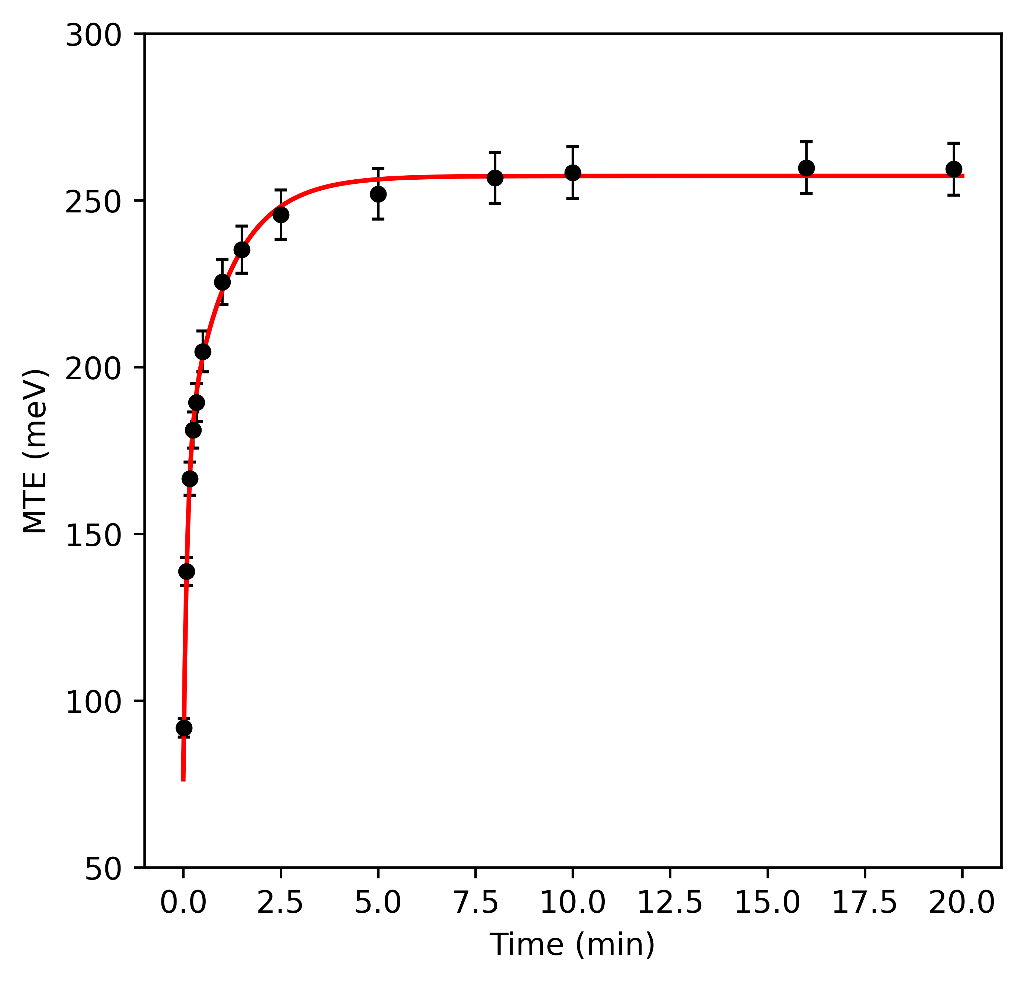
Laser cleaning: MTE(t)
− MTE(t) for Rh(110)
$MTE\left(t\right)∝\left(ħω−φ(t)\right)$ fit by double exponential:
$$MTE=A−Be^{t/{τ_{1}}}−Ce^{t/{τ_{2}}}$$
⇒ UV illumination decreases φ
(surface roughness constant)
(i) Initial fast φ reduction:
− Removal of surface adsorbates
(ii) Subsequent slower φ reduction:
− Removal of bonded OH, CO, H …
BOTH surface effects
τ₁ = 0.101min (6s)
τ₂ = 1.133min (68s)

Slide 14
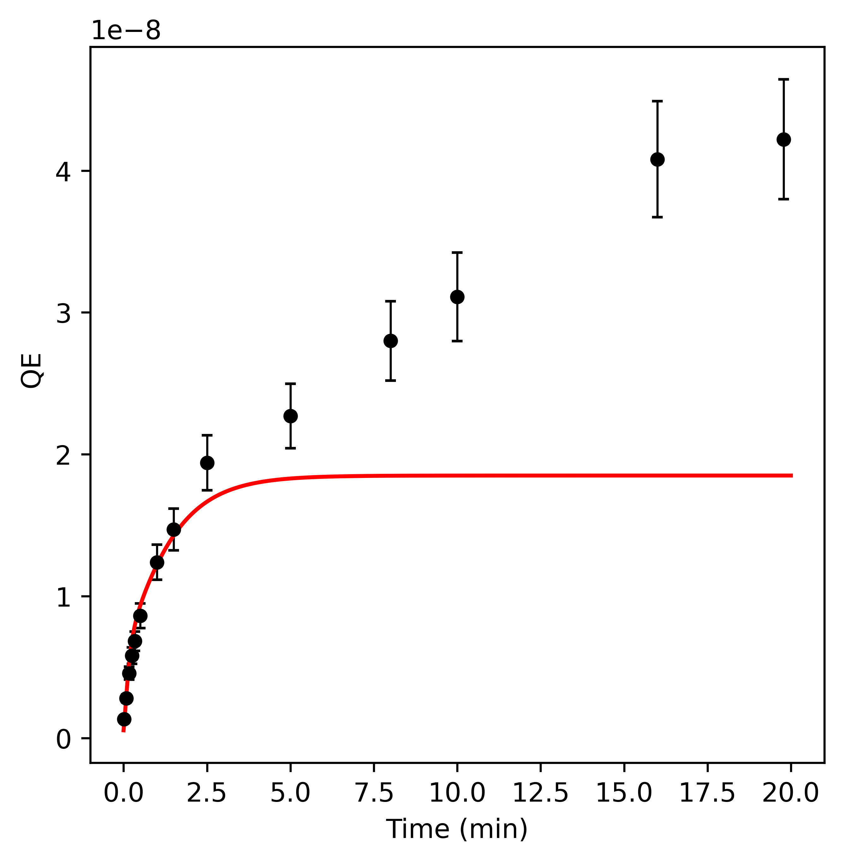
Laser cleaning: QE
For Rh(110):
$QE∝{(ħω)}^{2.89}$ and $MTE∝(ħω)$
⇒ $QE(t)∝{\left[MTE(t)\right]}^{n}$ with n = 2.89
… only consistent for t < 2 minutes
QE increase after t ≈ 2mins. at relatively ‘constant’ MTE
⇒ A bulk effect
− Expulsion of H from photocathode?
− …
QE (a.u.)

Slide 15
φ: Theory vs. Experiment
− Experimental ‘laser-cleaned’ QE^{1/n} intercept values for φ; DFT-based ‘half thin-slab’ calculations (Amsterdam Suite)
Photocathode | φ_{expt.} (eV) (±0.1eV) | φ_{DFT} (eV) (±0.1eV) | φ_{PE} (eV) | φ_{Recommended} (eV)
Ag(001) Mo(001) Nb(001) Rh(110) Ta(001) W(001) W(111) | 3.94 3.89 3.94 4.13 3.97 4.08 4.18 | 4.25 4.30 3.52 4.37 3.96 4.02 3.82 | 4.22 (±0.04) 4.53 (±0.02) 3.97 (±0.02) | 4.35 (±0.05) 4.46 (±0.11) 4.08 (±0.17) 4.86 (±0.21) 4.10 (±0.25) 4.70 (±0.06) 4.44 (±0.03)
Preliminary data
Some convergence between theory and experiment observed
BUT more work to be done … Cu(001), Ta(111), Cr(111), Re(0001), Hf(0001)
G.N. Derry et al., J. Vac. Sci. & Technol. A 33 (2015) 060801

Slide 16
Summary
Part I: Photocathode characterization system at UIC
− Design considerations
− Key components:
Tunable UV radiation source
DC gun
Electron (beam) detection
− Calibration and performance: QE ~ 10⁻¹⁰ and MTE ≥ 1-2meV
Part II: UV laser cleaning (low power)
− Video: Increase with t of both QE and MTE
− QE(t) & MTE(t) ⇒ φ reduction (t < 2mins.)
PLUS: Possible bulk effect
− φ determination: Experiment vs. Theory
… critical for study of near-threshold PE effects

Slide 17
UIC
Thank you!

