Slide 1
OptaDOS Photoemission
The Good, The Bad and The Interesting
Interesting
Felix Mildner, Nicholas M. Harrison
18/09/2024

Slide 2
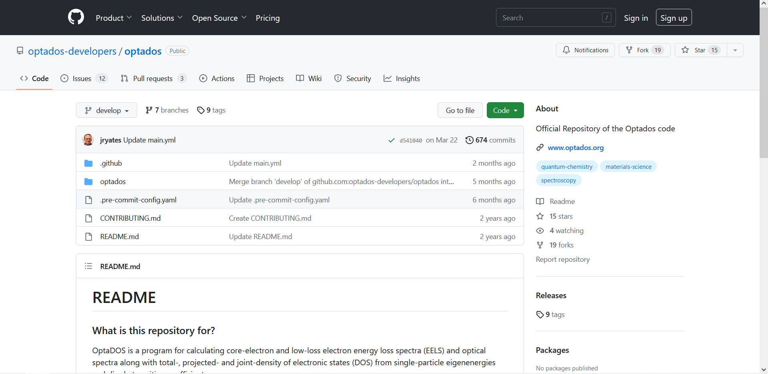
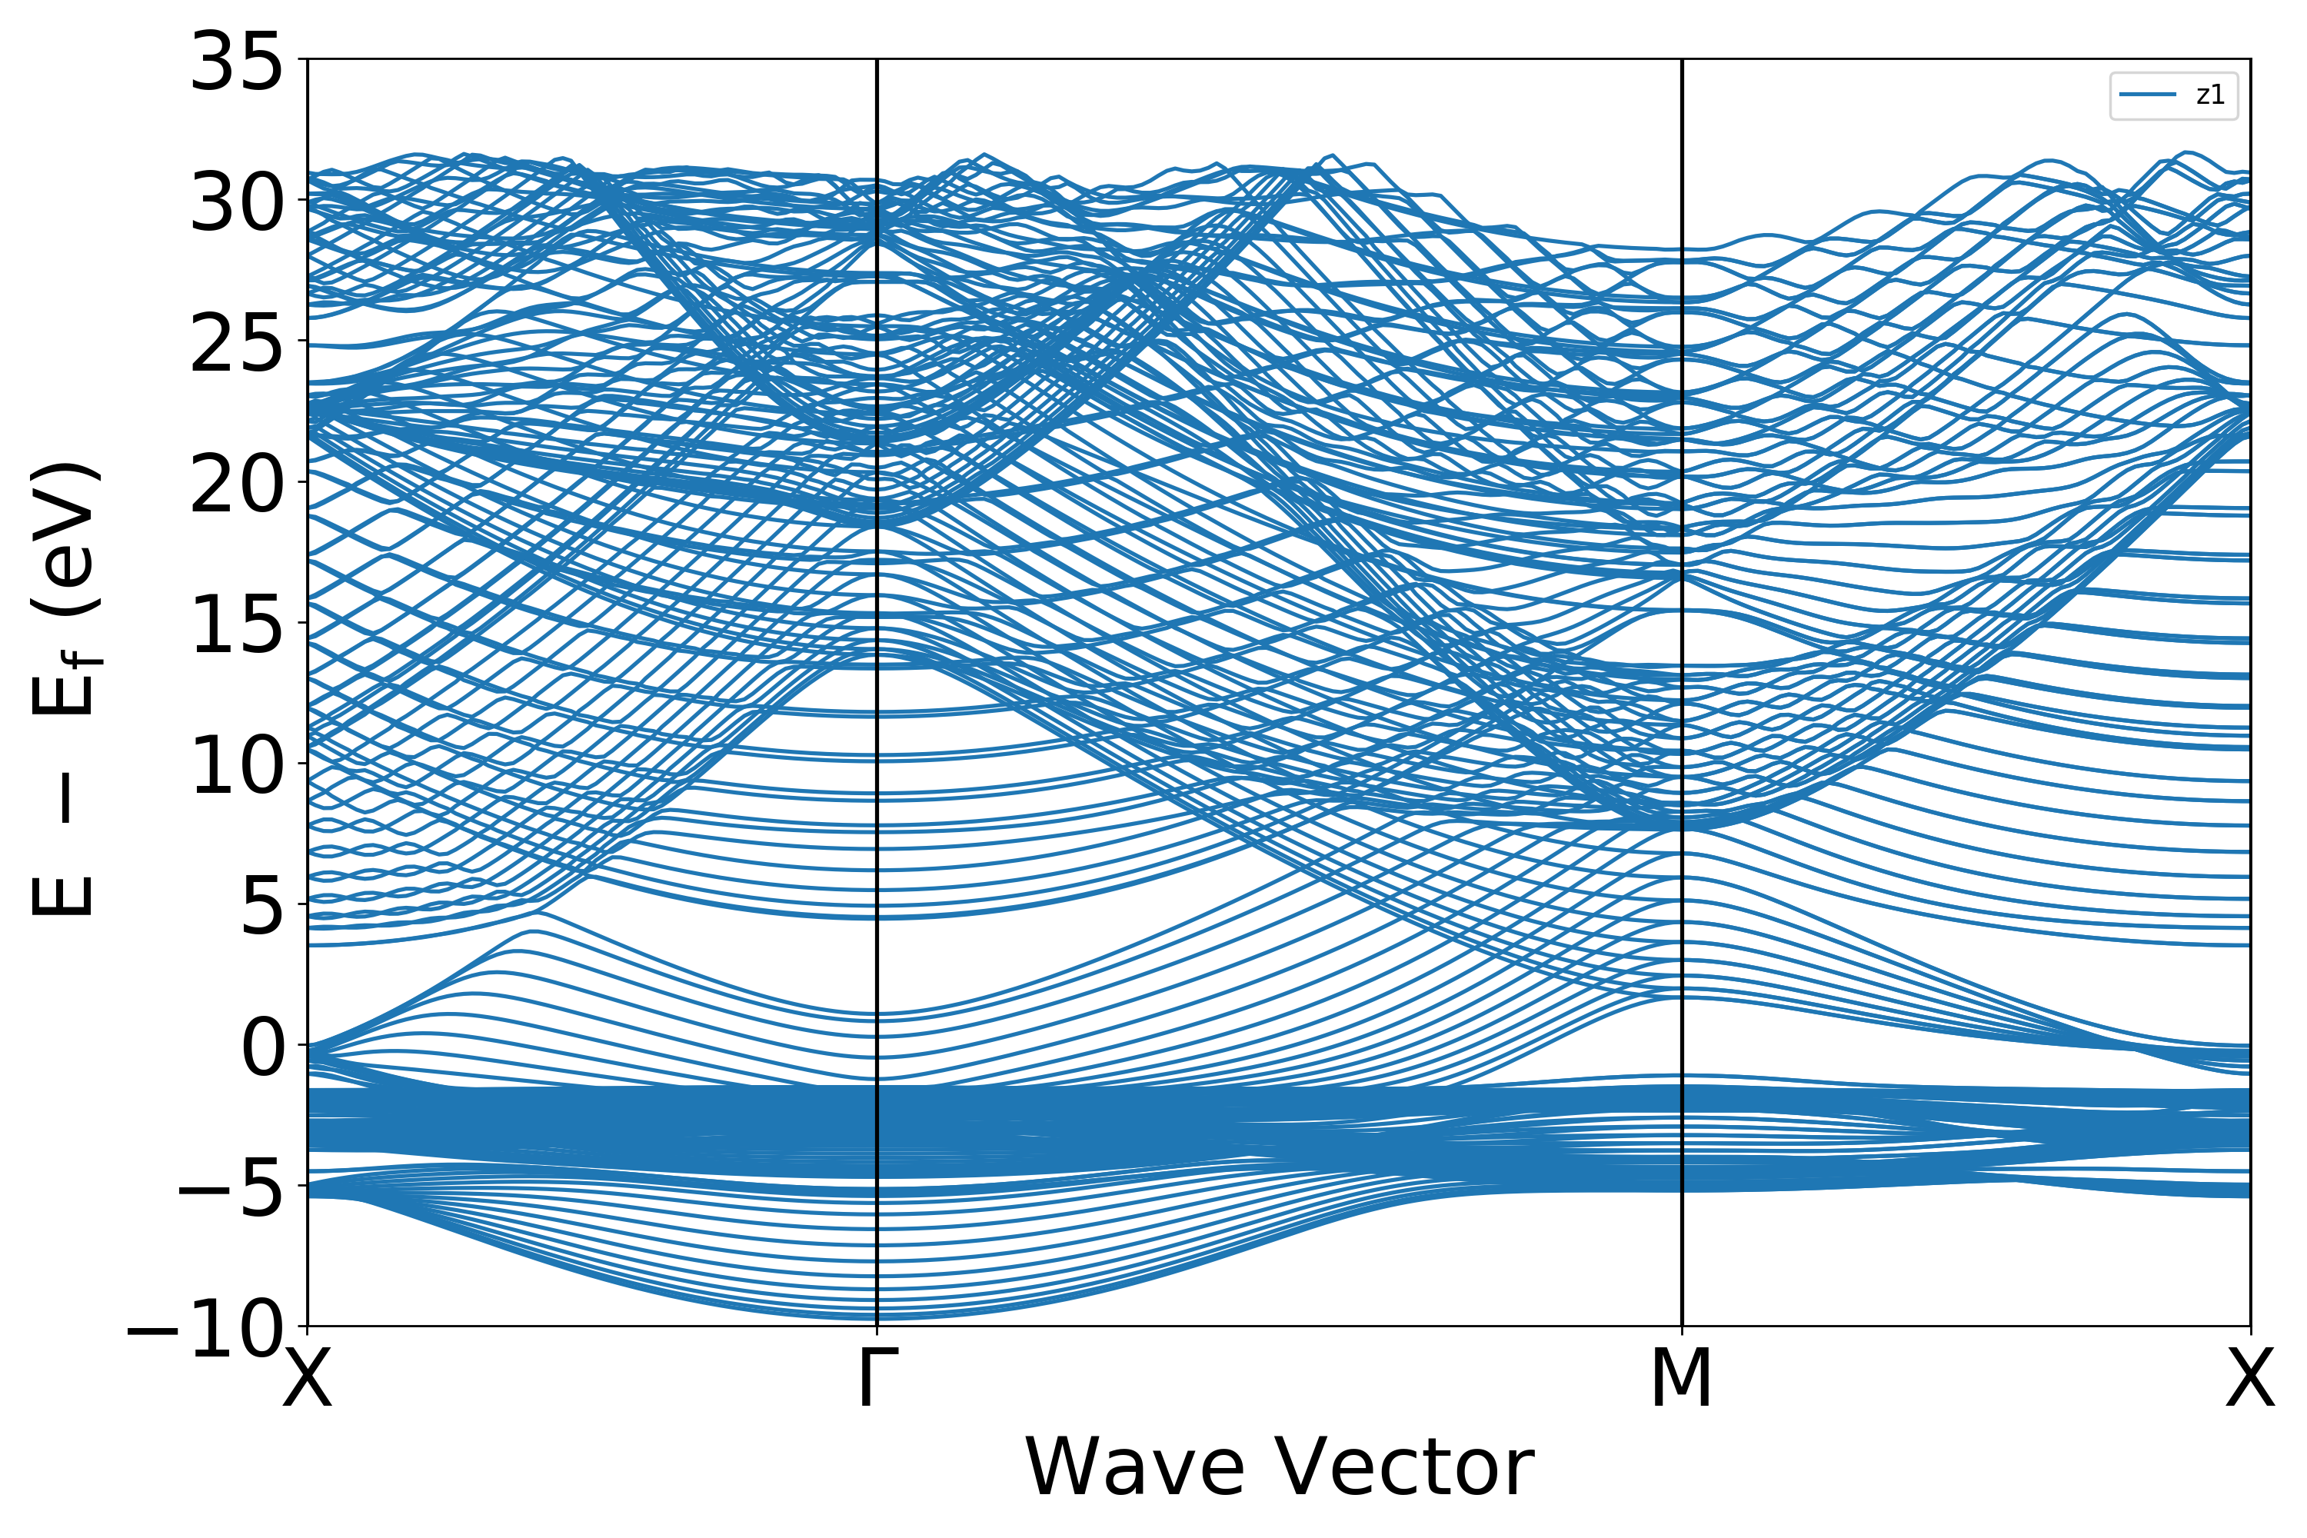
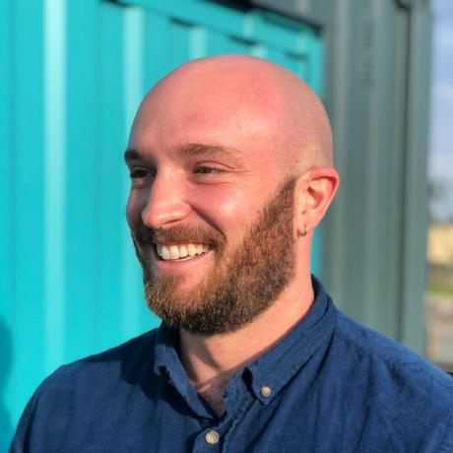
The OptaDOS Program Suite
From Optics to Photoemission
calculate DOS, PDOS and optical properties
Open source program
Photoemission part under active development
release in the next version of OptaDOS
Dr Victor Chang Lee
Dr Bruno Camino
Andrew J. Morris, R. J. Nicholls, C. J. Pickard and Jonathan R. Yates, The OptaDOS code, Comp. Phys. Comm. (2012).
R. J. Nicholls, A. J. Morris, C. J. Pickard and J. R. Yates, OptaDOS, Accepted for publication in Journal of Physics: Conf. Sers.

Slide 3
The Model
Things to Consider
Things we can take into account:
light intensity at each layer
$$I\left(N\right)=1−R\left(1\right)−\sum_{i=1}^{N−1}{A(i)}$$
emission probability based on depth
mean free path model
K-resolved excitations + emissions
explicit and detailed analysis of band contributions
electronic transverse energy (weighted MTE)
bulk region extension
repeat innermost layer until minimum emission probability is reached
$R\left(1\right)$ - reflection of layer 1
$A\left(i\right)$ - Absorption of layer i
…

Slide 4
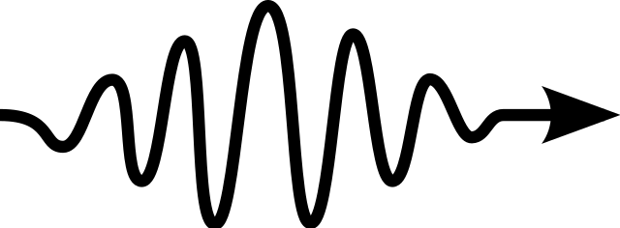
The Model – cont.
Energies and Probabilities
E
E_{electron - free}
E_{vacuum}
Optical Matrix Element (OME)
Fermi’s Golden Rule Type
$$Γ_{i→f}= \frac{2π}{ℏ} {\left|\left\langle ψ_{f} | H′ | ψ_{i}\right\rangle \right|}^{2} δ\left[E\left(f,k, s\right)−E\left(i,k,s\right) − ℏω\right]$$
$$hν$$
$$hν$$
Workfunction Ω
0
E_{fermi}
E_{electron – bound}
MTE, weighted sum
$$\text{MTE}\text{ (}\text{E}\text{)}= \sum_{K}{\frac{E_{trans}(K)QE(K)}{\sum_{K}{QE(K)}}}$$
$$E_{electron − free}=hν −(Ω+E_{electron − bound})$$

Slide 5
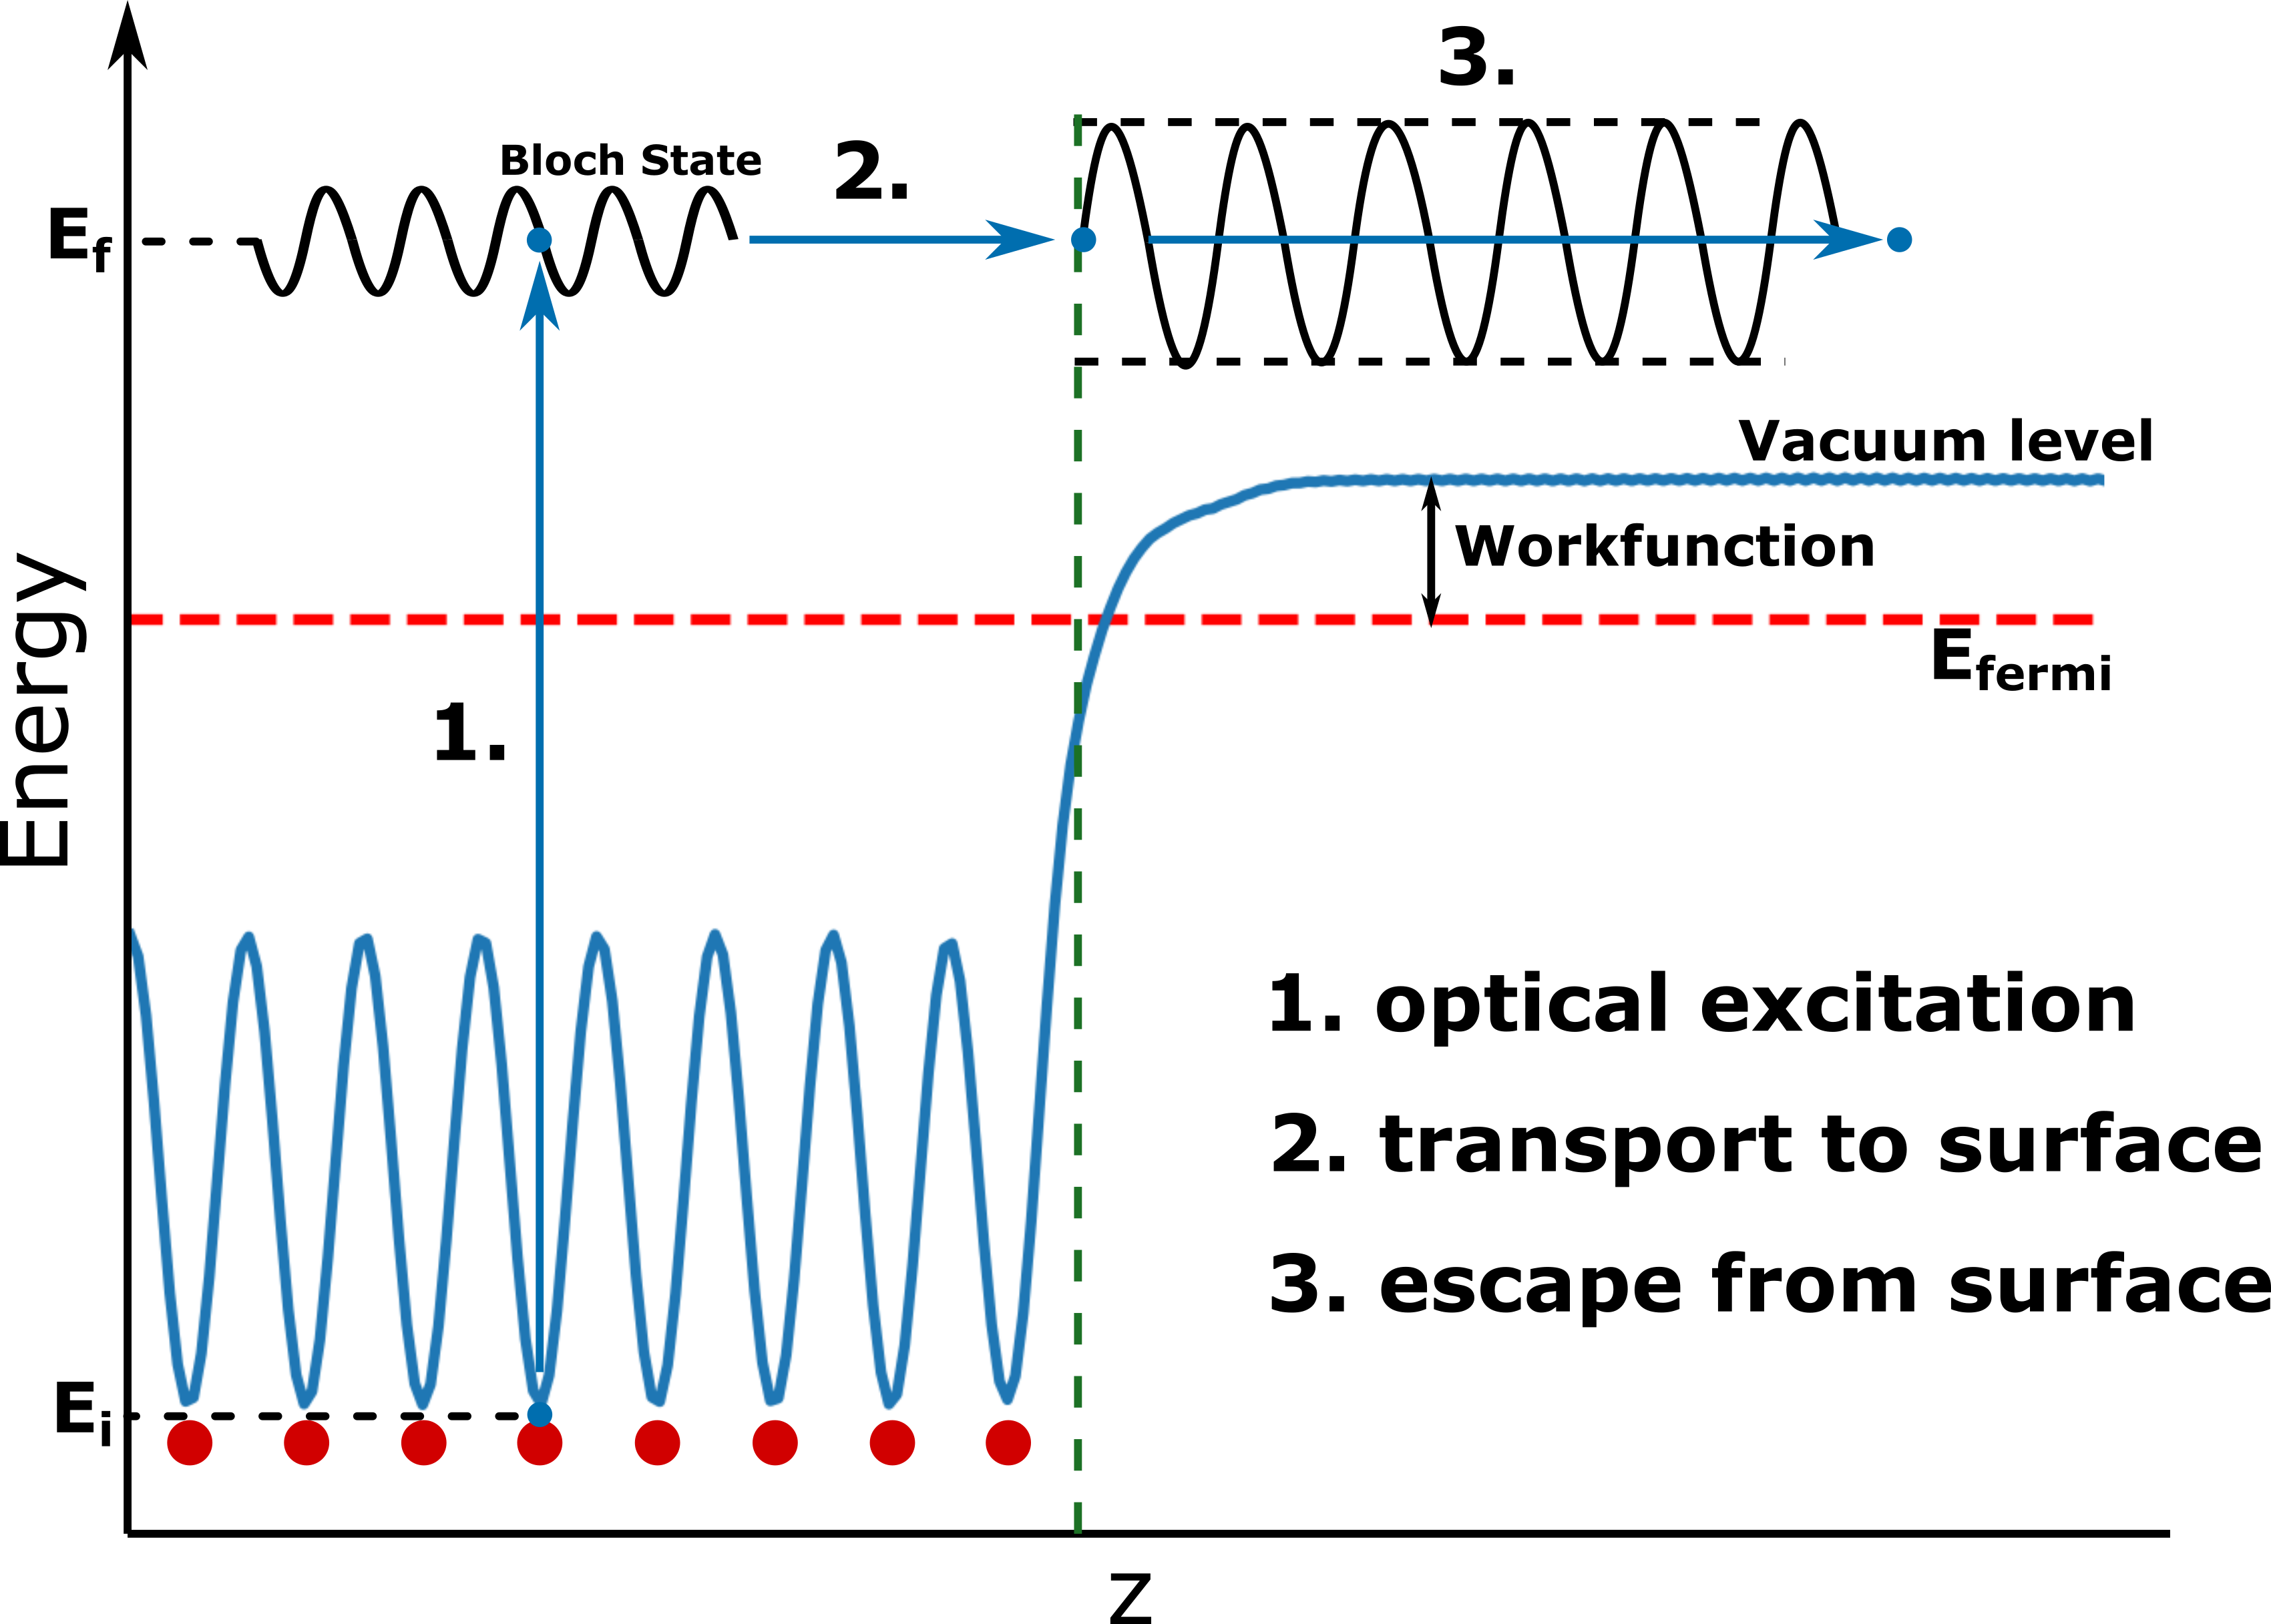
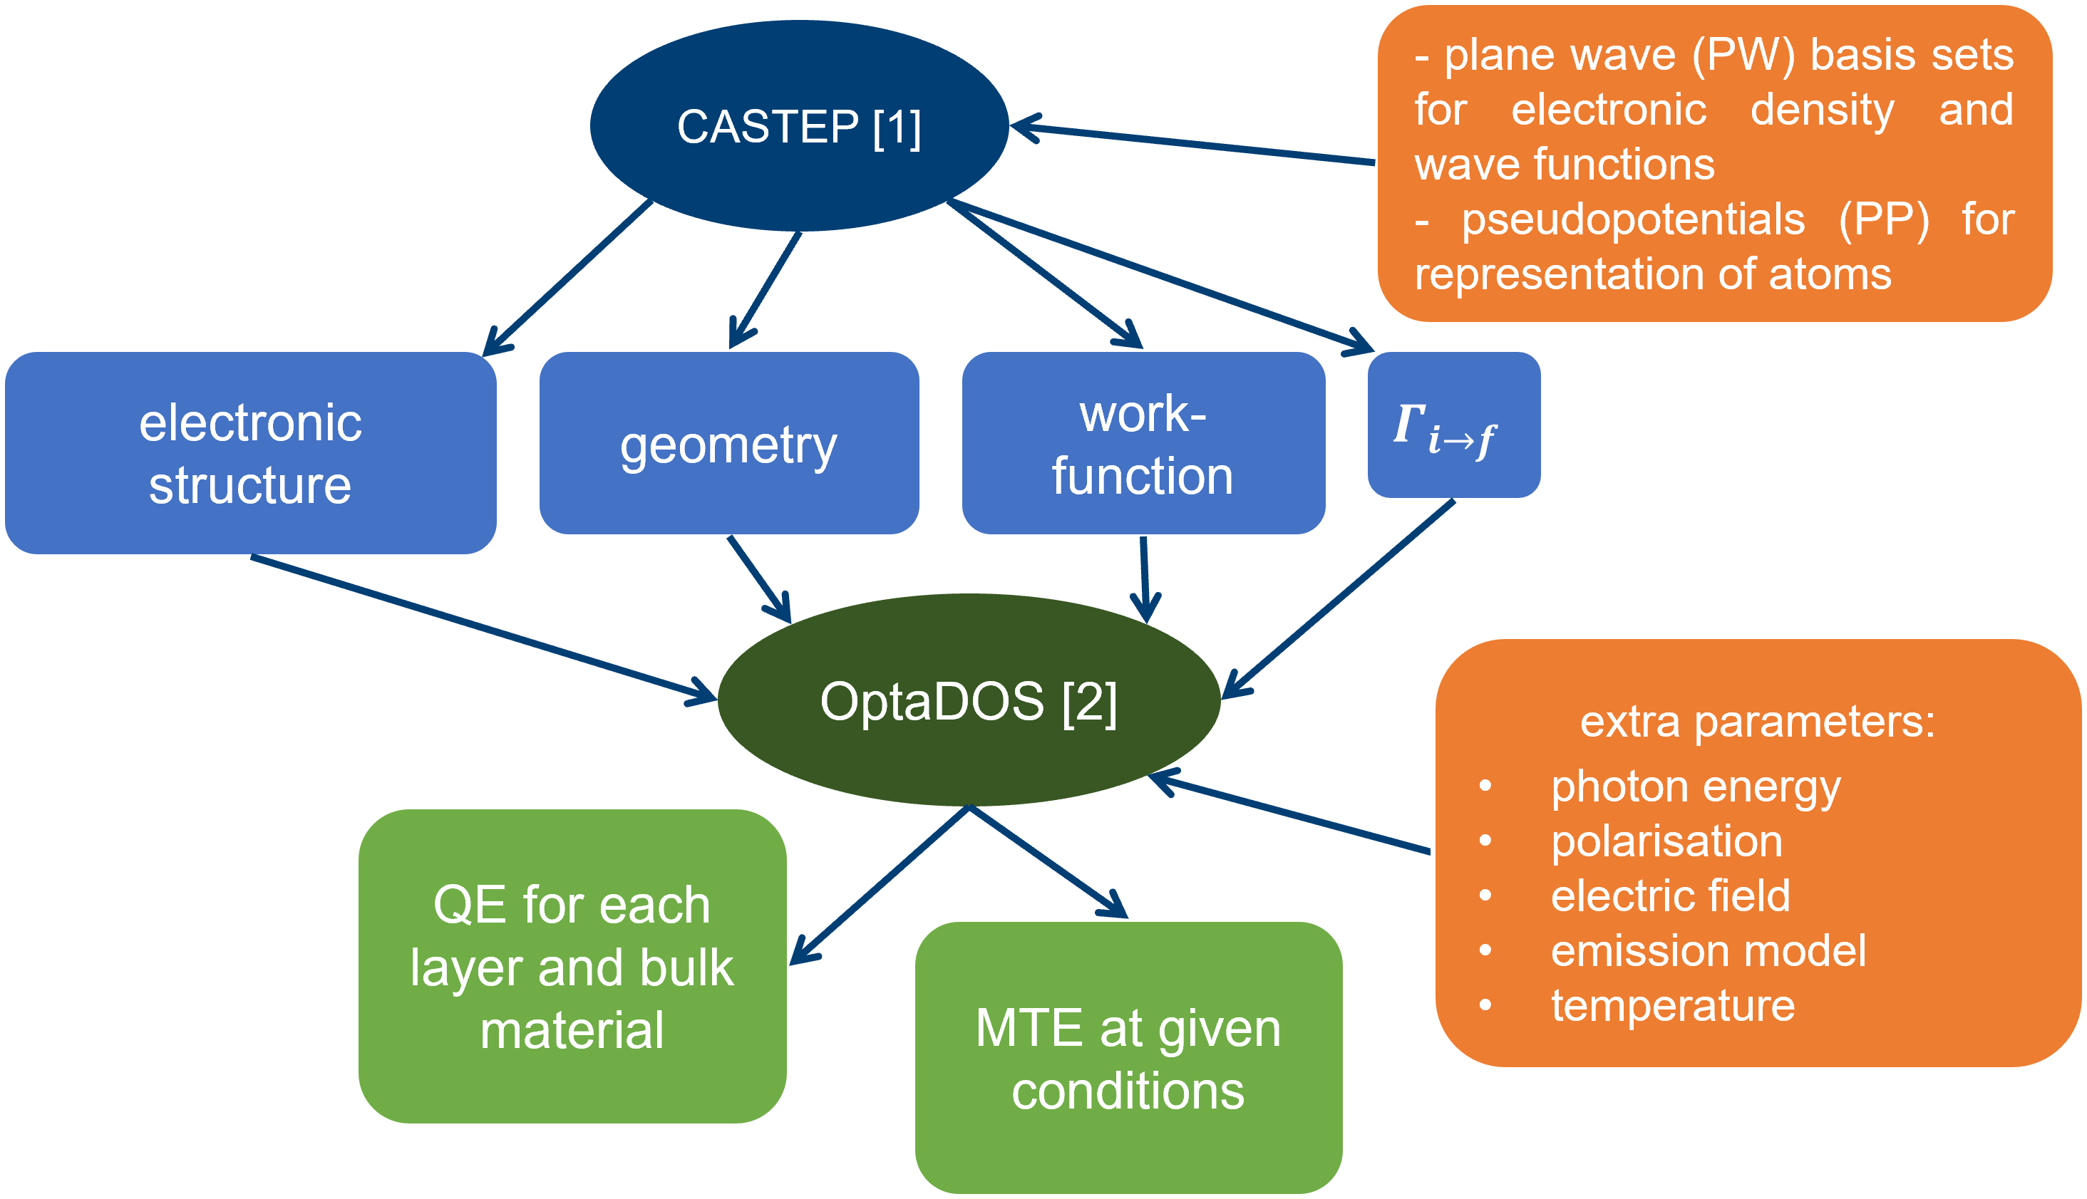
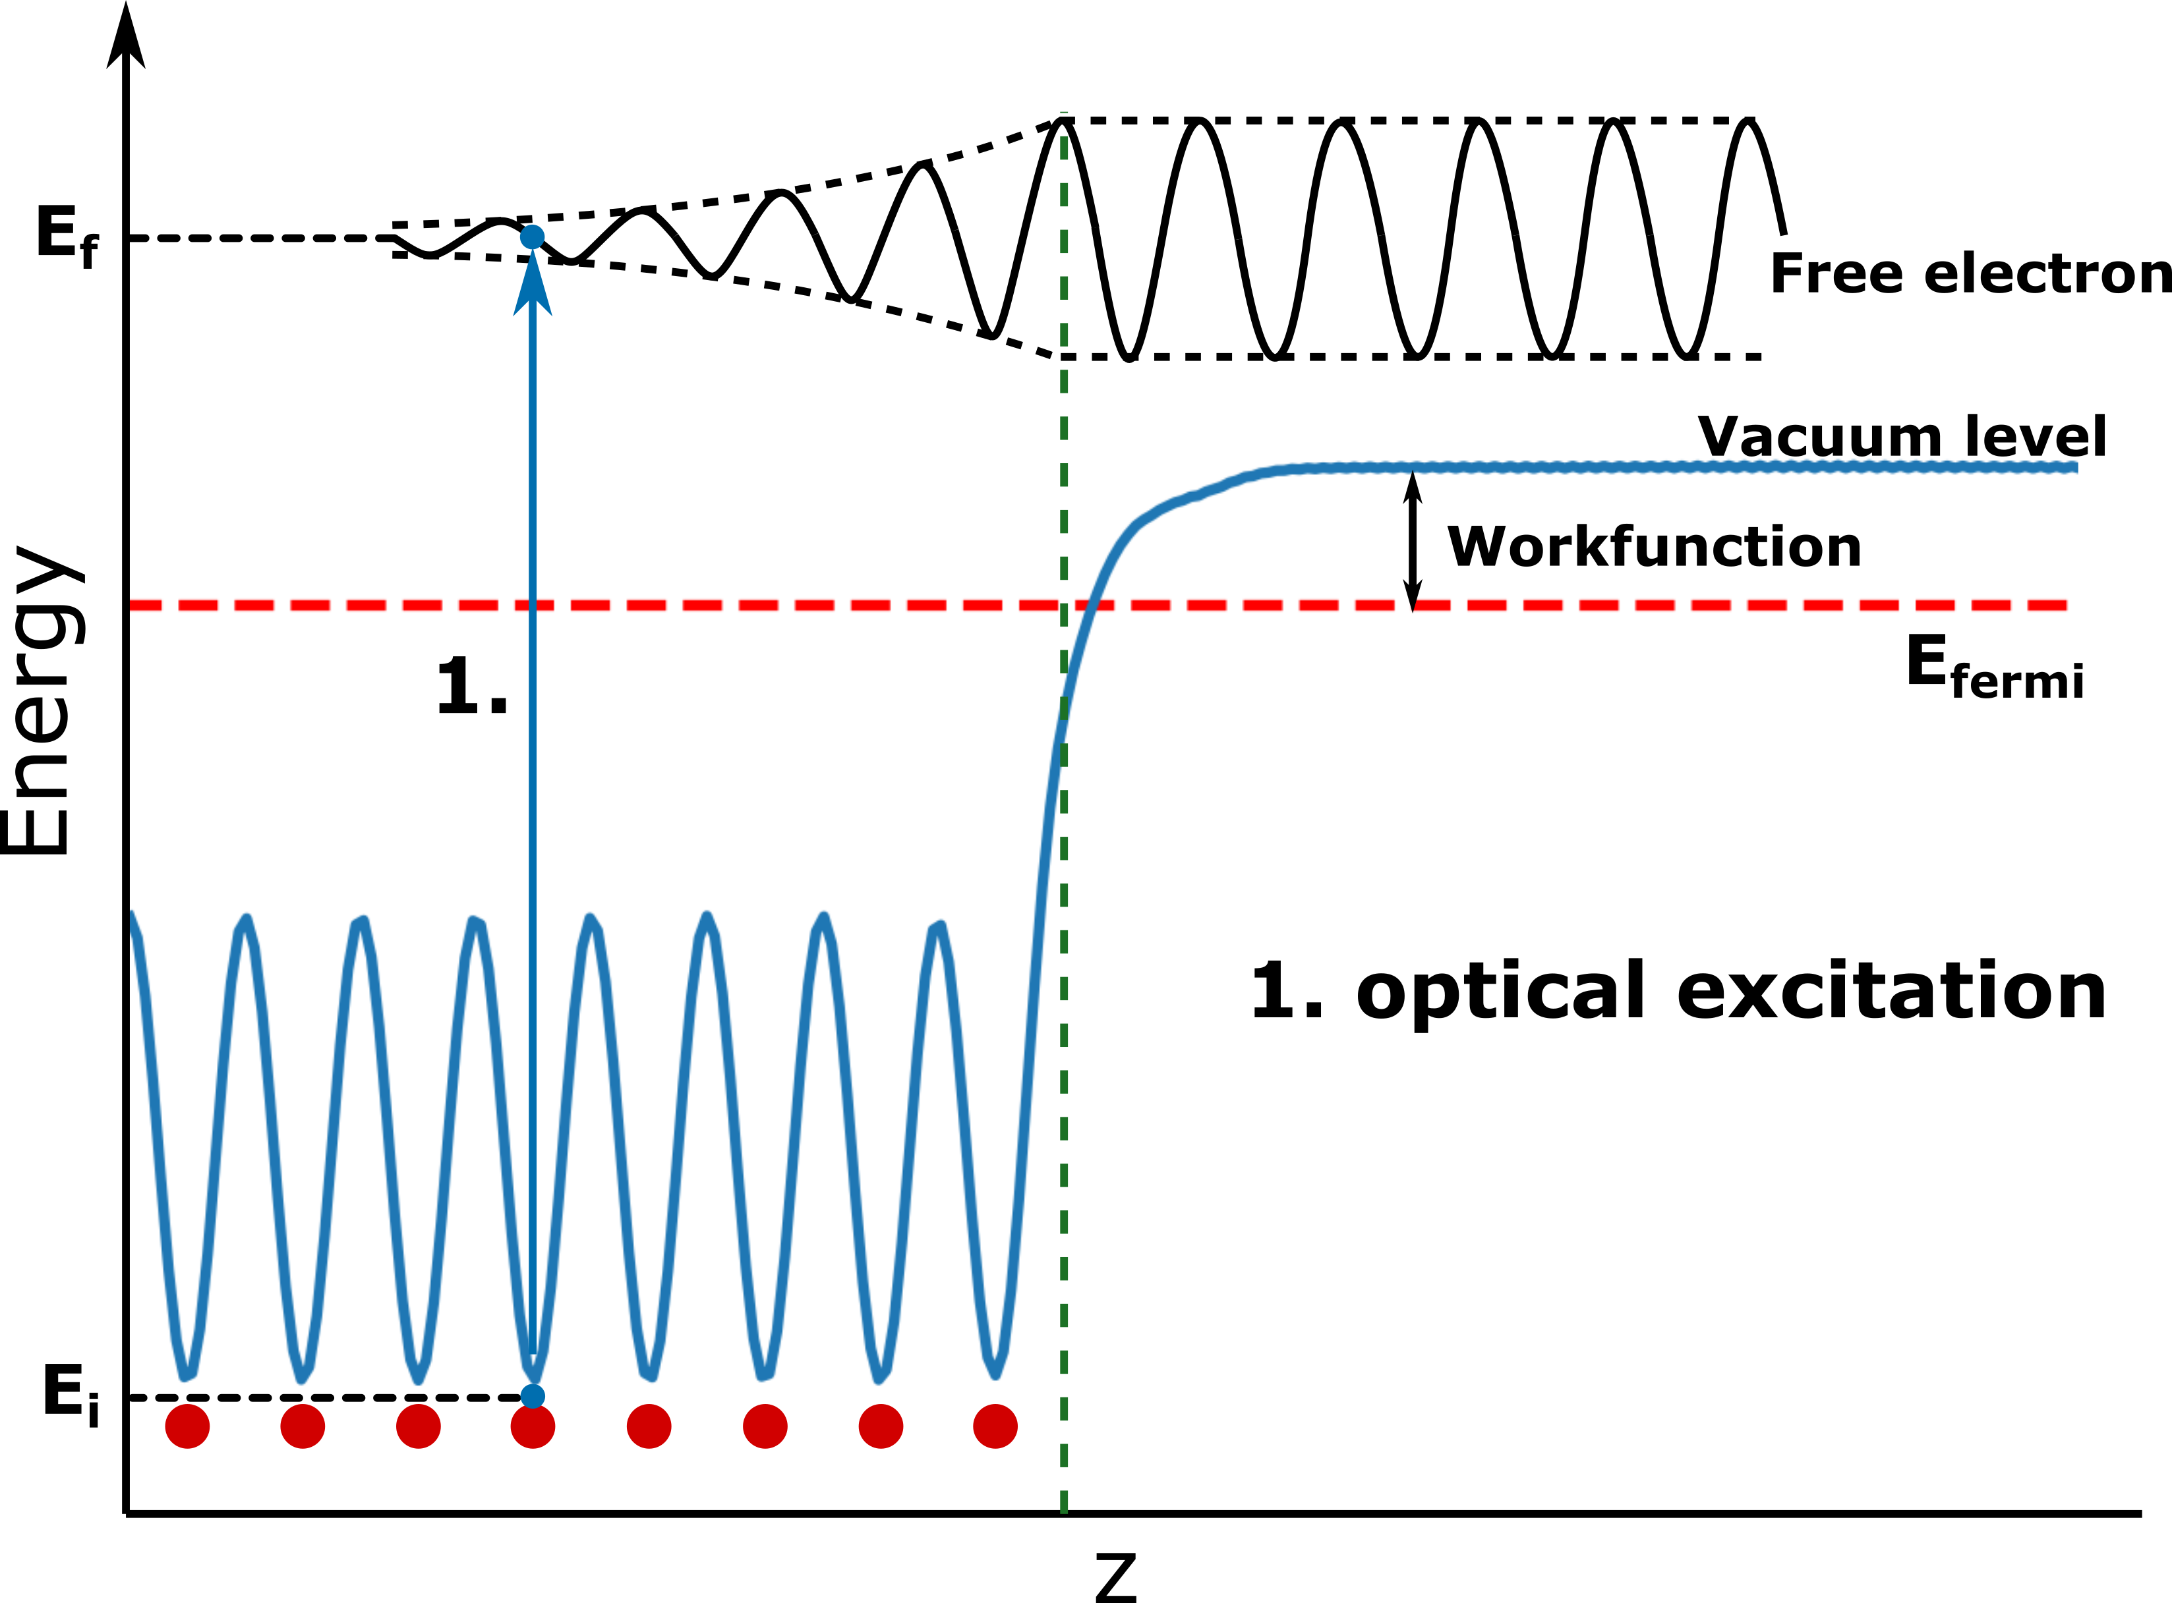
The Model – cont.
3-Step + 1-Step Model

Slide 6
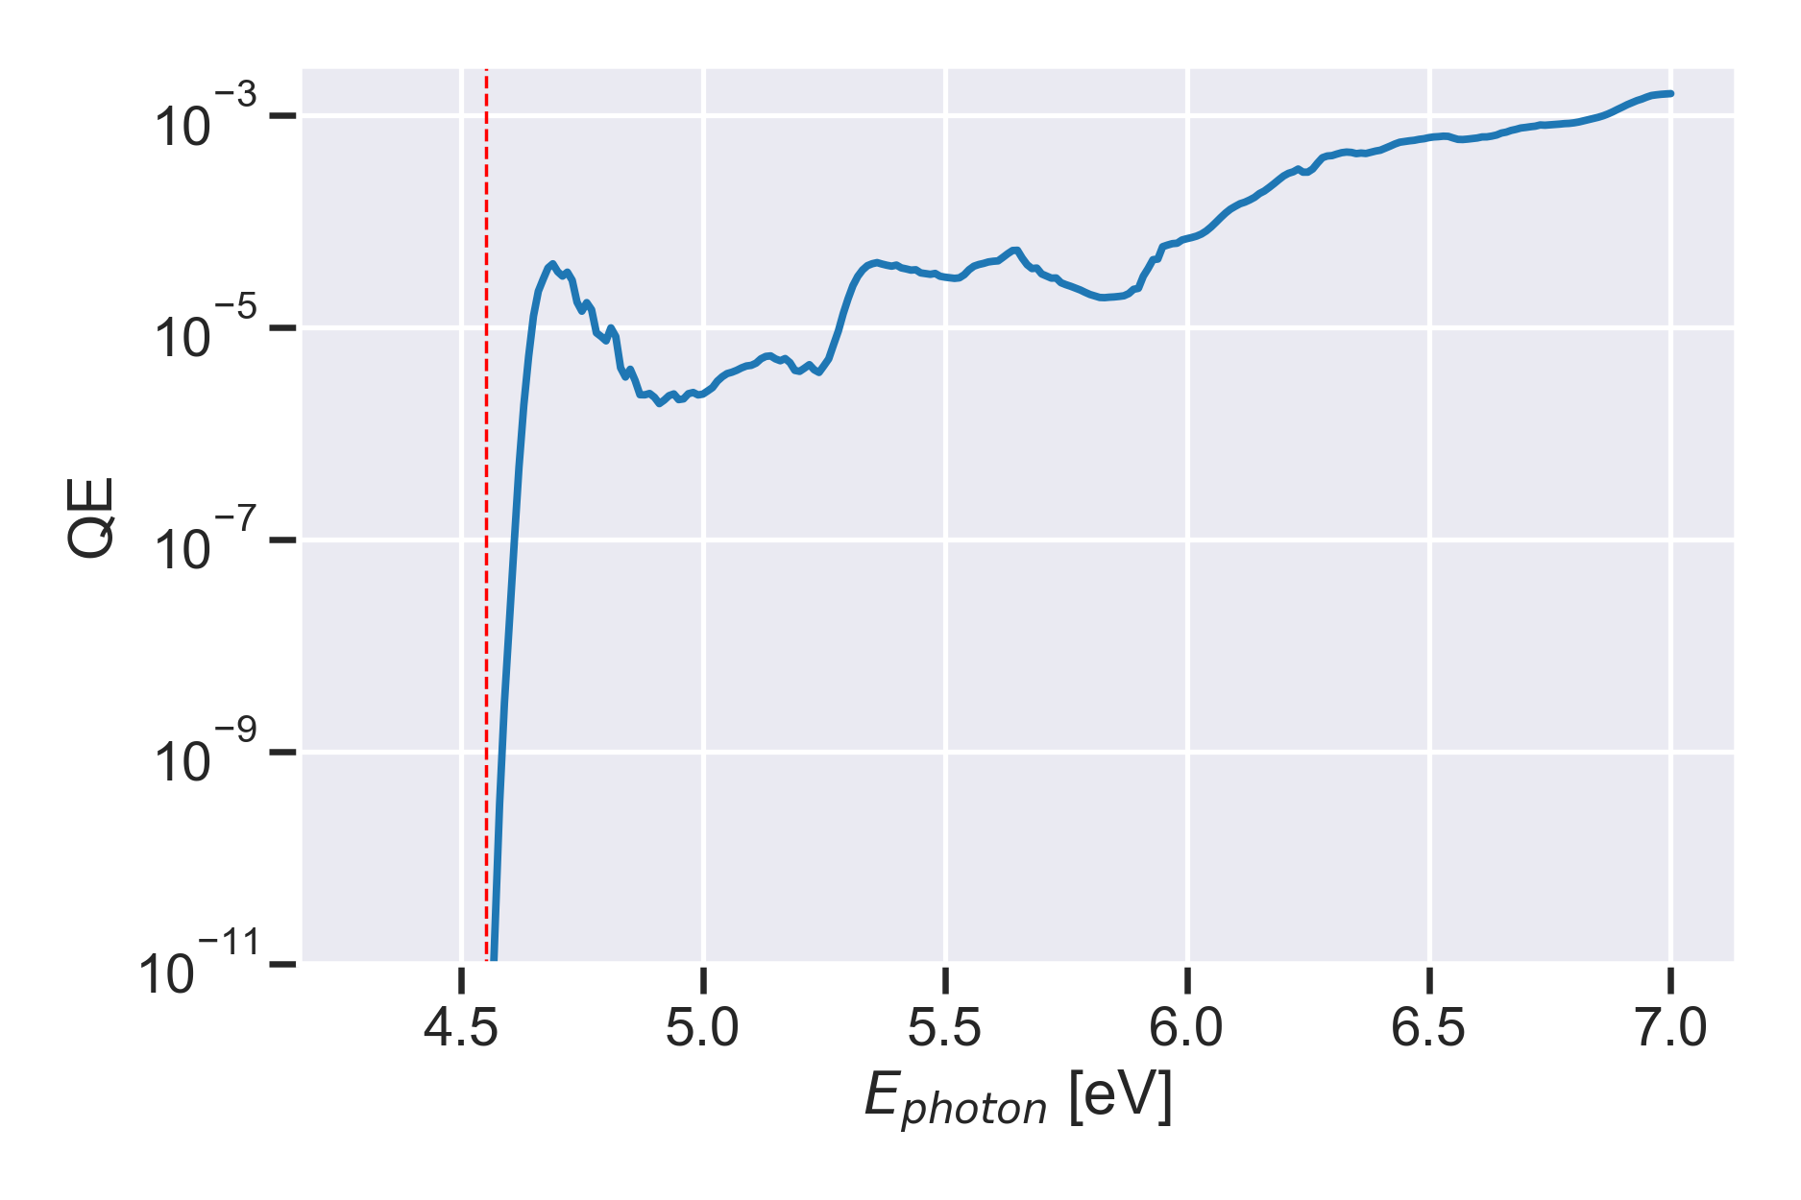
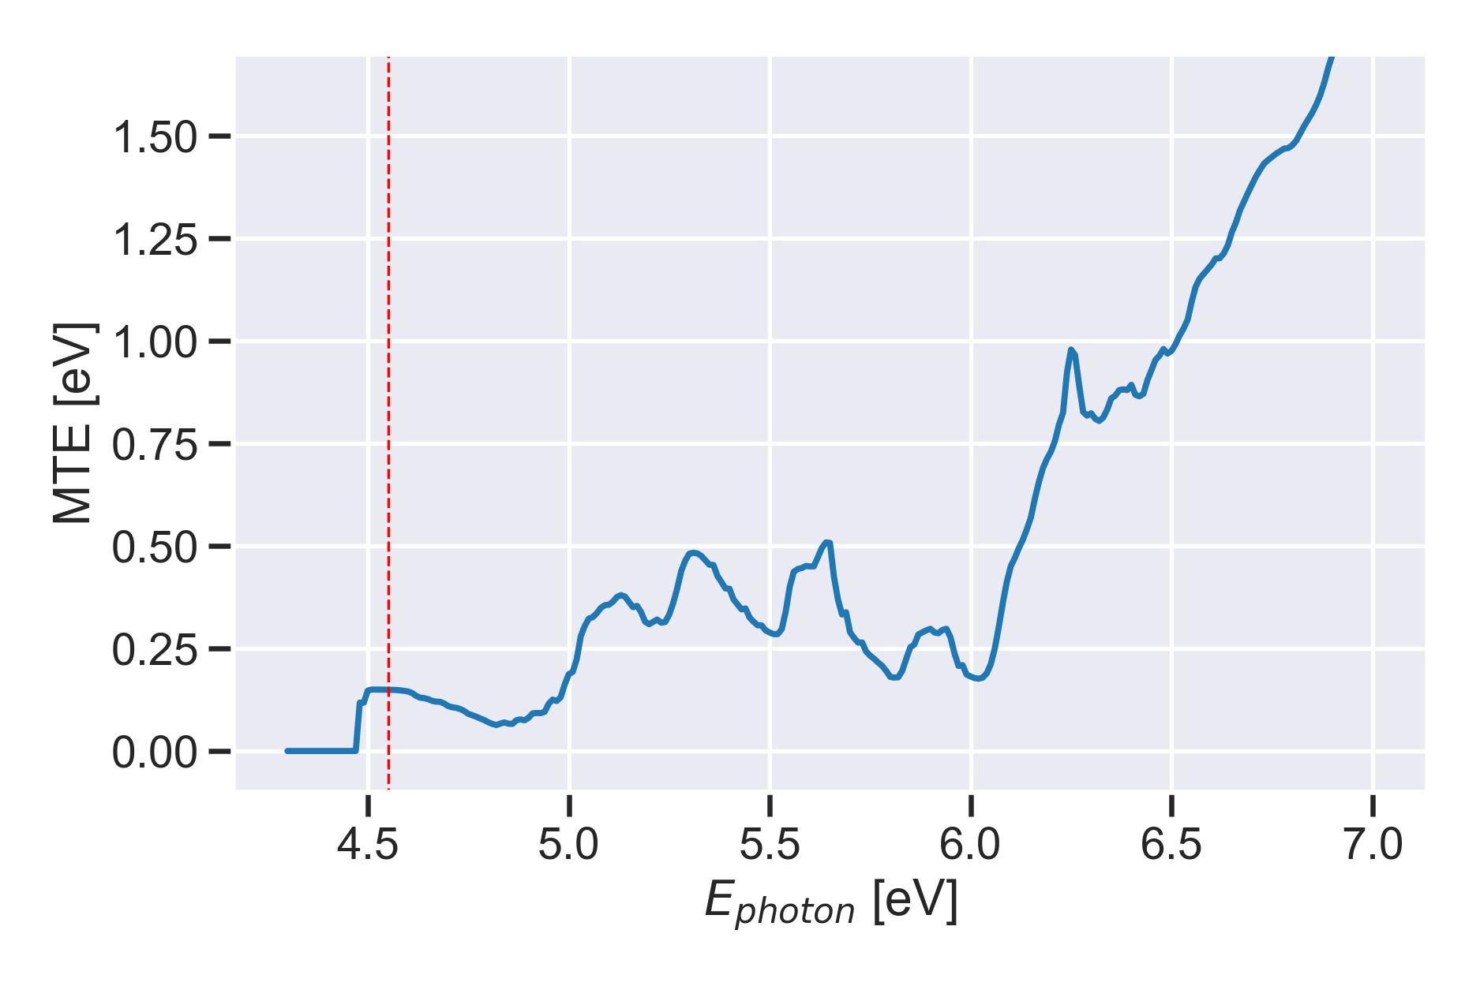
The Good
Detailed Contributions from Slab Layers
+---------------------- Bulk Approximation Slab Info ------------------------+
+ Number Bulk layers = 105 +
+ Vol. per layer = 11.2266 +
+ Total Volume = 1178.7943 +
+---- P_esc values for an electron with E = E_fermi and E_transverse = 0 ----+
+ Layer # 1 I_light = 0.529986E+00 P_esc = 0.469286E+00 +
+ Layer # 2 I_light = 0.517459E+00 P_esc = 0.426847E+00 +
+ Layer # 3 I_light = 0.499221E+00 P_esc = 0.388246E+00 +
+ ...... +
+ Layer # 103 I_light = 0.811068E-28 P_esc = 0.296874E-04 +
+ Layer # 104 I_light = 0.233806E-28 P_esc = 0.270026E-04 +
+ Layer # 105 I_light = 0.665977E-29 P_esc = 0.245607E-04 +
+----------------------------------------------------------------------------+
+----------------------------------------------------------------------------+ | Work Function 4.5519 eV Photon Energy 5.6600 eV | | Effective Work Function 4.5519 eV Electric Field 0.0000 V/A | | Final State : Bloch State | +----------------------------------------------------------------------------+ | Atom | Atom Order | Layer | Quantum Efficiency | | Cu 1 1 0.1181845906536724E-004 | | Cu 2 2 0.1663074525614247E-005 | | Cu 3 3 0.4194841801380124E-005 | | Cu 4 4 0.5232538050559572E-005 | | Cu 5 5 0.2940584626806248E-005 | | Cu 6 6 0.2580269949778397E-005 | | Cu 7 7 0.3055495698118412E-005 | | Cu 8 8 0.2217314887108183E-005 | | Bulk 0.1136553840413117E-004 | | Total Quantum Efficiency (electrons/photon): 0.4506811700886359E-004 | | Weighted Mean Transverse Energy (eV): 0.4243355184389246E+000 | +----------------------------------------------------------------------------+

Slide 7
The Good – cont.
Detailed Contributions from Bands and K-points

Slide 8
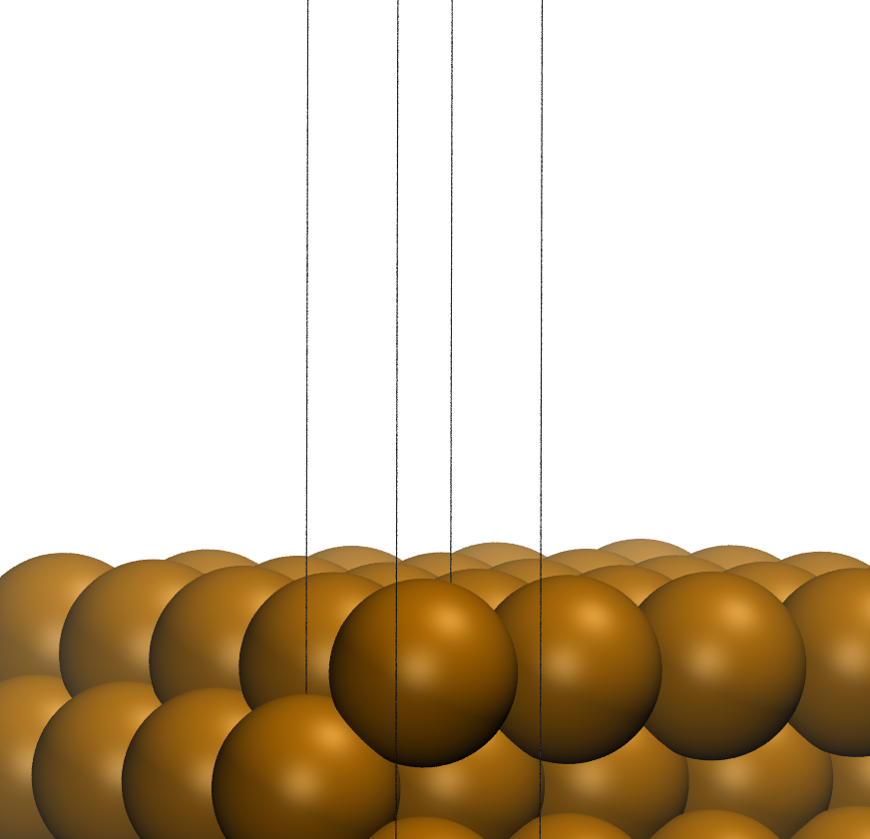
The Bad
Adapting a code made for bulk phase to slab geometries
$\frac{1}{V_{cell}}$ dependence -> bad reference for slab
Cu(100) – 16 layers

Slide 9
The Bad
Adapting a code made for bulk phase to slab geometries
Solved!
Cu(100) – 16 layers

Slide 10
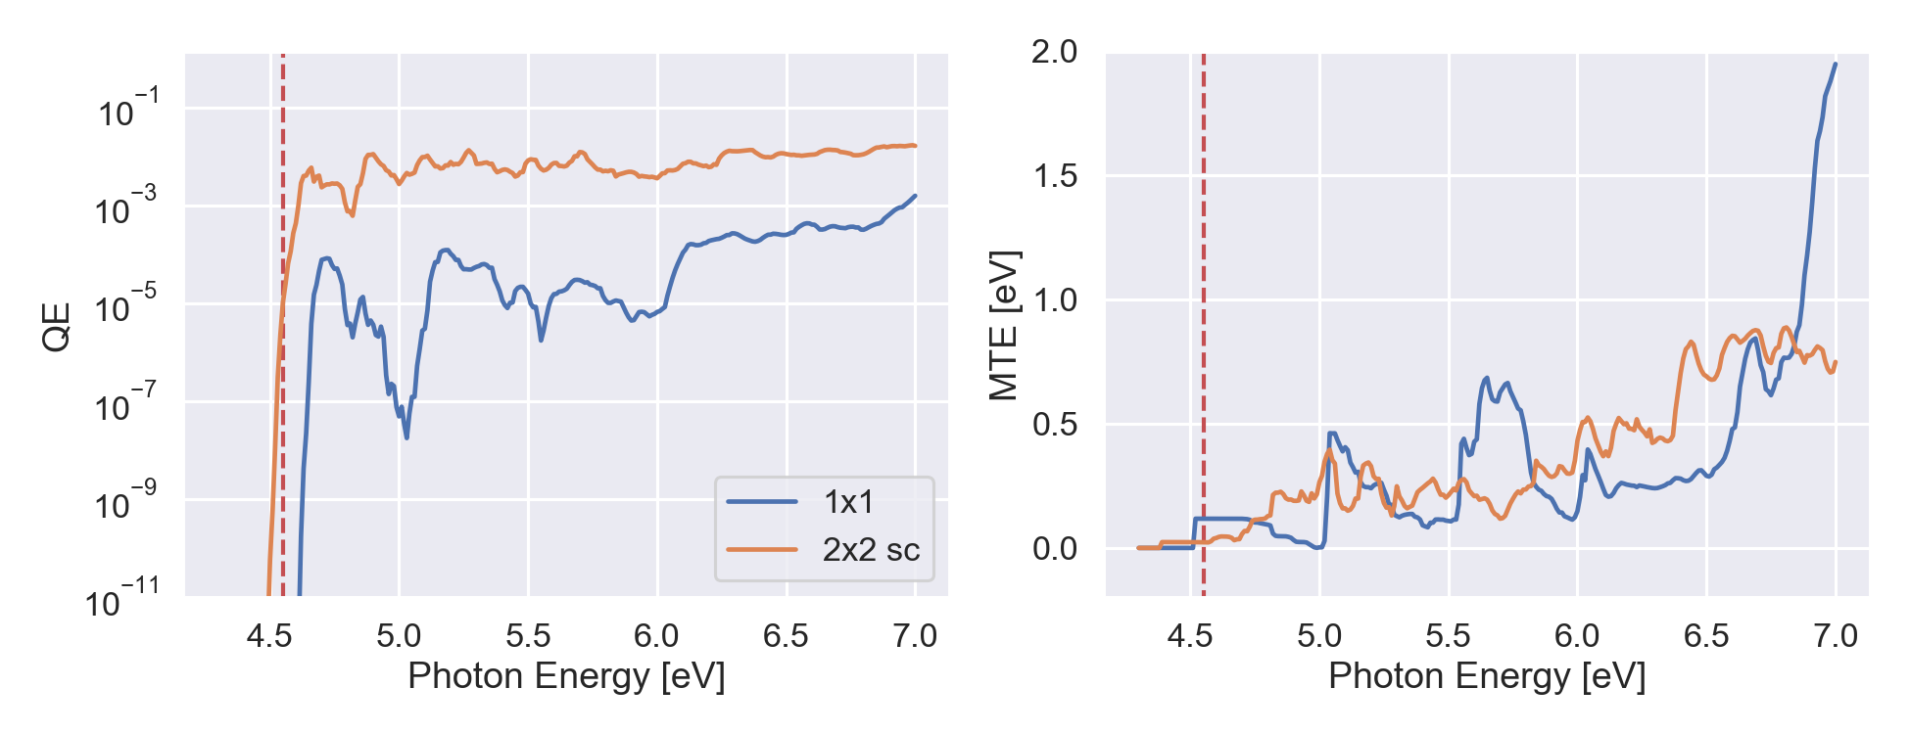
The Bad
Calculating Photoresponse of Supercells
possible application:
defective surfaces
pristine Cu(100) surface

Slide 11
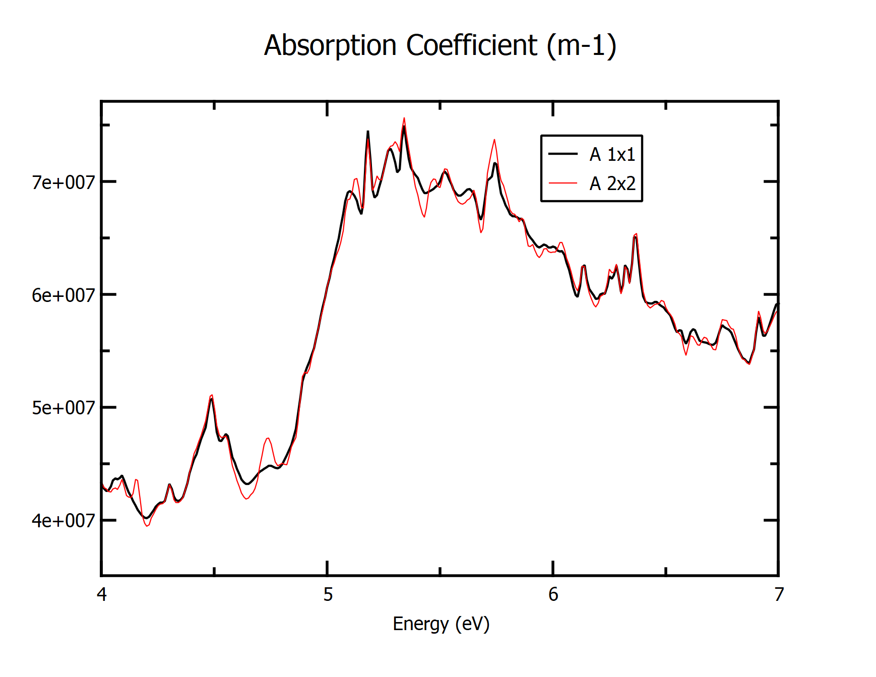
The Bad
Photoresponse of Supercells
primitive cell
supercell
pristine Cu(100) surface
possible solution: “unfolding” the bands
What is the right reference to unfold to?
Would different reference systems give equal answers?
We also need to unfold the excitation probabilities $Γ_{i→f}$
need to write this piece of software, too
Others?
$$E_{transverse}=\frac{ℏ^{2}\left(k_{x}^{2}+k_{y}^{2}\right)}{2m_{e}}$$

Slide 12
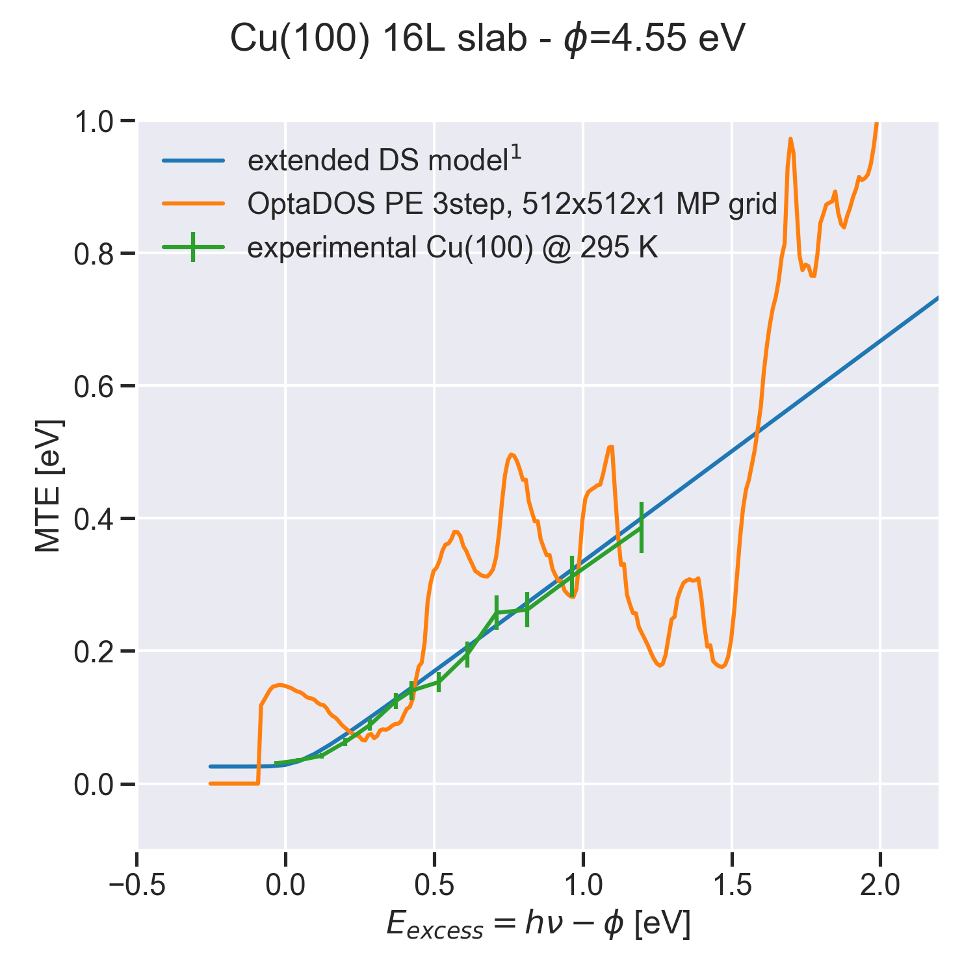
The Interesting
Quantum Efficiency (QE) and Mean Transverse Energy (MTE)
OptaDOS MTE, weighted sum
$$\text{MTE}\text{ (}\text{E}\text{)}= \sum_{K}{\frac{E_{trans}(K)QE(K)}{\sum_{K}{QE(K)}}}$$
ext. DS Model¹ MTE
MTE (E) = $f(E_{excess})$
$$E_{excess}=hν−φ$$
1. T. Vecchione, D. H. Dowell, W. Wan, J. Feng and H. A. Padmore, New York, 2013.

Slide 13
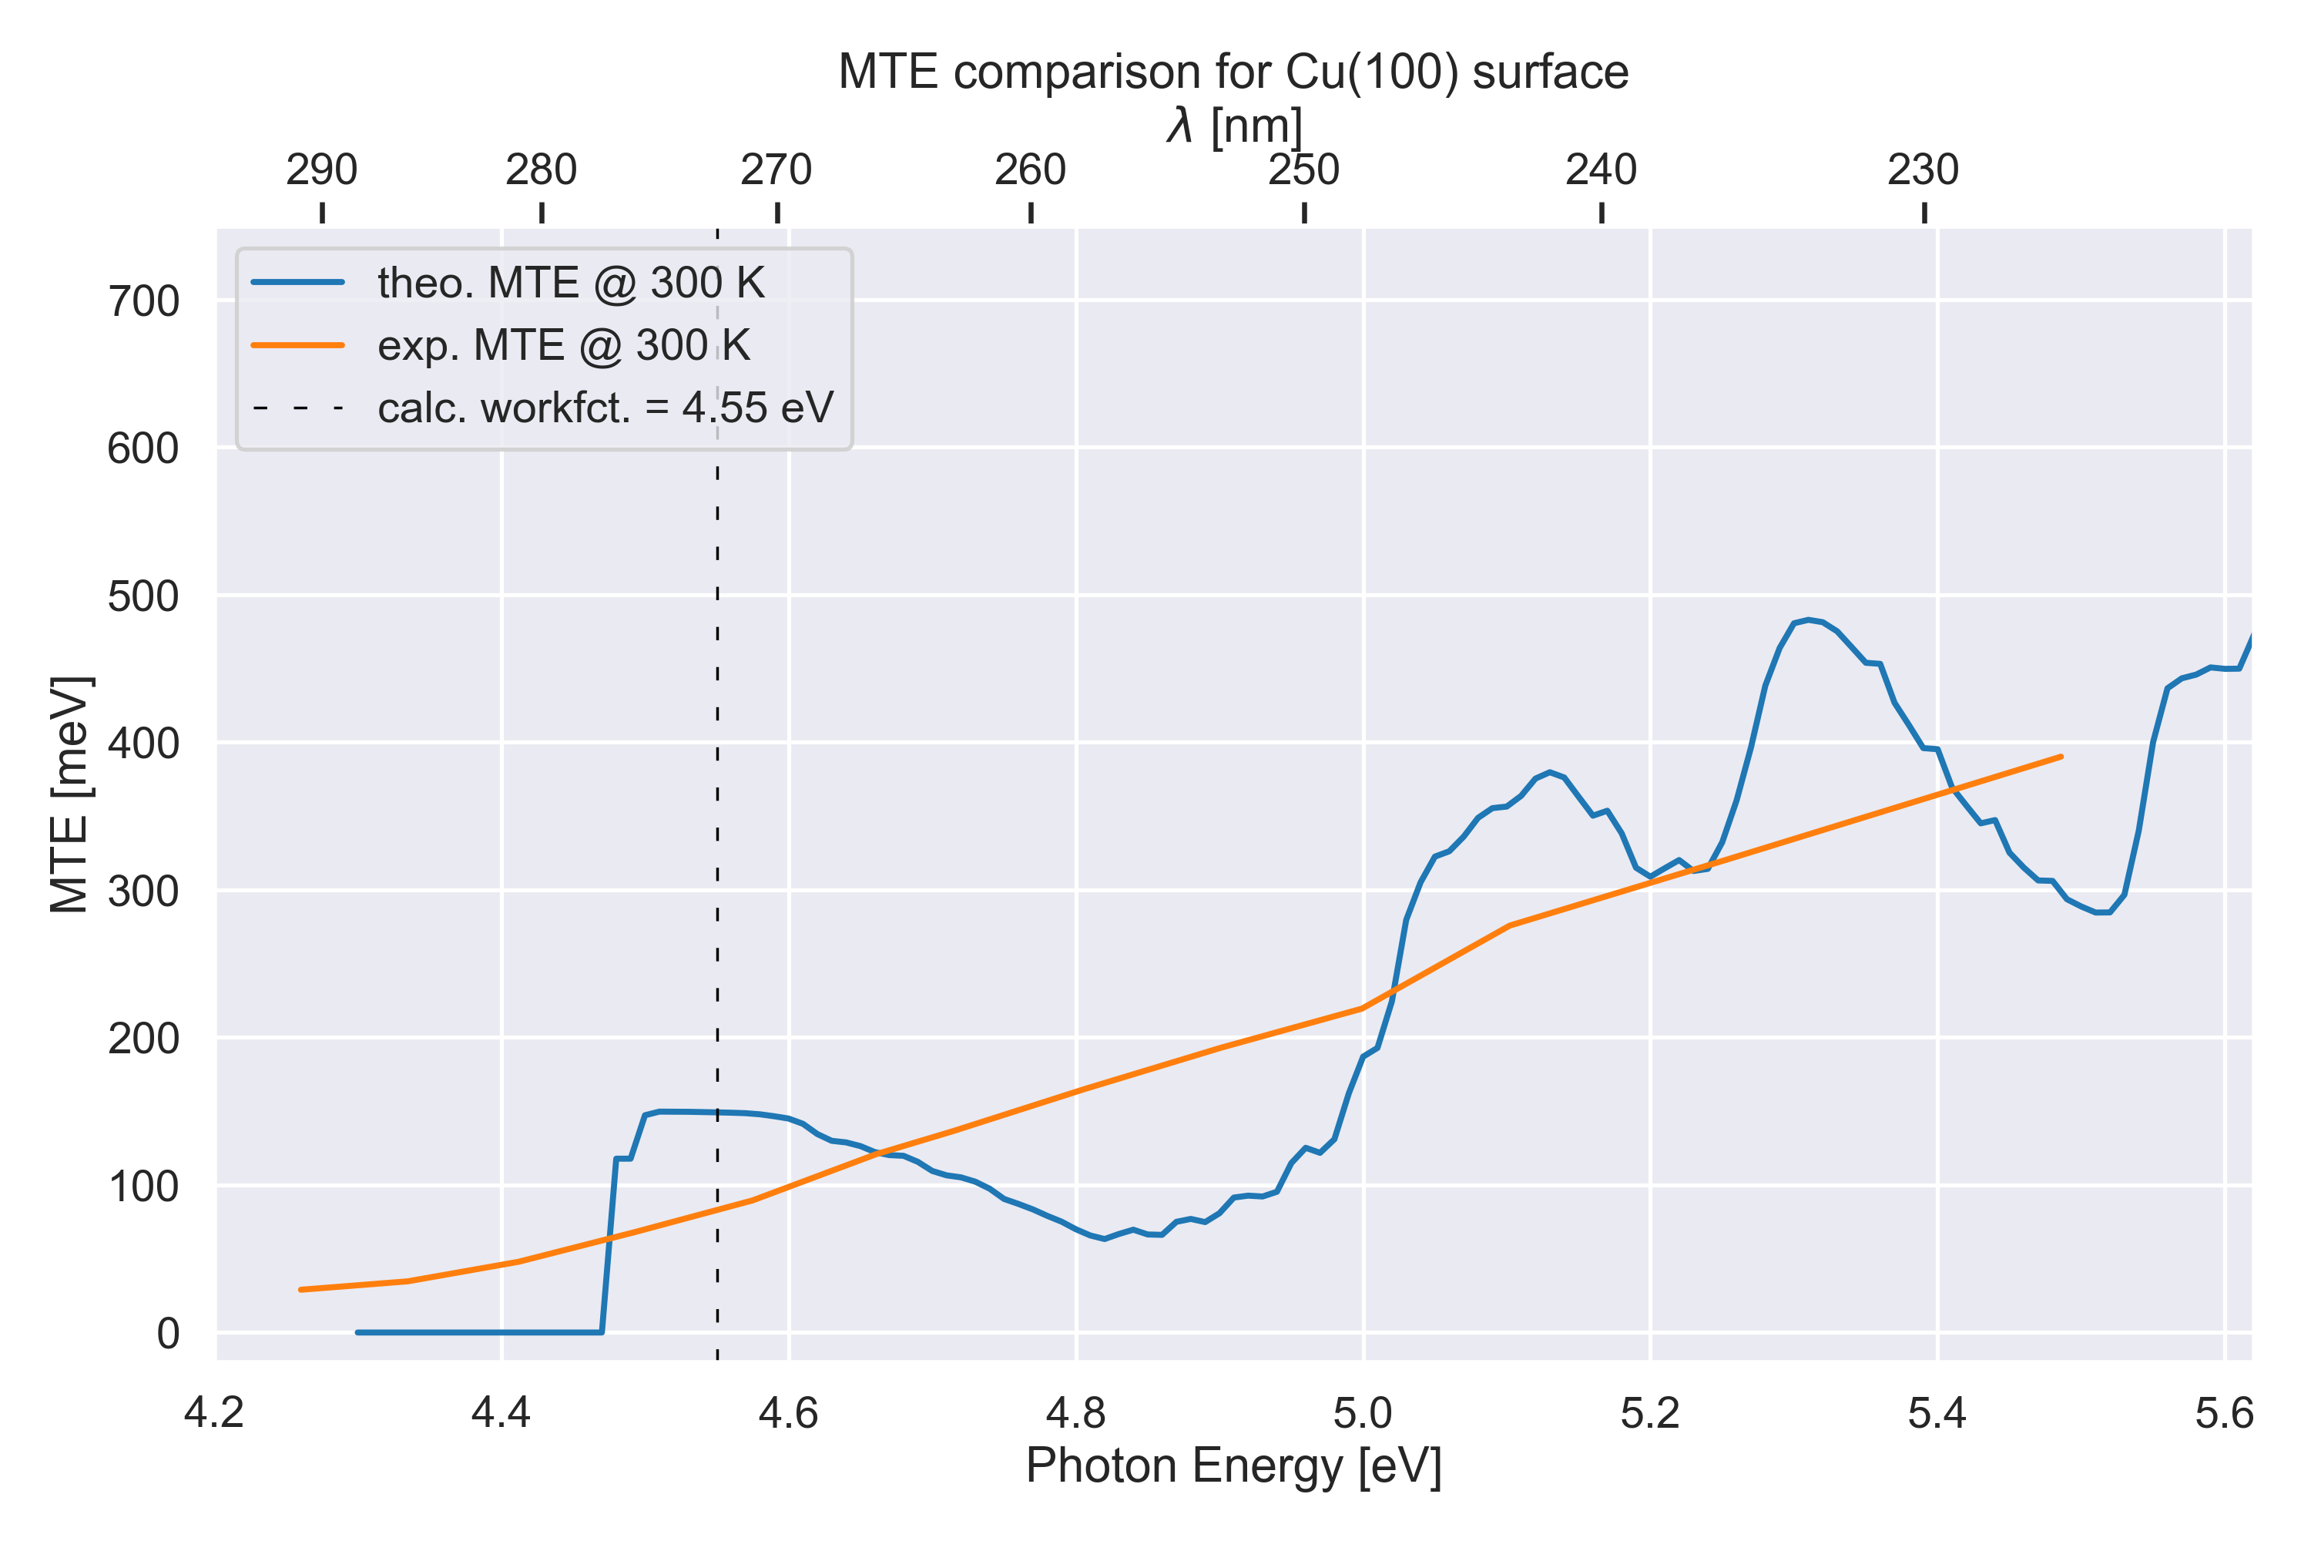
The Interesting
Comparison to Experimental Data

Slide 14
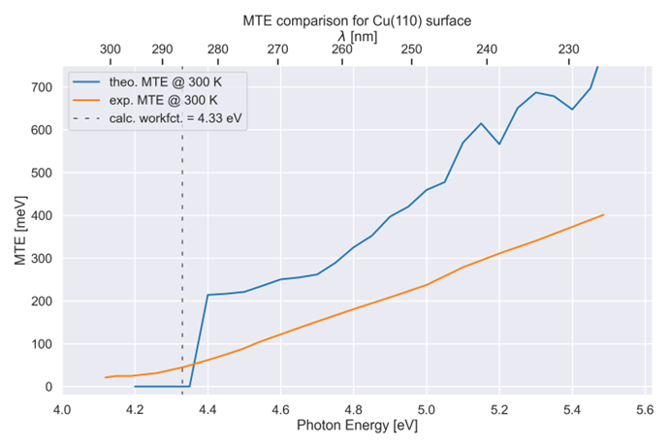
The Interesting
Comparison to Experimental Data

Slide 15
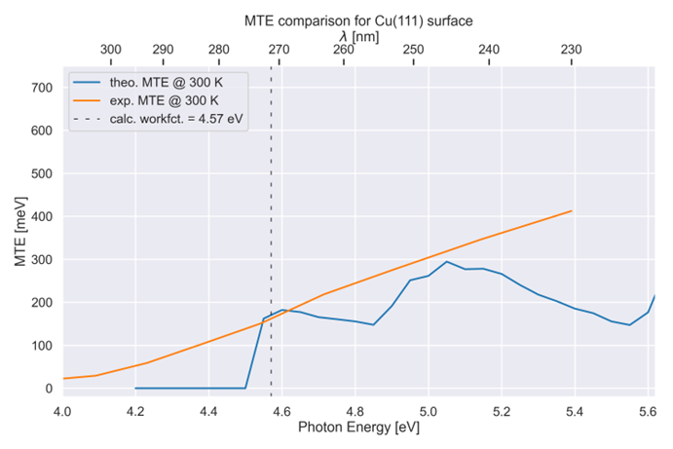
The Interesting
Comparison to Experimental Data

Slide 16
Summary + Future Work
OptaDOS Photoemission
K-resolved modelling of Photoemission
Very detailed analyses of contributions possible
currently working on:
supercell representation
weighted MTE calculation
Future work:
Adding other models into the code (e.g. P. Saha, et al^{.1}).
Add support for other DFT codes (Crystal, CP2K etc.).
1. P. Saha, O. Chubenko, J. Kevin Nangoi, T. Arias, E. Montgomery, S. Poddar, H. A. Padmore and S. Karkare, Journal of Applied Physics, 2023, 133.

Slide 17
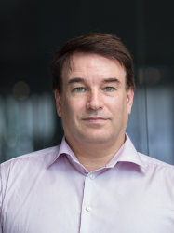
Acknowledgements
Dr Victor Chang Lee
Prof Nicholas Harrison
and the other members of the
Computational Materials Science Group
CDT in ‘Advanced
Characterisation of Materials’
Dr Tim Noakes, Dr Lee Jones,
Chris Benjamin, Hugh Churn
Dr Bruno Camino

Slide 18
Thank you
OptaDOS Photoemission – The Good, The Bad and The Interesting
18/09/2024

Slide 19
Cu(110) 16L slab
MTE near Threshold

Slide 20
Cu(110) 16L slab
MTE near Threshold

Slide 21
Cu(110) 16L slab
MTE near Threshold

Slide 22
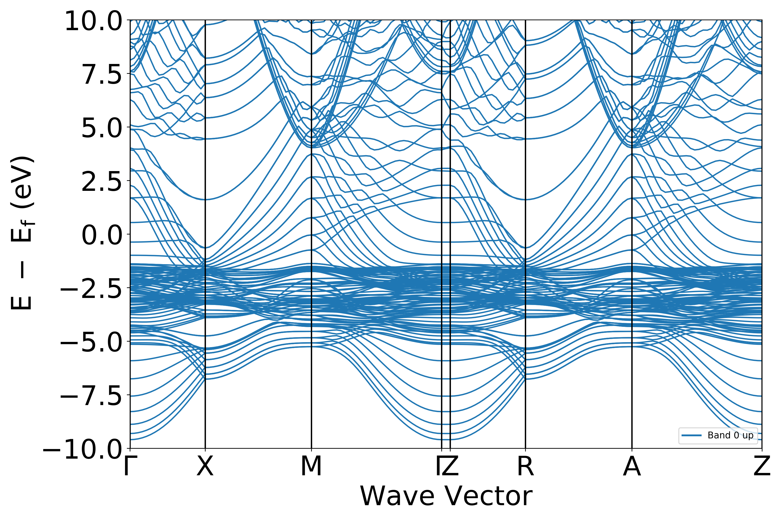
Cu(110) 16 layer slab

Slide 23
Cu(110) 16 layer slab

Slide 24
Cu(100) 16L slab
MTE near Threshold

Slide 25
Cu(100) 16L slab
MTE near Threshold

Slide 26
Cu(100) 16L slab
MTE near Threshold

