Slide 1
Development of Multialkali antimonides photocathodes for high-brightness photoinjectors
Event: EWPAA 2024 Photocathode Workshop, 17-19 September 2024, Dresden, Germany
Speaker:
Sandeep Kumar Mohanty
Co-authors:
M. Krasilnikov, A. Oppelt, F. Stephan
DESY, Zeuthen, Germany
D. Sertore, L. Monaco
INFN LASA, Segrate, Italy
Contents:
Introduction & Motivation
Second batch of Green cathodes
Photocathode Characterization
Photocathode Recipes
Preliminary Results of the Second Batch of Green Cathodes
Summary & Future plan
EWPAA 2024 Photocathode Workshop, September 17-19, 2023

Slide 2
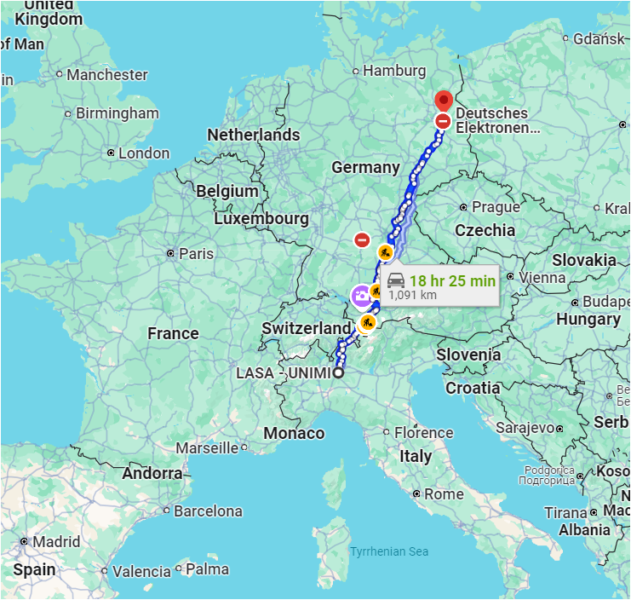
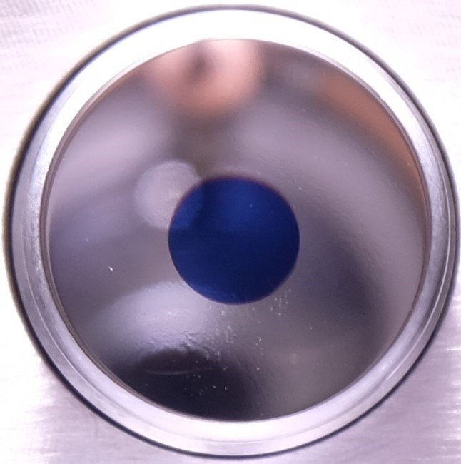
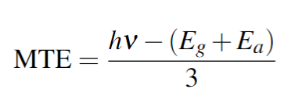
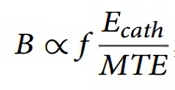
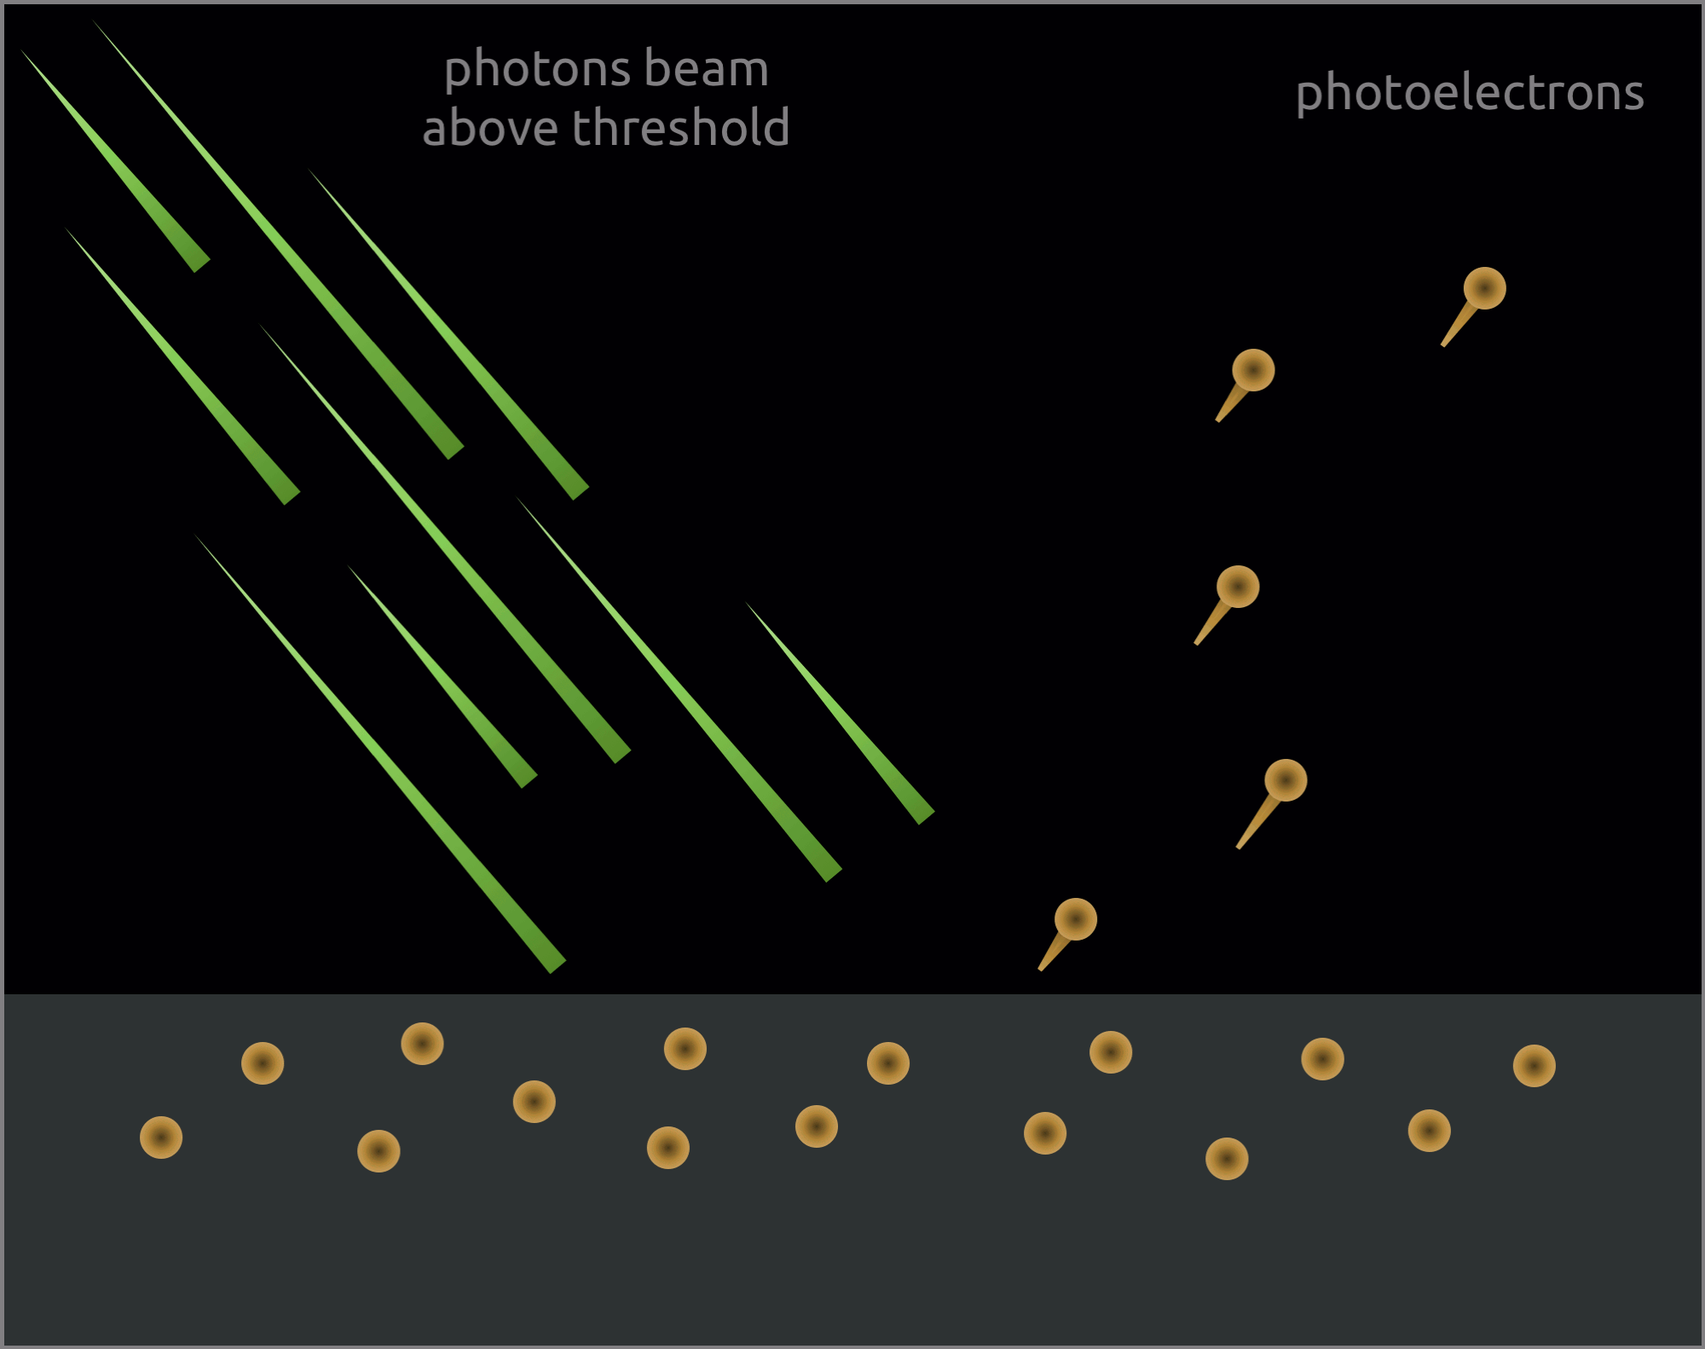
Introduction & Motivation
Why multi-alkali photocathode?
Higher QE compared to metal photocathodes
Comparable quantum efficiency to UV-sensitive Cs₂Te
Photoemission sensitivity in the green wavelength
Lower mean transverse energy (MTE) of photoelectrons
Examples: K₂CsSb, Na₂KSb(Cs), Cs₃Sb
(515 nm)
KCsSb film
Photon energy
Photoemission threshold
Less excess energy
Mo
Emittance
Brightness
Key advantages:
Low thermal emittance (0.5-0.6 µm/mm)
No UV conversion for cathode laser
Increase laser efficiency, and reduce optic damage in the UV wavelength
Alkali based Photocathodes (K₂CsSb, Na₂KSb, Cs₃Sb,….) have shown great potential in low gradient guns (<20 MV/m)
Cornell DC gun, BNL SRF gun
>1 % QE at green wavelengths, 0.5 - 0.6 mm.mrad/mm thermal emittance
High average current
hν
2.4 eV (515 nm)
DESY collaborates with INFN LASA to explore multi-alkali photocathode (K₂CsSb, Na₂KSb,…) performance in high-gradient guns
INFN LASA, Italy, develops cathode recipe and production
Photoinjector test facility at DESY Zeuthen site (PITZ) tests cathodes in a high-gradient RF gun.
Less energized electrons
In 2021, the first batch of KCsSb photocathodes showed high QE (4-8%), low thermal emittance (0.6 mm.mrad/mm), and fast response time (<100 fs), but had high dark current and a short lifetime (~48 hours).
$E_{g}+E_{a}$ ~ 2 eV

Slide 3
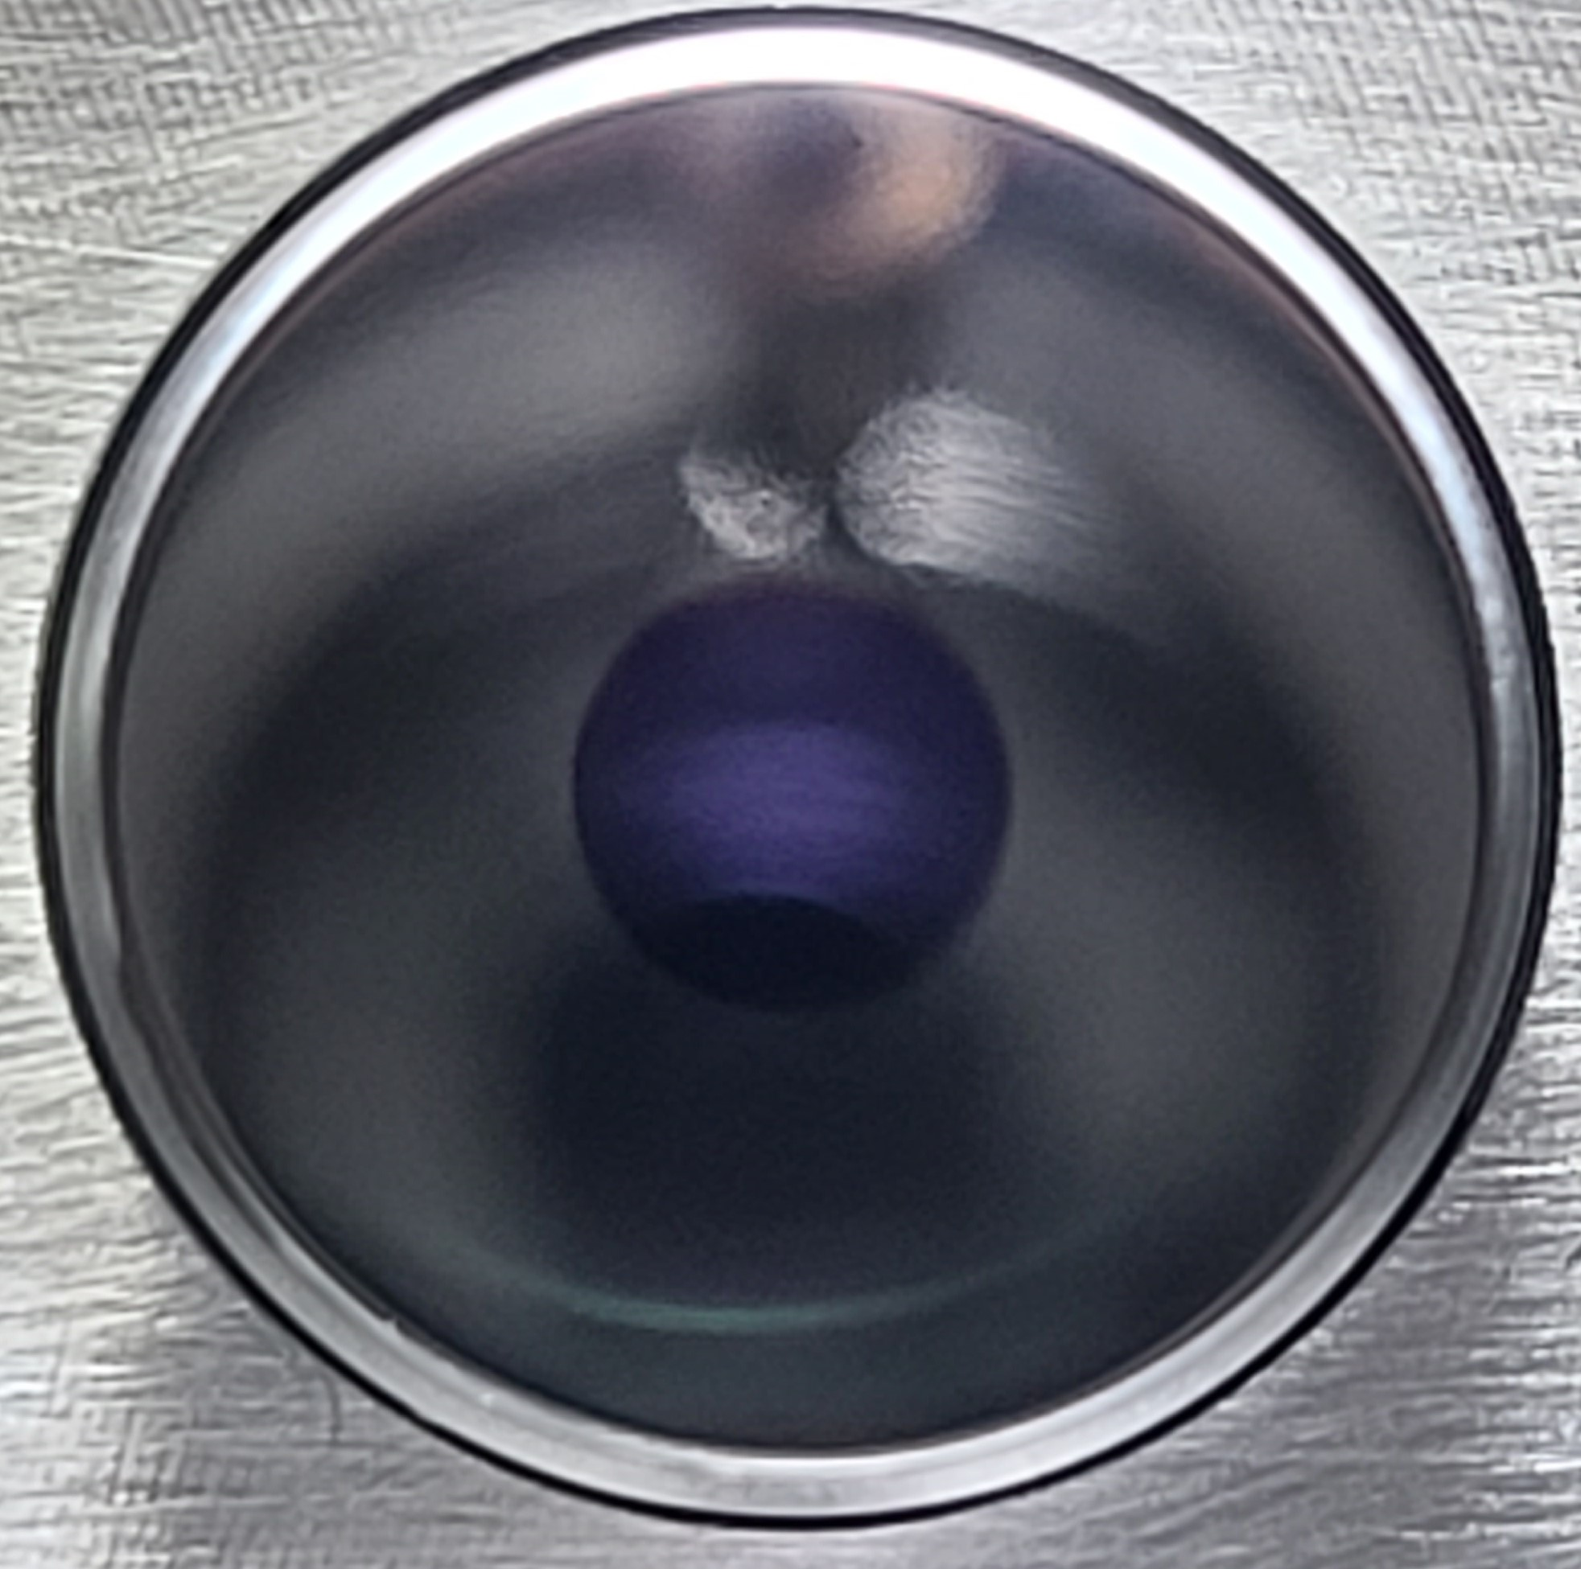
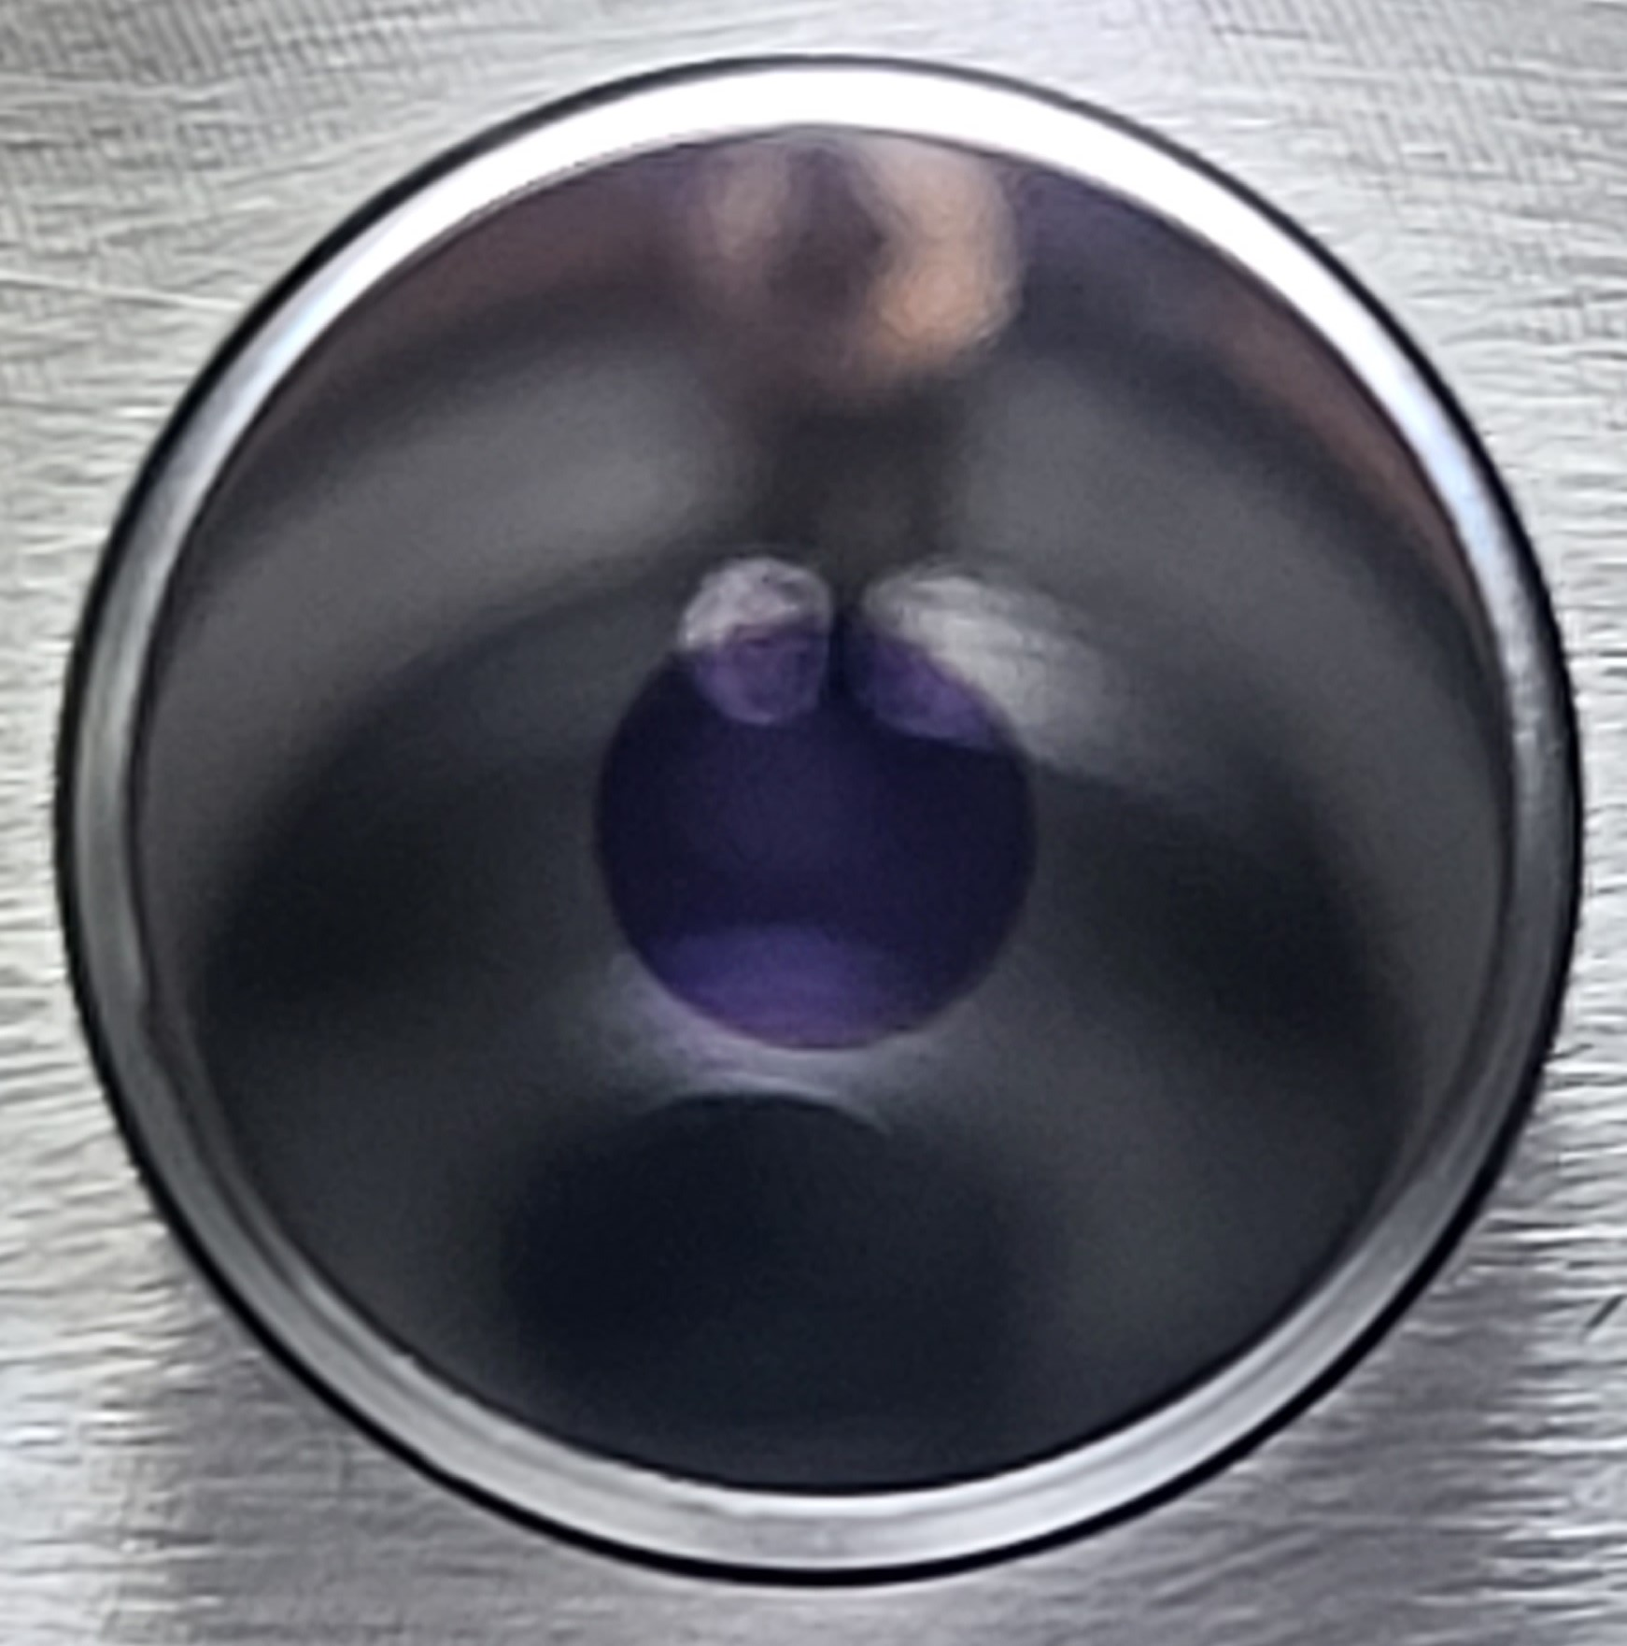
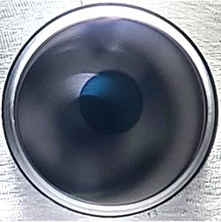
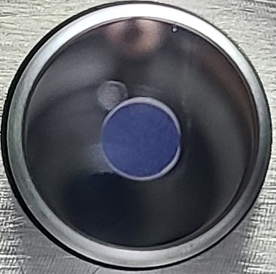
Second batch of Green cathodes
Preparation
To overcome the drawbacks of the 2021 batched cathode, we improved the cathode recipe. In June 2024, we produced 3 KCsSb cathodes and 1 NaKSb(Cs) cathode.
3 KCsSb cathodes have been produced with sequential deposition with QE @514 nm recorded 8-9.6 %.
Out of these, 1 KCsSb thin multi-layer cathode (cathode 99.1), 1 modified KCsSb thin cathode* (cathode 124.1, Sb = 5 nm), and 1 modified KCsSb thick cathode* (cathode 128.1, Sb = 10 nm) were produced.
1 NaKSb(Cs) cathode (cathode 131.1) has been produced through sequential deposition, achieving a QE of 0.006% at 514 nm.
For cathode 131.1 (NaKSb(Cs) cathode), a microbalance issue caused by contamination from the Na source led to incorrect deposition thickness, resulting in low QE.
99.1
124.1
128.1
131.1
Thin multi-layer
KCsSb
Thin
KCsSb
Thick
KCsSb
NaKSb(Cs)
*With a controlled K thickness

Slide 4
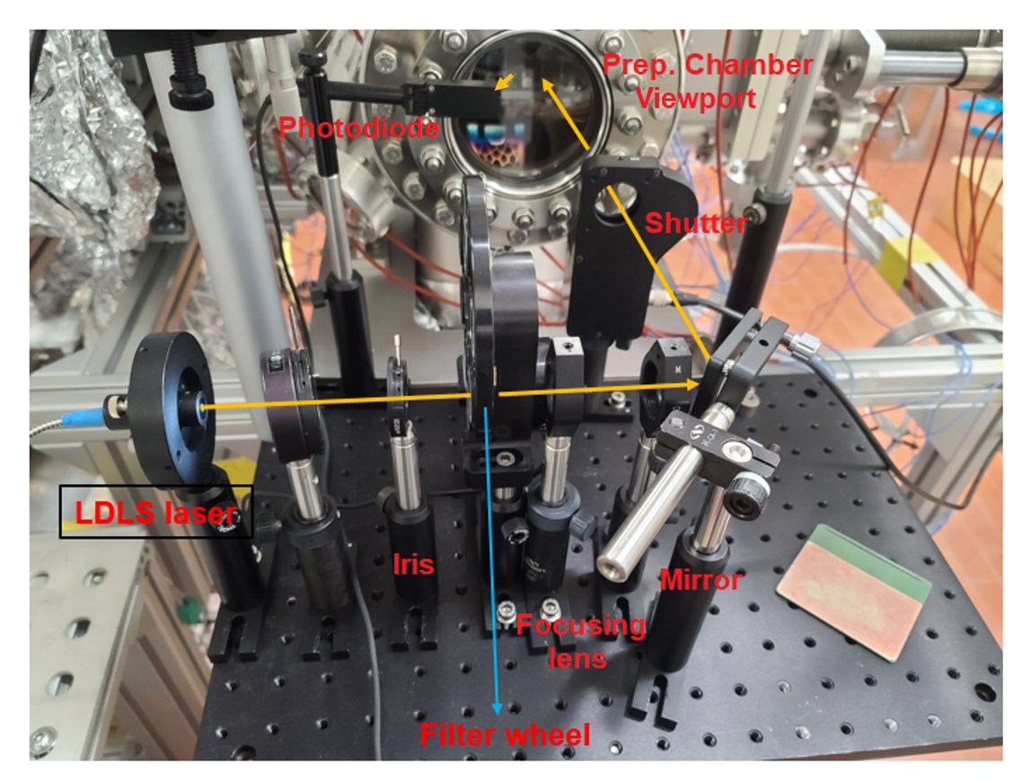
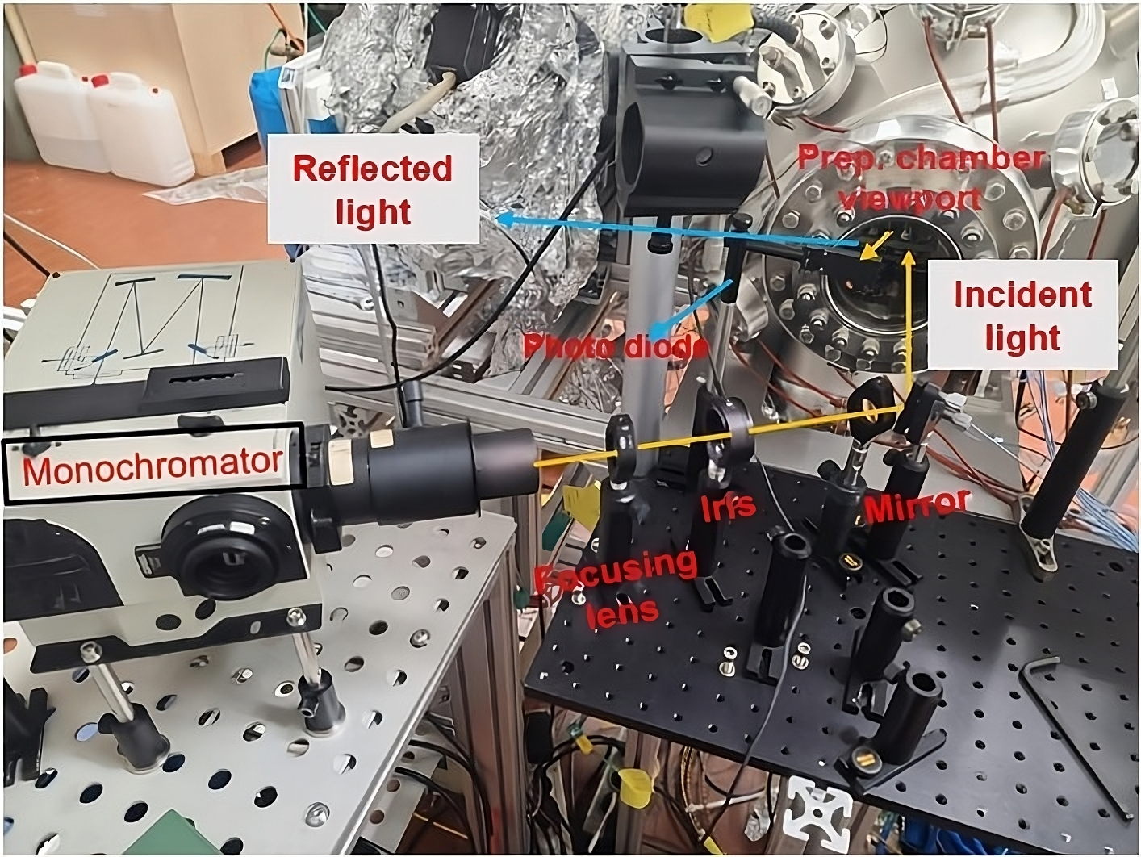
Photocathode Characterization
Characterization during deposition:
Multi-Wavelength Optical Diagnostics Setup
Real-time QE: 8 different λ (254 nm to 690 nm)
Real-time Reflectivity: 8 different λ (254 nm to 690 nm)
Light source: Laser-Driven Light Source (LDLS) with motorized filter wheel
Temperature
Thickness (via microbalance)
Vacuum quality
LDLS laser
Characterization after deposition:
Spectral response (from 297 nm to 1200 nm)
Spectral reflectivity ( from 297 nm to 1200 nm)
Light source: LDLS laser with a monochromator (170–1200 nm) or optical filters (239–690 nm).
Multi-Wavelength Optical Diagnostics Setup used during Deposition
Error Estimation:
$I_{net}$ = net Photocurrent
${\text{P}}_{\text{net}}$ = net light power
T = Transmittance of viewport material
Setups for spectral measurements used after deposition
Statistical errors are typically below 0.5%

Slide 5
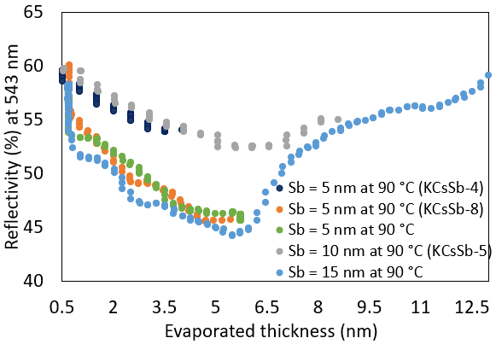
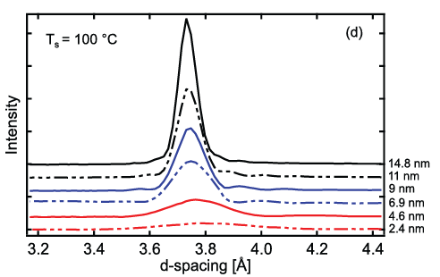
Second batch of Green cathodes (3 KCsSb cathodes)
Photocathode Recipes
KCsSb thin multi-layer (cathode 99.1) : (aim: multi-layer study)
Until QE reaches
maximum
QE = 0.04 %
@ 515 nm
Until QE reaches
maximum
QE = 4.4 %
@ 515 nm
Until QE reaches
maximum
QE = 1.9 %
@ 515 nm
Until QE reaches
maximum
QE = 9.6 %
@ 515 nm
Sb
K
KSb
(1st)
Cs
KCsSb
(1st layer)
Sb
K
KSb
(2nd)
Cs
KCsSb
(2nd layer)
~ 3 nm Sb
(before fully crystallized)
~3 nm Sb
(before fully crystallized)
KCsSb
(2nd layer)
Previous XRD findings [1]
KCsSb
(1st layer)
XRD spectra
during Sb
Mo
Sb
Real-time reflectivity (@ 543 nm) during Sb deposition
Crystallization of Sb typically begins around 4-6 nm.
Sb deposition was stopped at 3 nm to avoid crystallization.
AFM studies show that alkali metal diffusion into crystalline Sb can cause stress and structural changes, increasing roughness and leading to nano-pillar formation [2].
1] S. Schubert, J., Wong, J. Feng, S. Karkare, et al., “Bialkali antimonide photocathode growth: An X-ray diffraction study”, Journal of Applied Physics, vol. 120, no. 3, Jul. 2016. doi:10.1063/1.4959218
2] S. Schubert, M. Ruiz-Osés, et al., “Bi-alkali antimonide photocathodes for high brightness accelerators,” APL Materials,vol. 1, no. 3, AIP Publishing, Sep. 2013.doi:10.1063/1.4821625.

Slide 6
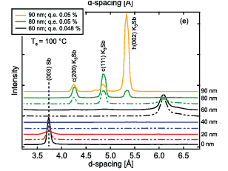
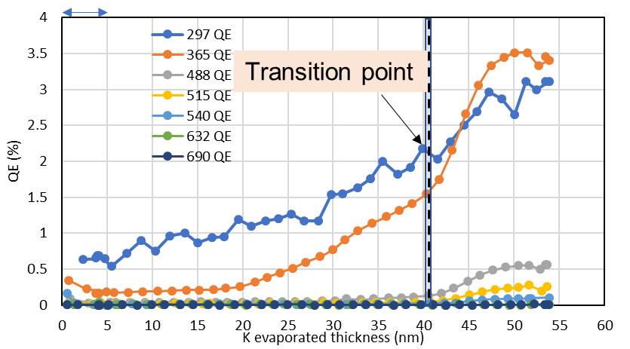
Second batch of Green cathodes
Previous XRD findings of KSb compound [3]
Photocathode Recipes
KCsSb thin multi-layer (cathode 99.1) : (aim: multi-layer study)
Modified KCsSb thin (cathode 124.1): (aim: make KCsSb structure mostly cubic type) Improve stability
K₃Sb (Hexa.)
QE = 0.15 %
@ 515 nm
Until QE reaches
maximum
QE = 8.7 %
@ 515 nm
K₃Sb (Cubic)
Until transition point
Sb
K
KSb
Cs
KCsSb
5 nm Sb
Sb Deposition: 5 nm deposited at a rate of 1 nm/min.
K Deposition: Continued until thickness reached ~36 nm
Thickness was chosen based on the transition point, when KSb shifts from amorphous to crystalline phase [1,2].
Deposition stopped at the transition point to maintain a cubic form of KSb.
Previous XRD confirms Cs reacts effectively with cubic KSb, forming predominantly cubic KCsSb [3].
Cs Deposition: Continued until photocurrent approached saturation level.
Sb
K
Standard Thin cathode
K deposition until QE max.
Stop K deposition
1] M. Ruiz-Osés, S. Schubert, K. Attenkofer, I. Ben-Zvi, et al.,“Direct observation of bi-alkali antimonide photocathodes growth via in operando x-ray diffraction studies”, APL Materials, vol. 2, no. 12, Dec. 2014. doi:10.1063/1.4902544
2] S. K. Mohanty, et al., “Development and Characterization of Multi-Alkali Antimonide Photocathodes for High-Brightness RF Photoinjectors,” Micromachines, vol. 14, no. 6, pp. 1182, May 2023. doi:10.3390/mi14061182.
3] S. Schubert et al., “Influence of growth method on K3Sb photocathode structure and performance”, Proc. IPAC’14, Dresden, Germany, Jun. 2014, pp. 624–626. doi:10.18429/JACoW-IPAC2014-MOPRI018

Slide 7
Second batch of Green cathodes
Photocathode Recipes
KCsSb thin multi-layer (cathode 99.1) : (aim: multi-layer study)
Modified KCsSb thin (cathode 124.1): (aim: make KCsSb structure mostly cubic type)
Modified KCsSb thick (cathode 128.1): (aim: make KCsSb structure mostly cubic type) Improve stability
QE = 0.18 %
@ 515 nm
Until QE reaches
maximum
QE = 8.1 %
@ 515 nm
Until transition point
Sb
K
KSb
Cs
KCsSb
10 nm Sb
Sb Deposition: 10 nm deposited at a rate of 1 nm/min.
K Deposition: Continued until thickness reached ~36 nm
Thickness was chosen based on the transition point, when KSb shifts from amorphous to crystalline phase [1,2].
Deposition stopped at the transition point to maintain a cubic form of KSb.
Previous XRD confirms Cs reacts effectively with cubic KSb, forming predominantly cubic KCsSb [3].
Cs Deposition: Continued until photocurrent approached saturation level.
1] M. Ruiz-Osés, S. Schubert, K. Attenkofer, I. Ben-Zvi, et al.,“Direct observation of bi-alkali antimonide photocathodes growth via in operando x-ray diffraction studies”, APL Materials, vol. 2, no. 12, Dec. 2014. doi:10.1063/1.4902544
2] S. K. Mohanty, M. Krasilnikov, A. Oppelt, F. Stephan, D.Sertore, et al., “Development and Characterization of Multi-Alkali Antimonide Photocathodes for High-Brightness RF Photoinjectors,” Micromachines, vol. 14, no. 6, pp. 1182, May 2023. doi:10.3390/mi14061182.

Slide 8
Preliminary Results of the Second Batch of Green Cathodes
KCsSb thin multi-layer (cathode 99.1) : (aim: multi-layer study)
Modified KCsSb thin (cathode 124.1): (aim: make KCsSb structure mostly cubic type)
Modified KCsSb thick (cathode 128.1): (aim: make KCsSb structure mostly cubic type)
Data analysis is ongoing

Slide 9
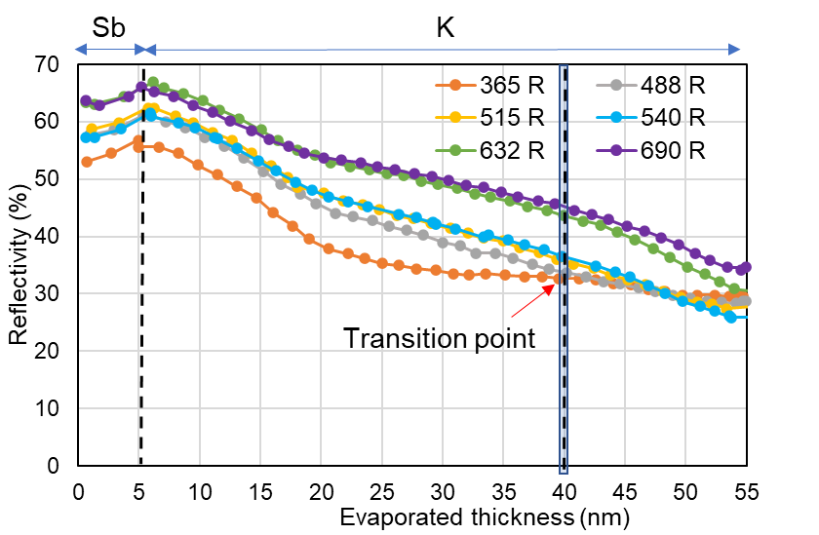
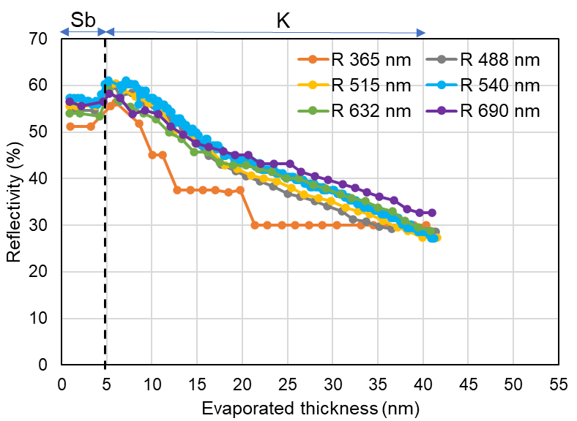
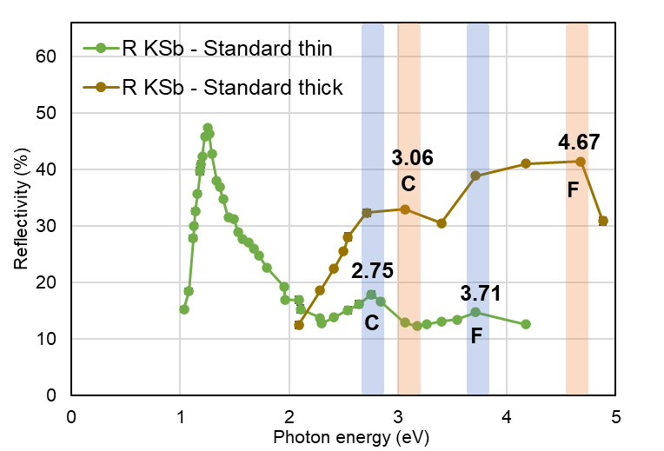
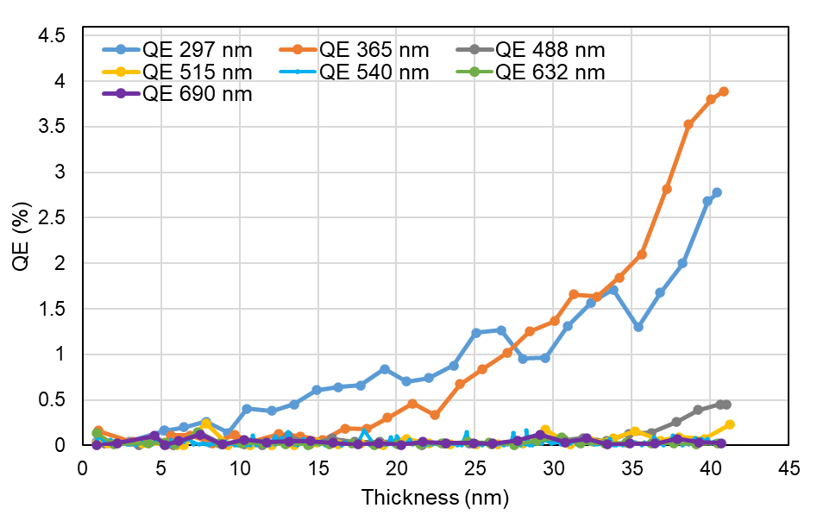
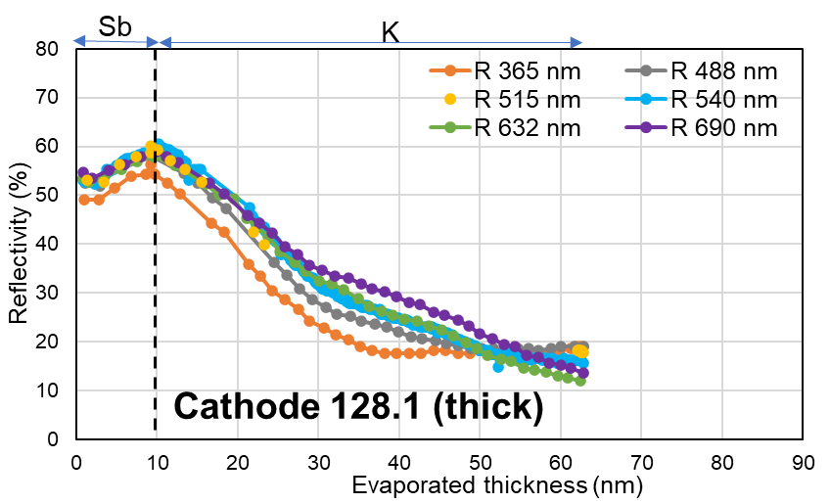
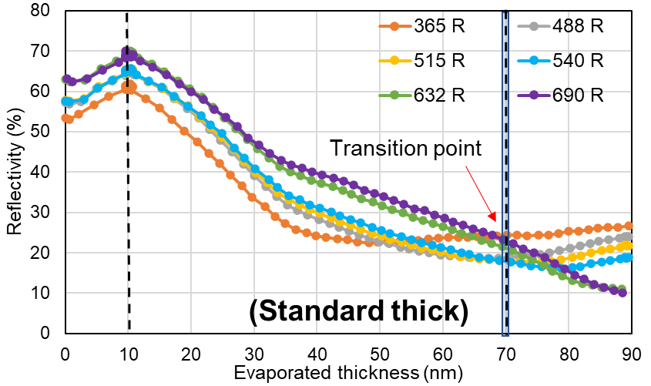
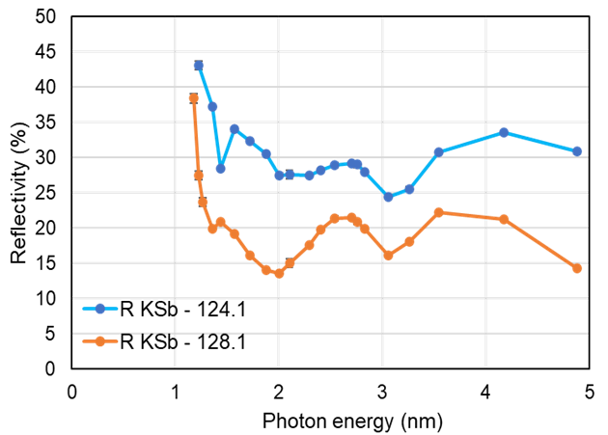
K-Sb Phase Results and Analysis
KCsSb Thin & Thick Cathodes (Cathode 124.1 and 128.1)
Standard Cathodes
(K deposition until QE maximum)
Modified Cathodes
(K deposition until transition point)
Comparison of
Spectral Reflectivity
Standard thin and thick cathodes
5 nm
Thick
(Standard thin)
Cathode 124.1 (modified thin)
Thin
Stop K deposition
Fingerprint of electronic structure!
Modified Thick and Thin Cathodes
C
2.7
F
3.9
10 nm
(Standard thick)
- thin
Cathode 128.1 (modified thick)
- thick
Real-time reflectivity
Real-time reflectivity

Slide 10
Spectral Reflectivity Peaks: A Comparative Analysis
Our Model
Interpretation of optical measurements requires theoretical models and assumptions about the underlying electronic structure.
The dielectric function (Kramer’s-Kronig equation) is used to calculate the optical properties of the material.
Refractive index n(ω) = ${\left[\frac{\sqrt{{ɛ₁}^{2}\left(ω\right)+{ɛ₂}^{2}\left(ω\right)}−ɛ₁(ω)}{2}\right]}^{0.5}$
Extinction coefficient k(ω) = ${\left[\frac{\sqrt{{ɛ₁}^{2}\left(ω\right)+{ɛ₂}^{2}\left(ω\right)}+ɛ₁(ω)}{2}\right]}^{0.5}$
Reflectivity R(ω) = $\frac{{\left(1−n\right)}^{2}+k^{2}}{{\left(1+n\right)}^{2}+k^{2}}$
Quantum Espresso software package and its postprocessing code epsilon.x
Optical properties like reflectivity etc.
Experimental reflectivity
Comparison

Slide 11
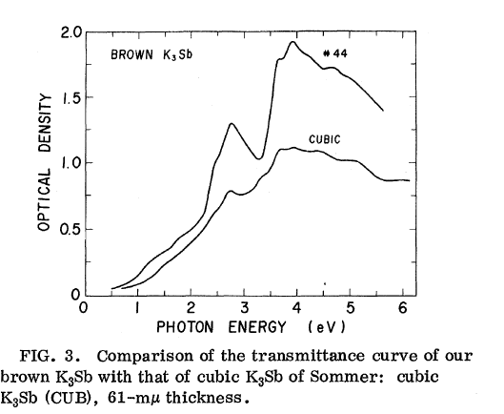
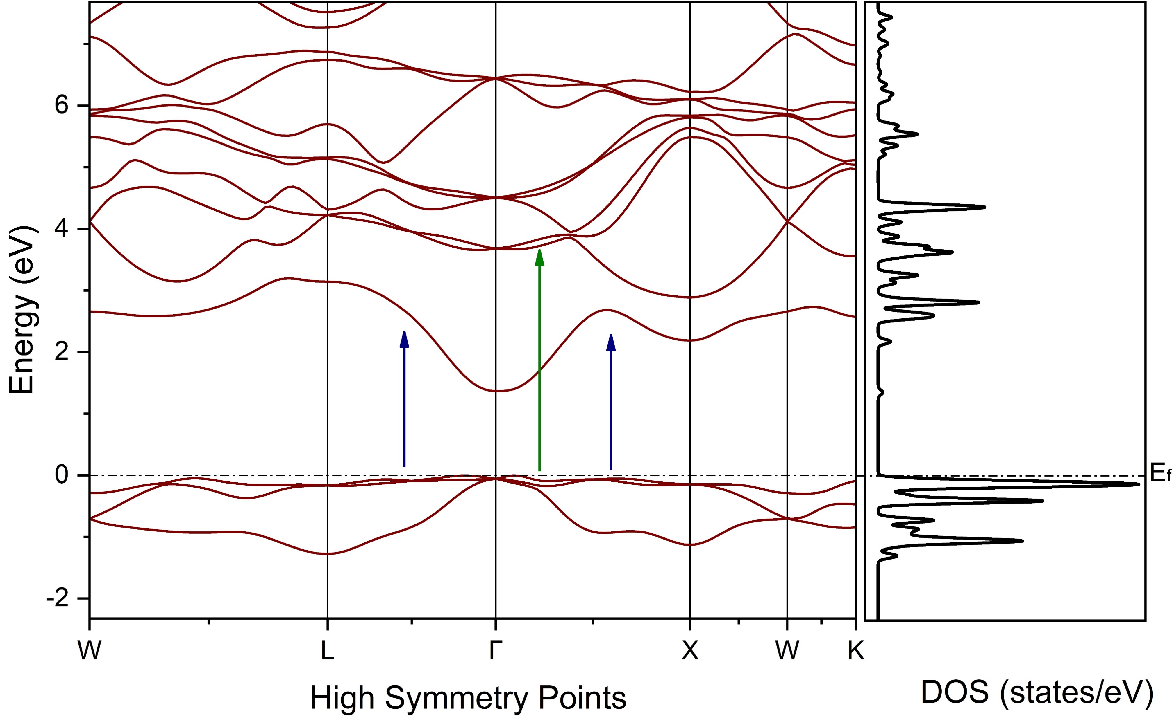
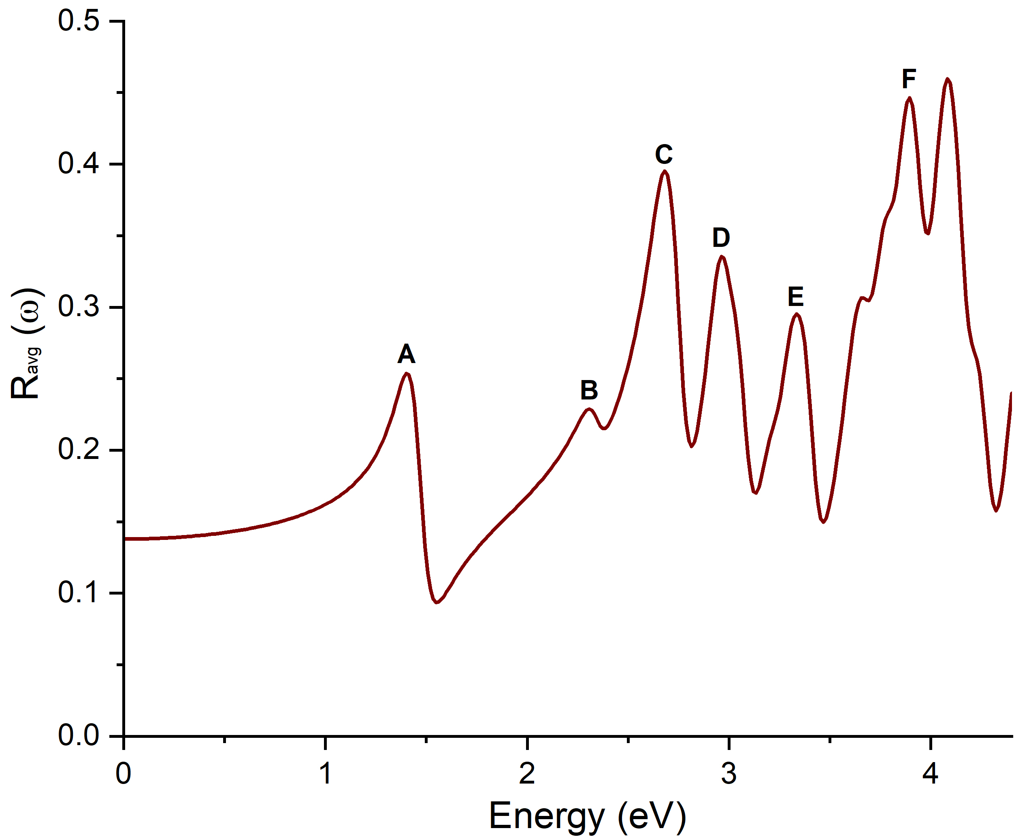
KSb Spectral Reflectivity Peaks: A Comparative Analysis
DFT-Simulated
Spectral Reflectivity of
K₃Sb (Cubic) [1,2]
Transmittance Curve
of K₃Sb (Cubic)
by A.H. Sommer (Experimental Literature) [3]
C
2.7
F
3.9
Electronic Band Structure and Density of States
of K₃Sb (Cubic)
C
2.67
F
3.89
Peak F
Peak C
1] S. Mohanty, “Development of Multi-Alkali Antimonide Photocathodes for High-Brightness RF Photoinjectors”, Dissertation, Universität Hamburg, 2024.
2] S. K. Mohanty, et al., “Development and Characterization of Multi- Alkali Antimonide Photocathodes for High-Brightness RF Photoinjectors,” Micromachines, vol. 14, no. 6, pp. 1182, May 2023. doi:10.3390/mi14061182.
3] A. Ebina and T. Takahashi, “Transmittance Spectra and Optical Constants of Alkali-Antimony Compounds K3Sb, Na3Sb, and Na2KSb”, Phys. Rev. B, vol. 7, no. 10, pp. 4712–4719, 1973. doi:10.1103/PhysRevB.7.4712.

Slide 12
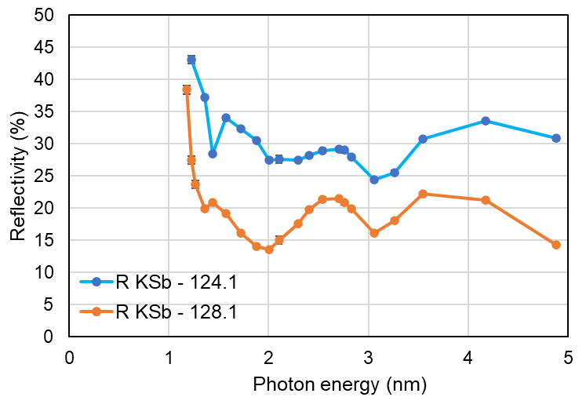
KSb Spectral Reflectivity Peaks: A Comparative Analysis
DFT-Simulated
Spectral Reflectivity of
K₃Sb (Cubic) [1,2]
Transmittance Curve
of K₃Sb (Cubic)
by A.H. Sommer (Literature) [3]
Experimental Spectral Reflectivity
of KSb: Modified thin and thick
Cathodes 124.1 and 128.1
F
3.89
C
2.7
F
3.9
C
2.7
F
3.9
C
2.67
- thin
- thick
Similar peak characteristics of Cathodes 124.1 and 128.1 with K₃Sb suggest a cubic crystal orientation.
1] S. Mohanty, “Development of Multi-Alkali Antimonide Photocathodes for High-Brightness RF Photoinjectors”, Dissertation, Universität Hamburg, 2024.
2] S. K. Mohanty, et al., “Development and Characterization of Multi- Alkali Antimonide Photocathodes for High-Brightness RF Photoinjectors,” Micromachines, vol. 14, no. 6, pp. 1182, May 2023. doi:10.3390/mi14061182.
3] A. Ebina and T. Takahashi, “Transmittance Spectra and Optical Constants of Alkali-Antimony Compounds K3Sb, Na3Sb, and Na2KSb”, Phys. Rev. B, vol. 7, no. 10, pp. 4712–4719, 1973. doi:10.1103/PhysRevB.7.4712.

Slide 13
KCsSb Spectral Reflectivity Peaks: A Comparative Analysis

Slide 14
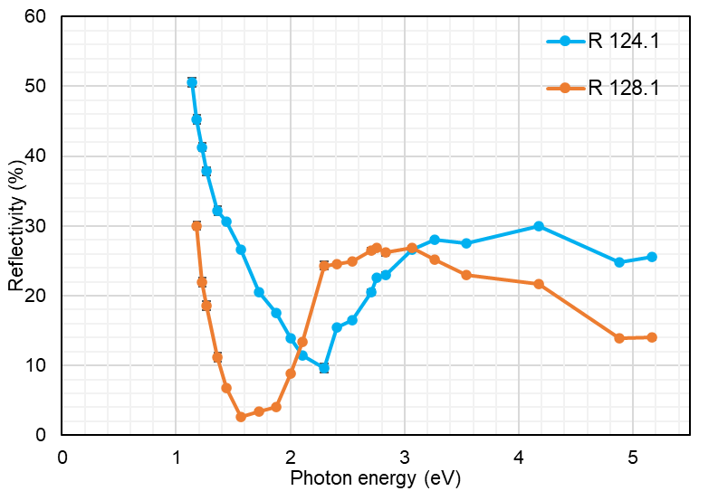
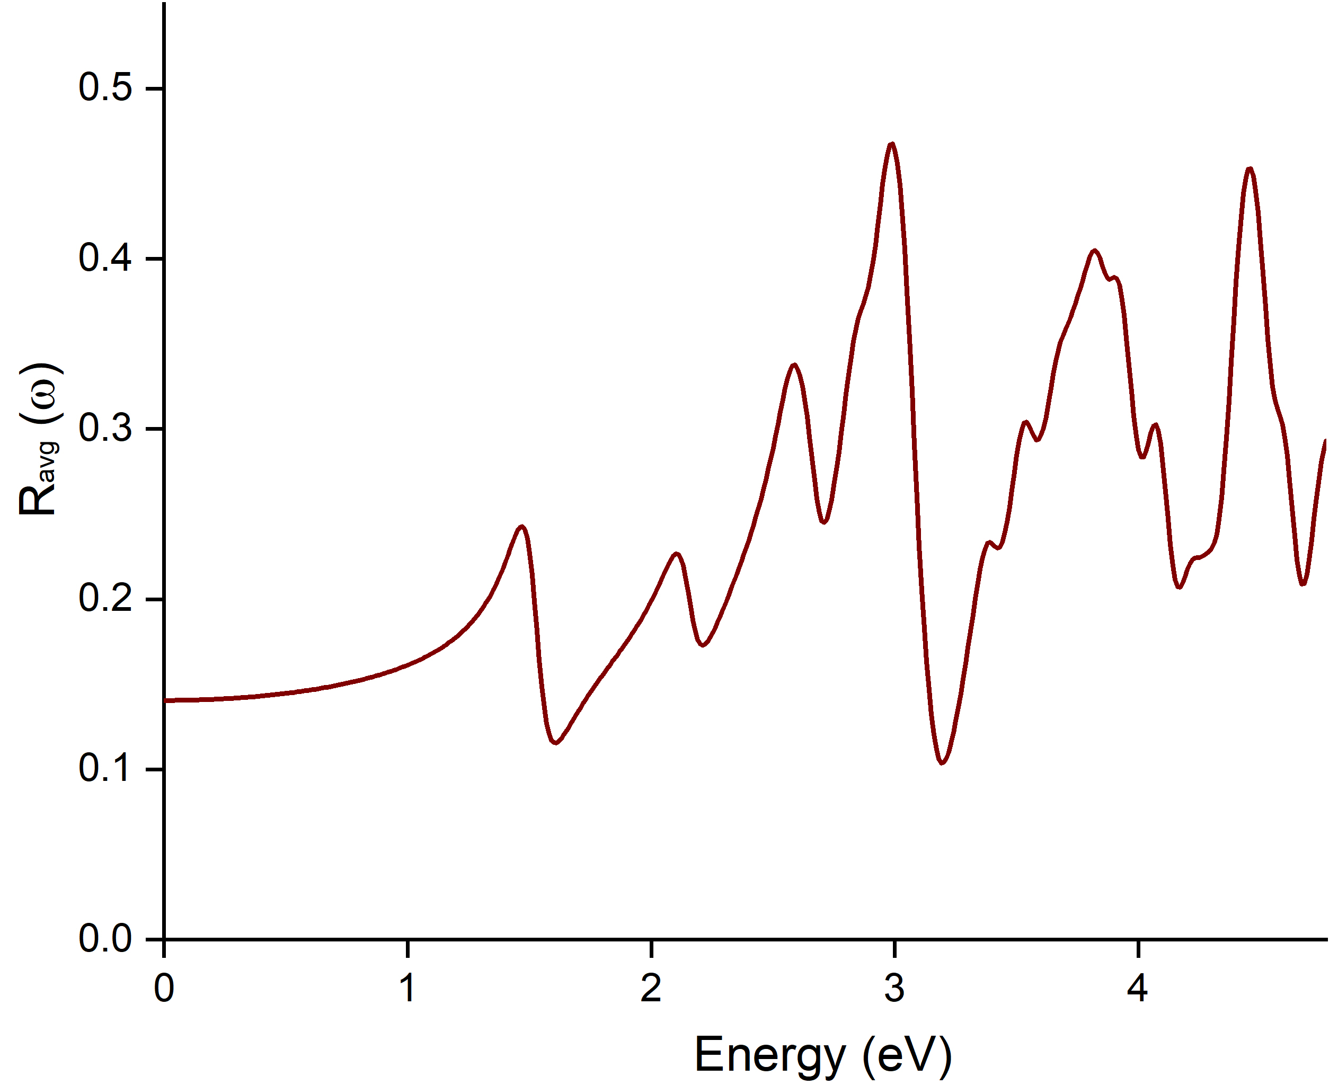
KCsSb Spectral Reflectivity Peaks: A Comparative Analysis
DFT-Simulated
Spectral Reflectivity of
K₂CsSb (Cubic) [1,2]
Experimental Spectral Reflectivity
of KCsSb: Modified thin and thick
Cathodes 124.1 and 128.1
D
2.98
modified thin
E
3.81
D
3.06-3.26
modified thick
C
2.58
C
2.75
E
4.17
B
2.29
B
2.1
Experimental and DFT peaks differ by less than 10%,
showing good agreement.
Similar peak characteristics of Modified thin and thick
with K₂CsSb (Cubic) suggest a cubic orientation.
1] S. Mohanty, “Development of Multi-Alkali Antimonide Photocathodes for High-Brightness RF Photoinjectors”, Dissertation, Universität Hamburg, 2024.
2] S. K. Mohanty, et al., “Development and Characterization of Multi- Alkali Antimonide Photocathodes for High-Brightness RF Photoinjectors,” Micromachines, vol. 14, no. 6, pp. 1182, May 2023. doi:10.3390/mi14061182.

Slide 15
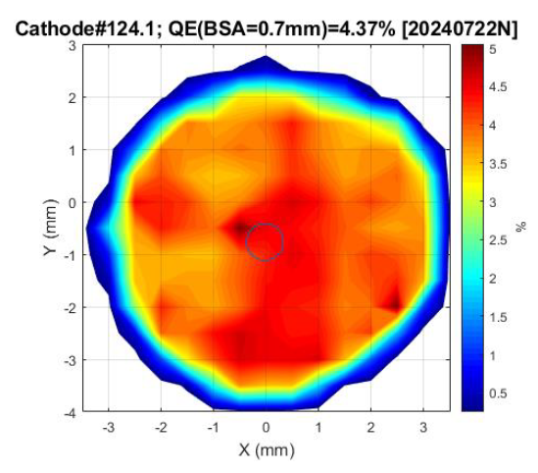
Preliminary Test Results in the RF Gun at PITZ
Cathode QE:
There is a difference between the fresh QE (at LASA) and the QE measured in the gun for these KCsSb cathodes.
The QE maps of these cathodes were uniform throughout the surface.
No major vacuum events with the second batch of green cathodes, unlike the first batch, where high vacuum events caused rapid QE degradation.
Cathode | QE (@ 515 nm) measured at INFN LASA | QE (@ 515 nm) measured at PITZ
99.1 - multi-layer | 9.6% | 4%
124.1 – modified thin | 8.7% | 4.4%
128.1 – modified thick | 8.1% | 7.5%
QE map of cathode 124.1

Slide 16
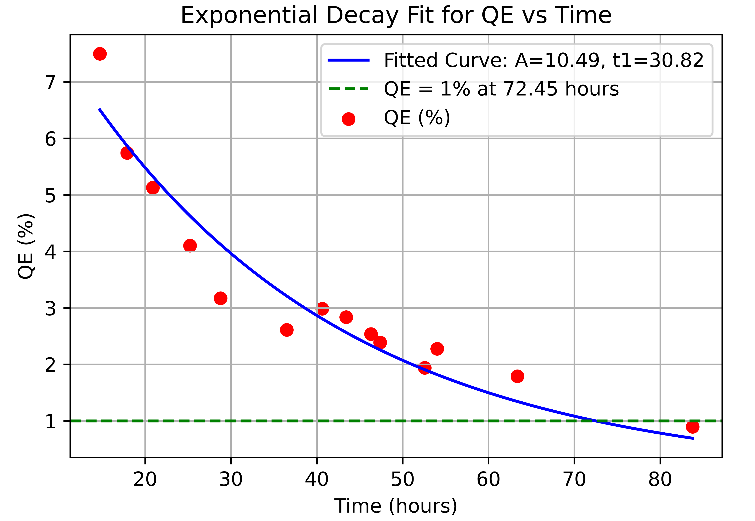
Preliminary Test Results in the RF Gun at PITZ
Cathode QE:
There is a difference between the fresh QE (at LASA) and the QE measured in the gun for these KCsSb cathodes.
The QE maps of these cathodes were uniform throughout the surface.
No major vacuum events with the second batch of green cathodes, unlike the first batch, where high vacuum events caused rapid QE degradation.
Dark current (DC):
DC of Cathode 99.1 (multi-layer) is similar to that of the first batch of cathodes.
Cathode 124.1 (modified thin) and Cathode 128.1 (modified thick) have a lower dark current (~ 2 times lower) compared to the first batch of cathodes (thin and thick), at least between gun gradients of 30-40 MV/m.
Lifetime:
QE degradation in ~3 days of operation (without significant vacuum events), compared to 2 days for the first batch of cathodes.
Life time
1st batch cathodes
Cs₂Te
2nd batch cathodes
QE map of cathode 124.1
~ 72 hours
Dark current comparison

Slide 17
Summary & Future plan
3 KCsSb cathodes and 1 NaKSb(Cs) cathode have been produced for testing in the PITZ RF gun.
Among these, 1 KCsSb thin multi-layer cathode (Cathode 99.1), 1 modified KCsSb thin cathode (Cathode 124.1, Sb = 5 nm), and 1 modified KCsSb thick cathode (Cathode 128.1, Sb = 10 nm) were produced.
3 KCsSb cathodes were produced with sequential deposition, recording QE of 8-9.6% at 514 nm.
Controlling K thickness during deposition (cathodes 124.1 & 128.1) was crucial for achieving cubic orientation in KSb compounds, as shown by the comparison of experimental spectral reflectivity with DFT simulations of K₃Sb (cubic).
Previous XRD confirms that Cs reacts effectively with cubic KSb to form predominantly cubic KCsSb, as validated by comparing DFT and experimental spectral reflectivity of KCsSb compounds (cathodes 124.1 and 128.1).
Cathodes 124.1 (thin) and 128.1 (thick) show relatively lower dark current compared to the first batch, uniform QE maps, no major vacuum events during operation, but a lifetime of ~3 days.
Future Plans:
TRAnsverse Momentum Measurement (TRAMM) device is currently being developed and planned to be integrated into the production system to measure thermal emittance.
Photoemission spectroscopy study.
Try on co-evaporation method
Thank You for your attention!

Slide 18
Additional slides

Slide 19
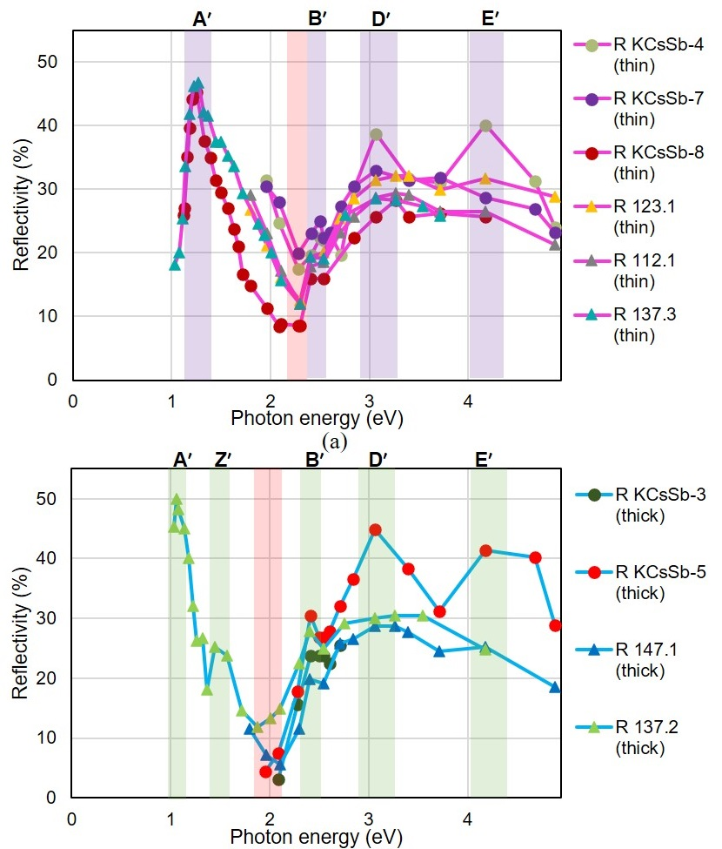
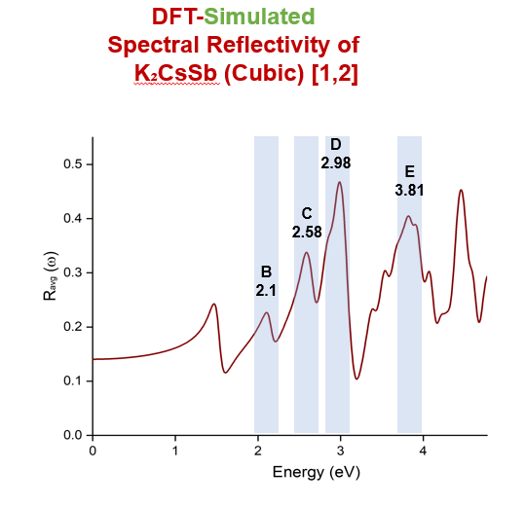
1.22
3.06
4.17
2.40
Standard Thin
1.05
3.06
4.17
2.40
1.44
Standard Thick

Slide 20
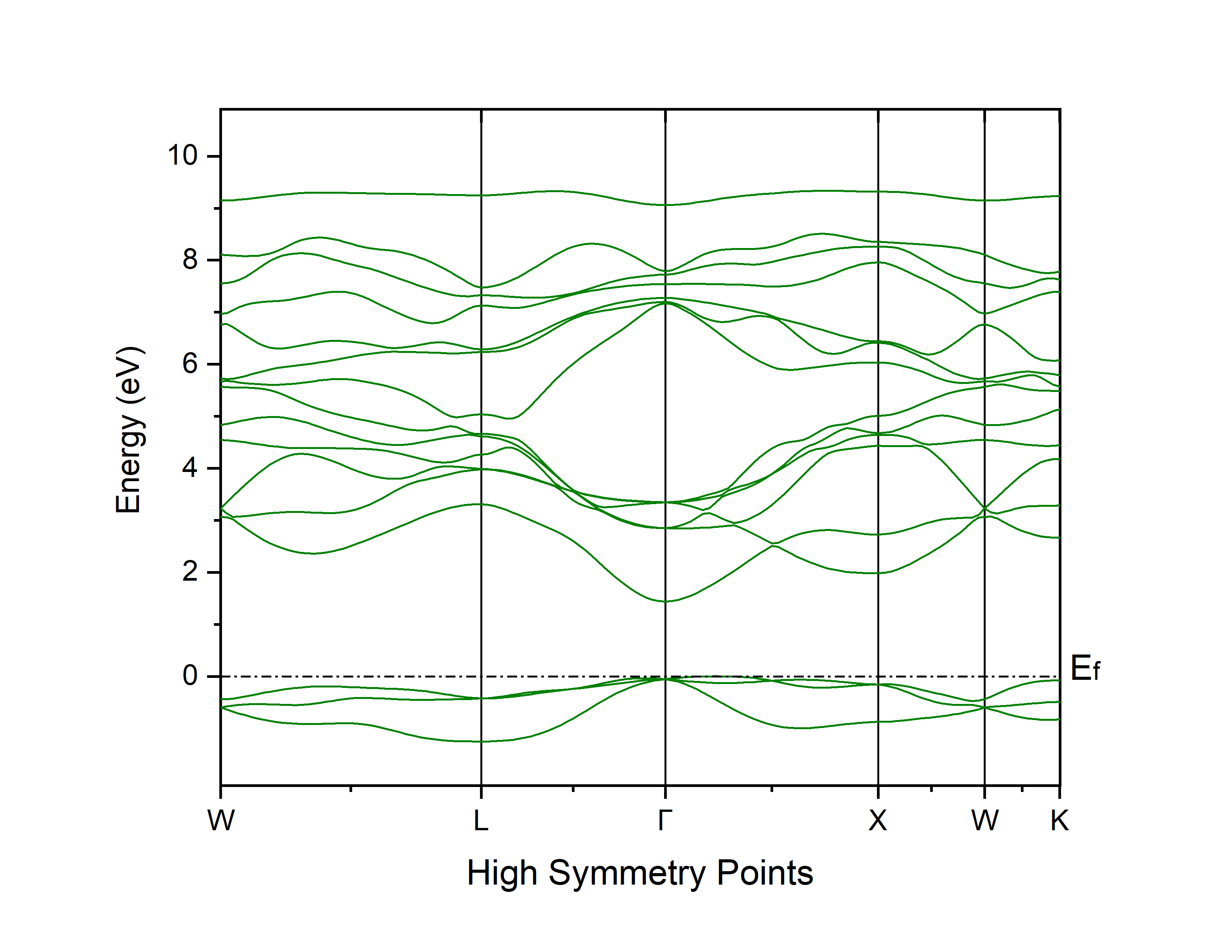
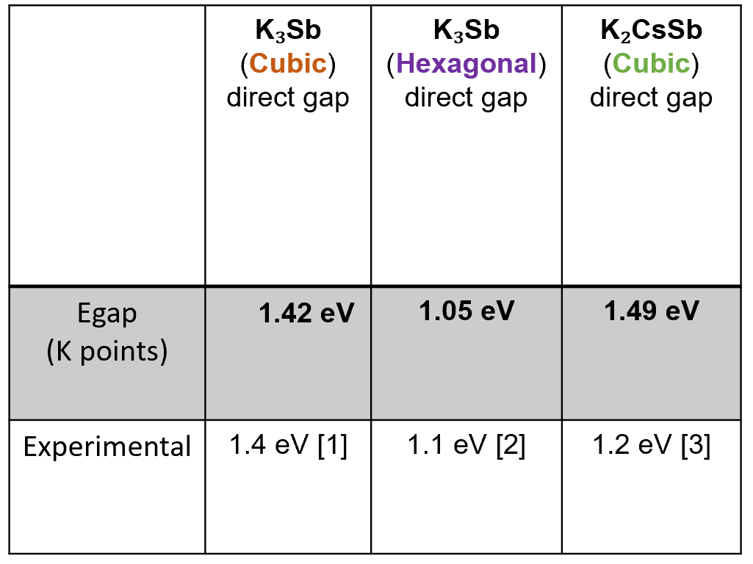
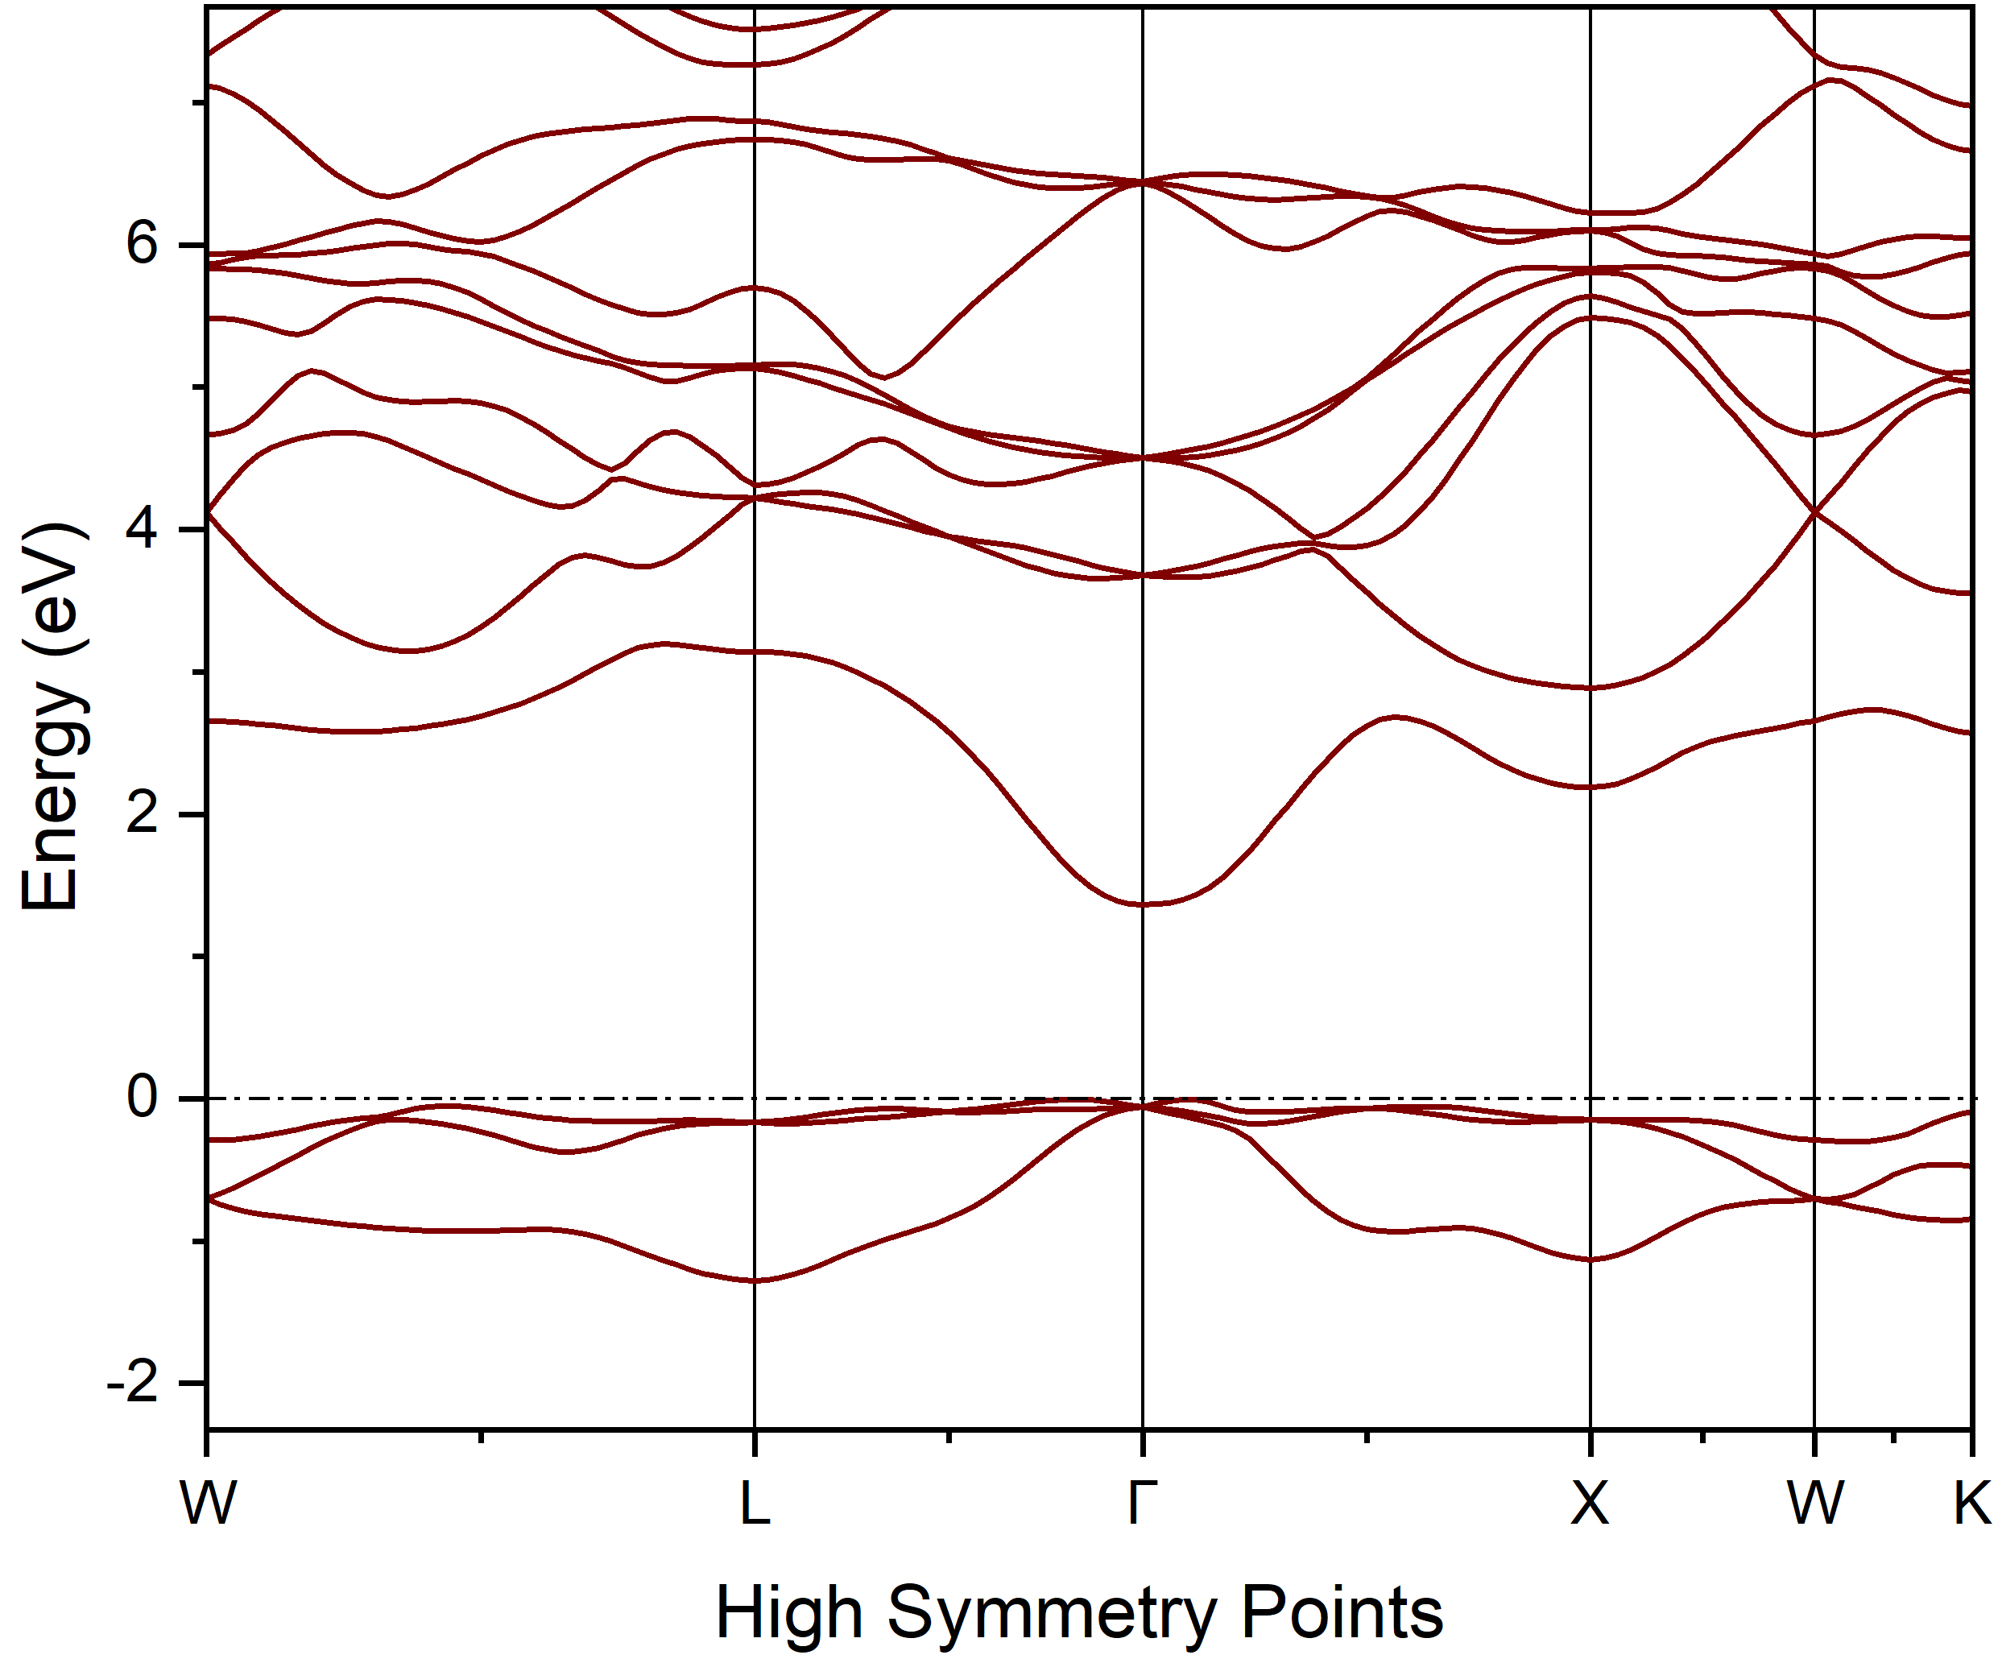
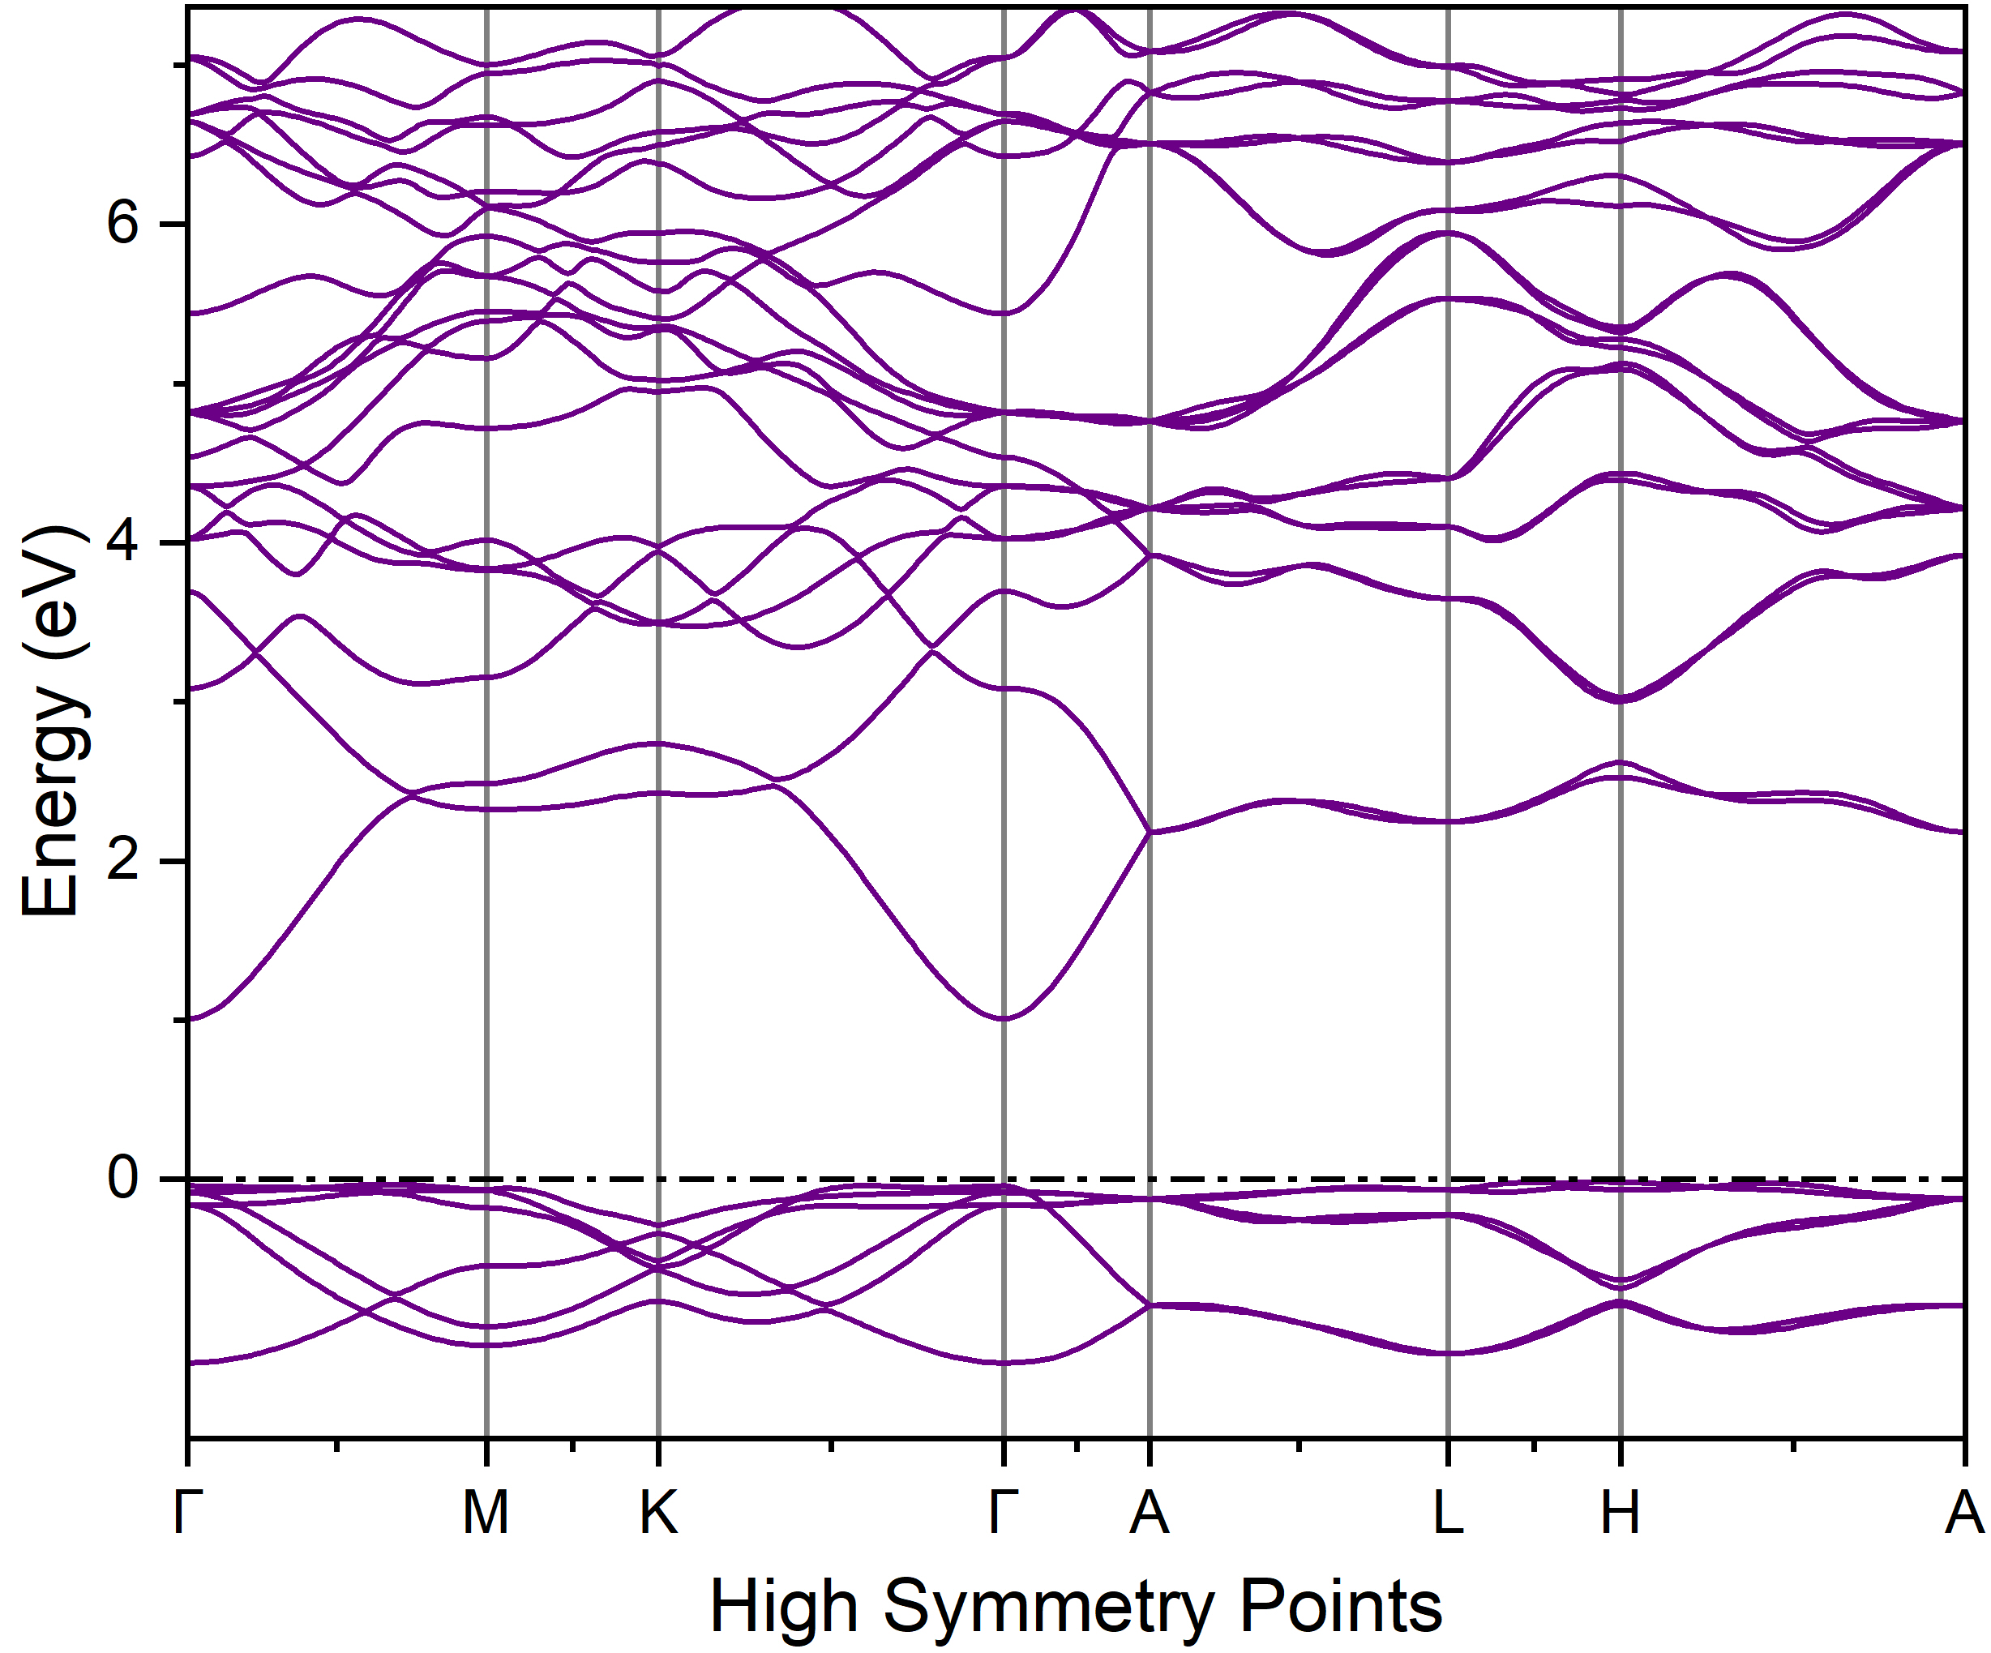
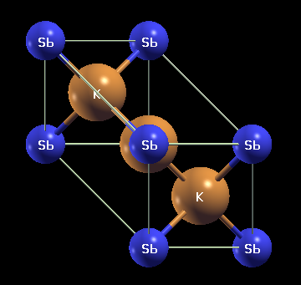
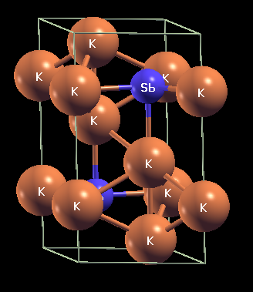
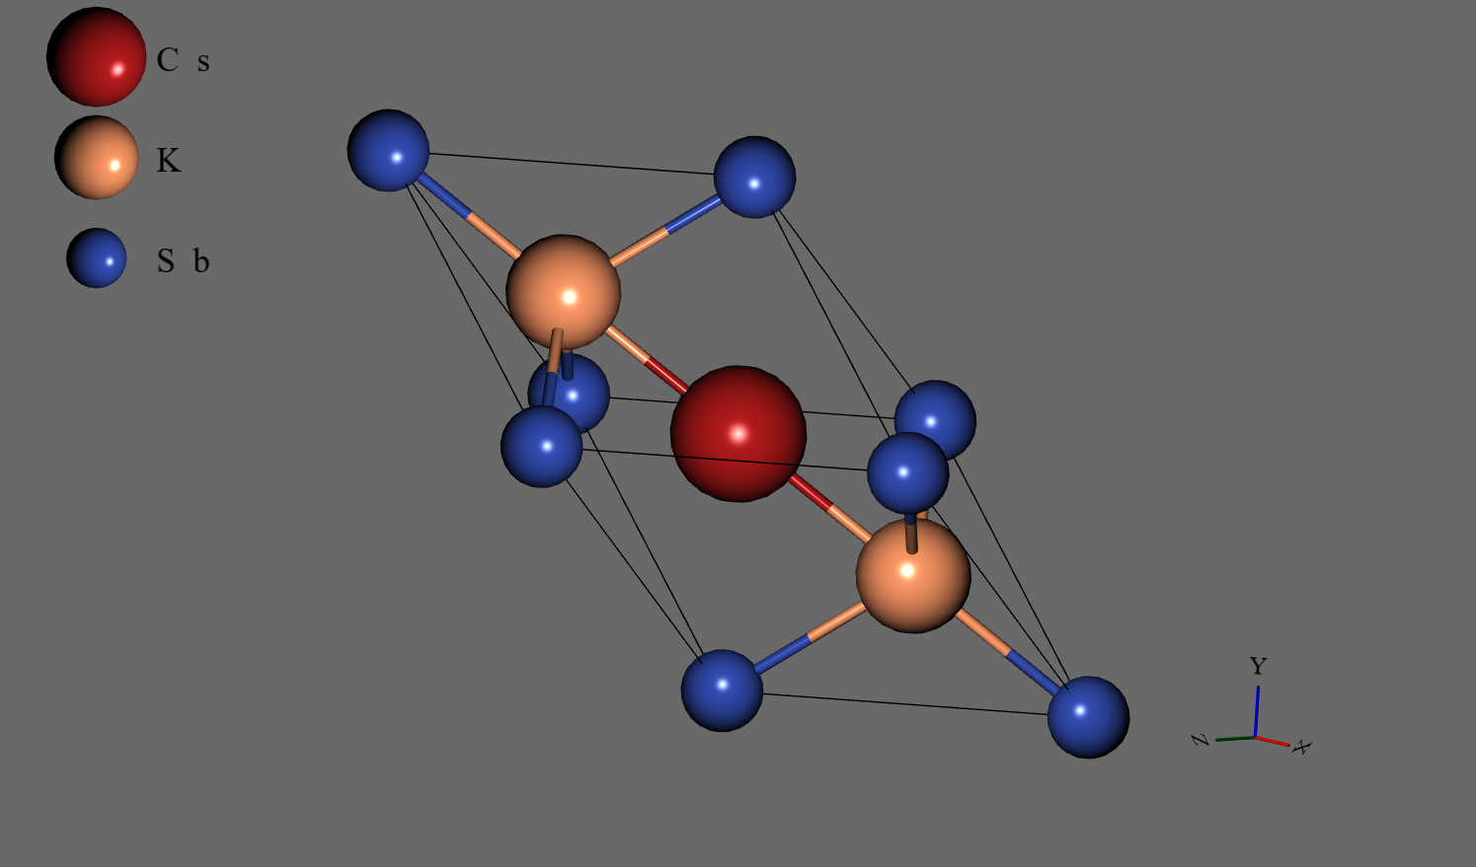
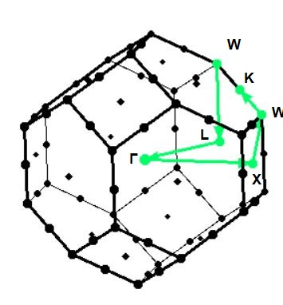
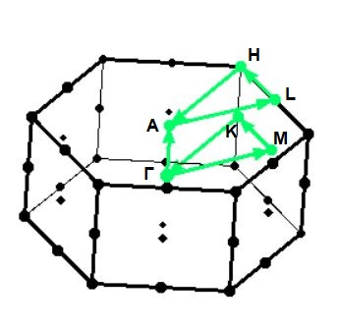
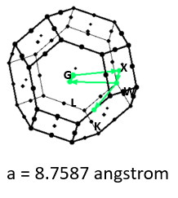
Electronic structure (DFT study)
Band structure calculation by HSE method
K₃Sb
(Cubic)
K₃Sb
(Hexagonal)
K₂CsSb
(Cubic)
[1] A. H. Sommer and W. H. McCarroll, “A New Modification of the Semiconducting
Compound K3Sb,” Journal of Applied Physics, vol. 37, no. 1, pp. 174–179, 062004.
[2] A. H. Sommer and W. H. McCarroll, “A New Modification of the Semiconducting
Compound K3Sb,” Journal of Applied Physics, vol. 37, no. 1, pp. 174–179, 06 2004.
[3] C. Ghosh and B. P. Varma, “Preparation and study of properties of a few alkali antimonide photocathodes,”
Journal of Applied Physics, vol. 49, no. 8, pp. 4549–4553, 08 2008
a = 8.493 angstrom
a = 6.025 angstrom
C = 10.690 angstrom

Slide 21
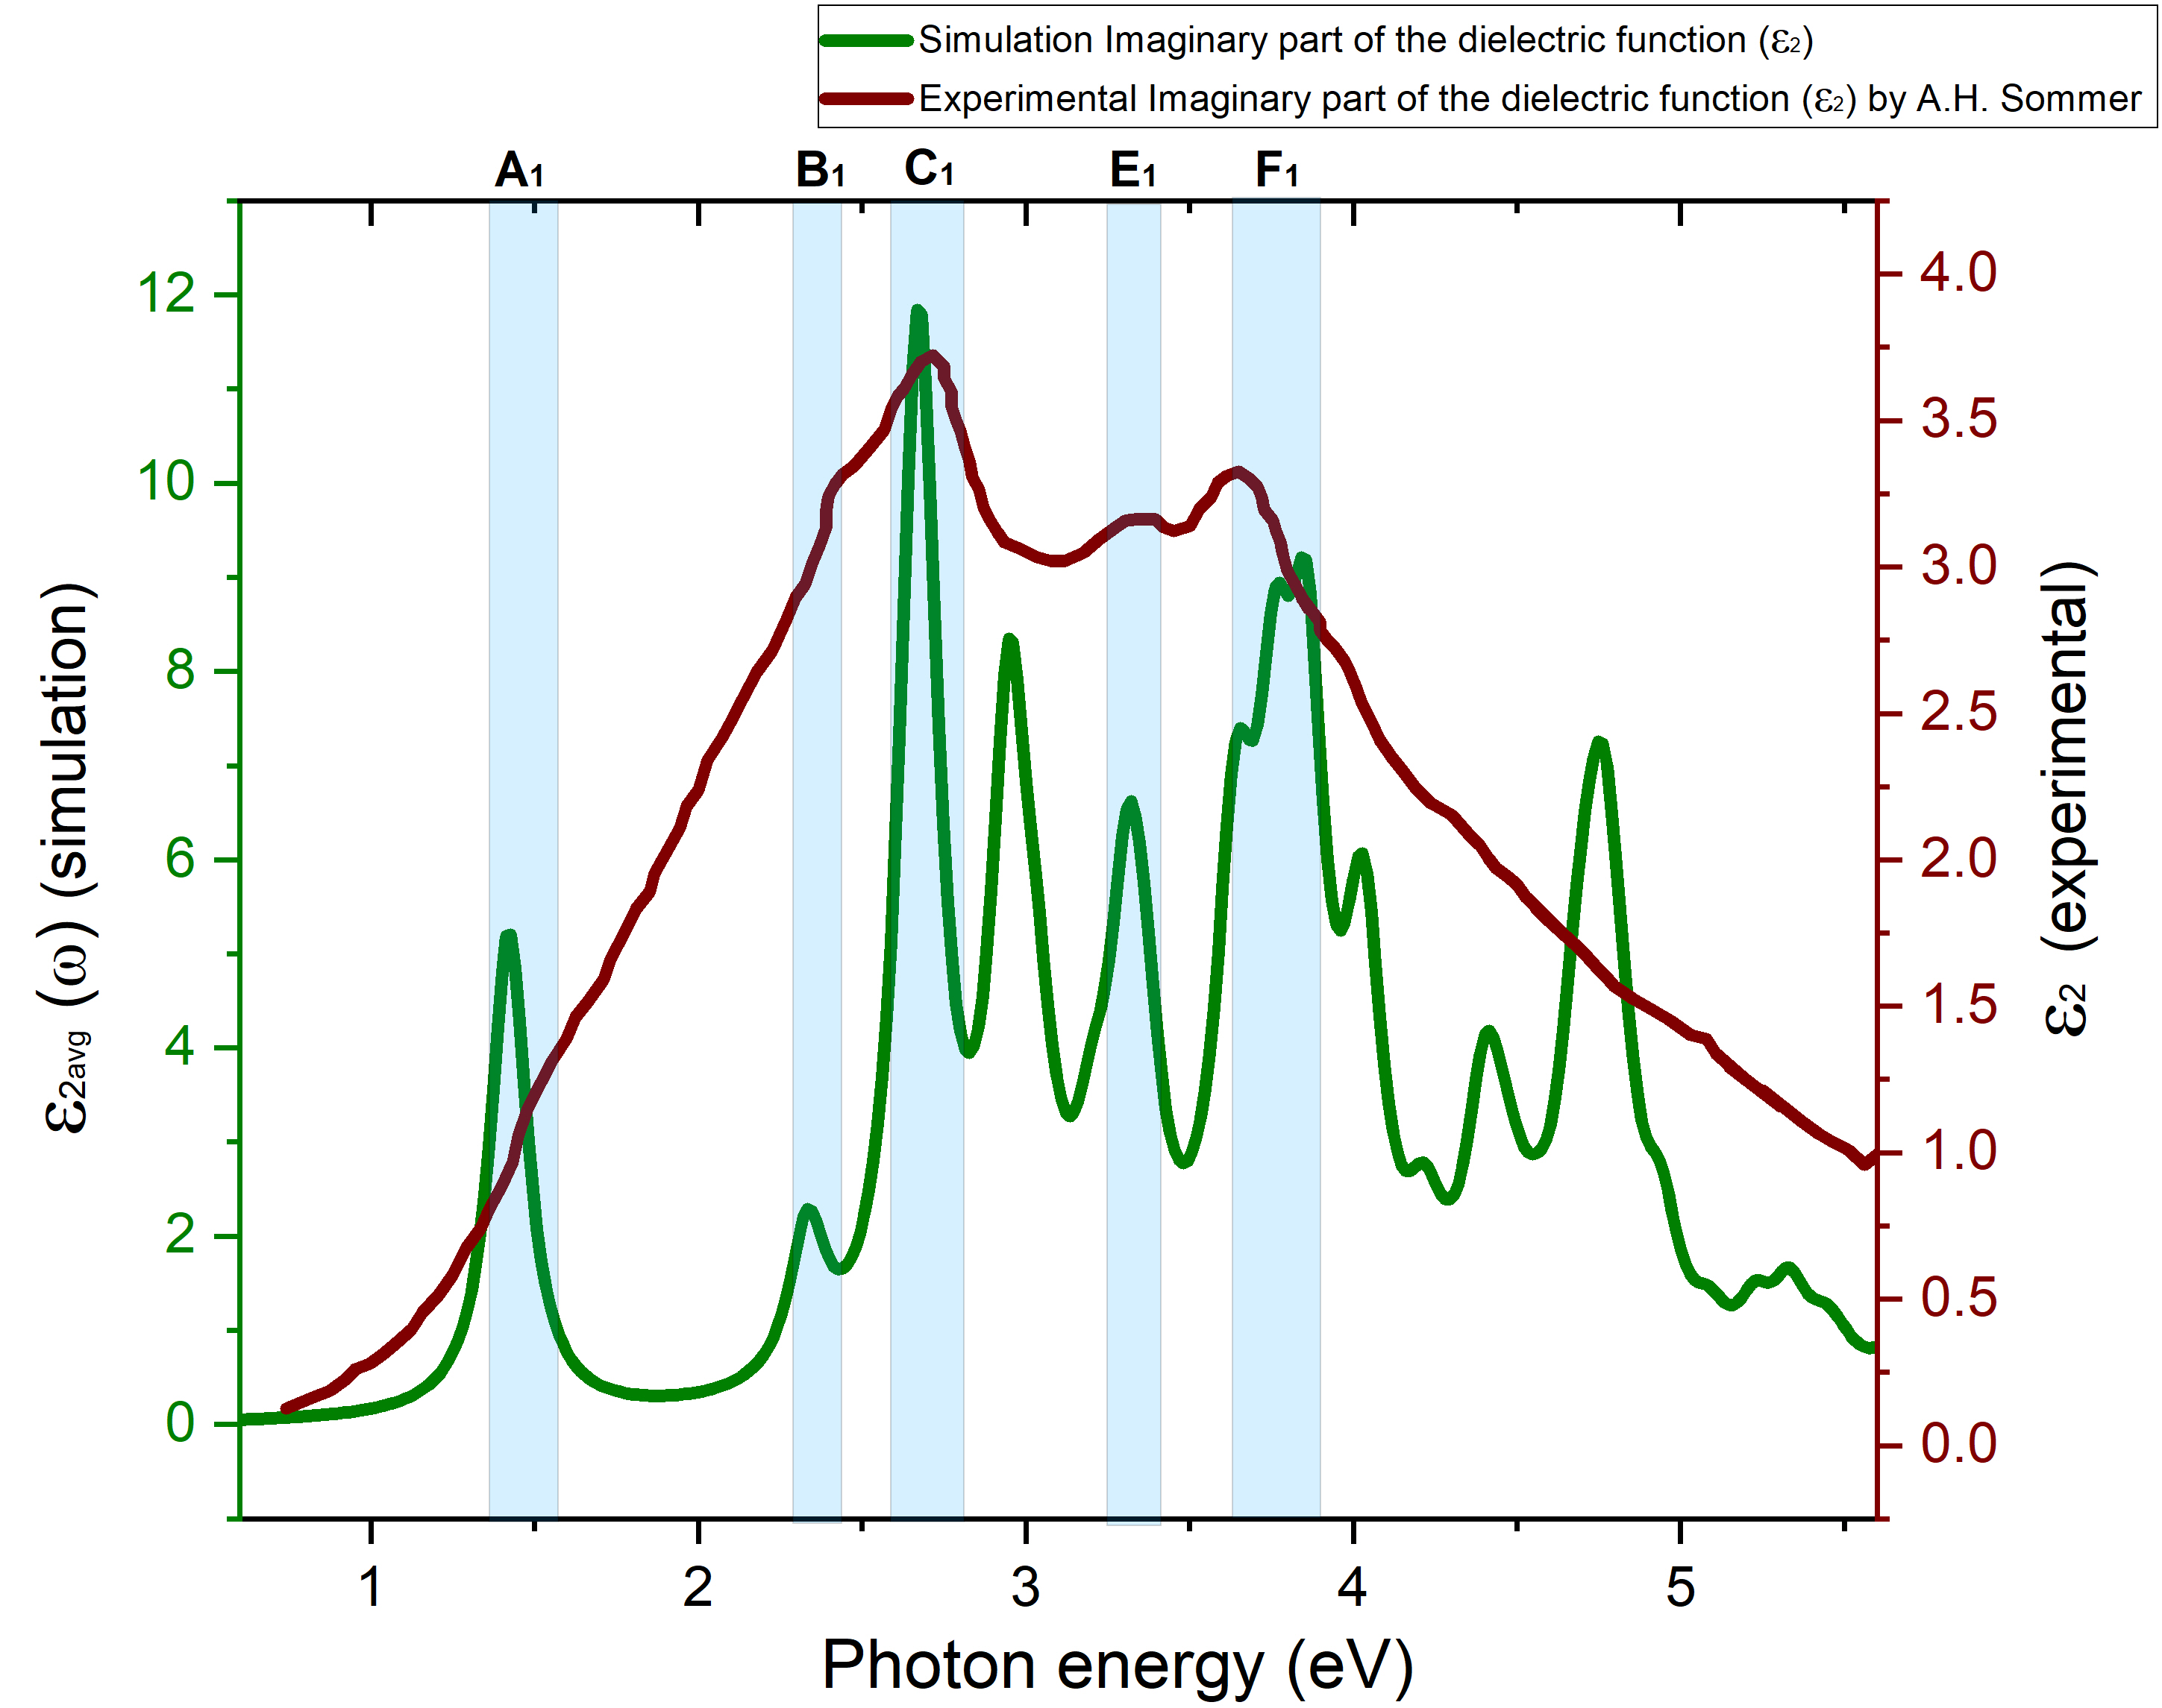
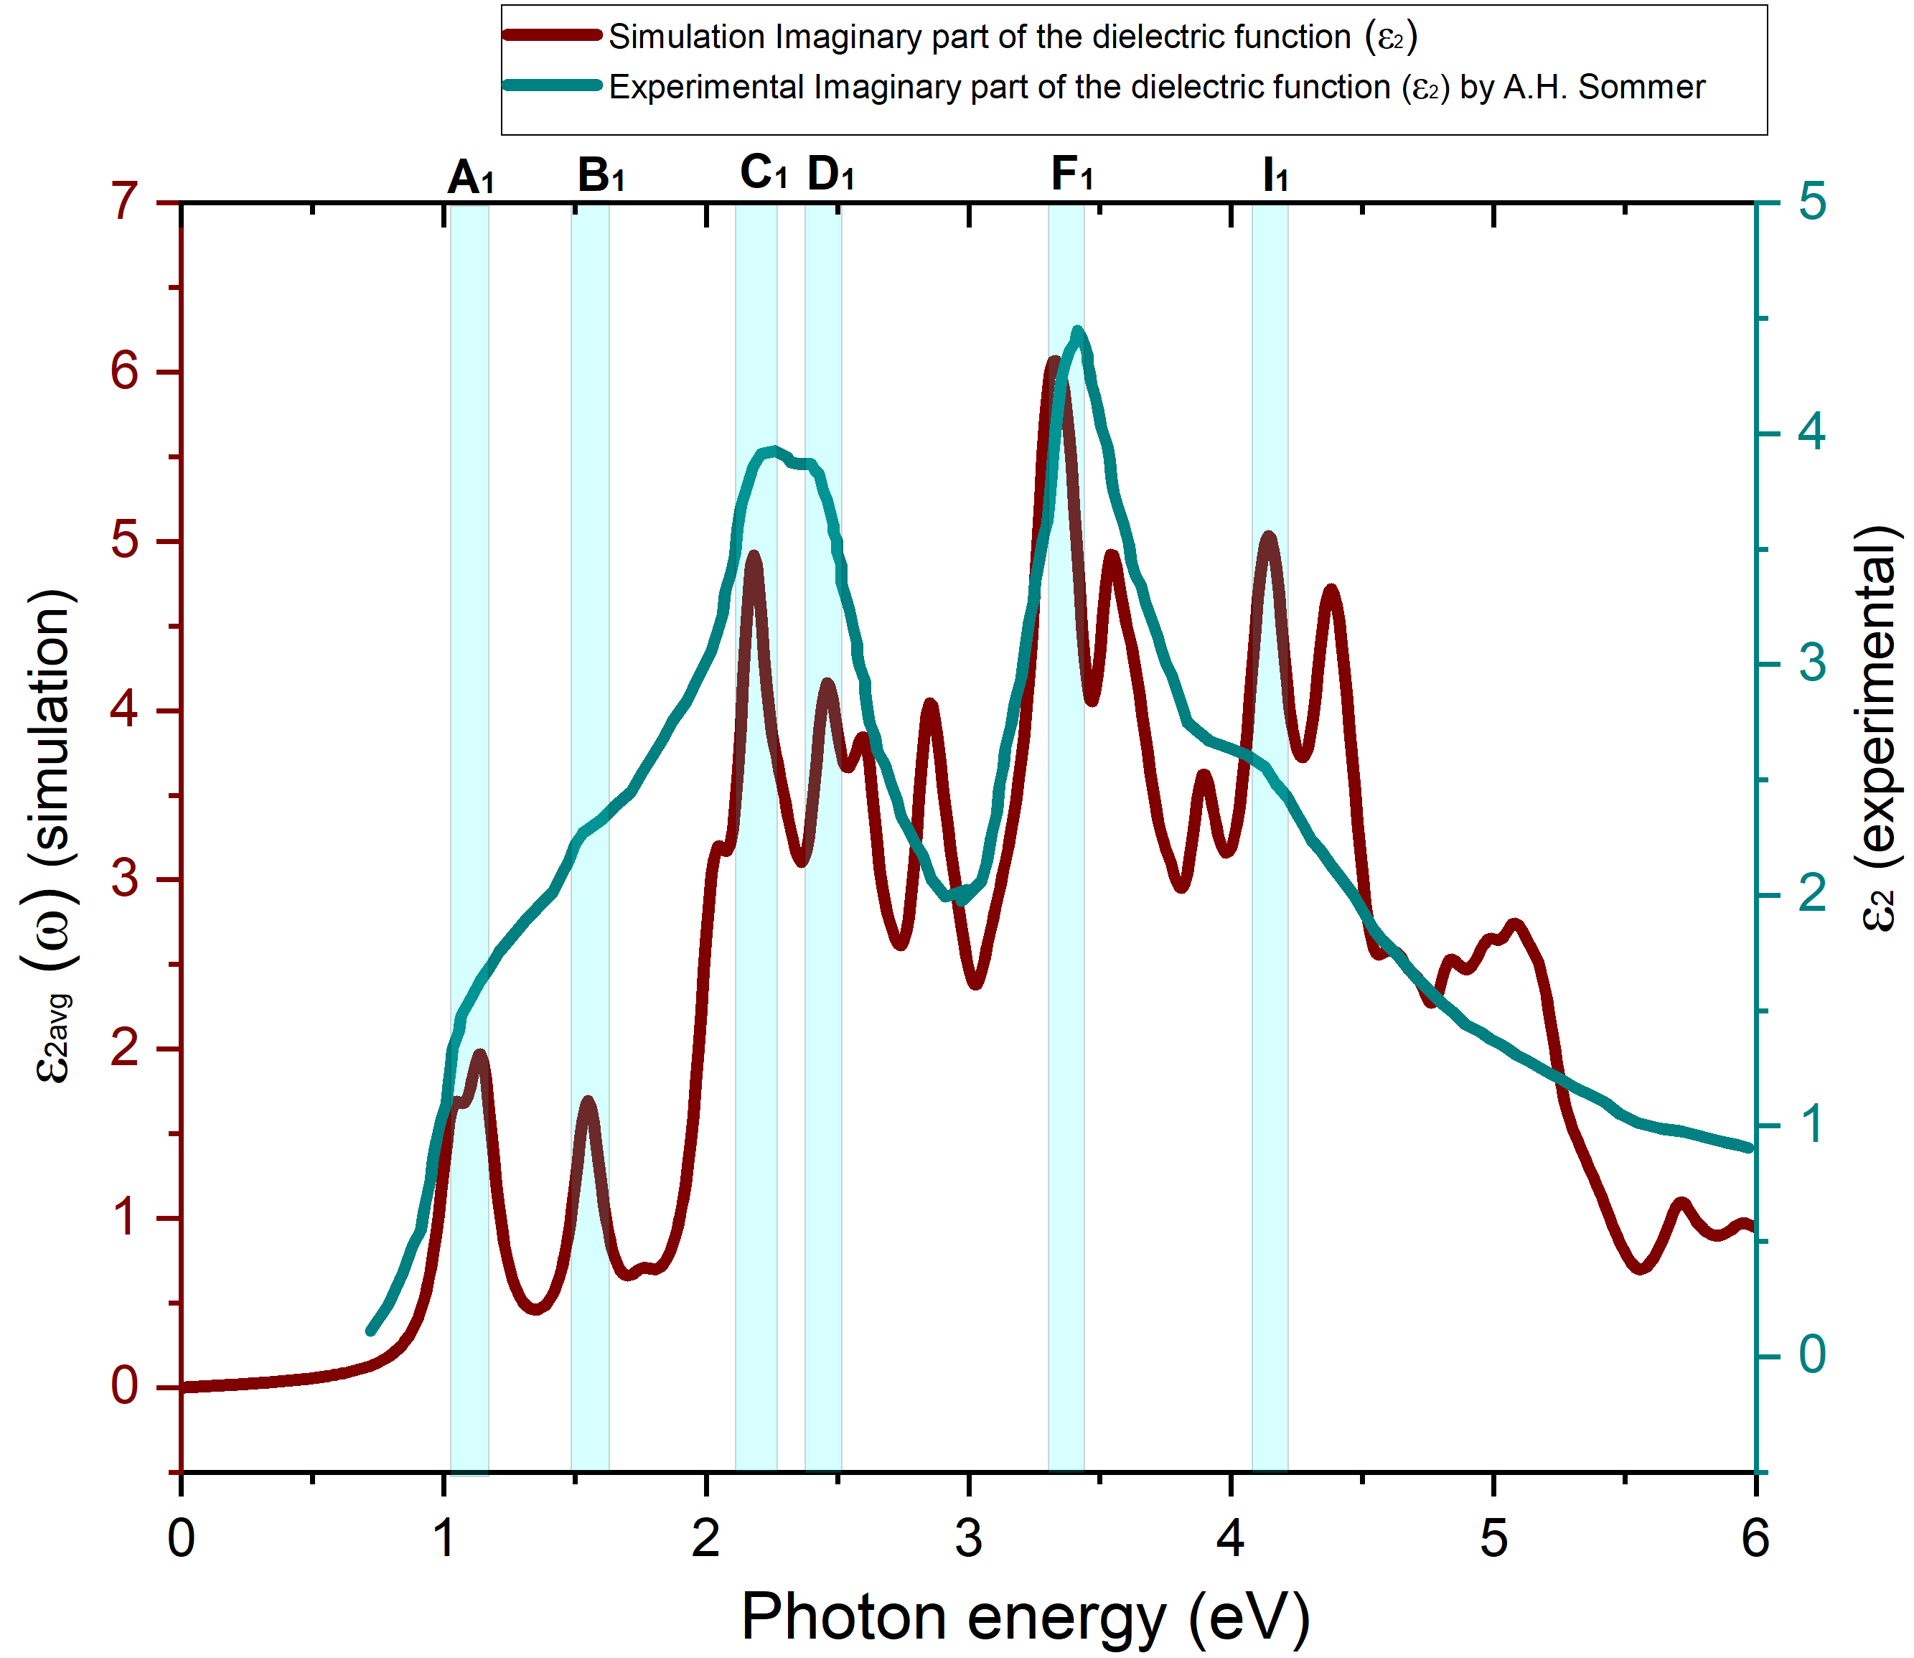
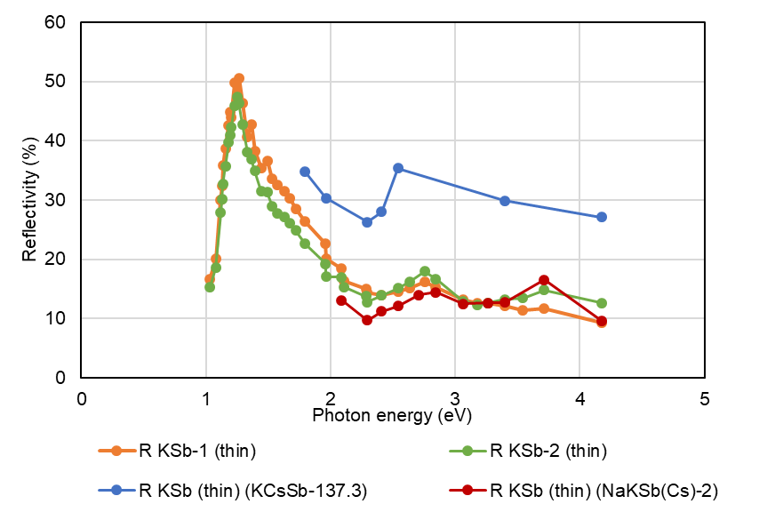
Comparison between the DFT Simulation and Experimental Data for K₃Sb
K₃Sb
(Cubic)
K₃Sb
(Hexagonal)
Experimental [1]
Simulation
Simulation
Experimental [1]
Comparison between the reference experimental [1] and simulated imaginary part of the dielectric function
Comparison between the reference experimental [1] and simulated imaginary part of the dielectric function
KSb-thin
However, the observed two major peaks in our KSb-thick cathodes do not match those of the K₃Sb hexagonal or cubic compounds.
Potentially thin KSb exhibits a cubic crystal orientation!
Comparison of the peaks between reference experimental [1] and our lab-grown KSb (thin) cathodes.
[1] A. Ebina and T. Takahashi, “Transmittance spectra and optical constants of alkali-antimony compounds k3sb, na3sb, and na2ksb,” Phys. Rev. B, vol. 7, pp. 4712–4719, May 1973.

Slide 22
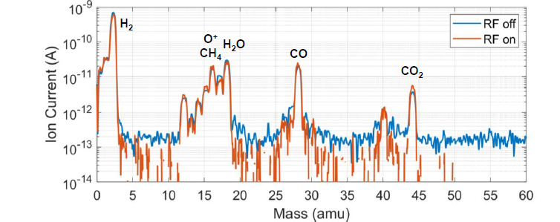
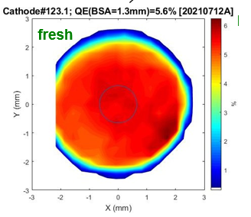
Cathode under high gradients (First batch of green cathodes)
2 days <1% QE (T~70 Cathode #123.1)
Cathode RF conditioning, QE, life time, vacuum
Cath in
Cath out
30/35 MV/m
5.6/5.5%
30/45 MV/m
0.8/1.2%
Cathode RF conditioning
Below 30 MV/m, almost not necessary, up to 400 us was tested without vac events
Above 30-40 MV/m, much more vac events than Cs₂Te conditioning, degrades QE significantly
Cathode QE
Fresh QE in gun is consistent with LASA measurements
QE decrease dominated by vac events during conditioning, QE also slowly decreases w/o vac events.
2 days <1% QE (T~50 Cathode #147.1)
Overnight run
No vac events
2 days <1% QE (T~50 Cathode #112.1)
QE slowly drops by 20% in 12 hours
Uniformity in QE

Slide 23
