Slide 1
Photocathodes for high brilliant electron beams
2024-09-18
Chen Wang
EWPAA2024
Dresden
Notes:
Update of photocathode lab

Slide 2
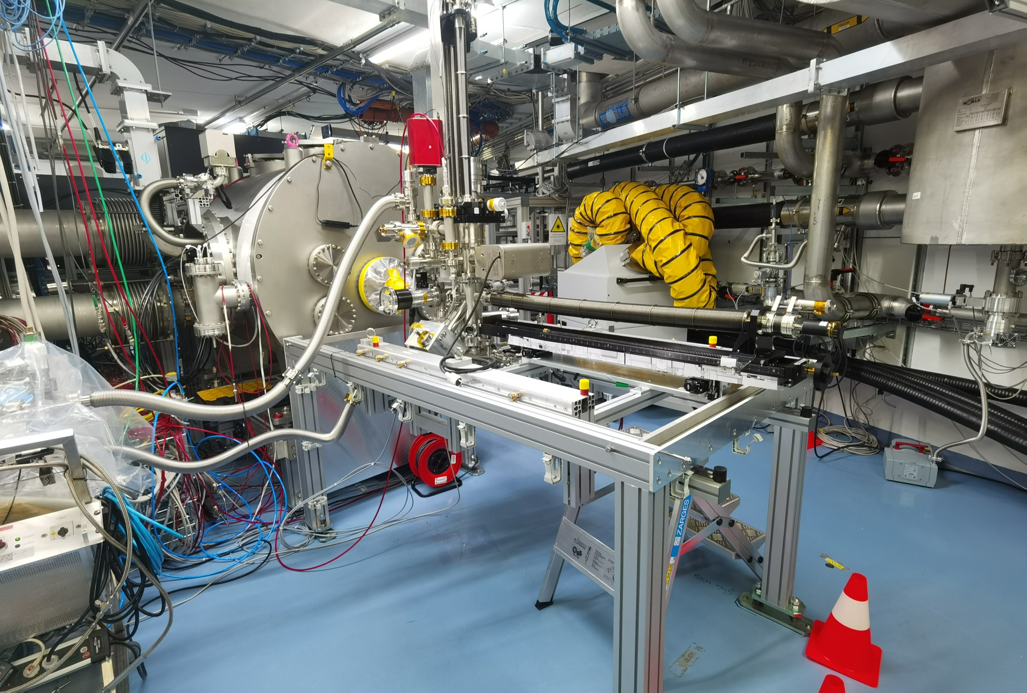
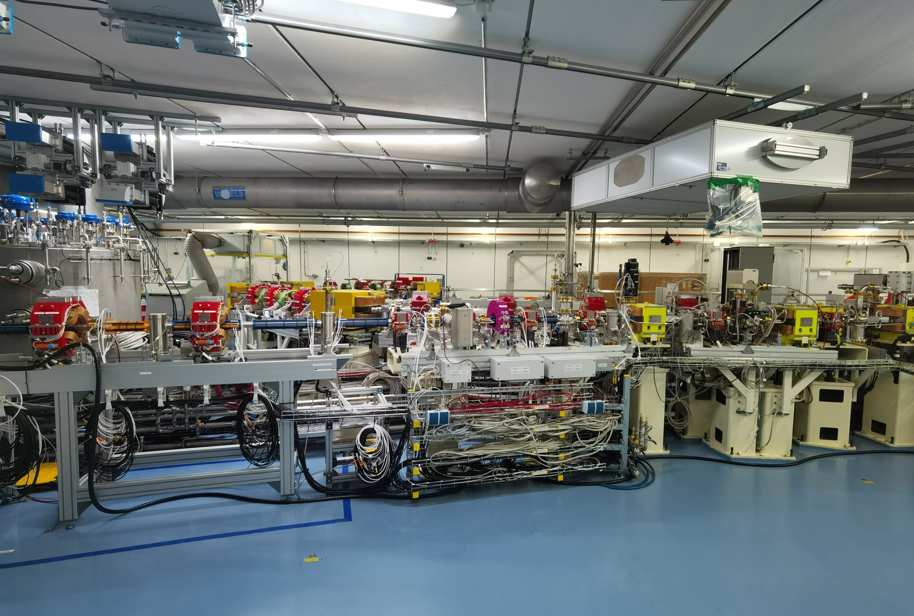
Sealab facility
Photocathode transfer system
Diagnose beamline
Notes:
As you know, the task of the lab is to produce qualified photocathode for sealab facility, which is the superconducting electron accelerator at hzb
On the left pic, you can see the photocathode transfer system.
The transfer system itself, the cavity, cooling system and laser system are ready.
On the right pic, you can see the diagnose beamline where the UED experiment can be done here.
Waiting for radiation permission, and hopefully have the first beam this year.

Slide 3
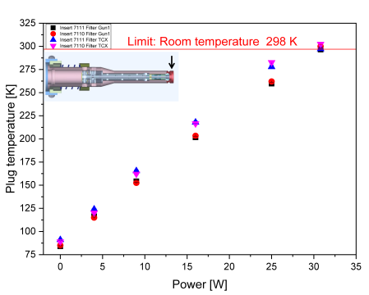
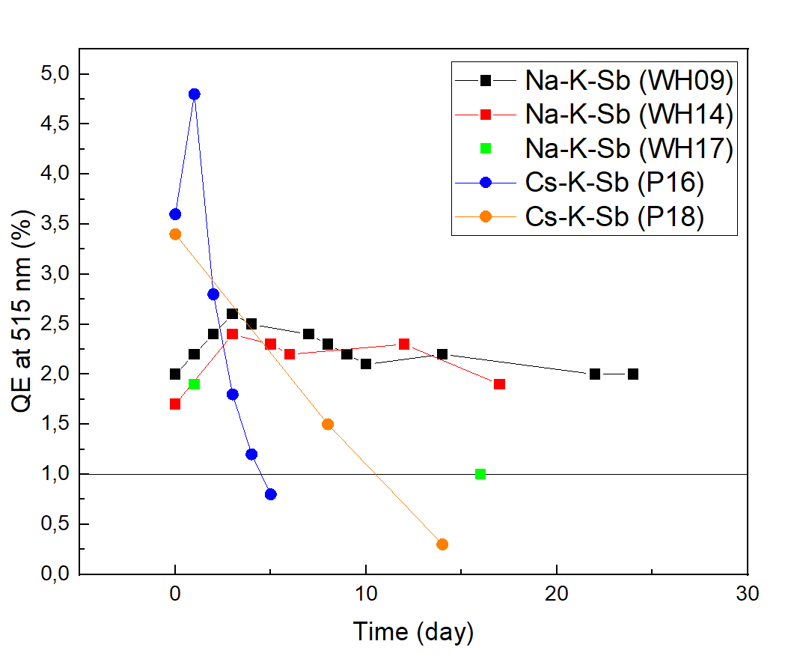
Motivation and Tasks
Superconducting RF Electron Accelerator LABorotory (Sealab/ bERLinPro) at HZB
Na-K-Sb photocathodes(1) (High Quantum Efficiency, low emittance contribution…)
Long lifetime
Operation lifetime
Dark lifetime (higher chemical stability than Cs-K-Sb)
Higher thermal stability than Cs-K-Sb photocathodes
Dark lifetime of several Na-K-Sb and Cs-K-Sb photocathode films
Different plug temperatures at different powers for two inserts and two RF-filters (2)
Schmeißer, Martin Anton Helmut. Photocathodes for high brightness, high average current photoelectron injectors. Humboldt Universitaet zu Berlin (Germany), 2019
Kühn, Julius, et al. "Thermal Load Studies on the Photocathode Insert with Exchangeable Plug for the BERLinPro SRF-Photoinjector." SRF'19, Dresden, Germany, 30 June-05 July 2019. JACOW Publishing, Geneva, Switzerland, 2019.
Notes:
Lets go back to photocathode lab, task is to produce photocathode for sealab facility.
Now, we are study Na-K-Sb in the photocathode lab.
For the sealab facility, the photocathode need to have high QE, low emittance contribution, and also long lifetime and high thermal stability.
For long lifetime, now we can only measure dark lifetime at photocathode lab, generally, the dark lifetime of Na-K-Sb is higher than Cs-K-Sb, as you can see in the pic.
And on the right you can see the thermal load test of the plug, in sealab, a maximum of 30W thermal load would apply to the photocathode, including 25W from laser + 5W rf field, therefore, higher thermal stability is also necessary for the photocathode in the project

Slide 4
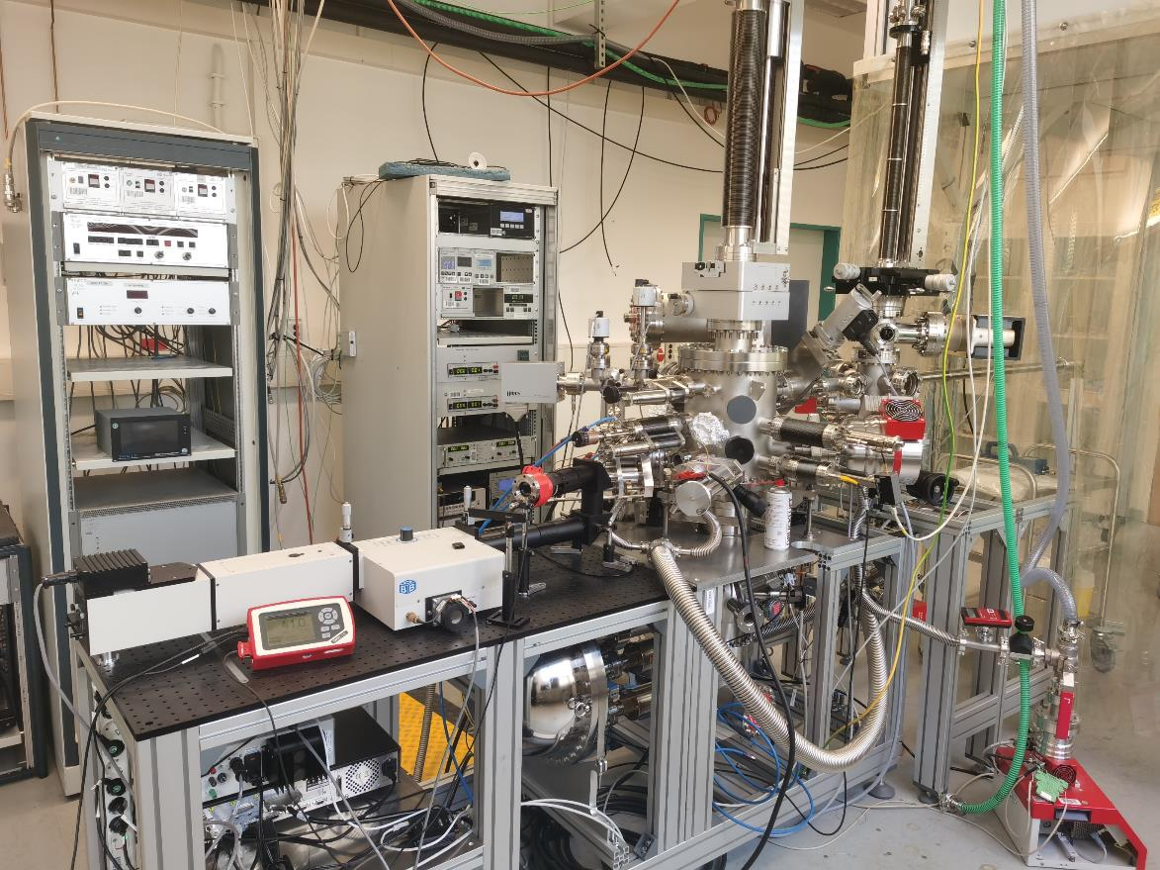
PREPARATION Chamber for alkali antimonide
Preparation & Analysis System (PAS) and
spectral response setup
Trasnfer system
<1·10⁻¹⁰ mbar
Load Lock
~3·10⁻⁸ mbar
Spectral Response System for QE(λ) measurement
Photocathode
Preparation Chamber
~1·10⁻¹⁰ mbarCC
Analysis Chamber for XPS measurement
~1·10⁻¹⁰ mbar
Schmeißer, Martin Anton Helmut. Photocathodes for high brightness, high average current photoelectron injectors. Humboldt Universitaet zu Berlin (Germany), 2019.
Notes:
This picture shows the preparation system in the old photocathode lab in 2023. We prepare the naksb film in preparation chamber and transfer it to analysis chamber for xps measurement. During film growth, With the spectral response system, photocurrent can be measured in-situ.

Slide 5
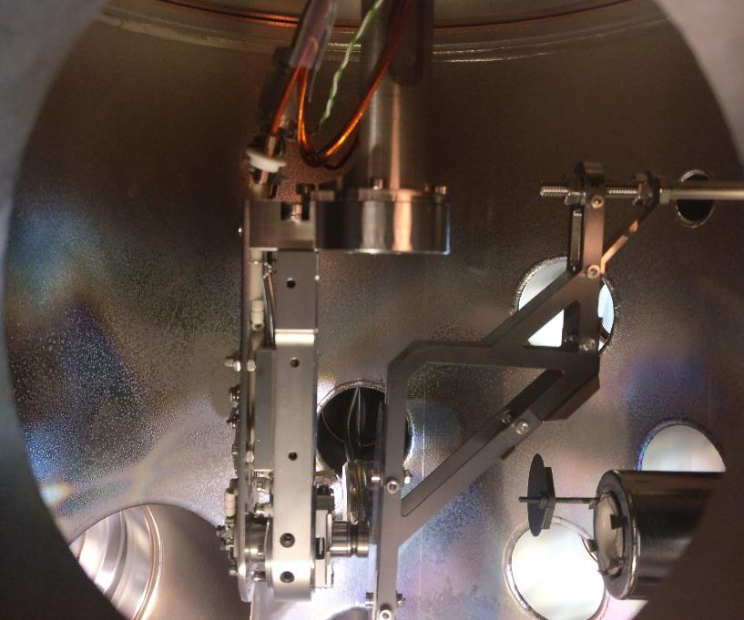
PREPARATION Chamber for alkali antimonide
manipulator
Aperture
Sample stage on XYZ,φ manipulator
QCM
Mo
Sb
source
Aperture
Sb source
Radiative heater
Thermocouples
alkali dispensers
Sample plug
Anode
Alkali dispensers
Notes:
Then let me show you the set up inside the preparation chamber, the sample is fixed in on the sample holder, which can heat the sample into desired temperature for film growing. The preparation of Na-K-Sb film is started with sb, after that, the sample will move to the alkali deposition area, Na and K is deposited on the sb film with a higher temperature in order to reacted with each other to form naksb film.

Slide 6
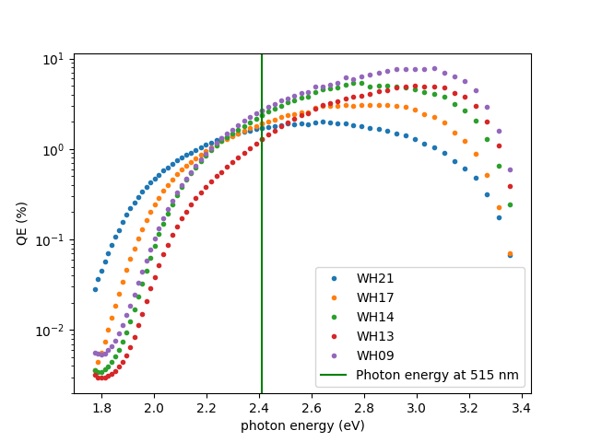
PREPARATION method and parameters
manipulator
Deposition of 40nm Sb at 90 °C
Aperture
Deposition of K at 90 °C for 180 min
Deposition of K and Na at around 130-150 °C until QE reaches peak
Mo
Sb
source
Deposition of Na and K at around 130 °C to 150 °C until QE reaches peak
Method 2
Deposition parameters control
Sample temperature
Deposition duration – controlled by photocurrent measurement
Deposition rate of alkalis – dispenser current
Other influencing factors: partial pressure of O2,H2O…
alkali dispensers
Method 1
QE curve of several Na-K-Sb photocathodes
Notes:
From 2022 to 2023, we have developed 2 recipes for Na-K-Sb film growth.
Both of the methods are started with Sb film growth.
Then we can either deposit K for 3 hours to get K-Sb and start the deposition of Na.
Or directly do deposition of both K and Na after Sb deposition.
QE curves of several Na-K-Sb photocathodes.

Slide 7
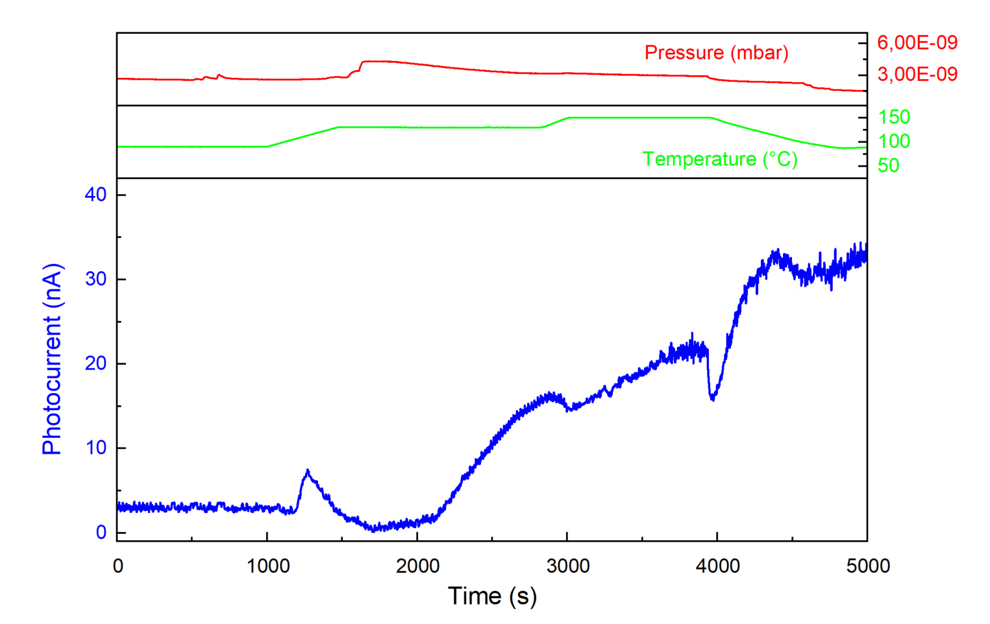
PREPARATION method and parameters
Na dispenser on (40mins)
K dispenser on
Deposition of 40nm Sb at 90 °C
150 °C
90 °C
130 °C
Deposition of K at 90 °C to 130 °C for 180 min
 | QE at 515 nm | XPS stoichiometry content
 | QE | Na | K | Sb | (Na+K)/Sb
WH13 | 1.3% | 2.0 | 0.9 | 1.0 | 2.8
Deposition of Na and K at around 130 °C to 150 °C until QE reaches peak
K-Sb
~0.3% QE
Switch off Na dispenser
Immediately when current stable
To avoid Na over saturation
Method 1
Growth of WH13 Na-K-Sb
Notes:
This pic shows a growth of method 1.
First is the growth of K-Sb, the QE of K-Sb can achieve 0.1-0.3% at 515nm.
Then we start the deposition of Na, at a increasing temperature, the photocurrent will goes down and increase again, as you can see.
Then we need to switch off Na dispenser Immediately when current stable To avoid Na over saturation, but still you can see this photocathode is slightly Na saturated, which we will come back to it in following slide.

Slide 8
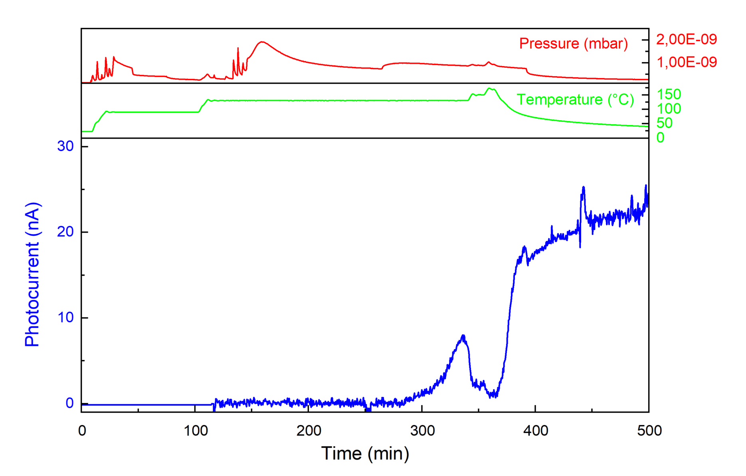
PREPARATION method and parameters
IK >INa
Sb
deposition
Na dispenser on
K dispenser on
Deposition of 40nm Sb at 90 °C
90 °C
130 °C
 | QE at 515 nm | XPS stoichiometry content
 | QE | Na | K | Sb | (Na+K)/Sb
WH13 | 1.9% | 1.5 | 1.9 | 1.0 | 3.4
Co-deposition of K and Na at around 130 °C or higher until QE reaches peak
T sample increasing
Cooling down
Method 2
Growth of WH17 Na-K-Sb
Notes:
This is the second method.
First is the deposition of Sb, then is the deposition of K and Na at 130°C, with the flow rate of K higher than Na.
Nothing happened before 250 mins of the film growth, then the photocurrent increased gradually.
Then we chose to increase temperature to accelerate the reaction, and switch off dispenser after 20 mins.
As you can see the photocurrent increased as temperature goes down.

Slide 9
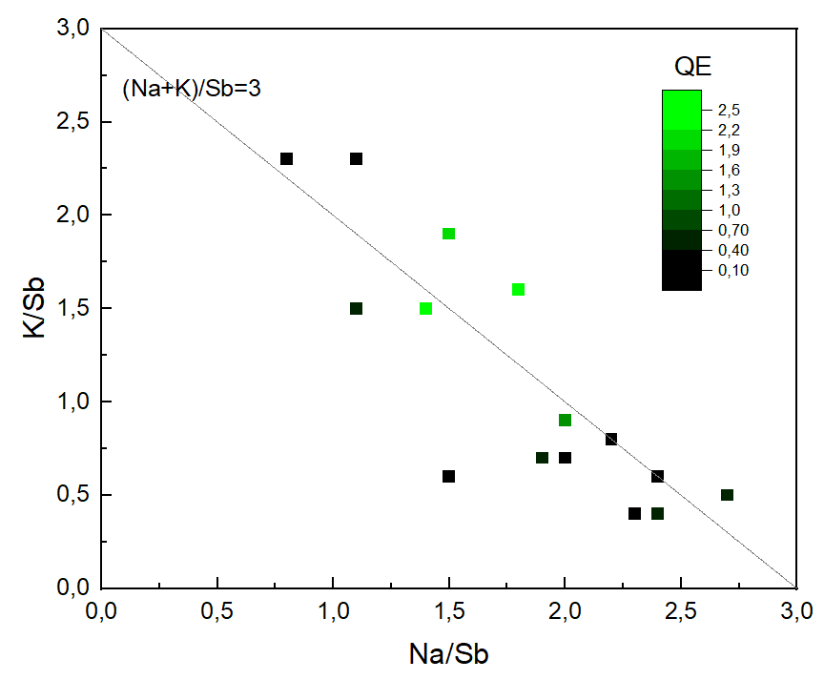
composition of stable Na-K-Sb photocathode
Group 1: Green point
QE higher than 1%, K/Sb ∈[1.0, 2.0]
Group 2: far away from the line (Na+K)/Sb=3
alkali deficiency samples
short deposition time or long distance between sample and dispensers
Group 3: Bottom right
Na saturated and K deficiency samples
high sample temperature (loss K), too long deposition time/ high Na dispenser current/ unstable Na dispenser problem.
Group 4:Top left
Na deficiency samples (uncommon)
low Na deposition time/current, Unstable Na dispensers
QE and chemical composition of 15 Na-K-Sb photocathodes
Notes:
This pic shows the QE and chemical composition of 15 Na-K-Sb photocathodes.
The X and Y axis represent its chemical composition, the line of (Na+K)/Sb=3 represent the Sb is almost fully reacted in the surface layer.
Each point represents a photocathode, and the color of it represent the QE.
4 groups, first group—qualified photocathodes
Second, third, last
Let focus on the first group in next slide…
2 points form far away from the line, alkali deficiency- short deposition time or long distance
Bottom right: Na saturated and K deficiency samples, high sample temperature (loss K), too long deposition time/ high Na dispenser current/ unstable Na dispenser problem.
Top left, not enough Na deposition time/ Unstable Na dispensers
Green point: QE higher then 1%, K 1-2
K/Sb more accurate than Na/Sb
Right table: deviation for Na higher, long mean free path, multiplied by factor twice larger than K or Sb.
Transmission function not calibrate for many years, large difference in Kinetic Energy between Na1s and K, Sb…

Slide 10
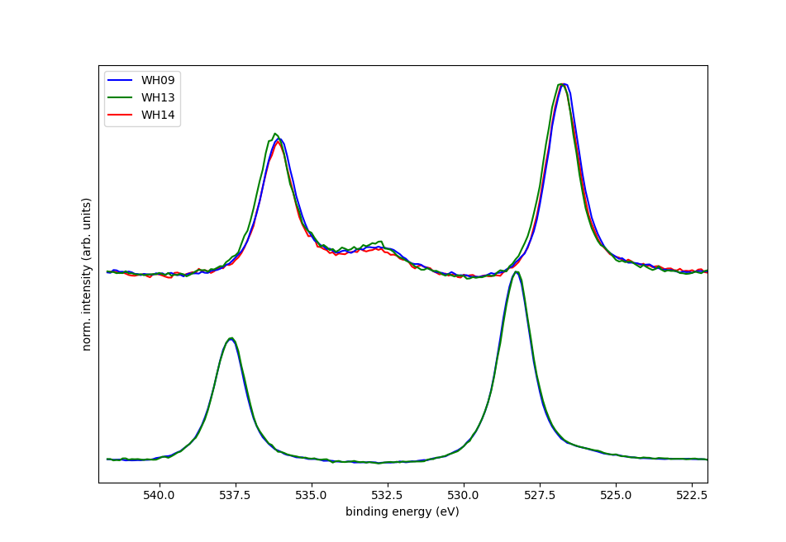
Recipe of stable Na-K-Sb photocathode
Sb (0)
Sb (3-)
 | QE at 515 nm | XPS stoichiometry content
 | QE | Na/Sb | K/Sb | (Na+K)/Sb | Na/K
WH13 | 1.3% | 2.0 | 0.9 | 2.9 | 2.2
WH09 | 2.6% | 1.4 | 1.5 | 2.9 | 0.9
WH14 | 2.4% | 1.8 | 1.6 | 3.4 | 1.1
WH17 | 1.9% | 1.5 | 1.9 | 3.4 | 0.8
Sb 3d 5/2
Sb 3d 3/2
O 1s
Na-K-Sb
QE and stoichiometry of Na-K-Sb films
Sb
Sb fully reacted
Avoid K deficiency and Na saturation
higher QE with K/Sb≈1.5 up 2.6%
Peak position of Sb 3d for Sb and Na-K-Sb films:
Sb (0) 3d 5/2 at 528.3 eV
Sb (3-) 5/2 shift to lower energy to 526.8 eV
S. Mistry, T. Kamps, J. Kühn, and C. Wang, “Multi-Alkali Antimonide Photocathode Development for High Brightness Beams”, in Proc. IPAC'22, Bangkok, Thailand, Jun. 2022, pp. 2610-2613. doi:10.18429/JACoW-IPAC2022-THPOPT019
Notes:
As you can see, The stoichiometry and the the QE of group 1 photocathode are list in the table.
We can conclude that, in a good photocathode with high QE, it has 2 features in stoichiometry.
First, Sb fully reacted, (Na+K)/Sb is close to 3.
Second, Avoid K deficiency and Na saturation, as you can see the K/Sb 1-2.
On the left pic, you can see the xps spectrum of Sb 3d peaks. In metallic Sb, the peak position is 528.3eV.
In Na-K-Sb, the peak is shifted to 526.8eV, without and shoulder, it also indicates the Sb is fully reacted.

Slide 11
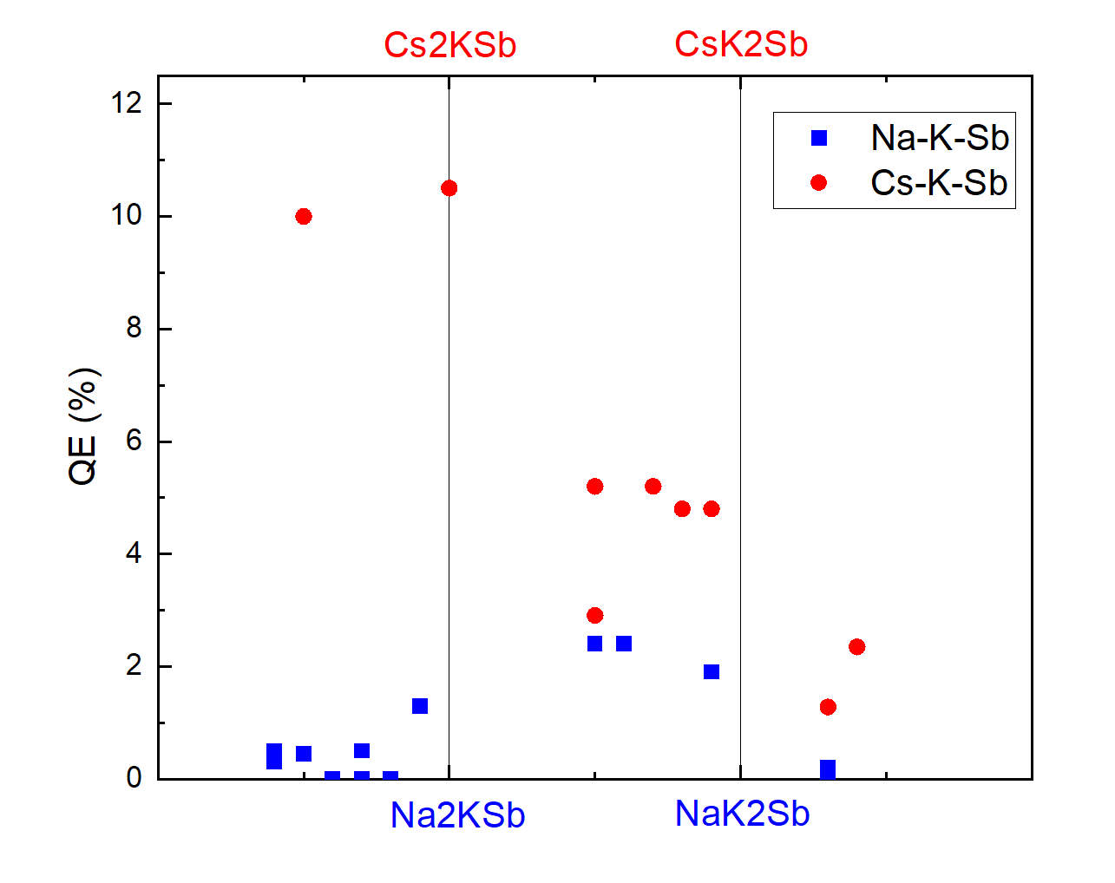
QE of Na-K-Sb and Cs-K-Sb
Type | Number | QE at 515 nm | XPS stoichiometry content
 |  | QE | Na | Cs | K | Sb | (Alkali)/Sb
Na-K-Sb | WH09 | 2.6% | 1.4 | - | 1.5 | 1.0 | 2.9
 | WH14 | 2.4% | 1.8 | - | 1.6 | 1.0 | 3.4
Cs-K-Sb | P14 | 10% | - | 1.8 | 0.5 | 1.0 | 2.3
 | P15 | 10.5% | - | 2.3 | 1.0 | 1.0 | 3.3
Chemical composition and the QE of the alkali antimonide films
QE of 13x Na-K-Sb and 9x Cs-K-Sb photocathodes
Schmeißer, Martin Anton Helmut. Photocathodes for high brightness, high average current photoelectron injectors. Humboldt Universitaet zu Berlin (Germany), 2019.
Notes:
This pic show the QE and 13x Na-K-Sb and 9x Cs-K-Sb photocathodes.
Square represent Na-K-Sb, dots for Cs-K-Sb,
From left to right is photocathodes with different chemical composition, and the bottom to up is its QE.
Generally the QE of Cs-K-Sb is higher than the Na-K-Sb…
K/Sb, rule out not fully reacted sample

Slide 12
QE of Na-K-Sb and Cs-K-Sb
Type | Number | QE at 515 nm | XPS stoichiometry content
 |  | QE | Na | Cs | K | Sb | Alkali /Sb
Na-K-Sb | WH09 | 2.6% | 1.4 | - | 1.5 | 1.0 | 2.9
 | WH14 | 2.4% | 1.8 | - | 1.6 | 1.0 | 3.4
Cs-K-Sb | P14 | 10% | - | 1.8 | 0.5 | 1.0 | 2.3
 | P15 | 10.5% | - | 2.3 | 1.0 | 1.0 | 3.3
WH13
Chemical composition and the QE of alkali antimonide films
K3Sb
Cs-K-Sb, QE peaks at high Cs content
Na-K-Sb, QE peaks at moderate Na content
QE of 13x Na-K-Sb and 9x Cs-K-Sb photocathodes
Schmeißer, Martin Anton Helmut. Photocathodes for high brightness, high average current photoelectron injectors. Humboldt Universitaet zu Berlin (Germany), 2019.
Notes:
For Cs-K-Sb, QE peaks at high Cs content,
And for Na-K-Sb, QE peaks at moderate Na content.
If Na is over saturated, the QE will goes down.
Then let me show you a example of a slightly Na over saturated sample, WH13

Slide 13
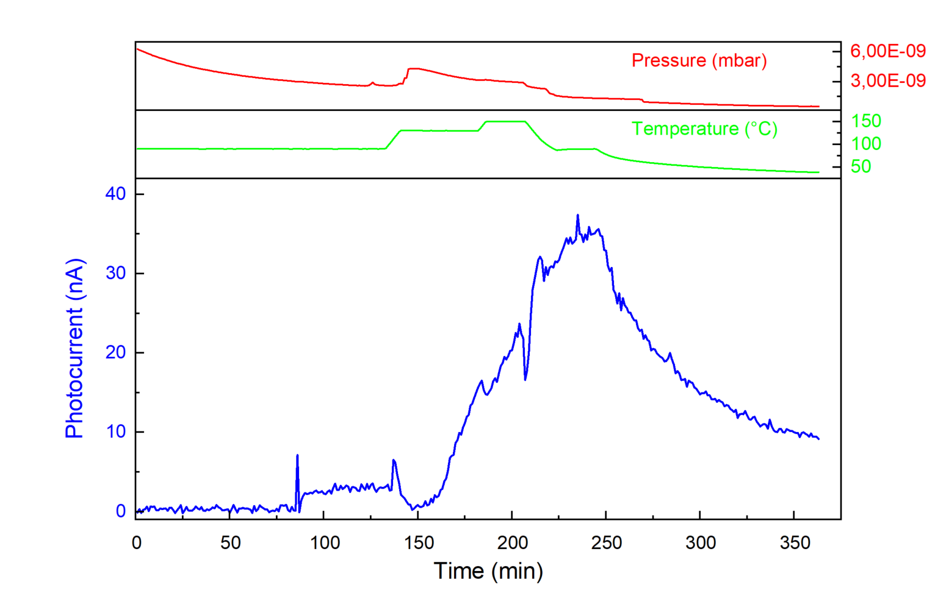
A example of Na over saturated Na-K-Sb
Na on
K dispenser on
Current starts to fall back as T goes down, indicate alkali saturation
 | QE at 515 nm | XPS stoichiometry content
 | QE | Na | K | Sb | (Na+K)/Sb
WH13 | 1.3% | 2.0 | 0.9 | 1.0 | 2.8
Reversible
208
225
Growth of WH13 Na-K-Sb
Notes:
Here we can just focus on the last part of this pic.
After growth, the photocurrent current starts to fall back as T goes down, indicate alkali saturation, which is also the general feature of over Na saturated samples.
Reversible

Slide 14
Dark lifetime of Na-K-Sb and Cs-K-Sb
Chemical composition (K/Sb) of Na-K-Sb photocathodes and their dark lifetime at low ${10}^{−10}$ mbar
 | QE (max) at 515 nm | XPS stoichiometry content |  |  |  |  | Days >1.0%
 | QE | Na | K | Sb | (Na+K)/Sb | Na/K | >1.0%
WH09 | 2.6% | 1.4 | 1.5 | 1.0 | 2.9 | 0.9 | ++
WH14 | 2.4% | 1.8 | 1.6 | 1.0 | 3.4 | 1.1 | ++
WH17 | 1.9% | 1.5 | 1.9 | 1.0 | 3.4 | 0.8 | 16
P16 | 4.8% | - | - | - | - | - | 5
P18 | 3.4% | - | - | - | - | - | 11
Chemical composition and the dark lifetime of the film
High K composition - Dark lifetime (chemical stability) decreased
Dark lifetime of Na-K-Sb and Cs-K-Sb photocathodes
Notes:
This pic show the Dark lifetime of Na-K-Sb and Cs-K-Sb photocathodes.
Still, the square represent the Na-K-Sb photocathodes, and dots represent Cs-K-Sb.
Generally, the dark lifetime of Na-K-Sb is higher than the Cs-K-Sb.
And can last for several weeks for WH09 and WH13 but for WH17, it is lower.
And we assume it is because of its higher K composition, but still higher than Cs cathodes

Slide 15
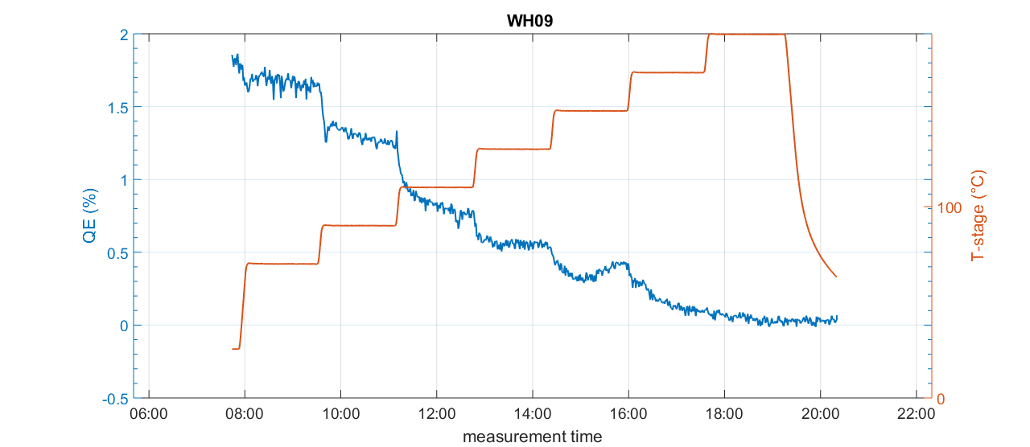
Thermal stability test (WH09)
150°C
1.7%
130°C
1.2%
110°C
90°C
70°C
0.8%
0.6%
QE remain higher than 1 % below 100 °C (90 °C stage temperature)
Notes:
This is the thermal stability test of WH09, it can remain 1.2% QE at 90 deg stage temperature which correspond to 100°C on the sample surface.

Slide 16
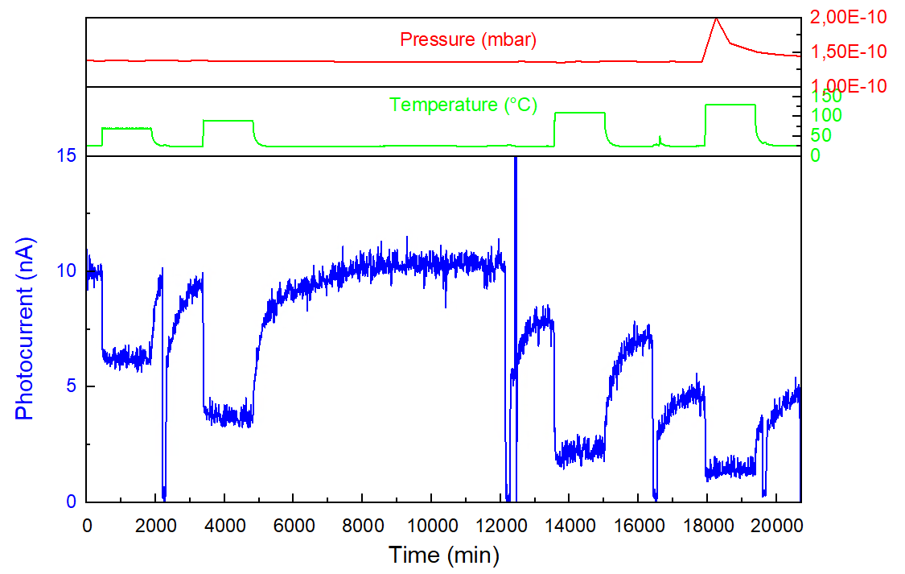
Thermal stability test (WH17)
70°C
90°C
110°C
130°C
24h
24h
24h
24h
XPS
XPS
XPS
XPS
Fully restored
Notes:
Back up pages for Page 14
X-ray also contribute to the loss of photocurrent
K-loss, xps, discussion session
Convert to qe
To hour

Slide 17
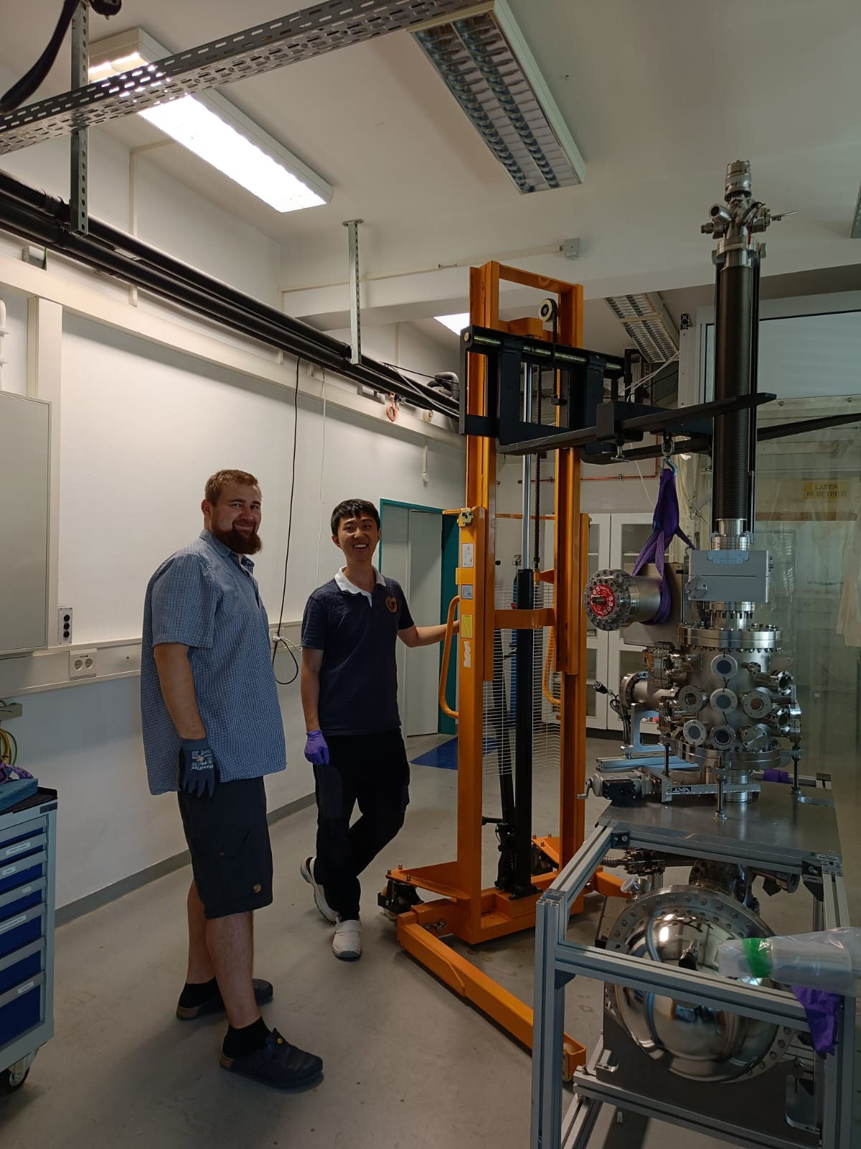
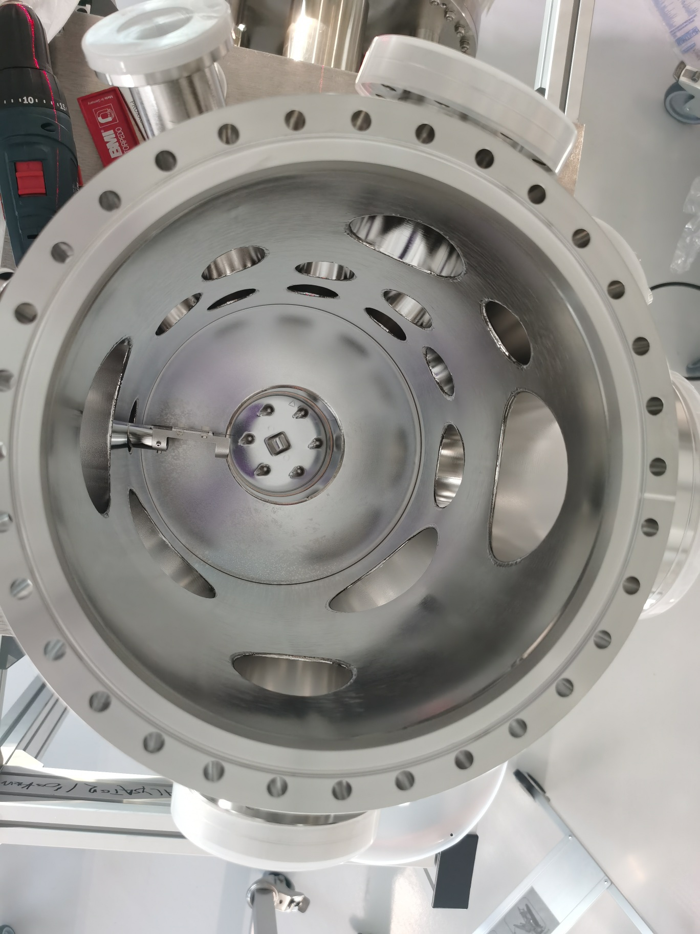
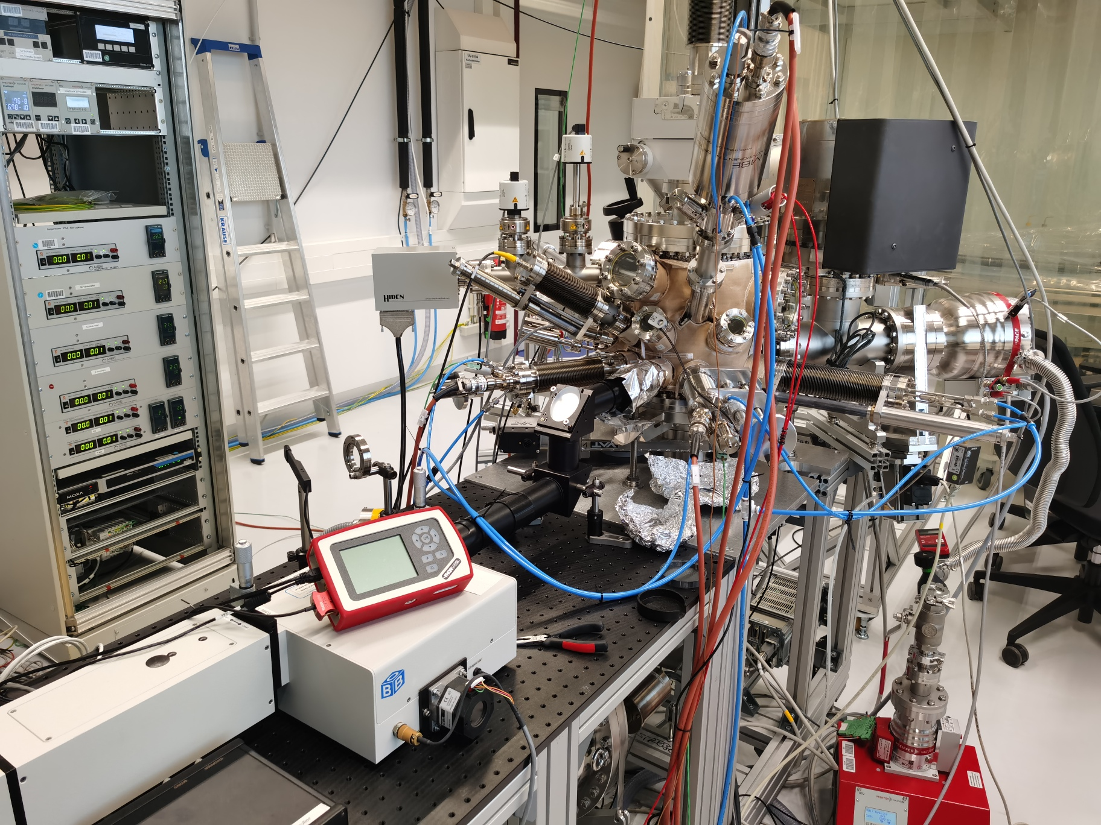
Lab move
Sep. 2023
Jan. 2024
June. 2024
Notes:
Everything was fine in our old lab, until the mid of 2023, fist the XPS broken then is the cyber attack, no computer is working, including our lab computers.
So we decide to move the lab in sep. 2023.
First chamber in new lab
Everything works again

Slide 18
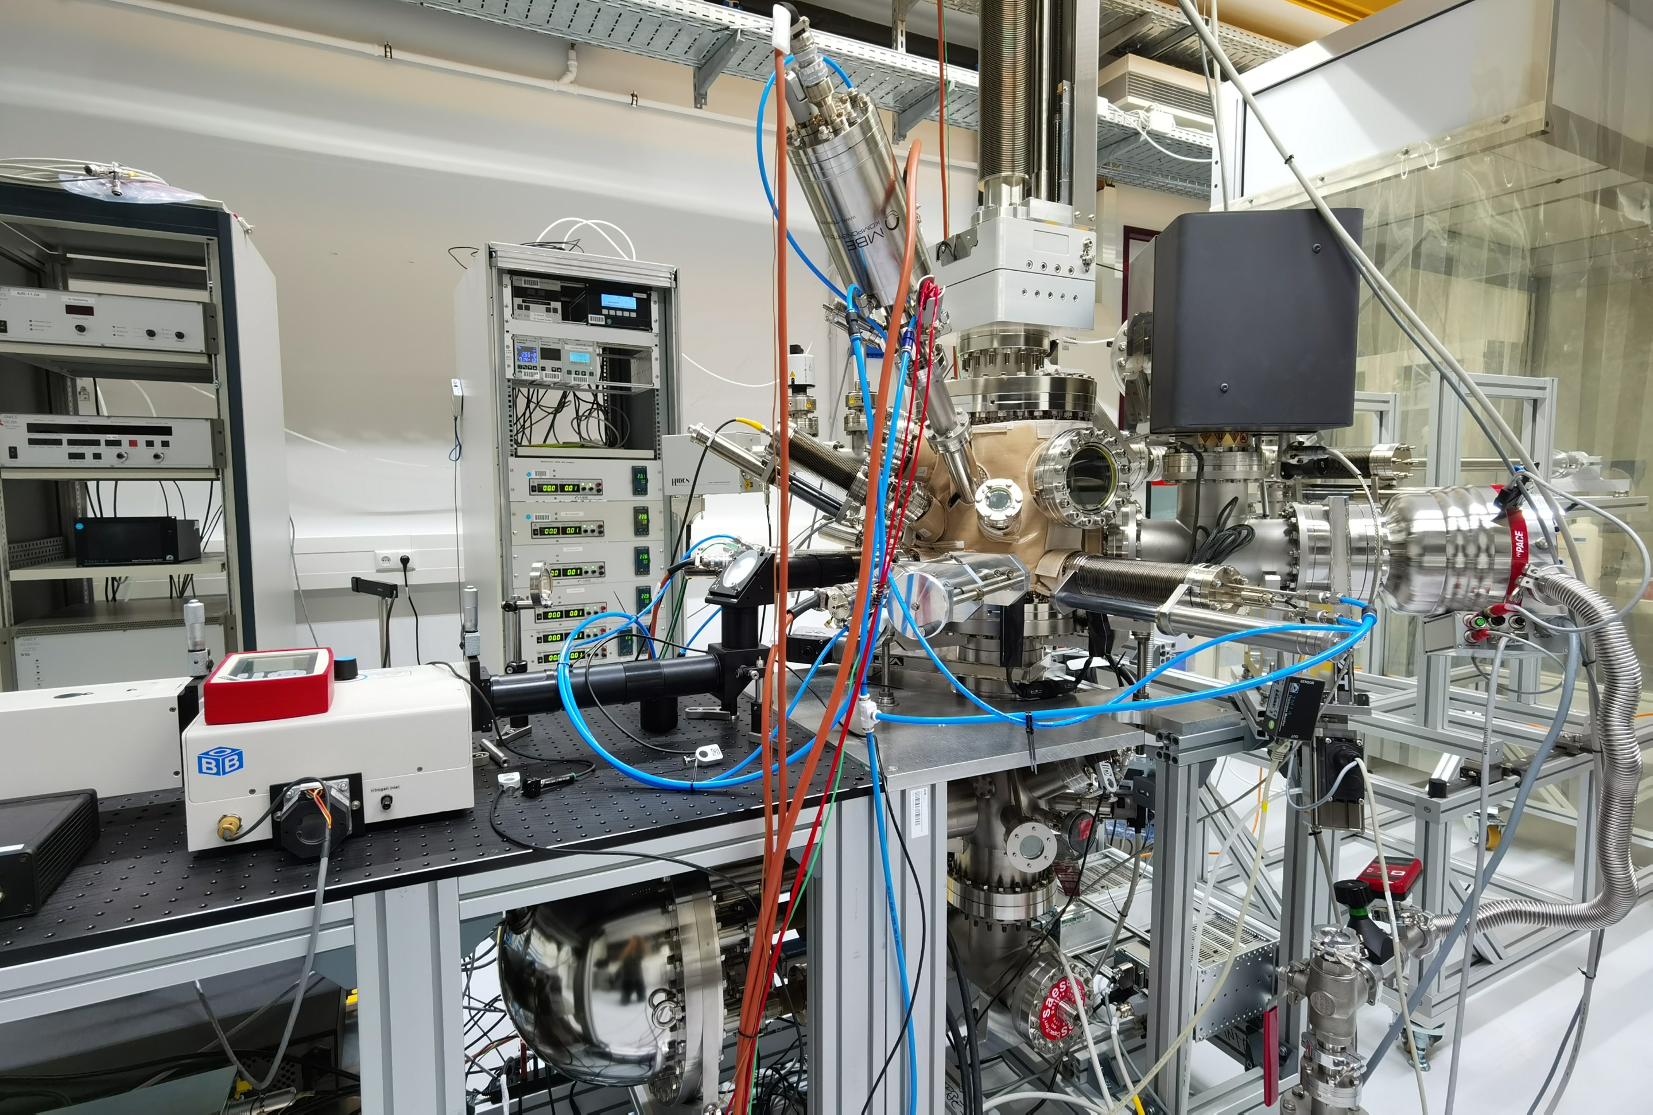
PREPARATION Chamber for alkali antimonide
Manipulator
Preparation & Analysis System (PAS) and
spectral response setup
Aperture
Sb
thermal crack cell
Photocathode
Preparation Chamber
~1·10⁻¹⁰ mbar
148mm
Spectral Response System for QE(λ) measurement
51deg
Mo
alkali effusion cells
40-190mm
30deg
Analysis Chamber for XPS measurement
~1·10⁻¹⁰ mbar
Alkali pills
Notes:
This picture shows the preparation system in the new photocathode lab.
We also upgrade the preparation system.
Triple evaporation
Sb…thermal crack cell
Replace alkali dispensers to pills, multiple growth without change sources.

Slide 19
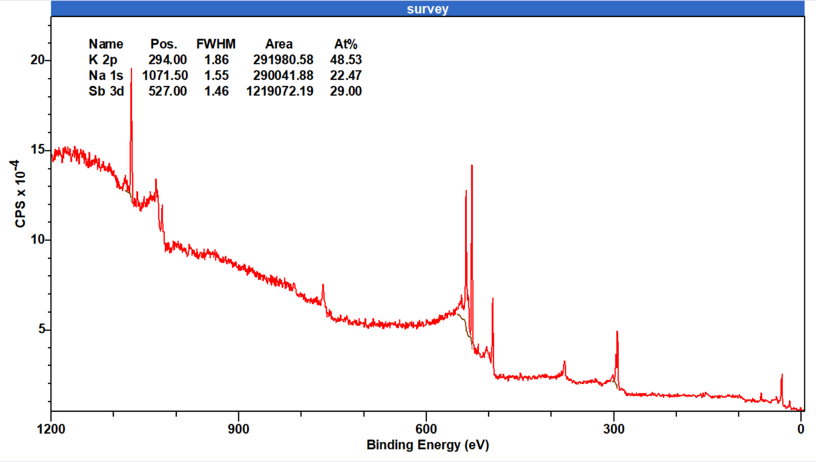
First XPS measurement
Sep. 2023
Jan. 2024
June. 2024
Na 1s
Sb MNN
Sb 3d
First XPS spectrum for Na-K-Sb film in new chamber
Sb 3p
Na KLL
K
2p
K
2s
Sb 4d
Na
2s
Mo 3d

Slide 20
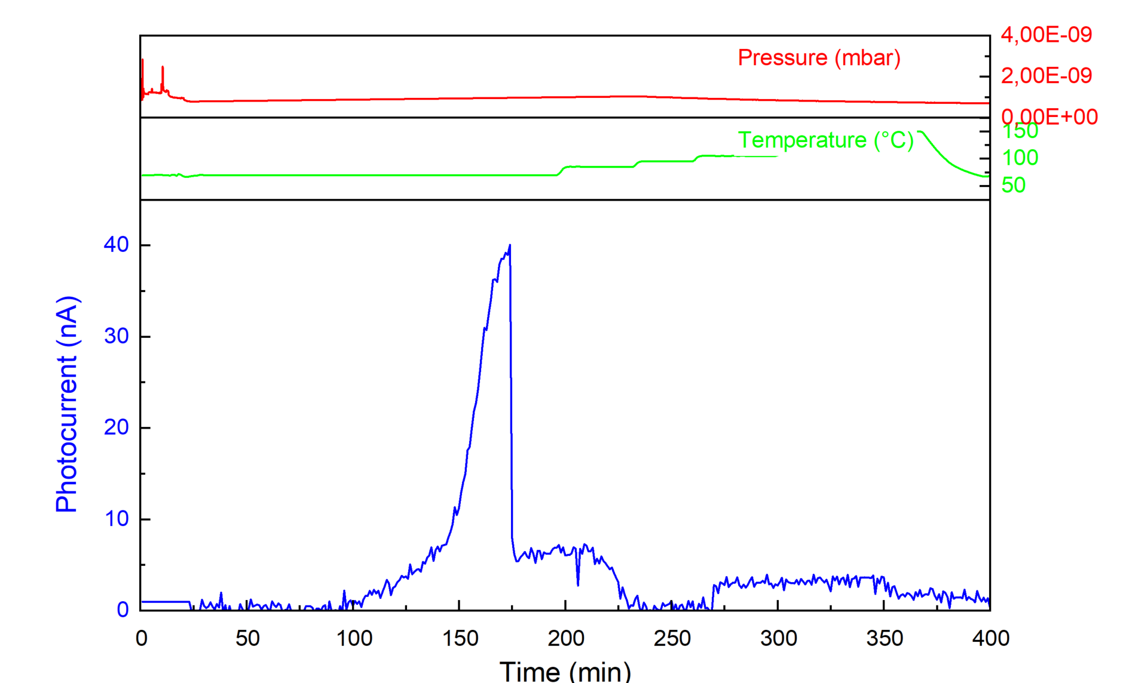
Growth in new chamber
Sep. 2023
Jan. 2024
Sep. 2024
1% QE at 450nm
0.1% QE at 520nm

Slide 21
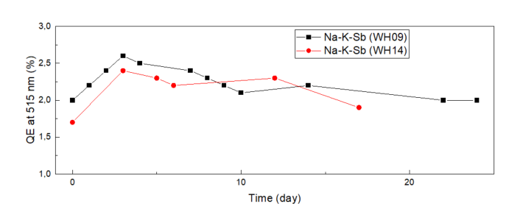
Summary and Work plan
Summery of Na-K-Sb photocathode preparation
Work plans
QE results
QE=2.6% at 515 nm
Stability
WH09 and WH14 remains >1.5% QE after 2 weeks
WH09 remains 1.2% QE at 100°C
XPS result
Ideal stoichiometry: (Na+K)/Sb ~3
K/Sb = 1.5
Synchrotron radiation study of Na-K-Sb will be conducted at EMIL in Early October.
Provide Sealab facility with a satisfying photocathode in October.
Notes:
Triple evaporation, qcm, pills

Slide 22
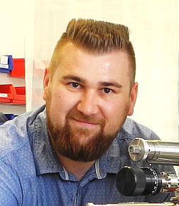
Prof. Dr. Thorsten Kamps
Dr. Julius Kühn
Dr. Sonal Mistry
Chen Wang
Jonas Dube
THANK YOU FOR YOUR ATTENTION
Prof. Dr. Caterina Cocchi
Holger-Dietrich Saßnick
Richard Schier
Prof. Dr.
Alice Galdi
Notes:
DFG add
NaKzSb has a hexagonal structure (McCarroll 1960) and is n-type. It is well known that the cubic alkali antimonides NazKSb, K3Sb, and CssSb have a very definite composition and are unstable under alkali excess. On the contrary, hexagonal alkali antimonides are stable under a high alkali excess (Sommer 1968)

Slide 23
EMIL
XPS in depth
XAS
Element | Edge | Energy range
K | K | 3605-3625
Sb | L1 | 4660-4730
Resonant inelastic X-ray scattering

Slide 24
EMIL
Cavity
Cooling system
Transfer system

Slide 25
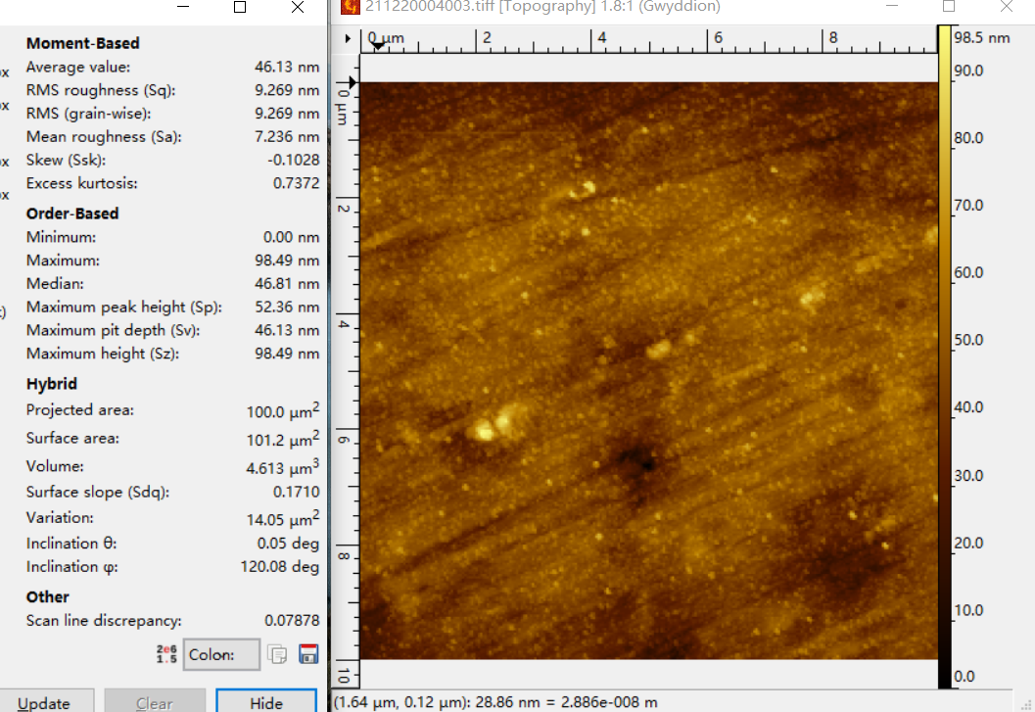
Surface roughness and Beam Emittance measurement
Emittance of electron beam contributed by photocathode:
Surface roughness (SR), and
Energy of incident electrons and work function of the photocathode
Surface roughness (SR) induced emittance:
Surface roughness of photocathode is highly dependent on:
Surface roughness of substrate
The growth method of Na-K-Sb film (Epitaxy layer)
(mismatch between substrate and Na-K-Sb crystal plane)
$$ε_{SR}=σ_{x,y}\sqrt{\frac{π^{2}a^{2}Ee}{2m_{0}c^{2}b}}$$
dfε_{SR} = SR induced emittance
σ_{x,y}= laser beam size- 1.52 mm for Sealab
a= amplitude of surface roughness
E= field gradient- 10-30 MV/m for Sealab
b= period of surface roughness
K= constants
ε_{n},_{SR} = SR induced emittance normalized to laser spot
Surface roughness of Mo substrate (Sq = 9.3nm)
Notes:
Ra, sq, sa
Thermal emittance, electron field

Slide 26
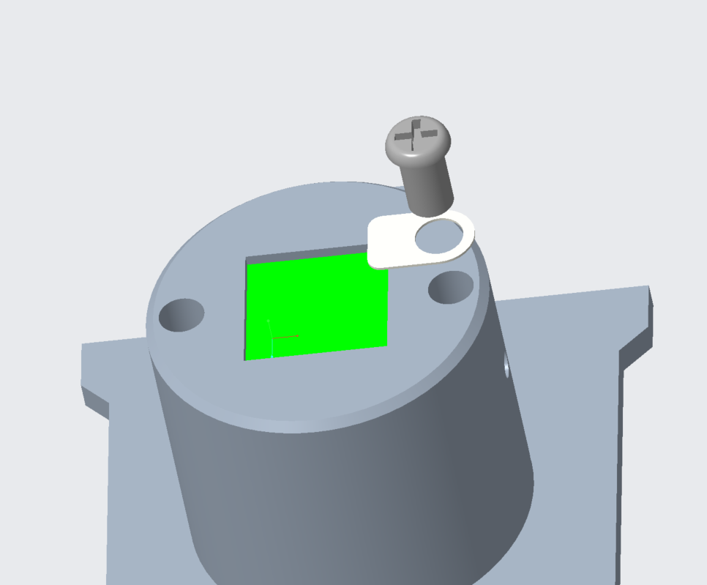
Task 5: Surface roughness and Beam Emittance measurement
Emittance of electron beam contributed by photocathode:
Surface roughness (SR), and
Energy of incident electrons and work function of the photocathode
Surface roughness of photocathode is highly dependent on:
Surface roughness of substrate
The growth method of Na-K-Sb film (Epitaxy layer)
(mismatch between substrate and Na-K-Sb crystal plane)
M1.6 Ti screws form NBK
0.1mm Mo leaf spring (workshop)
Mo plug
Plug design for holding smoother substrate
(Si, SiC, with Ra<0.1nm)
Surface roughness of Mo substrate (Sq = 9.3nm)
Notes:
Jonas chamber
Thermal emittance, electron field

Slide 27
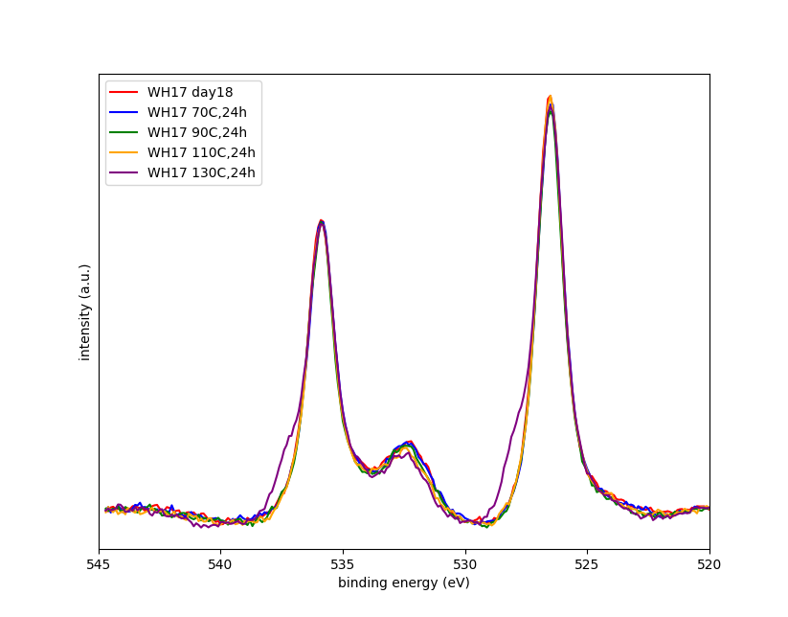
B2: thermal stability of Na-K-Sb
Chemical composition change during thermal degradation of Na-K-Sb
Chemical composition change after heating
WH17 | QE 515nm at RT | XPS stoichiometry content
 |  | Na (1s) | K | Sb | (Na+K)/Sb
Day 18 | 1.1% | 1.6 | 1.9 | 1.0 | 3.5
70°C24h | 1.1% | 1.5 | 1.9 | 1.0 | 3.4
90°C24h | 1.1% | 1.6 | 1.8 | 1.0 | 3.4
110°C24h | 0.8% | 1.8 | 1.7 | 1.0 | 3.5
130°C24h | 0.5% | 1.7 | 1.4 | 1.0 | 3.1
A second peak appears after heating up to 130°C
Sb 3d 5/2
Sb 3d 3/2
O 1s
Photocurrent decreases at higher temperature
Peak broadening of Sb 3d peak after heating up to 130°C
XPS spectrum of Sb 3d for Na-K-Sb films (WH17)
Notes:
A second peak appears after heating up to 130°C, for peak fitting please go to next page

Slide 28
B2: thermal stability of Na-K-Sb
Chemical composition change during thermal degradation of Na-K-Sb
Chemical composition change after heating
WH17 | QE 515nm at RT | XPS stoichiometry content
 |  | Na (1s) | K | Sb | (Na+K)/Sb
Day 18 | 1.1% | 1.6 | 1.9 | 1.0 | 3.5
70°C24h | 1.1% | 1.5 | 1.9 | 1.0 | 3.4
90°C24h | 1.1% | 1.6 | 1.8 | 1.0 | 3.4
110°C24h | 0.8% | 1.8 | 1.7 | 1.0 | 3.5
130°C24h | 0.5% | 1.7 | 1.4 | 1.0 | 3.1
Slightly decrease of O 1s peak after heating up to 130°C
Sb 3d 5/2
Sb 3d 3/2
O 1s
Photocurrent decreases at higher temperature
Peak broadening of Sb 3d peak after heating up to 130°C
No trace of oxidation during thermal stability study
XPS spectrum of Sb 3d for Na-K-Sb films (WH17)

Slide 29
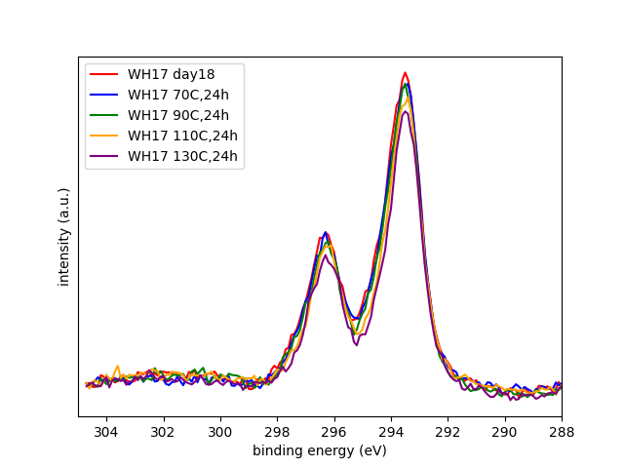
B2: thermal stability of Na-K-Sb
Chemical composition change during thermal degradation of Na-K-Sb
K 2p 3/2
Chemical composition change after heating
WH17 | QE 515nm at RT | XPS stoichiometry content
 |  | Na (1s) | K | Sb | (Na+K)/Sb
Day 18 | 1.1% | 1.6 | 1.9 | 1.0 | 3.5
70°C24h | 1.1% | 1.5 | 1.9 | 1.0 | 3.4
90°C24h | 1.1% | 1.6 | 1.8 | 1.0 | 3.4
110°C24h | 0.8% | 1.8 | 1.7 | 1.0 | 3.5
130°C24h | 0.5% | 1.7 | 1.4 | 1.0 | 3.1
Decrease of K 2p peak after heating up above 110°C
K 2p 1/2
Photocurrent decreases at higher temperature
Peak broadening of Sb 3d peak after heating up to 130°C
No trend of oxidation during thermal stability study
Decrease of K 2p peak after heating up above 110°C
XPS spectrum of K 2p for Na-K-Sb films (WH17)
Notes:
K content before 90C, 24h is relatively stable, K to Sb ratio maintains 1.8 – 1.9 , after that it decreases to 1.7 at 130C, 24h, and 1.4 at 110C. It suggests that the degradation of photocurrent is due to the loss of alkali (at least K) content.

Slide 30
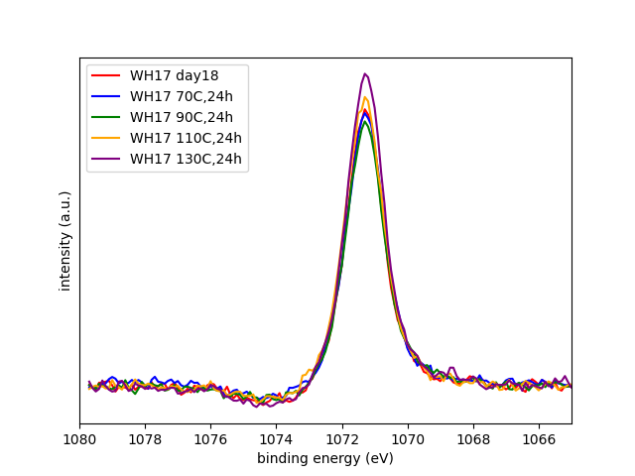
B2: thermal stability of Na-K-Sb
Chemical composition change during thermal degradation of Na-K-Sb
Na 1s
Chemical composition change after heating
WH17 | QE 515nm at RT | XPS stoichiometry content
 |  | Na (1s) | K | Sb | (Na+K)/Sb
Day 18 | 1.1% | 1.6 | 1.9 | 1.0 | 3.5
70°C24h | 1.1% | 1.5 | 1.9 | 1.0 | 3.4
90°C24h | 1.1% | 1.6 | 1.8 | 1.0 | 3.4
110°C24h | 0.8% | 1.8 | 1.7 | 1.0 | 3.5
130°C24h | 0.5% | 1.7 | 1.4 | 1.0 | 3.1
Increase of Na 1s peak after heating up to 130°C
Photocurrent decreases at higher temperature main due to the loss of K composition and decomposition of Na-K-Sb phase.
Peak broadening of Sb 3d peak after heating up to 130°C
No trace of oxidation during thermal stability study
Decrease of K 2p peak after heating up above 110°C
Increase of Na 1s peak after heating up to 130°C
XPS spectrum of Na 1s for Na-K-Sb films (WH17)
Notes:
Peak intensity of Na 1s increases after heating up to 130°C, it indicates the diffusion of Na to the surface.
The reason for the decrease in QE may be due to changes in surface chemical composition (increase in Na, decrease in K, and formation of a "metallic" Sb phase). This means that the Na-K-Sb phase (which contribute to high QE) decomposes at higher temperatures and forms an alkali deficient second phase, and this phase does not contribute much to QE

Slide 31
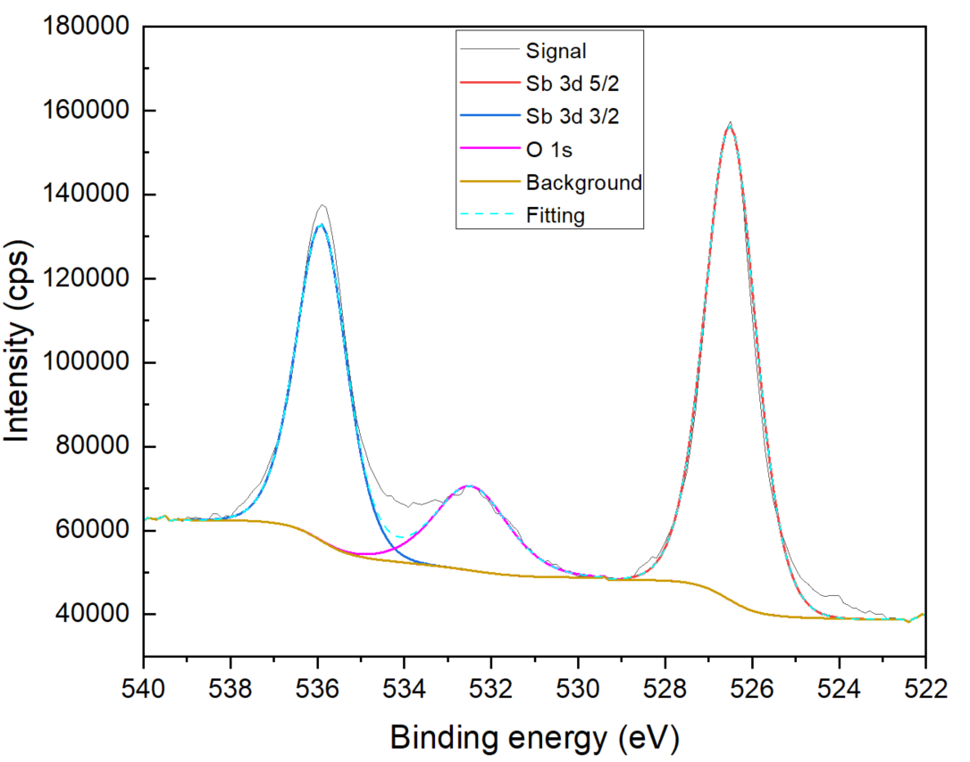
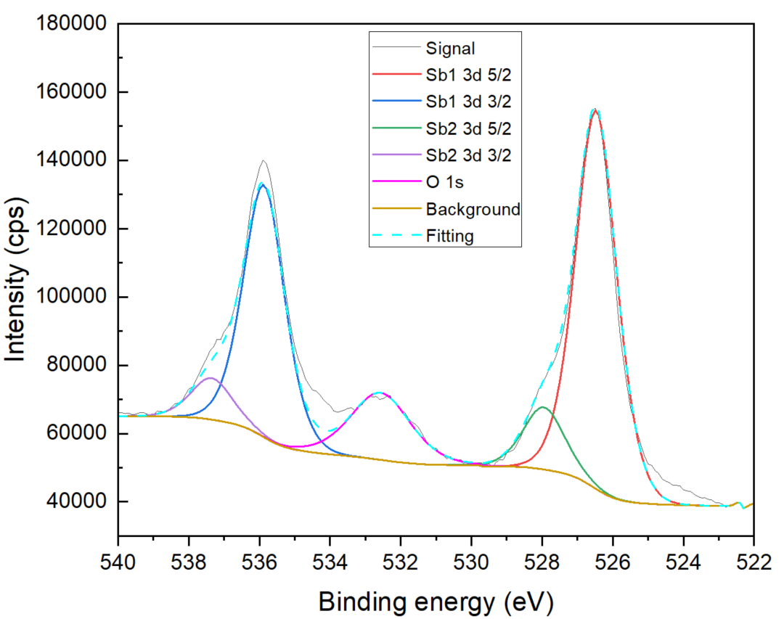
Back up pages Thermal stability study of Na-K-Sb
526.5
526.5
535.9
535.9
537.4
532.6
532.4
528.0
XPS spectrum of Sb 3d after 110°C, 24h
XPS spectrum of Sb 3d after 130°C, 24h
Notes:
The fitting of Sb also supports this point, a second peak of Sb 3d 5/2 appears at higher energy, which indicates some more “metallic” Sb (actually, it could be some alkali deficient phases) exists, and it suggests the deficiency of alkalis.

Slide 32
Overview Na-K-Sb photocathodes grown in 2022-2023
Sample | QE | Composition by XPS |  |  | Method | Remark
 | 515 nm | Na | K | Sb
WH04 | - | 1.5 | 0.6 | 1 | Sequential | low alkali content
WH05 | - | 2.2 | 0.8 | 1 | Co-deposition | high Na content
WH06 | 0.5 % | 2.4 | 0.4 | 1 | Co-deposition | high Na content,
WH06+K | 0.4 % | 2.7 | 0.5 | 1 |  | Additional K deposition after WH06
WH07 | - | 2 | 0.7 | 1 | Sequential deposition | temperature too high for K deposition
WH08 | 0.2 % | 0.8 | 2.3 | 1 | Hybrid-deposition | High K content (Hybrid without heating up to 150C)
WH09 | 2.6 % | 1.4 | 1.5 | 1 | Hybrid-deposition | Sample position y=5 closer to alkali metal sources
WH10 | 0.5 % | 1.1 | 1.5 | 1 | Hybrid-deposition | repetition of WH09, Sample position y=0, low alkali content
WH11 | 0.5 % | 1.9 | 0.7 | 1 | Hybrid-deposition | repetition of WH09, Sample position y= 10, high Na content
WH12 | 0.3% | 2.3 | 0.4 | 1 | Hybrid-deposition | repetition of WH09, Sample position y= 5, high Na content
WH13 | 1.3 % | 2 | 0.9 | 1 | Hybrid-deposition | Sample position y=5, high Na content
WH14 | 2.4 % | 1.8 | 1.6 | 1 | Co-deposition | different temperatures
WH15 | - | 1.1 | 2.3 | 1 | Hybrid deposition | different temperatures, single Na-dispenser
WH16 | - | 2.4 | 0.6 | 1 | Co-deposition | Repetition of WH14, long co-deposition time 6h, high Na content
WH17 | 1.9 % | 1.5 | 1.9 | 1 | Co-deposition | different temperatures

Slide 33
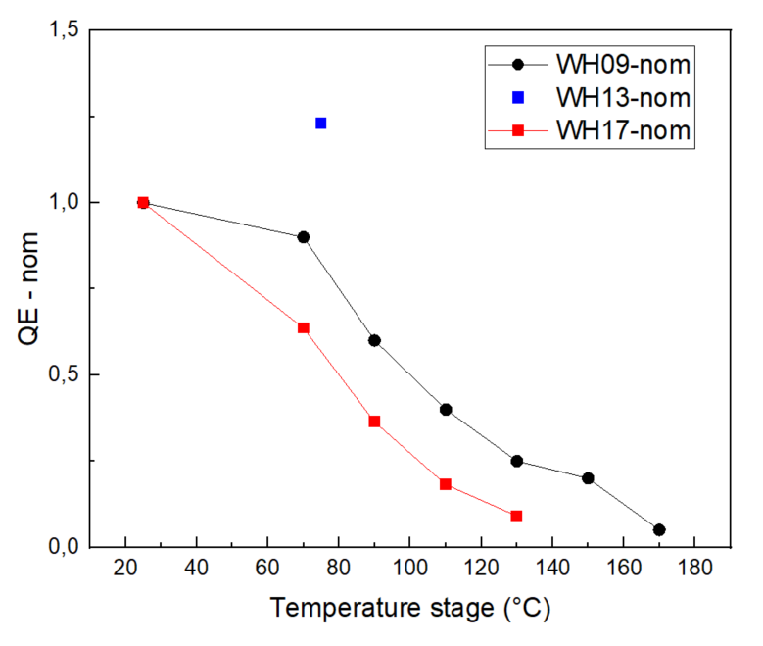
Thermal stability study
Thermal stability study of Na-K-Sb, the thermal stability and chemical composition of the film
 | XPS stoichiometry content |  |  |  |  | QE data
 | Na | K | Sb | (Na+K)/Sb | Na/K | QE at 25°C | QE at 70°C | remain
WH17 | 1.5 | 1.9 | 1.0 | 3.4 | 0.8 | 1.1% | 0.7% | 63%
WH09 | 1.4 | 1.5 | 1.0 | 2.9 | 0.9 | 2.0% | 1.8% | 90%
WH13 | 2.0 | 0.9 | 1.0 | 2.9 | 2.2 | 1.3% | 1.6% | 120%
Chemical composition and the thermal stability of the film
Experiment condition of WH09, WH13 and WH17 are different.
Research plan (missing data): 1 thermal study of Na-K-Sb with high K/Sb (at around 2.0)
1 thermal study of Na-K-Sb with low K/Sb (at around 1.0)
Photocurrent change during heating
Notes:
Pic change, expriement condition not same

Slide 34
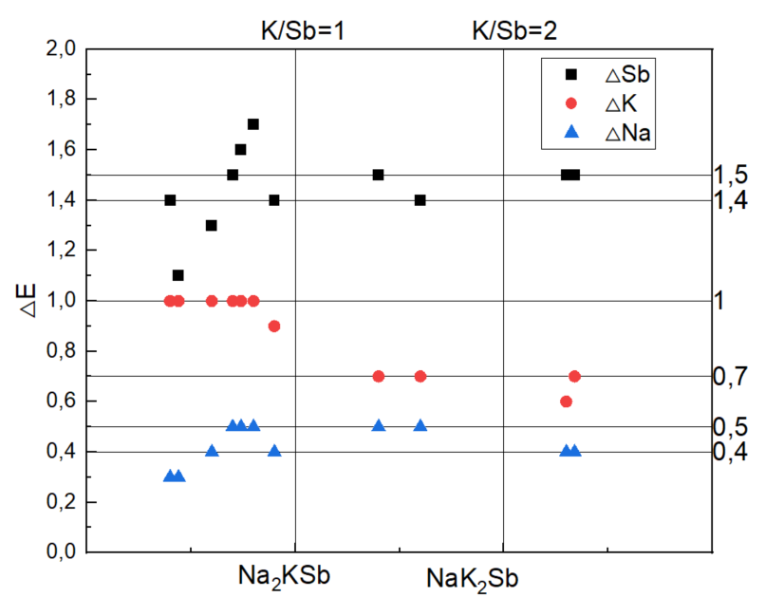
Task 1: Experiment result compare with Theory study
For NaK2Sb,
From Experiment:
△Sb = 1.4 – 1.5 eV
△K = 0.7 eV
△Na(high deviation) = 0.4 – 0.5 eV
From Calculation:
△Sb = 1.5eV
△K = -0.7 eV
△Na = -0.6eV
+-37%
Notes:
Most Na dominated sample are alkali deficient sample
Na value is reference value, due to the transmission function problem

Slide 35
Number | K% | Na% | Sb | △Sb | FWHM | K | △K | Na | △Na | FWHM | QE
6 | 0,4 | 2,4 | 526,8 | 1,4 | 1,41 | 293,4 | 1,0 | 1071,7 | 0,3 | 1,39 | 0.5%
12 | 0,4 | 2,3 | 527,1 | 1,1 | 1,39 | 293,4 | 1,0 | 1071,7 | 0,3 | 1,34 | 0.3%
16 | 0,6 | 2,4 | 526,9 | 1,3 | 1,41 | 293,4 | 1,0 | 1071,6 | 0,4 | 1,4
7 | 0,7 | 2 | 526,7 | 1,5 | 1,35 | 293,4 | 1,0 | 1071,5 | 0,5 | 1,37
11 | 0,7 | 1,9 | 526,6 | 1,6 | 1,27 | 293,4 | 1,0 | 1071,5 | 0,5 | 1,31 | 0.5%
5 | 0,8 | 2,2 | 526,5 | 1,7 | 1,43 | 293,4 | 1,0 | 1071,5 | 0,5 | 1,48
13 | 0,9 | 2 | 526,8 | 1,4 | 1,29 | 293,5 | 0,9 | 1071,6 | 0,4 | 1,36 | 1.3%
9 | 1,4 | 1,5 | 526,7 | 1,5 | 1,35 | 293,7 | 0,7 | 1071,5 | 0,5 | 1,35 | 2.6%
14 | 1,6 | 1,8 | 526,8 | 1,4 | 1,26 | 293,7 | 0,7 | 1071,5 | 0,5 | 1,32 | 2.4%
15 | 2,3 | 1,1 | 526,7 | 1,5 | 1,26 | 293,8 | 0,6 | 1071,6 | 0,4 | 1,23
8 | 2,3 | 0,8 | 526,7 | 1,5 | 1,13 | 293,7 | 0,7 | 1071,6 | 0,4 | 1,09 | 0.2%

Slide 36
Peak position
 |  | QE at 515 nm | Peak position for Sb 3d 5/2 (eV) | Peak position for K 2p 3/2 (eV)
P007 | Sb | / | 528.3 | /
 | K-Sb | - | 526.3 | 293.3
 | Cs-K-Sb | 1.6% | 526.3 | 293.3
P006 | Cs-K-Sb | 4.8% | 526.3 | 293.3
P009 | Cs-K-Sb | 2.6% | 526.3 | 293.3
P013 | Cs-K-Sb | 5.6% | 526.3 | 293.3
WH15 | Sb | / | 528.2 | /
 | K-Sb | 0.3% | 526.3 | 293.4
 | Na-K-Sb | 0 | 526.8 | 293.8
WH09 | Na-K-Sb | 2.4% | 526.8 | 293.7
WH14 | Na-K-Sb | 2.4% | 526.8 | 293.7

Slide 37
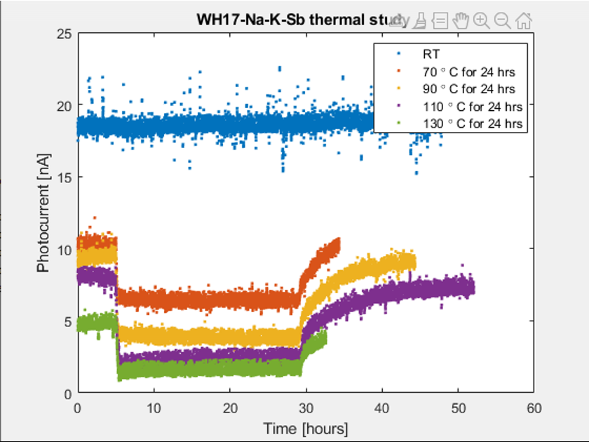
thermal
 | Day | XPS stoichiometry content
 |  | Na (1s) | Na(2s) | K | Sb | (Na+K)/Sb
WH17 | 16 | 1.6 |  | 1.8 | 1.0 | 3.4
WH17 | 70C24h | 1.4 |  | 1.9 | 1.0 | 3.3
WH17 | 90C24h | 1.6 | 1.2 | 1.8 | 1.0 | 3.4
WH17 | 110C24h | 1.8 | 1.0 | 1.7 | 1.0 | 3.5
WH17 | 130C24h | 1.6 | 0.9 | 1.4 | 1.0 | 3.0

