Slide 1
Promoting Epitaxy in Alkali Antimonides Jared Maxson Cornell University EWPAA, Sep 18 2024 HZDR

Slide 2
Overview
The phrase “promoting epitaxy” has two interpretations:
Encouraging the conditions for epitaxy during material growth
Popularizing/advertising the benefits of epitaxial cathodes
I will try to do both.

Slide 3
Acknowledgements
The data in this talk is the result of the work of a large team. I take credit for very little of it!
Cornell: C. Pennington, E. M. Echeverria, C. Parzyck, J.K. Nangoi, T. Wu, W. DeBenedetti, K. Shen, D. Schlom, M. Hines, T. Arias, H. Paik, C. Hu
Brookhaven National Lab: M. Gaowei, , K. Evans-Lutterodt, K. P. Mondal
U. Salerno: A. Galdi
U. Vienna: T. Juffmann
Arizona State: S. Karkare, P. Saha
SLAC: J. Smedley
Leiden University: S.J. van der Molen, W.G. Stam
IBM: R.M. Tromp
This work was funded in part by DOE Basic Energy Sciences, as part of a grant to study photocathodes for LCLS-II-HE, and by the NSF Center for Bright Beams.
Special thanks to my “Gurus”:
A. Galdi (MBE, RHEED)
J. Smedley + M. Gaowei (X-ray characterization

Slide 4
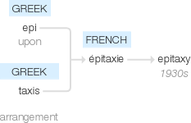
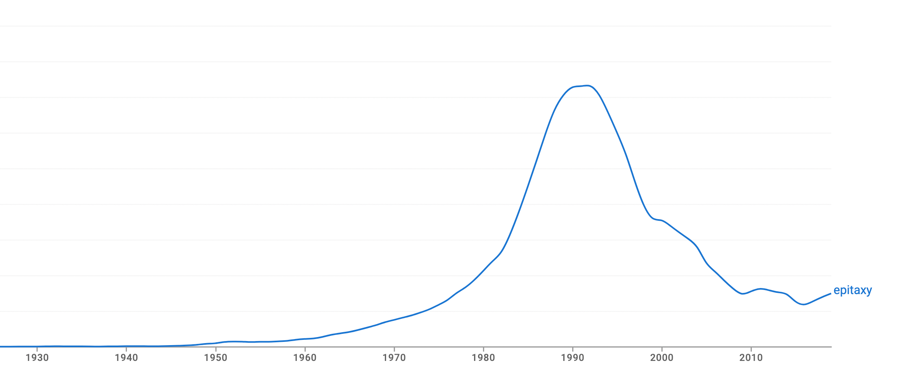
The meaning of “epitaxy”
Epitaxy: using a crystalline substrate to seed the growth of (at least approximately) lattice-matched films.
An epitaxial films has only one or few definite lattice relationships between the substrate and film.
Often the goal is a single relationship between substrate and film, approaching single crystal growth. “Lattice matching”.
Google Etymology
1920
1991
now
Google Ngram Viewer
Usage in Books
year

Slide 5
Benefits of Epitaxy
Epitaxial films can be near-atomically smooth.
Why care?
MTE from “chemical” roughness
MTE from physical roughness
Surface potential
variation
Fourier Amplitude
$$MTE∝\frac{ΔV^{2}}{E_{0}}$$
Applied field
Applied field
$$MTE∝\sum_{λ}{\frac{A^{2}\left(λ\right)E_{0}}{λ}}$$
Karkare and Bazarov. Phys. Rev. Appl., 4:024015 (2015)
G. S. Gevorkyan et al.,
Phys. Rev. Accel. Beams 21, 093401 (2018)
wavelength
Feng et al., J. Appl. Phys. 121, 044904 (2017) (see references therein)
Note: Limited experimental demos of these so far (hard to control!), but these rules are very fundamental.

Slide 6
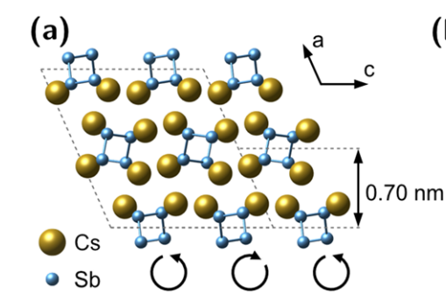
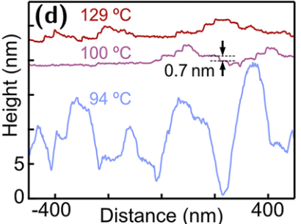
Benefits of Epitaxy
Epitaxial films can be near-atomically smooth.
Example: Cs₁Sb (See A. Galdi’s talk)
Grown on lattice matched substrates (3C-SiC and Rutile TiO₂)
Not perfectly epitaxial: Rotational in-plane disorder w.r.t substrate.
But nonetheless very flat, as measured by STM.
Cs₁Sb
looking down
[010]
STM Measurements @ Cornell
Note: Epitaxial films need not be smooth, and smooth films need not be epitaxial. It is a good place to start, though!

Slide 7
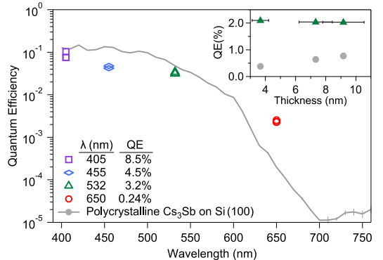
Benefits of Epitaxy
Epitaxial photocathodes have high QE even when very thin (fast)
Single crystal Cs₃Sb
(Explanation of how we know later)
Thin and high QE
As yet mysterious red enhancement! (work function? Less defect/impurity scattering?)
Parzyck et al., PRL 128, 114801 (2022)
Thin also means less scattering overall: perhaps closer to a “one step photoemitter?”

Slide 8
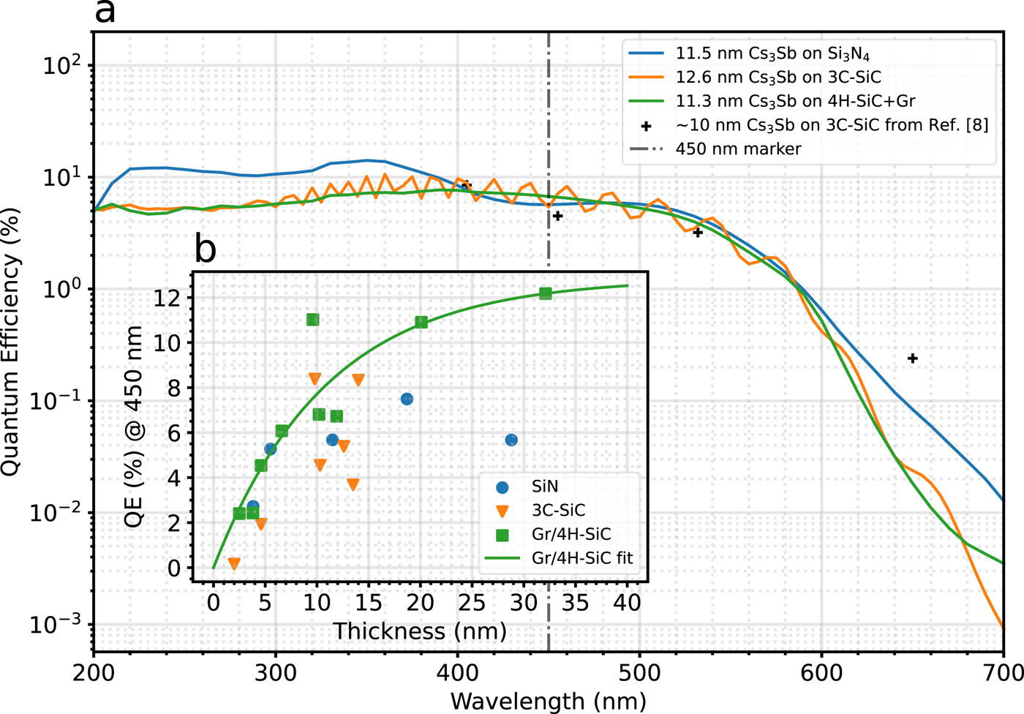
Benefits of Epitaxy
Epitaxial photocathodes have high QE even when very thin (fast)
A series of Cs₃Sb photocathodes grown on Si₃N₄, 3C-SiC, and Gr/4H-SiC also show very high QE at small thickness values.
W. G. Stam et al., APL Mater. 12, 061114 (2024)
Thin also means less scattering: perhaps closer to a “one step photoemitter?”

Slide 9
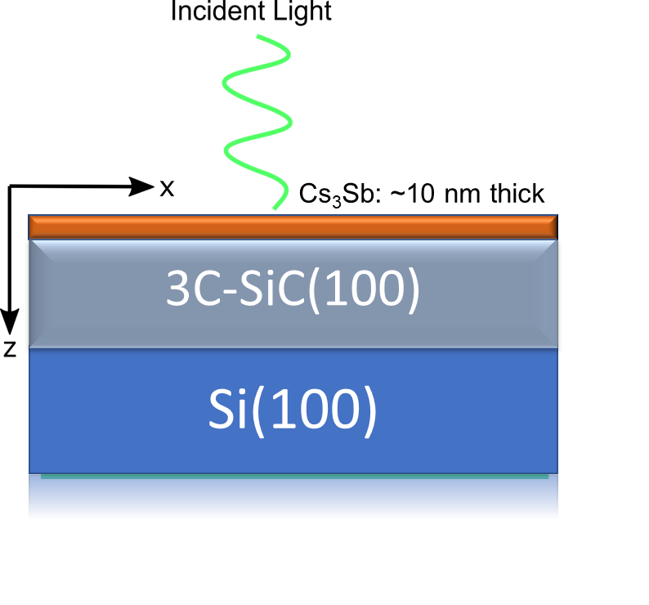
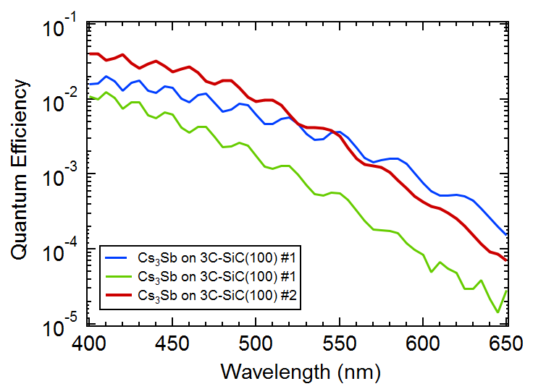
Benefits of Epitaxy
Single crystal substrates and smooth cathodes have another benefit: interference enhancement to QE:
Cs₃Sb
1.3 um
~0.5 mm
Interference in the film thanks to substrate reflections
(SiC is ~transparent here). NB: Still fast!

Slide 10
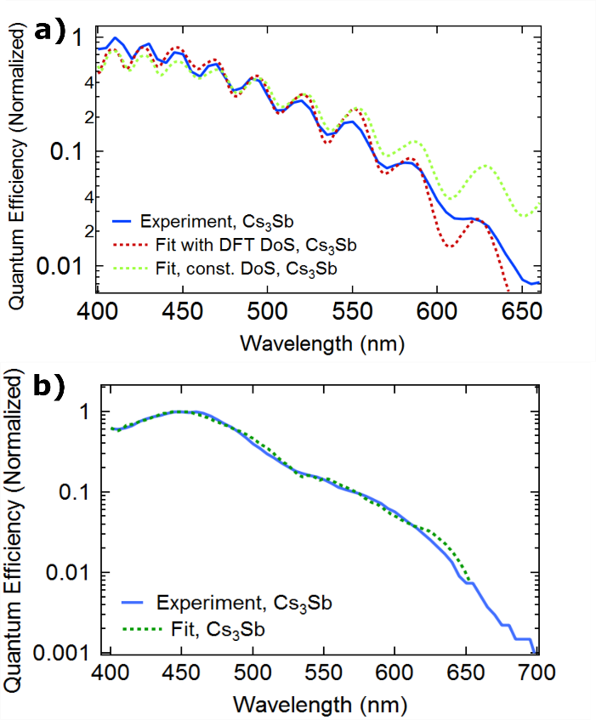
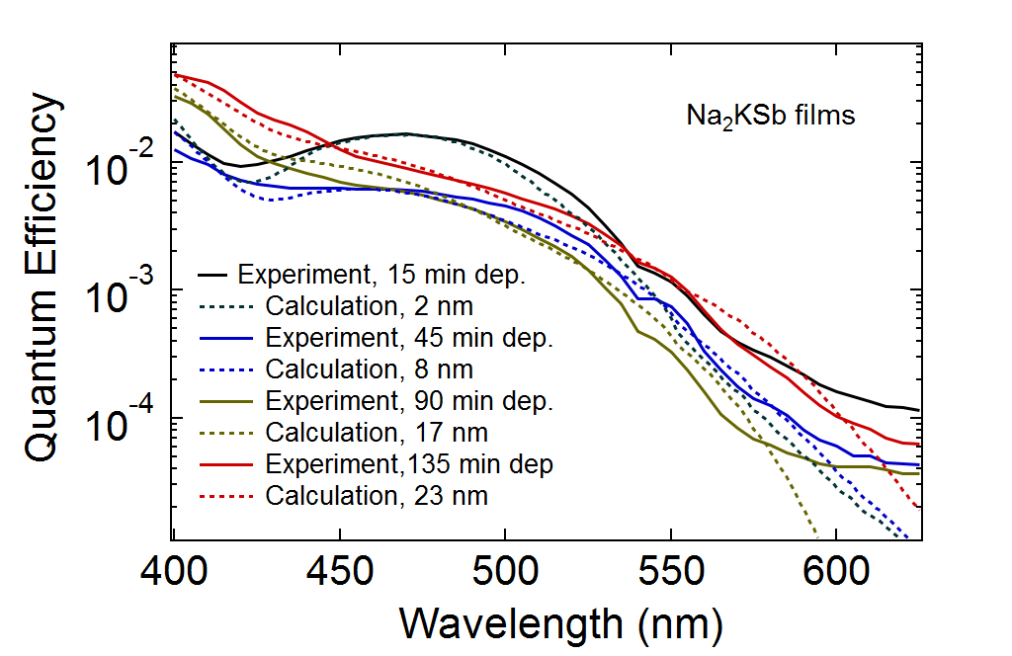
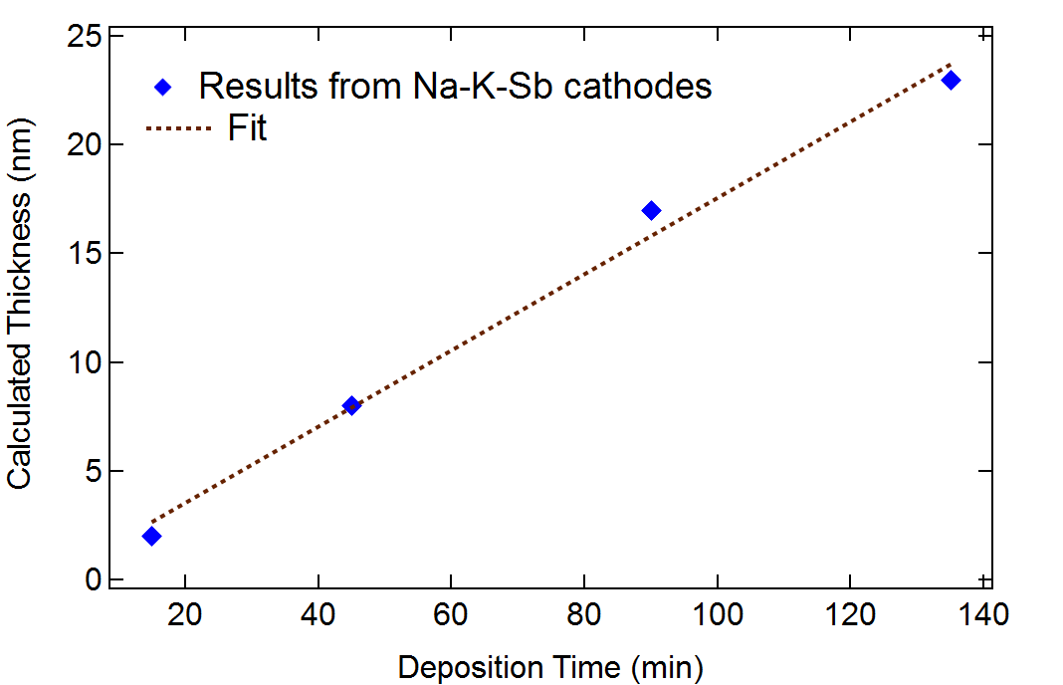
Some details on interference effects
We can model the interference effects quite well
Use DFT for calculation of material properties (DoS, indices of refraction)
1.3 um SiC layer
0.3 um SiC layer
Fits to the data seem to yield reasonable thickness values!

Slide 11
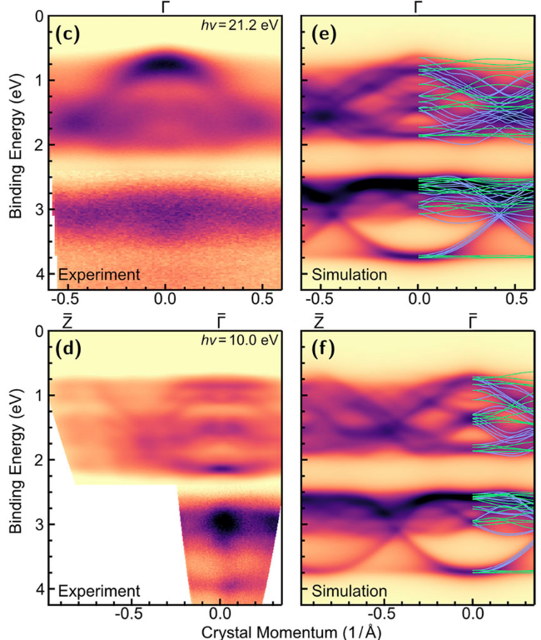
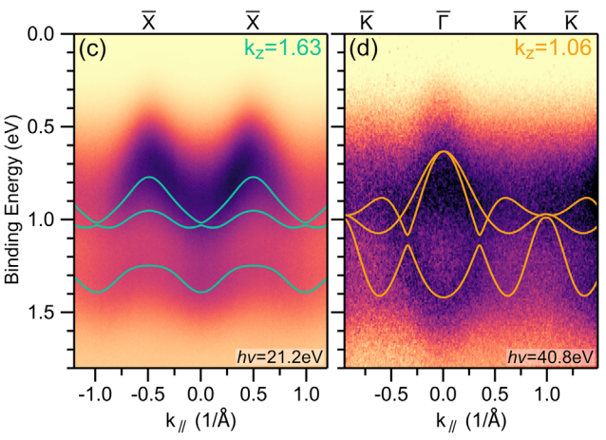
Benefits of Epitaxy
You can understand what you’ve grown!
Examples: ARPES measurement compared to DFT
Epitaxial Cs₃Sb on 3C-SiC
Fiber-Textured
Cs₁Sb₁
Has a ~1-D band structure:
Even rotational disordered films show ARPES signals
Solid Curves:
DFT
Parzyck et. al, APL Mater. 11, 101125 (2023)
Parzyck et al., PRL 128, 114801 (2022)

Slide 12
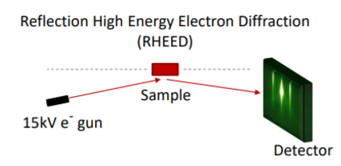
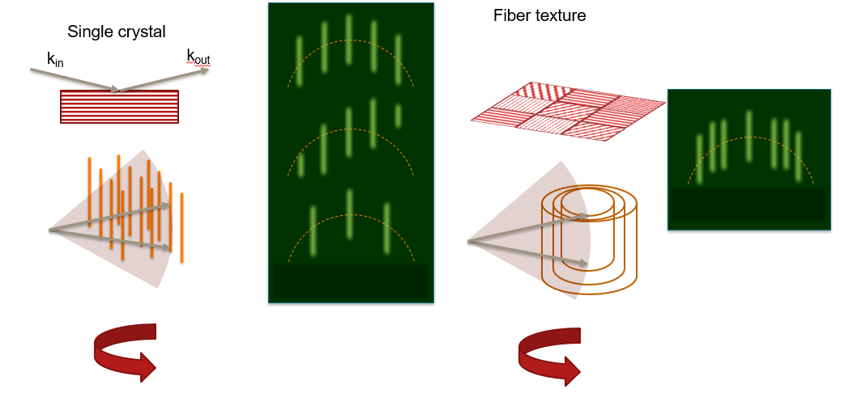
Promote and Measure Epitaxy
Required: a structural probe on your growth system.
Electron beams: Reflection high energy electron diffraction (RHEED)
What you’re often looking for:
Sign you’re on the right track…
mounted directly on growth chamber
Sensitive to sub-monolayer changes

Slide 13
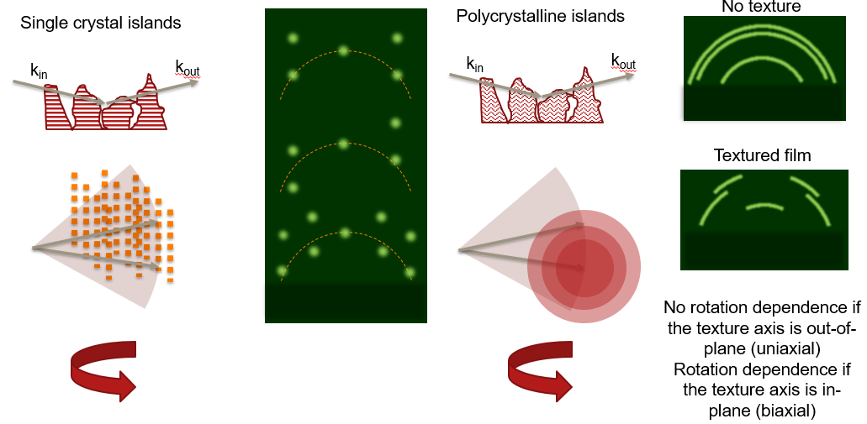
Promote and Measure Epitaxy
Required: a structural probe on your growth system.
Electron beams: Reflection high energy electron diffraction (RHEED)
“Signs of roughness”
“At least it’s not amorphous!”
mounted directly on growth chamber
Sensitive to sub-monolayer changes
NB: RHEED is often, not always, qualitative.

Slide 14
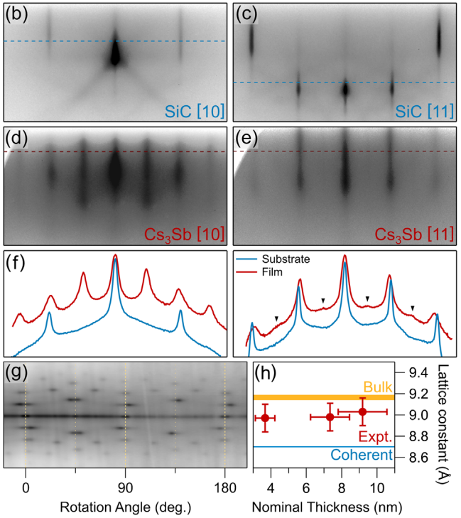
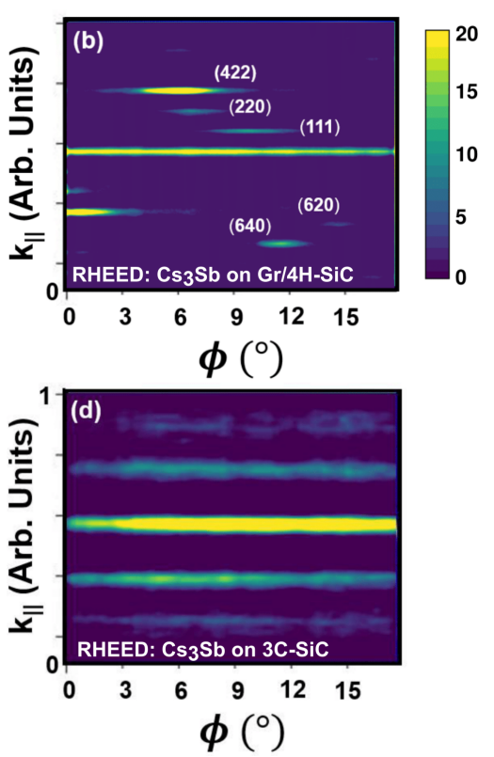
RHEED Examples
3C-SiC
substrate
Cs₃Sb on Gr/4H-SiC
(multiple orientations)
Film
Lineouts
Cs₃Sb on 3C-SiC
Fiber textured
Parzyck et al., PRL 128, 114801 (2022)
C. Pennington et al.,
arXiv:2407.12224

Slide 15
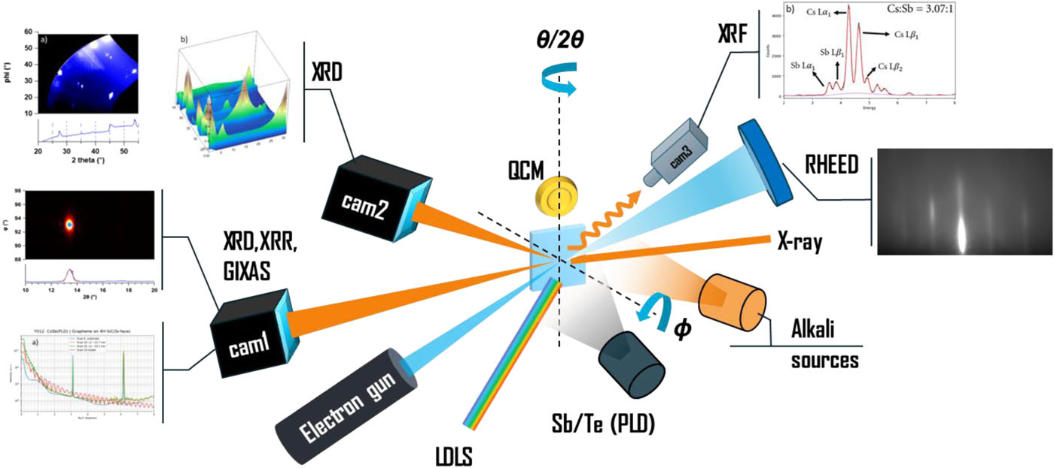
Even more comprehensive: x-rays
Stoichiometry
Structure
Surface,
Structure,
roughness
“One stop shopping” at NSLS-II, ISR Beamline 4-ID
W. G. Stam et al., APL Mater. 12, 061114 (2024)

Slide 16
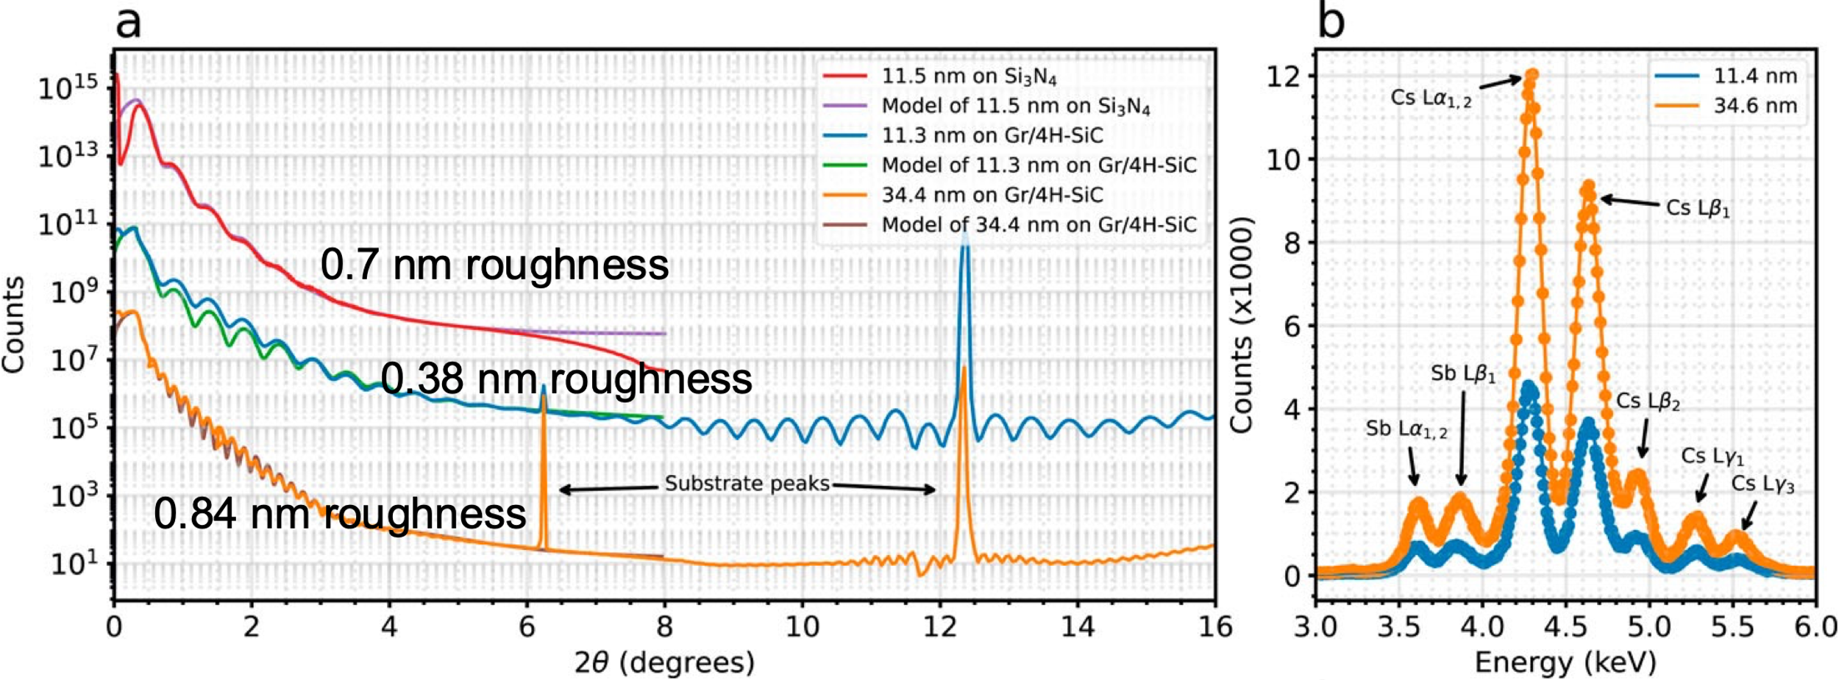
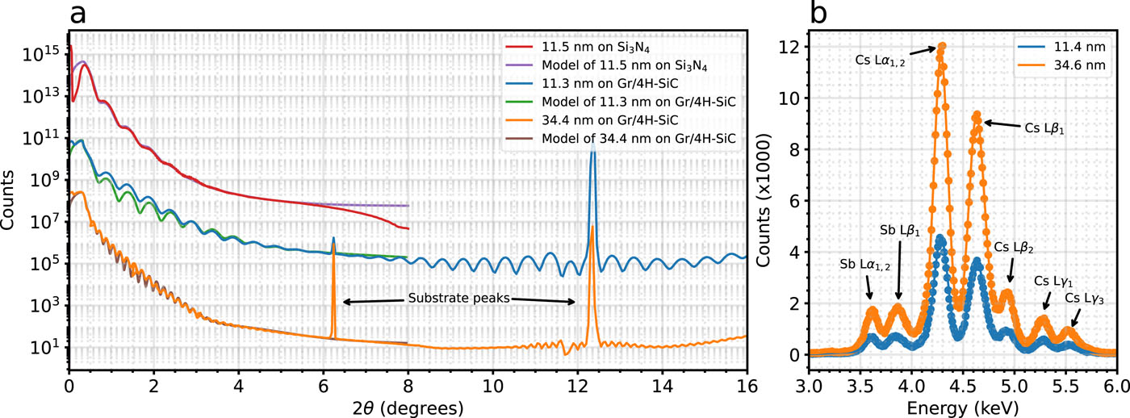
X-ray studies on Cs₃Sb on Gr/4H-SiC
X-ray Reflectivity
X-ray Fluorescence
0.7 nm roughness
W. G. Stam et al., APL Mater. 12, 061114 (2024)
0.38 nm roughness
0.84 nm roughness
X-ray reflectivity models include surface
roughness (often RMS) as a fit parameter.
Quantification of stoichiometry
In this case:
3.05:1 and 2.84:1 (Cs:Sb)
2 nm
4 nm
10 nm
20 nm

Slide 17
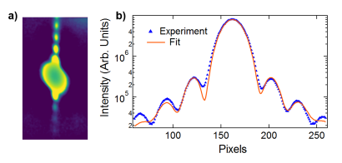
X-ray studies on Cs₃Sb on Gr/4H-SiC
X-rays: high coherence large scattering angle (compared to RHEED) allows you to see:
Laue fringes around Bragg peaks. Only appear if the crystal coherence length is at least comparable to the thickness.
An indicator of high crystallinity
Permits a fit of the film “coherent” thickness. Useful to compare this to XRR
High resolution view of strain relaxation: here, seen as peak splitting.
Laue Fringes in Cs₃Sb
Strain relaxation
during growth
C. Pennington et al.,
arXiv:2407.12224
thickness
2 nm
4 nm
10 nm
20 nm

Slide 18
X-ray vs Electron structural probes
Synchrotron X-rays
One stop shopping: many techniques
Very high structural resolution and dynamic range
Sensitive to whole film
Expensive and complex
Can be challenging to assess surface vs bulk contributions
Electrons (RHEED)
Much more “portable”: amenable to most growth systems
Extremely surface sensitive
Limited bulk sensitivity
Limited dynamic range and coherence
One or few probe techniques
Very complimentary!

Slide 19
Summary and outlook
Epitaxy in the alkali antimonides has already unlocked new capabilities:
Extremely flat surfaces, interference enhancement, high QE while very thin
It may lead to additional new capabilities
Atomic scale layer engineering: heterostructures, polarized cathodes?
MTEs dominated by band structure? (Particularly for thin cathodes)
X-ray and electron beam probe suites are vital for epitaxial growth: diffraction, spectroscopy, reflectivity, ….
Epitaxy enables precise understanding of materials properties and detailed comparison to ab-initio theory.

