Slide 1


mA current level operation of K₂CsSb photocathode in DC-SRF-II gun
XIE Huamu on behalf the SRF team at PKU
Sep 17-19, 2024
EWPAA 2024

Slide 2
Fabrication and Transport of K₂CsSb photocathode
mA level operation of the K₂CsSb photocathode in the DC-SRF gun
Emittance measurement
Summary
Outline

Slide 3

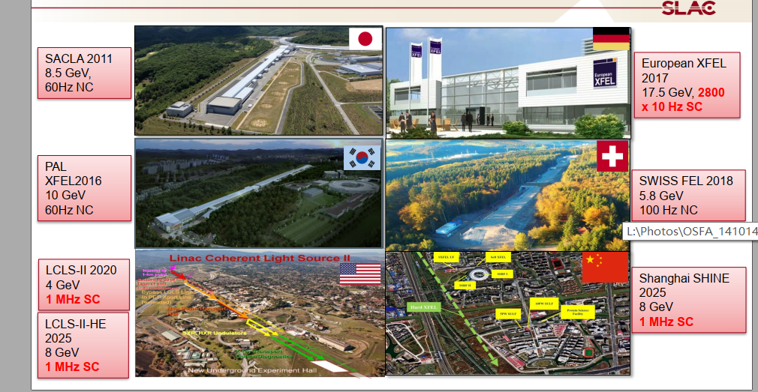
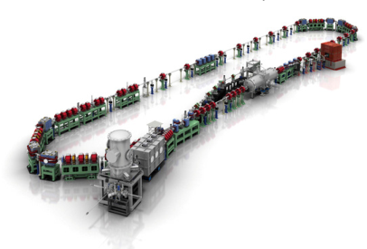
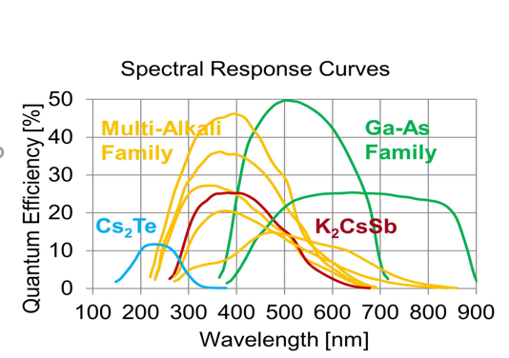
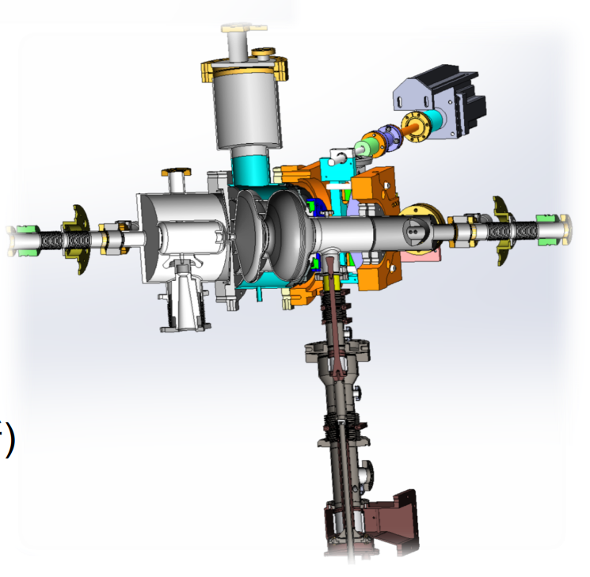
Demand of K₂CsSb photocathode
(Bruce Dunham, P3 Meeting 2018)
(Sonal Mistry, P3 Meeting 2018)
XFEL around the world
BERLinPro
DC-SRF II
K-Cs-Sb
The spectral response of semiconductor photocathode
DC-SRF-II gun at PKU

Slide 4
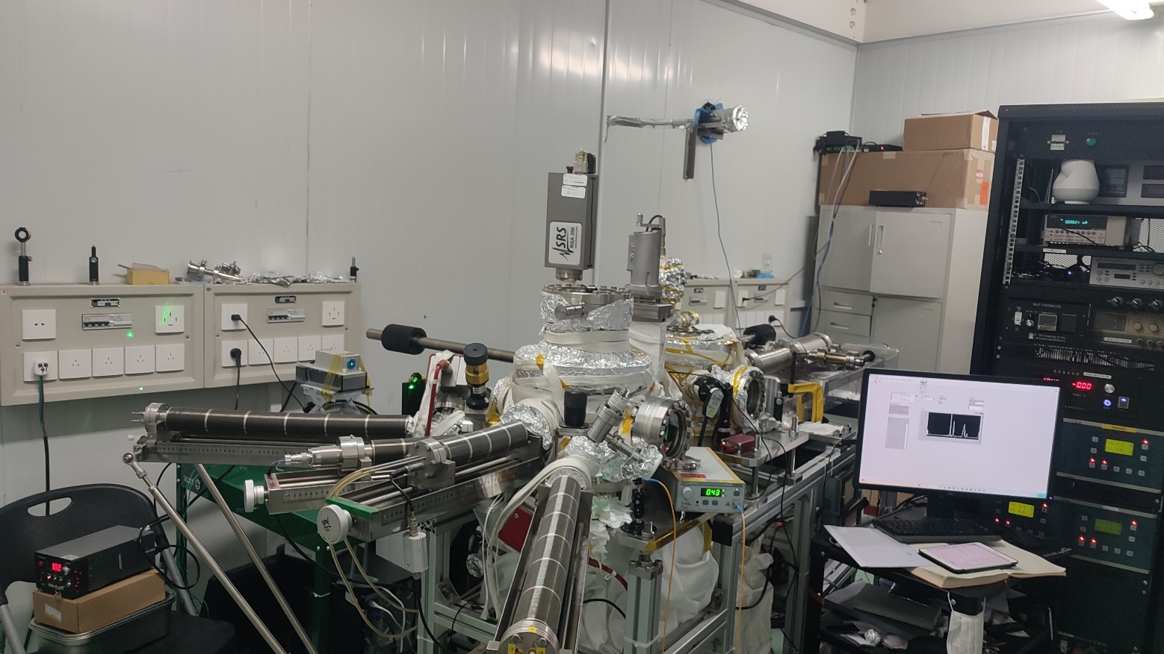
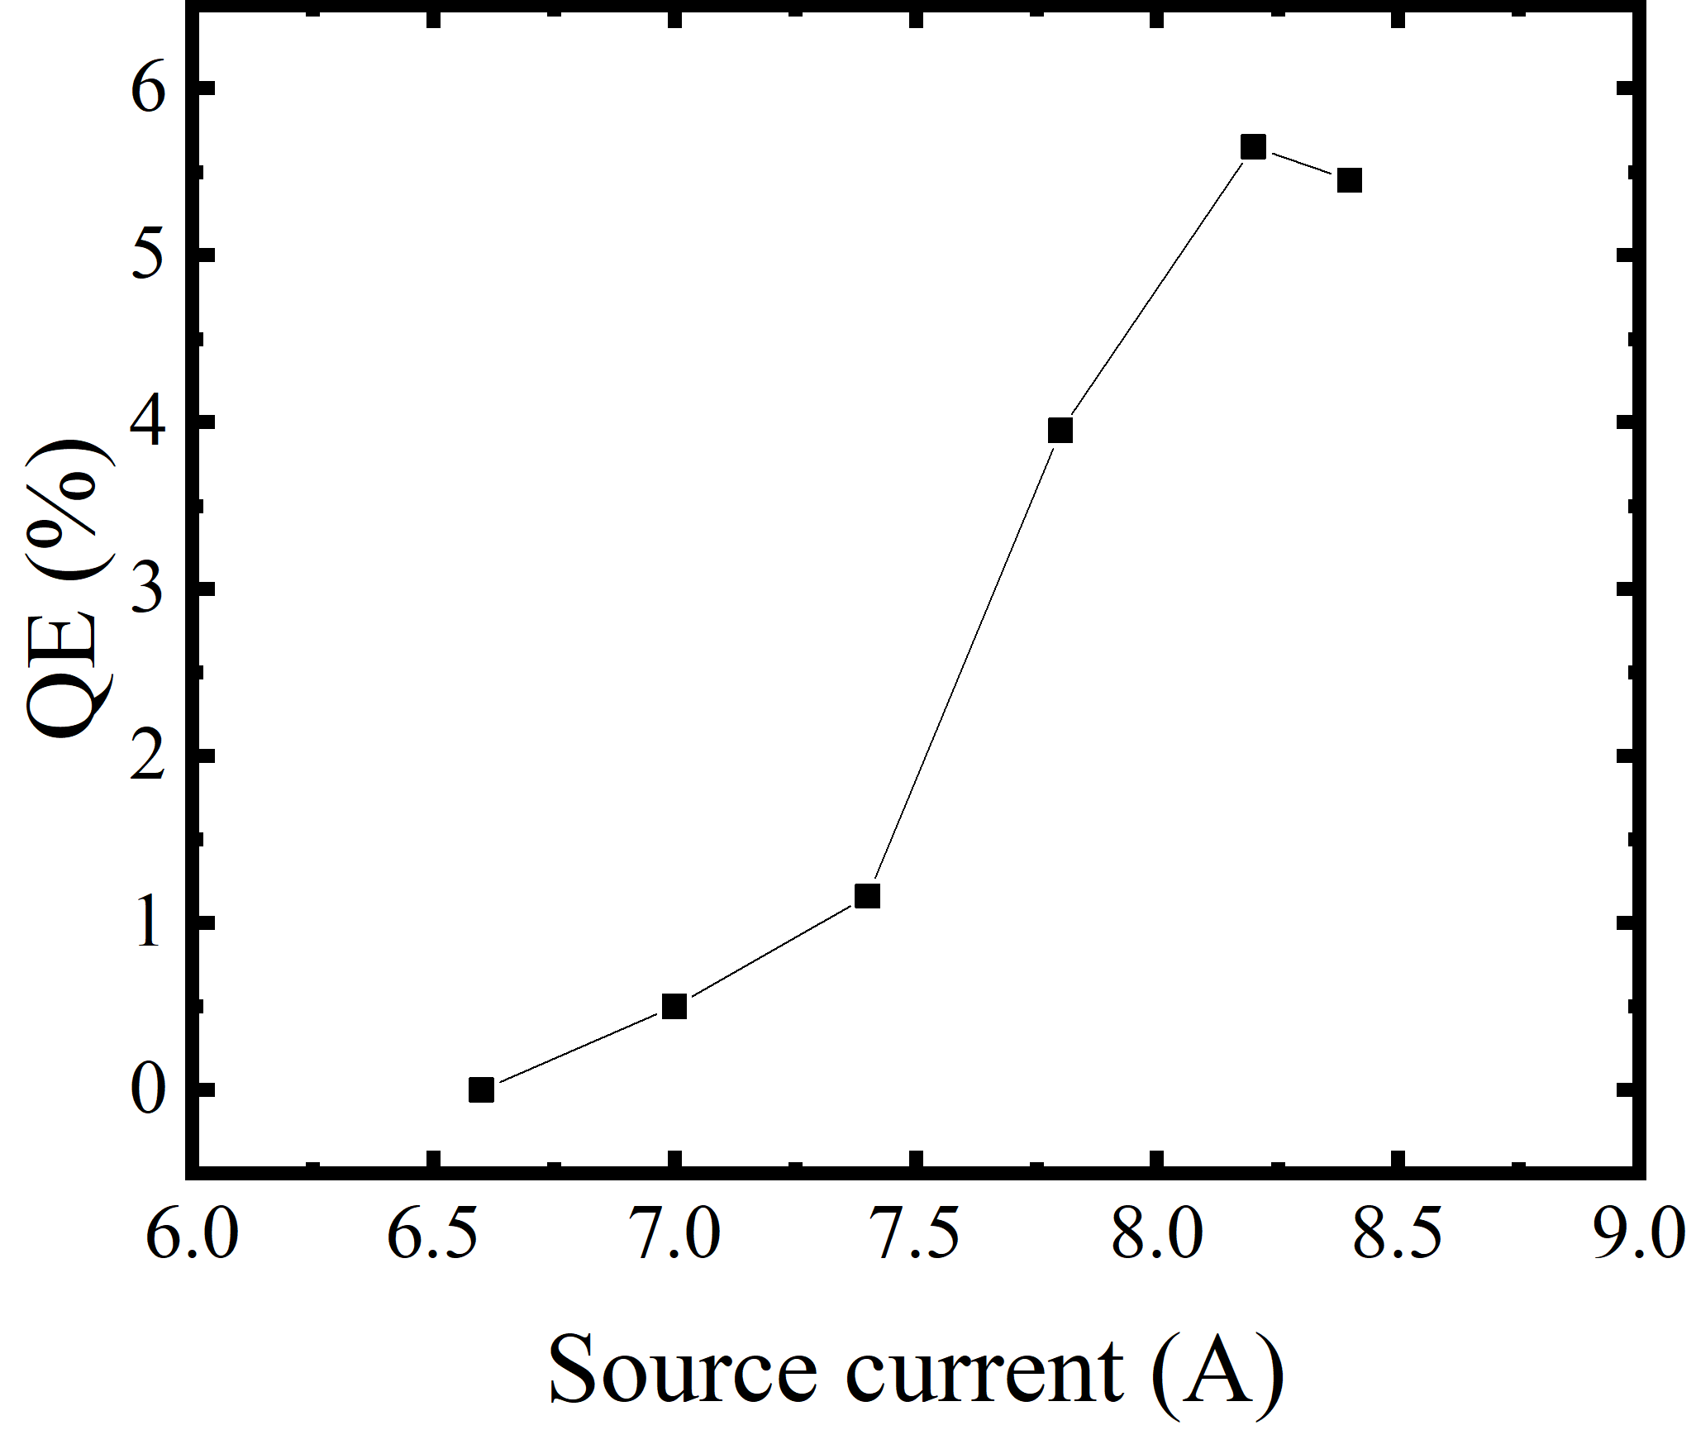
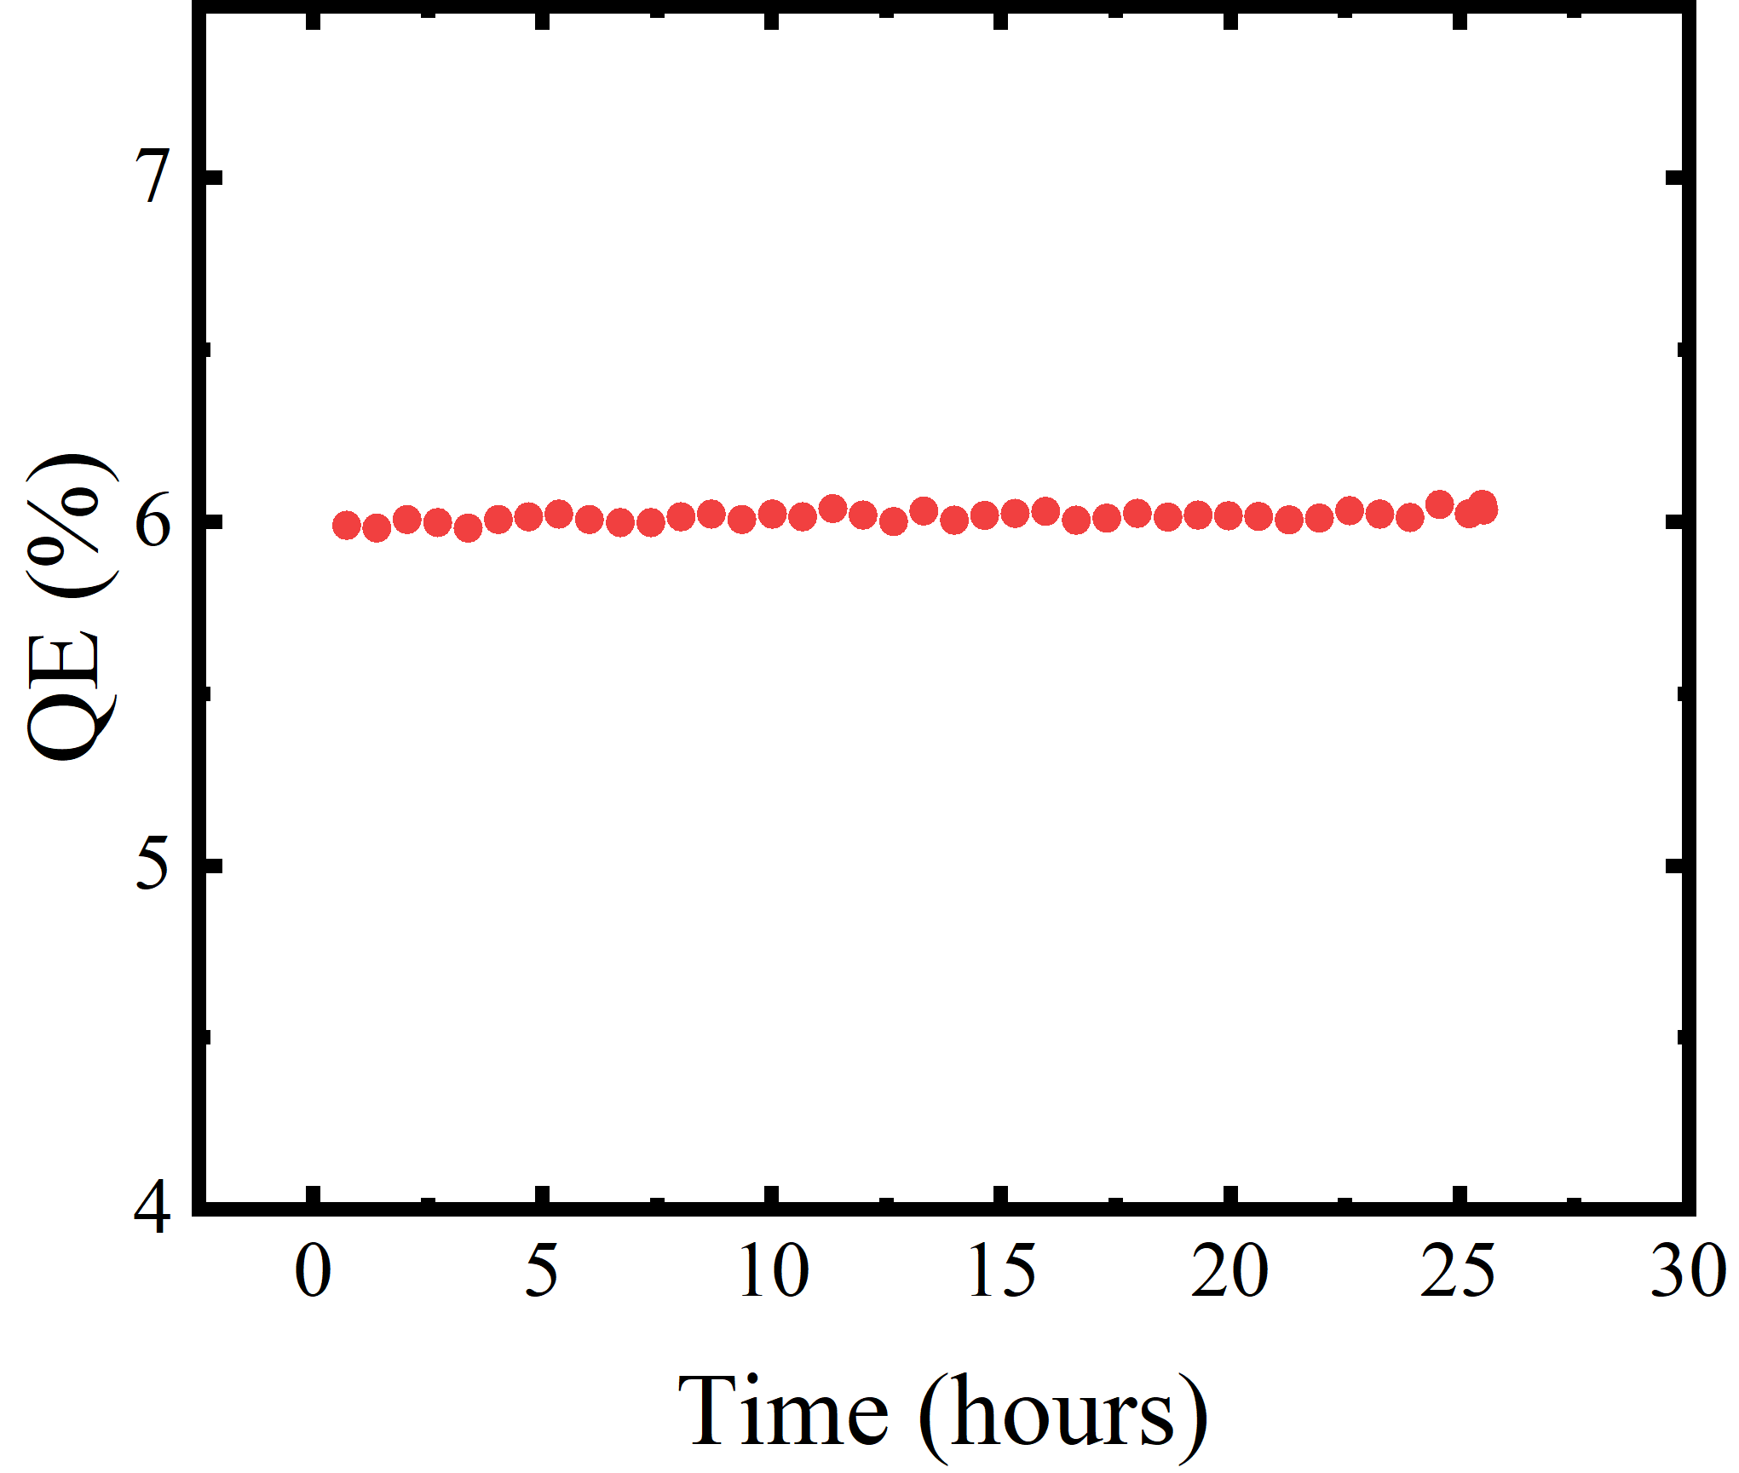
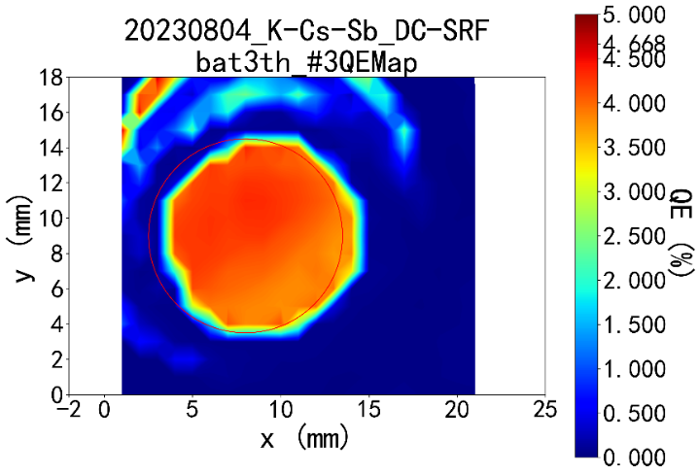
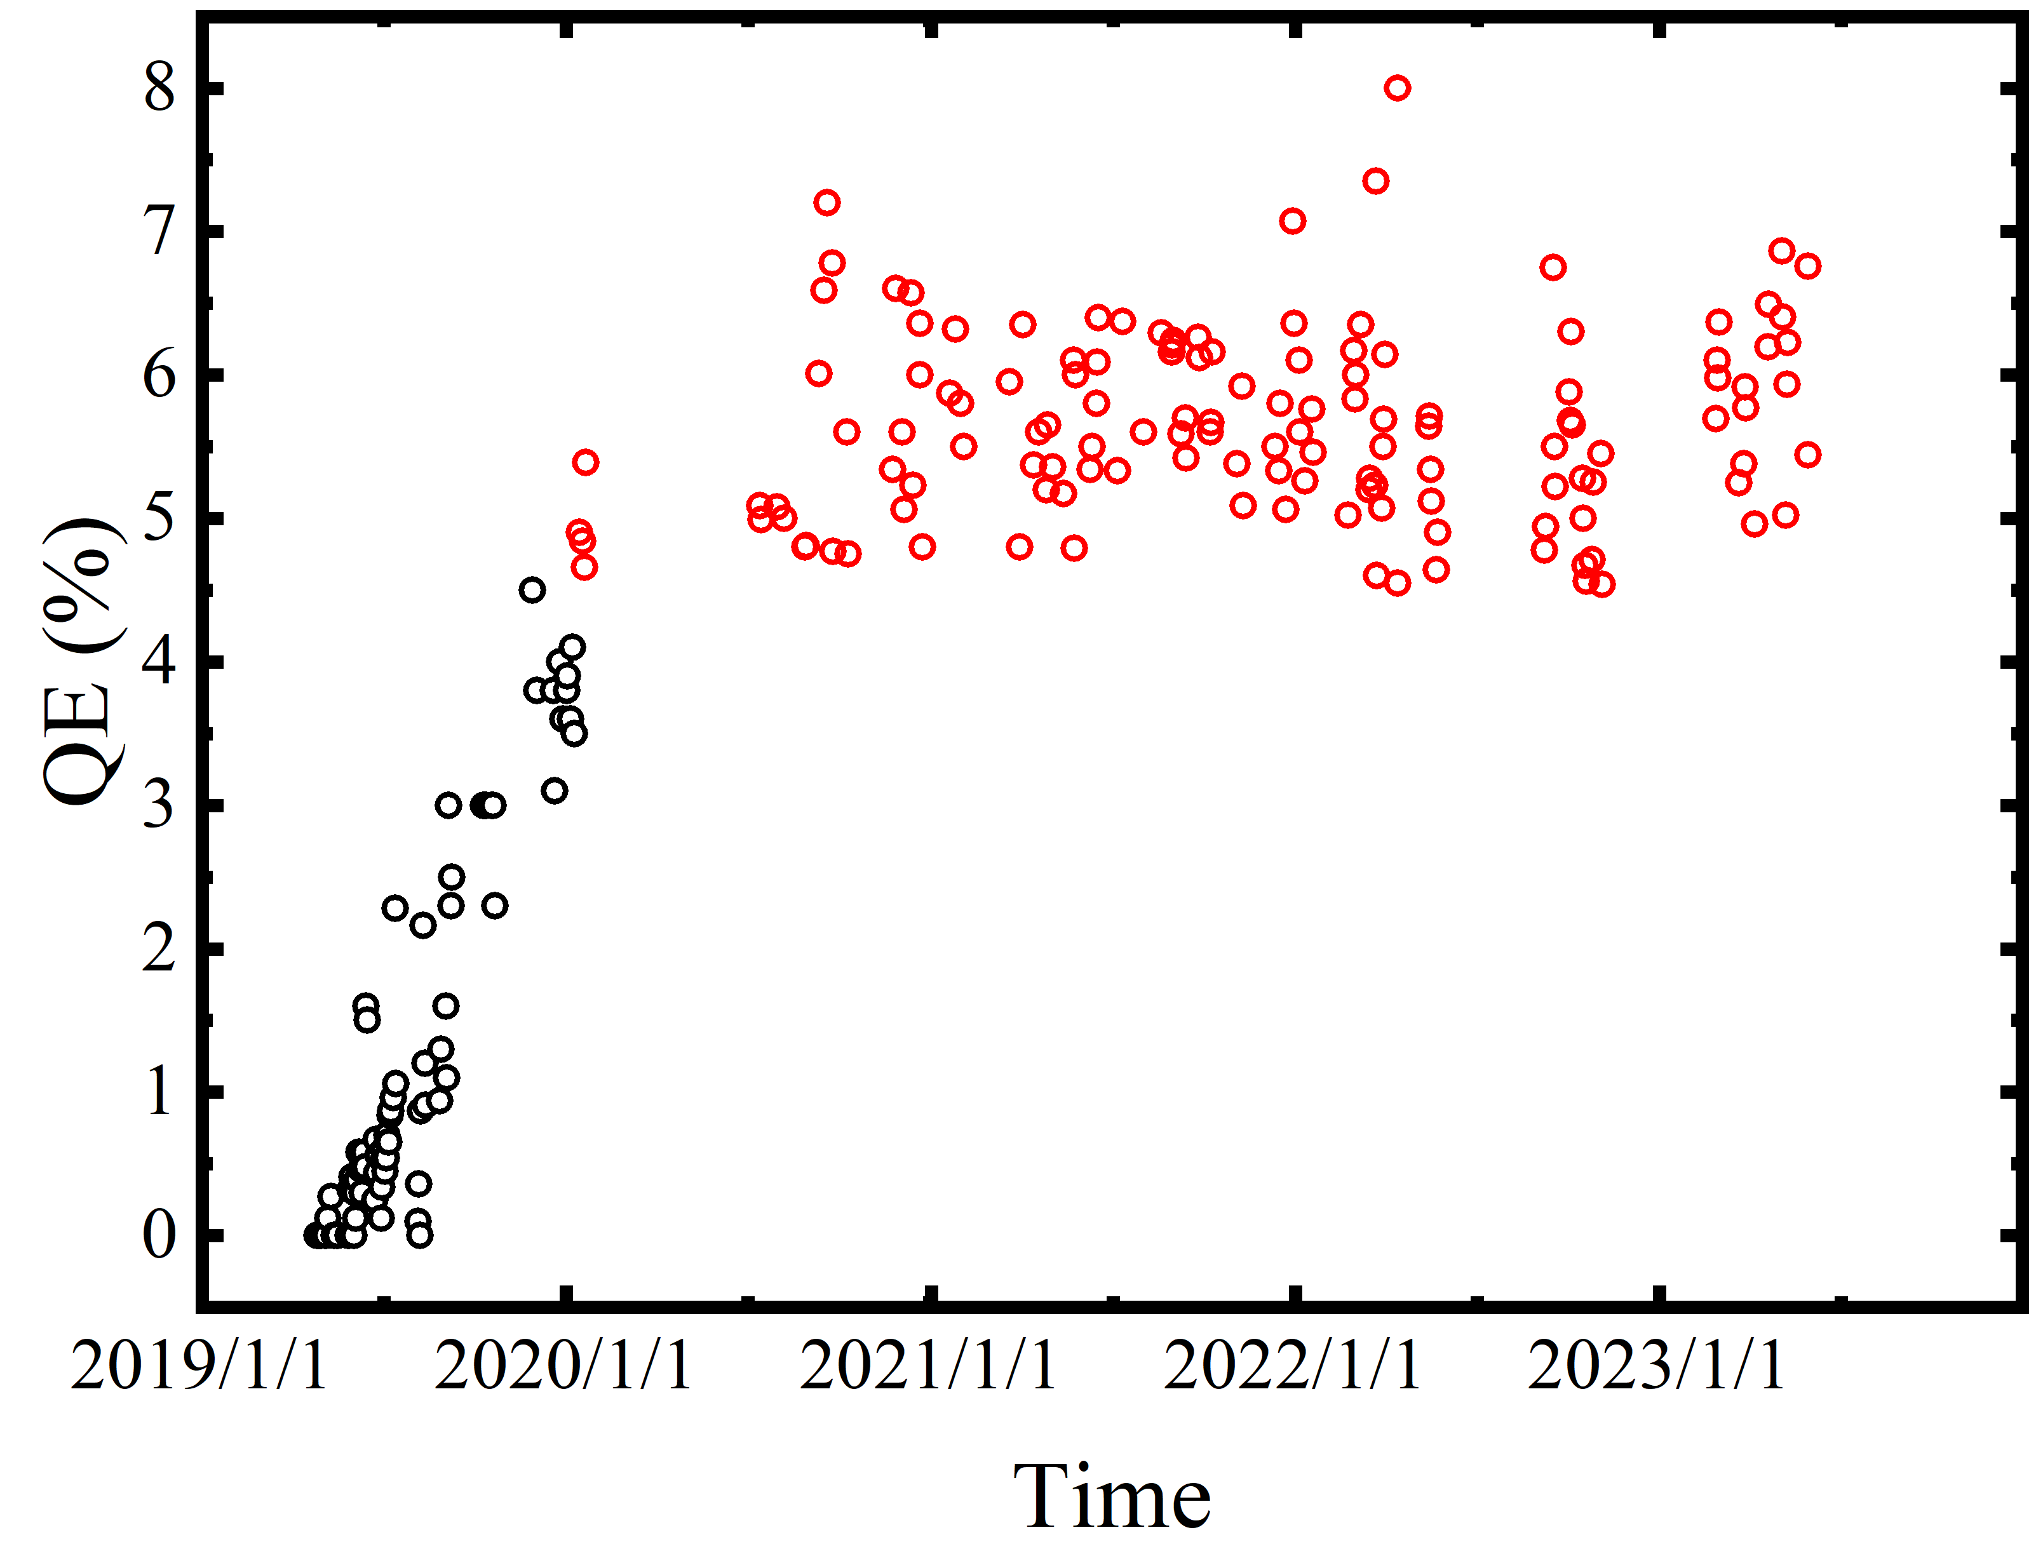
K₂CsSb photocathode deposition system
“Fast Cesiation” sequential deposition recipe, the total activation time cost less than 10 min. The QE keeps growing in the following days after activation.
Photocathode grown by co-evaporation method

Slide 5
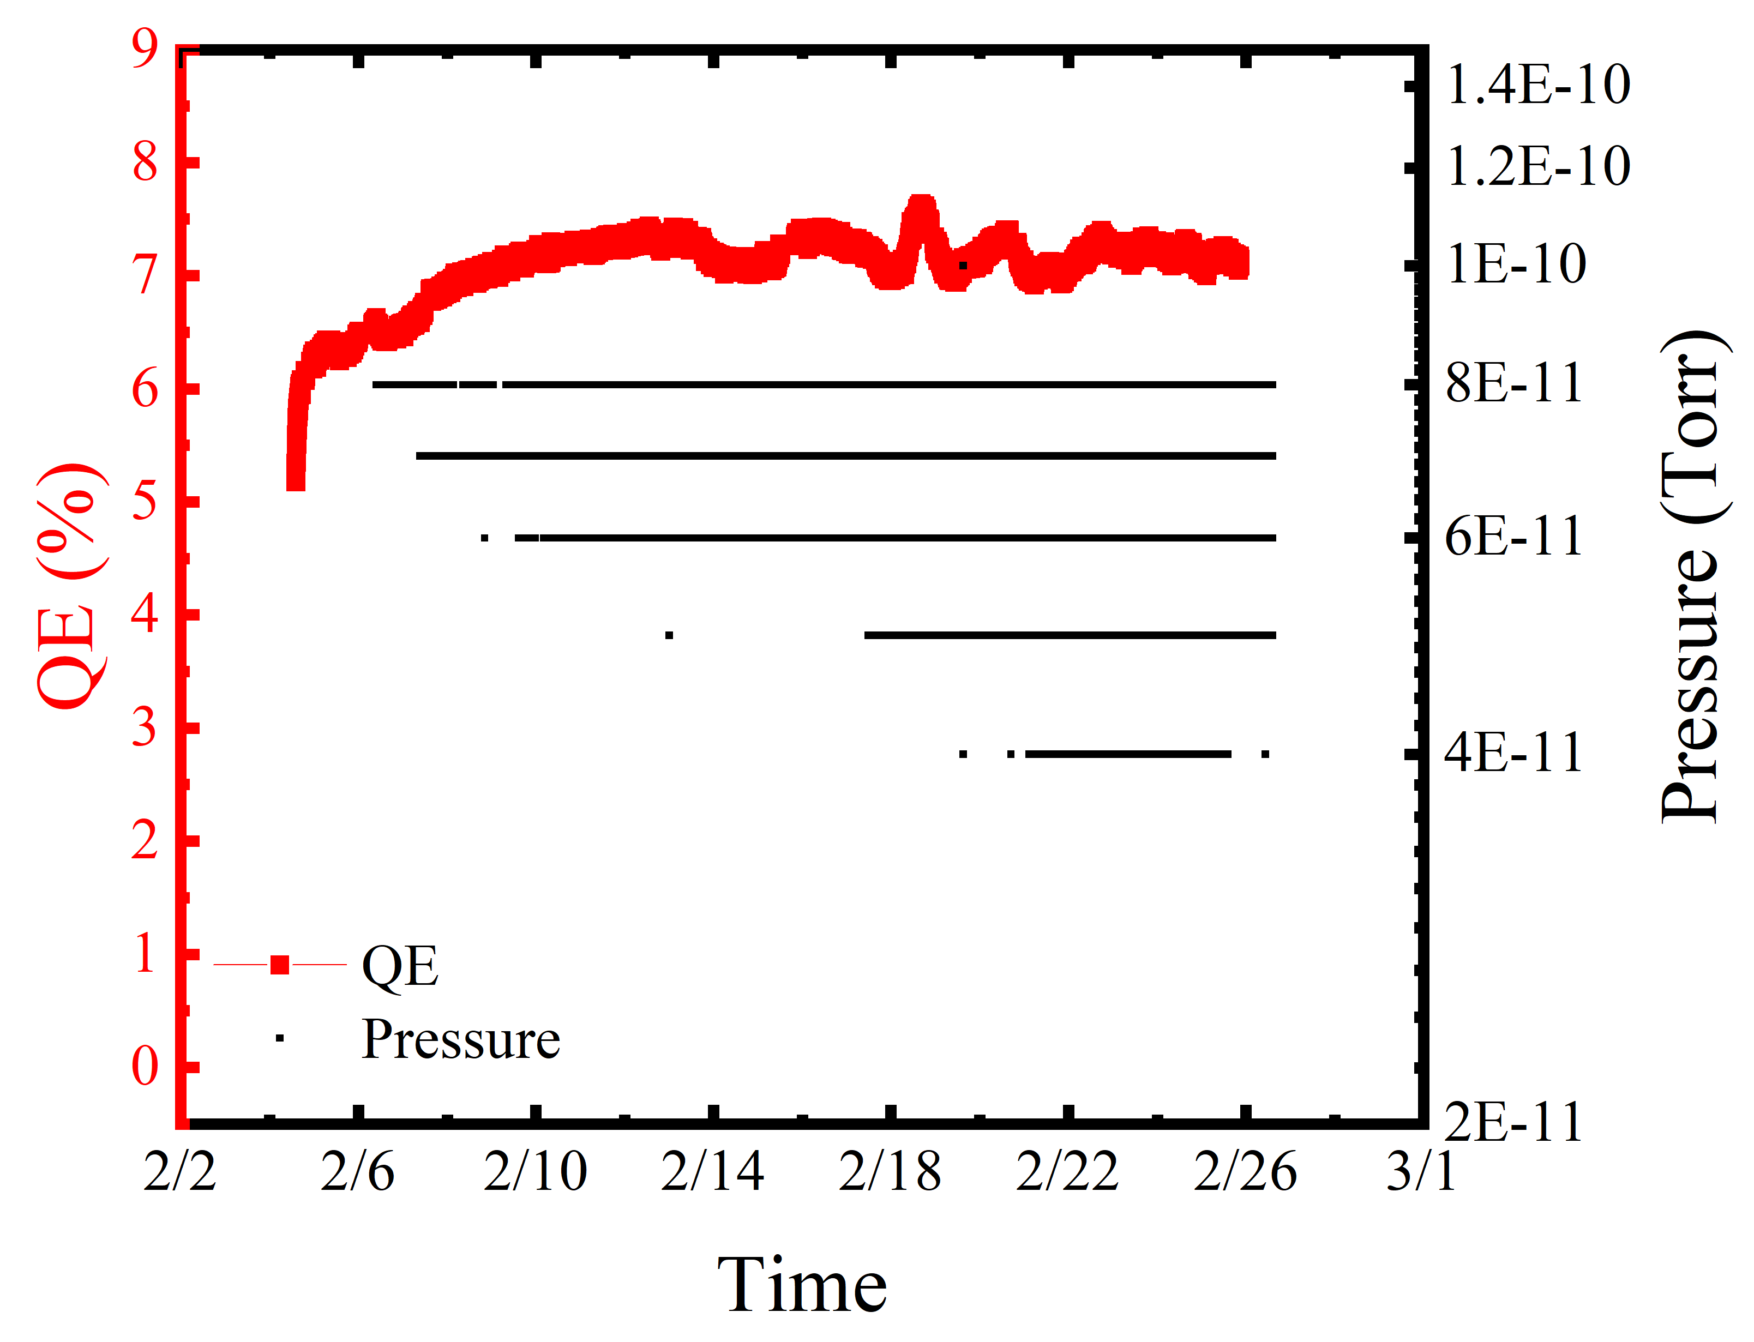
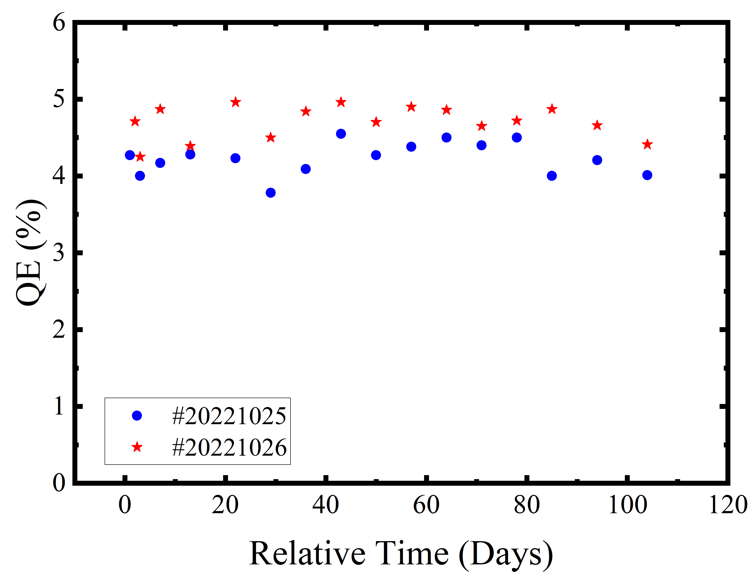
Dark lifetime in Deposition chamber and UHV suitcase
K₂CsSb photocathode samples fabricated with Fast-cesiation recipe usually have a long dark lifetime in UHV environment.
In deposition chamber with a base vacuum of 4 ×10⁻¹¹ Torr, the QE of K₂CsSb photocathode sample was measured every 10 min, and remained at ~7% for more than 500 h.
We also tested the dark lifetime of K₂CsSb photocathode in UHV suitcase, the QE showed no obvious decay for more than 3 weeks.

Slide 6
Fabrication and Transport of K₂CsSb photocathode
mA level operation of the K₂CsSb photocathode in the DC-SRF gun
Emittance measurement
Summary
Outline

Slide 7
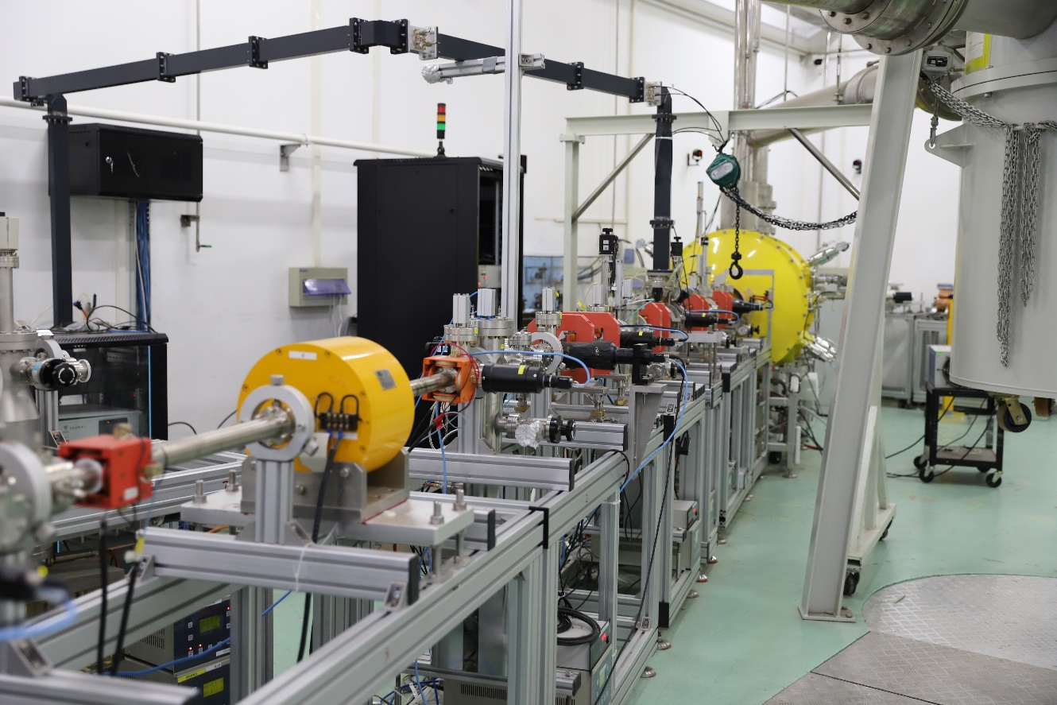
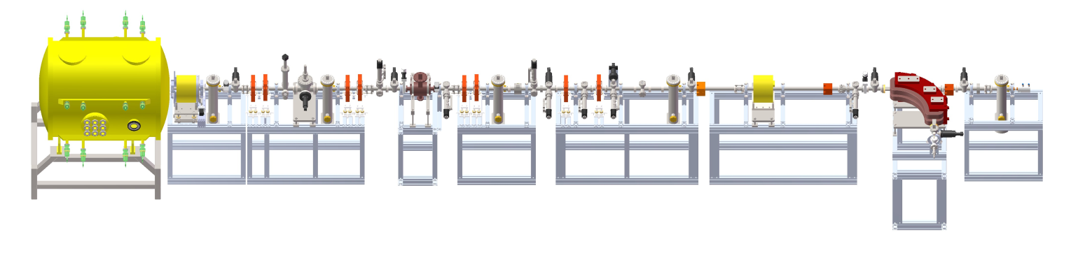
DC-SRF-II parameters and layout
Parameters | Unit | Value
Beam energy | MeV | ~2
DC voltage | kV | 100
Dark current | pA | 100(CW)
Bunch charge | pC | 10-100
Bunch repetition rate | MHz | 1, 81.25
Normalized RMS emittance | mm.mrad | 0.28 @ 20 pC；0.43@ 50 pC；0.54 @ 100 pC
Laser wavelength | nm | 515
DC-SRF-II gun
solenoid
2856MHz deflecting cavity
B magnet
corrector
YAG & FC
Faraday cup

Slide 8
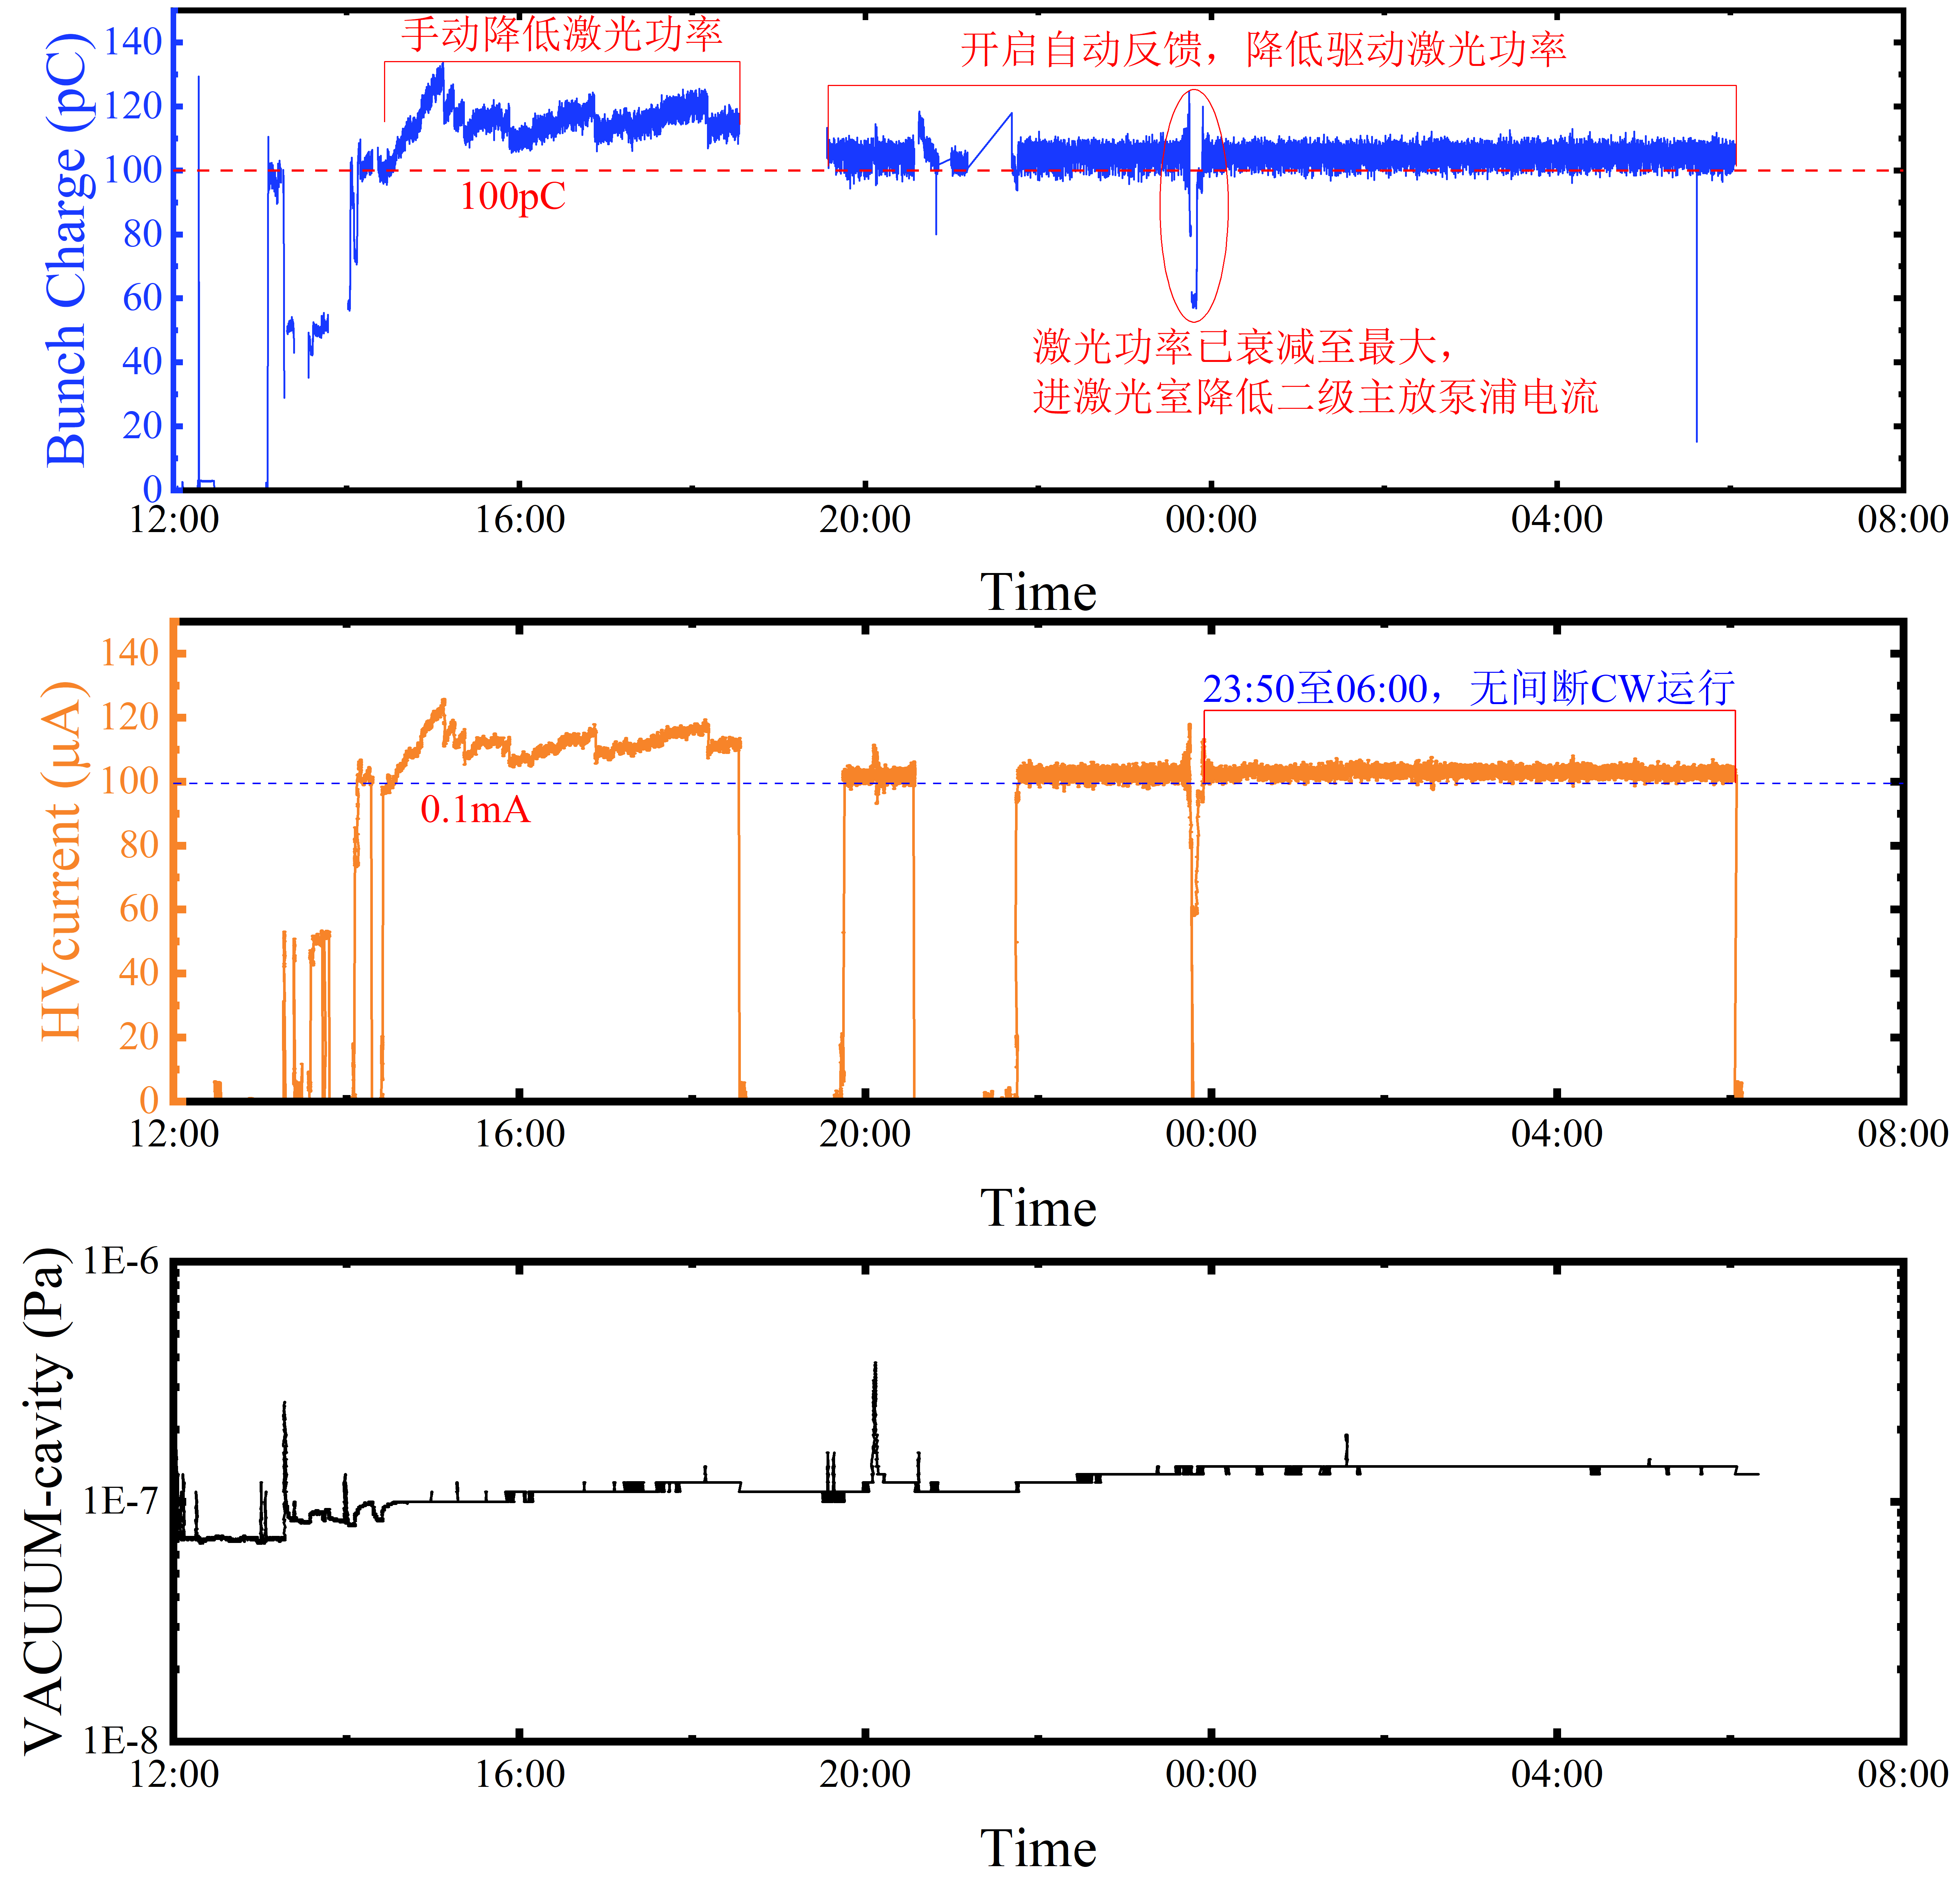
CW operation of 100 μA
20230914#3 sample
Extraction charge >5 C@5 mm
20231221#3 sample

Slide 9
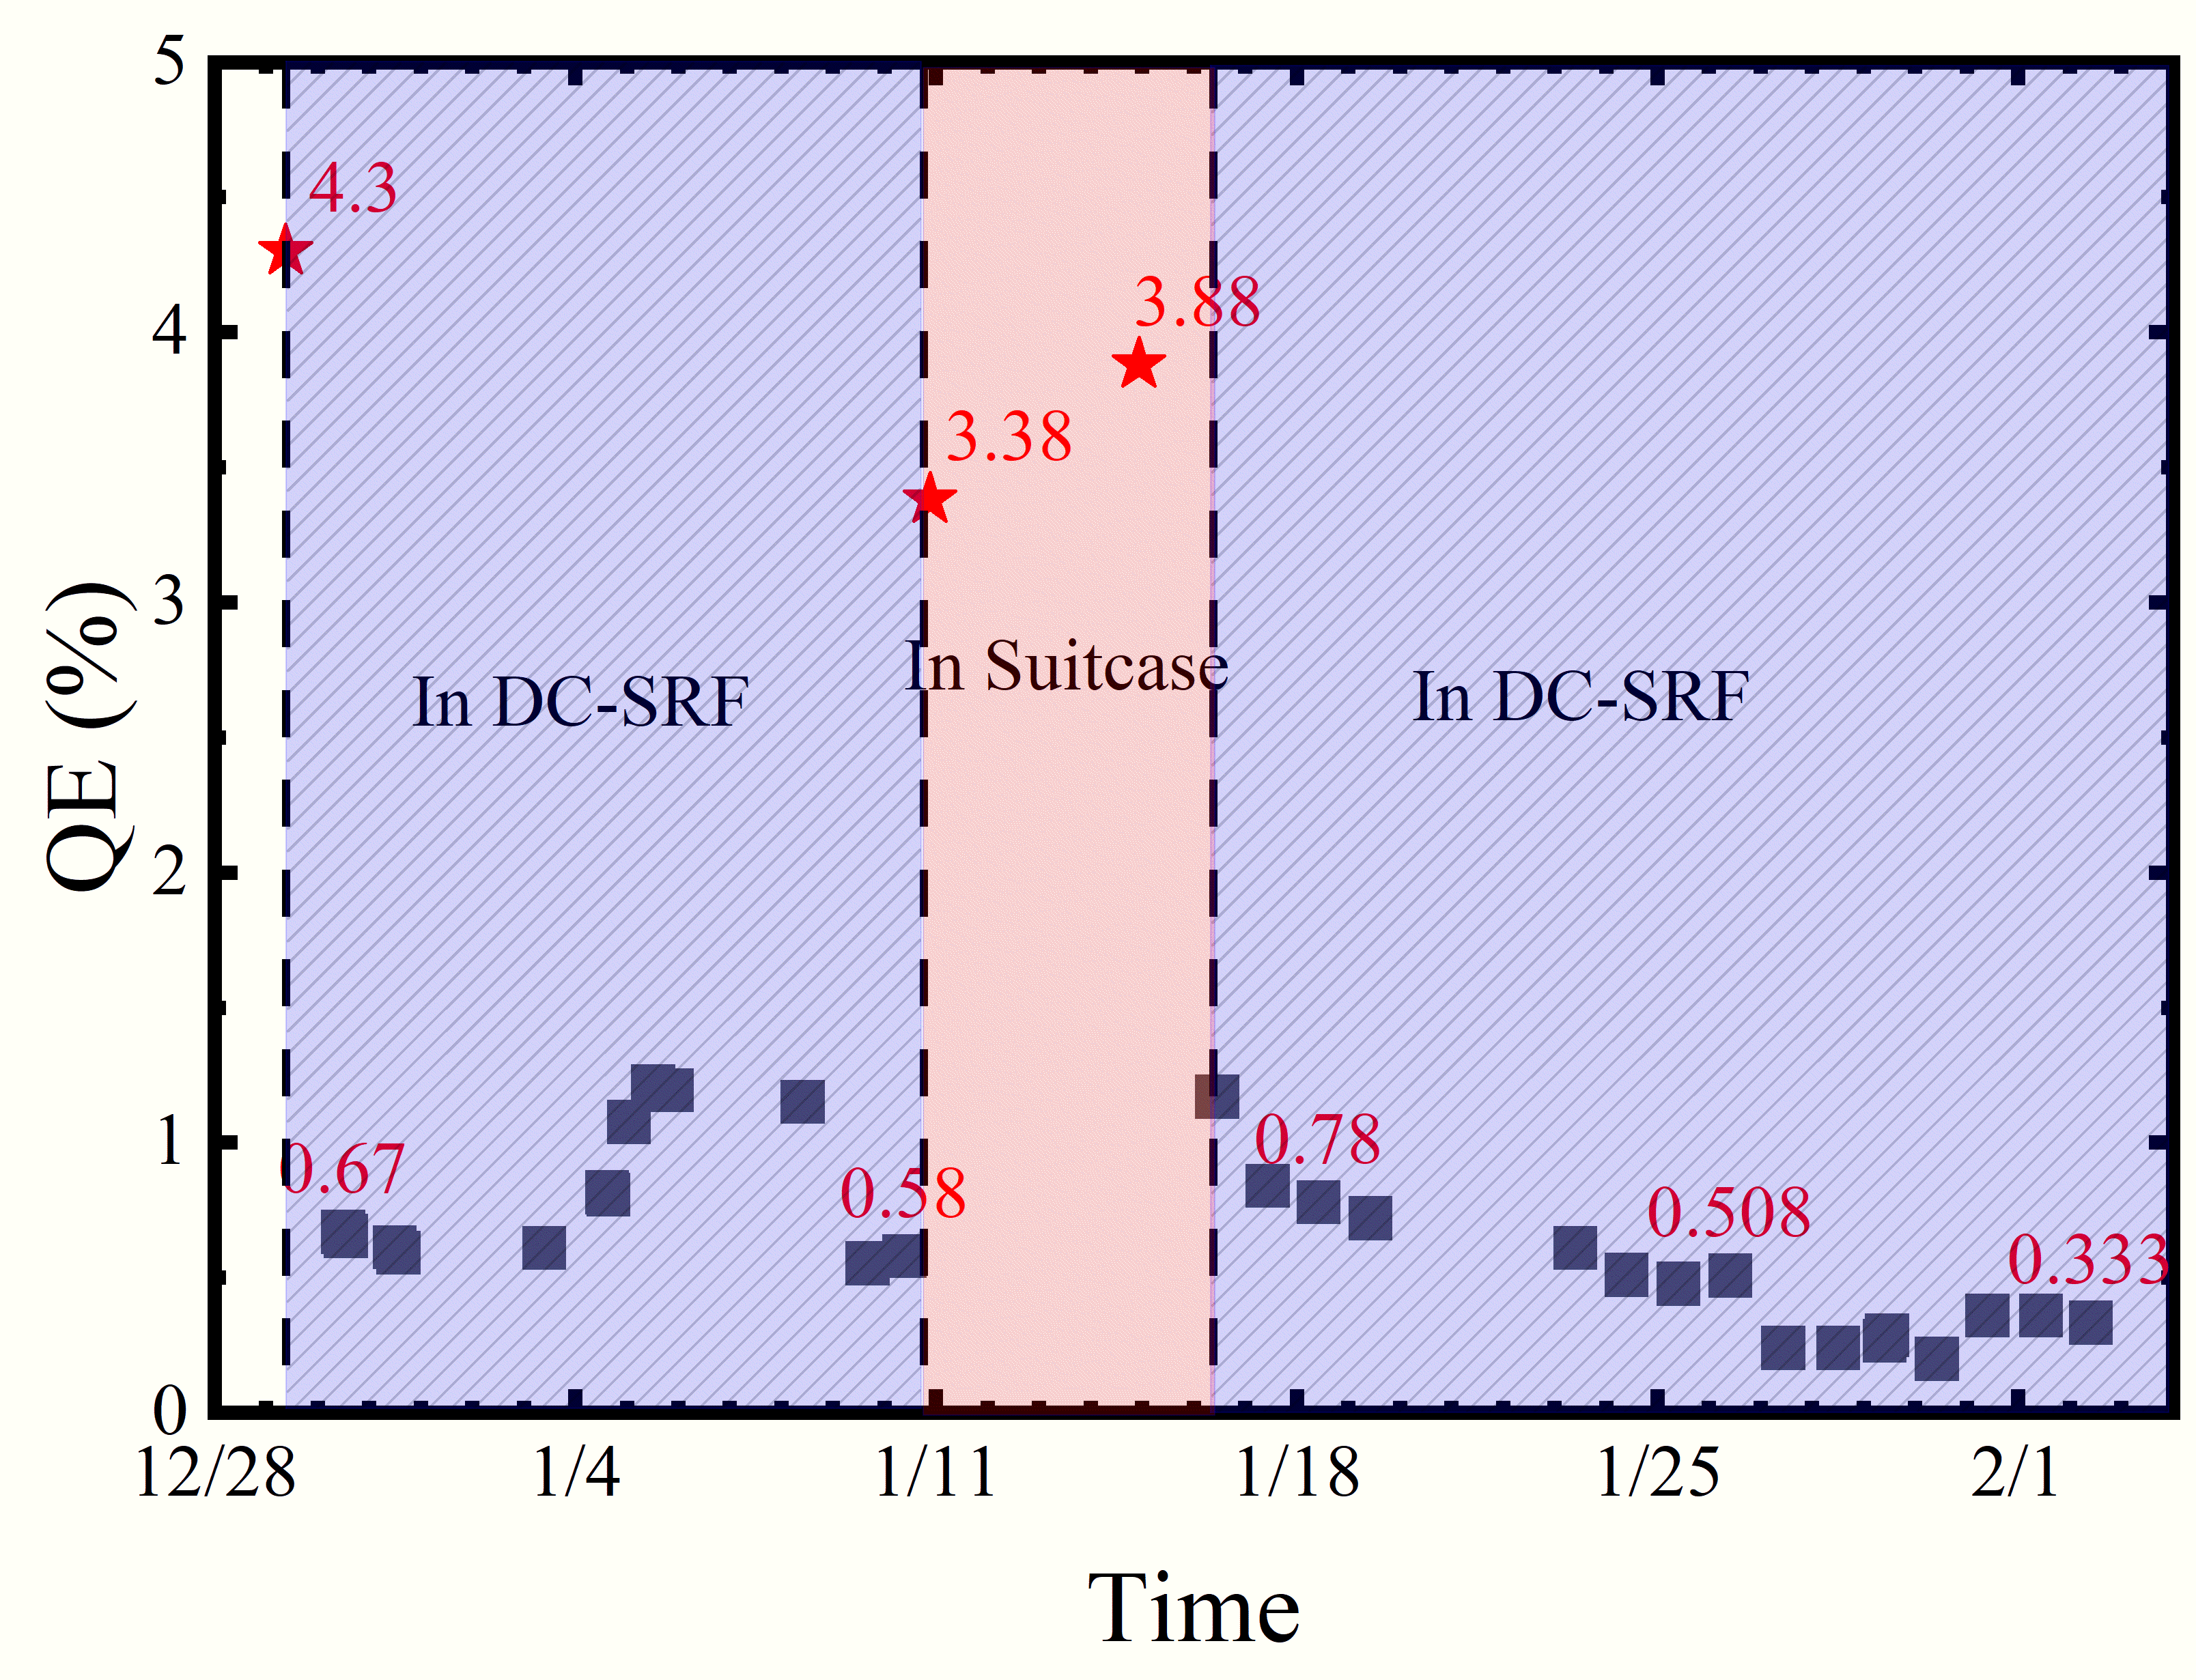
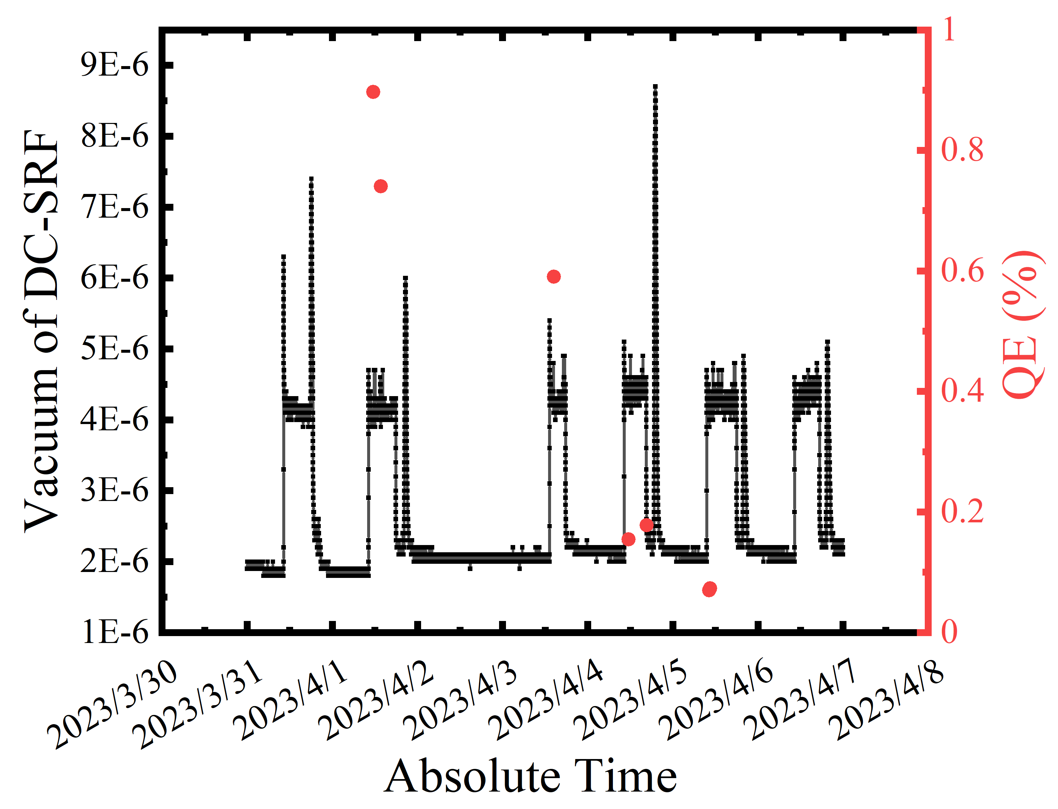
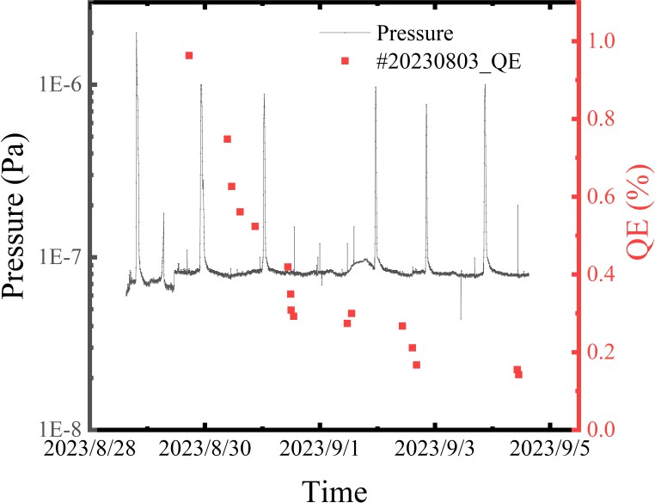
QE evolution during beam experiments
As the result of cryogenic temperature effect and Schottky effect, the QE of K₂CsSb photocathode in DC-SRF-II gun is usually ~20% of that in UHV suitcase at room temperature.
1st round-Decay from 0.9% to 0.2% within 3 days
2nd round-Decay from 1.0% to 0.2% within 7 days
Commissioning time | Pressure at the exit of DC-SRF-II[Pa] | Average lifetime[D]
#1-2023.03.31-06.28 | 2E-6 | ~3
#2-2023.08.28-09.28 | 8E-8 | ~7
#3-2023.12.29-2024.2.6 | 3E-8 | >20
3rd round
QE remained above 0.5% for more than 22 days
QE reduced by ~10% at room temperature after 2-week-operation
Still worked well after transferred into DC-SRF-II gun again

Slide 10
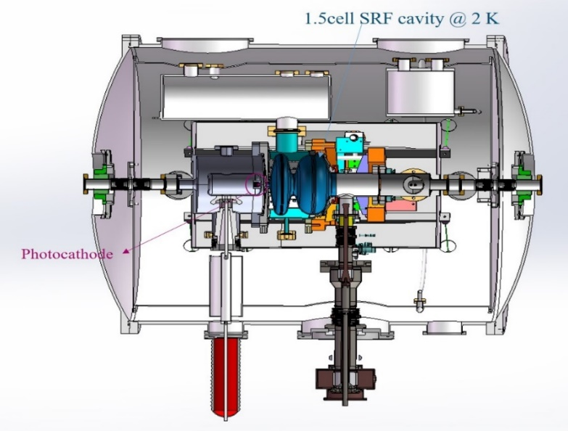
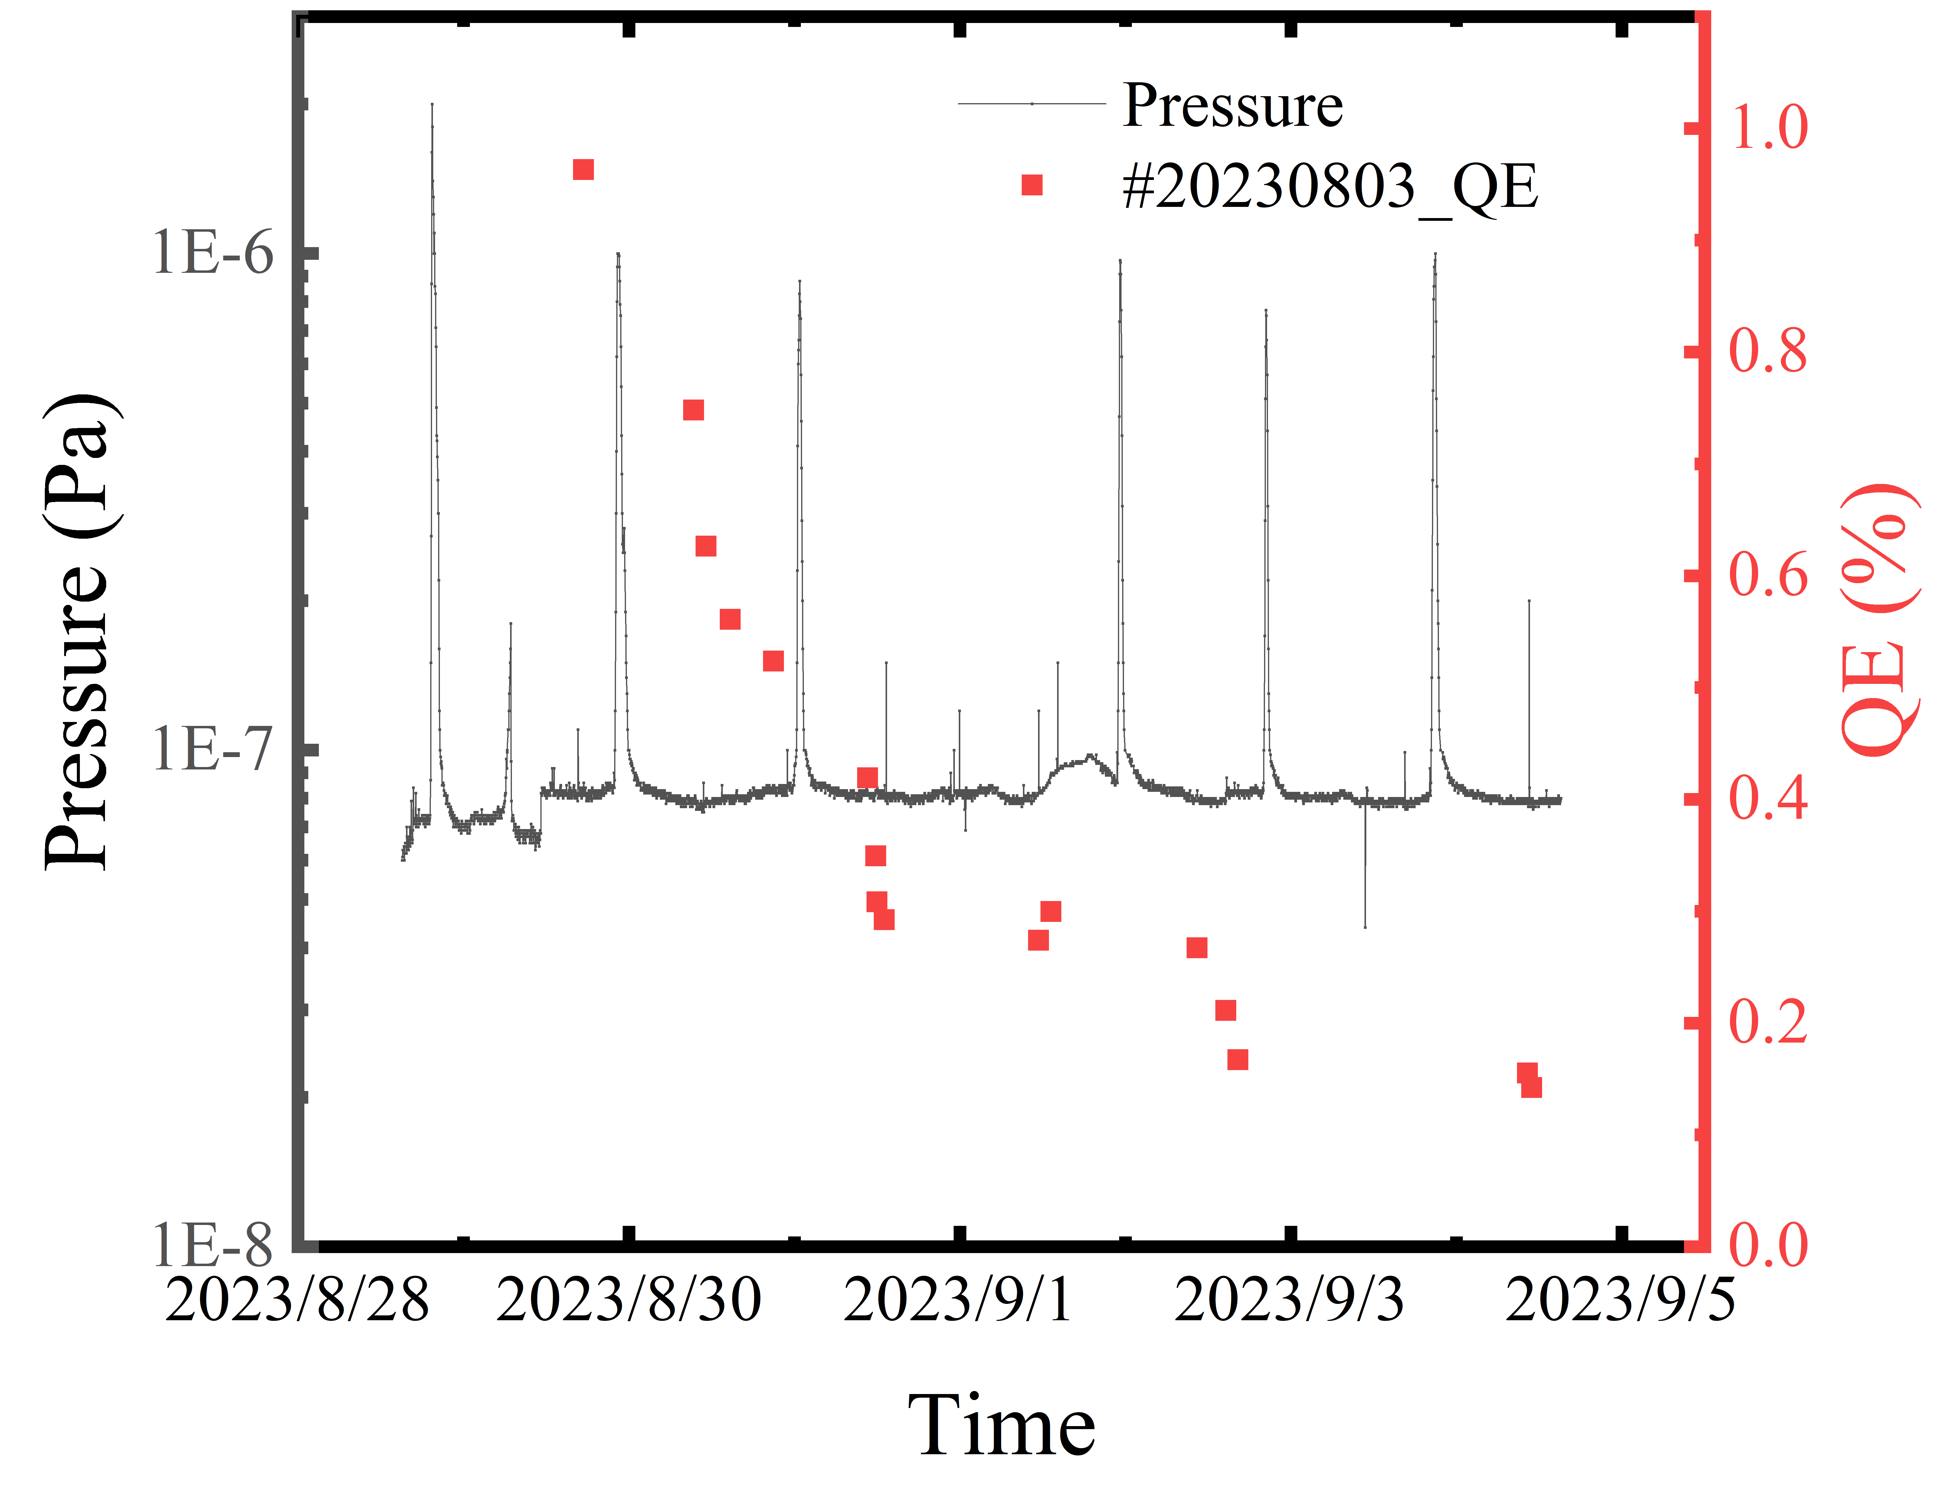
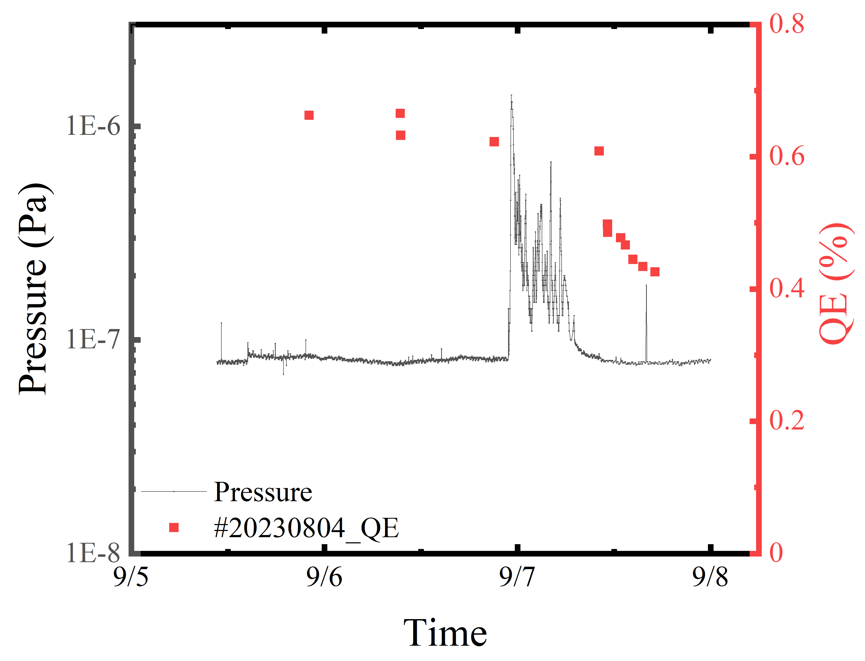
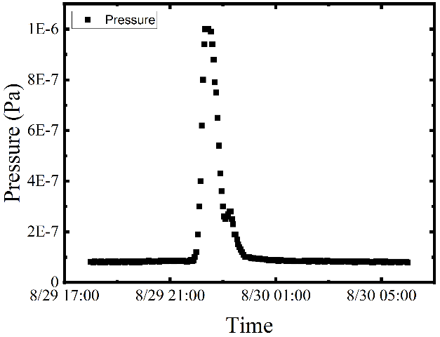
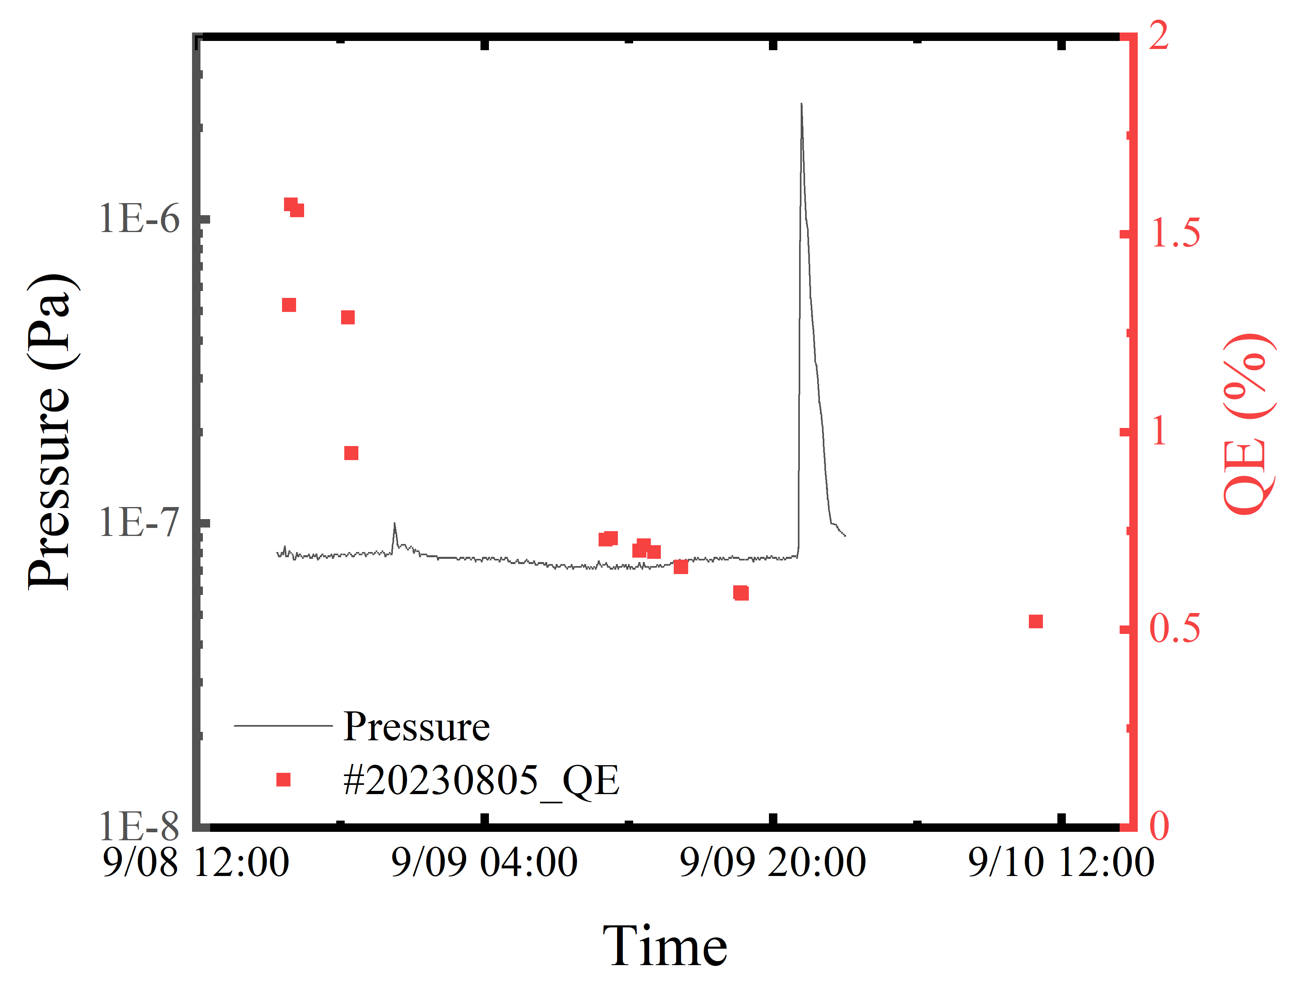
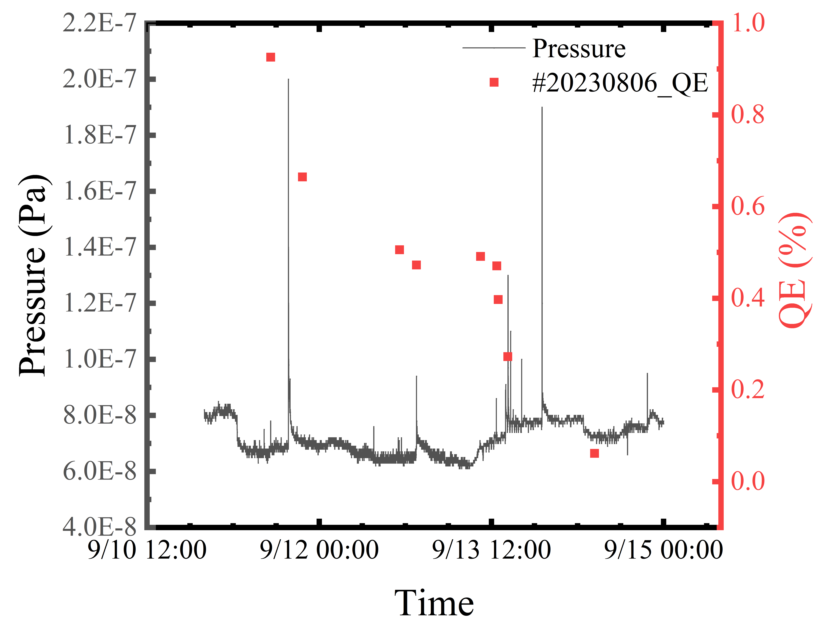
Lifetime of the photocathode in DC-SRF gun
The photocathode in the suitcase has a quantum efficiency (QE) of about 5%. However, when inserted into the gun, the QE drops to approximately 1%. Once returned to the suitcase, the QE recovers to 5%.
QE is influenced by the vacuum conditions within the cavity, which are mainly determined by the cryogenic system. When the 2K system is closed, gases released from the cavity can poison the photocathode

Slide 11
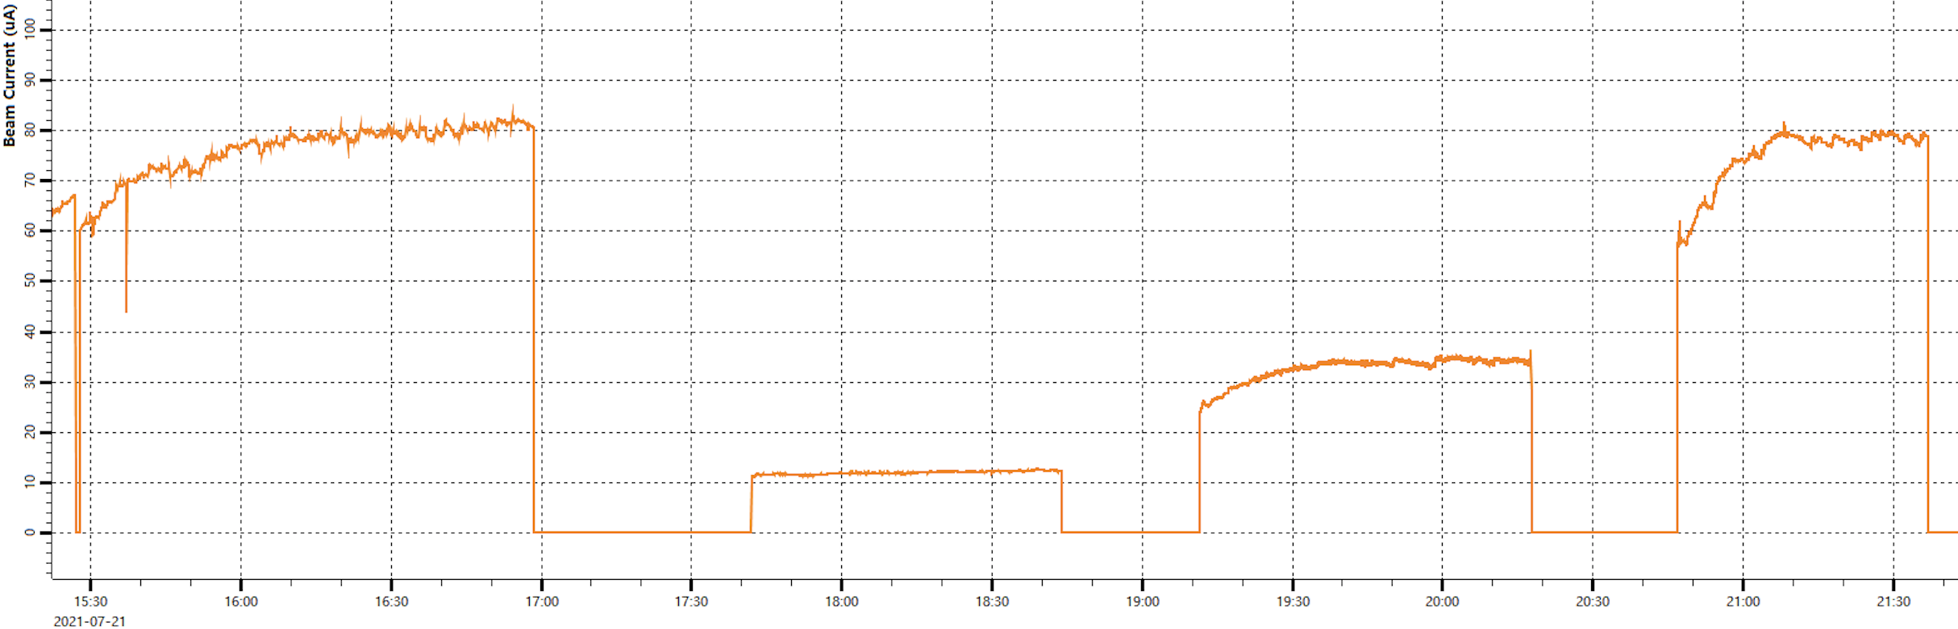
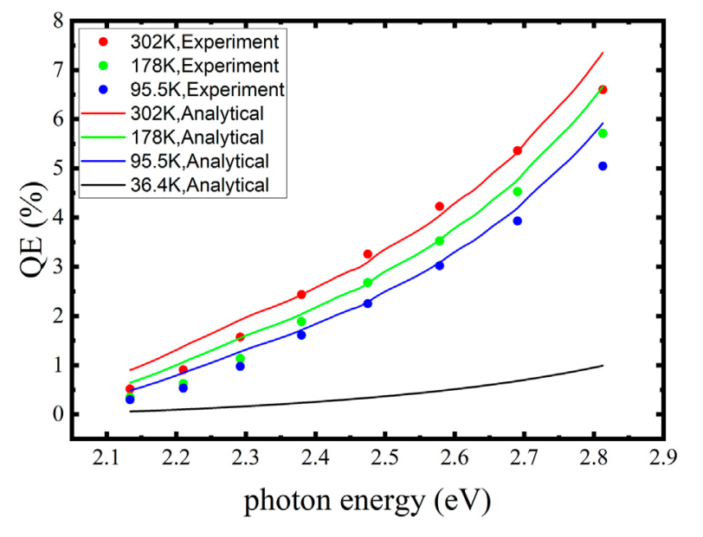
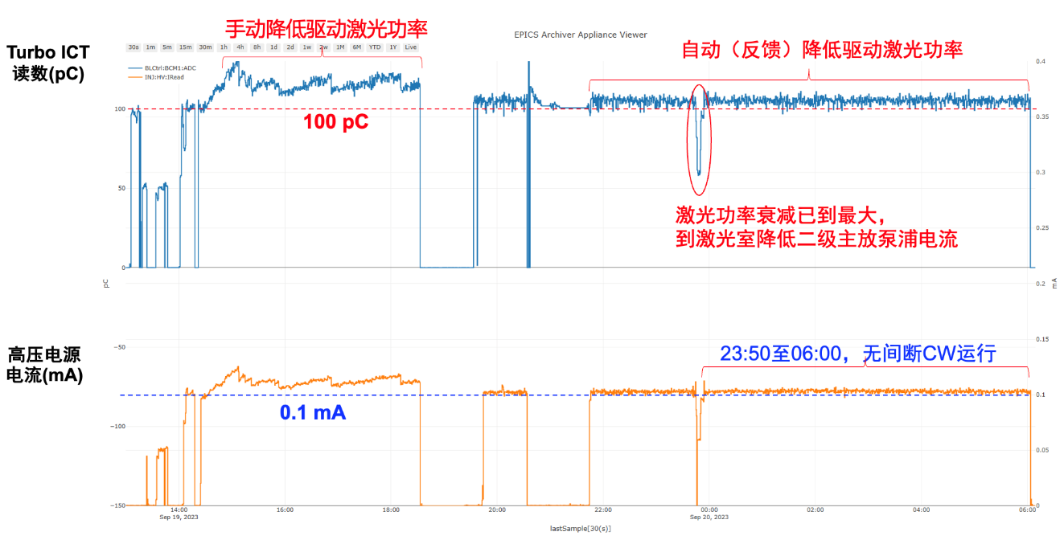
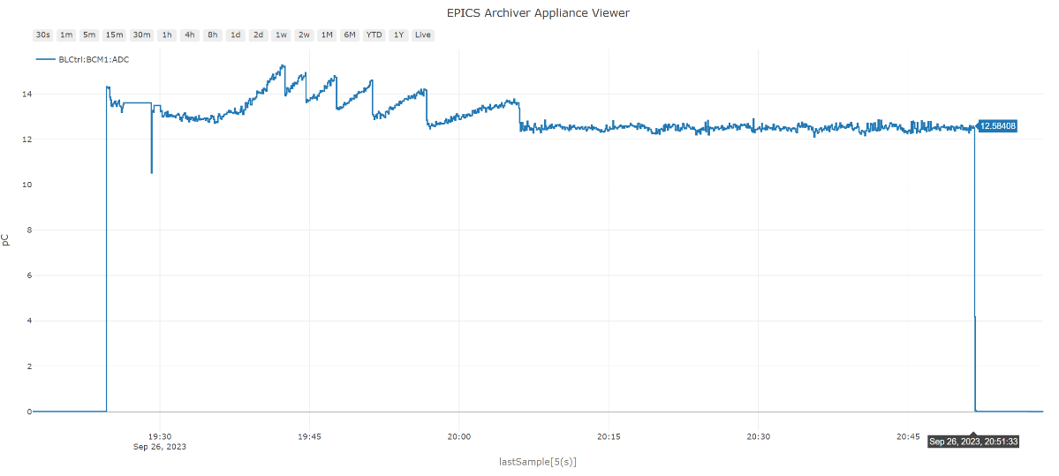
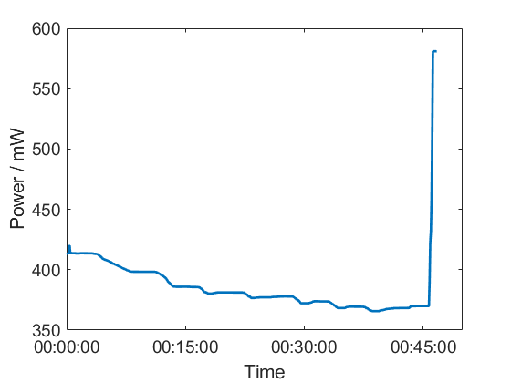
QE increasement during the beam experiment-observed in every beam experiment
CW
Q ~ 80 pC
CW
Q ~ 78 pC
50% Duty factor
Q ~ 68 pC
20% Duty factor
Q ~ 60 pC
Rise of photocurrent by 1MHz, 0.65W CW laser irradiation, Experiments on Jul 21, 2021
Laser feedback added
1mA CW, Rise of QE
Laser power
Rise of QE
13 pC, 81.25 MHz CW operation on September, 2023
100 pC, 1 MHz CW operation, 6 Colum charge extracted from this cathode #202309
11

Slide 12
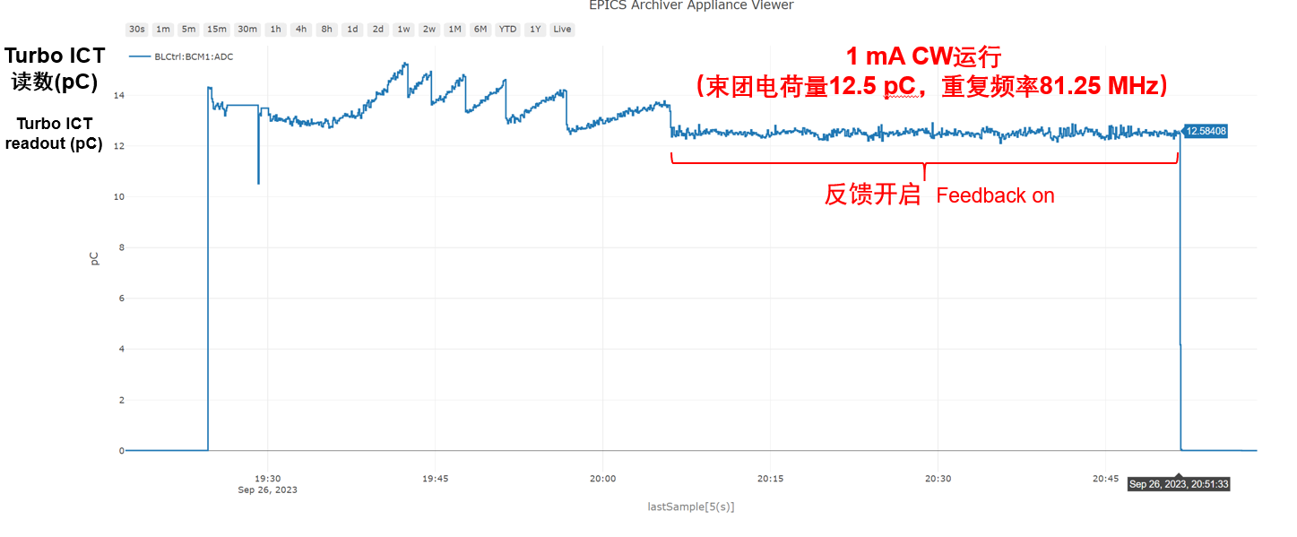
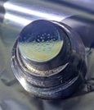
High current operation
CW operation at high average current---1 mA
QE increase due to laser power deposited on the plug
mA level CW beam extraction at a repetition rate of 81.25 MHz, QE kept growing during operation
5 mm laser spot for 1 mA operation, with a total extraction charge of 1.3 C

Slide 13
CW operation of 2~3 mA
3mA CW operation
2mA CW operation
0914#3—1.4 C
0913#2—0.9 C
3 mm laser spot for 2 and 3 mA operation, with a total extraction charge of 1.4 C and 0.9 C, respectively.
A continuous wave (CW) average current of 2 to 3 mA (12 to 40 pC at 81.25 MHz) has also been achieved in the DC-SRF-II gun.

Slide 14
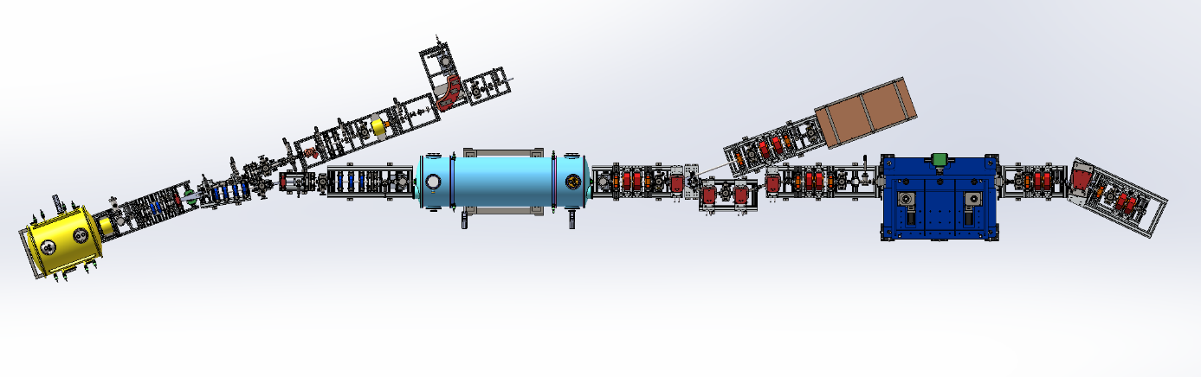
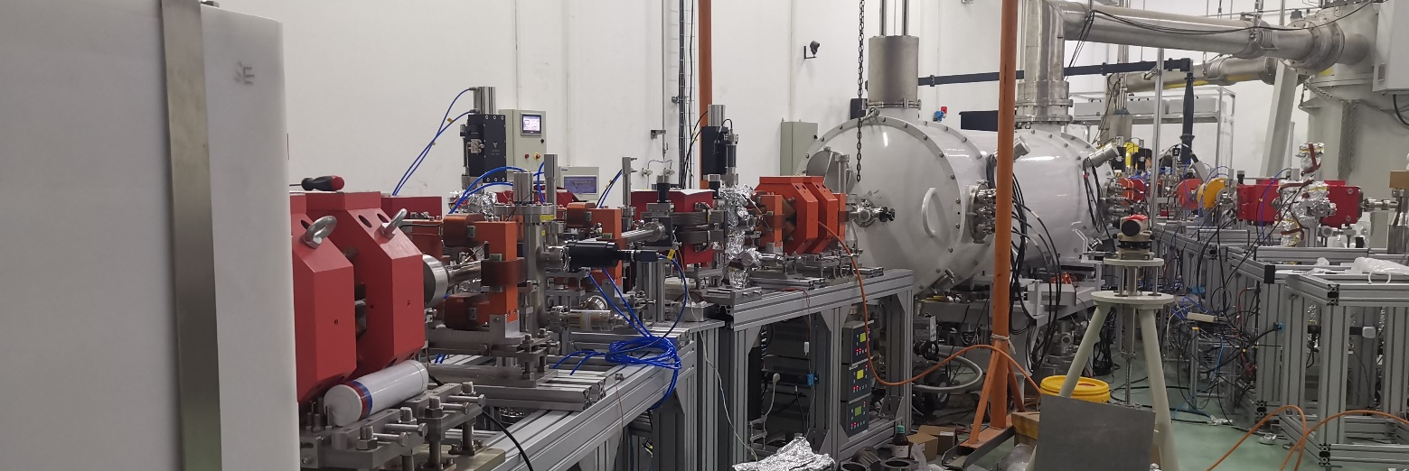
1 mA beam acceleration with 2×9 cell accelerator
The beam line of DC-SRF gun and 2×9 cell accelerator
There are solenoid, dipole, Farady cup, ICT, YAG, CCD, deflecting cavity in the beam line. And the energy, bunch charge, emittance and the pulse length can be measured from the beamline.
The beam before(left) and after(right) the bending magnet

Slide 15
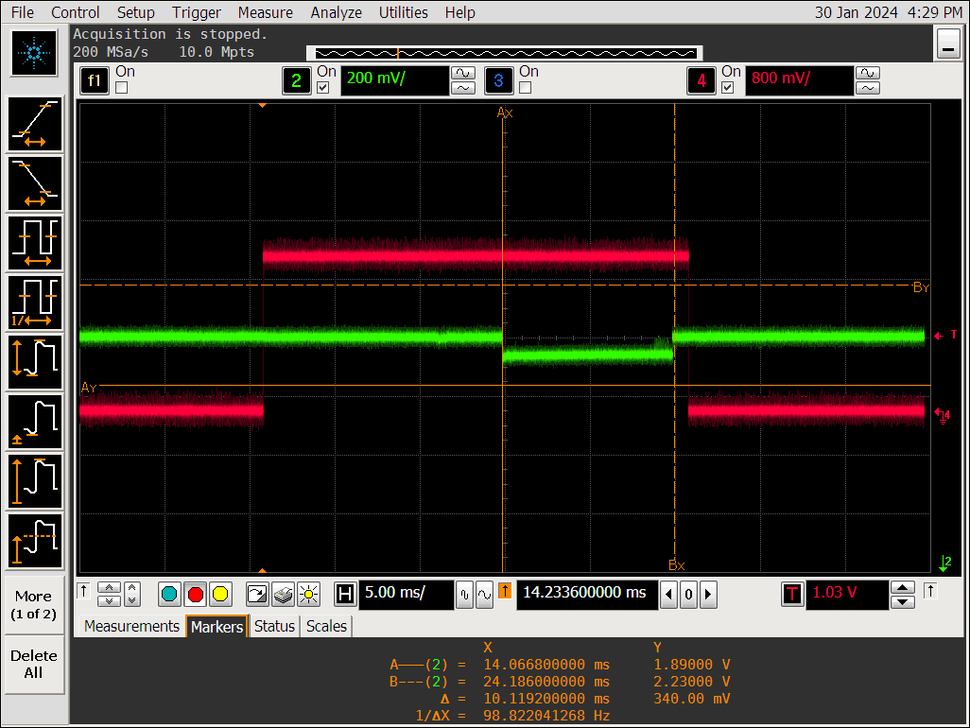
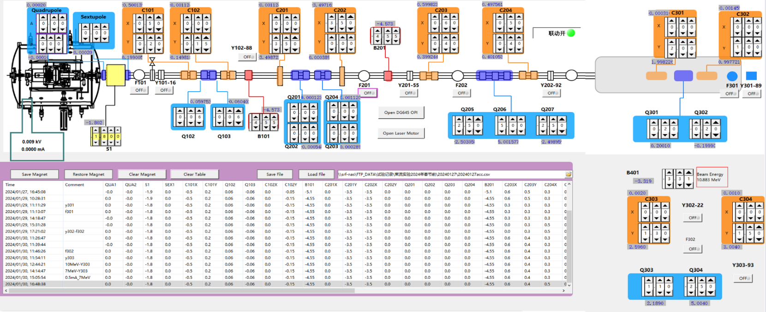
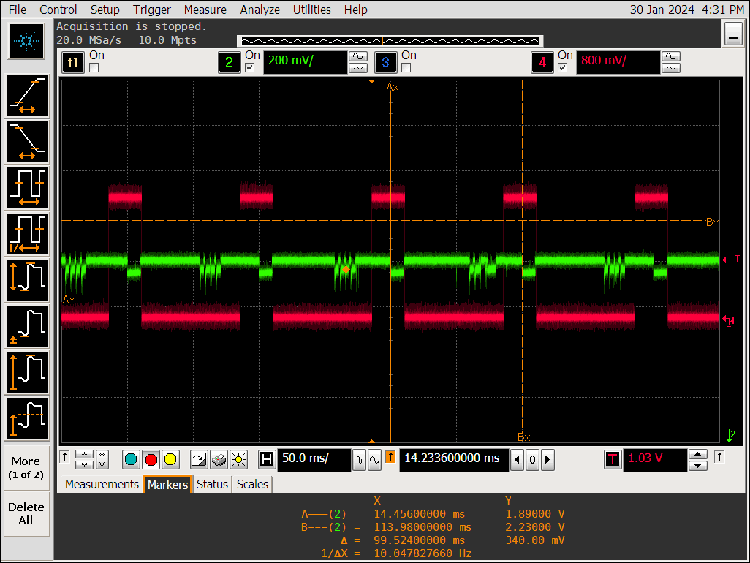
Beam energy measurement
DC-SRF gun
2×9 cell accelerator
The control panel of the beam experiment
Duty Factor Measurement
The bunch repetition rate is set at 10 Hz, with a macro-pulse duration of 10 ms, and a duty factor of 10%.
Final test results indicate a beam energy of approximately 10.61 MeV, a duty factor of 10%, and an average current of 1 mA (limited by the amplifier's power) in the macropulse after the 2×9 cell accelerator.

Slide 16
The challenge of the photocathode in cryogenic environment
How can the bialkali photocathode be utilized for high current/CW applications in a cryogenic environment(SRF gun)?
The QE of the bialkali photocathode should be maintained at a stable level. Previous investigations have shown that changes in the QE of the bialkali photocathode are significantly affected by temperature variations. This is only observed for bialikali photocathode, not observed for Cs₂Te photocathode at cryogenic temperature, such as Cs₂Te in SRF gun at HZDR, and Cs₂Te in DC-SRF-I gun at PKU.
The bunch charge is changed during the operation, which is not good for the XFEL and other application. So the control loop of the laser is important to keep the bunch charge and the average current stable.
Other ways to keep the QE of the bialkali photocathode stable at cryogenic temperature?
For high current application, it is better to keep the temperature of the bialkali photocathode at RT more than cryogenic temperature. For example, with flowing water(bialkali photocathode in 112 MHz QWR SRF gun at BNL) or back illuminating heating laser.

Slide 17
Fabrication and Transport of K₂CsSb photocathode
mA level operation of the K₂CsSb photocathode in the DC-SRF gun
Emittance measurement
Summary
Outline

Slide 18
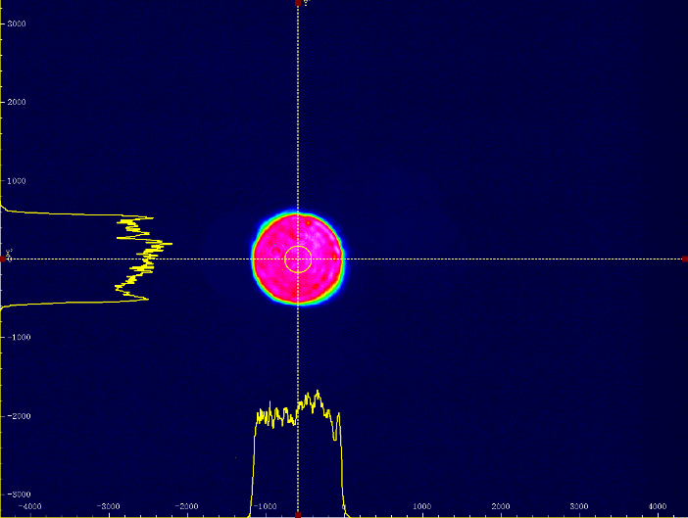
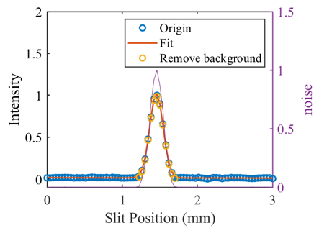
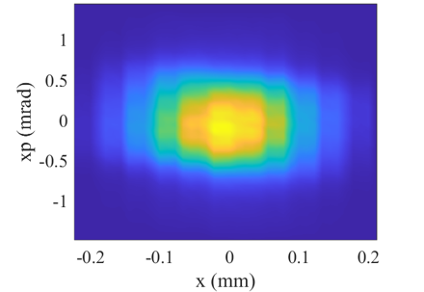
Emittance measured in the DC-SRF gun
Parameters of the experiment:
Electron energy(E_{k}) 2.23 MeV
Bunch charge(Q) 1.6 fC
Pulse length (FWHM) 1 ps
Laser spot (σ) 0.30 mm
transverse distribution of the laser spot
Transverse distribution of the electron pulse after multipole field calibration
The normalized emittance: 0.13 mm-mrad;
The intrinsic emittance: 0.42 mm-mrad/mm@30K, 515 nm.
Compared to 0.5 mm.mrad/mm measured at room temperature in 100 kV HV DC gun.
Preliminary results, will be measured further!
Emittance measurement by slit scanning

Slide 19
Summary
The continuous wave (CW) operation of the photocathode can be sustained for up to 16 hours at an average current of 0.1 mA (100 pC, 1 MHz), with average currents between 1 and 3 mA (CW, 81.25 MHz) having been successfully demonstrated in the DC-SRF-II gun.
To achieve high average current applications, additional research is required to optimize the performance of bialkali photocathodes operating at cryogenic temperatures. The quantum efficiency (QE) of the photocathode should be maintained at a constant value by regulating the temperature around room temperature (RT) through controlled water flow. This regulation is essential for stabilizing the bunch charge of the electron pulse; otherwise, laser feedback mechanisms must be employed.
The intrinsic emittance of the K₂CsSb photocathode is approximately 0.5 mm·mrad/mm at room temperature as measured in the high voltage (HV) DC gun, and about 0.4 mm·mrad/mm at 30 K, measured in the DC-SRF gun (preliminary results).
The photocathode has been effectively operated in the DC-SRF gun, demonstrating reliable performance within the cryogenic environment. Following insertion into the gun, the QE of the photocathode stabilized near 0.6~1%. During the CW beam experimentation, the QE gradually increased to 2 to 3 times this initial value. Notably, when the cold cathode is extracted back to RT conditions, its QE can return to the original value exceeding 5%.
Furthermore, the lifetime of the bialkali photocathode is significantly affected by the vacuum conditions within the gun; a low 10⁻⁸ Pa pressure is required to ensure prolonged operation within the gun.

Slide 20



Lab of Superconducting Radio Frequency Accelerator
Thanks for your attention!

