Slide 1
WP5: Keynote
V. Bagnoud
GSI- Helmholtzzentrum für Schwerionenforschung, TU Darmstadt

Slide 2
Outlook
WP5 at a glance
Wavefront control
Beam distortion types and beam control hardware
Beam control strategy – Hardware side
Beam control strategies
Task 5.4

Slide 3
WP5 at a Glance
Task 5.1: near field quality improvement
Task 5.2: far field stabilization and control
5.2a: real time AO system
5.2b: focusing system with adjustable focal length
Task 5.3: software integration (not started yet)
Task 5.4: machine learning
Related tasks:
Task 3.3: coherent beam combining

Slide 4
Understanding wavefront distortion origin and management
Knobs | Wavefront Aberration
 | Static | On-shot | Thermal (slow) | Mechanical (fast)
Specification | x
Deformable mirror (DM) | x | x | x
Fast Deformable mirror (FDM) |  | x | x | x
Lens position: defocus |  | x | x
Bending mirror: astigmatism |  | x | x
Tip-tilt mirror: pointing |  | x | x | x
High-perf diagnostics | x | x | x | x
Various tools differentiated by their precision, speed, dynamic range

Slide 5
The relative magnitude of the different aberrations is variable
Laser systems | Wavefront Aberration
 | Static | On-shot | Thermal (slow) | Mechanical (fast)
PHELIX (GSI)
ATON (ELI)
Apollon (LULI)
Different systems suffer from different aberrations
All need to be handled to get a “good” wavefront

Slide 6
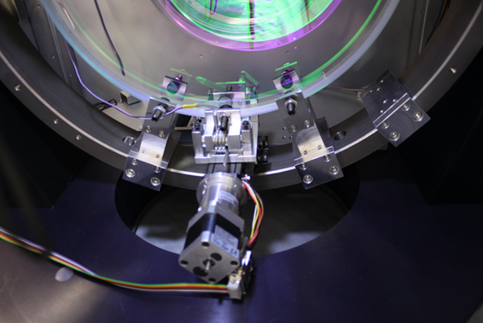
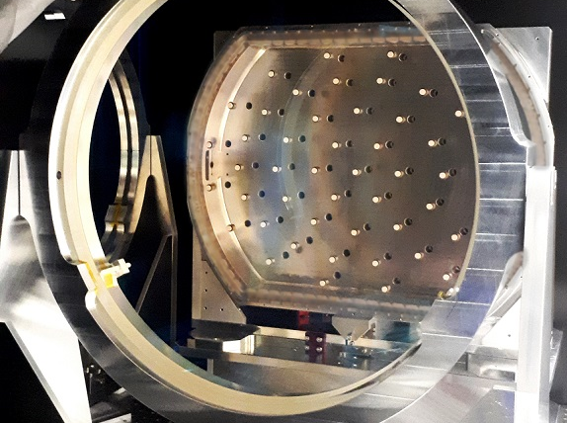
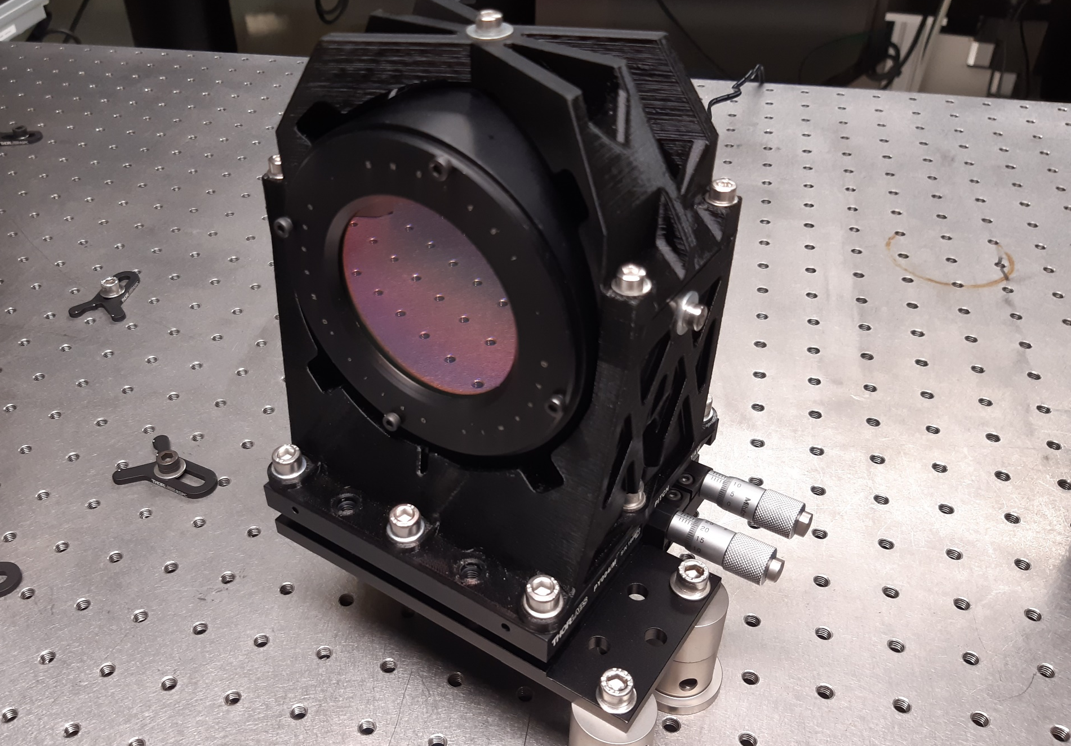
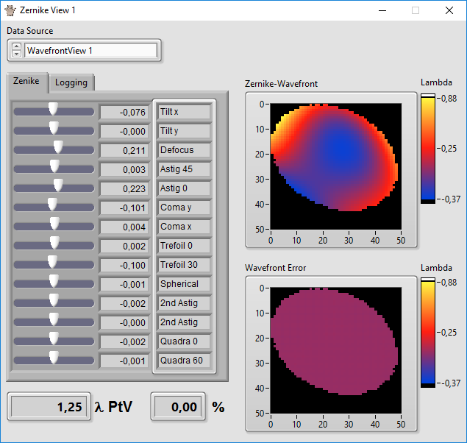
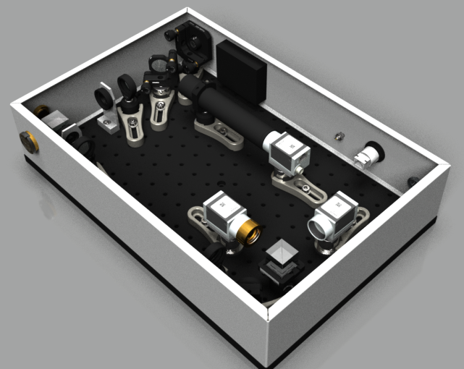
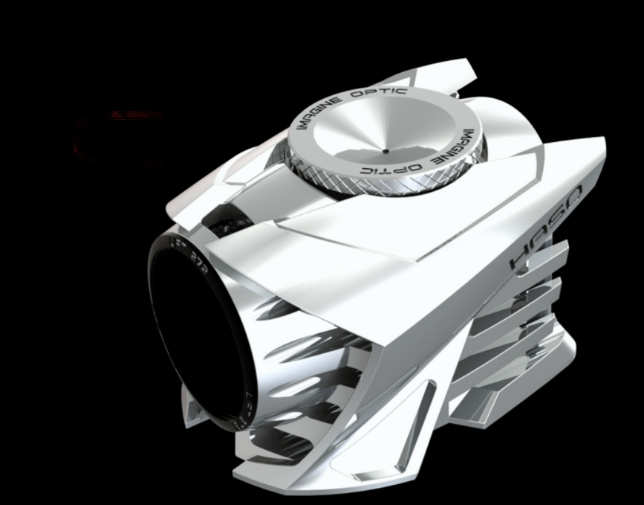
Hardware for beam quality control
astigmatic mirror (PHELIX)
deformable mirror (PHELIX)
fast deformable mirror (Apollon)
control system
cam box (PHELIX)
wavefront sensor (Imagine Optics)

Slide 7
Strategy for Beam aberration control
1
amplifier
sensor
front end + stretcher + pre-amplifier
adaptive control
system
amplifier
linear transfer function
compressor
typical beam control loops:
1. Amplifier loop
2. Experiment loop
2
end of chain
sensor
adaptive control
system
beam transport
linear transfer function
The principle of beam wavefront correction is simple but it has some pre-requisite
an excellent understanding of the system is necessary
enough dynamic range of the active device
outsource simple beam distortions (defocus, pointing, astigmatism)

Slide 8
Human-performed tasks in wavefront control
Apply basic principles
apply WF correction as close as possible to distortion source
minimizes secondary effects like spatio-temporal coupling and phase-to-amplitude modulations
handle a wavefront budget by:
clever correction distribution
keeping dynamic range of each device in check
fair load distribution of the wavefront correction
Apply correction in loop
understand what the goal is and when to stop
system quasi linear but limited by
measurement hardware precision
control hardware hysteresis
System prediction
wavefront control is deterministic: same causes produce same effects + temporal correlations exist

Slide 9
Task 5.4: from the proposal…
This task is intended to build up a foundation; therefore, the following steps will be done:
we will define an open data-format standard and corresponding acquisition workflow in collaboration with Amplitude; this standard shall ensure that any laser system can adapt their data logging system such that the data can be fed directly to a corresponding ML model;
the ML algorithm will be implemented as an invertible surrogate model, including outlier detection; it allows not only to train the model to detect correlations in a robust manner but also to provide quantified knowledge on the uncertainty associated with it; this software will be released as open source code.
We will test the model using beam data at HZDR and apply this approach to tasks 5.1-5.3 of this WP.
Deliverable 5.5: release of an open source machine learning code for beam stability investigation (HZDR, M46) The code will be released under an open source license on a suitable platform, e.g. GitLab

Slide 10
THANK You!

