Slide 1
HELPMI: the Helmholtz Laser-Plasma Metadata Initiative
Start developing a data standard for the global LPA community

Slide 2
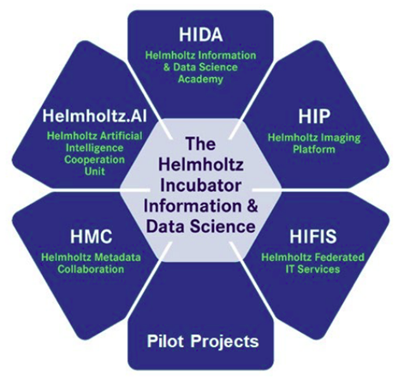
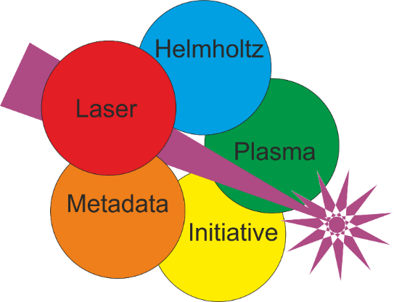
Helmholtz Laser-Plasma Metadata Initiative
Helmholtz Association operates most large-scale research centers and infrastructures in Germany
Incubator framework for innovation: Metadata, AI, IT services etc.
Yearly call for proposals for quick projects (2 years), conducted by >2 Helmholtz partners
200k€ additional funding for projects, allowing to prioritize certain activities
HELPMI: within HMC (Helmholtz Metadata Collaboration)
GSI, HI Jena and HZDR
April 2023-‘25

Slide 3
HELPMI: Main Goals
Initiative: start the development of a data standard for LPA experiments
Consulting and assistance from HMC community
Concepts, tools, trends, best practices, lessons learned…
Adopt NeXus standard from PaN experimental community
Use existing base classes, possibly define new ones
Propose application definition
Extend the openPMD standard and API for arbitrary hierarchies
Currently established for simulations in LPA community
Fileformat-agnostic
„an umbrella over a family of standards, currently for experiment data in the Photon and Neutron science community“
Generate a glossary: Domain-specific terms

Slide 4
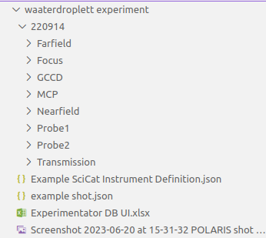
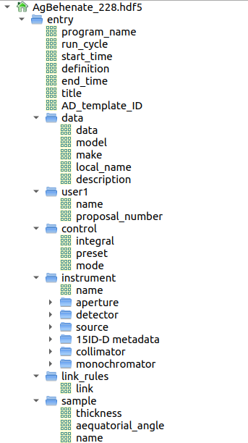
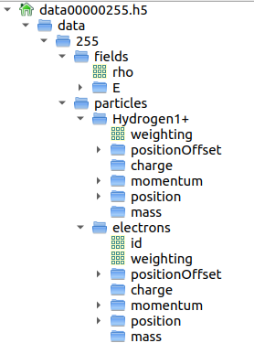
HELPMI: Working example
Example data chunk to perform our trials, and other examples
Data fields with attributes
Groups for logical gathering (hierarchy)
Links for arbitrary layouts
Hierarchical structure
Meta/Data in folder names
Files containing instrument and experiment description
Setup models, calibration, scripts
NeXus base classes encoded in attributes NX_class
Named fields
partly by definition

Slide 5
DDC* as vocabulary draft
*: Devices, Detectors, Components
> 40 entries already, keep fixed at the moment and try to settle all MD properties
Detectors: particles + radiation from interaction, laser-specific, environmental (vacuum, temperature,..), generic (CCD, diode, …)
Devices: actuators, laser-specific, placeholders
Targets
Laser system blocks
Probe beams (lasers, radiation, particle)
Proposed template for data and metadata
Technical MD: rarely changing
Procedural MD: role in experiment
Access/Security MD
Data
to be discussed: DublinCore, DataCite, Provenance MD

Slide 6
Laser data and NeXus
currently in progress
What do we need? Observables and schematics?
NXcollection: only wrapper class
NXbeam: (global) properties at given location, not entire beam path;
has spectrum, polarization, divergence attributes
unaware of time structure
can be spectrally resolved, unclear if for higher dimensions like for profile
NXdetector: 2D detector
NXdetector_channel: 3D detector
do we need own definitions?

Slide 7
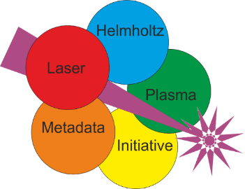
Facility-wide activities in LPA domain
Data
Tools
and
automation
Domain-specific standard
Data repository
Electronic Lab Documentation
Simulations
Experiments
Metadata
Metadata catalogue

Slide 8
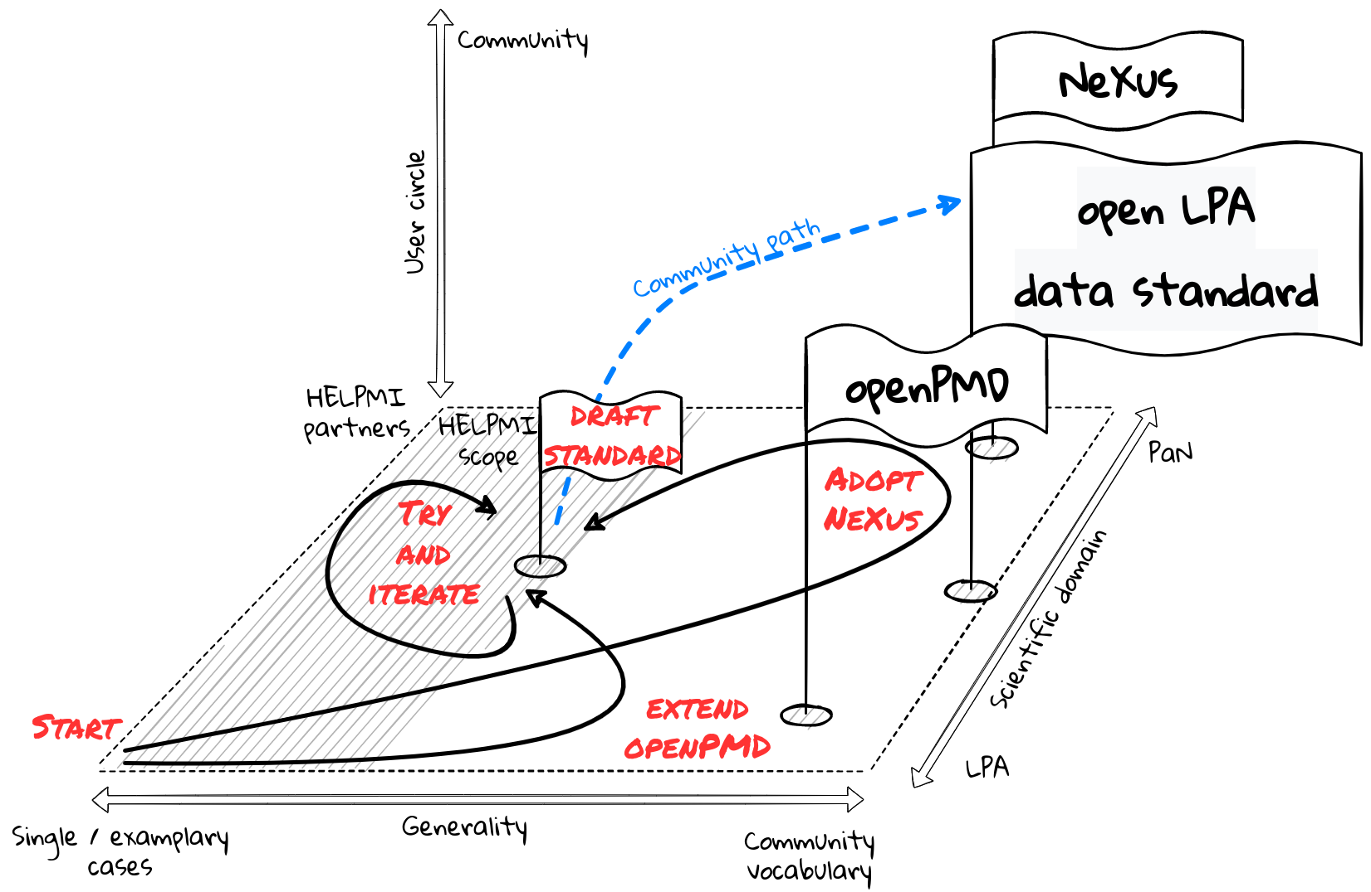
HELPMI scope, paths and limitations

Slide 9
Acknowledgements
Contact us: helpmi@hzdr.de
Website planned
Some slides were inspired by
S. Brockhauser @ FAIRmat Tutorial #6 on Metadata standarisation
B. Watts @ HDF5 and Nexus
Who is HELPMI?
GSI: Johannes Hornung, Udo Eisenbarth, Vincent Bagnoud
HI Jena: Alexander Kessler, Matthew Schwab, Marco Hornung, Malte Kaluza
HZDR: Franz Pöschel, Michael Bussmann, Alexander Debus, Hans-Peter Schlenvoigt
Project Observers: Axel Huebl, Andreas Doepp, Rajeev Pattathil, Birgit Plötzeneder, Lajos Schrettner, Balázs Bagó
This project (ZT-I-PF-3-066) was funded by the Initiative and Networking Fund of the Helmholtz Association in the framework of the Helmholtz Metadata Collaboration project call.

Slide 10
Data and metadata
Their connection to information and knowledge
+
=
Input data
DATA
some representation of information
contextual information to retrieve information from data and to connect to existing knowledge
01001000 01000101 01001100 01010000 01001101 01001001 00111010 00100000 01010100 01101000 01100101 00100000 01001000 01000101 01101100 01101101 01101000 01101111 01101100 01110100 01111010 00100000 01001100 01100001 01110011 01100101 01110010 00101101 01010000 01101100 01100001 01110011 01101101 01100001 00100000 01001101 01100101 01110100 01100001 01100100 01100001 01110100 01100001 00100000 01001001 01101110 01101001 01110100 01101001 01100001 01110100 01101001 01110110 01100101 00001010
48 45 4C 50 4D 49 3A 20 54 68 65 20 48 45 6C 6D 68 6F 6C 74 7A 20 4C 61 73 65 72 2D 50 6C 61 73 6D 61 20 4D 65 74 61 64 61 74 61 20 49 6E 69 74 69 61 74 69 76 65 0A
HELPMI: The HElmholtz Laser-Plasma Metadata Initiative.
Metadata
Application: search, analysis, visualization
NEW DATA
New Metadata

Slide 11
Metadata standardization
Data-ization of metadata
DATA
Parameterized story
Metadata: a long story
Experiment
Instrument:
Description
Parameters
Sample
What kind of experiment, which instrumentation
What sample, which detectors, parameters
Calibration data, processing workflows
Experiment type
Detector A:
Description
Calibration
Processing
Detector B:
Description
Calibration
Processing
other
Name, material

Slide 12
Modelling of experiments
Level of complexity to be defined by community
Physics Model
Quantities
Relations
Interactions
Approximations
Observables
Conceptual design model
Implementation-independent
Experiment parameters
To be set
To be measured
Experiment
Type
Instrument
Sample
Detectors
Technical design model
Implementation-specific
How to be measured or set
e.g. accuracy

Slide 13
Why standards?
Why tie myself down?
Why fix something that‘s not broken?
Why follow external rules?
What‘s in for me?
Working with others is a hassle!
You commit only to your own community.
When your‘s breaks, it‘s your problem.
Contribute and make them your rules!
Efficiency means less work on long term.
Interoperability shares the work!

