Slide 1
The Draco laser and it‘s data for ML / AI (and some examples..)
S. Bock, R. Gebhardt, U. Helbig, T. Püschel,
U. Schramm and the FWKT team

Slide 2
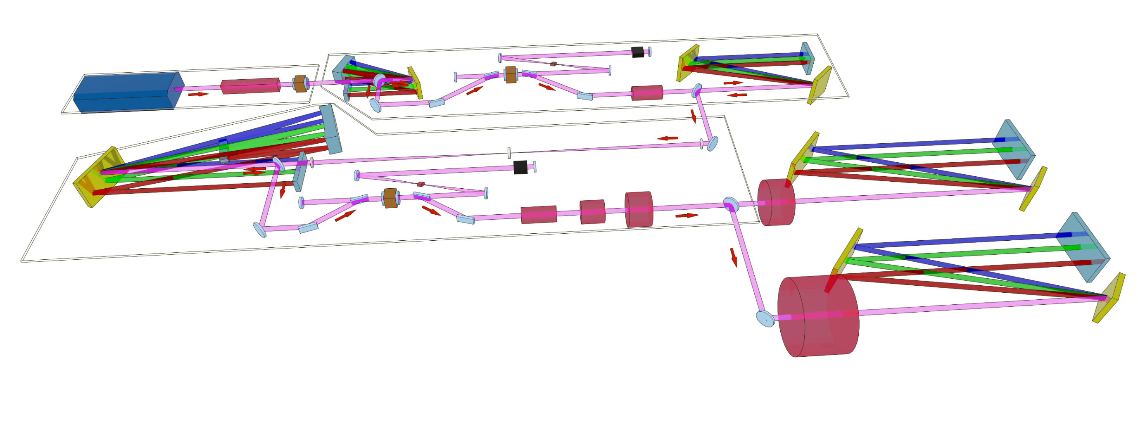
The Draco laser
CPA1
Pulse selection out of oscillator pulse train, stretching, amplification, spectral shaping and compression of 20mJ output energy, spliting for XPW seed and probe beam usage (before compression)
Compression
Individual compressor chambers with beam distribution to individual target areas and diagnostic, Wavefront correction with DM
CPA2
Stretching, amplification and spectral shaping of XPW cleaned pulses up to 1.2J output, (50mJ pickup for probe beam usage)
50:50 Beam splitting and individual pulse picking (PC and fast shutter) for seeding of the main amplifiers
Main amplifiers
6J cryogenic cooled amplifier with 1Hz pumping
40J twin amplifier (with 2.5J pre-amp) with pump on demand for thermal lensing control

Slide 3
The Draco laser - CCM
Embedded network
Ellioos-srv1
Host network
Embedded
Host network
Embedded network
emb1
host1
Host
emb2
host2
emb3
Database
emb4
host3
Dazzler
Data receiving from embedded side
Virtualizing of data in blocks
Providing access to blocks from host side
Sending data to database server
API/Gateway for Tango, etc.
host4
Mazzler
emb13
Wizzler
Camera readout (incl. derived data, e.g. beam pointing
Spectrometers
Instruments (e.g. Genpulse, Masterpulse, etc.)
Laser control
Security
Shot counter
host12
Accessing of the individual Blocks
Displaying of cameras and spectrometers
Setting control of functions/instruments
Local value saving, performance traces, …
Remote access of out-of-CCM instruments
+ gateways to the HZDR and experimental networks

Slide 4
Block representation
Blocks:
CPA1
CPA2
150mJ / 1.5J
6J main amp
40J main amp
Compressor(s)
Each block representation contains all relevant instruments
Security settings are done each block, but are as well acting onto other parts

Slide 5
CCM Functionality

Slide 6
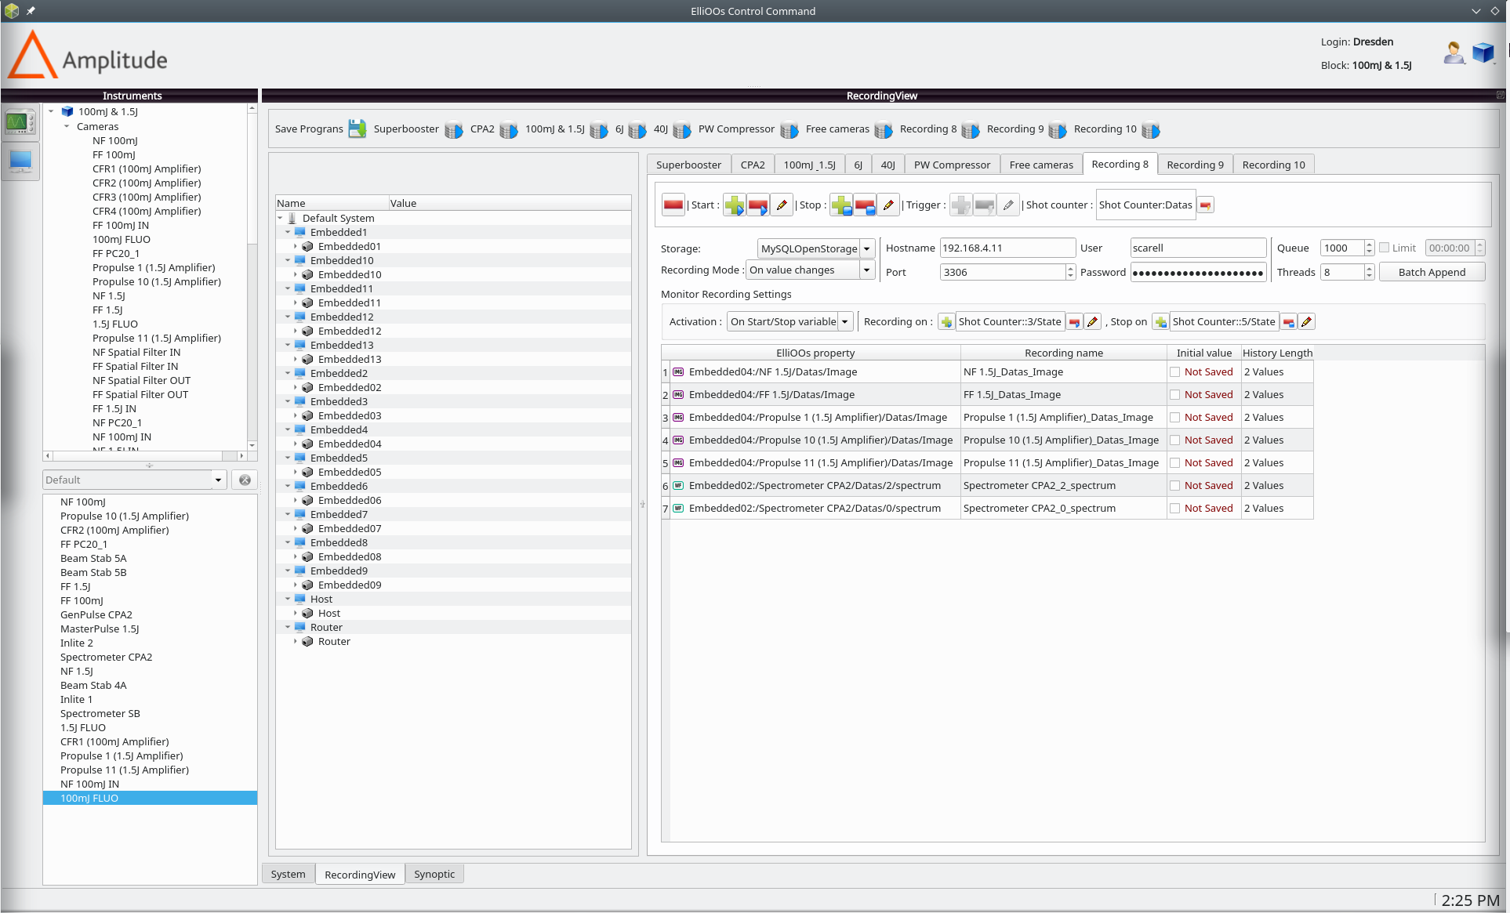
CCM Central data saving
Data saving can be configured for different triggers:
Every periode
Everytime a value is changed (this value is saved)
On trigger
Shotcounter and runID as individual identifier for the shot (also usable for experiment)
Data is send to database via different recording processes

Slide 7
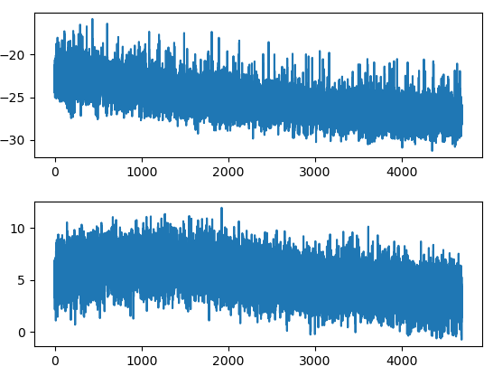
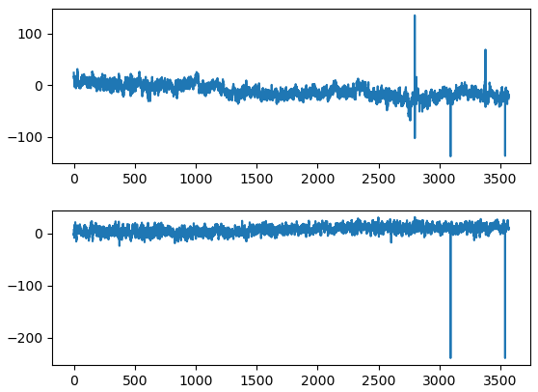
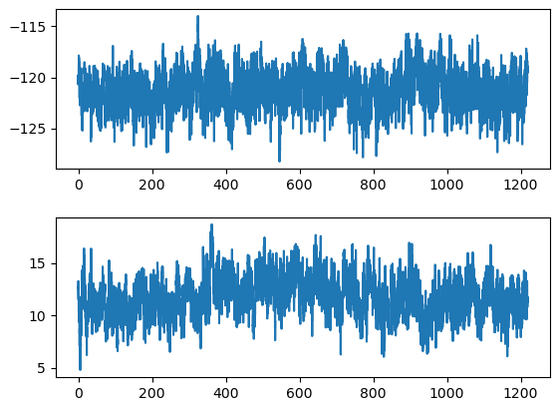
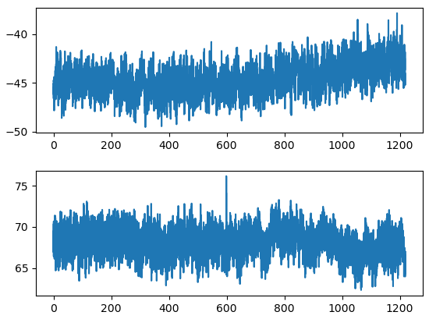
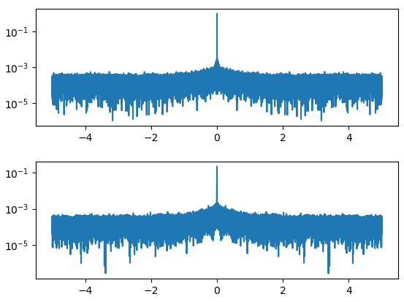
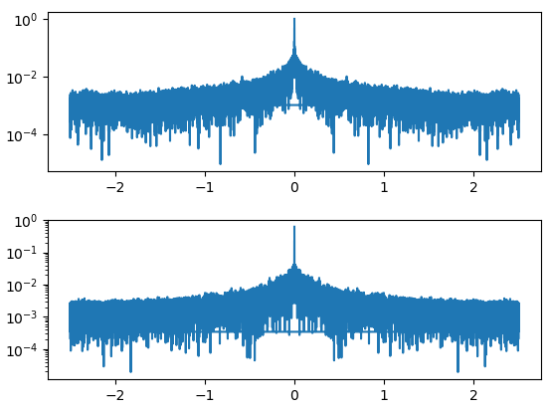
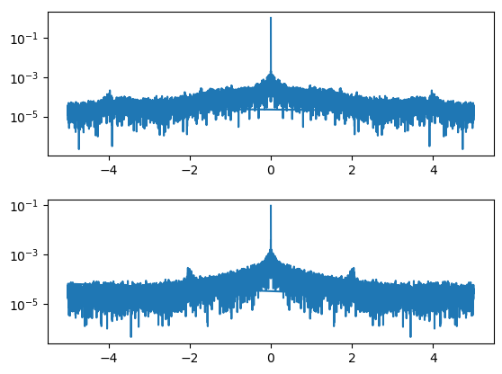
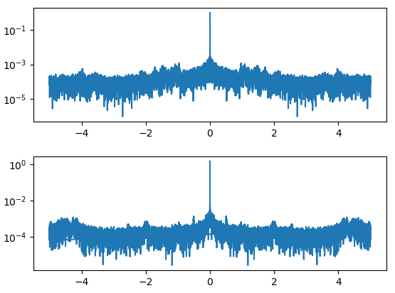
Beampointing and Impact on Laser Performance
Historic data from 2015
Frontend
Transferbeamline
Post compressor
Target area
Beampointing FE mainly affected by drift (on daily scale), no specific frequencies
Transferbeamline slightly higher noise
Adding specific frequencies in compressor setup and beyond (e.g. pumps, etc.)

Slide 8
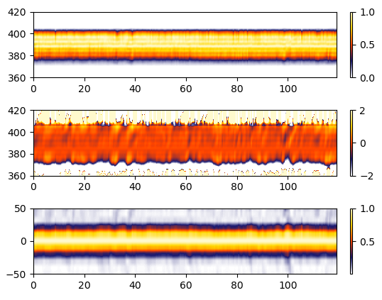
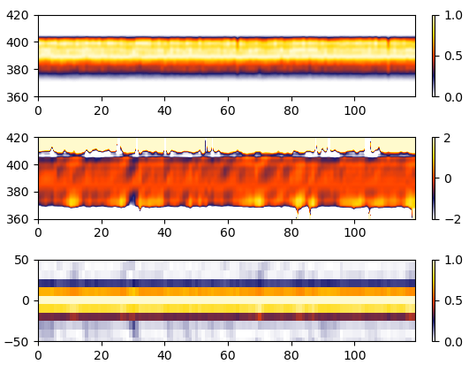
Beampointing and Impact on Laser Performance
→ angular fluctuations can influence compression in grating compressor
Probebeam AC
6J pickup AC
→ No significant impact on compression on probe and main beam pickup (before transfer to main compressor)

Slide 9
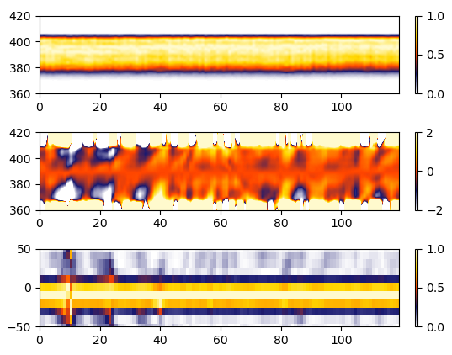
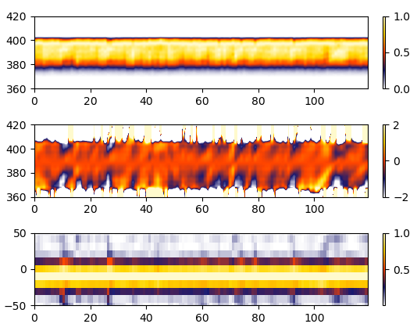
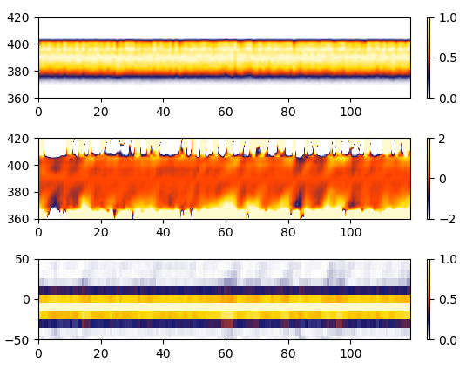
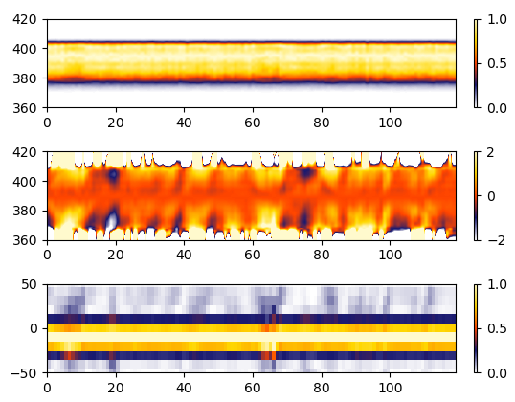
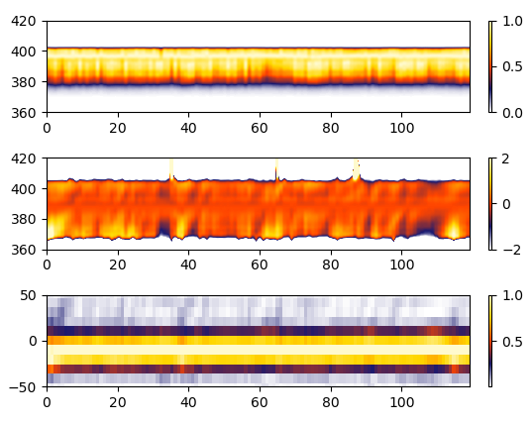
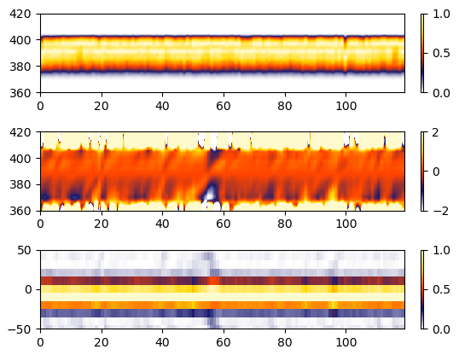
Beampointing and Impact on Laser Performance
01.02.2023 6J
22.05.2023 6J
09.02.2023 40J
02.02.2023 6J
24.05.2023 6J
31.03.2023 40J
Compression of main beams
Impact on spectral phase stability

Slide 10
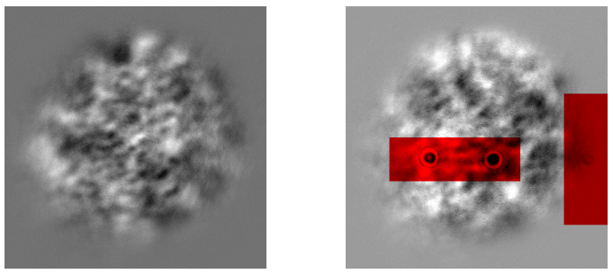
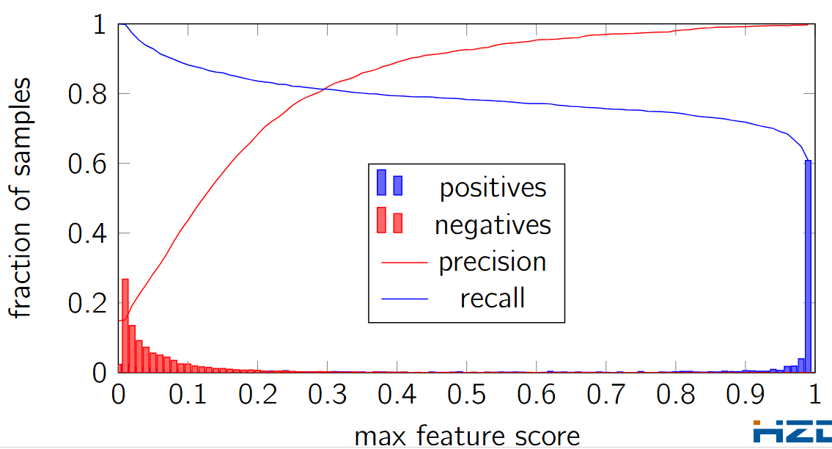
ML application I – defect detection for interlocking
priority: low false positives
⇒ tune threshold t to the high end, at the expense of recall
precision even for high threshold actually not good enough
threshold | precision | false positives / hour
0.80 | 99.13% | 313
0.98 | 99.92% | 29

Slide 11
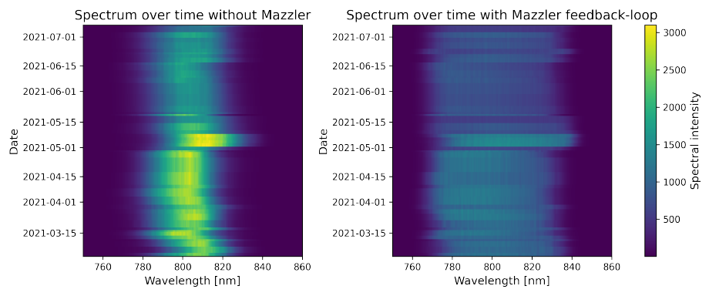
ML application II – spectral shaping using Mazzler
On the left, a two-dimensional visualization of the unmodified initial spectrum of the DRACO laser is provided. The spectra modified with the Mazzler and the corresponding feedback loop is provided on the right side.
Differences in day-to-day performance by laser system influence the reproducability of the spectral shaping
Iterative loop generates small ripples → impact on contrast?
Can AI/ML help us here?

Slide 12
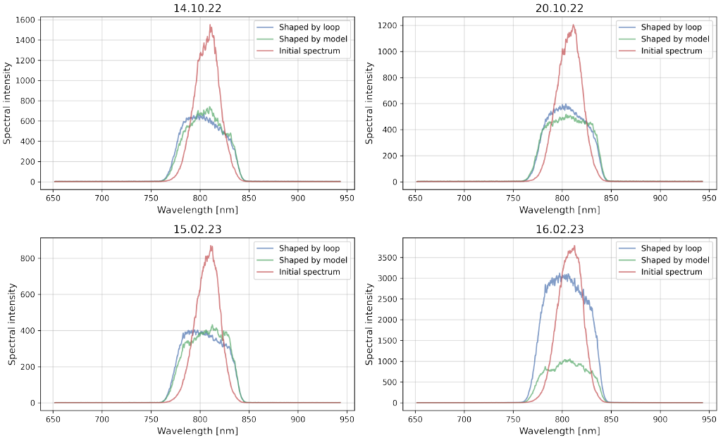
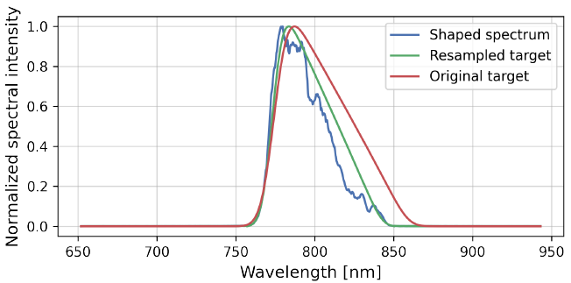
ML application II – spectral shaping using Mazzler

Slide 13
Conclusion
ML / AI can improve laser operation and performance
Beampointing
ML / AI can help to identify the coupling between different stages of the laser with respect to fluctuations
„traditional“ measures and procedures can be applied then
Do we have all informations out of the laser? → no, we need more informations on the enviorment, if needed
Defect detection
With one single camera false positive rate is to large
Combination of different cameras has potential to improve that
Spectral shaping
Application to spectral shaping is promising
Further investigations required
Similar approaches for spectral phase and compression
Similar approaches for temporal pulse shaping for ns lasers

Slide 14
Thank you for your attention!

