Slide 1
System Data Acquisition & Management at PHELIX
Jonas B. Ohland, Udo Eisenbarth, Stefan Götte

Slide 2
Agenda
PHELIX in a nutshell
The PHELIX Control System (PCS)
The PHELIX Shot DataBase (PSDB)
  Motivation/Design considerations
  Snapshot data
  Time series data
  Data access

Slide 3
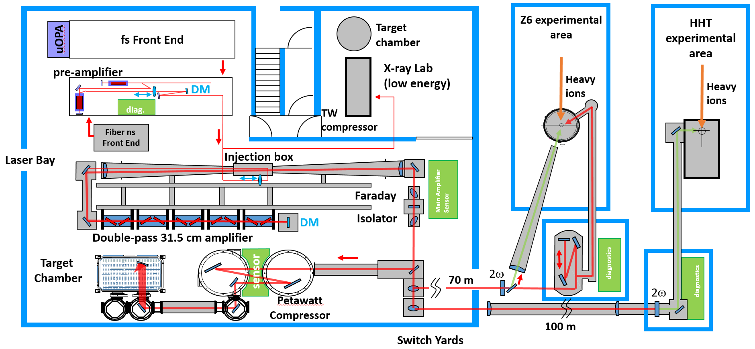
PHELIX in a nutshell
Two front-ends:
- short pulse “fs”
- long pulse “ns”
- coming soon:
incoherent ns
Nova-type Nd:Glass
main amplifiers
=> 1 shot/90 min,
=> 6 shots/day
Three experimental
areas:
- Petawatt TA
- Z6 (with UNILAC)
- HHT (with SIS18)
User facility

Slide 4
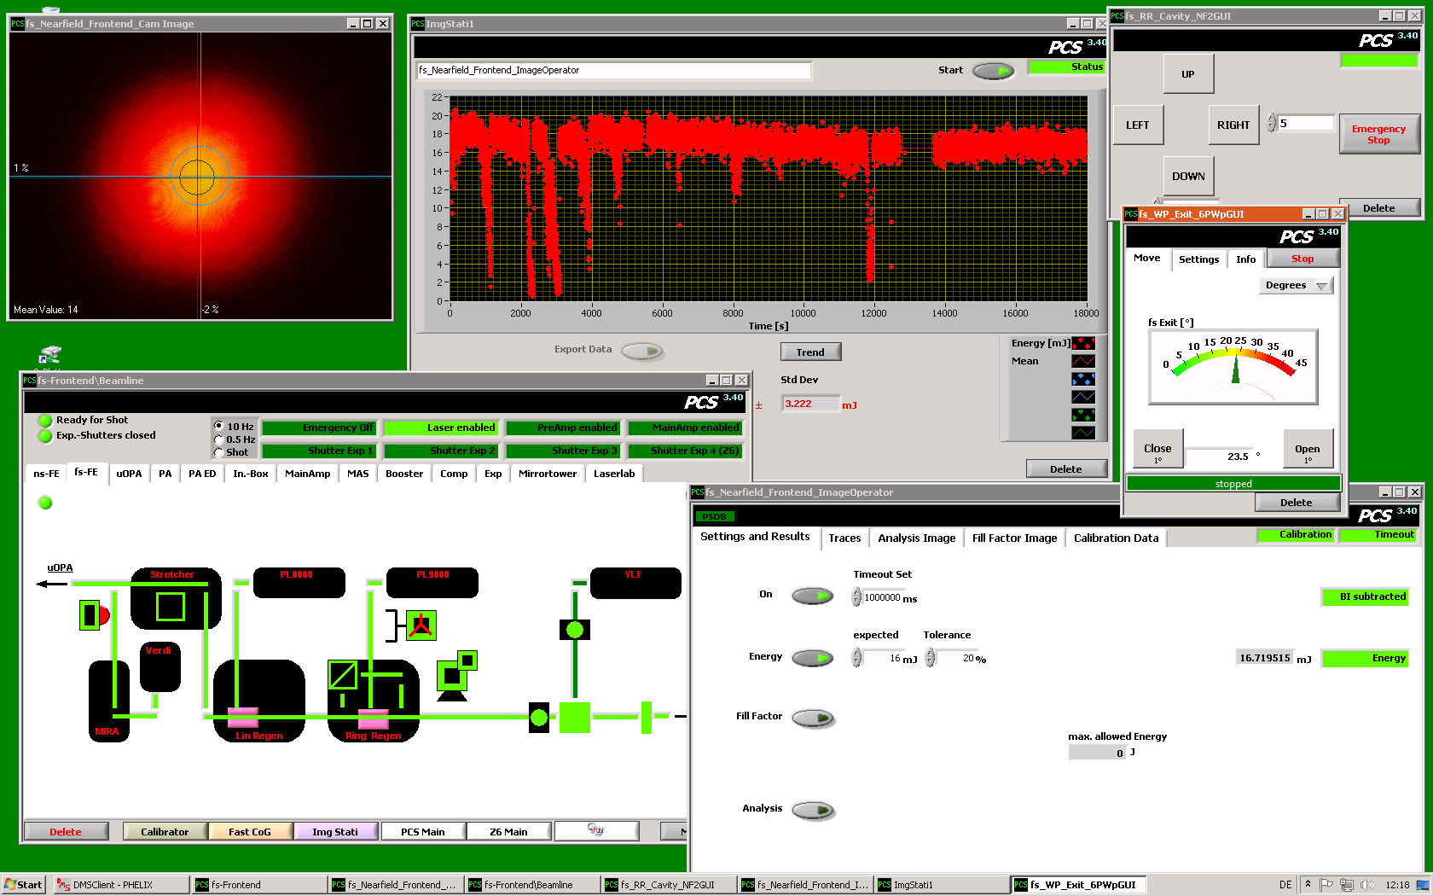
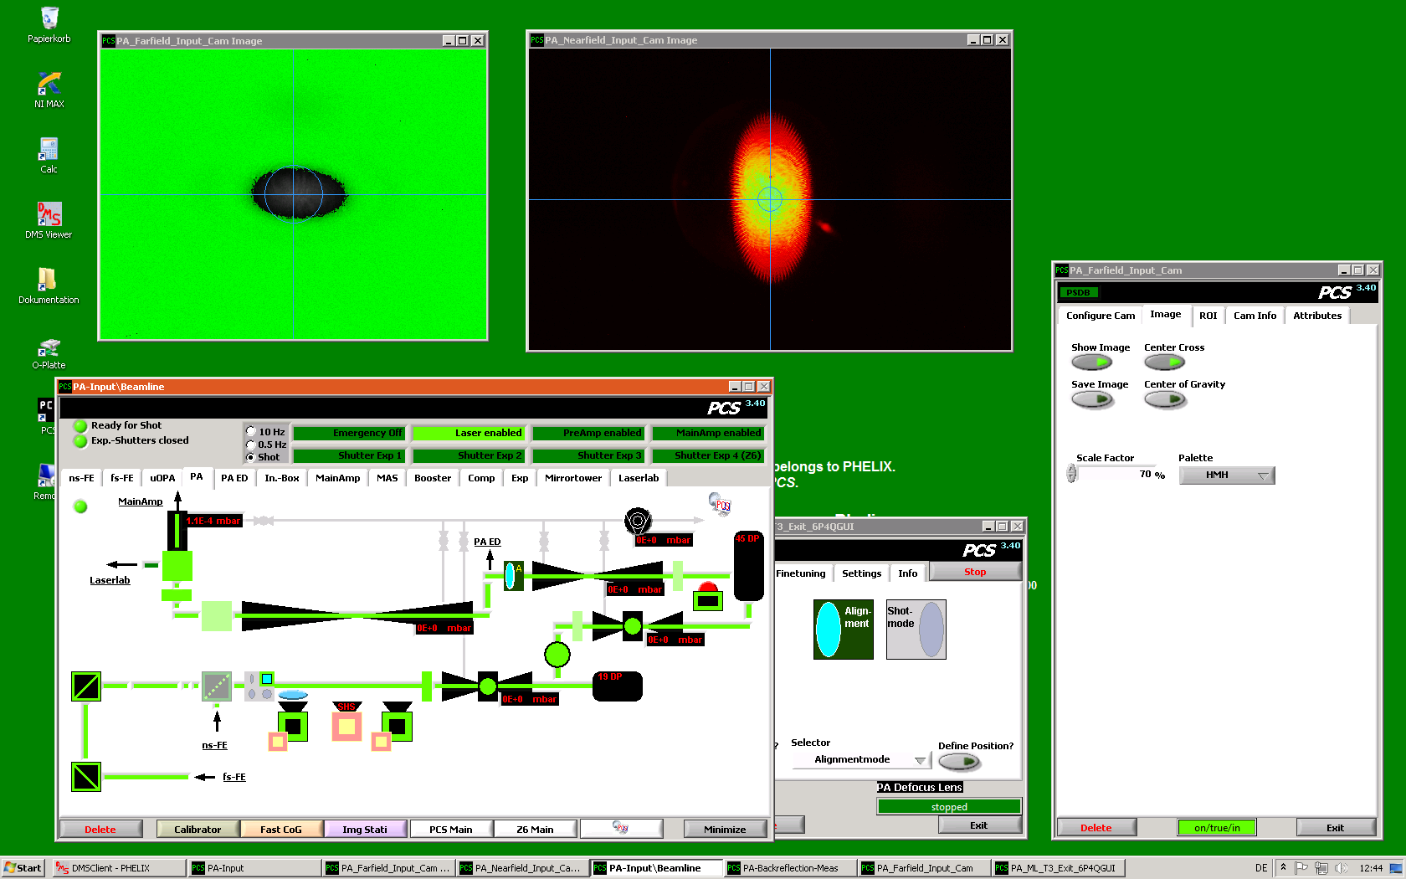
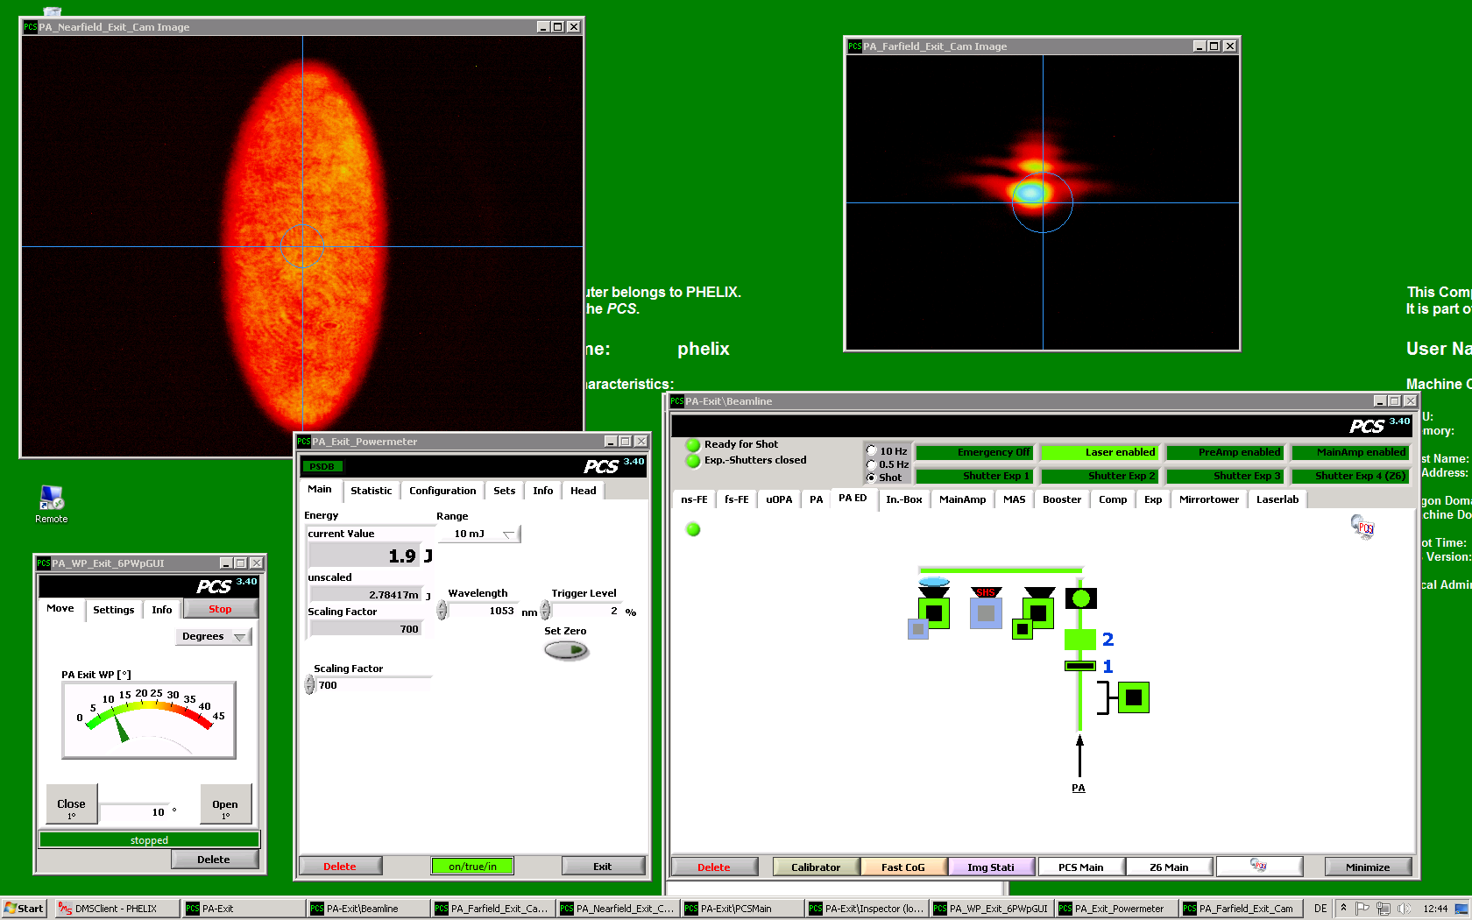
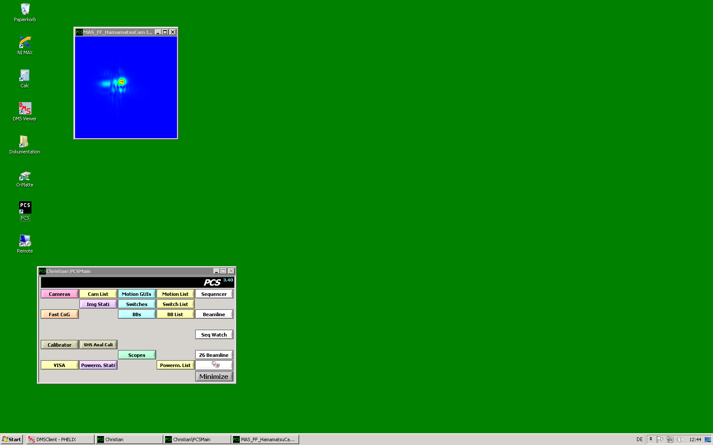
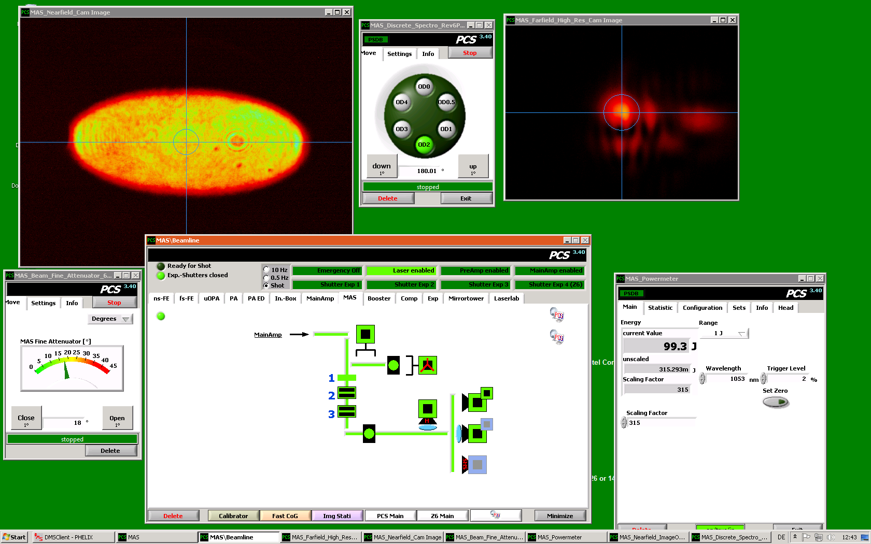
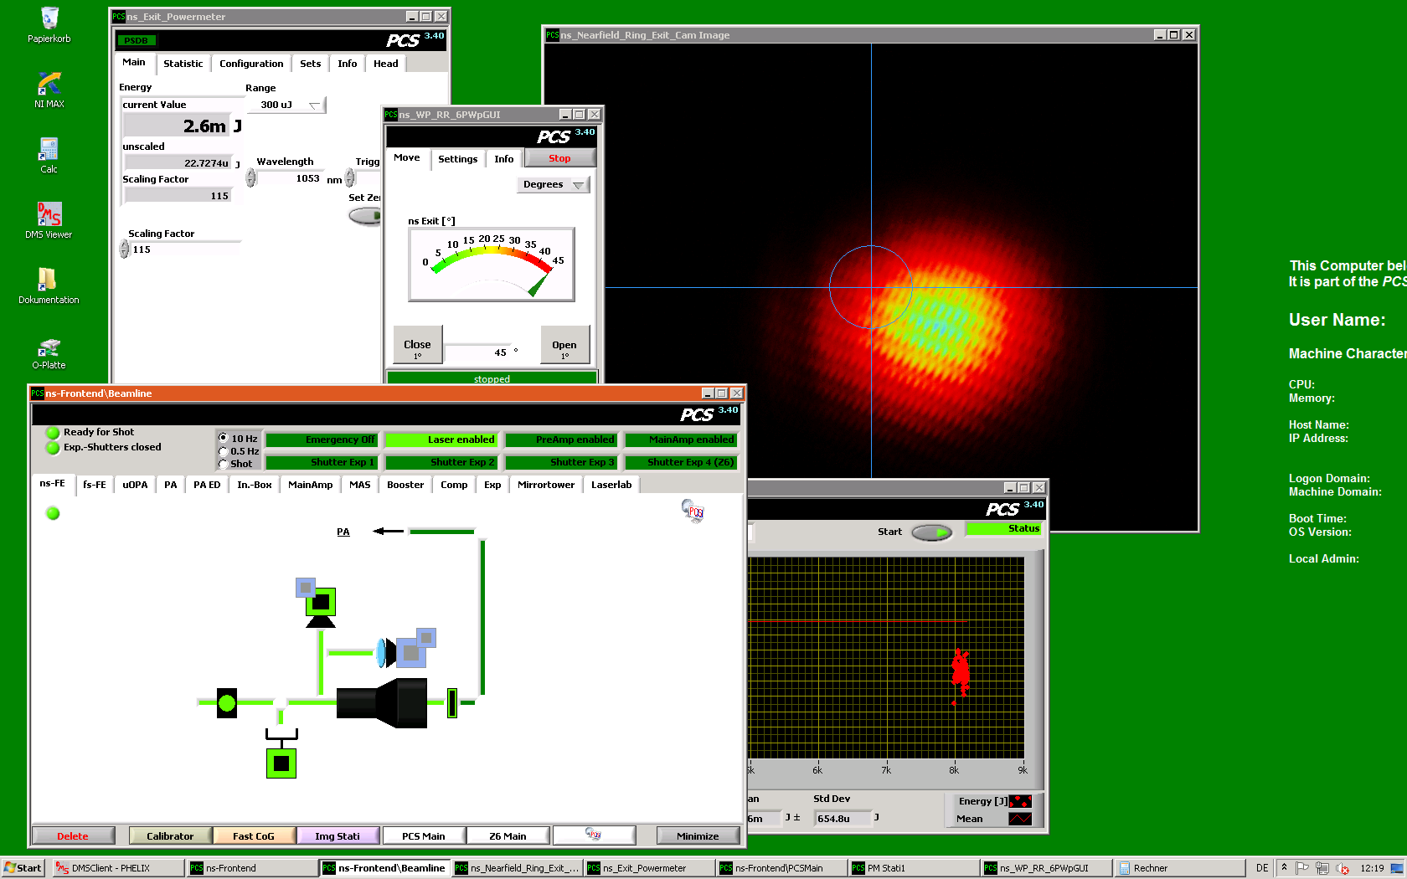
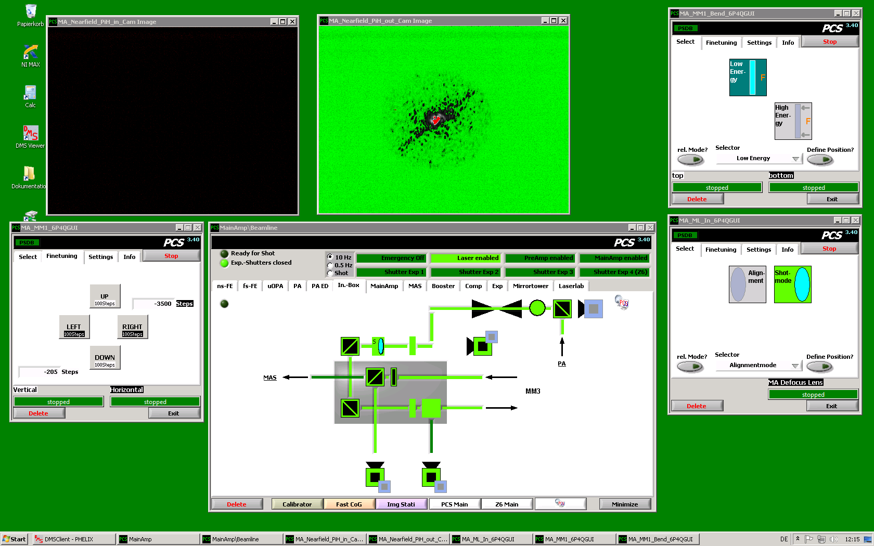
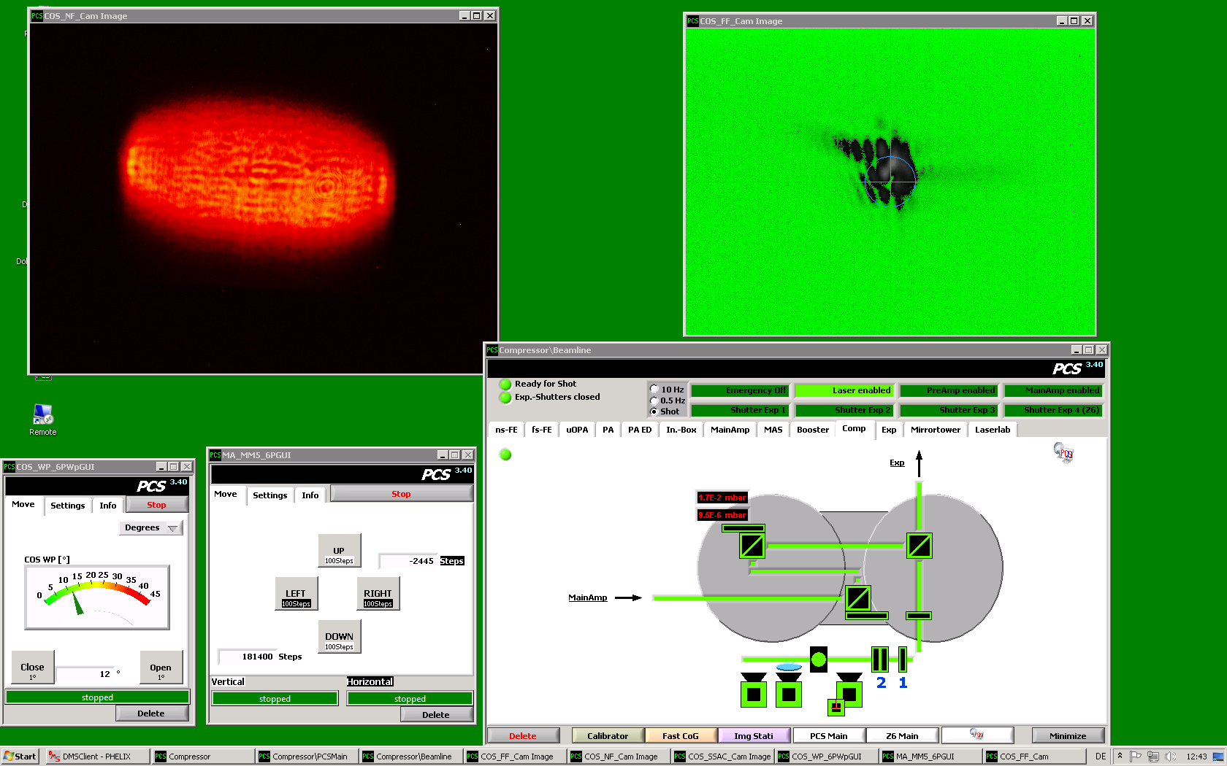
PCS Architecture
OS: Windows
  Cross platform compatible
LabVIEW 2019
  no higher version due to FireWire
  no lower due to many reasons
Distributed on 38 nodes:
  34 PCS
  2 developer
  2 hardware test nodes
one executable
about 146 PHELIX classes
  36 Base classes
  about 500 instances
about 10000 process variables
PCS nodes in the PHELIX laser hall (selection)

Slide 5
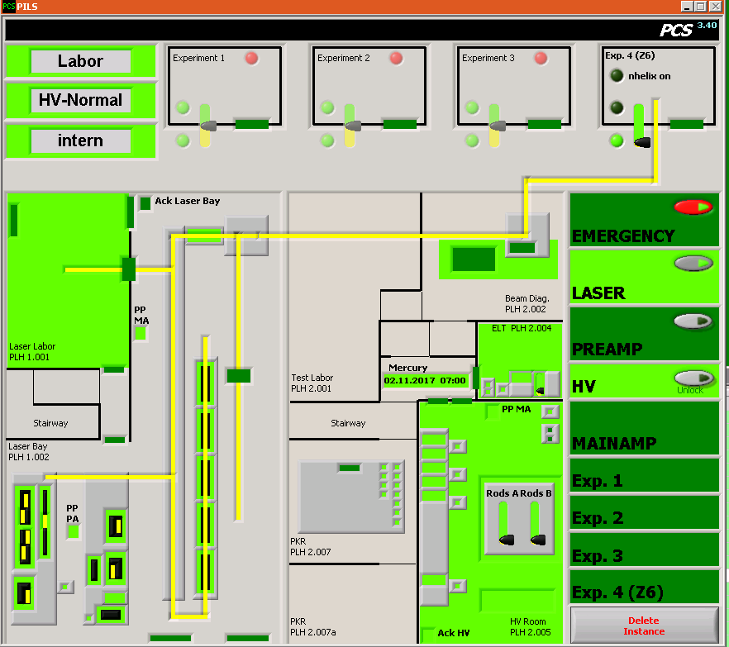
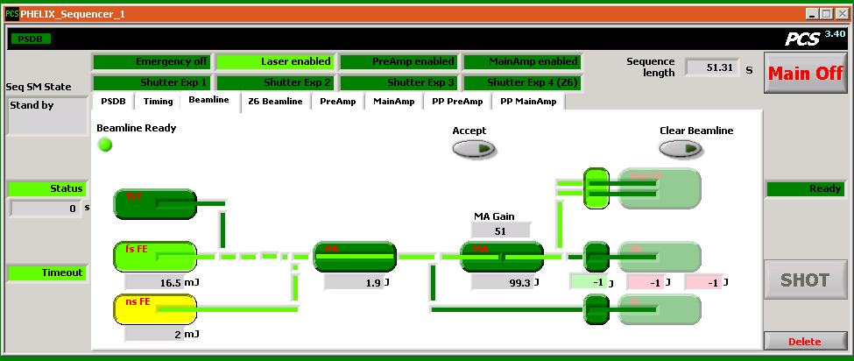
PCS Interfaces (selection)
Beamline GUI
Shot Sequencer (state machine)
Security monitoring/control
Motion control
Data acquisiton/visualization/logging

Slide 6
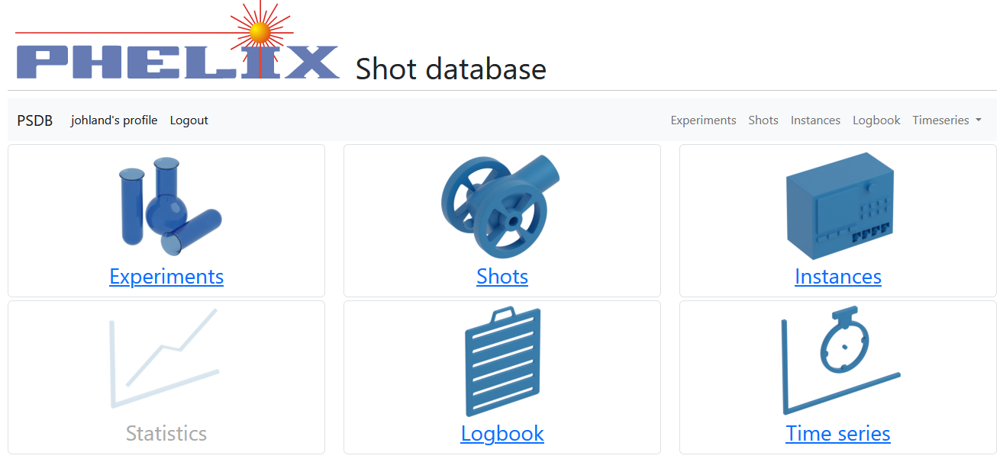
PHELIX shot database (PSDB)
Primary motivation: tool for operating crew
  Search and compare shots
  Generate statistics/identify trends
  Prepare similar shots
Requirements:
  Reliable (working for 12 years)
  Future safe
  (e.g. new data types, devices …)
  Group shots by experiments
  Easy access from everywhere
  As little maintenance as possible
Current PSDB web interface

Slide 7


PSDB design considerations
Workflow
Snapshot structure
Data redundancy
Create experiment entry
via web interface
once at beginning of experiment
Camera 1
Example: camera data
Image:
Exposure: 20 µs
Data | Changes? | Type & size
Image | each shot | Image (~MByte)
Exposure | sometimes | Numeric (8 byte)
Serial # | rarely | Numeric (8 byte)
Shot
Shot procedure
Select experiment
Select shot type (test/experiment)
Press shot button
Id (Shot #)
Timestamp
Comment
Experiment
Shot type
Camera 2
Image:
Exposure: 15 µs
Powermeter 5
Add/modify shot comment
via web interface
Energy: 123 J
Shutter 4
For each shot ALL data is written:
  information redundancy
  no versioning necessary
► Strongly reduced maint. effort
Position: open
Attach additional shot files
via web interface

Slide 8
PSDB ↔ PCS com. on Shot delivery
PCS Start Up
Preparation
Shot Delivery
User
Experiment,
Shottype
Shot
PCS
Sequencer
Sequencer
Sequencer
possible
Experiments,
Shottypes
Experiment,
Shottype
Start
Standby
Data controller
Data controller
Data controller
Status
Write with
Shot ID
possible
Experi-
ments,
Shottypes
Device
Device
Device
Device
Device
Device
Device
Device
Device
Shot
ID
Name
Device
ID
Data
PSDB

Slide 9

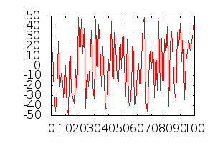
Logical Data structure
Devices
PA_Input_NF_Cam
MAS_Filt1_BB
MAS_Spectrometer
…
Data types
Numeric, String,
Image, Spectrum,
…
Experiment
Internal
P010
P018
P155
…
Shot
Shot #
Timestamp
Experiment #
Shot type
Shot comment
Automatically assigned
2010-25-1 15:00
Device Data
Shot # | Device # | Parameter | Data type | Data
4711 | 1 | Shutter | Numeric | 412
4711 | 1 | Picture | Image
4711 | 2 | Filt_in | Numeric | 1
4712 | 1 | Shutter | Numeric | 515
4712 | 3 | Spectrum | Spectrum
… | … | … | … | …
Best shot ever, blah…
Shot type
Test shot
Experiment shot
Snapshot

Slide 10
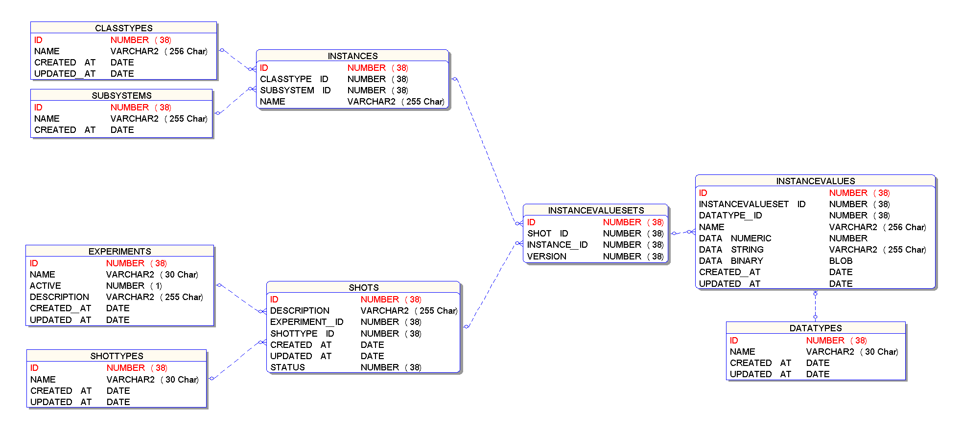
Database Structure
Recent development:
Time series
Device Definition
Instance ID Number
Timestamp Date
Value Number
Range Min. Number
Range Max. Number
Granular Data Entries
Device Data List
Shot Definition

Slide 11
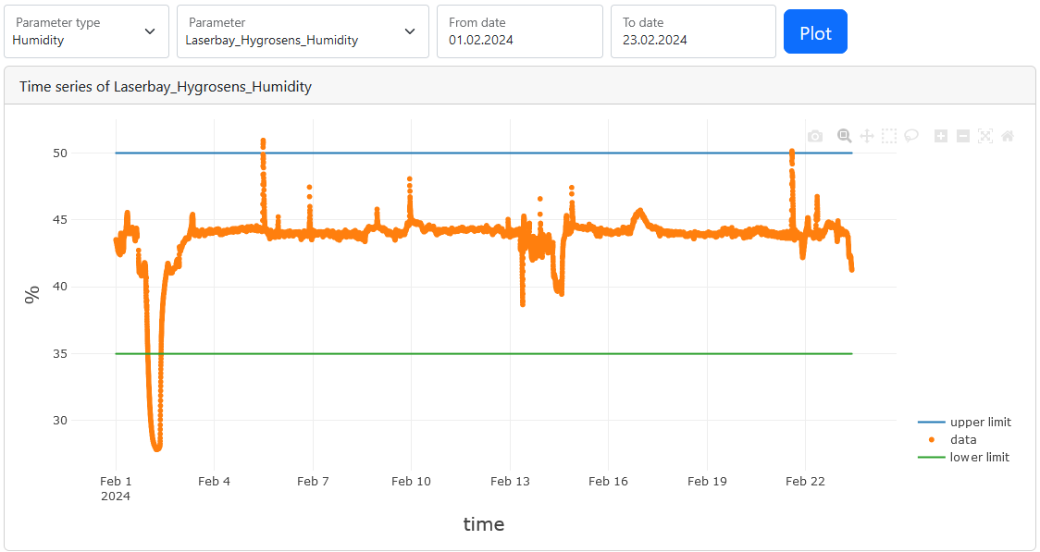
Time Series Measurements
Periodic logging of numeric data chunks
Intended for sparse monitoring
Not optimized for high-throughput
  Every data point is a DB entry
  => Easy access & low maintenance
Web interface view of a humidity time series

Slide 12
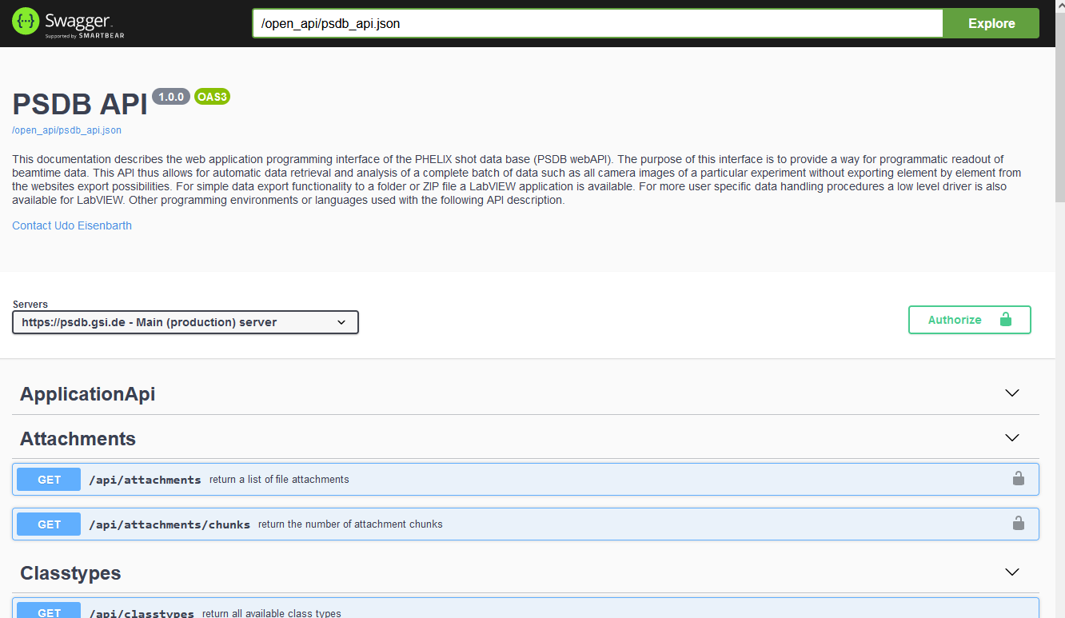
Data Access
PSDB
Webserver
https://psdb.gsi.de
Application written in Ruby on Rails
Web browser
View & Export data to file
Open API
Direct, programmatical data access
Current PSDB web interface
Online API documentation

Slide 13
Conclusion
PCS:
  Distributed system
  Easy & robust shot data acquisition
  Asynchronous logging to PSDB
  No real-time capability
PSDB:
  Intended for operator use
  Robust and flexible layout
  Designed for low repetition rates (low throughput)
  Optimized for low maintenance
  Data programmatically accessible via API

Slide 14
Jonas B. Ohland (random presenter):
phone: +49 6159 71 3381
email: j.b.ohland@gsi.de
Udo Eisenbarth (PSDB developer):
phone: + 49 6159 71 1301
email: u.eisenbarth@gsi.de
Stefan Götte (PCS developer):
phone: +49 6159 71 1445
email: s.goette@gsi.de

