Slide 1
Astronuclear Laboratory improvements (JRA1)
Marco La Cognata
WP3 coordinator

Slide 2
Overview
JRA1 –WP3 tackles four key challenges faced by the ChETEC-INFRA astronuclear laboratories that limit progress:
  solid targets (task 3.1, PI R. Spartà/INFN, participants: IFIN-HH, ATOMKI, UKE, UoC, CNRS, UNIPD, about 43 person-months)
  gas targets (task 3.2, PI T. Szücs/ATOMKI, participants: HZDR, CNRS, TUD, UMIL, UNIPD, about 17 person-months)
  neutron detection (task 3.3, PI L. Swiderski/NCBJ, participants: INFN, PTB, ISMA*, UNIPD, about 32 person-months)
  accelerator mass spectrometry: production of nuclear charge separated beams (task 3.4, PI Robin Golser/UNIVIE, participants: HZDR, about 12 person-months)
  *External collaboration – no person-months GUF IS INVOLVED IN ALL THE ACTIVITIES CONCERNING THE WEBSITE

Slide 3

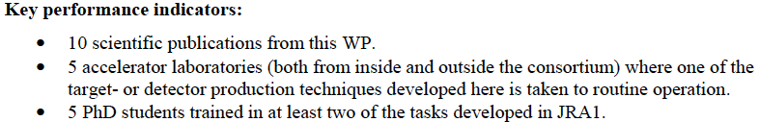
Deliverables
D3.1 | Report on the experimental techniques used for solid target production on the project web site
D3.2 | Report on the development of a gas-jet target with in-beam target thickness diagnostic, on the project web site and in a scientific journal
D3.3 | Provide to the community, upon request, one sample each of three possible scintillator materials for neutron detector in cooperation with industry
D3.4 | Report on testing by radioactive sources and beam bombardment of the solid targets produced
D3.5 | Report, on ChETEC-INFRA web site, on community-accepted methods to measure two non-routine AMS isotopes of astrophysical relevance
D3.6 | Scientific publication on isobar suppression by ion-gas or ion-laser-interaction
D3.7 | Publication on ChETEC-INFRA web site and in a scientific journal of target production protocols, characterization procedures, and results
D3.8 | Report on the development of a gas cell target to be used for angular distribution measurements, on the project web site and in a scientific journal
D3.9 | Report on the ChETEC-INFRA web site on different materials studied for neutron detection and position sensitive neutron detectors

Slide 4
Gantt chart

Slide 5
Task 3.1 General overview
ultra-pure material targets for low reaction yields to be studied
noble gases targets implanted into a host material
Characterization of targets using sources and in-beam approaches (thickness, contaminants, long-term stability…)
Also (proposal to be implemented):
thin self-supporting rotating target systems (1000 rpm)
R. Spartà, T. Szücs, M. Heine, M. Moukaddam, S. Courtin, L. Trache, M. La Cognata, A. Caciolli, D. Mengoni, A. Tumino, G. Lanzalone, A. Zilges, A. Blazhev, S. Prill, S. Wilden, F. Heim, …

Slide 6

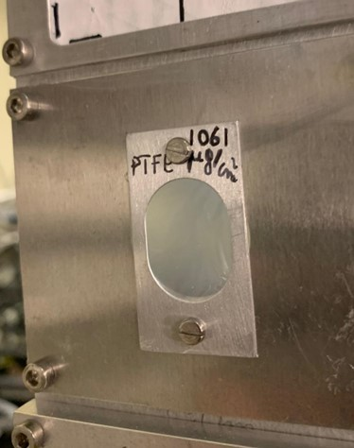
Deliverable 3.4
Report on testing by radioactive sources and beam bombardment of the solid targets produced
The STAR work has continued producing new ultrapure targets to meet the latest experimental needs, and testing them, under radioactive source or beam bombardment.
Standardized testing of the produced targets has been implemented and was also offered as a service for the community, including contaminant identification and stability tests.
Laboratories involved: INFN-LNS, INFN-LNL, University of Cologne, IFIN-HH
So far, 11 novel targets successfully tested → → → see table at this link:
The deliverable was completed in due time,
and the report is available at the link https://www.chetec-infra.eu/jra/startest.
University of Cologne aknowledges the PhD Student granted by ChETEC-INFRA
(Markus Muellenmeister)

Slide 7
Other successful implementations
For more details please check
@13.55 talk «New solid targets for nuclear astrophysics experiments»
→ R. Spartà (INFN-LNS & UKE)
Report on deliverables status
Target produced @INFN-LNS, @INFN-LNL
Noble elements solid targets facility status
Perspectives
A. Spiridon (IFIN-HH)
- Report on targets produced @IFIN-HH

Slide 8
Task 3.2 General overview
Windowless targets
Thin-window gas-cell targets
Diagnostics
  effective gas thickness
  Composition
  Long term stability
  Nuclear Resonance, off-beam XRF and in-beam PIXE, RBS
  setups. Cyclotron/tandetron accelerator for target analysis.
  T. Szücs, M. Heine, M. Moukaddam, S. Courtin, D. Bemmerer, U. Bilow, K. Zuber, A. Guglielmetti, A. Caciolli, D. Mengoni, R. Depalo, …

Slide 9
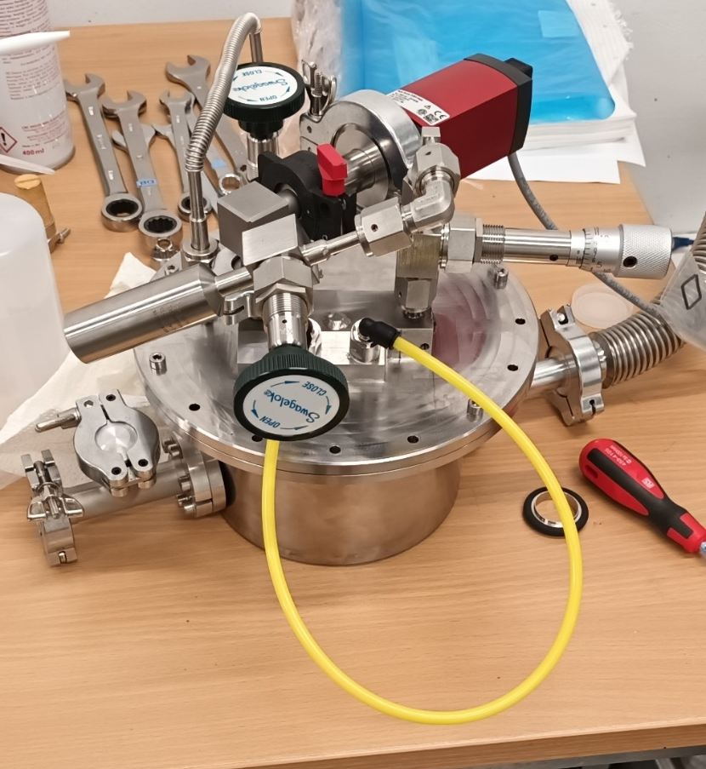
Deliverable 3.8
Report on the development of a gas cell target to be used for angular distribution measurements, on the project web site and in a scientific journal
Progress on the deliverable (due in April 2025):
Vacuum tight windows were acquired and successfully installed, though their thickness is big for low energy alpha measurements.
Irradiations have been done with proton beam, above given power the windows were failing.
Changes in the design of the cell is planned.
Picture of the first prototype →

Slide 10
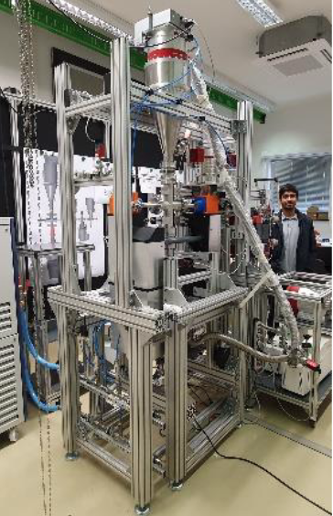
Other successful implementations
The gas-jet target in Dresden is being further developed:
Delivery 3.2 (Publication about the new gas-jet target) is fulfilled on time for the 24th month.
Suitable nozzles was tested and found.
Stable gas-jet production is achieved with suitable vacuum levels at other parts of the setup.
Gas jet density dependence of the inlet pressure was measured with alpha energy loss.
The setup is scheduled to be transported to the Felsenkeller and build up during August and September.

Slide 11
Task 3.3 General overview
Develop and test new neutron detector materials, such as composite scintillators, new plastics, etc. especially with low afterglow
neutron-gamma discrimination capabilities
new methodologies and algorithms for neutron/gamma discrimination
Develop a read-out system based on SiPM or Photomultipliers that will allow to obtain a spatial resolution and to be used in environments with intense gamma flash
L. Swiderski, J.J. Valiente Dobon, R. Nolte, E. Pirovano, M. Dietz, A. Caciolli, D. Mengoni, R. Depalo, A. Gottardo, M. Grodzicka-Kobylka,
J. Iwanowska-Hanke…

Slide 12
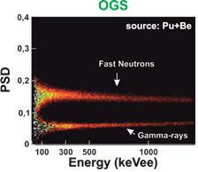
Deliverable 3.9
Report on the ChETEC-INFRA web site on different materials studied for neutron detection and position sensitive neutron detectors
Progress on the deliverable (due in April 2025):
Continuation of tests on position sensitive neutron detection with Organic Glass Scintillator (OGS, 51 mm x 51 mm x 8 mm) + 2x SiPM_x8 (6x6 mm²)
OGS: a solid state scintillator offering good
neutron/gamma discrimination performance.
light readout: 2 tiles of 8 SiPMs
neutron/gamma discrimination capability
capability to determine position of radiation detection

Slide 13
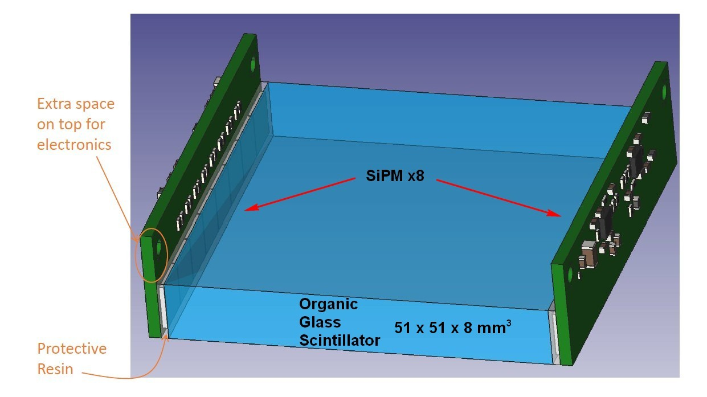
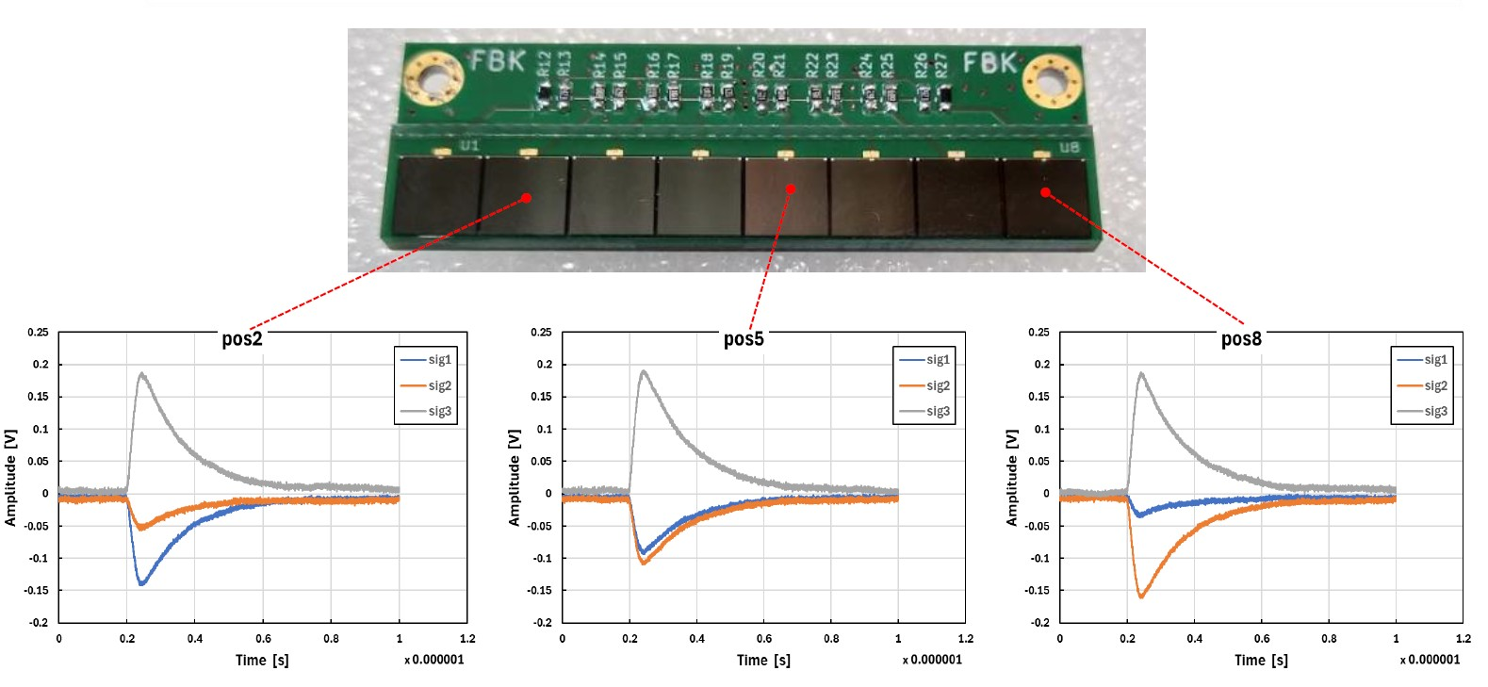
Deliverable 3.9

Slide 14
Other successful implementations
Using Neural Network for γ/n Discrimination
Unsupervised (autoencoder)
Supervised
A network is trained to compress high-dimension set (such as a signal) to only few dimensions, and then to decode it. The backpropagation optimizes the discrepancy between input and output
A network is trained with some labels, the backpropagation uses the discrepancy between the predicted class with respect to the label
DRAWBACKS
The features that are extracted are not necessarily of interest for the analysis and might depend on things such as preamp instability
ADVANTAGES
Can be used not only for categorization but also for:
  Noise reduction
  Anomaly detection
  Generation of new data
  Data compression
DRAWBACKS
The performances of supervised learning has the upper limit set by the quality of the labels set.
The in-beam datasets might not mimic well enough the source data used for labelling, thus decreasing the performance
ADVANTAGES
The performance is easy to estimate
Notes:
https://www.domsoria.com/2022/11/che-cosa-e-lo-spazio-latente-o-latent-space-ed-a-cosa-serve/

Slide 15
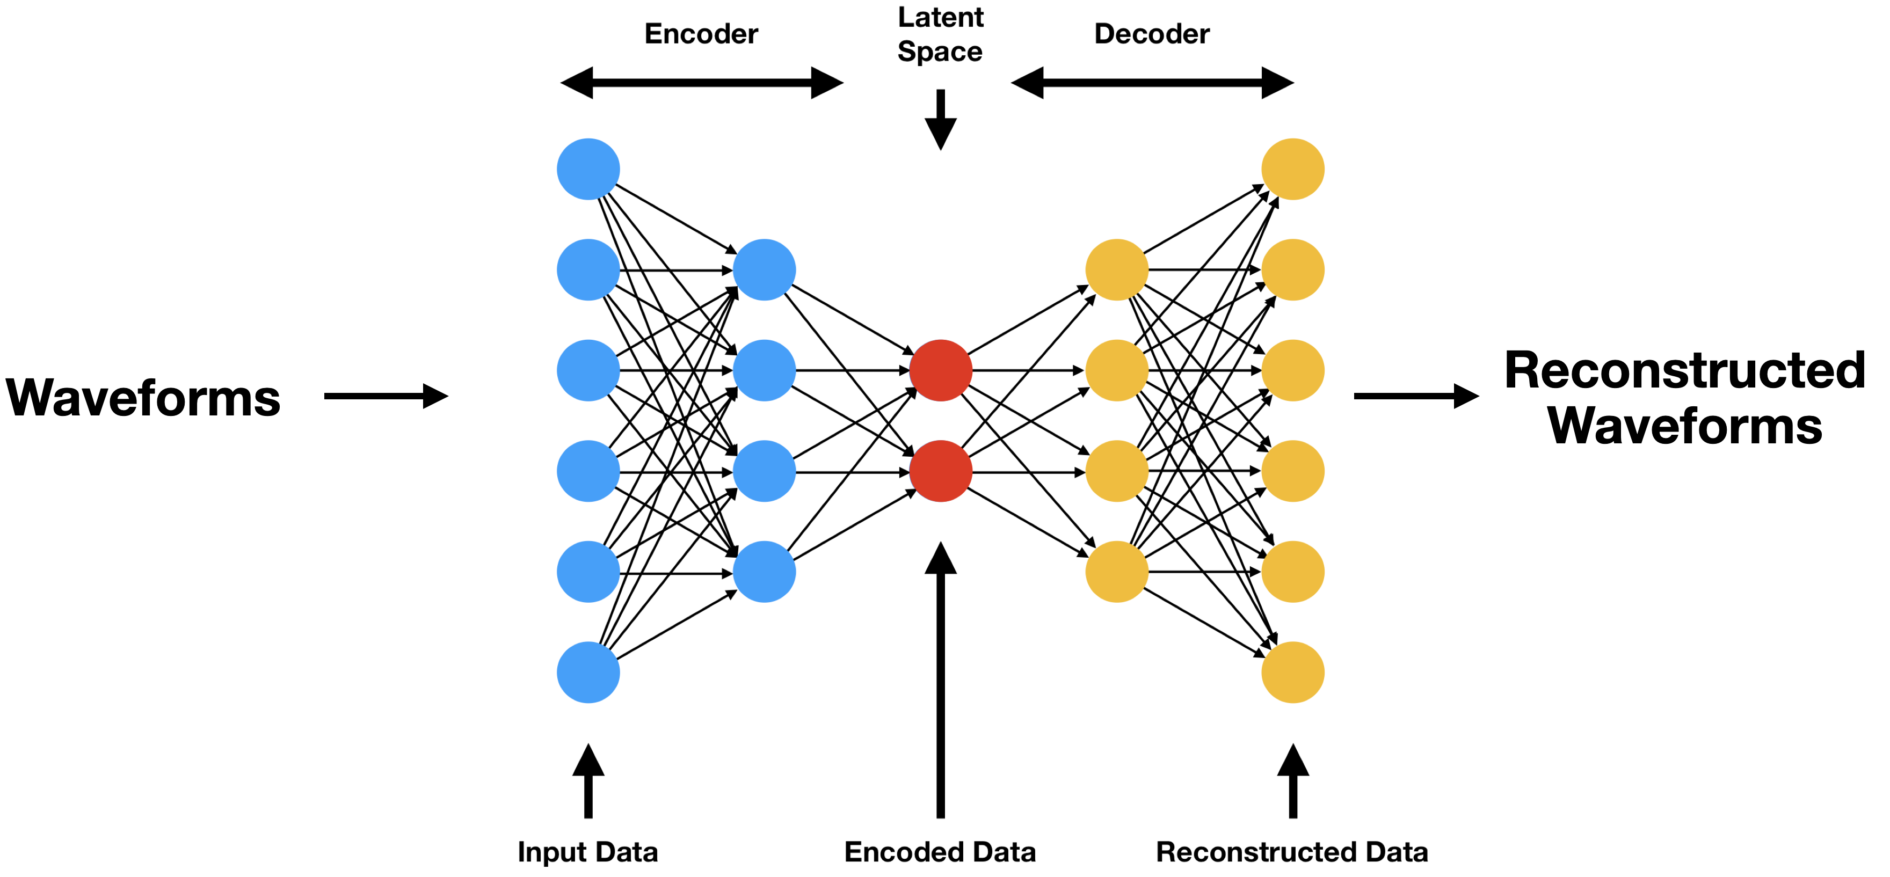
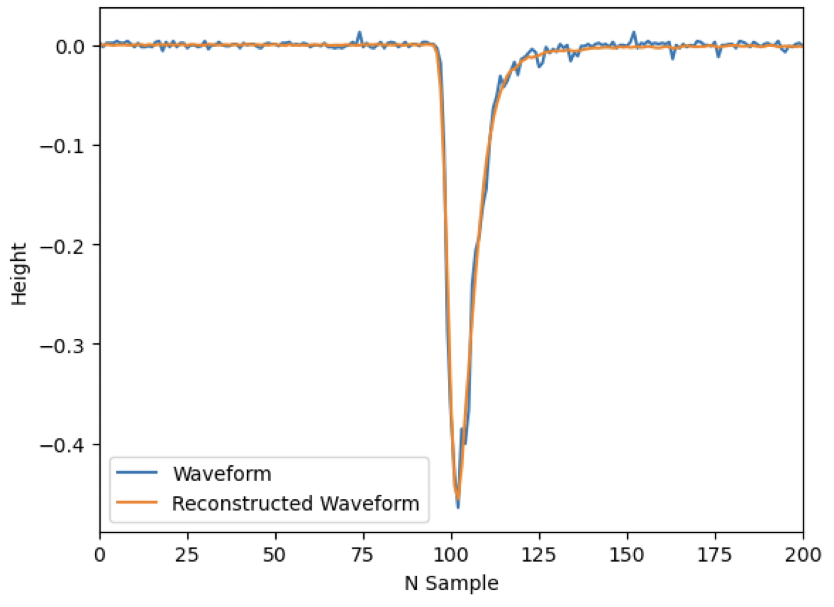
Other successful implementations
Using Neural Network for γ/n Discrimination
Latent space:
In the case of neural networks, the trained models produce a vector space or a compressed representation of information as a result. The compressed version of the data distribution is called latent space.
This is the part we are interested in!
Notes:
https://www.domsoria.com/2022/11/che-cosa-e-lo-spazio-latente-o-latent-space-ed-a-cosa-serve/

Slide 16
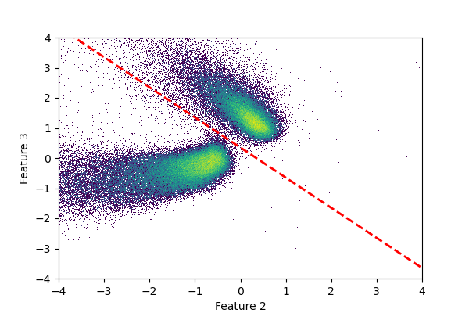
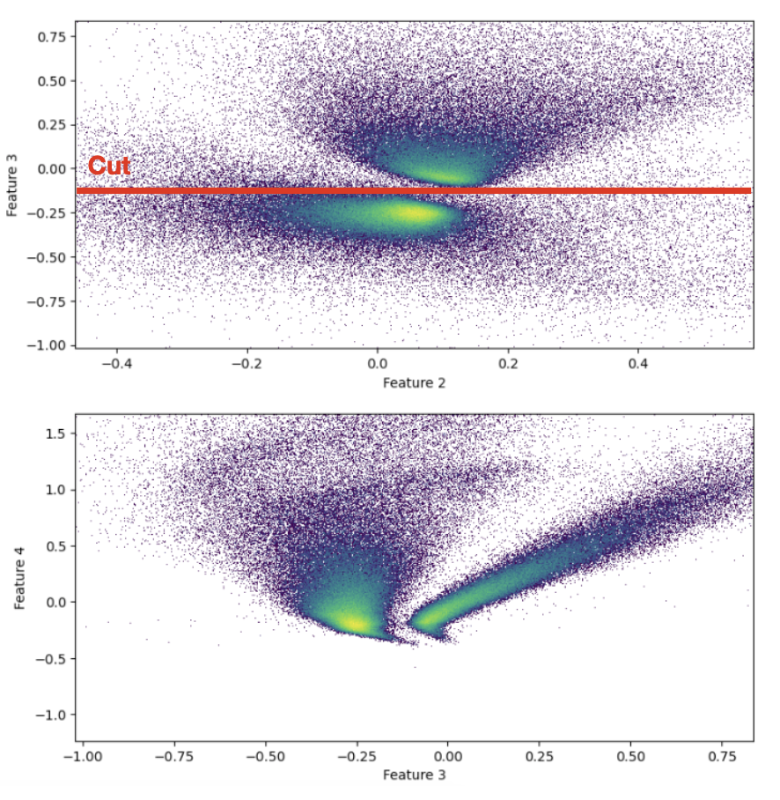
Preliminary results
First Test
Second Test
To Do
Correlate network parameters (features) with physical ones
Include advanced clusterization
Compare the network with classic (PSD) method
Test on other detectors for reproducibility
From the first to the second test a clear improvement in the clusterization is observed

Slide 17
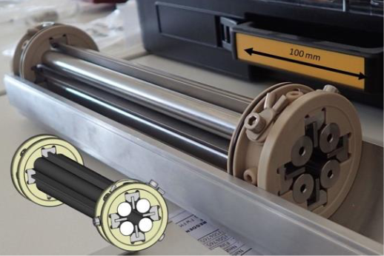
Task 3.4 General overview
Chemical element sensitive accelerator mass spectrometry
(PI: Robin Golser/UNIVIE, participants: HZDR)
development of techniques to access the nuclear charge of the isotope to be provided for accelerator mass spectrometry (AMS), e.g., by ion-gas or ion-laser-interaction
development of shared, community-accepted protocols for extracting non-routine AMS isotopes, which have high astronuclear relevance such as ⁷Be, ⁴⁴Ti and ⁵⁵Fe

Slide 18


Deliverable 3.5
Report, on ChETEC-INFRA web site, on community-accepted methods
to measure two non-routine AMS isotopes of astrophysical relevance
https://www.chetec-infra.eu/jra/Sr-90_Cs-135
← Please check the report at this link
chemical separation of ⁹⁰Sr and ¹³⁵Cs
from complex matrices developed and published
until now mainly for environmental studies
[Honda et al., 2022a; 2022b; Winkler et al., in prep.]

Slide 19
Deliverable 3.5
Report, on ChETEC-INFRA web site, on community-accepted methods
to measure two non-routine AMS isotopes of astrophysical relevance
https://www.chetec-infra.eu/jra/Sr-90_Cs-135
← Please check the report at this link
Ion-Laser InterAction Mass Spectrometry (ILIAMS) [Martschini et al., 2022] setup at U Vienna → suppression of isobars (⁹⁰Zr,¹³⁵Ba) by ion-gas and ion-laser interaction
→ most sensitive analytical method for these two
astrophysically interesting radionuclides [Wieser et al., 2023]

Slide 20
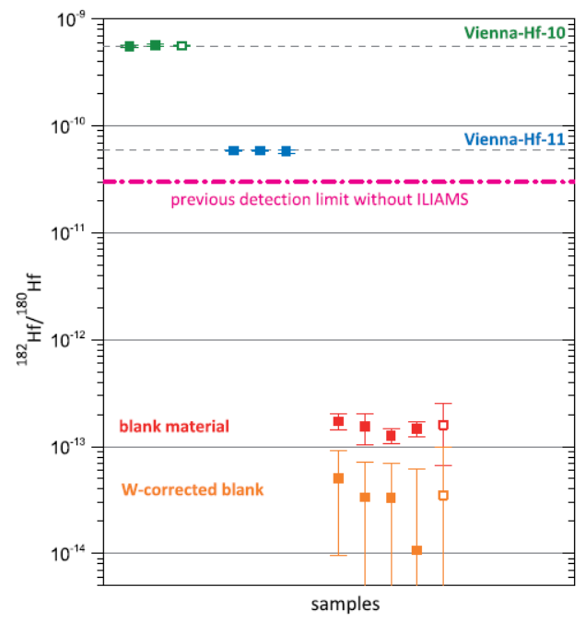

Milestone 9
Measurement capability for Hf-182 by AMS
developed and ready for external users
Status 2019:
overall Hf-detection efficiency: 1.4‰
W-corrected blank: ¹⁸²Hf/¹⁸⁰Hf = (3.4 ± 2.1)∙10⁻¹⁴
chemical separation
  sufficient decontamination factor of >10⁸
  chemical yields: 91-100%
  →1–2 mg HfF₄-target from 1 g n-irradiated W
  & mixed with PbF₂: W <10 μg/g
  use of Suprapur® chemicals necessary
  as otherwise remaining W originate
  from chemical products & consumables
  BaHfF₆ as suggested [Vockenhuber et al., 2004] is ion source poison → disqualification as AMS-target
[Vockenhuber et al., 2004]
170 x
Martschini et al., 2020

Slide 21
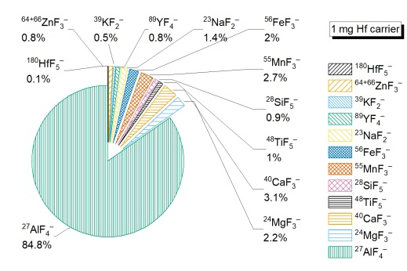
Milestone 9
Measurement capability for Hf-182 by AMS
developed and ready for external users
Status now:
yet unpublished results for ¹⁸⁶W(n,nα)¹⁸²Hf measured @¹⁸²Hf/¹⁸⁰Hf~10⁻¹²
as Vienna Hf-10/-11 standards are likely (2.0±0.2)-times higher [Martschini et al., 2020]
→ need for reliable reference materials
development of chemical preparation of HfF₄ AMS targets from deep-sea MnFe crusts
  isobar (¹⁸²W) separation works [Martschini et al., 2020]
  main elements (Mn,Fe) largely reduced
  Ca, K, Na, Mg easily removable by precipitation of Hf(OH)₄
  → need for Al(&Ti)/Hf separation
cross contamination & ion source memory @<1%
→ need for reliable reference materials down to 10⁻¹³ level

Slide 22
Milestone 9
Measurement capability for Hf-182 by AMS
developed and ready for external users
Status now:
yet unpublished results for ¹⁸⁶W(n,nα)¹⁸²Hf measured @¹⁸²Hf/¹⁸⁰Hf~10⁻¹²
as Vienna Hf-10/-11 standards are likely (2.0±0.2)-times higher [Martschini et al., 2020]
→ need for reliable reference materials
development of chemical preparation of HfF₄ AMS targets from deep-sea MnFe crusts
  isobar (¹⁸²W) separation works [Martschini et al., 2020]
  main elements (Mn,Fe) largely reduced
  Ca, K, Na, Mg easily removable by precipitation of Hf(OH)₄
  → need for Al(&Ti)/Hf separation
cross contamination & ion source memory @<1%
→ need for reliable reference materials down to 10⁻¹³ level
¹⁸²Hf AMS available to
external users providing HfF₄
→ results will be accurate by a factor of 2
soon of higher accuracy

Slide 23
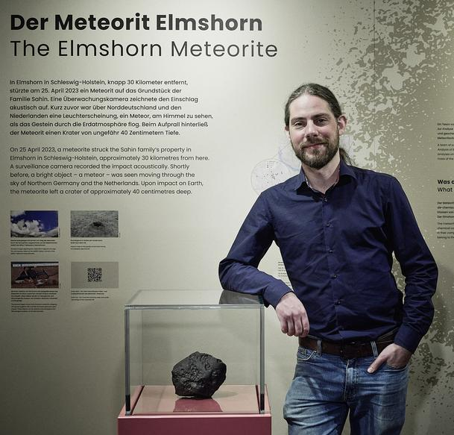







“Other” nuclides (via TNA)
²⁶Al & ⁴¹Ca in stony meteorites and meteor-wrongs via Instrumental AMS
  Elmshorn (H3-6) Bischoff et al., 2024
  XXXXXXX (aubrite) Bischoff et al., subm.
  “not-Dyalpur” (terrestrial) Pittarello et al., in prep.
²⁶Al with J. Feige, Berlin
“Detection of past close-by Supernovae:
Depositional age dating of Atacama Desert soils with meteoric ²⁶Al”)
²¹⁰Pb with D. Koll, HZDR-AMS ECR
“Pb-210 AMS development for the
key background in the search for dark matter”
⁴⁴Ti with Felsenkeller BSc. & U Vienna MSc
“⁴⁰Ca(α,γ)⁴⁴Ti”
https://www.sabre-experiment.org.au/
https://idw-online.de/de/image?id=391934

Slide 24
THANKS FOR YOUR ATTENTION

