Slide 1
The Center for Advanced Systems Understanding
Prof. Dr. Sc. Thomas D. Kühne | Director of CASUS
25.10.2023 | Meeting of the Scientific Advisory Board of the HZDR

Slide 2

The Center for Advanced Systems Understanding
Prof. Dr. Sc. Thomas D. Kühne | Director of CASUS
25.10.2023 | Meeting of the Scientific Advisory Board of the HZDR

Slide 3
Center for Advanced Systems Understanding
Overview

Slide 4
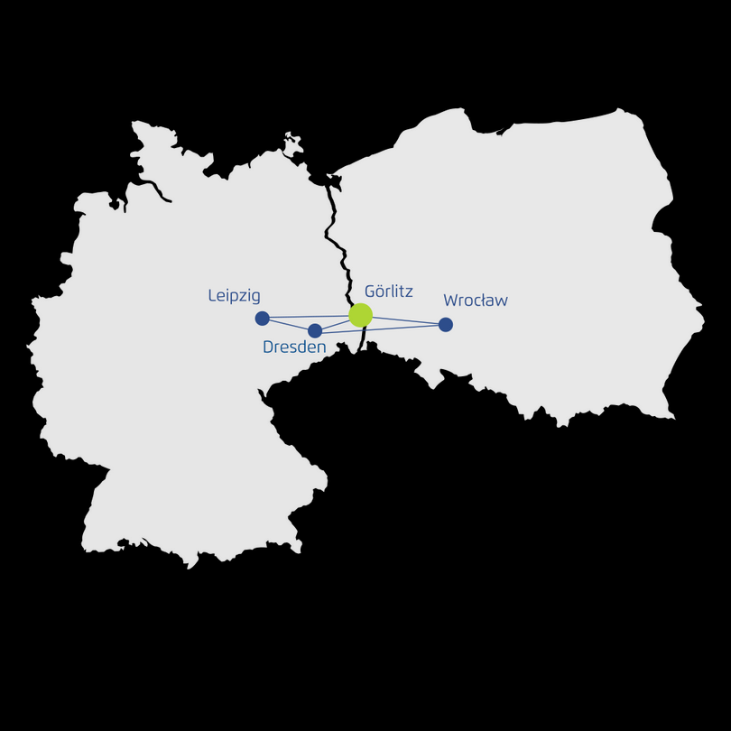








CASUS as an international meeting place for scientists
Joint professorial appointments
Long- and short-term visitors
Independent Young Investigator Groups
Workshops and Conferences
Scientific Computing Core
Scultetus Center
German-polish relations

Slide 5



Center for Advanced Systems Understanding
Overview
Nonlinear Dynamics
Multiscale Modelling
Emergent Phenomena
Machine Learning
High Performance Computing
Realtime Analytics
Quantum Computing
F.A.I.R. Data
AI & Data-driven Science
Interactive
Visualisation
Optimization
Parallel Algorithms
& Data Structures
Surrogate
Modeling
Complex Systems Science
Interpolation/
Extrapolation
Effective Models
Uncertainty
Quantification

Slide 6
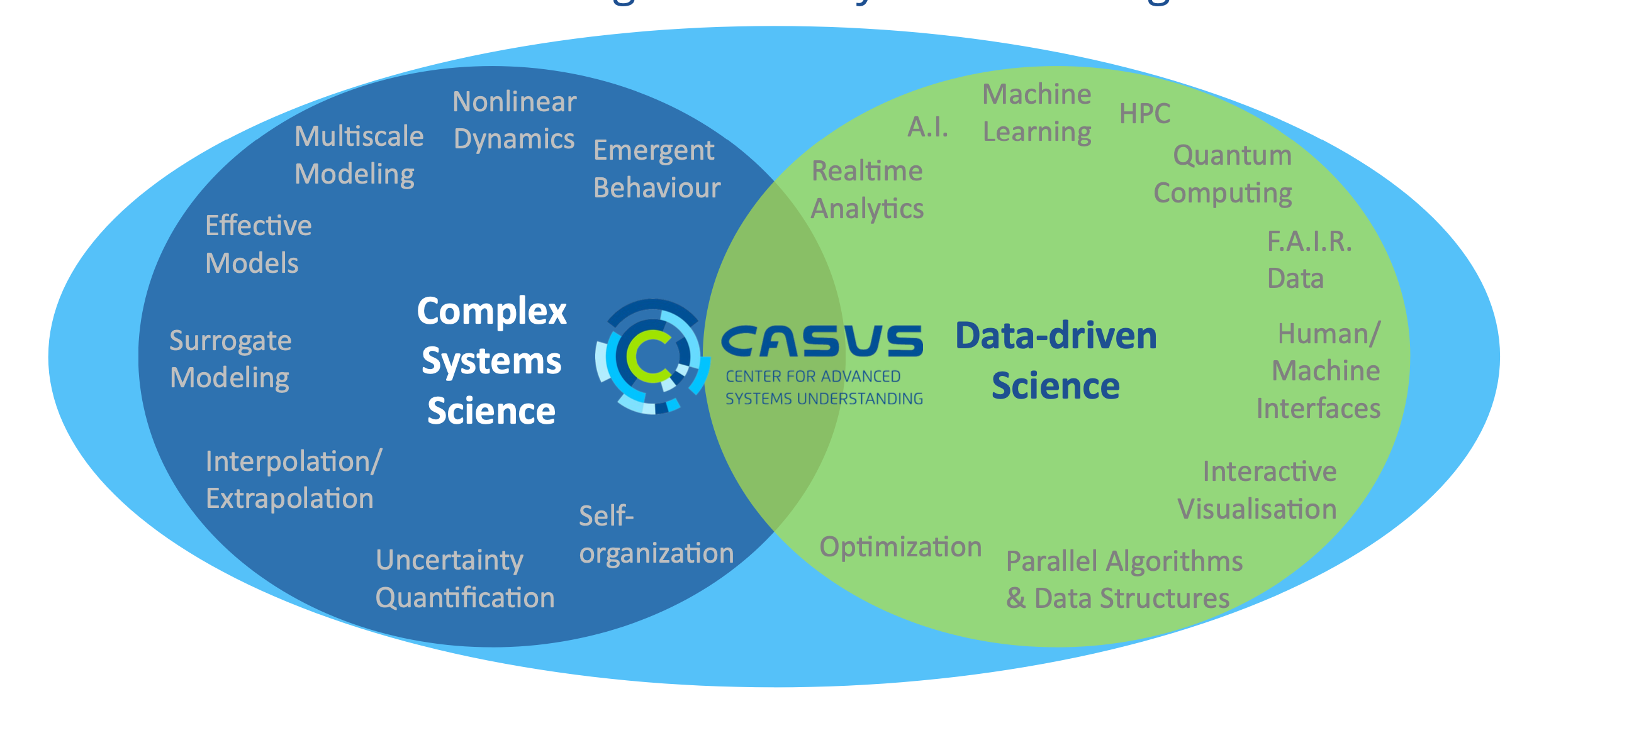
Center for Advanced Systems Understanding
Overview

Slide 7
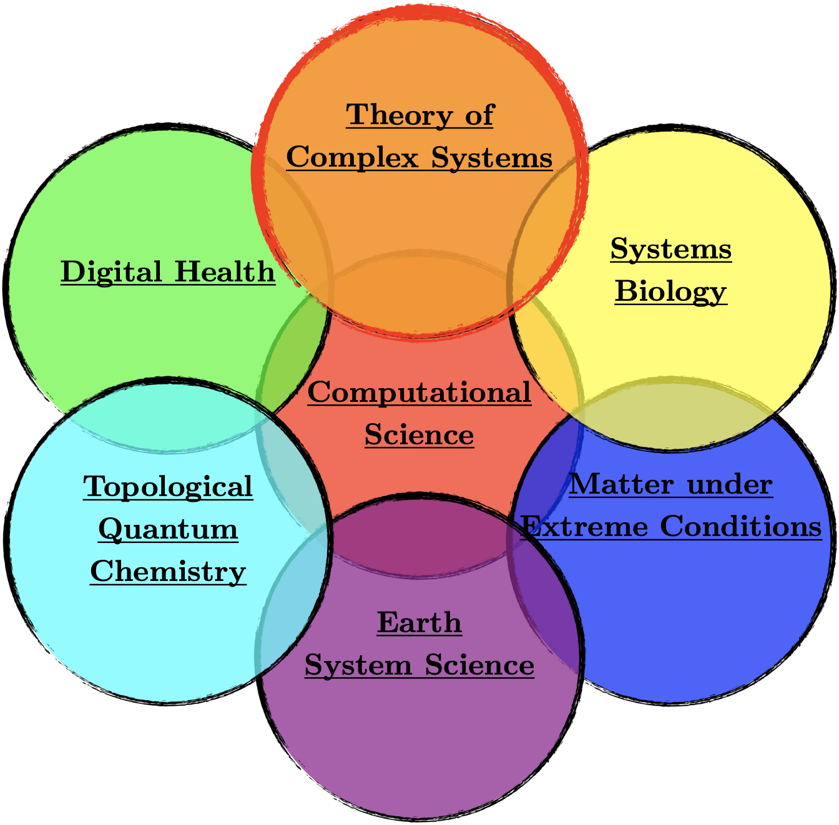
Structure of CASUS

Slide 8
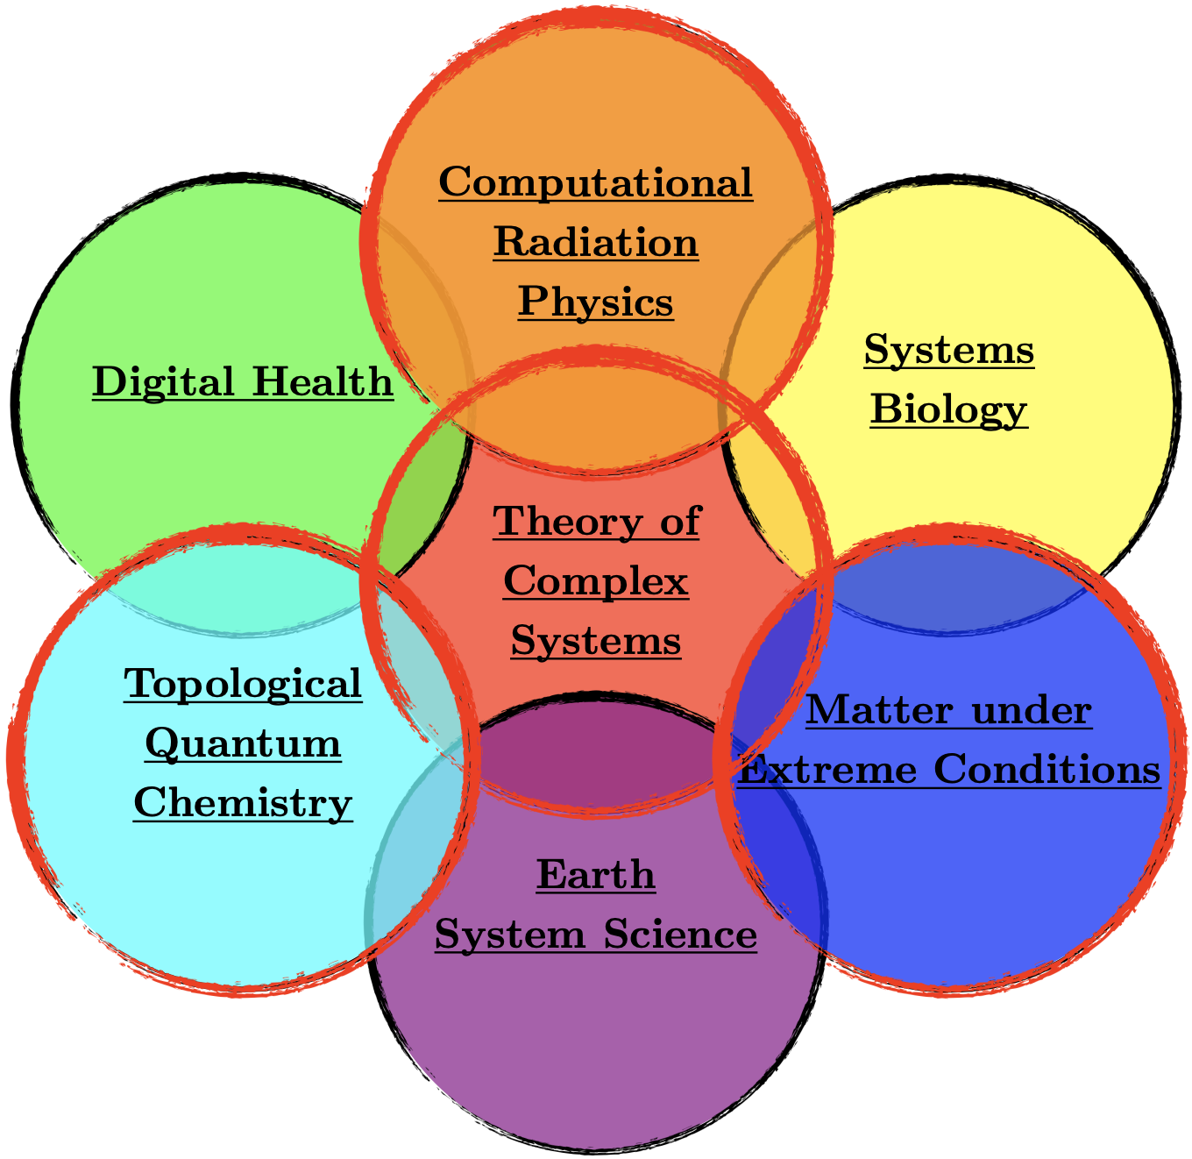
Structure of CASUS

Slide 9




DFG-funded Collaborative Research Programs
Incl. possible joint professorships
Excellence Clusters
Collaborative Research Centres

Slide 10





Strategic Collaborations
Large-scale research centres
Central Scientific Institutions

Slide 11
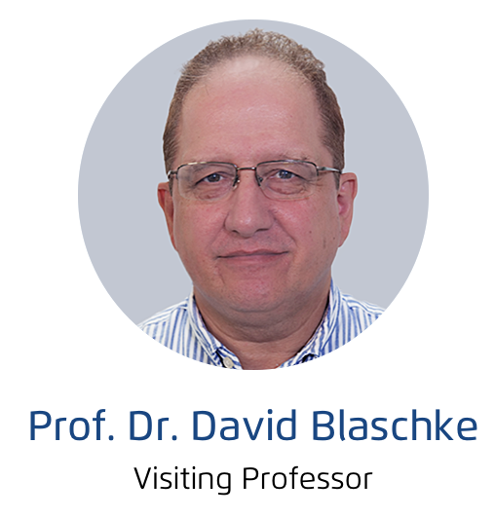
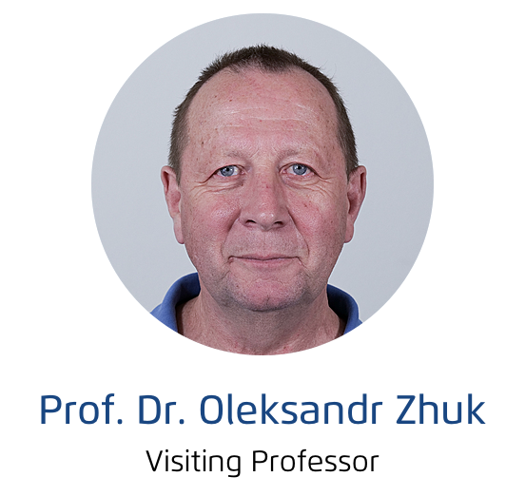
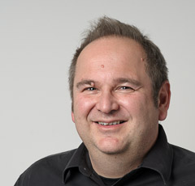
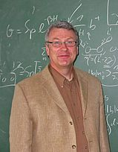
CASUS Distinguished Fellows

