Slide 1
Probing hadron-quark mixed phase in twin stars using f-modes
arXiv:2309.08775
David Álvarez Castillo
Institute of Nuclear Physics PAS
Cracow, Poland
Many-Particle Systems Under Extreme Conditions
Polish-German WE-Heraeus Seminar & Max Born Symposium
Synagoge Görlitz, Germany
4 Dec. 2023
dalvarez@ifj.edu.pl

Slide 2
Outline
A brief introduction to the physics of compact stars.
The neutron star twins scenario and the role of pasta phases.
Study of f-modes in compact stars and their observation with third-generation gravitational wave detectors.

Slide 3
Motivation
New channels of multi-­messenger observations like gravitational radiation from merger events of binary systems of compact stars or radio and X­-ray signals from isolated pulsars allow to study their most basic structural properties like mass, radius, compactness, cooling rates and compressibility of their matter.
Nuclear measurement and experiments have narrowed the Equation of State (EoS) uncertainty in the lowest to intermediate density range.
Violent, transient energetic emissions are associated not only with the strong magnetic fields and extreme gravity in the proximity of NS but with explosive, evolutionary stages often triggered by mass accretion from companion stars. It is expected that are f-modes are excited in many of these astrophysical processes.

Slide 4
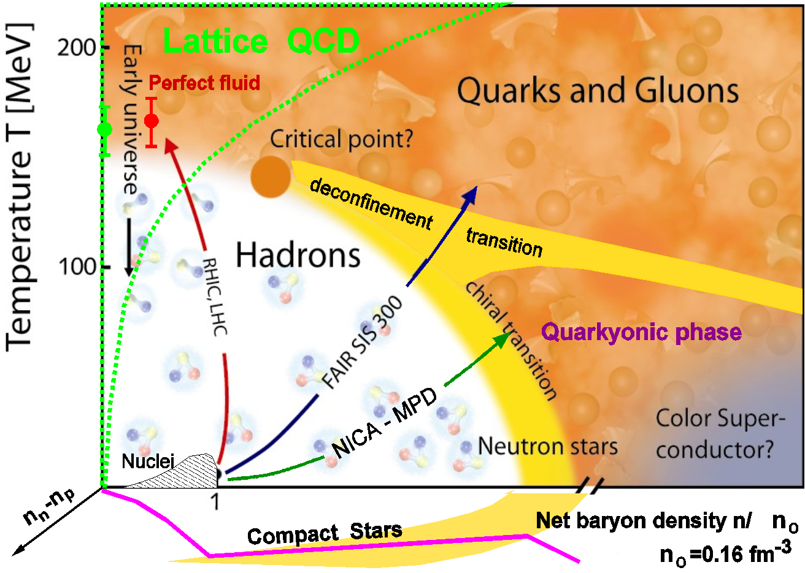
Critical Endpoint in QCD

Slide 5
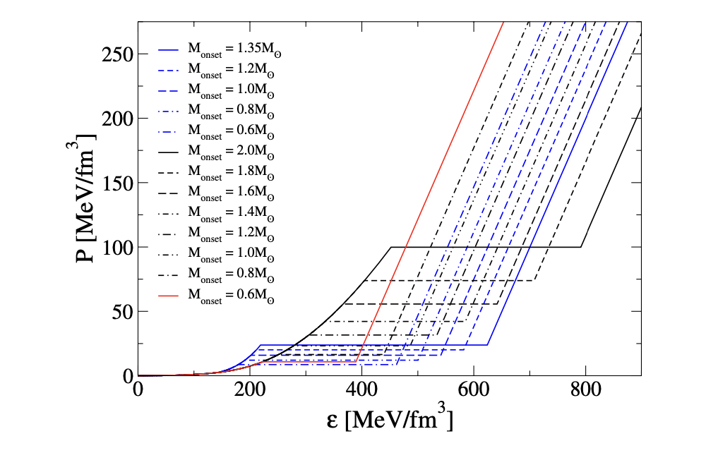
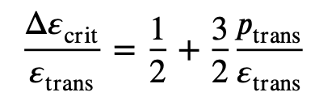
Compact Star Mass Twins
D. Alvarez-Castillo - Astron. Nachr. 1–6 (2021)

Slide 6
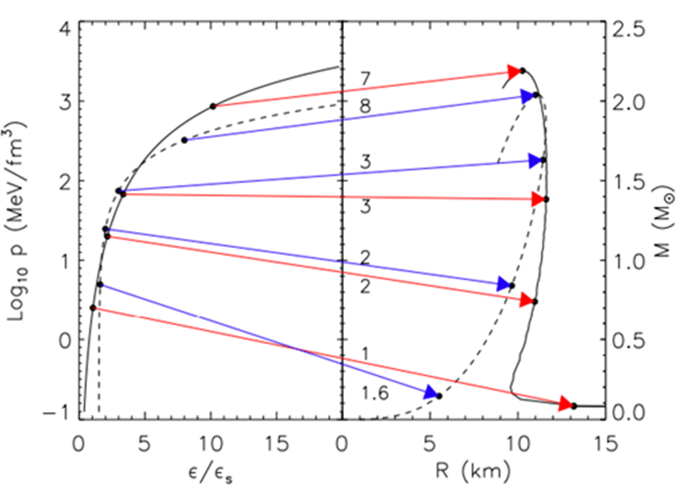
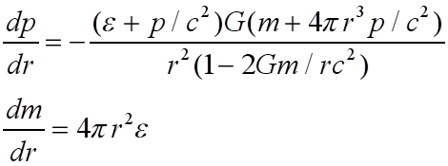
Compact Star Sequences
(M-R ⇔ EoS)
TOV Equations
Equation of State (EoS)
James Lattimer,
Annu. Rev. Nucl. Part. Sci. 62, 485 (2012), arXiv:1305.3510

Slide 7
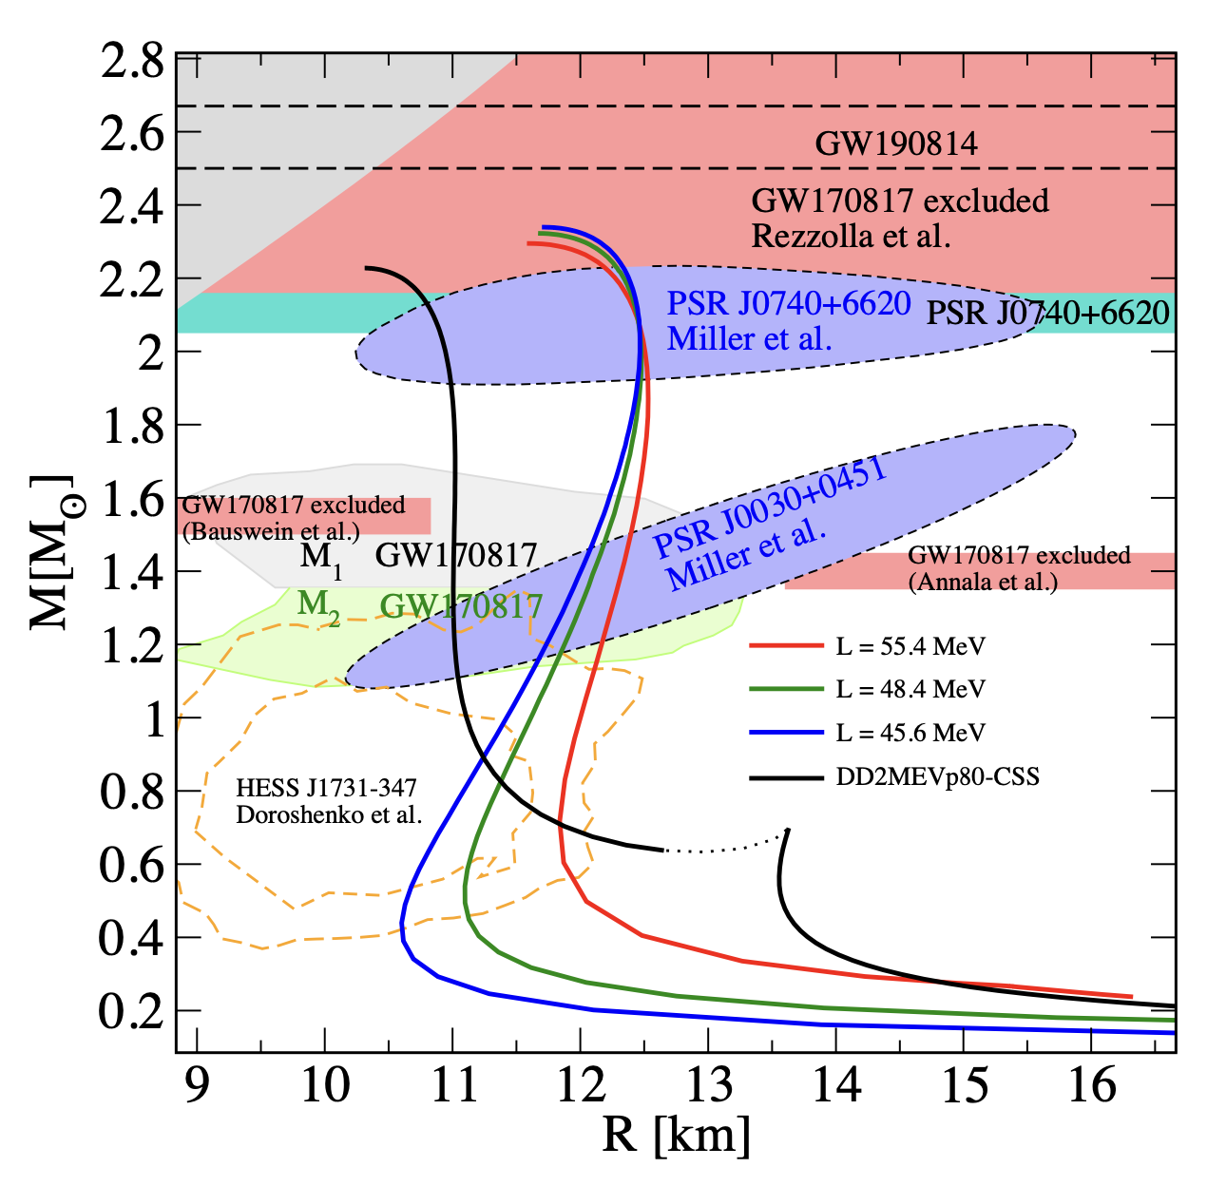
RMF models: arXiv:2307.02979, Phys. Rev. C 108, 054010 (2023)

Slide 8
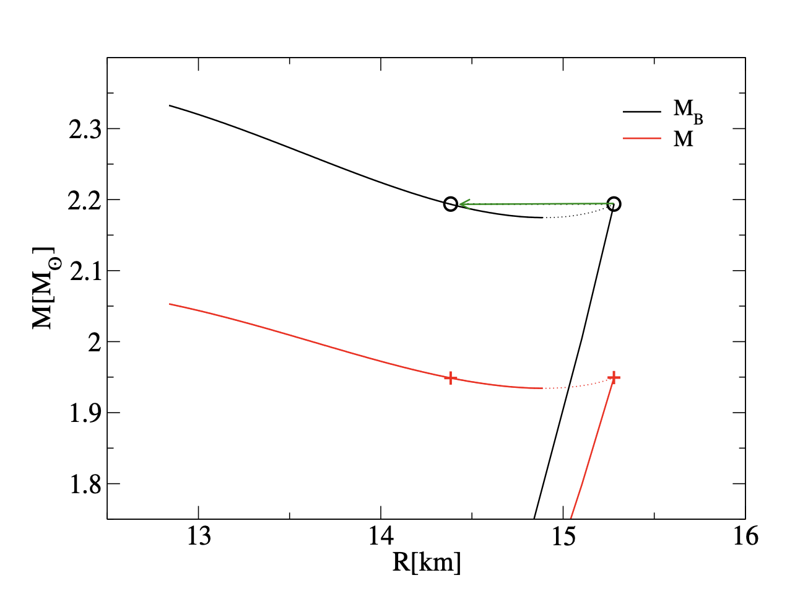
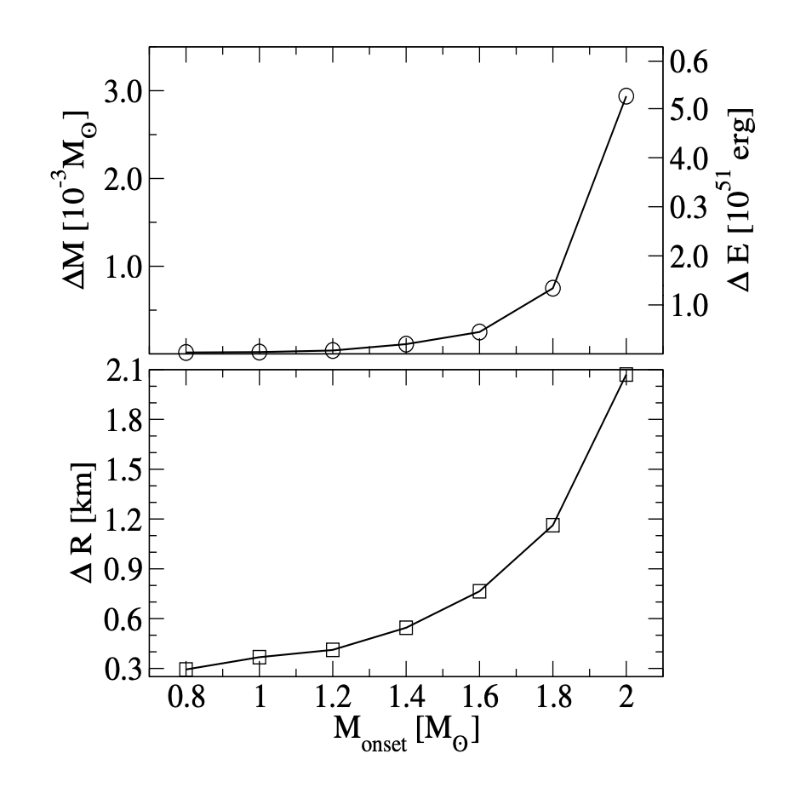
Mass Twins – Energy Released
DD2MEV-CSS EoS, D. A-C, Astronomischen Nachrichten (2021) 1–6, arXiv: 2011.11145

Slide 9
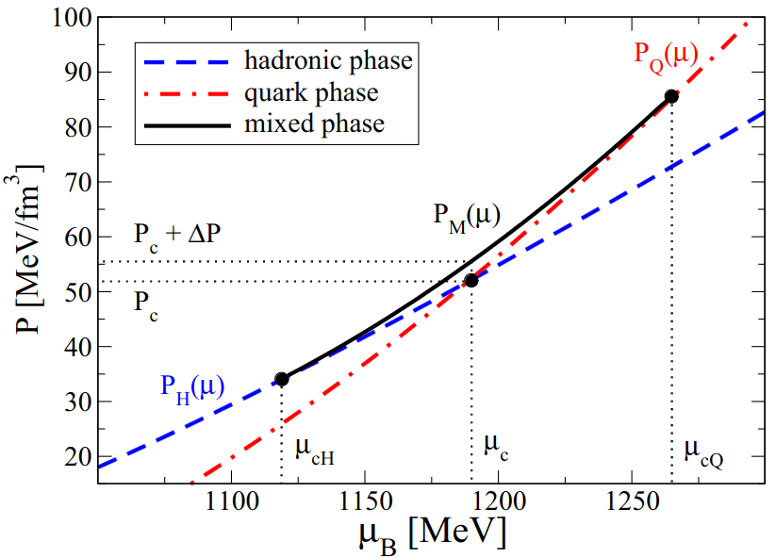
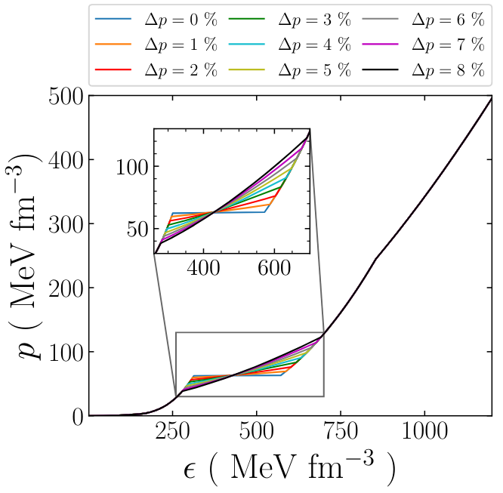
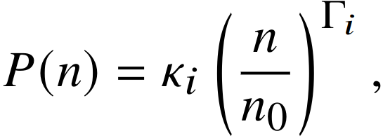
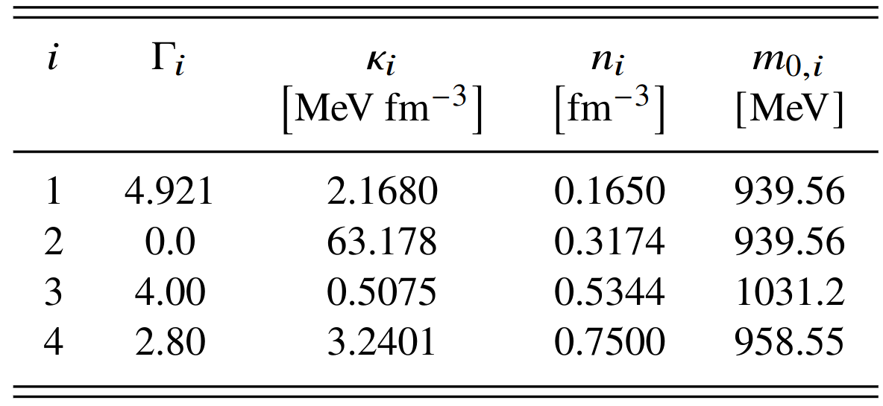
The EoS Model : Phenomenological Description
A. Ayriyan , H. Grigorian, EPJ Web of Conferences. p. 03003,(2018),
A. Ayriyan, N. Bastian, D. Blaschke, H. Grigorian, K. Maslov, D. N. Voskresensky, PRC 97, 045802 (2018), ,
V. Abgaryan,D. Alvarez-Castillo, A. Ayriyan, D. Blaschke,H. Grigorian, Universe, 4, 94 (2018).
Surface tension effect leads to existence of pasta phases.
A parabolic interpolation method used to construct the mix phase.
Determined from the continuity of pressure and its derivative.
Mix Phase is parametrized by Δp = ΔP/P_{c}.
Δp =0 : Maxwell Construction.
ACB4 Parametrization:
D. E. Alvarez-Castillo., D. Blaschke, PRC, 96, 045809,(2017) ,
V. Paschalidis, K. Yagi, D. Alvarez-Castillo, D Blaschke, A Sedrakian, PRD, 97, 084038, (2018).

Slide 10
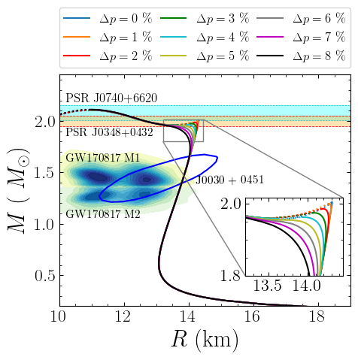
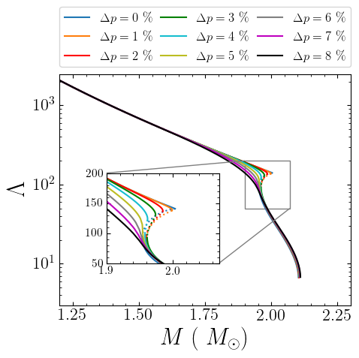
Stellar Properties
The second and third family merge to form a single branch for Δp > 4% .
Precise measurement of M-R required for detection of twin star.
The jump ΔΛ (if any) can be measured ~15 % (< 90% CI) with next-generation GW detectors
( P. Landry & K. Chakravarti , arXiv:2212.09733 ,2022).

Slide 11
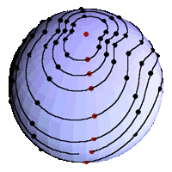
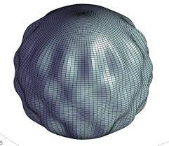
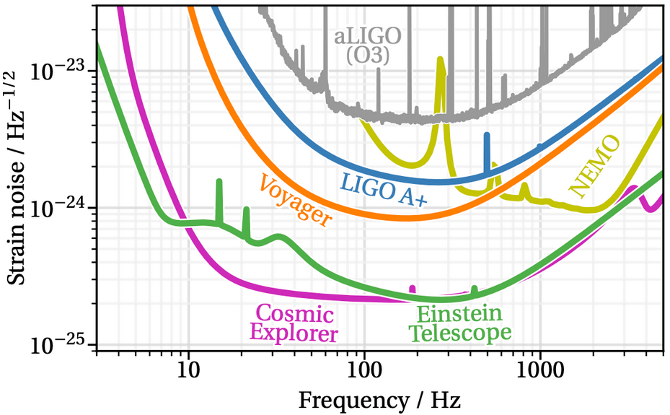
Gravitational Waves from NS
Non-radial QNMs raised from time varying quadrupole deformations are source of GWs.
fundamental (f) mode,
no node, probe for mean density,(1 kHz < f < 3kHz)
pressure (p) mode,
Sound speed, (5 kHz < f < 10kHz)
gravity (g) mode,
(50 Hz < f < 500 Hz)
R-mode, for rotating stars only.
Viscosity, (0.5 kHz < f < 2kHz)
Space-time (w) mode.
5 kHz< f
Credit: C. Hanna and B. Owen
Credit: CERN/Indico
PC: cosmicexplorer.org/sensitivity

Slide 12
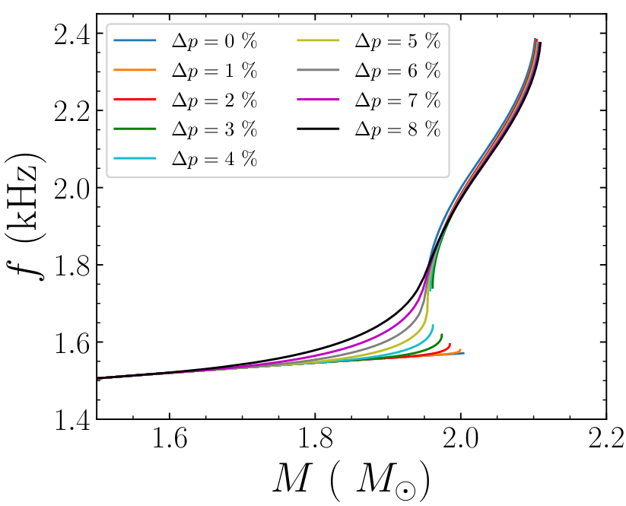
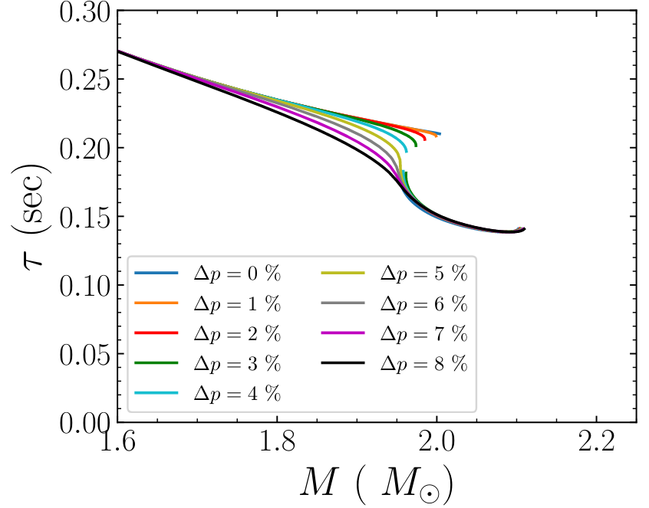
f-mode characteristics
f-mode characteristics are obtained within General relativistic formalism.
Sudden increase (decrease ) in the frequency (damping time) observed with appearance of twin star.
Detections of f-mode GWs from compact stars with known mass may reveal the presence of twin stars.
Simultaneous measurement of M-f (from binary system) can be used to comment on twin stars.
David Alvarez-Castillo, Bikram Keshari Pradhan, Debarati Chatterjee - arXiv:2309.08775

Slide 13
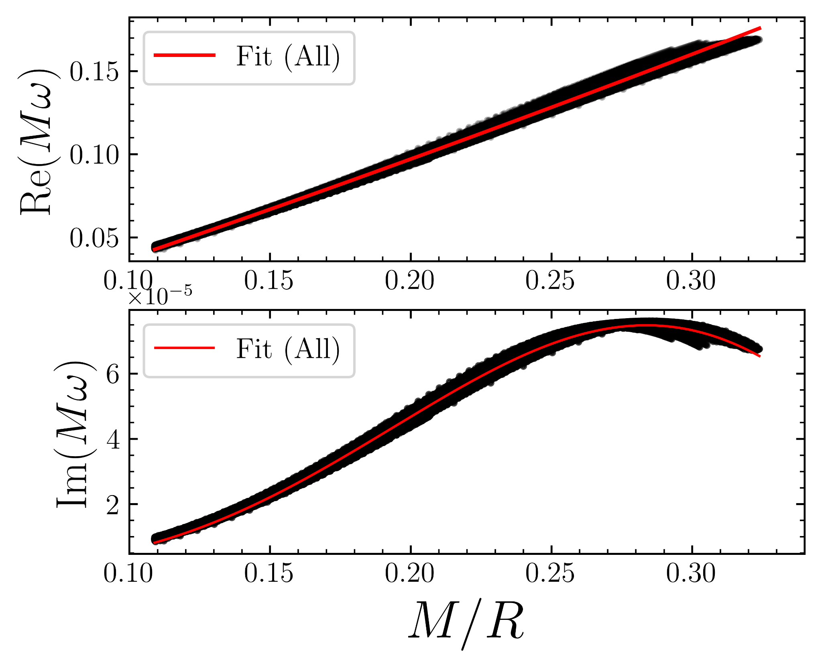
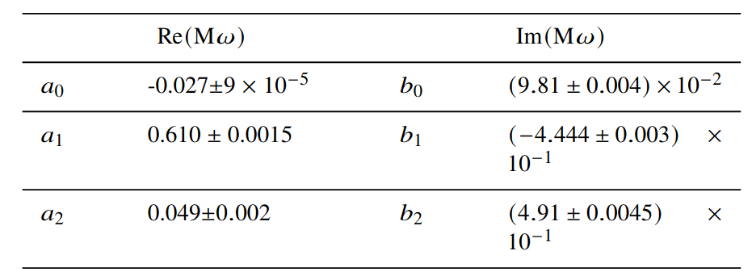
Asteroseismology and Universal Relations
URs among f-mode characteristics (f, τ_{f} or ⍵=2πf+1/τ_{f} ) and NS observables.
Empirical relations (EOS dependent)
Scaled Universal relations are more useful.
The URs can be used for EoS inference.
URs involving tidal deformability have also been examined.
David Alvarez-Castillo, Bikram Keshari Pradhan, Debarati Chatterjee - arXiv:2309.08775

Slide 14
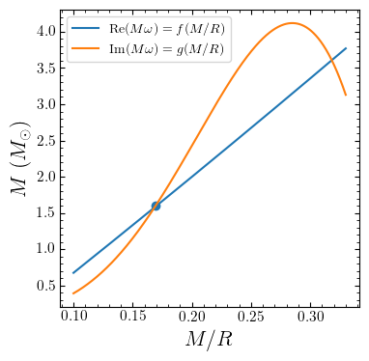
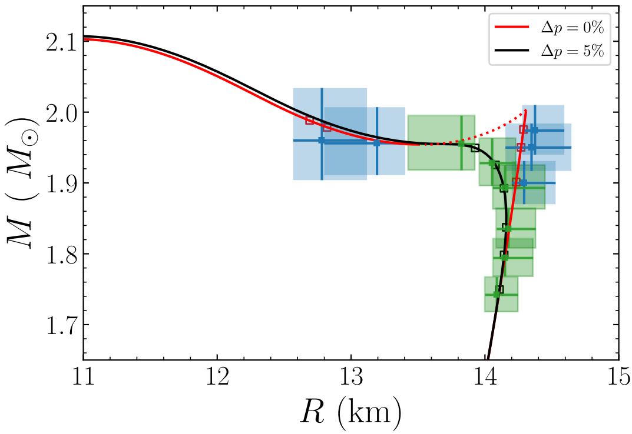
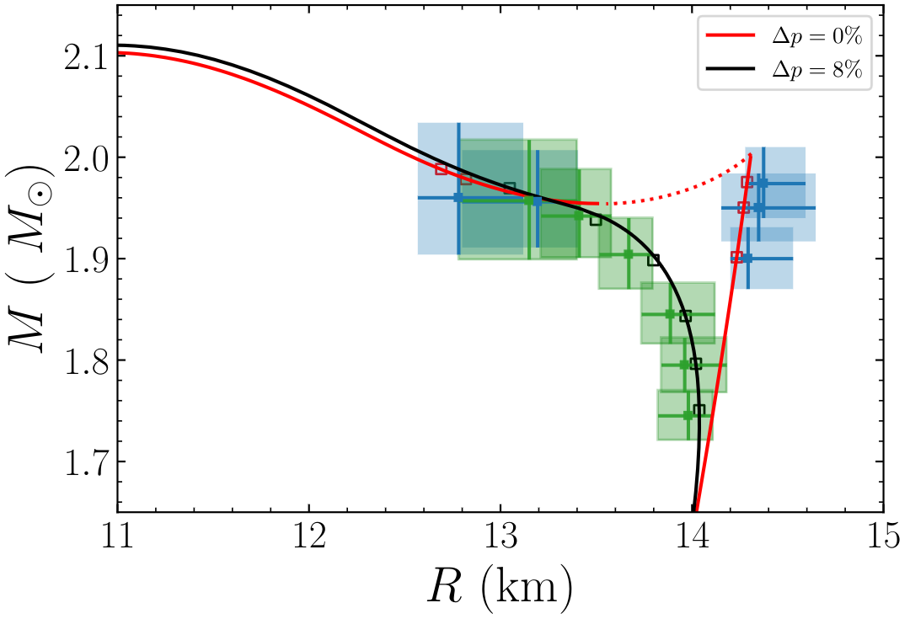
Compact star observables from f-mode observations: the role of UR Uncertainty
Determination under the assumption that f, τ are measured precisely.
Errors on UR results uncertainties on M-R.
The presence of the twins maybe confirmed with exact measurement of f, and τ .
The unstable branch of Δp = 0% can be distinguished from the connecting stable branch of Δp =8%.
Differentiating among Δp =0% and Δp =5% is more challenging.
David Alvarez-Castillo, Bikram Keshari Pradhan, Debarati Chatterjee - arXiv:2309.08775

Slide 15
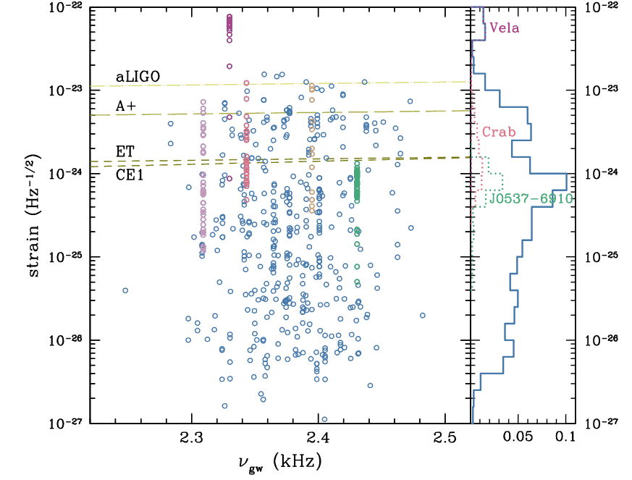
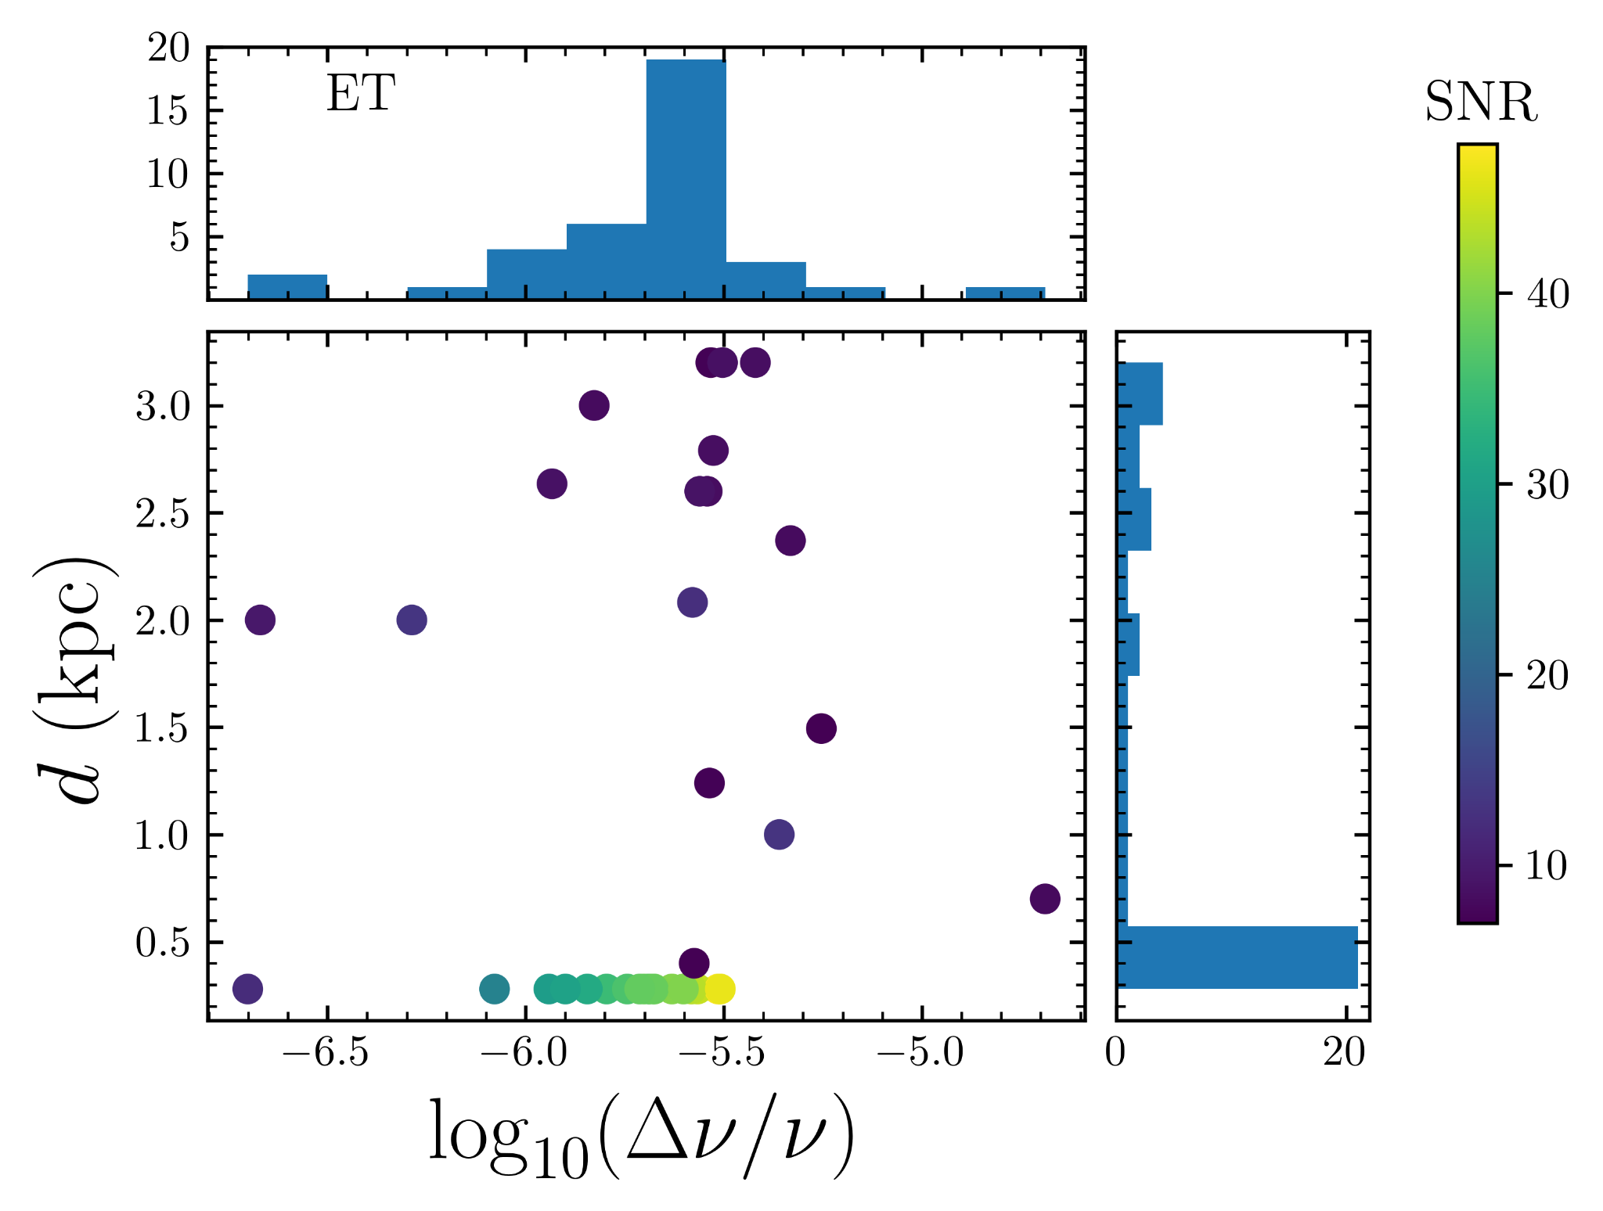
Inclusion of Observational Uncertainties
F-mode being excited during pulsar glitches. All the energy radiated through GW.
The burst waveform is modelled as an exponentially damped oscillation.
(B.J. Owen,2010, Ho et al. 2020 )
f-modes GW
Ho et al ,PRD 101, 103009 (2020)
B. K. Pradhan, D. Pathak, and D. Chatterjee,
ApJ 956 38, ( 2023 )
B. Abbott et al.,LVC, ApJ 874 163, 2019.
R. Abbott et al.,LVK, PhRvD, 104, 122004, 2021.
R. Abbott, et al., LVK, arXiv:2210.10931, 2022.
R. Abbott, et al., LVK, arXiv:2203.12038, 2022.
D. Lopez et al., PhRvD, 106, 103037, 2022
David Alvarez-Castillo, Bikram Keshari Pradhan, Debarati Chatterjee - arXiv:2309.08775

Slide 16
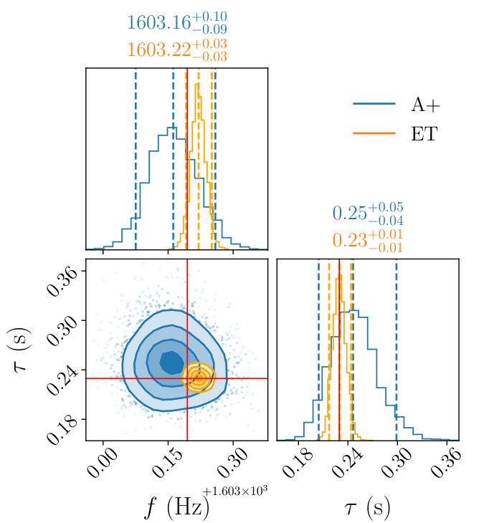
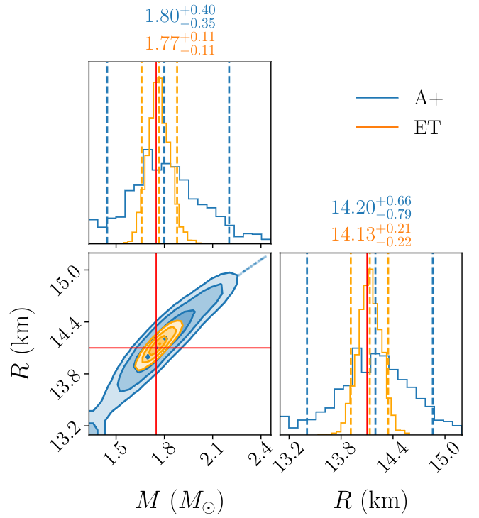
Inclusion of Observational Uncertainties
Parameter Estimation for GW signal parameters are carried out using Bilby.
Priors are kept,
logUniform in E_{gw} .
𝜈_{f} 𝝐 U[800,3500] Hz.
𝝉_{f} 𝝐 U[0.05,0.7] s.
Distance is fixed.
Frequency can be measured accurately in A+ and ET.
Damping time can have error ~20-50% in A+ and ~5-15% in ET.
M-R posterior is obtained using UR.
Within a 90% CI, M can be measured to ~6% in ET.
Within a 90% CI, R can be measured to ~2% in ET.
Error on M,R are large in A+.
UR
David Alvarez-Castillo, Bikram Keshari Pradhan, Debarati Chatterjee - arXiv:2309.08775

Slide 17
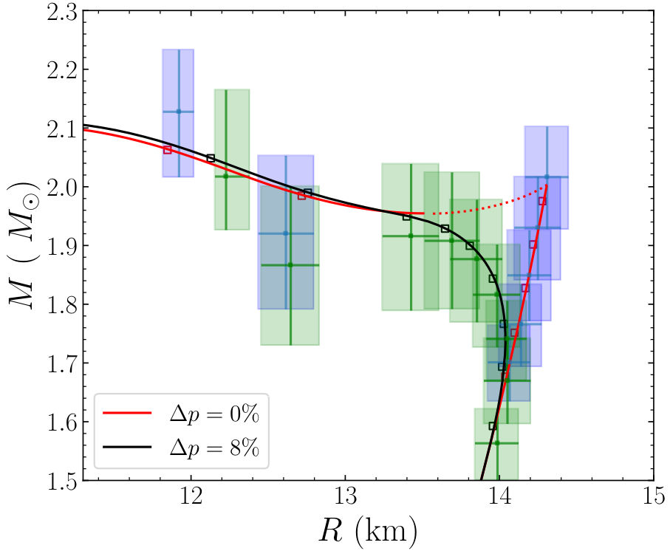
Inclusion of Observational Uncertainties
Glitching pulsars data taken from the Jodrell Bank Glitch catalogue.
Spin frequency, distance (d) and sky position to each pulsar are assign from ATNF Pulsar Catalogue.
Consider few random mass configurations with an assumed EOS model .
Then f-mode frequency, damping time, moment of inertia to pulsars from the assume EoS model.
QNM-mode detection
M,R,Λ
UR
(f,τ,..)
The measurement of R from f-mode observation may confirm the presence of twins.
More challenging for low mass twins. However, we have more observations at low masses.
Differentiating the nature of Δp is more challenging.
David Alvarez-Castillo, Bikram Keshari Pradhan, Debarati Chatterjee - arXiv:2309.08775

Slide 18
Outlook
Multi-messenger astronomy and collider experiments will continue probing the properties of dense matter.
Bayesian Analysis and Machine Learning methods are useful for estimation of unknown physical parameters.
f-mode oscillation of hybrid stars and twin stars involving the “pasta phase” has been investigated.
Re-examination of the asteroseismology problem considering the twin stars.
Precise f-mode measurement provides suitable scenario for twin star detection.

Slide 19
Outlook
f-mode GW detection with next-generation GW offers a promising scenario for confirming the existence of the twin stars.
Distinguishing the nature of hadron-quark crossover phase transition requires a more advance study.
Consideration of the effect of rotation and magnetic fields can potentially improve this study.
A detailed Bayesian study is in progress to constrain the pasta phase parameters from f-mode/binary observation.

