Slide 1





T-Matrix Theory of Strongly Coupled QGP
Ralf Rapp
Cyclotron Institute +
Dept of Phys & Astro
Texas A&M University
College Station, TX, USA
Polish-German WE-Heraeus Seminar & Max Born Symposium
Many-Particle Systems under Extreme Conditions
Dec. 3-6, 2023, Görlitz (Germany)

Slide 2
Outline
1.) Introduction
● Nonperturbative QCD Force + sQGP
2.) Thermodynamic T-Matrix
● Selfconsistent Quantum Many-Body Theory
● Input Potential + Constraints from Lattice QCD
3.) Hamiltonian Approach to sQGP Structure
● Thermodynamic Potential + EoS
● Spectral + Transport Properties
4.) Heavy-Flavor Transport in Heavy-Ion Collisions
● QCD Matter in the Lab
● Open HF Phenomenology
5.) Conclusions

Slide 3

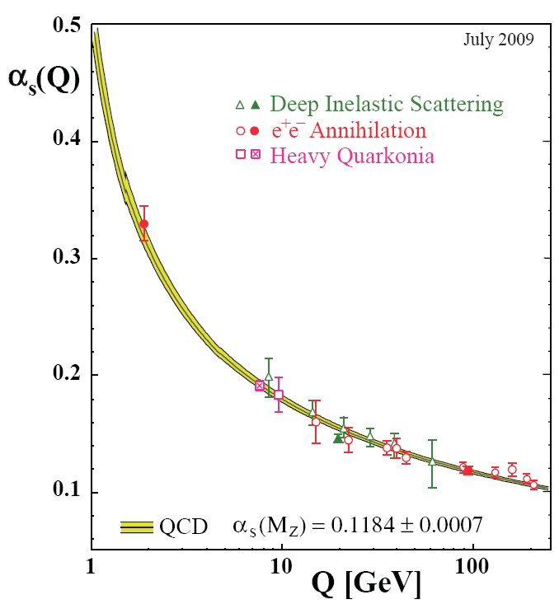
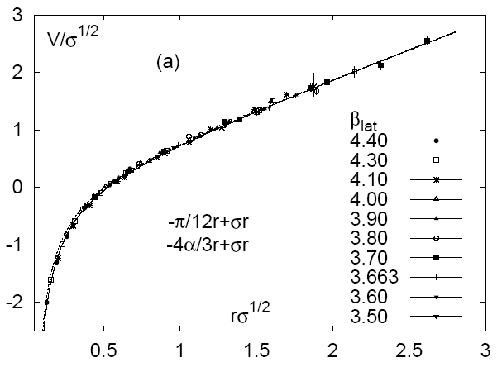
1.1 Quantum Chromodynamics in Vacuum
[Gross,Politzer
+Wilczek ‘73]
Running Coupling Heavy-Quark Potential
Bethke
V(r) [0.5 GeV]
r [fm]
0.25 0.5 0.75 1.0 1.25
[Kaczmarek
et al ’05]
Q² ≤ 1 GeV² → “strong QCD”
Confinement
mass generation
(M_{p} ≈ 1 GeV )
Non-perturbative for r ≥ 0.25 fm
Operational definition of confinement
Well-calibrated force describes
charm-/bottom-onium spectroscopy

Slide 4
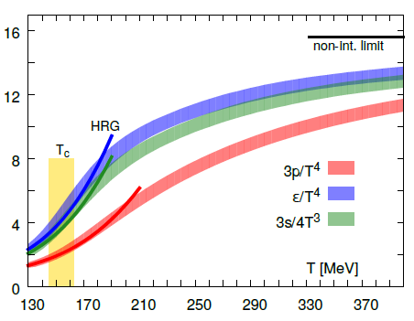
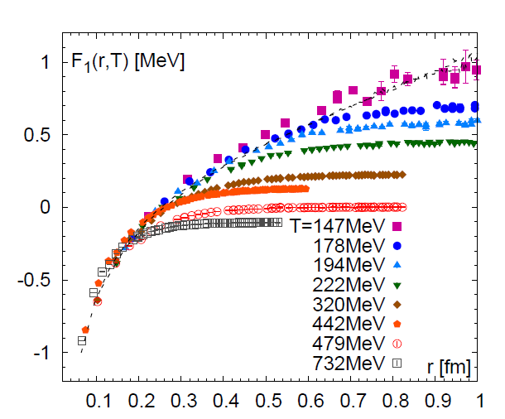
1.2 QCD Matter and In-Medium Force
Equation of State Heavy-Quark Free Energy
μ_{Β} = 0
[GeV]
[Bazavov
et al ’13,’14]
- - -
“Change” in degrees of freedom
above T~160 MeV
F_{QQ} = U_{QQ} – T S_{QQ}
Non-perturbative above T_{c}
Connection between QCD Matter and in-medium forces?
Heavy-quark transport as a microscopic probe
⇒ Deduce structure of strongly coupled QGP

Slide 5
1.3 Strongly Coupled Quark-Gluon Plasma
⇔ Quantum liquid with transport coefficients
near conjectured lower bounds
Microscopic calculation of transport coefficients should
obey quantum-lower bounds
Bulk medium should encode strong-coupling properties
→ universality? D_{s}(2πT) ~ (4π)η/s ~ σ_{el}/T
Large scattering rates → large collisional widths
→ broad spectral functions → off-shell (quantum) effects
Q

Slide 6
Outline
1.) Introduction
● Nonperturbative QCD Force + sQGP
2.) Thermodynamic T-Matrix
● Selfconsistent Quantum Many-Body Theory
● Input Potential + Constraints from Lattice QCD
3.) Hamiltonian Approach to sQGP Structure
● Thermodynamic Potential + EoS
● Spectral + Transport Properties
4.) Heavy-Flavor Transport in Heavy-Ion Collisions
● QCD Matter in the Lab
● Open HF Phenomenology
5.) Conclusions

Slide 7
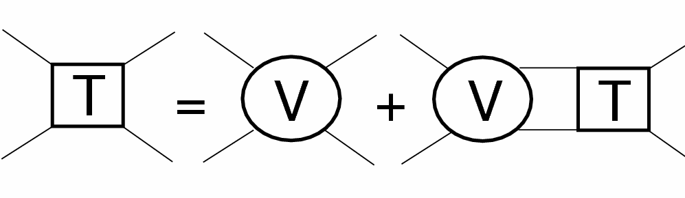
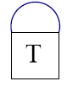

2.1 Thermodynamic T-Matrix
Scattering
equation
j=Q
i=Q,q,g
Born approximation (weak coupling): T_{Qi} ≈ V_{Qi}
Strong coupling → resummation: T_{ji} = V_{ji} + ∫ V_{ji} G_{j} G_{i} T_{ji}
Dyson equation: G_{i} = 1 / [ω – ω_{k} –Σ_{i}(ω,k)]
Parton self-energies → self-consistency:
i=q,g
Σ_{Q}
=
Qi
Vacuum: Cornell potential → HQ spectroscopy
In-medium:
→ constrain screening masses m_{d,s} using lattice-QCD data
[TAMU ’04-’23]

Slide 8
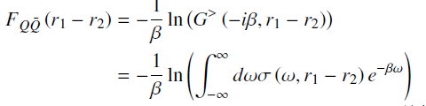

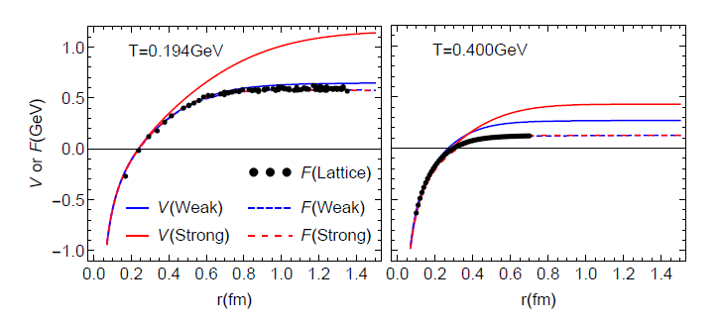
2.2 Potential Extraction from Lattice QCD
Free energy:
Quarkonium Spectral Function:
Weakly Coupled Scenario: potential close to F, Γ_{Q} ~ 0.1 GeV
SCS: remnants of confining force, Γ_{Q} ~ 0.6 GeV;
Quantum effects + self-consistency limit coupling strength

Slide 9
Outline
1.) Introduction
● Nonperturbative QCD Force + sQGP
2.) Thermodynamic T-Matrix
● Selfconsistent Quantum Many-Body Theory
● Input Potential + Constraints from Lattice QCD
3.) Hamiltonian Approach to sQGP Structure
● Thermodynamic Potential + EoS
● Spectral + Transport Properties
4.) Heavy-Flavor Transport in Heavy-Ion Collisions
● QCD Matter in the Lab
● Open HF Phenomenology
5.) Conclusions

Slide 10
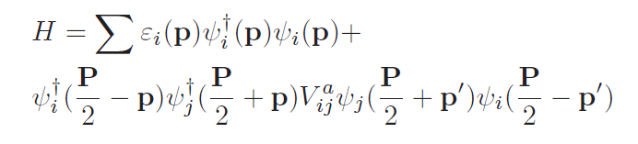

3.) Hamiltonian Approach to QGP
In-Medium Parton Hamiltonian with 2-body interactions
- effective parton masses
Interaction: Cornell potential with relativistic corrections
- as used in heavy-quark sector
Implement into Brueckner / Luttinger-Ward-Baym approach

Slide 11
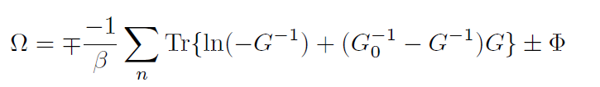



3.2 QGP Equation of State + Spectral Functions
Thermodynamic
Potential (2-PI)
Selfconsistent SFs
Lutttinger-Ward
Functional
S
G = G₀ + G₀S G
S = GT
T = V + VGGT
n,n
Fully off-shell resummed Luttinger-Ward functional (!)
→ allows for dynamically emerging hadronic resonances
Fit “bare” quark + gluon masses

Slide 12
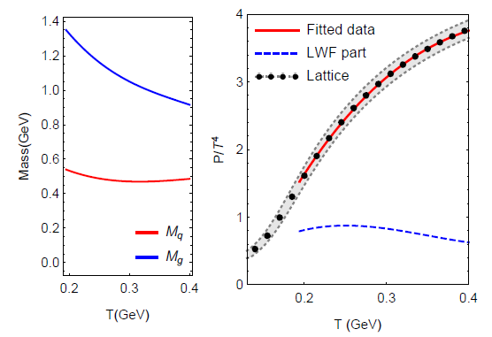
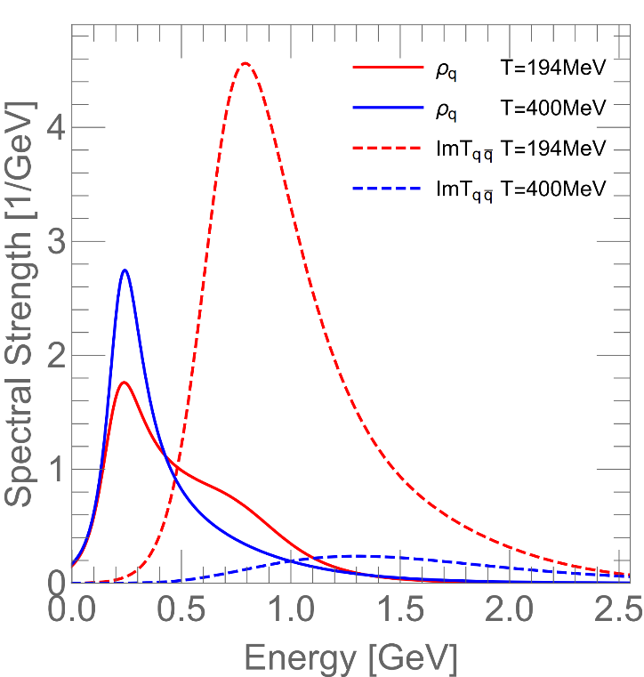
3.3 QGP Equation of State + Degrees of Freedom
Input Masses Pressure Quark + “Meson” Spectral Fcts
Confining force near T_{c} : ⇒ soft partons melt, Γ_{q} ≥ m_{q}
⇒ broad hadronic resonances emerge

Slide 13
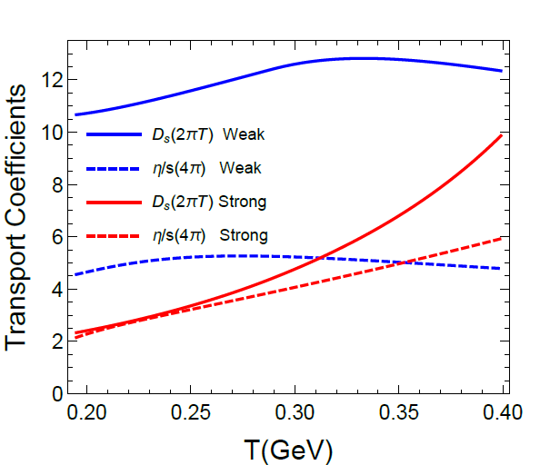
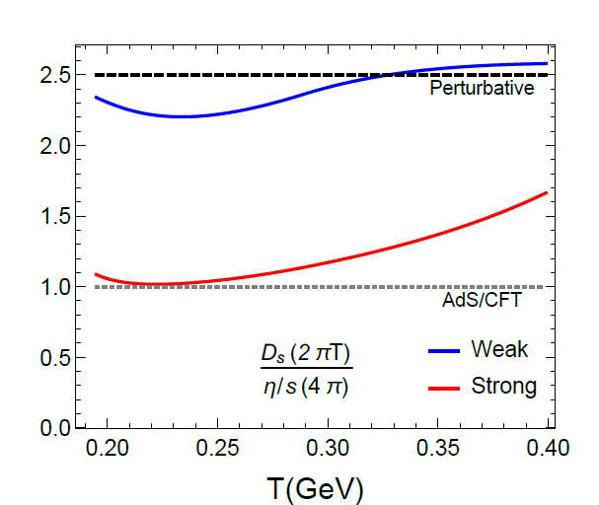
3.4 Transport Coefficients + Strong-Coupling Limit
Shear Viscosity and Heavy-Quark Diffusion
Strongly coupled: (2πT) D_{s} ~ (4π) η/s
Perturbative: (2πT) D_{s} ~ 5/2 (4π) η/s
Transition as T increases

Slide 14
Outline
1.) Introduction
● Nonperturbative QCD Force + sQGP
2.) Thermodynamic T-Matrix
● Selfconsistent Quantum Many-Body Theory
● Input Potential + Constraints from Lattice QCD
3.) Hamiltonian Approach to sQGP Structure
● Thermodynamic Potential + EoS
● Spectral + Transport Properties
4.) Heavy-Flavor Transport in Heavy-Ion Collisions
● QCD Matter in the Lab
● Open HF Phenomenology
5.) Conclusions

Slide 15
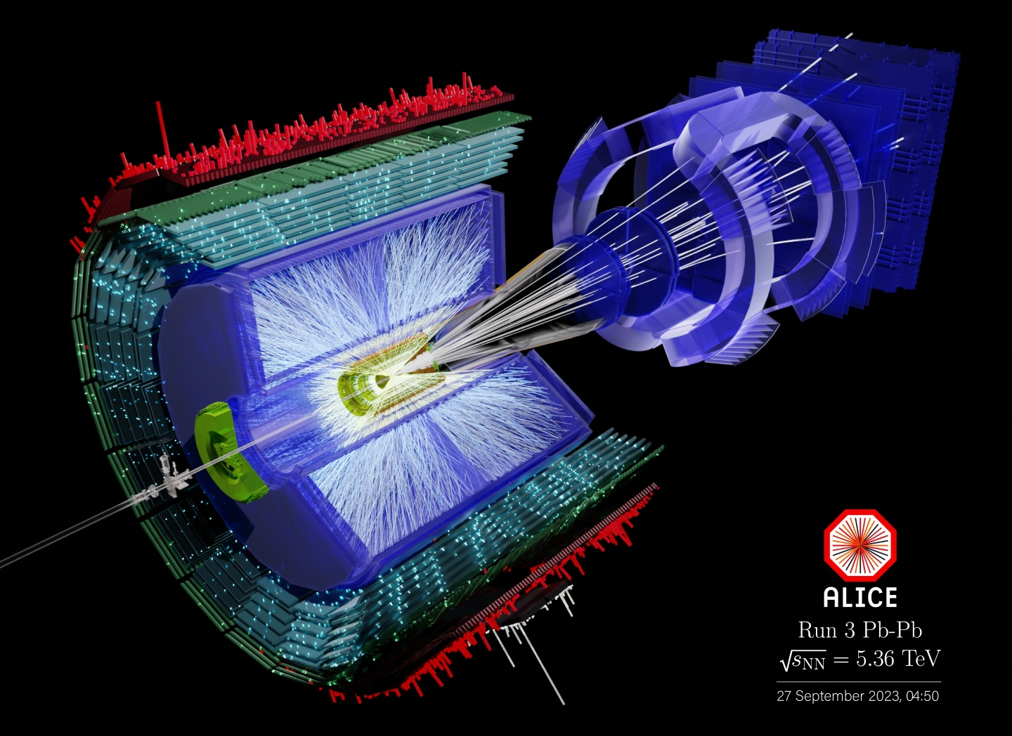
4.1 QCD Matter in the Lab: Heavy-Ion Collisions
c
Freeze-Out
D
Pb + Pb
QGP
Hadron Matter
Heavy-Quark Probe of QCD Medium
Pb+Pb → X
“Brownian markers” of coupling
strength: m_{Q} >> T
Requires transport approach

Slide 16

4.2 Heavy-Flavor Transport in QGP
p² ~ m_{Q} T >> q² ~ T² ⇒ Fokker-Planck Equation:
Q
thermalization rate momentum diffusion coefficient
γ p = ∫ d³q w_{Q}(q,p) q
~ ∫ |T_{Qi}|² (1-cosθ) f ^{i}
D_{p} = ∫ d³q w_{Q}(q,p) q²
Thermal relaxation time τ = 1/γ
Spatial diffusion constant: D_{s} = T / γ (p=0) m_{Q}
Key ingredient: heavy-light scattering amplitude T_{Qi}

Slide 17
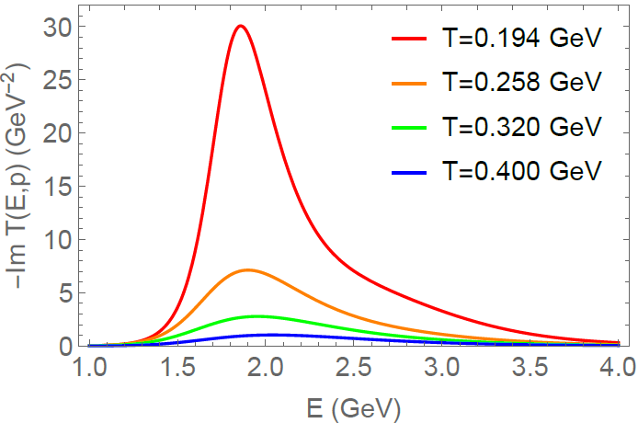
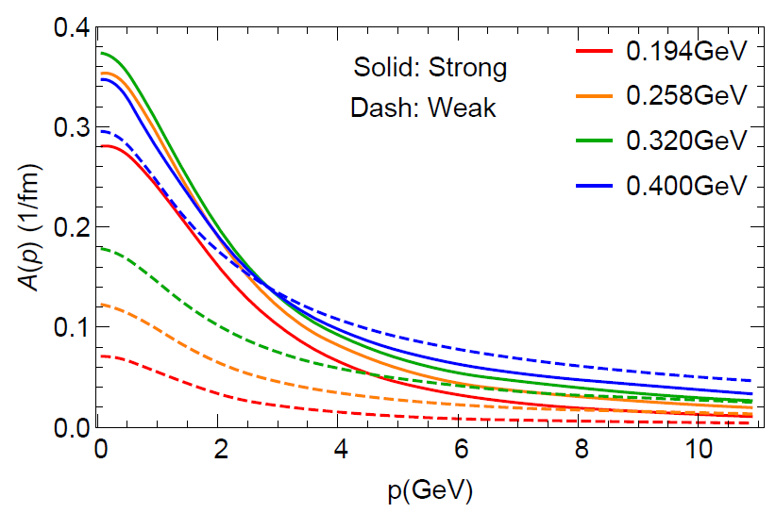
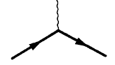
4.3 Charm-Quark Scattering in QGP
Charm-Light Quark T-Matrix Thermal Relaxation Rate
- Im T_{cq} [GeV⁻²]
-
cq threshold
γ_{c}(p)
Broad D-mesons emerge near T_{c}
→ connects diffusion + hadronization!
τ_{c} = 1/γ_{c} ≈ 3 fm/c , D_{s} (2πT) ≈ 2
Off-shell (quantum) effects critical!
k
QGP
k’
p
p’
[Liu,He+RR ‘19]

Slide 18
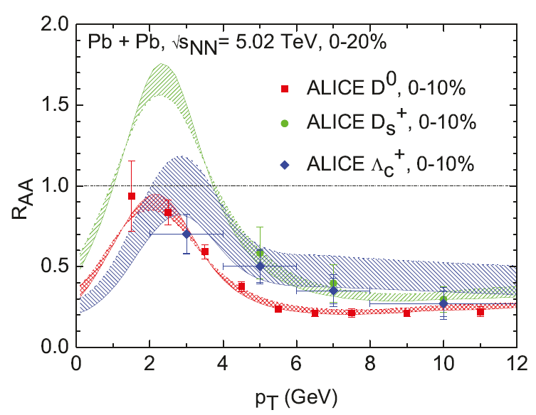
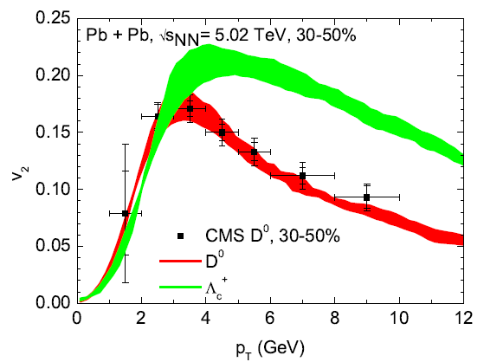
4.4 Charm-Hadron Spectra in Heavy-Ion Collisions
Spectra Ratio PbPb/pp ``Elliptic” Flow
Q
Charm quarks dragged along with fireball
⇒ “flow bump” in R_{AA} + large v₂
⇒ strong coupling near T_{c}
[M.He+RR ‘19]
Diffusion coefficient D_{s}(2πT) ~ 2 near T_{c}
[Tang et al ‘23]

Slide 19
Topical Collaboration in Nuclear Theory:
HEavy Flavor TheorY (HEFTY) for QCD Matter
Mukherjee
Qiu
Frawley
Vogt
Petreczky
Mehen
Dong
[Rapp (PI), Petreczky + Vogt (co-spokespersons), + 9 co-PIs]
Vitev
Rapp
Strickland
Lee
Bass

Slide 20
5.) Summary
Quantum Many-Body Theory of sQGP:
- Accounts for key aspects of strong coupling:
nonperturbative forces, resummation, quantum effects (large widths)
- Input parameters constrained by lattice QCD, recover vacuum limit
QGP structure driven by remnants of long-range confining force
→ - melts long-wavelength quasi-partons
- forms hadronic bound states near T_{c}
- generates liquid properties (small D_{s}, η/s, …)
- quantum effects ubiquitous
Heavy quarks serve as Brownian Markers of sQGP in HICs
Self-consistency essential for quantum bounds!?

